Slide 1
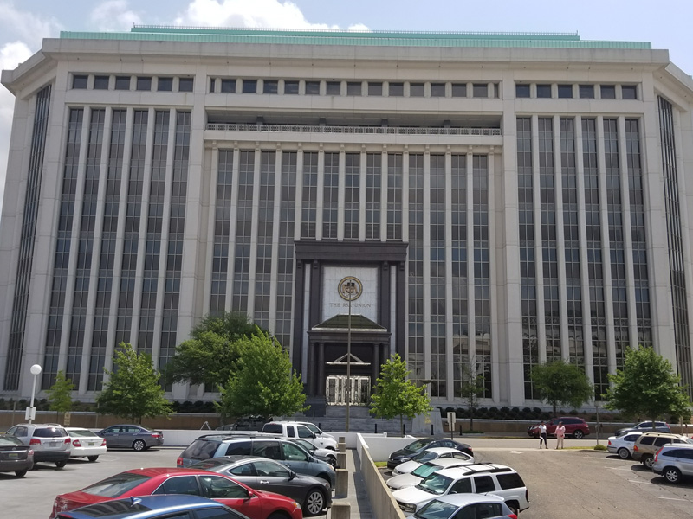
Alabama Commission on Higher Education
June 9, 2017 Commission Meeting

Slide 2
I. CALL TO ORDER

Slide 3
II. ROLL CALL and QUORUM DETERMINATION

Slide 4
III. APPROVAL OF AGENDA

Slide 5
IV. APPROVAL OF THE MINUTES
March 10, 2017

Slide 6
V. CHAIRMAN’S REPORT

Slide 7
VI. EXECUTIVE DIRECTOR’S REPORT

Slide 8
Follow up from March 10 Board meeting FAFSA Completion Project
March presentation by Kristina Scott – Alabama Possible and Christian Becraft (Governor Ivey’s Office)

Slide 9
Millions “Left on the Table Annually”
U.S. figures (2014-2015) :
45% of high school graduates did not complete the FAFSA
Of the 1,445,732 non completers 747,579 or 52% are PELL Grant-Eligible
Average PELL Grant in 2014-15 = $3,599
Total PELL Grant Money Left on the Table in the U.S = $2,692,574,521
Notes:
https://www.nerdwallet.com/blog/loans/student-loans/college-students-fafsa-money/

Slide 10
Millions “Left on the Table Annually”
Alabama figures (2014-2015) :
55% of high school graduates did not complete the FAFSA
Of the 25,963 non completers, 15,743 or 61% are PELL Grant-Eligible
Average PELL Grant in 2014-15 = $3,733
Total PELL Grant Money Left on the Table in Alabama = $58,731,020
Notes:
https://www.nerdwallet.com/blog/loans/student-loans/college-students-fafsa-money/

Slide 11
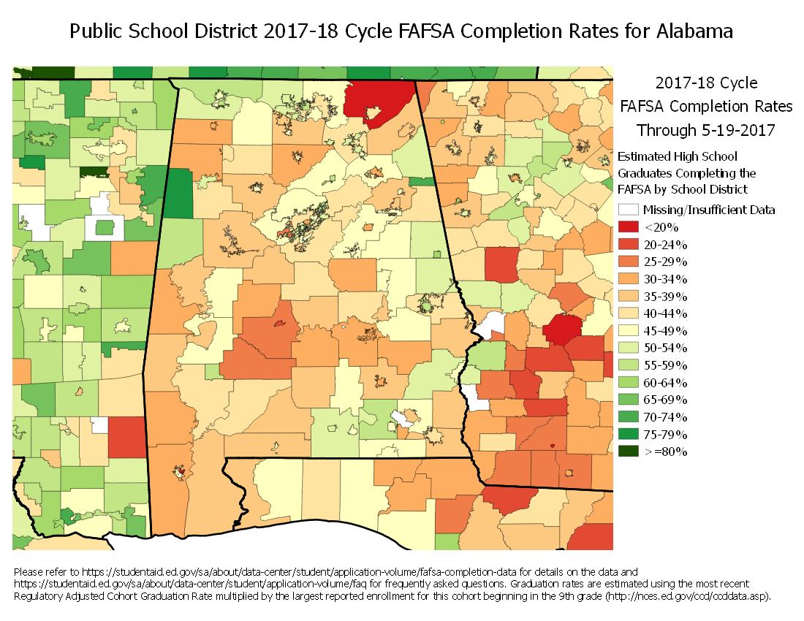

Slide 12
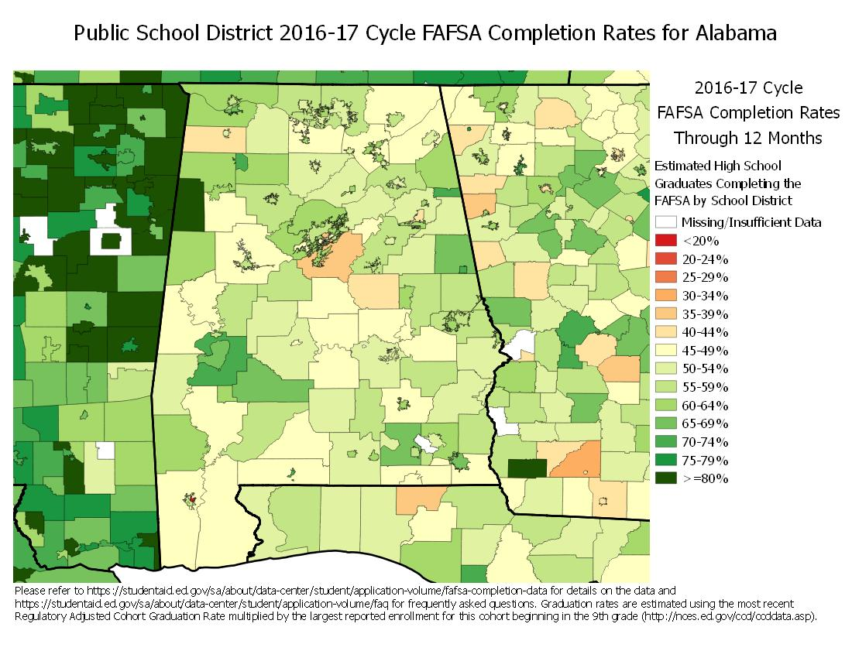

Slide 13
Process Flow Diagram
Continue process as needed.
ACHE
Compares/Matches data using Colorado developed software to see who has completed FAFSA
Connect EDU
ACHE Downloads Federal FAFSA Data
Federal FAFSA Database
AL Dept of Education
Submits student data to ACHE
School Districts
Participating Districts request and receive participation reports
Student Applies for Federal Financial Aid using a FAFSA
Authorized staff work with Students that have
an incomplete application or have not applied
High Schools

Slide 14
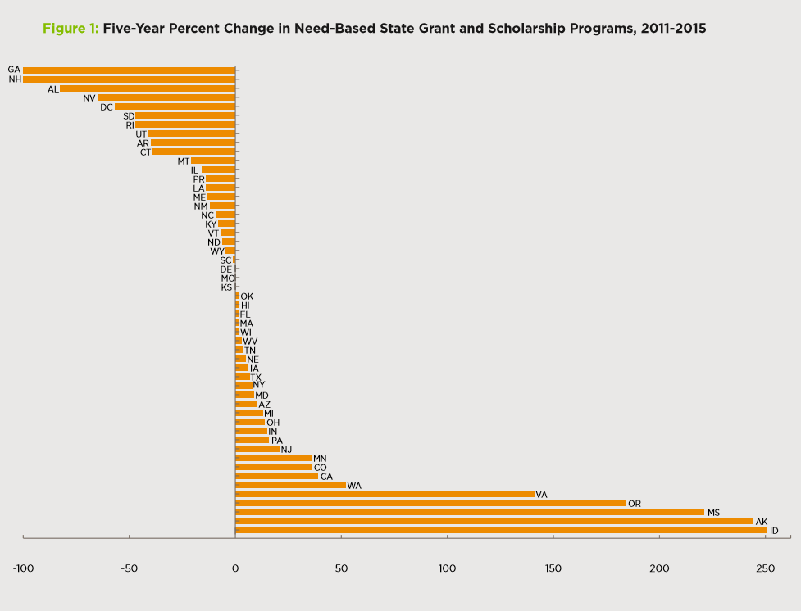
-82.74 decrease in need-based aid
While at the same time increasing state support for higher education by 4.5% and increasing tuition by 27%

Slide 15
Why responding to workforce needs
matters more than ever

Slide 16
Of the 11.6 million jobs created between January 2010 and January 2016, 11.5 million went to folks with at least some form of college education.
A combination of automation and overseas competition also managed to wipe out millions of blue-collar mining and manufacturing positions that historically "offered a pathway to the middle class for many Americans, especially men."

Slide 17
“The speed of technological innovations in robotics and A.I. is truly exciting,” said Futureproof Bama founder and technological futurist, Taylor Phillips. “People are already being displaced by robots and computers in many areas. As more innovations become mainstream, a million or more Alabama citizens could lose their jobs.
“The speed of technological innovations in robotics and A.I. is truly exciting,” said Futureproof Bama founder and technological futurist, Taylor Phillips. “People are already being displaced by robots and computers in many areas. As more innovations become mainstream, a million or more Alabama citizens could lose their jobs.

Slide 18
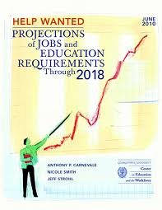
In 1970, 74% of the middle class had a high school diploma or less education.
In 2007, only 39% of middle class had a high school diploma or less education.
Middle Class:
Family income range from 35,000 to 91,000

Slide 19
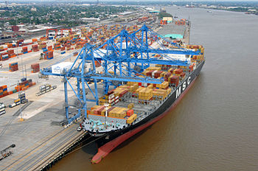
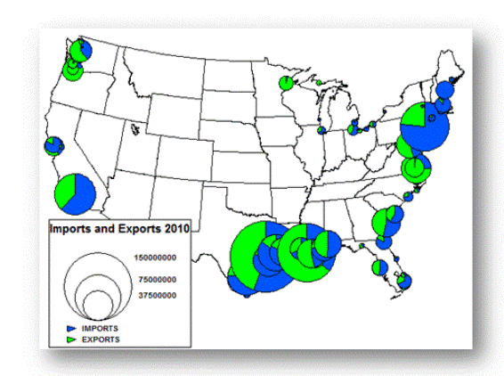
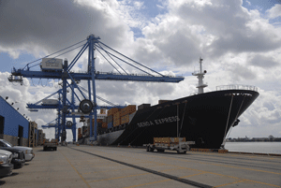
Rose (2012) found that jobs connected to export industries (such as agriculture, natural resources and manufacturing) changed drastically over the last generation. In 1967, nearly 80% of export industries employed persons with a high school diploma or less. Whereas, a generation later (2007), nearly 60% of the employees in the export industries are persons credentialed with an associate degree or higher.

Slide 20
Alabama’s Economy can no longer be based upon it being a conveniently located source of low-wage low-skill labor.

Slide 54
Slate.com

Slide 55
Workforce Changes are Often Abrupt and Permanent
Compression of wages
Restructuring of the economy
Those that adapt flourish
Those that could not . . .

Slide 56
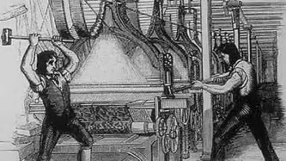
Workforce Changes are Often Abrupt and Permanent
Anyone who owned a mechanical loom could, with the help of one or two assistants – perhaps his wife and children – do more work than a hundred trained weavers.
So whatever became of all the weavers in a town into which a mechanical loom was introduced? . . . they woke up one day to discover that they weren’t needed any more. Everything it had taken them years to learn, first as apprentices and then as journeymen, was useless.
Trivia: Where does the term Luddite come from?
Luddites are named after Ned Ludd, an apprentice who allegedly smashed two knitting machines in 1779 and whose name has become emblematic of machine destroyers.

Slide 57
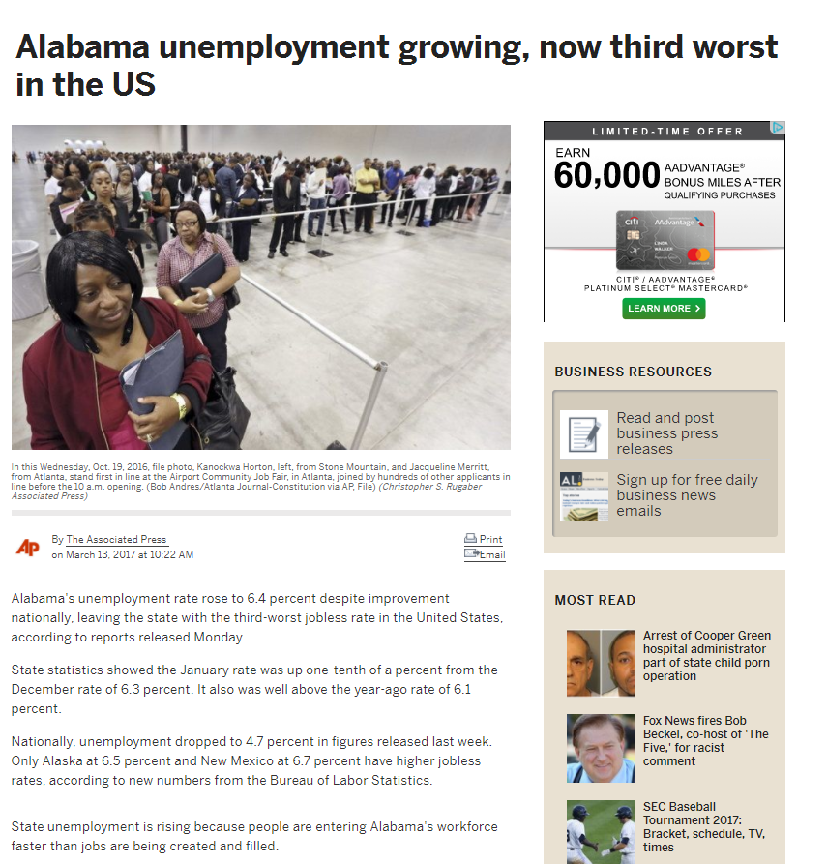
Alabama's unemployment rate rose to 6.4 percent despite improvement nationally, leaving the state with the third-worst jobless rate in the United States, according to reports released Monday.
Nationally, unemployment dropped to 4.7 percent in figures released last week. Only Alaska at 6.5 percent and New Mexico at 6.7 percent have higher jobless rates, according to new numbers from the Bureau of Labor Statistics.

Slide 59
Good news:
Employers are hiring
Bad news:
Not all employers can find the skilled workers they need. Experts say that such a high number of job openings is due partially to a gap between the job skills employers demand and the skills job seekers have.
skills gap … is holding down overall wage growth in the US

Slide 60
Density of educated/ skilled workers
Access to good schools, colleges, universities
Local leadership
Regional economic development strategies rather than state-wide strategies
Return to city-states
Sparta and Athens
Work ready communities

Slide 61
A Strong Correlation Across 261 Metro Areas
Increase the level of education of a community’s citizenry by 1 year of postsecondary education:
17.4% increase in GDP per capita
17.8% increase in real wages per worker

Slide 63
Address the needs of Business and Industry
Focus on increasing enrollment and research that address the needs of business and industry
Respond to specific geographic workforce needs
Expand adult degree completion programs
Crediting of Industry credentials
Provide oversight and accountability
Expand information-based decision making resources
Develop performance funding metrics
Support campus management needs
Use resources efficiently
Expedite academic program review
Re-evaluate financial aid strategies
Enhance enrollment management
Increase the use of Open Educational Resources

Slide 64
Alabama Fiscal Support for Higher Education
Per $1,000 of Personal Income, 1961-2015
Current state support for our colleges and universities is at the 1967 level!

Slide 65
civic involvement
volunteer activity by education levels
50%
45.6% (60 hours)
B.A. or Higher
40%
34.1% (52 hours)
Some College
30%
21.7% (48 hours)
Percentage Volunteering
20%
High School Diploma
9.9% (48 hours)
10%
Less Than High School Diploma
0%
Bureau of Labor Statistics. Volunteering in the United States, 2003. USDL03-888. U.S. Department of Labor.

Slide 66
civic involvement
blood donation by education level
percentage who donate regularly
20%
17%
13%
B.A. or Higher
15%
Percentage Donating Blood
11%
Some College
10%
High School Diploma
6%
5%
Less Than High School Diploma
0%
Source: DBD Worldwide. DBD Lifestyle Survey. Chicago. www.bowlingalone.com.

Slide 67
government
participation assistance programs
education level
24.3%
Less Than High School Diploma
10.2%
High School Diploma
4.6%
Some College & Bachelor’s Degree or More
Ever Participated in Assistance Programs
Source: Postsecondary Education Opportunity,

Slide 68
government
incarceration rates by education levels
2.5%
1.9%
2.0%
Less Than High School Diploma
1.5%
Percentage Incarcerated
1.2%
1.0%
High School Diploma
0.5%
0.3%
Some College
0.1%
0.0%
B.A. or Higher
Source: Harlow, C.W. Education and Correctional Populations. Bureau of Justice Statistics, Department of Justice. NCJ195670.

Slide 69
economic
Percent Below Poverty Threshold
40%
32%
30%
Less Than High School Diploma
Percentage Home Ownership
20%
15%
High School Diploma
10%
10%
Some College
4%
0%
B.A. or Higher
Census Bureau

Slide 70
economic
unemployment rates and education level
9.7%
10
Less Than High School Diploma
7.5%
8
High School Diploma
6
5.1%
4.6%
Some College
B.A. or Higher
4
2
0
Source: Employment Policy Institute (2004)

Slide 71
Quality of Life
Home Ownership
80%
75%
B.A. or Higher
69%
70%
66%
Percentage Home Ownership
High School Diploma
Some College
60%
58%
Less Than High School Diploma
50%
Census Bureau, American Housing Survey for the United States

Slide 72
Safety
Seatbelt Use while intoxicated
percentage who use seatbelt
80%
78%
66%
60%
B.A. or Higher
52%
Percentage Donating Blood
41%
Some College
39%
40%
Less Than High School Diploma
High School Diploma
31%
20%
20%
15%
0%
Source: American Journal of Public Health

Slide 73
Average family income by educational attainment
economic
175
150
125
100
Income ($000)
75
50
25
Source: Postsecondary Education Opportunity
0
LT-9
9-12
HSG
Some
AA
BA
MA
PhD
Prof
College

Slide 74
economic
The Impact of Education on Individuals: Lifetime Earnings
Education Level
Estimated
Lifetime
Earnings
Difference
Compared to
High School Graduate
Less than 9th grade
$976,350
-$478,903
High school dropout
1,150,698
-304,555
High school graduate
1,455,253
0
Some college, no degree
1,725,822
270,569
Associate degree
1,801,373
346,120
Bachelor's degree
$2,567,174
$1,111,921
Master's degree
2,963,076
1,507,823
Doctorate
3,982,577
2,527,324
Professional degree
5,254,193
3,798,940
Source: Federal Reserve Bank of Dallas

Slide 75
At the end of WWII, the U.S made a bold decision to invest in the future of its economy by providing $1.9 billion annually to the education of returning veterans of the war. This commitment to human capital helped enable the WWII generation to become the “greatest generation”.
Possibly, Alabama’s greatest generation is at the schoolhouse door waiting for the opportunity to propel Alabama into the global economy.

Slide 76
VII. NOMINATING COMMITTEE APPOINTMENT

Slide 77
VIII. DISCUSSION ITEMS

Slide 78
Alabama Commission on Higher Education
Fifteen Year Report:
Alabama Higher Education Professional Development
for K-12 Teachers
Fiscal Years:
2002-2003 through 2016-2017

Slide 79
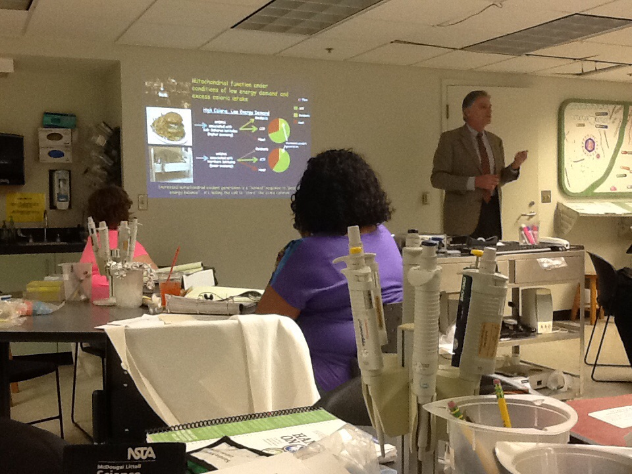
State Objectives
Long Term
Sustained
Intensive
Statewide Access

Slide 80
High Need County and City School Systems

Slide 81
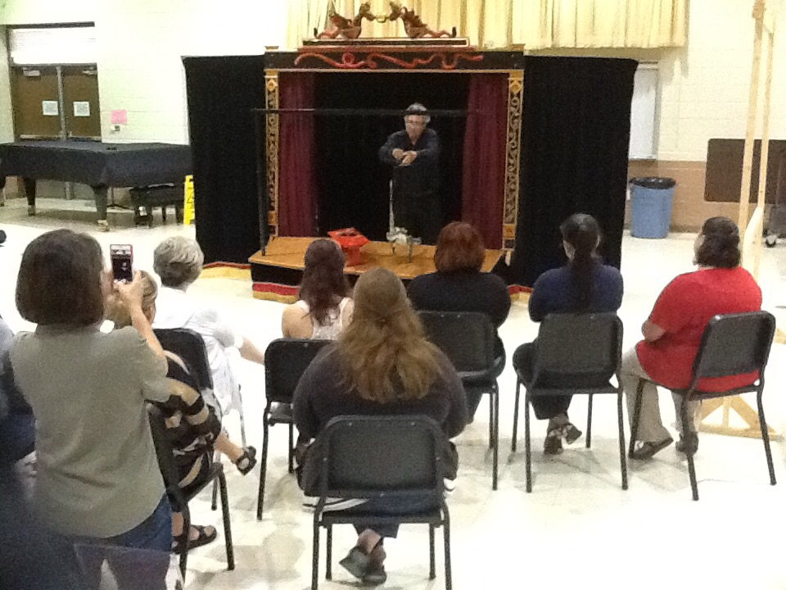
Performance Outcomes
Funding
Teachers
Students

Slide 82
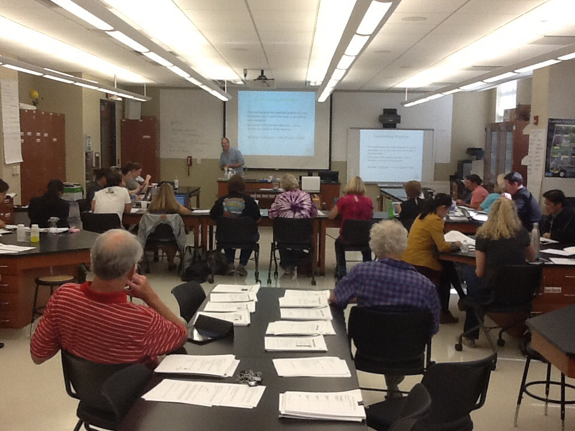
Acknowledgements
Partnerships
Vision
Leadership

Slide 83
ALAHASP Alabama Hands-On Activity Science Program
University of Alabama at Birmingham
Project Director: Dr. J. Michael Wyss
Co Directors: Ms. Katie Busch, Ms. Kay Garcia, Ms. Joan Dawson, Ms. Beverly Radford
2002-2017=15 Years

Slide 84
AMSTI (Alabama Math Science and Technology Initiative)Lead Teacher Enhancement Project (ALSDE)
University of North Alabama (2008-2009)
Athens State University (2011-2016)
Jacksonville State University (2009-2015)
University of Alabama in Huntsville (2012-2016)
Auburn University (2014-2016)
Wallace Community College – Selma/Alabama State University (2014-2016)
Troy University (2015-2016)
University of South Alabama (2016-2017)
2011-2017=6 Years

Slide 85
AMSTI Lead Teacher Enhancement Project (ALSDE)
Project Directors: Ms. Shelly Hollis (UNA)
Dr. Debra Baird (ATSU), Ms. Carrie Lin (ATSU), Dr. William Carr (JSU) Dr. Jordan Barkley (JSU), Dr. Kelly Ryan (JSU), Dr. Eric Lee (JSU), Ms. Carol Mueuller (UAH), Dr. James Miller (UAH), Ms. Carolyn Pistorius (UAH), Ms. Mary Lou Ewald (AU), Mr. Clarence Pettway (WCC-Selma), Ms. Kimberly Dove (TU), Ms. Sherrie Blackmon (TU), Dr. André Green (USA)
Principal Administrators: Ms. Joyce Waid (ATSU), Ms. Tanya Barnes (JSU), Ms. Elizabeth Hickman (AU)
2011-2017=6 Years
Notes:
Dr. French requested 2nd AMSTI Slide Title smaller than the 1st Slide.

Slide 86
Comprehensive Discipline Based Arts Education
University of West Alabama (2002-2004)
University of South Alabama (2003-2017)
Alabama Institute for Education in the Arts (2002-Present)
Project Directors: Martha Lockett (2002-2007; 2011-Present)
Jeanette Fresne (2003-Present) Ms. Linda Dean (2007-2010)
Co Director: Dr. Paige Vitulli
Principal Administrators: Ms. Jessica Freeland, Mr. Randy Foster
2002-2017=15 Years

Slide 87
IMPACTSEED: IMproving Physics And Chemistry Teaching in SEcondary EDucation
Jacksonville State University (2002-2009; 2014-2017)
Snead State Community College (2010-2013)
Project Director: Dr. Nouredine Zetilli
Principal Administrator: Dr. Noureddine Bekhouche
2002-2017=15 Years

Slide 88
PS-21: Physical Science in the 21st Century
University of Alabama
Project Director: Dr. Dennis Sunal
Principal Administrator: Dr. Cynthia Sunal
2007-2017=10 Years

Slide 89
The University-School Partnership for Secondary Science (BioTeach)
University of Alabama at Birmingham
Project Director: Dr. J. Michael Wyss
Principal Administrators: Dr. Mary Williams, Dr. Eric Blackwell, Mr. Ryan Reardon, Dr. Laura Cotlin, Dr. Sabrina Walthall, Mr. Kevin Jarrett, Dr. Vanessa Williams, Dr. Ollie Kelly, Dr. Danielle Yancey, Dr. Patrice Capers
2004-2017=13 Years

Slide 90
STAR: Success Through Academic Research Project/Independent Study Program
University of Alabama in Huntsville
Project Directors: Dr. John Pottenger (2002-2014)
Dr. Andrea Word (2015-Present)
Principal Administrators: Ms. Anita Rathz, Ms. Luciana Findlay, Ms. Evoxia Chronis, Ms. Tammy Pailtchikov
2002-2017=15 Years

Slide 91
Wiregrass Math, Science, and Technology Leadership Academy
Troy University-Dothan
Project Directors: Dr. Vijaya Gompa (2010-2016)
Dr. Shawn Plash (2016-2017)
2010-2017=7 Years

Slide 92
A Vision for the Future
“….An investment of this magnitude will continue to pay dividends for the foreseeable future, until these teachers will reach retirement age and possibly beyond. In fact, we can state with a high degree of certainty that this investment will continue to generate dividend even after the cohort has gone into retirement. The reason is simple: teachers will end up mentoring their junior colleagues in the various areas they have acquired such as knowledge content, teaching skills and best practices, pedagogy, and use of technology to deliver coursework effectively in content areas of specialization. As such, it becomes self-evident that a long-lasting seed has been planted in school districts of Alabama, including those of “high need”, that will continue to bear fruit for the foreseeable future.”

Slide 93
IX. DECISION ITEMS

Slide 94
Academic Programs and Extensions/Alterations of Existing Programs

Slide 95
ALABAMA COMMUNITY COLLEGE SYSTEM

Slide 96
Bevill State Community College
1. Associate in Applied Science in Business (CIP 52.0201)
The program will include instruction in management theory, human resources management and behavior, accounting and other quantitative methods, purchasing and logistics, organization and production, marketing, and business decision-making.
The program will prepare graduates for employment in the areas of business such as retailing, entrepreneurial endeavors, accounting, sales and marketing, and management.
The program will have short-certificates in Business Essentials, Entrepreneurship, Accounting, and Retail Management.

Slide 97
Lurleen B. Wallace Community College
Associate in Applied Science in Diesel and Heavy Equipment Mechanics (CIP 47.0605)
The program will include a natural gas component that will prepare technicians to perform maintenance of alternative fuel vehicles, and perform conversion of standard vehicles to utilize alternative fuels.
LBW provided employment projections from the Alabama Department of Labor for Bus and Truck Mechanics and Diesel Engine Specialists that indicate the average annual openings in Alabama for related jobs is 145 with an annual average salary of $40,322 a year.

Slide 98
FOUR-YEAR INSTITUTIONS

Slide 99
Alabama A&M University
Addition of a Concentration in Logistics and Supply Chain Management to the Existing BS in Logistics and Supply Chain Management (CIP 52.0203)
The program with the proposed concentration will require a total of 133 semester hours (sh):
General Education 46 sh
Program Core 27 sh
Concentration 24 sh
Other Coursework 36 sh
Total 133 sh
According to AAM officials, proficiencies in Logistics and Supply Chain Management are currently some of the most highly demanded and needed skills in today's workforce.
The concentration will be offered on-ground as well as via online delivery.
Budgetary Impact: None.

Slide 100
Alabama A&M University
2. Addition of a Concentration in Management to the Existing BS in Business Management and Administration (CIP 52.0201)
The program with the proposed concentration will require a total of 133 semester hours (sh):
General Education 46 sh
Program Core 27 sh
Concentration 24 sh
Other Coursework 36 sh
Total 133 sh
According to the Occupational Outlook Handbook, employment of management occupations is projected to grow 6 percent from 2014 to 2024, about as fast as the average for all occupations.
The concentration will be offered on-ground as well as via online delivery.
Budgetary Impact: None.

Slide 101
Alabama A&M University
3. Addition of Concentrations in Urban Planning and Design and Transportation Management to the Existing BS in Urban and Regional Planning (CIP 04.0301)
The program with the proposed concentrations will require a total of 124 semester hours (sh):
General Education 46 sh
Program Core 45 sh
Concentration 21 sh
Other Coursework 12 sh
Total 124 sh
Urban Planning and Design Concentration: The rationale for this concentration is that it will enable students to contribute to the design, function, and sustainability of communities.
Transportation Management Concentration: This concentration would expose students to the administration, logistics, and economics that are related to transportation planning.
These two concentrations will be offered on-ground as well as via online delivery.
Budgetary Impact: None.

Slide 102
Auburn University
Bachelor of Science in Professional Flight (CIP 49.0102)
According to AU, its flight education roots back more than 80 years and has served the needs of the state, nation, and world by providing leading aviation-related instruction, research, and outreach. The proposed program will be an elevation of a current option within AU’s existing BS in Business Administration and Management. Elevating the Professional Flight option to program status will allow students to receive additional coursework in professional flight education.
The program will better prepare students to meet the needs of industry and allow them to enter the workforce sooner by earning a Restricted Airline Transport Pilot license with 1,000 flight hours.
External funding provided for the new facility will be applied to the proposed program and the following Aviation Management program.

Slide 103
Auburn University 2. Bachelor of Science in Aviation Management (CIP 49.0104)
Elevating the current Aviation Management option to program status will implement a new aviation core curriculum with a more robust aviation course portfolio that will open new aviation instruction, research, and outreach opportunities.
AU will be the only four-year institution that offers a degree in Aviation Management in the state
Students will possess a broad knowledge of aviation industry issues ranging from airline operations to corporate aviation to airport management.
Construction of the Airport Aviation Education Facility will begin this summer. The building will house classrooms, a flight simulator lab, debriefing rooms, flight dispatch and departmental spaces.

Slide 104
Auburn University
3. Master of Science in Architecture (CIP 04.0201)
The Master of Science in Architecture program with an option in Public Interest Design is a post-professional degree that will be offered to graduates of professional degree programs in architecture.
The program will address issues of architectural design and innovation leadership in the realm of public interest and community service, design tectonics, architectural project documentation and dissemination. Graduates of the proposed program will be prepared to pursue professional opportunities in private practice, the public sector and academia in a number of fields related to architectural practice.
According to the Bureau of Labor Statistics, the employment of architects is projected to grow 7 percent from 2014-2024.
Other than AU, no Alabama public institutions currently have a program at any level within CIP Code 04.0201.

Slide 105
Auburn University
4. Establishment of the Department of Aviation Within The University College
At its February 3, 2017 meeting, Auburn University's Board of Trustees approved the creation of the new department. The University plans to implement this change effective Fall 2017.
The Department will house two baccalaureate degrees, the BS in Aviation Management and the BS in Professional Flight.
Future plans for the Department include the creation of additional academic programs, including certificates in Unmanned Aircraft Systems and a graduate degree in aviation.
Both the BS in Professional Flight, and the BS in Aviation Management are professional programs with accreditation provided by the Aviation Accreditation Board International (AABI).

Slide 106
Auburn University at Montgomery
Tabled Request to Amend Post-Implementation Conditions: Master of Science in Cybersystems and Information Security (CIP 11.1003)
The program did not meet post-implementation conditions for graduates or new enrollees. The conditions were met for employment, and the submission of an overall assessment of the program.
At the March 10, 2017 Commission meeting AUM provided reasons for not meeting these conditions.
Since that meeting, AUM has provided additional information supportive of the tabled request for the Commissioners’ consideration.
Chancellor Stockton and Provost and Senior Vice Chancellor Varma reaffirmed AUM’s strong commitment to meeting the post-implementation conditions.
There are new faculty associated with this program.
There will be further programmatic redesign and the seeking of approval for the development of relevant tracks, anticipated to increase enrollments and number of completers.

Slide 107
Auburn University at Montgomery
2. Tabled Request to Amend Post-Implementation Conditions: Master of Science in Homeland Security and Emergency Management (CIP 43.0301)
The program did not meet post-implementation conditions for graduates. The conditions were met for enrollment, employment, and the submission of an overall assessment of the program.
At the March 10, 2017 Commission meeting AUM provided reasons for not meeting these conditions.
Since that meeting, AUM has provided additional information supportive of the tabled request for the Commissioners’ consideration.
Chancellor Stockton and Provost and Senior Vice Chancellor Varma reaffirmed AUM’s strong commitment to meeting the post-implementation condition.
Further marketing efforts are planned including further considerations for uniformed individuals and the provision of scholarships.
AUM is the only master’s level program in the State at CIP 43.0301.

Slide 108
Auburn University at Montgomery
3. Tabled Request to Amend Post-Implementation Conditions: Master of Science in Information Systems Management (CIP 52.1201)
The program did not meet post-implementation conditions for graduates or enrollees. The conditions were met for employment and the submission of an overall assessment of the program.
At the March 10, 2017 Commission meeting AUM provided reasons for not meeting these conditions.
Since that meeting, AUM has provided additional information supportive of the tabled request for the Commissioners’ consideration.
Chancellor Stockton and Provost and Senior Vice Chancellor Varma reaffirmed AUM’s strong commitment to meeting the post-implementation condition.
Monies have been reallocated in further support of the program.
There are anticipated over 40 completers this year in the related bachelors degree; thereby indicating a significant enrollment and subsequent completers pipeline for this master’s degree program.

Slide 109
Jacksonville State University
1. Bachelor of Science in Forensic Investigation (CIP 43.0111)
The new degree will expand a successful existing concentration from its Bachelor of Science in Criminal Justice into a full Bachelor of Science with two tracks and increased employment opportunities for JSU graduates.
Track One: Criminal Investigations, and
Track Two: Forensic Laboratory/Technician
The proposal projected that a total of $120,188 in estimated new funds will be required to support the proposed program. A total of $853,935 will be available through tuition.
Letters of support from Chief of Police, Anniston Police Department, Shane Denham and Sheriff, Calhoun County, Matthew Wade are provided.

Slide 110
Jacksonville State University
2. Master of Science in Nursing in Nursing (CIP 51.3801)
This program provides the opportunity for students to earn the MSN degree en route to the DNP degree when the students have clearly met the requirements for a degree at the master’s level.
JSU is in a rural area which serves a variety of vulnerable populations, many of whom are in need of increased access to primary and acute care clinicians to achieve positive and optimal health outcomes.
The local and regional community of interest has requested delivery of additional graduate nursing programs at JSU. Community partners have expressed strong levels of support for the program in terms of collaborative clinical opportunities.
The proposal projected that a total of $0 in new funds will be required to support the proposed program. A total of $791,154 will be available through tuition.

Slide 111
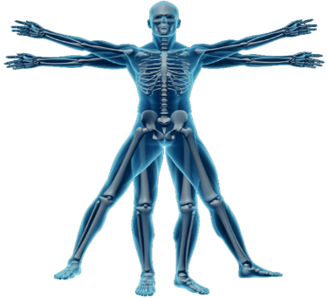
Troy University
Master of Science in Kinesiology (CIP 31.0505)
The program is primarily intended to address employment needs in the fields of coaching/teaching and exercise science.
Program will not further compete with other institutions in Alabama because the Troy focus is unique.
Encourages its graduates to further their education and pursue doctoral and professional degrees.
The proposal projected that $0 will be required for the program in the first five years, and that $936,807 will be available over the same period through tuition and extramural funding.

Slide 112
University of Alabama
Master of Science in Human Nutrition (CIP 19.0504)
The Accreditation Council on Education in Nutrition and Dietetics (ACEND), the credentialing agency for registered dietitians, has mandated that a graduate degree will be required for all dietetics/nutrition professionals to become registered to practice, effective 2024.
All courses are currently in place and each course is offered both on campus and via distance education.
The proposal projected that $0 in new funds will be required to support the proposed program. A total of $1,773,887 will be available through tuition.
Bureau of Labor Statistics Occupational Employment Statistics growth for nutritionists and dietitians is estimated nationally to be at 16 percent over the next decade, which is much higher than growth in other fields. Further, this growth is projected to be even higher in Alabama (17.7 percent) and the SREB states (18.8 percent).

Slide 113
University of Alabama
2. Master of Science in Rural Community Health (CIP 51.2208)
The ultimate purpose of the program is to prepare students to be community health leaders in rural Alabama.
A degree appropriately labeled as Rural Community Health will help identify graduates as having a specific set of skills that can open up employment opportunities in community health centers and public health agencies.
There will be two concentrations:
Rural Medical Scholars, and
Rural Community Health Scholars
The proposal projected that $0 in new funds will be required to support the proposed program. A total of $2,017,090 will be available through extramural funding and tuition.

Slide 114
University of Alabama
3. Master of Arts in Instructional Technology (CIP 13.0501)
Online degree program for individuals who wish to increase their understanding of technology’s role in teaching, learning, design, and training, as well as application to enhance technology use in teaching and learning.
UA has a well-established Ph.D. program in Instructional Leadership, with an emphasis in Instructional Technology. The Instructional Technology (M.A.) program provides a path to doctoral study should students choose to pursue a terminal degree.
The proposal projected that $30,000 in new funds will be required to support the proposed program. A total of $186,069 will be available through tuition.

Slide 115
University of Alabama
4. Master of Public Health in Health Education and Promotion (CIP 51.2201)
M.P.H. degree program in Health Education & Promotion in the College of Human Environmental Sciences will provide a high quality, student-oriented, and health equity focused curriculum designed to deliver core public health competencies that emphasize the application of health education & promotion.
The proposed M.P.H. degree program in Health Education and Promotion will seek accreditation from the Council on Education for Public Health (CEPH).
All of the required courses (100 percent) for the proposed M.P.H. program will be delivered both on-campus and online.
The proposal projected that $0 in new funds will be required to support the proposed program. A total of $1,170,680 will be available through tuition.

Slide 116
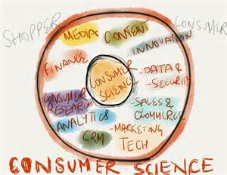
University of Alabama
5. Master of Science in Consumer Sciences (CIP 19.0401)
The program prepares students in the areas of Consumer Economics and Family Financial Planning and Counseling to advance knowledge in this discipline. For students desiring to continue to a Ph.D. degree, it is strongly preferred by other institutions that this is on their transcripts.
Graduates will also be prepared for careers in financial planning, banking, insurance, investments, estate planning, consumer advocacy, public policy, and consumer economics.
According to the Bureau of Labor Statistics (BLS), the job outlook from 2014-2020 is projected at 30 percent nationally, growing faster than the average for all occupations. The BLS estimates that there will be 73,900 new positions added between 2014 and 2024.
The proposal projected that $0 in new funds will be required to support the proposed program. A total of $544,995 will be available through tuition.

Slide 117
University of Alabama
Addition of Concentrations in Clinical Nurse Leader and Nurse Case Manager to the Existing MSN in Nursing (CIP 51.3801)
The program with each Concentration will require a total of 39-42 semester hours (sh):
Program Core 29 sh
Concentration 10 sh
Thesis (Optional) 3 sh
Total 39-42 sh
According to UA officials, both concentrations are needed because of a 2010 report released by the Institute of Medicine released a report called the Future of Nursing: Leading Change, Advancing Health that recommended nurses achieve higher levels of education, and that nurses must be full partners in the redesign of healthcare.
Budgetary Impact: No additional resources will be needed.

Slide 118
University of Alabama
Addition of a Concentration in Social Media Marketing to the Existing MS in Marketing (CIP 52.1401)
The program with the proposed concentration will require 30 semester hours (sh), as listed below:
Program Core 21 sh
Concentration 9 sh
Total 30 sh
The proposed concentration consists of the following three courses: Digital and Social Media Marketing; Digital and Social Media Analytics; and Advanced Digital and Social Media Marketing.
Budgetary Impact: No additional monetary resources will be needed to implement the proposed concentration.

Slide 119
University of Alabama
Addition of a Concentration in Value Investing to the Existing BSCBA in Banking and Finance (CIP 52.0801)
The program with the proposed concentration will require 120 semester hours (sh), as listed below:
General Education 60 sh
Program Core 43 sh
Concentration 9 sh
Electives 8 sh
Total 120 sh
The proposed concentration will have the following three courses: Financial Analysis for Investing, Advanced Investments, and Principles of Value Investing.
Budgetary Impact: NONE

Slide 120
University of Alabama
Addition of a Concentration in Nurse Education to the Existing EdD in Instructional Leadership (CIP 13.0404)
The program with the proposed concentration will require 60 semester hours (sh), as listed below:
Program Core 33 sh
Concentration 12 sh
Electives 15 sh
Total 60 sh
Courses in the proposed concentration are: Nursing Faculty Roles and Responsibilities (3 sh); Instructional Media in Nurse Education (3 sh); Curriculum: Theory and Practice (3 sh); and Doctoral Seminar in Research (3 sh).
Budgetary Impact: None

Slide 121
University of Alabama at Birmingham
1. Addition of a Health Informatics Track to the Existing PhD in
Administration/Health Services (CIP 51.0701)
The program with the proposed track will require a total of 69 semester hours (sh):
Program Core 48 sh
Track 21 sh
Total 69 sh
The proposed track will have the following 7 courses: Information Systems Theory and Practice, Mixed Method Research I, Principles of Health Informatics, Grantwriting, and three Health Informatics Elective courses.
Budgetary Impact: Marketing for the proposed track is expected to be under $3,000.

Slide 122
University of South Alabama
Bachelor of Science in Business Administration in International
Business (CIP 52.1101)
The International Business concentration within the Marketing program has been offered for a number of years at the USA. Elevating the concentration to program status increases its value to potential employers.
USA recognizes the importance of international trade and global commerce as well as the increasing number of U.S. firms that transact a portion of business through international channels.
The program curriculum will require proficiency in a foreign language and will include courses in management, marketing, economics, finance, accounting, and business law that will prepare students for a variety of jobs in multinational companies.

Slide 123
University of North Alabama
Bachelor of Science in Education in Early Childhood Education (CIP 13.1210)
Candidates with a B.S.Ed. in Early Childhood Education that leads to recommendation for the current ALSDE professional educator certification in P-3 will be highly qualified to seek employment in preschools, daycares, and other childcare environments that teach students ranging in age from infancy through eight years (grade three).
UNA’s B.S.Ed. in Early Childhood Education is aligned with Alabama Core Teaching Standards and the National Association for the Education of Young Children Standards, both of which ensure a strong framework for the planning, instruction, and assessment of the program.
UNA currently houses the Kilby Laboratory School. Kilby, which is unique in Alabama, includes a First-Class Pre-K and a 3 year old class. In addition to Kilby, UNA enjoys rich partnerships with local childcare providers.
The proposal projected that $0 in estimated new funds will be required to support the proposed program over the first five years. A total of $367,224 will be available through tuition.

Slide 124
University of North Alabama
2. Addition of a Concentration in Sales and New Business Development to the Existing MBA in Business Management and Administration (CIP 52.0201)
The program with the proposed concentration will require a total of 34 semester hours (sh):
Program Core 25 sh
Concentration 9 sh
Electives 0 sh
Total 34 sh
According to the request, employer demand for sales skills among graduate-level business administration professionals increased by 58 percent in the last three years.
UNA has met with regional industry professionals who are encouraged by UNA’s proposed efforts to help meet their needs with graduate level talent.
Budgetary Impact: A faculty position that is opening up for the Department of Management and Marketing will be used. College of Business funds for Adjunct Instructors will also be utilized.

Slide 125
University of West Alabama
Addition of a Track in Publishing to the Existing BA/BS in English (CIP 23.0101)
The program with the proposed track will require a total of 120 semester hours (sh):
General Education 48 sh
Program Core 27 sh
Track 9 sh
Electives 36 sh
Total 120 sh
According to UWA officials, the track would provide students with a credential and more formalized training for a career in Publishing, without compromising the English major.
Budgetary Impact: Offering the practica more often may require the occasional faculty adjunct overload teaching assignment, but other than that there should be no impact.

Slide 126
X. INFORMATION ITEMS

Slide 127
University of Alabama at Birmingham – Establishment of the INTO UAB Center and a Change in the Name of the English Language Institute (ELI) to English Language Programs (ELP)
University of Alabama at Birmingham – Establishment of the Vulcan Materials Academic Success Center
University of Alabama – Establishment of the Remote Sensing Center (RSC)
University of Alabama – Establishment of the Transportation Policy Research Center (TPRC)
University of Alabama – Establishment of the Alabama Life Research Institute (ALRI)

Slide 128
University of Alabama – Establishment of the Alabama Transportation Institute (ATI)
University of Alabama – Establishment of the Alabama Water Institute
University of Montevallo – Change in the Name of the Department of Counseling, Family and Consumer Science and Kinesiology to the Department of Health And Human Services
University of South Alabama – Change in the Name of the College of Education to the College of Education and Professional Studies

Slide 129
University of South Alabama – Change in the Name of the Department of Professional Studies to the Department of Counseling and Instructional Sciences
University of Alabama at Birmingham – Change in the Name of the Department of Computer and Information Sciences to the Department of Computer Sciences
University of Alabama at Birmingham – Establishment of the STEM Education Center
University of Alabama at Birmingham – Establishment of the Division of Genomic Diagnosis and Bioinformatics in the Department of Pathology in the School of Medicine

Slide 130
University of Alabama in Huntsville – Change in the Name of the College of Business Administration to the College of Business
Implementation of Approved Programs
Summary of Post Implementation Reports
Implementation of New Short Certificate Programs (Less than 30 Semester Hours)
Implementation of Distance Education Programs
Changes to the Academic Program Inventory
Implementation of Non-Degree Programs at Senior Institutions

Slide 131
XI. ADJOURNMENT

