Slide 1
Alabama Commission on Higher Education
Commission Meeting
September 28, 2017

Slide 2
CALL TO ORDER

Slide 3
II. ROLL CALL and QUORUM DETERMINATION

Slide 4
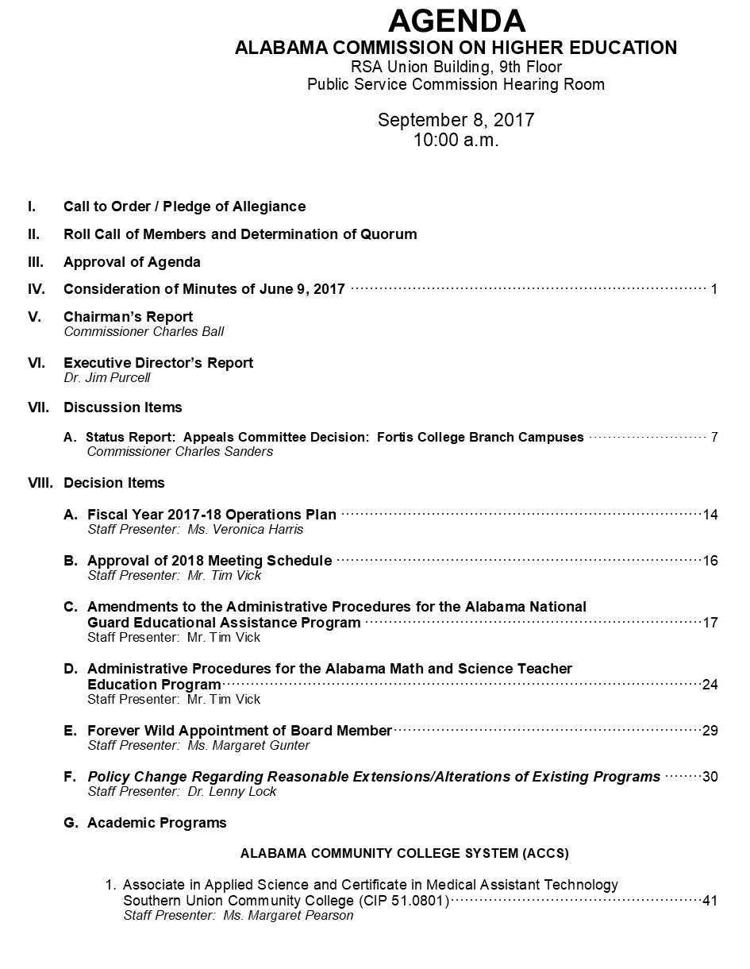
III. APPROVAL OF AGENDA
September 28, 2017

Slide 5
IV. APPROVAL OF MINUTES
June 9, 2017

Slide 6
V. CHAIRMAN’S REPORT

Slide 7
VI. EXECUTIVE DIRECTOR’S REPORT

Slide 8
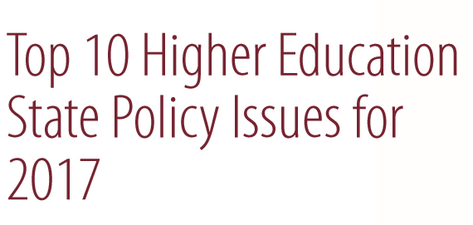
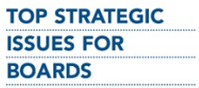

Slide 9
1. Softening State Budgets. Immediate challenge for many states will be to craft state budgets amid sluggish tax receipts, deficit projections and limited comfort in what future federal funding priorities will be.
2. Affordability. Due to growing concerns about affordability and student debt, state lawmakers have tied higher education funding increases to tuition freeze. The free tuition movement has also sparked legislative interest. Four states now fund community college tuition, but differ in approach.
3. Economic and Workforce Development. The 2016 election sent a clear message regarding economic distress and demand for more high-paying jobs. The economic environment remains marked by a starker divide between those with and without education and training beyond high school.

Slide 10
4. Undocumented and DACA Students. Policies directed at undocumented immigrants, including college students, will be one of the most closely tracked issues this year.
5. Campus Sexual Assault. National attention on this issue has translated into campus and state-level policy changes. Recent federal guidelines that provide greater protection of students are being challenged by those arguing that the current policies violate due process rights. Education Secretary DeVos recently revisited this issue and is proposing changes.
6. Guns on Campus. Allowing students and campus staff to carry guns on campus will continue to be one of the most contentious higher education policy issues. Alabama has a 21st Century Taskforce on Guns.

Slide 11
7. Institutional Productivity and Student Success. With limited revenues in many state coffers this year, there will be renewed interest in state policies aimed at incentivizing improved institutional outcomes with existing resources. The most prominent of these policies is performance-based higher education funding (PBF), a policy that has expanded to states since the beginning of the decade. 38 state have some form of performance-based funding.
8. Academic Freedom, Civil Rights and Social Issues. Higher education has often been accused of liberal and progressive biases and the dominance of conservative lawmakers in some states may lead to more conflicts and arguments over bias in the academy in 2017.

Slide 12
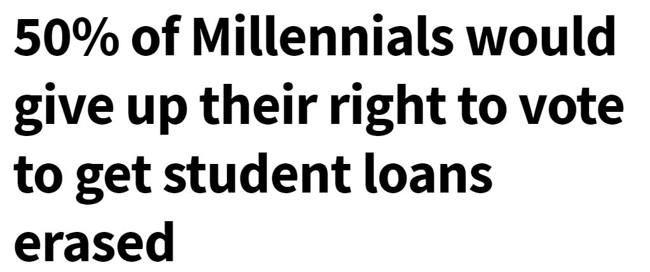
9. Dual Enrollment. With continued concerns over college affordability and college readiness, policies that allow students to take courses that count toward a high school diploma and a college credential remain popular with governors and state legislatures.
10. Student Debt Management. State policymakers have an increasing number of constituents who rely on debt as a mechanism for financing their postsecondary education, making student loan refinancing, loan forgiveness and related policies an emerging policy priority.

Slide 13
Honorable Mention
Consumer Protection for students of For-Profit Colleges. Fraud and abuse among for-profit college providers will likely continue to be a topic of interest.
Policies to Help Vulnerable and Needy Students. There is a renewed interest in helping with basic needs, such as housing, food and childcare, as well improving the success of students transitioning from foster homes.
College Access and Success for Veterans/Current Military Members & Families. Many states are seeking to expand financial support for the military, veterans, and their families in accessing higher education.
Free Speech on Campus. Growing state-level efforts to eliminate free speech zones on campus and 1st Amendment rights advocacy groups seeking to expand free speech to the entire campus.

Slide 14
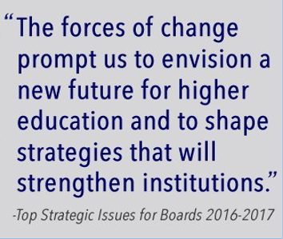

Slide 15
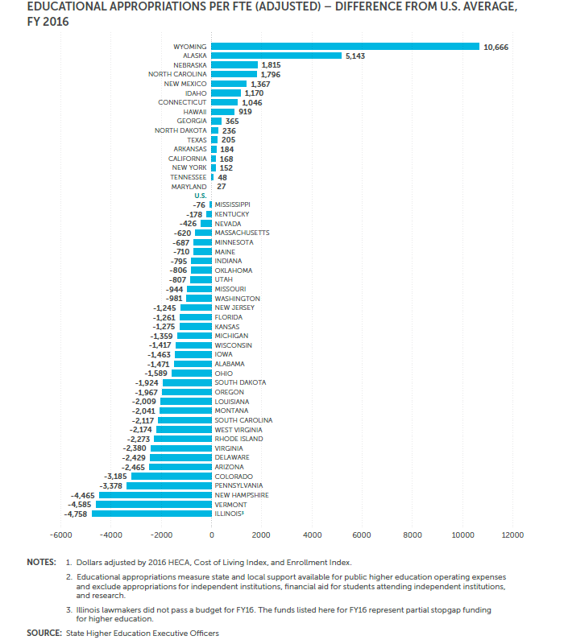
The Business Model
From 2000 to 2012, the number of students at American colleges grew by 45%, while state appropriations fell by 37%
In 2016, higher education support per capita in AL was 79% the size of the U.S. average

Slide 16
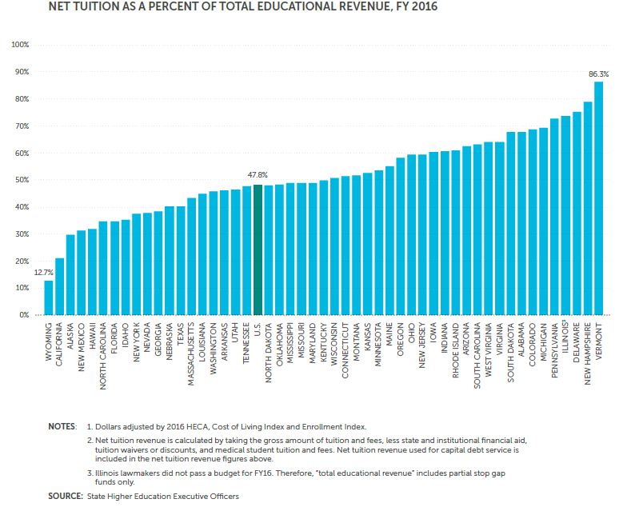
The Business Model
Due to the reduction in appropriations, colleges are more reliant on tuition revenue than ever before
Alabama ranks 8th in reliance on Tuition
The AGB recommends that colleges focus more on identifying and improving efficiencies rather than tuition increases
(SHEEO SHEF FY 2015 Report)
Notes:
http://www.providencejournal.com/article/20141119/NEWS/311199983 – source for tuition increase data
SHEEO is the source for the other data and charts

Slide 17
The Value Proposition
The benefits of a college degree are being questioned today more than ever, regarding affordability, quality, and value
Only half of college graduates strongly agree that their education was worth the cost
Colleges will need to prove the societal benefits of a postsecondary education rather than just the labor market benefits
Title IV students (Federally Aided Students)
Measured in 2012 & 2013 (not enrolled 10 years after entry into workforce)
(AGB, 2016)

Slide 18
The Partnership Imperative
The AGB stresses the growing importance of public and private partnerships and cooperative agreements between the non-profit and for-profit sectors
Florida Atlantic University partnered with Balfour Beatty Campus Solutions to build campus residences; the company invested in the project
The Ohio State University completed a 50-year lease of its parking facilities through a private consortium, with the funds going directly into their endowment
Consortia between institutions are also beneficial as they can help;
Conduct programs in faculty and professional development
Offer joint academic programs
Share information technology
Foster economic development
Encourage sustainability programs
In the United Kingdom, businesses spend over 20 times more on collaborations with universities than on licensing technology from them

Slide 19
The Partnership Imperative
Alabama Examples of Collaborations
Institution to Institution:
Reverse Transfer between 2-year and 4-year institutions.
UAB has a Joint Admission program with area community colleges.
Institution to Business:
Alabama community colleges selected for Apple training program.
AU and the City of Auburn teamed up to discuss innovation and entrepreneurship in Auburn.
UA is one of four universities selected by the NSF to tackle challenges facing technological advances in automobiles.
ASU’s Small Business Development Center in the College of Business Administration provides technical assistance to small businesses.
Maintaining and growing these partnerships is an essential task.

Slide 20
Student Success and Completion
(SHEEO SHEF FY 2015 Report)

Slide 21
Diversity and Inclusivity
The American college landscape is going to continue to see a major influx of diverse students, both from race and age divides
Between 2013-2024 the NCES projects;
A 7% increase in white students
A 28% increase in black students
A 25% increase in Hispanic students
A 10% increase in Asian/Pacific Islander students
Source: NCES

Slide 22
Diversity and Inclusivity
While the minority populations among students is growing consistently, the same is not true for minorities working for the colleges as faculty, administrators, or Board members
Nearly a third of college students are black or Hispanic, yet only 11% of faculty identify as such.
Boards can play a major role in facilitating and supporting institutional efforts towards greater inclusivity and the rejuvenation of the campus environment
(AGB, 2016)

Slide 23
The Academic Workplace
In 2011, 51% of college faculty members were part-time, compared to 30% in 1975.
The AGB warns that over-reliance on part-time and adjunct faculty may contribute negatively to the weakening of campus life, culture and community
(AGB, 2016)
Source: IPEDS

Slide 24
Campus Safety
Sexual Assault
Campus Shootings
By one estimate, as many as 90% of campus sexual assault victims do not report the offense
Therefore, colleges must be proactive and not reactive when it comes to acts of sexual violence on campuses
Secretary DeVos plans to change how campuses approach allegations of sexual violence
In 2015 alone, at least 23 shootings occurred at colleges and universities
While some universities struggle with deciding to be open-carry or gun-free schools, it is most important for colleges to set up extensive safety protocols in the event of an attack
AL: 78 reported, possibly 702 not reported
(AGB, 2016)

Slide 25
Campus Safety
28 states have introduced or enacted legislation on campus sexual violence in 2015 – Alabama was not one of them
As the map shows, much more work remains to be done to ensure campus environments are safe for all students
Status of affirmative consent laws, InsideHigherEd.com

Slide 26
In Summary
In the face of budget cuts and diminishing support for higher education institutions, we must focus on making our colleges more efficient rather than more expensive.
As student populations become more diverse, colleges themselves must also embrace diversify, for the sake of both inclusivity and success.
The preservation of campus life, culture and community is imperative to help keep the university a safe and enjoyable place for everyone.

Slide 27
VII. DISCUSSION ITEMS

Slide 28
A. Status Report: Appeals Committee Decision: Fortis College Branch Campuses

Slide 29
VIIi. Decision ITEMS

Slide 31
Fiscal Year 2017-2018
Sources of Revenue
Restricted/Earmarked and Unrestricted
$ 30,796,674

Slide 32
Alabama Commission on Higher Education
Budgetary Facts
The Commission has 25 programs under 5 appropriation units.
This represents nearly an 17.9% increase over the previous year.
Two new programs were added to the Commission’s budget for FY 2017-18:
Math and Science Teacher Education Program
Alabama Trails Foundation
The FY 2017-18 Operations Plan, showing expenditures for each of the fiscal year’s quarters, was submitted to Executive Budget Office (EBO) on July 31, 2017. Any changes made by the Commission can be made through a Operations Plan revision after October 1, 2017.

Slide 33
Level Funded other than these Changes
Financial Aid
Pass Thru Programs

Slide 38
Alabama Commission on Higher Education
FY 2017-18 Budget - Restricted/Earmarked and Unrestricted
Expenditures by Object | Amount | Percent
Personnel Costs | 2,556,986 | 8.3%
Employee Benefits | 811,713 | 2.6%
Travel In-State | 36,155 | 0.1%
Travel Out-of-State | 53,805 | 0.2%
Repairs and Maintenance | 4,800 | 0.0%
Rentals and Leases | 568,524 | 1.8%
Utilities and Communications | 40,916 | 0.1%
Professional Services | 342,857 | 1.1%
Supplies and Operations | 210,432 | 0.7%
Transportation Expenses | 15,400 | 0.1%
Grants and Benefits | 26,052,428 | 84.6%
Other Equipment Purchases | 102,678 | 0.3%
Total | 30,796,694 | 100.0%

Slide 40
B. Approval of 2018 Meeting Schedule
Proposed Meeting Schedule for 2018
March 9, 2018
June 8, 2018
September 14, 2018
December 7, 2018

Slide 41
Amendments to Administrative Procedures for the
AL National Guard Educational Scholarship Program (ANGEAP)
Major Changes to the Administrative Code:
Changes award amount to an amount not to exceed the average cost of tuition & required fees per semester at the four-year public institutions.
Based on the FY 2017-18 average tuition & required fees, this will equate to approximately $5,080 per semester and a max of $15,240.
Annual award was $1,000 per semester and a max of $2,000 per year.
Funds may no longer be used to cover the costs of books and supplies.
Benefits to be applied only after all other available resources have been exhausted.
Recipients are required to maintain a 2.0 cumulative grade point average.

Slide 42
D. Administrative Procedures for the Alabama Math and Science Teacher Education Program
In order to participate in the program, recipients must:
be an Alabama resident;
attend an eligible participating institution of higher education;
be unconditionally admitted to an ALSBE approved program in math or science based on that institution’s admission criteria (to include the PRAXIS Core Test or any other such test subsequently approved to take its place by the ALSBE);
be one of the following:
undergraduate junior or senior enrolled in a secondary education program in math or science and taking 12 ≥ semester hours, with preference given to students classified as seniors,
currently certified teacher enrolled in courses to earn certification in math or science,
a graduate student enrolled in a secondary math or science Alternative Class A program approved by the ALSBE;
Continues next page

Slide 43
D. Administrative Procedures for the Alabama Math and Science Teacher Education Program
In order to participate in the program, recipients must:
5. maintain the required College/School/Division/Department of Education GPA (cumulative);
6. sign a letter of acceptance for the award;
7. sign a statement that they intend to:
finish the program in which they are enrolled,
meet all testing requirements,
apply for an Alabama Educational Certificate.

Slide 44
E. Forever Wild Appointment of Board Member
Dr. Jason E. Bond
Professor and Chairman, Auburn University, Department of Biological Sciences
Has served as a North American council member for the IUCN Red List of Threatened Species, the world’s most comprehensive inventory of the global conservation status of biological species
Has experience in conservation and land management practices
Former director of the Auburn University Museum of Natural History and the Alabama Natural Heritage Program
Has published 86 papers and specializes in the field of arthropod evolutionary biology and systematics
Central District appointment will begin October 1, 2017 – September 30, 2023

Slide 45
F. Policy Change Regarding Reasonable Extensions/Alterations of Existing Programs
The Commission defines a reasonable extension or alteration, under its rule-making authority Chapter 300-2-1-.01 Program Review, “Definitions Recognized By The Commission,” as “a modification of an existing unit or program of instruction that does not change its essential character, integrity, or objectives.”
Such modifications do not create new units or programs of instruction.
The current policy “Guidelines for the Review of Extension and Alterations of Existing Programs” requires that extensions/ alterations determined to be substantive be submitted to the Commission as decision items.

Slide 46
The basis for the request is that the criteria of reasonable extensions-alterations can be sufficiently applied and determined by Commission Staff.
In any instance that Commission Staff are not satisfied that the definition criteria of a “reasonable extension-alteration” has been met, the institution may withdraw the item or request that the item come before the Commission as a decision item.
There will be no change in the form used by the institutions for submitting the request for Staff review as a reasonable extension-alteration.

Slide 47
G. Academic programs

Slide 48
ALABAMA COMMUNITY COLLEGE SYSTEM (ACCS)

Slide 49
Southern Union Community College
1. Associate in Applied Science and Certificate in Medical Assistant Technology (CIP 51.0801)
According to SOU officials, there are over 100 physicians located in the college’s service area. In addition to the large number of general and specialty physician practices, there are general, acute, specialty, and trauma hospitals located in SOU’s service area.
According to the U.S. Department of Labor, employment of medical assistants is expected to grow 23 percent from 2014 to 2024, much faster than the average for all occupations.

Slide 50
FOUR-YEAR INSTITUTIONS

Slide 51
Auburn University
Master of Engineering Management in Engineering Management (CIP 15.1501)
The Master of Engineering Management (MEM) degree will primarily provide specialized education to practicing engineers, enabling them to manage technical projects and/or other engineers effectively.
This program will provide graduates that will assist their organizations to improve operational efficiency, improve safety in the workplace, expand product development, and improve management of highly complex technical systems.
The MEM degree will offer four specially focused options to tailor the graduate education to selected interest areas (manufacturing, occupational safety and ergonomics, product innovation, and systems).
The proposal projected that $0 in new funds will be required for the program over the first five years, and that $8,757,339 will be available over the same period through tuition.

Slide 52
Auburn University 2. Auburn University and Auburn University at Montgomery Dissolution of the Joint Master of Science in Nursing [MSN] in Nursing (CIP 51.3801)
The Joint Master of Science in Nursing in Nursing program was established in 2006 (Approved by ACHE on September 23, 2005) and professionally accredited in 2009 by the Commission on Collegiate Nursing Education (CCNE).
Since that time, the Auburn School of Nursing and Auburn University at Montgomery College of Nursing and Health Sciences have worked together effectively to provide this MSN degree.
The Provosts of both institutions have signed a letter formally requesting the dissolution.
The letter further details the impetus, context, and bases of curricular alignment and restructuring as well. (Letter provided in Attachment 1 of that item)

Slide 53
Auburn University
3. Master of Science in Nursing in Nursing (CIP 51.3801)
Graduates of this program will be visual representations of Auburn's mission statement and strategic plan, by planning, providing, and evaluating quality health care that is delivered to residents of Alabama and the nation.
The purpose of the master's program is to develop primary nurse practitioners and nurse educators capable of making a positive impact on quality patient care and health outcomes in under-served communities. There are two proposed tracks: MSN Nurse Practitioner (NP) Track and Nurse Educator (NE) Track.
The Auburn University School of Nursing will seek accreditation for the MSN program from the Commission on Collegiate Nursing Education (CCNE). This accreditation assures the quality and integrity of the program. Currently, the AU baccalaureate and the joint AU/AUM program are accredited by CCNE.
The proposal projected that $664,496 in new funds will be required for the program over the first five years, and that $980,100 will be available over the same period through tuition and internal reallocations.

Slide 54
Auburn University at Montgomery
Master of Science in Nursing in Nursing (CIP 51.3801)
The purpose of this proposal is to establish a Master of Science in Nursing (MSN) Degree Program at Auburn University at Montgomery (AUM) to better serve the needs of the institution’s students and the community. This program directly relates to the University’s mission and goals.
The AUM MSN program will have two tracks: the preparation of Family Nurse Practitioners (FNP) and Nurse Educators for Interprofessional Practice (NE for IPP).
The AUM School of Nursing will seek accreditation for the MSN program from the Commission on Collegiate Nursing Education (CCNE). This accreditation assures the quality and integrity of the program. Currently, the AUM undergraduate and the joint AU/AUM program are accredited by CCNE.
The proposal projected that $55,950 in new funds will be required for the program over the first five years, and that $392,366 will be available over the same period through tuition.

Slide 55
University of Alabama
Bachelor of Fine Arts in Theatre (CIP 50.0501)
The proposed Theatre program will have concentrations in Acting, Musical Theatre, and Design/Technical Theatre.
The University of Alabama has a successful Department of Theatre and Dance that includes a New York Senior Showcase, a professional summer theatre, an award winning feature film, and recent graduates performing lead roles on Broadway.
No new funds are needed since existing coursework is currently being offered through UA’s BA in Theatre program.

Slide 56
University of Alabama at Birmingham
Clinical Doctorate in Occupational Therapy (OTD) (CIP 51.2306)
The proposed Occupational Therapy Doctorate (OTD) program is designed to provide advanced educational and clinical opportunities for Occupational Therapy (OT) practitioners to develop knowledge and skills to improve health care for persons with functional limitations that influence their occupational performance or everyday living skills, and to improve the health, well-being, and quality of life for all people, populations, and communities.
The Department of Occupational Therapy at UAB has been in existence for almost 50 years, delivering entry-level OT education, initially at the bachelor's level (1968-2000) and then at the master's level (2000-present). There were 45 master’s level completers in 2015-2016.
The program is designed for online delivery. Approximately 95 percent of the total program's courses offered will be provided by distance education.
The proposal projected that a total of $347,000 in estimated new funds will be required to support the proposed program. A projected total of $1,104,840 in new funds will be available from tuition.

Slide 57
University of Montevallo 1. Bachelor of Science in Computer Informatics (CIP 11.0104)
There will be over 1,600 projected job openings in UM’s service area over the next five years.
According to the proposal, there is sufficient student demand indicating interest in the proposed program.
UM is the only public four-year institution not offering a program in a computing field.
A total of $1,005,400 will be available through tuition.

Slide 58
University of North Alabama
Master of Arts in Education in Early Childhood Education (CIP 13.1210)
There is an escalated need for teachers in early childhood education; therefore, UNA desires to provide a master’s degree opportunity for candidates desiring to focus studies in that teaching field.
This proposal serves to re-establish a stand-alone M.A.Ed. degree under CIP 13.1210 for candidates seeking Class A professional educator certification exclusively in the area of Early Childhood Education (ECE).
UNA currently houses the only National Association for the Education of Young Children (NAEYC) accredited child development center within a 50 mile radius of the Shoals area.
The proposal projected that $0 in estimated new funds will be required to support the proposed program over the first five years. A total of $116,625 will be available through tuition.

Slide 59
University of West Alabama
1. Bachelor of Science in General Science (CIP 30.0101)
The proposed program is designed primarily for students wishing to become certified to teach General Science at the secondary level.
No new funds are needed since the program will use existing coursework from the teacher certification general science option at UWA. The option is being elevated to program status.
According to UWA officials, the proposed program will meet a critical need for the institution’s service area in providing a pipeline of qualified science teachers.

Slide 60
University of West Alabama
Bachelor of Science in Business Administration in Quantitative Finance and Econometrics (CIP 45.0603)
The Central State Occupational Projections Survey indicates Alabama is projected to have 970 job openings in the next 5 years in areas such as Actuaries, Brokerage Clerks, Budget Analysts, Cost Estimators, Credit Analysts, Credit Authorizers, and Economists.
The proposed program will give students more rigorous training in economics and finance, as these areas are high in demand for graduate programs and the workforce for both fields.

Slide 61
H. Extensions/Alterations of Existing Programs

Slide 62
Proposed Extensions/Alterations of Existing Programs of Instruction
Alabama A&M University, Addition of a Specialization in Ambient Energy Systems to the Existing MS in Physics (CIP 40.0801)
The program with the specialization will require a total of 30 semester hours. The specialization portion with the Thesis choice entails 15 semester hours. The specialization portion with the Non-Thesis choice entails 21 semester hours. Budgetary Impact: None.
Alabama A&M University, Addition of a Specialization in Ambient Energy Systems to the Existing PhD in Applied Physics (CIP 40.0899)
The program with the specialization will require a total of 60 semester hours. The specialization entails 14 semester hours. Budgetary Impact: None.
Alabama A&M University, Addition of a Concentration in Criminal Justice to the Existing BS in Criminal Justice (CIP 43.0103)
The program with the proposed concentration will require a total of 126 semester hours. The proposed concentration will consist of 21 semester hours. Budgetary Impact: None.
Alabama A&M University, Addition of a Concentration in Political Science to the Existing BA in Political Science (CIP 45.1001)
The program with the proposed concentration will require a total of 123 semester hours. The proposed concentration will consist of 21 semester hours. Budgetary Impact: None.
Alabama A&M University, Addition of a Concentration in Sociology to the Existing BA in Sociology (CIP 45.1101)
The program with the proposed concentration will require a total of 123 semester hours. The proposed concentration will consist of 21 semester hours. Budgetary Impact: None.
6) Athens State University, Addition of an Option in Health Care Administration to the Existing BS in Health Science (CIP 51.9999)
The program with the proposed option will require a total of 124 semester hours. The option
portion entails 15 semester hours. Budgetary Impact: None.

Slide 63
Proposed Extensions and Alterations to Existing Programs of Instruction (Cont.)
Auburn University, Alteration of the PhD in Fisheries (CIP 01.0303)
AU has proposed an alteration of the program title from Fisheries to Fisheries, Aquaculture, and Aquatic Sciences. The content and character of the affected program will not be altered. The change is in title only. Budgetary Impact: None.
Auburn University, Alteration of the PhD in Agronomy and Soils (CIP 01.1191)
AU has proposed an alteration of the program title from Agronomy and Soils to Crop, Soil, and Environmental Sciences. The content and character of the affected program will not be altered. The change is in title only. Budgetary Impact: None.
Enterprise State Community College, Addition of a Certificate in Legal Assistant/Paralegal to the Existing AAS in Legal Assistant/Paralegal (CIP 22.0302)
The Certificate will consist of 47 semester hours and will provide a credential for students as they complete the degree program or an exit point and credential for students who may be unable to complete the entire degree program. Budgetary Impact: None.
Jacksonville State University, Addition of a Traditional Concentration to the Existing BS in Mathematics (CIP 27.0101)
The program with the proposed concentration will require a total of 120 semester hours. The concentration is comprised of 39 semester hours. Budgetary Impact: None.
Southern Union State Community College, Addition of a Certificate in Business Management and Supervision to the Existing AAS in Business Management and Supervision (CIP 52.0101)
The Certificate will consist of 45 semester hours and will provide a credential for students as they complete the degree program or an exit point and credential for students who may be unable to complete the entire degree program. Budgetary Impact: None.
University of Alabama, Addition of Concentrations in Natural Resources and Ecosystem Conservation to the Existing BS in Environmental Science (CIP 03.0104)
The program with proposed concentrations will require a total of 121-127 semester hours. The proposed concentrations will consist of 21-27 semester hours each. Budgetary Impact: None.

Slide 64
Proposed Extensions and Alterations to Existing Programs of Instruction (Cont.)
University of Alabama at Birmingham, Addition of an Option in Applied Professional Spanish to the Existing BA in Foreign Languages (CIP 16.0101)
The program with the proposed option will require a total of 120 semester hours. The proposed option will consist of 30 semester hours. Budgetary Impact: None.
University of Alabama at Birmingham, Addition of an Ethics Track to the Existing BA in Philosophy (CIP 38.0101)
The program with the proposed track will require a total of 120 semester hours. The proposed track will consist of 15 semester hours. Budgetary Impact: None.
University of North Alabama, Addition of an Emphasis in Resource Management to the Existing BS in Sport and Recreation Management (CIP 31.0504)
The program with the emphasis will require a total of 120 semester hours. The emphasis component entails 33 semester hours. Budgetary Impact: None.
University of West Alabama, Addition of Options (6) to the Existing MBA in Business Administration (CIP 52.0201)
UWA has proposed the addition of options in Management; Marketing; Accounting; Sport Management; Entrepreneurship and Innovation; and Computer Information Systems to the existing program. The program with each proposed option will require a total of 33 semester hours. The proposed options will consist of 9 semester hours each. Budgetary Impact: None.
University of West Alabama, Addition of a Concentration in Military History to the Existing BA/BS in History (CIP 54.0101)
The program with the proposed concentration will require a total of 126 semester hours. The proposed concentration will consist of 15 semester hours. Budgetary Impact: None.

Slide 65
I. Public Drawing to Determine the Order of Payment of Alabama Student Grant Program (ASGP) Funds for 2017-2018 Academic Year

Slide 66
ix. information ITEMS
Implementation of Approved Programs
Summary of Post-Implementation Reports
Implementation of New Short Certificate Programs (Less than 30 Semester Hours)
Changes to the Academic Program Inventory
Implementation of Non-Degree Programs at Senior Institutions
Establishment of, Administrative Changes to, and Name Changes of Units
Distribution of 2017-2018 Alabama Student Assistance Program (ASAP) Funds

Slide 67
X. adjournment
The next meeting will be held on December 8, 2017

