Slide 1

Alabama Commission on Higher Education
Commission Meeting
December 8, 2017

Slide 2

CALL TO ORDER

Slide 3
II. ROLL CALL and QUORUM DETERMINATION

Slide 4
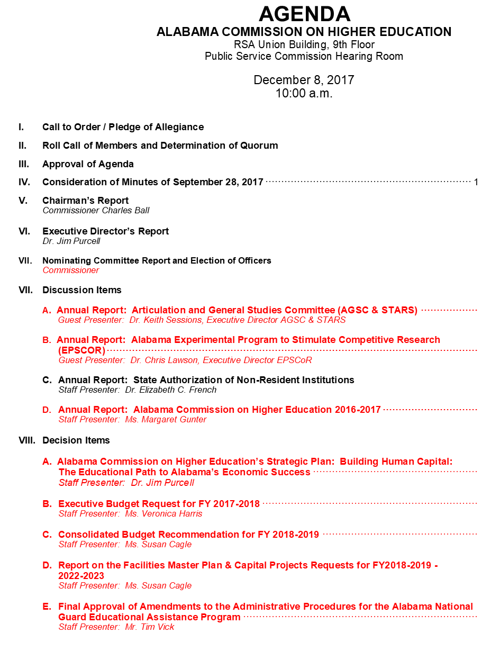

III. APPROVAL OF AGENDA

Slide 5

IV. APPROVAL OF MINUTES
September 28, 2017

Slide 6

V. CHAIRMAN’S REPORT

Slide 7
VI. EXECUTIVE DIRECTOR’S REPORT

Slide 8

Work Session
Sarah Ancel, Vice President of Complete College America (CCA). Sarah works with state and system leaders to advance policies proven to increase college completion and close achievement gaps. Alabama recently joined the consortium of states that make up CCA, with the support of Governor Ivey.

Slide 9
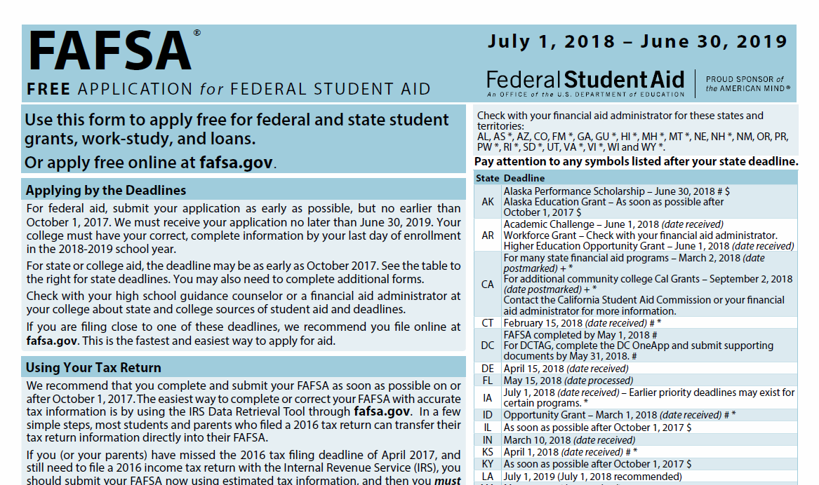
FAFSA Completion Project
FAFSA Completion PortalFAF
Ron Leonard
Nikesha Ross

Slide 10
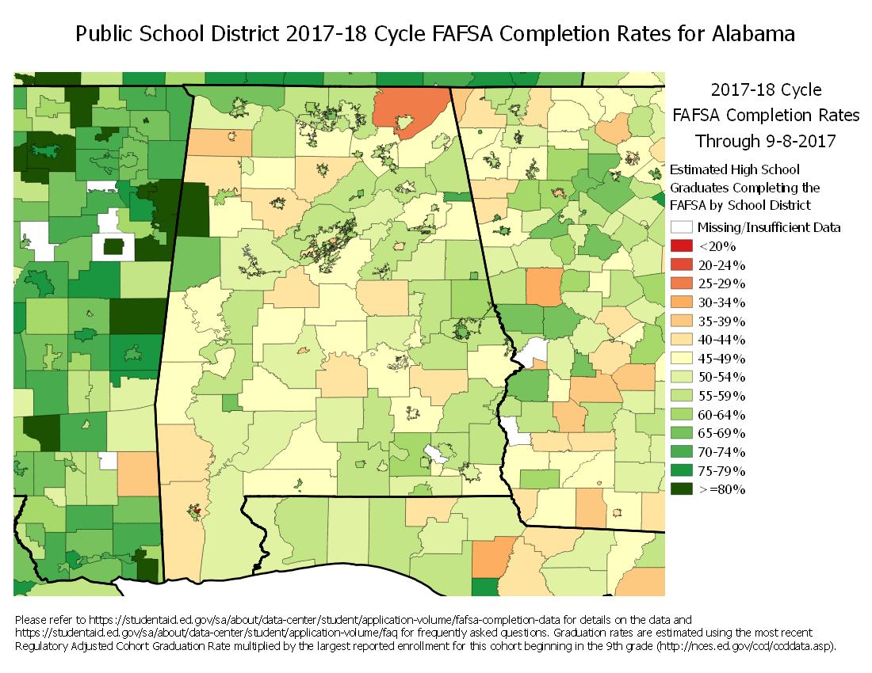
Notes:
This is why it’s important…the completion rate across the state isn’t good. It can be improved, and that’s the reason for this project.

Slide 11

Jim Purcell (ACHE), Amanda Kin (Jefferson State Community College) and Ron Leonard (ACHE /NAAL)

Slide 12
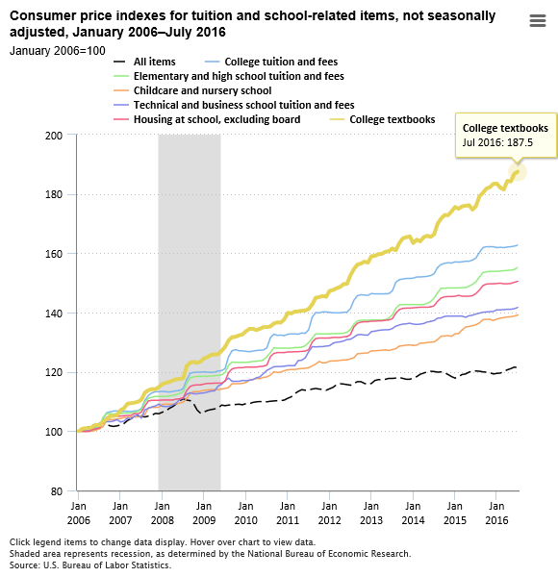
Factors Contributing to the High Cost of College
The cost of college textbooks increased by 88% between 2006 and 2016.*
*Bureau of Labor Statistics, U.S. Department of Labor, The Economics Daily, College tuition and fees increase 63 percent since January 2006 on the Internet at https://www.bls.gov/opub/ted/2016/college-tuition-and-fees-increase-63-percent-since-january-2006.htm (visited September 25, 2017).

Slide 13

OER Workshops
ACHE Staff will coordinate 3 OER workshops in different parts of the state in 2018. ACHE staff will also be available to speak at campuses.
OER implementation will be encouraged, but not required.

Slide 14
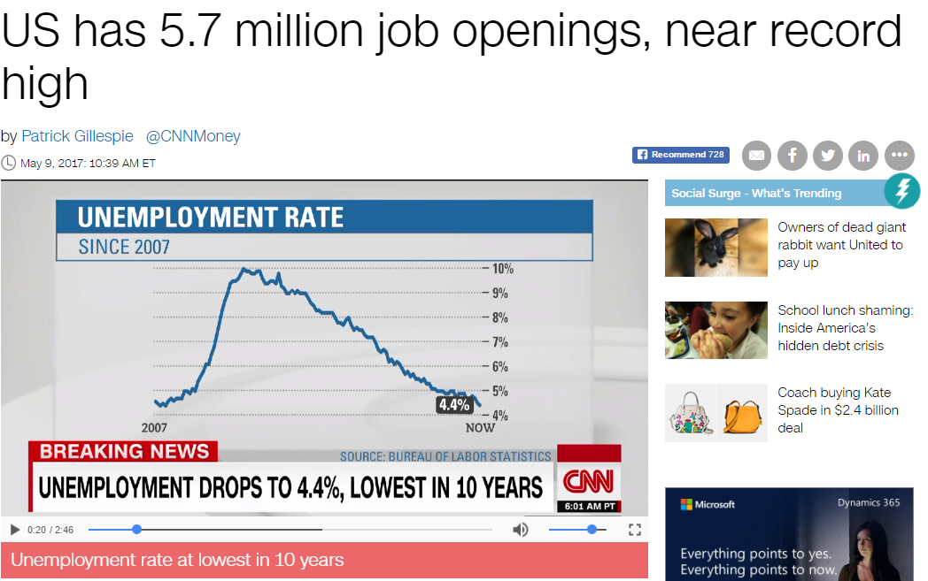
Good news:
Employers are hiring
Bad news:
Not all employers can find the skilled workers they need. Experts say that such a high number of job openings is due partially to a gap between the job skills employers demand and the skills job seekers have.
skills gap … is holding down overall wage growth in the US

Slide 15
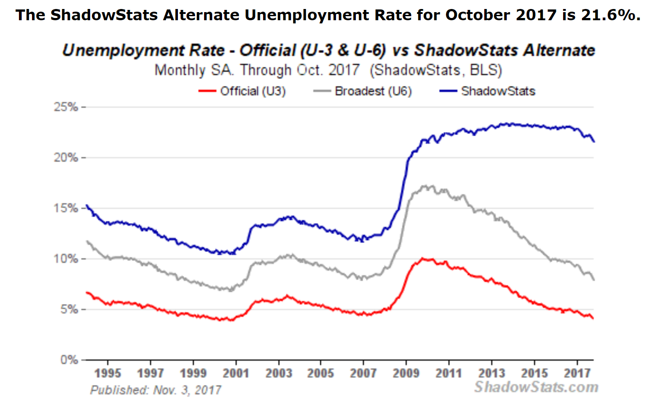
. The “official” reporting unemployment rate is of those seeking work. Once a person is unemployed for so long and quits trying to look for a job they are not shown. Rather than underemployment being at less than 5%, more than 20% are unemployed.

Slide 16

There is some urgency for credential production
The current educational requirements of the occupations that may grow are higher than those for the jobs displaced by automation.
If displaced workers are not reemployed quickly, countries will face rising unemployment and depressed wages
Globally, up to 375 million workers may need to switch occupational categories by:
2030

Slide 17
166 Million
Alabama can be proactive and position itself to prosper during this dramatic economic transition by preparing its citizenry.

Slide 20
In advanced economies . . . the transition may include a period of higher unemployment and wage adjustments. For the three advanced economies we focus on in this report—Germany, Japan, and the United States—economies are flexible enough to absorb most if not all the displaced workers by 2030 in all reemployment scenarios.
If these workers are retooled with the necessary technical proficiencies

Slide 21
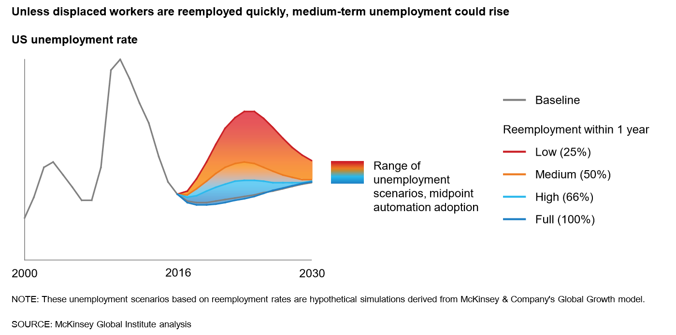

Slide 22
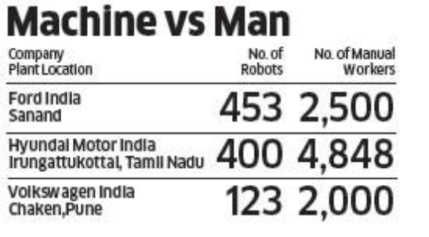

WAGE POLARIZATION MAY CONTINUE IN SOME ADVANCED ECONOMIES Middle-wage jobs have felt the impact of automation in the past decades in the United States, creating a polarization phenomenon. Modeling the potential impact of automation, we find that this polarization could continue and become exacerbated in advanced economies
auto.economictimes.indiatimes.com
Alabama workers will need to be credentialed to have access to jobs requiring higher skills and credentials.
Geekwire.com

Slide 23
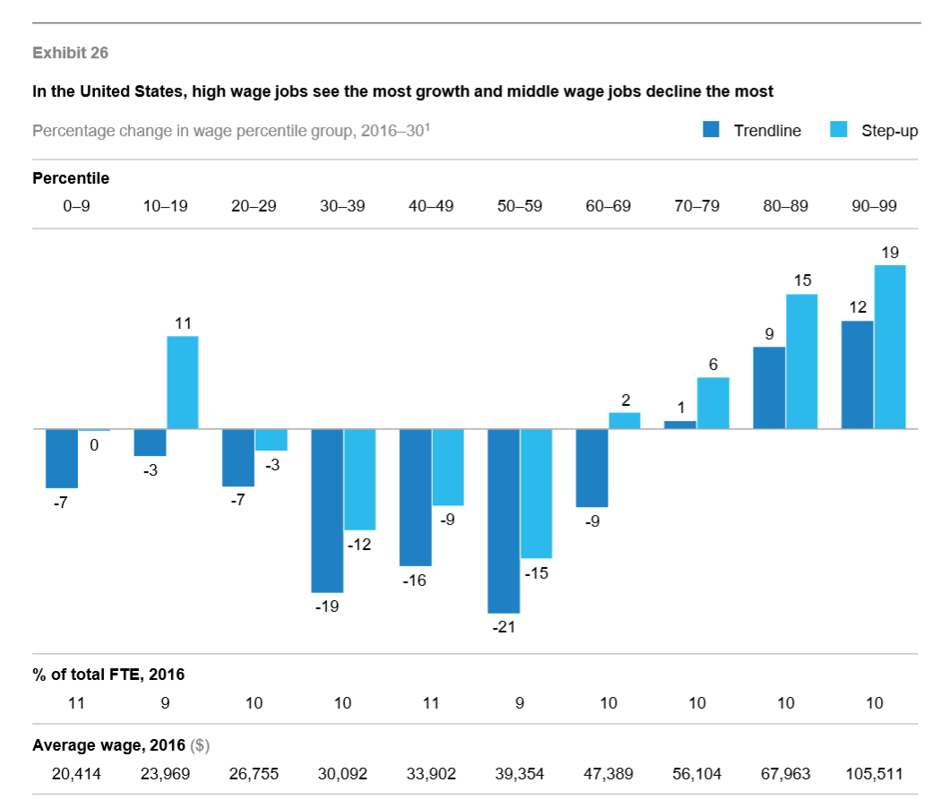
Middle Class Jobs are at greatest risk
Persons we train for mid-level jobs today will need to be training for a higher credentialed job in the near future.

Slide 24
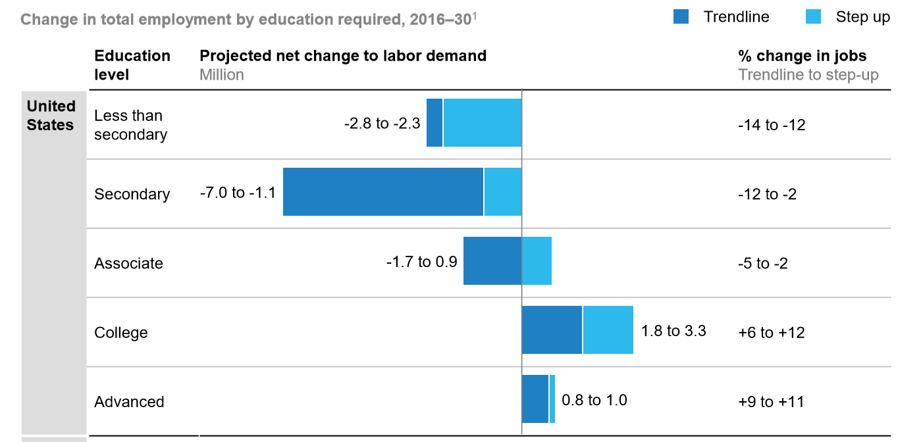
Continued decline in low skilled work
Emphasis in even higher levels of education by 2030
Enabling individuals to learn marketable new skills throughout their lifetimes will be a central challenge for some countries over the next decade and beyond.

Slide 25
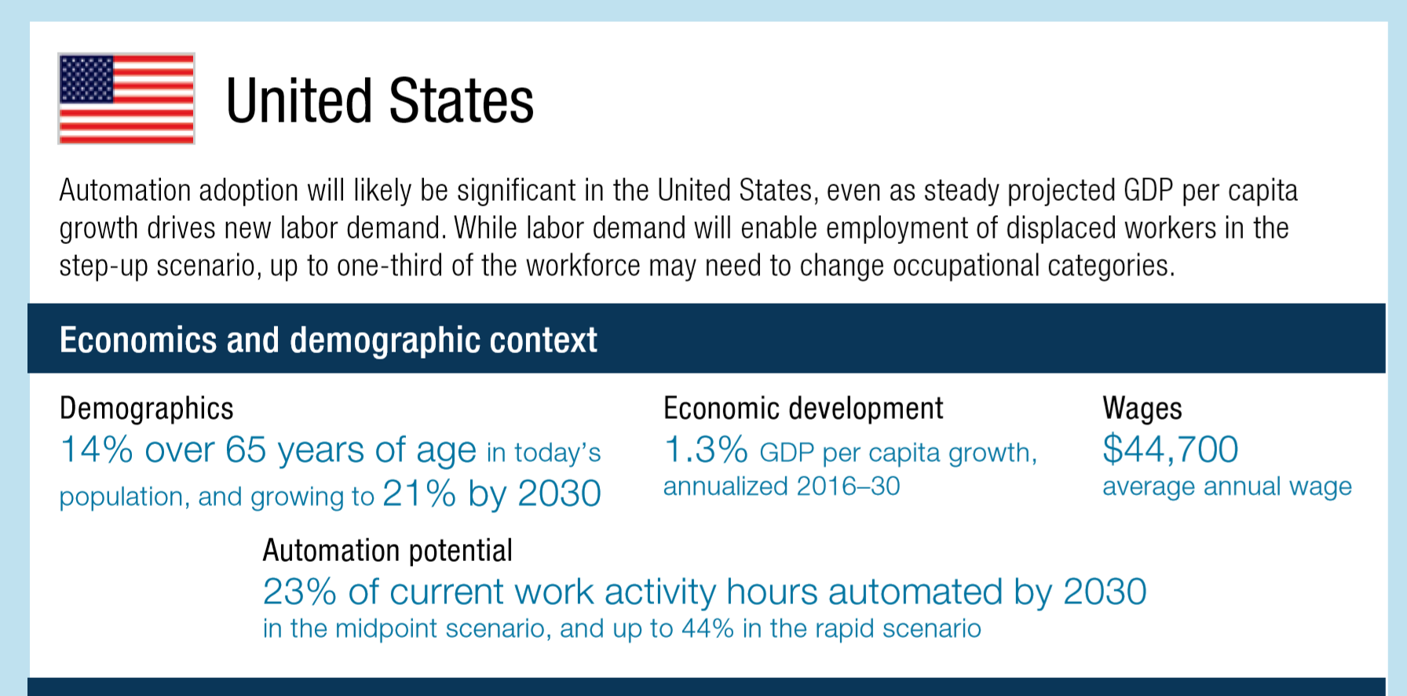

Slide 26


For more than 20 years, futurists have made a call for action regarding the need for more and more education as a way to mitigate the loss of jobs from improvements in automation and technology
The 2010 Meltdown: Solving the Impending Jobs Crisis
up to 50 percent of America’s adult population today lacks the advanced skills that are the foundation for most future high-paying jobs in today’s complex knowledge economy.
BLS assures us that over the long term, labor supply and demand will balance. (pg 18)
Edward E. Gordon
"The key to success in the 21st century is alignment. Staying in alignment with a world that will be characterized by complexity, diversity, and pace of change." - Ed Barlow, Futurist

Slide 27


Density of educated/ skilled workers
Access to good schools, colleges, universities
Local leadership
Regional economic development strategies rather than state-wide strategies
Return to city-states
Sparta and Athens
Work ready communities

Slide 28
History offers examples of large-scale programs to improve the skills of workers

Slide 29
The United States provides examples of two at-scale investments in the past century:
US High School Movement (1910 to 1940), which made attending secondary school the norm for all children.
School enrollment increased from 18 percent in 1910 to 73 percent in 1940. Graduation rates for 17-year-olds rose from 9 percent to 51 percent in the same period.
28 percent of the economic growth to human capital accumulation and technological progress, is attributed to the secondary school movement.
The 1944 GI Bill, which enabled millions of returning war veterans to obtain a tertiary education. Half of all veterans tapped the education benefits in some form, greatly exceeding the government’s projections.

Slide 30

At the end of WWII, the U.S made a bold decision to invest in the future of its economy by providing $1.9 billion annually to the education of returning veterans of the war. This commitment to human capital helped enable the WWII generation to become the “greatest generation.”
Possibly, Alabama’s greatest generation is at the schoolhouse door waiting for the opportunity to propel Alabama into the global economy.

Slide 31
VII. DISCUSSION ITEMS

Slide 32

2016-2017 Annual Report

Slide 33
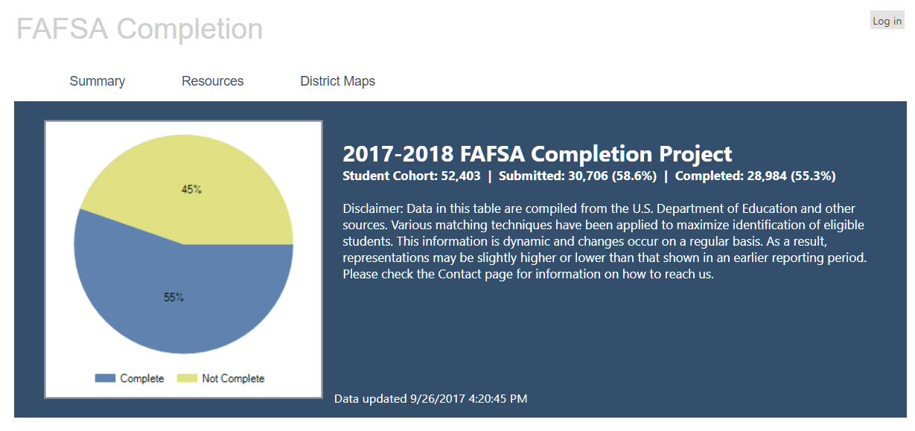
Free Application for Federal Student Aid
(FAFSA)
FAFSA completions are a must in order to qualify for Pell Grants
$45 million in Pell left on the table last year

Slide 34
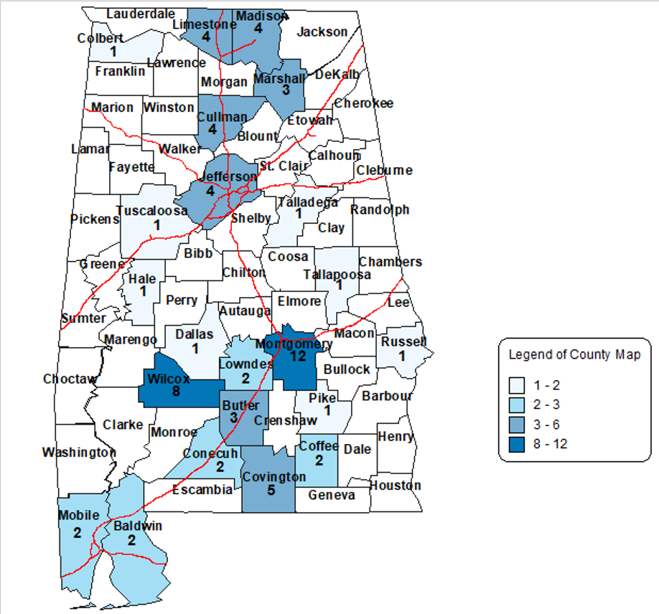
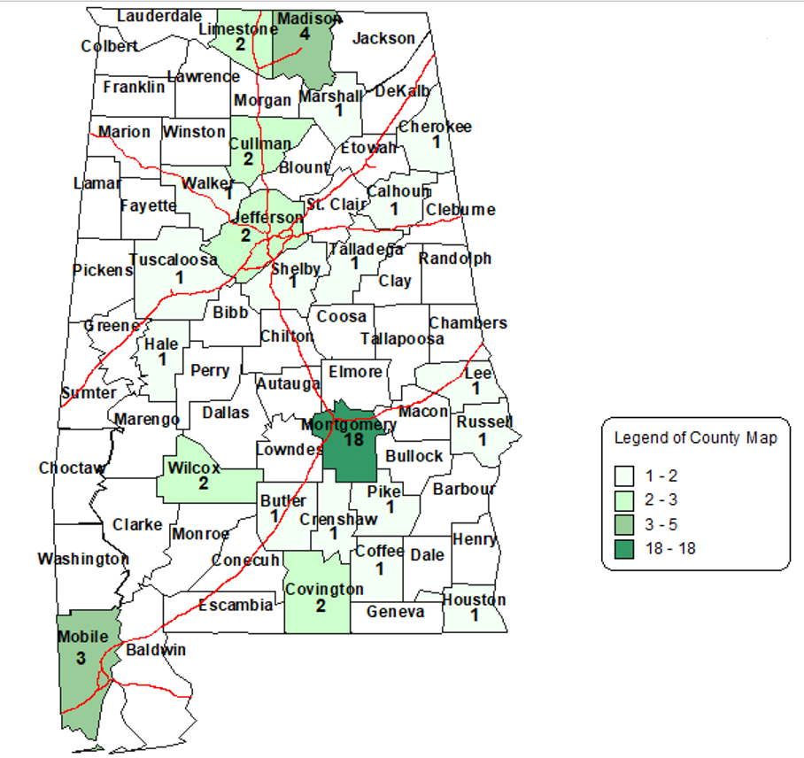
Student Assistance
Legislature allocates $325,000 for Math and Science Scholarships
65 Science Teachers Needed
50 Math Teachers Needed

Slide 35
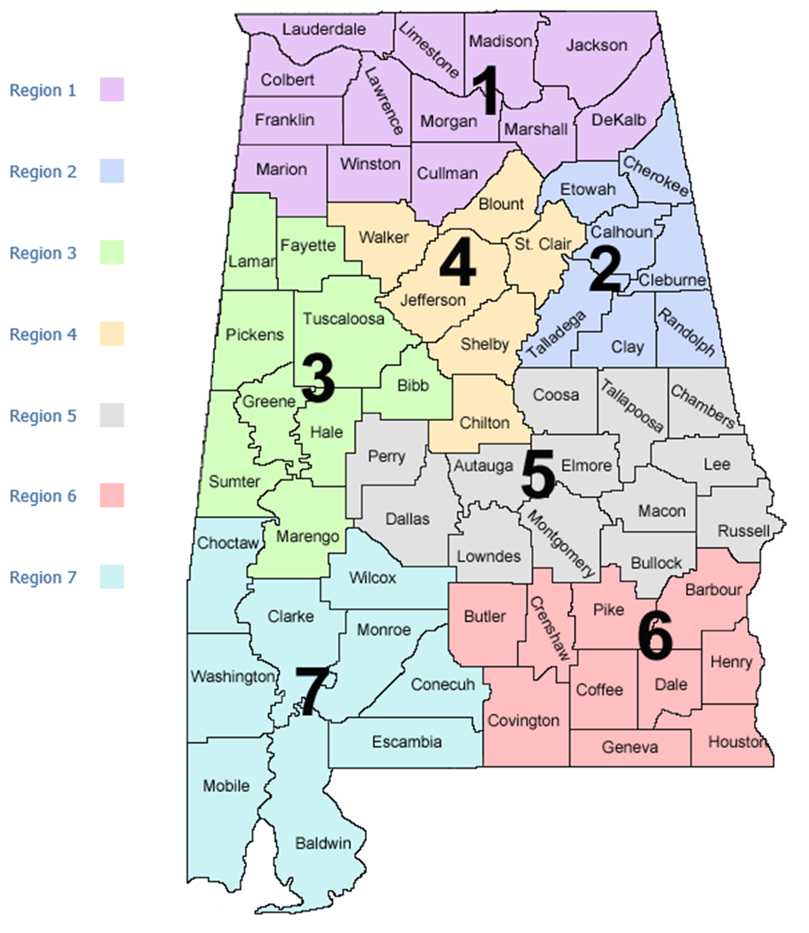
Research Services
11 million student records in Alabama Student Database
Multiple reports produced for Education and Workforce
Workforce by Region

Slide 36
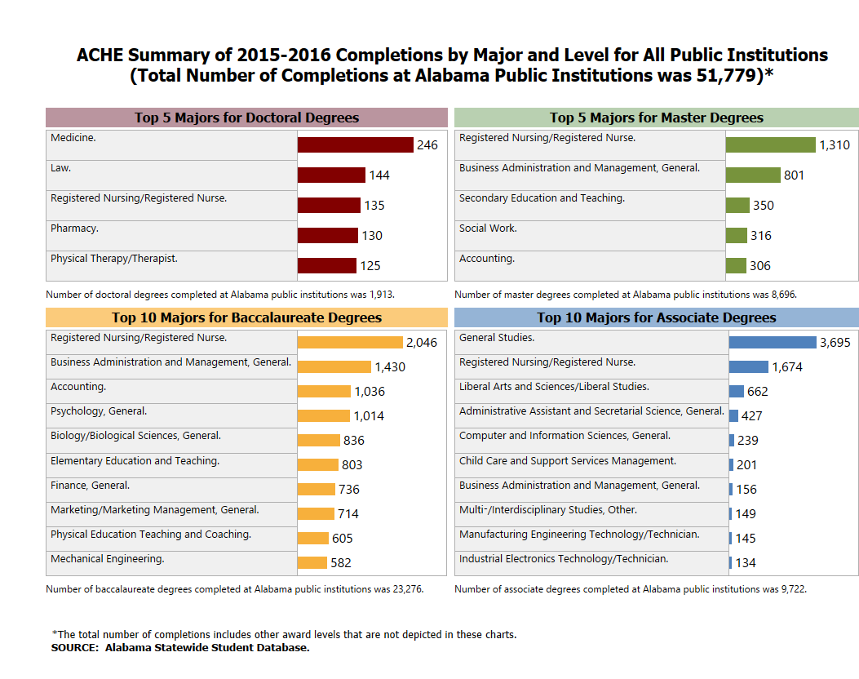
One report identifies completions by major and level for all public institutions

Slide 37
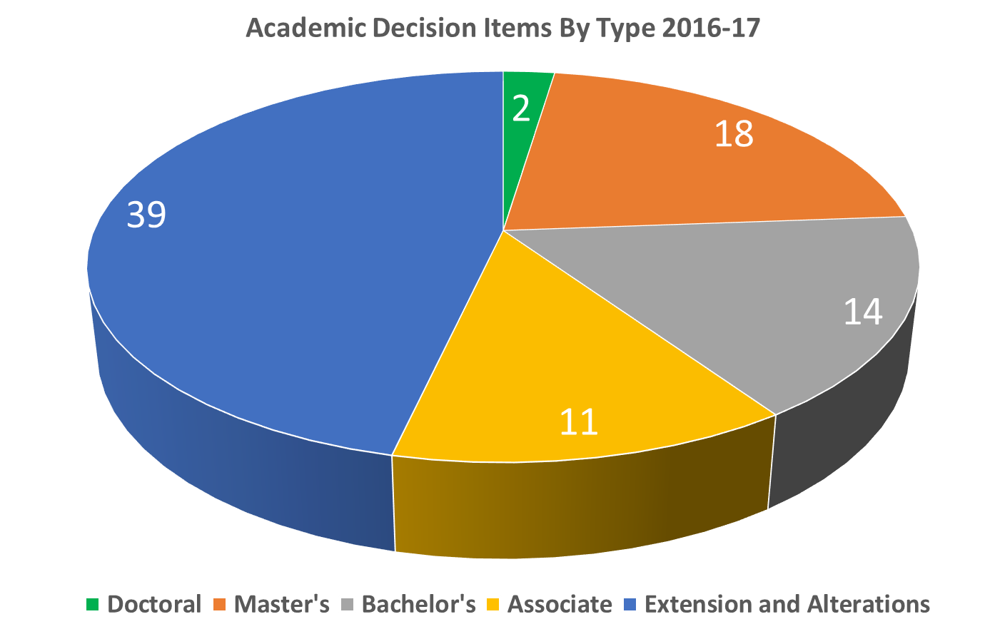
Instruction
230 instructional activities were presented to the Commission as decision or information items

Slide 38

No Child Left Behind Competitive Grant Program (NCLB)
Final year of federal funding to state agencies for higher education to administer NCLB competitive grants
$922,503 is supporting eight continuation awards to six institutions
Projects will provide professional development in 62 public school districts and 12 private schools through September 30, 2018. Projected impact:
499 K-12 teachers
35 administrators
6 para-professionals
46,000 students

Slide 39

Articulation and General Studies Committee Statewide Transfer & Articulation Reporting System (AGSC/STARS)
Since the fall of 1998, over one million transfer guides have been issued to students to ensure a seamless transfer of credit from public two- to four-year institutions
More than 1300 courses have been approved for transfer by the AGSC
Priorities for 2017-18 include a statewide conference on transfer and student success, as well as making the STARS guides more accessible on mobile platforms.

Slide 40
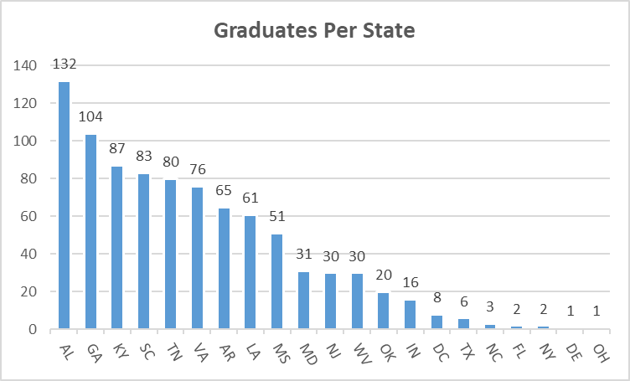
Special Programs
Alabama #1 in SREB Doctoral Scholars Graduates

Slide 41
Alabama Established Program to Stimulate Competitive Research
(ALEPSCoR)
In January, Experimental was renamed Established with the passage of the American Innovation and Competitiveness Act
In September, the Alabama EPSCoR was awarded one of the five new National Science Foundation’s Research Infrastructure Improvement grants in the amount of $20 million
Thirty two students received awards under the Graduate Research Scholars Program, a competitive grant program funded by the legislature

Slide 42
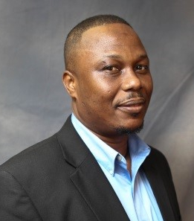

Dr. Alfred Tcherbi-Narteh is Assistant Professor of Materials Science and Engineering at Tuskegee University and a co-principal investigator of the $20 million plasma science grant awarded by the National Science Foundation

Slide 43
VIIi. Decision ITEMS

Slide 44
A. Alabama Commission on Higher Education’s STRATEGIC PLAN

Slide 45
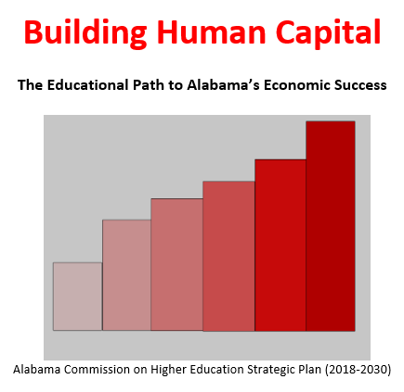

Slide 46
Density of educated/ skilled workers
Access to good schools, colleges, universities
Local leadership
Regional economic development strategies rather than state-wide strategies
Return to city-states
Sparta and Athens
Work ready communities

Slide 47
Five Priorities
Improving Access
Enhancing Student Success
Enhancing STEM Programs
Developing Alabama’s Economy and Workforce
Organizational Effectiveness and Efficiency

Slide 48
1. Improving Access
After years of lagging behind other states, Alabama is beginning an economic revival. To maintain that momentum, all ages of Alabamians must be equipped with the essential skills needed to succeed in the modern economy. Today’s job market demands postsecondary credentials and competency in math, science, writing and verbal skills.
Increase the Number of High School Students Prepared for College in the Institution’s Service Area
Increase Access to College and University Offerings
Increase the Number of Students Receiving Financial Aid
Reduce the Cost of Attending College

Slide 49
2. Enhancing Student Success
In order to meet Alabama’s commitment goal of improving statewide attainment to 65% by 2025, we must not compromise our commitment to excellence in providing students a world-class education.
Rethink Developmental Education
Improve Retention and Persistence
Redesign Financial Aid
Promote the Seamless Transfer of Students
Expand Alternative Pathways to Expedite Obtaining a Postsecondary Credential
Increase the Use of Experiential Learning

Slide 50

3. Enhancing STEM Programs
A key factor in economic growth is the ability of persons to create, build and maintain complex things. The more individuals with Science, Technology, Engineering and Math (STEM) skills, the greater the ability to move the economy forward.
Increase the Number and Quality of Secondary Teachers in Math and Science
Increase the Number of Community College Transfer Students into Four-Year STEM Programs
Increase Support of STEM Students *
Math and Science Teacher Education Scholarships
Public and Private Universities competed for funds
Evaluated on three major criteria:
Previous experience addressing workforce shortages 30%
Student support plan design 50%
Ability to Credential 20%
Prorated by available funds ($1,800,000 in requests for $325,000 in funds)

Slide 51
4. Developing Alabama’s Economy and Workforce
A major focus on the needs of business and industry is an essential element of Alabama’s economic recovery. Although trailing other states, Alabama does have bright spots in specific areas; the state’s public colleges and universities must support and actively participate in economic and workforce development.
Increase Each Higher Education Institution’s Role as a Steward of the Communities in Their Service Area
Identify the Workforce Needs of the State and Region and Address Them

Slide 52
4. Developing Alabama’s Economy and Workforce
Develop an annual “human capital development fund” to be utilized at the state’s colleges and universities to address critical workforce needs and to expand high-demand, high-wage programs of study *
Human Capital Development Fund
One-time funds
Funds used to expand existing programs or to create new programs in areas that are an economic priority
Priorities determined annually by recommendation of a “workforce cabinet”
Commerce, Labor, ALSDE, ACHE, ACCS, University Presidents Council, AICU, Others
Competitive RFP administered by ACHE and evaluated on ability to produce the desired outcomes. Evaluated similarly to STEM teacher shortage initiative:
Previous experience addressing workforce shortages 30%
Student support plan design 50%
Ability to Credential 20%
Cost effectiveness/sustainability
$ 5,000,000

Slide 53

5. Organizational Effectiveness and Efficiency
The modern economy requires organizations to be more responsive to issues and concerns. The higher education system must finally make the paradigm shift to being more effective and efficient.
Optimize Institutional Performance
Optimize Coordinating Board and System Performance

Slide 54
5. Organizational Effectiveness and Efficiency
Review existing policies and procedures and streamline where possible
Review academic program degree production and vitality as per 16-5-8 (a)(1) *
Assist colleges and universities with their planning, performance and budgeting processes by providing comparative information regarding institutional peers and recommending areas for emphasis. *
Create a dedicated website where students can apply for state scholarships*
Eliminate bureaucratic redundancy by consolidating private institution licensure (ACCS) and academic program review (ACHE). Require the unit to be funded solely on application and renewal fees *
Offer professional development opportunities that would be beneficial to the state’s colleges and universities.

Slide 55

5. Organizational Effectiveness and Efficiency
Review existing policies and procedures and streamline where possible
Reduced new academic program review time from a max of 10 months to 90 days
Eliminate ACHE board vote on minor curricular revisions
Change process for post implementation of new programs –establishing a standard threshold for programs (Vote Dec17)

Slide 56
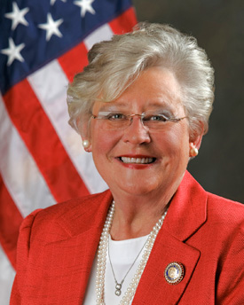
Building Human Capital
Governor Ivey on Human Capital
“The best investment in economic development is an investment in education. If we don’t have a qualified, effective, up-to-date workforce, then the top companies will not come to Alabama no matter what we do. A well-trained workforce is essential.”

Slide 57
Fidelity of Implementation
Alabama’s future is dependent on its ability to develop human capital. In order for the state to take advantage of this transition point in the world’s economy, immediate action must be taken on the proposed plan. Imagining how the future can be built is a crucial first step in the process; but it is the implementation of these initiatives that will make Alabama an economic success story.

Slide 58
B. Executive Budget Request FY 2018-2019

Slide 59

STATE OF ALABAMA
Department of Finance
STATE AGENCY
BUDGET REQUEST INSTRUCTIONS
Fiscal Year 2019
Kay Ivey
Governor

Slide 60
BUDGET REQUEST SUBMISSION
The Code of Alabama, Title 41, Chapter 19, Section 6 (a) (3) states that, each state agency/department, on the date and in the form and content prescribed by the Department of Finance, shall prepare and forward to the Budget Officer the budget requested to carry out its proposed plans in the succeeding fiscal year.
The Executive Budget Office’s (EBO) due date for the FY 2018-19 budget requests was November 1, 2017.
In order to comply with the designated submission deadline, a draft budget request was submitted to EBO.
Any changes made by the Commission will be submitted through a budget request revision.

Slide 61

Alabama Commission on Higher Education
FY 2018-19 Executive Budget Request
ACHE is requesting a total of $38,551,287 for FY 2018-19, of which $38,008,048 is from state funds.
This represents an overall 25.18% increase over FY 2017-18.
The FY 2018-19 Request contains requests for 27 programs under 5 appropriation units.
This includes two new programs: (1) the Human Capital Development Fund and (2) the Non-Resident Alumni Recruitment Initiative

Slide 62

New Program Requests for FY 2018-19
1. Human Capital Development Fund - Funds will be used by the state’s colleges and universities to address critical workforce needs and to expand high-demand, high-wage programs of study. Appropriated funds will be distributed by ACHE among the campuses by competitive requests for proposals (RFP) based on workforce issues determined by the Governor’s Workforce Council.
2. Non-Resident Alumni Recruitment Initiative - The purpose of this initiative is to contact alumni from Alabama’s public institutions working in other states and inform them of Alabama’s robust economy and of employment opportunities in the State in the hope that they would consider returning.

Slide 63

Planning assumptions used in developing the
FY 2018-19 Executive Budget Request:
Planning and Coordination (Operations and Maintenance)
A 10% increase is being requested due to:
1. Increased need for employee termination costs (retirements) and replacements.
2. Increased costs for employer contributions for health insurance.
3. Increased costs for building operations and rent.
4. Increased need to cover increases in Information Service Division (ISD) charges, postage, and telephone services.
Increased cost for subscriptions, software purchases, replacement of computers and printers, UPS/FedEx shipping costs, SHEEO dues, and general office supplies.
6. Increased costs for the purchasing student data for Alabama residents attending out-of-state institutions from the National Student Clearinghouse and for Comptroller Office transaction charges.

Slide 64
Assumptions for Other Programs
Alabama Student Assistance Program: A 100% increase is being requested for the state’s need-based student financial aid program. Since 2011, tuition has increased 27%, while state need-based aid was cut 83%. This request is the first step in helping to correct this problem. $2,897,551 to $5,795,102
Alabama Math and Science Teacher Education Program (AMSTEP): A 123.08% increase is being requested for this program. Alabama is experiencing a critical shortage of secondary math and science teachers. This program is designed to decrease that shortage. $325,000 to $725,000
Police Officers and Firefighters Survivor’s Educational Assistance Program: A ten percent increase is being requested to ensure that sufficient funds are available to meet obligations. $250,725 to $275,798

Slide 65
Assumptions for Other Programs, continued
Five (5) percent increases are being requested for the following programs to offset increased operating costs and in some instances to offset rising tuition:
1. Alabama Student Grant Program
2. Alabama National Guard Educational Assistance Program
3. Southern Regional Educational Board
4. Network of Alabama Academic Libraries
Articulation and General Studies Committee/Statewide Transfer Articulation Reporting System
Experimental Program to Stimulate Competitive Research
Level funding is being recommended for all other items in the budget.

Slide 67
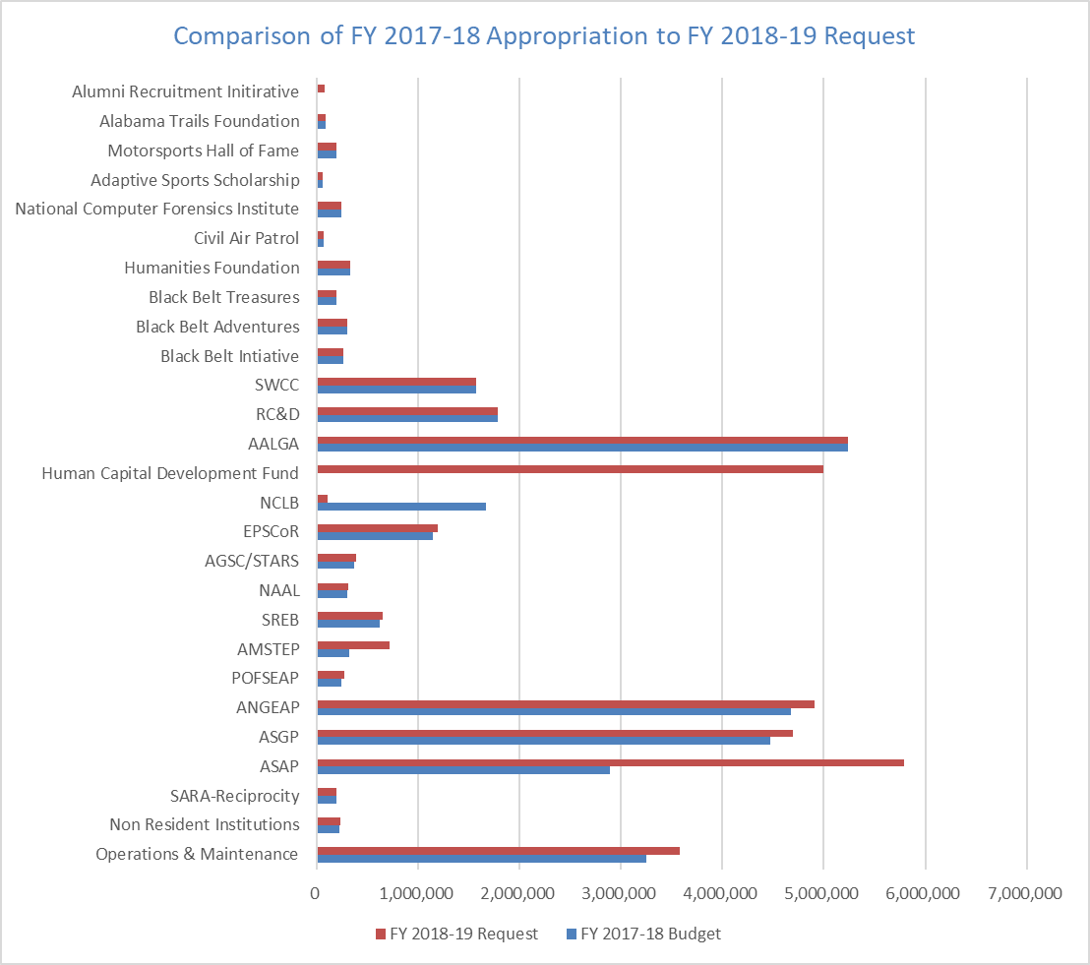

Slide 68
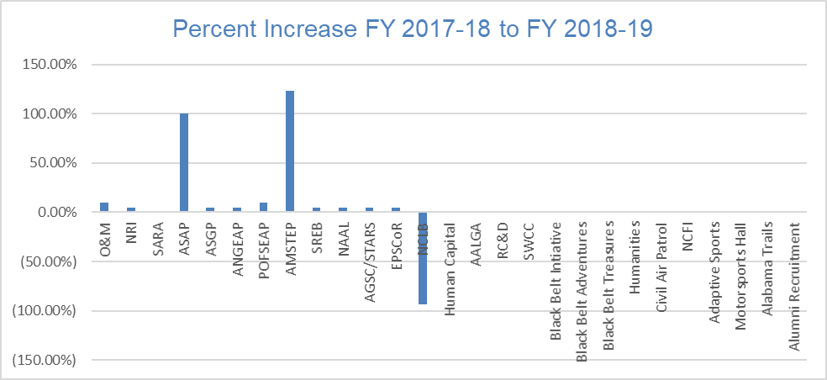

Slide 69
Consolidated Budget Recommendation
FY 2018-2019

Slide 70

Consolidated Budget Recommendation for FY 2018-2019
Section 16-5-9(b) of the Code of Alabama states that “...The Commission ... shall present to each institution and the Governor and legislature, a single unified budget report containing budget recommendations for the separate appropriations to each of the institutions.”

Slide 71

Consolidated Budget Recommendation for FY 2018-2019
In creating the recommendation ACHE staff has first attempted to determine an estimate of the basic funding requirements for the State public colleges and universities. This calculation is referred to as the ACHE Standard calculation.
The amount calculated for FY 2018-2019 in the ACHE Standard for the public two- and four-year colleges and universities was $2,875,876,884. This amount is $1.5 billion over the FY 2017-2018 appropriation amount.

Slide 72

Consolidated Budget Recommendation for FY 2018-2019
In developing the Consolidated Budget Recommendation (CBR) there are things that need to considered:
Cap placed on ETF appropriation due to the Rolling Reserve Act
Revenue Projections
New Initiatives being Considered
Split between Higher Education, K-12, and Other Education Lines
Requested amounts

Slide 73


Consolidated Budget Recommendation for FY 2018-2019
The recommendation is based on the following:
1) TRS retirement rate increase (two and four-year institutions).
2) Fund a rate increase for mandated PEEHIP retirees' health insurance for public senior institutions who do not participate in PEEHIP (all except AAMU, Athens and JSU).
The funds needed to cover the cost of these items for the four and two-year institutions are approximately $7 million or an increase of less than 1%.
Additional amount needed so that all institutions receive a total increase of four percent (4%).
Statewide lines were recommended for varying amounts.

Slide 74

Consolidated Budget Recommendation for FY 2018-2019
Increase Recommended for the Universities - $43,144,395
Increase Recommended the Two-Year Colleges - $12,397,628
Increase Recommended the State-Wide Lines - $11,771,007
Total Increase FY 2018-2018 Consolidated Budget Recommendation - $67,313,030

Slide 76
Report on the Facilities Master Plan & Capital Projects Requests for
FY 2018-2019 – FY 2022-2023

Slide 77


Report on the Facilities Master Plan & Capital Projects Requests for
FY 2018-2019 - FY 2022-2023
Section 16-5-15 of the Code of Alabama requires that each public college & university annually submit a 5-year facilities master plan to the Commission. Each institution is also required to prioritize its capital requests and to provide a needs assessment for requested projects.
The five years reported are broken into three time segments: Immediate, Intermediate, and Long-Term capital projects.
Immediate projects are defined as those within the first year of the master planning cycle (FY 2019).
Intermediate projects are defined as those within the second year of the planning cycle (FY 2020).
Long-Term projects fall into the last three years of the planning cycle (FY 2021 - 2023).
The projects are further divided into four separate project categories:
New Construction/Acquisition
Renovation and Remodeling
Major Capital Equipment
Deferred Maintenance/Facilities Renewal.

Slide 78
$1,318,778,514 requested in Immediate Capital Projects. Almost 40% of which is for other than New Construction.

Slide 79
Immediate Capital Requirements Projects by Projected Funding Source -
FY 2018-2019
$376,884,644 of the requested Immediate Projects are projected to use ETF funds.

Slide 80
$975,210,346 requested in Intermediate Capital Projects. 38% of which is for other than New Construction.

Slide 81
Intermediate Capital Requirements by Projected Funding Source –
FY 2019-2020
$243,975,881 of the requested Intermediate Projects are projected to use ETF funds

Slide 82
$2,812,613,416 requested in Long-Term Capital Projects. 55% of which is for other than New Construction.

Slide 83
Long-Term Capital Requirements by Projected Funding Source
FY 2020-2021 - 2022-2023
$1,314,347,249 of the requested Long-Term Projects are projected to use ETF funds.

Slide 84
$5,106,602,276 requested in Capital Projects for the 5-Yr period. 47% of which is for other than New Construction.

Slide 85
Total Capital Requirements by Projected Funding Sources
FY 2018-2019 - 2022-2023
$1,935,140,774 of the requested Projects for the 5-Year period are projected to use ETF funds.

Slide 86
40% of the buildings being used by the public colleges and universities in Alabama were built between 1960 and 1989. An additional 14% of the buildings built prior to 1960

Slide 87


Bond Issues and Debt Service
The State of Alabama does not provide regular funding for capital projects for education; this is true for K-12 as well as Postsecondary Education.
The institutions in Alabama are allowed to float their own bond issues.
The four- and two-year institutions currently have approximately $3.5 billion in bonds outstanding.
The institutions paid approximately $256 million in debt service in the last fiscal year to pay these bonds off. ($229M-4YR / $27M-2YR)
The source of revenue to pay these bonds is usually through tuition or fees that the students pay.

Slide 88

E. Final Approval of Amendments to the Administrative Procedures for the Alabama National Guard Educational Assistance Program

Slide 89
Final Approval of
Amendments to Administrative Procedures for the
AL National Guard Educational Scholarship Program (ANGEAP)
Major Changes to the Administrative Code:
Changes award amount to an amount not to exceed the average cost of tuition & required fees per semester at the four-year public institutions.
Based on the FY 2017-18 average tuition & required fees, this will equate to approximately $5,080 per semester and a max of $15,240.
Annual award was $1,000 per semester and a max of $2,000 per year.
Funds may no longer be used to cover the costs of books and supplies.
Benefits to be applied only after all other available resources have been exhausted.
Recipients are required to maintain a 2.0 cumulative grade point average.

Slide 90
F. Final Approval of Amendments to the Administrative Procedures for the Alabama Math and Science Teacher Education Program

Slide 91

Final Approval of Administrative Procedures for the
Alabama Math and Science Teacher Education Program
In order to participate in the program, recipients must:
be an Alabama resident;
attend an eligible participating institution of higher education;
be unconditionally admitted to an ALSBE approved program in math or science based on that institution’s admission criteria (to include the PRAXIS Core Test or any other such test subsequently approved to take its place by the ALSBE);
be one of the following:
undergraduate junior or senior enrolled in a secondary education program in math or science and taking 12 ≥ semester hours, with preference given to students classified as seniors,
currently certified teacher enrolled in courses to earn certification in math or science,
a graduate student enrolled in a secondary math or science Alternative Class A program approved by the ALSBE;
Continues next page

Slide 92
Administrative Procedures for the Alabama Math and Science Teacher Education Program
In order to participate in the program, recipients must:
5. maintain the required College/School/Division/Department of Education GPA (cumulative);
6. sign a letter of acceptance for the award;
7. sign a statement that they intend to:
finish the program in which they are enrolled,
meet all testing requirements,
apply for an Alabama Educational Certificate.

Slide 93
Final Approval of Amendments to the Administrative Procedures Regarding Reasonable Extensions-Alterations of Existing Units and Programs of Instruction

Slide 94

Final Approval of Administrative Procedure Change Regarding Reasonable Extensions/Alterations of Existing Programs
The Commission defines a reasonable extension or alteration, under its rule-making authority Chapter 300-2-1-.01 Program Review, “Definitions Recognized By The Commission,” as “a modification of an existing unit or program of instruction that does not change its essential character, integrity, or objectives.”
Such modifications do not create new units or programs of instruction.
The current policy “Guidelines for the Review of Extension and Alterations of Existing Programs” requires that extensions/ alterations determined to be substantive be submitted to the Commission as decision items.

Slide 95
The basis for the request is that the criteria of reasonable extensions-alterations can be sufficiently applied and determined by Commission Staff.
In any instance that Commission Staff are not satisfied that the definition criteria of a “reasonable extension-alteration” has been met, the institution may withdraw the item or request that the item come before the Commission as a decision item.
There will be no change in the form used by the institutions for submitting the request for Staff review as a reasonable extension-alteration.

Slide 96
Procedural Changes Regarding
Post-Implementation Conditions Review

Slide 97

POST-IMPLEMENTATION CONDITIONS REVIEW STATUTORY AUTHORIZATION
The Code of Alabama 1975 in Section 16-5-8 (a)(1) authorizes the Commission on Higher Education to review periodically all new and existing programs and units of instruction, research, and public service funded by state appropriations at the state universities and colleges and to share with the appropriate governing board, through the president of the institution, and state Legislature, its recommendations.
Additionally, the Code of Alabama 1975, Section 16-5-8 (2) states, “as a part of its program review process, the commission shall enforce, monitor, and report on minimum degree productivity standards for all existing programs of instruction at public two-year and four-year institutions of higher education.”

Slide 98
PROCEDUREAL CHANGES REGARING POST-IMPLEMENTATION CONDITIONS REVIEW APPROVAL PROCESS
The preliminary approval of the procedural changes regarding Post-Implementation Conditions Review will be filed with the Legislative Services Agency after today’s meeting and subsequently published in the December 31, 2017 issue of Alabama Administrative Monthly.
Interested parties will have 35 days to comment. Should there be no substantive changes made due to comments and the Commission grants final approval to these proposed changes on March 9, 2018, the proposed changes will go into effect 45 days after the changes are certified by the Executive Director and subsequently filed with the Legislative Services Agency.

Slide 99
POST-IMPLEMENTATION CONDITIONS REVIEW PROPOSED CHANGES
Element | Current | Proposed
Post-Implementation Review Monitoring Period | 5 years | 7 years for all degree levels. This includes a 1-year start-up period where data is not reported. An additional monitoring year may be requested for doctoral programs.
Number of Graduates / Completers | Program specific based on figures provided in the program proposal | If the institution has not met the projection that was provided at the time the program was approved by the Commission, the following standards established in the Code of Alabama, 1975 for use in Program Viability Studies will be applied: Associates and Baccalaureates = 7.5, Masters’ = 3.75, Education Specialists = 3.0, Doctorates = 2.25.

Slide 100
POST-IMPLEMENTATION CONDITIONS REVIEW PROPOSED CHANGES - CONTINUED
Element | Current | Proposed
Graduates/Completers Monitoring Period | A range from 3 to 5 years is used depending on the figures provided in the program proposal | A range from 3 to 6 years will be used depending on the figures that are provided in the program proposal.
Projected New Enrollments | Program specific based on figures provided in the program proposal | At the end of the monitoring period when the post implementation report is submitted, if the institution has not met the new enrollment projection, the original projection will be reduced by 25%.
Related Employment / Continuing Education | 75% find related employment or continue their education | This information will still be collected and reported in the post-implementation assessment report, but will no longer be used as a post-implementation condition.

Slide 101
POST-IMPLEMENTATION CONDITIONS REVIEW PROPOSED CHANGES - CONTINUED
Element | Current | Proposed
Ability to amend conditions | Allowed. There is no limit on asking for amended conditions. | Allowed, but only due to extraordinary circumstances. Any request to amend conditions must be made by the institution’s chief academic officer.
Deadline to Implement New Programs | 2 years | 2.5 years

Slide 102
POST-IMPLEMENTATION CONDITIONS REVIEW – OTHER PROPOSED CHANGES
Programs with program-specific accreditation will be required to report steps to be taken to obtain accreditation in the proposal/application, and the accreditation status as a post-implementation condition of approval.
Programs which require licensure will be required to report steps to be taken to optimize exam pass rates in the proposal/application, and the licensure pass rate as a post-implementation condition of approval.
All applicable forms utilized in this post-implementation process will be revised to reflect 7 years instead of 5 years, as it is currently.

Slide 103
POST-IMPLEMENTATION CONDITIONS REVIEW TRANSITION PROCESS
The transition process is applicable to those programs that are already approved. There are over 150 such programs that have been approved by the Commission and will have post-implementation reports due through 2022.
These programs would have the same conditions as shown within the “Proposed Changes” except that:
The five (5) year timeframe as previously approved by the Commissioners would be used.
Unless specifically listed as a condition of approval, transition programs with program-specific accreditation will not be required to report accreditation status for the post implementation; however, the institutions are strongly encouraged to do so.
Unless specifically listed as a condition of approval, transition programs which require licensure will not be required to report exam pass rates; however, the institutions are strongly encouraged to do so.

Slide 104
I. Academic programs

Slide 105














FOUR-YEAR INSTITUTIONS

Slide 106


Auburn University
1. Doctor of Nursing Practice in Nursing (CIP 51.3801)
The National Organization of Nurse Practitioner Facilities (NONPF) support the Doctor of Nursing Practice degree as entry level for the nurse practitioner role. This position is further supported by The National Task Force (consisting of members from NONPF and American Association of Critical-Care Nurses).
Graduates of the program will likely seek practice leadership roles in a variety of settings – management of quality initiatives, executives in health care organizations, directors of clinical programs, and faculty positions responsible for clinical program delivery and clinical teaching.
DNP graduates will be employed in both the pubic and private sectors. Advanced practice nurses have long been in demand nationwide, especially in small towns, rural areas, and underserved neighborhoods. Their role not only expands access to care, but also increases treatment options and affordability to underserved populations.

Slide 107

Auburn University at Montgomery
2. Doctor of Nursing Practice in Nursing (CIP 51.3818)
AUM is located in the Black Belt region of Alabama, Montgomery County, which has been designated as a medically underserved area.
The proposed DNP program at AUM would prepare the next generation of faculty needed for the River Region. Increasing the pool of doctoral prepared nurse faculty will allow the AUM School of Nursing to increase enrollment at the undergraduate and graduate levels that will result in increasing the pipeline of nurses for the local community.
The proposed program will be administered by faculty who are academically and experientially prepared to teach graduate students. More than 50 percent of the current faculty members hold DNP degrees at AUM.

Slide 108


Athens State University
Bachelor of Science in Health Care Management (CIP 51.0701)
According to the U.S. Bureau of Labor Statistics, employment of medical and health services managers is projected to grow by 17 percent from 2014 to 2024, a much faster growth than the average for all occupations. As increased demand for health services create the need for more physicians, healthcare workers, and healthcare facilities, managers are vital for running operations, staff, fiscal, and technological resources.
Most of the growth is expected in offices of health practitioners, particularly medical group practices, as they become larger and more complex. At the state level, medical and healthcare manager positions in Alabama are expected to grow by close to 13 percent during the same time period.

Slide 109


Troy University
1. Bachelor of Science in Electronics Engineering Technology (CIP 13.1319)
A letter of support from the Lockheed-Martin Pike County Operations Director further emphasizes the need for this type of program.
According to TROY officials, the decision to offer the proposed program has been primarily based on the numerous requests received both in person and through telephone and email queries.
TROY will seek accreditation through the Council for Higher Education Accreditation (CHEA) recognized Accreditation Board for Engineering and Technology (ABET) for the proposed Electronic Engineering Technology program.

Slide 110

Troy University
2. Bachelor of Science in Interdisciplinary Studies (CIP 30.9999)
Existing courses, faculty delivery, and course management/oversight are already in place and governed by department chairs and college deans.
The proposed program will enhance student interest for individuals who seek knowledge in more than one academic discipline content area.
TROY has a significant number of students who are active duty military and the proposed degree program would be an important degree pathway for this group as the program will be offered via distance education technology.

Slide 111
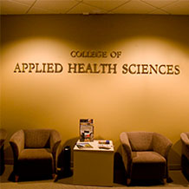
Troy University
3. Bachelor of Science in Applied Health Sciences (CIP 51.0000)
The Allied Health Sciences program will have concentrations in Communications, Health and Nutrition, and Health and Humanities.
The proposed program provides degree plans for students who are interested in entering the health sciences field but do not wish to pursue specific licensure programs such as Nursing.
Graduates of the proposed program will be equipped to enter the job market upon graduation in areas such as health education, health promotion and wellness, pharmaceutical and medical device sales, and health information services

Slide 112

Troy University
4. Bachelor of Science in Occupational Education (CIP 13.1319)
The proposed program will be offered entirely online.
According to TROY officials, thousands of qualified military technicians with Associate Degrees in the United States Air Force (USAF) and Department of Defense (DoD) personnel would benefit from this program.
The BS in Occupational Education will combine theory with experience to prepare students as workforce development professionals in a variety of settings and occupations. Students qualify for the proposed program based upon completion or possession of an Associate degree from an accredited college or university.

Slide 113


University of Alabama
1. Master of Science in Population Health Sciences (CIP 51.2299)
The Population Health Sciences (M.S.) program will offer the state's first graduate program in Population Health designed specifically for experienced health professionals.
The program will provide a comprehensive foundation in the essentials of Population Health, i.e. new care-delivery structures, socioeconomic determinants of disease, data analytics, health finance and economics, and basics of healthcare quality and safety.
The program will provide additional skills required for leadership positions -- healthcare policy development, epidemiology, outcomes analysis, coalition building and stakeholder management.

Slide 114

University of Alabama
2. Doctor of Philosophy in Human Nutrition (CIP 19.0504)
The University of Alabama states that it is uniquely poised to administer a program in Human Nutrition that focuses on educating students in translational nutrition. The proposed program relies on a strong core of nutrition faculty with a history of successful collaborative research agendas.
Additionally, the diverse research faculty represent nutrition expertise in a balanced manner across multiple, distinctive areas of nutrition research. These include one nutritional epidemiologist, two food scientists, two nutritional biochemists, three clinical nutrition researchers, and three community nutrition researchers.
Unhealthy
Healthy

Slide 115

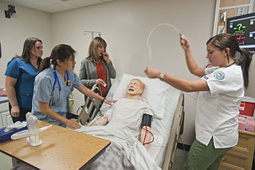
University of Alabama at Birmingham
1. Master of Science in Healthcare Simulation (CIP 30.0601)
Simulation programs are integral for the success of healthcare delivery. Both direct and indirect providers of health care can be trained in this manner and studies show that those with simulation training in a high fidelity and realistic environment emerge as more confident and able to react appropriately in emergent situations.
No other simulation programs exist in this region. In addition, by targeting recruitment of direct and indirect health professionals, UAB is in an advantageous position to offer a unique professional graduate program that no other institution in the country offers and to become a leader in the field of Healthcare Simulation.

Slide 116
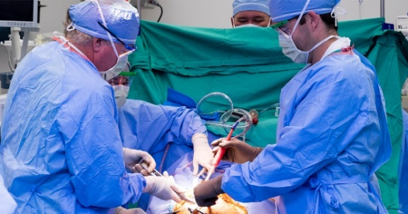
University of Alabama at Birmingham
2. Establishment of the Department of Orthopaedic Surgery in the School of Medicine
This department will provide greater opportunity for improved patient care, expansion of research efforts and increased educational opportunities. Elevating the Orthopaedic Division to departmental status will benefit the university by providing clinical, teaching, and research opportunities, as well as create boundless opportunities administratively and within the broader scientific community.
According to the Commission’s operational definitions, administrative changes at the department level generally are submitted as information items. At UAB, however, departments in the School of Medicine are more prominent units than academic divisions. Consequently, this item is submitted for Commission approval.

Slide 117


University of Alabama in Huntsville
Bachelor of Science in Cybersecurity (CIP 11.0103)
According to UAH officials, Cybersecurity is a national, state, and local priority for both industry and government.
The 2015 Global Information Security Workforce Study by the Information Security Council states that I.5 million more cybersecurity professionals will be needed to accommodate the predicted global shortfall by the year 2020.
The proposed BS in Cybersecurity will meet the local, state, and national need for Cybersecurity professionals.

Slide 118


University of North Alabama 1. Bachelor of Science in Information Technology (CIP 11.0103)
Career and College Readiness/Preparation Projected Job Openings indicate over 2,900 occupation related to Information Technology in UNA’s service area, with over 5,600 in the state within the next 5 years.
The program will have concentrations in Human-Computer Interaction/User Experience (HCI/UX) and Software Development.
The proposed program will utilize existing facilities and faculty resources from the Department of Computer Science and Information Systems.

Slide 119

University of North Alabama 2. Master of Science in Mathematics (CIP 51.2299)
The program provides students with skills, knowledge, and expertise in diverse disciplines (mathematics, science, technology) that allows them to pursue employment in a variety of fields.
The program is available to students through a distance education/hybrid format.
The program emphasizes technical and oral communication skills necessary for employment in the disciplines.
Estimated new funds to support the proposed program are minimal.

Slide 120

University of West Alabama 1. Doctor of Education in Rural Education (CIP 13.9999)
The program is unique and is the only doctoral program in the nation that focuses on rural educational and societal issues for transforming rural schools and communities.
Intended for working professionals, classes will be scheduled on the weekends and will utilize both hybrid, and online delivery systems in order to accommodate and benefit from the full-time employment of program participants.
The program is designed specifically to assist working professionals in a wide variety of public agencies, as well others who have an interest in rural education, in furthering the acquisition of skills required to analyze educational policies and actual practices on a broader social, political, and economic scale.
There are letters of support contained in the proposal from 14 area superintendents.

Slide 121

ALABAMA COMMUNITY COLLEGE SYSTEM (ACCS)

Slide 122


Bishop State Community College
1. Certificate in Structural Welding (CIP 48.0508)
The proposed Structural Welding certificate program will be an additional career technical program to satisfy the projected short fall of qualified welders in the Gulf Coast Region.
The program will prepare students to earn National Center for Construction Education & Research (NCCER) credentials for welding trades in order to enhance the student’s employability.

Slide 123

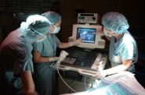
Gadsden State Community College
1. Associate in Applied Science in Diagnostic Medical Sonography (CIP 51.0910)
According to the Alabama Community College System Region 2 Report, Diagnostic Medical Sonography is one of the top five fastest growing occupations.
According to the US Department of Labor, the median pay for a Diagnostic Medical Sonographer is $62,540 or $30.07 per hour.

Slide 124


Ingram State Technical College
1. Certificate in Carpentry (CIP 46.0201)
The proposed program will expand on the current 29-hour Short-Term Certificate in Carpentry at ING. The institution has been accredited by the Council on Occupational Education (COE) for over two decades.
The purpose of the proposed certificate is to provide students with additional learning opportunities, which will prepare them to acquire industry-recognized credentials from the National Center for Construction Education & Research (NCCER).
ING is the sole mandated provider of career technical education to incarcerated individuals under the control of the Alabama Department of Corrections at facilities across the state including, but not limited to those located geographically proximate to where the program is offered.

Slide 125
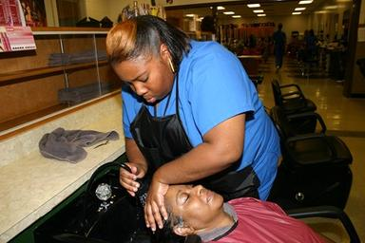
Ingram State Technical College
2. Certificate in Cosmetology (CIP 12.0401)
The proposed program will expand on the current 29-hour Short-Term Certificate in Cosmetology at ING. The purpose of the long certificate is to provide students with additional learning opportunities, which will prepare them to acquire licensure in the Cosmetology field.
ING is the sole mandated provider of career technical education to incarcerated individuals under the control of the Alabama Department of Corrections at facilities across the state. ING offers programs and services at the following correctional facilities: Frank Lee (ING main campus), Draper, Stanton, Tutwiler, Elmore, Kilby, Red Eagle, Donaldson, and Columbiana.
The proposed Certificate in Cosmetology will be offered at the Julia Tutwiler Prison for Women.

Slide 126
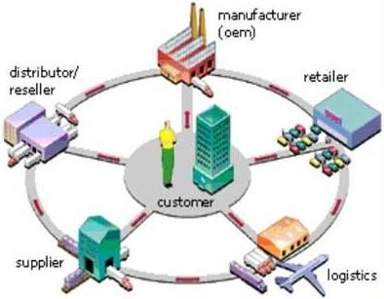
Ingram State Technical College
3. Certificate in Logistics and Supply Chain Technology (CIP 52.0203)
The proposed long certificate will expand on the current 29-hour Short-Term Certificate in Logistics and Supply Chain Technology at ING. The purpose of the long certificate is to provide students with additional learning opportunities, which will prepare them to acquire industry recognized Manufacturing Skills Standards Council (MSSC) credentials and enhance their opportunities to obtain employment in field.
ING is the sole mandated provider of career technical education to incarcerated individuals under the control of the Alabama Department of Corrections at facilities across the state. ING offers programs and services at the following correctional facilities: Frank Lee (ING main campus), Draper, Stanton, Tutwiler, Elmore, Kilby, Red Eagle, Donaldson, and Columbiana.

Slide 127

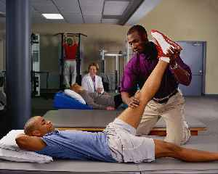
Southern Union State Community College
1. Associate in Applied Science in Physical Therapy Assistant (CIP 51.0806)
Students who successfully complete the program will be eligible to take the National Physical Therapy Examination (NPTE). SOU will seek accreditation of the program through the Commission on Accreditation of Physical Therapy education (CAPTE) of the Physical Therapy Association (APTA).
According to the U.S. Department of Labor, employment of PTA’s is expected to grow 41 percent from 2014 to 2024, much faster than the average for all occupations. Demand for Physical Therapy services is expected to increase in response to the health needs of an aging population, particularly the large baby-boom generation.
SOU received letters of support from the following healthcare facilities: Alacare Home Health and Hospice, East Alabama Medical Center, and Total Rehab in support of the proposed Physical Therapy Assistant program.

Slide 128


Trenholm State Community College
1. Associate in Applied Science in Nursing-ADN (CIP 51.3801)
Courses completed at TRE will transfer to public four-year colleges and universities within Alabama via the Statewide Transfer Articulation and Reporting System (STARS) network.
According to the Alabama Department of Industrial Relations Department of Labor, growth projections for the State of Alabama for Registered Nurses indicates an increase from 46,000 in 2014 to 53,000 in 2014. Over this ten-year period, this represents an average of 665 new job openings annually.

Slide 129
H. Extensions/Alterations of Existing Programs

Slide 130
Proposed Extensions and Alterations to Existing Programs
1. Alabama A&M University, Addition of a Concentration in General Music to the Existing BM in Music (CIP 50.0901)
The program with the concentration will require a total of 120 semester hours. The concentration will consist of 21 semester hours. Budgetary Impact: None. [Item prepared by M. Pearson]
2. University of Alabama at Birmingham, Addition of a Concentration in Cybersecurity Management to the Existing BS in Management Information Systems (CIP 52.1201)
The program with the proposed concentration will require a total of 120 semester hours. The proposed concentration will consist of 12 semester hours each. Budgetary Impact: None. [Item prepared by M. Pearson]
3. University of Alabama at Birmingham, Addition of a Concentration in Exercise Bioenergetics to the Existing BSEd in Kinesiology (CIP 13.1314)
The program with the proposed concentration will require a total of 121 semester hours. The proposed concentration will consist of 23 semester hours. Budgetary Impact: None. [Item prepared by M. Pearson]
4. University of Alabama at Birmingham, Addition of an Option in Environmental and Occupational Health to the Existing MPH in Public Health (CIP 51.2201)
The program with the option will require a total of 43 semester hours. The proposed option will consist of 23 semester hours. Budgetary Impact: None. [Item prepared by M. Pearson]
5. University of North Alabama, Addition of an Option in Chemical Engineering Technology to the Existing BS in Engineering Technology (CIP 15.0000)
The program with the concentration will require a total of 120 semester hours. The concentration entails 36 semester hours. Budgetary Impact: None. [Item prepared by M. Pearson]
6. Troy University, Addition of a Nursing Leadership Track to the Existing DNP in Nursing (CIP 51.3802)
The program with the track will require a total of 65-69 semester hours. The track will consist of 15 semester hours. Budgetary Impact: None. [Item prepared by M. Pearson]

Slide 131
ix. information ITEMS
1. Implementation of Approved Programs
2. Summary of Post Implementation Reports
Implementation of New Short Certificate Programs (Less than 30 Semester Hours)
Changes to the Academic Program Inventory
5. Implementation of Non-Degree Programs at Senior Institutions
6. Implementation of Distance Education Programs
7. Change in the Name and Establishment of Centers and Departments
8. Annual Off-Campus Site Follow-Up Report for Academic Year 2016-17
9. University of North Alabama, Addition of an Alternative Class A Teaching Certificate in
Family and Consumer Sciences to the Existing MAEd in Secondary Education (CIP 13.1205)

Slide 132
X. adjournment
The next meeting will be held on March 9, 2018

