Slide 1
Alabama Commission on Higher Education
Commission Meeting
March 9, 2018

Slide 2
CALL TO ORDER and PLEDGE OF ALLEGIANCE

Slide 3
II. ROLL CALL and QUORUM DETERMINATION

Slide 4
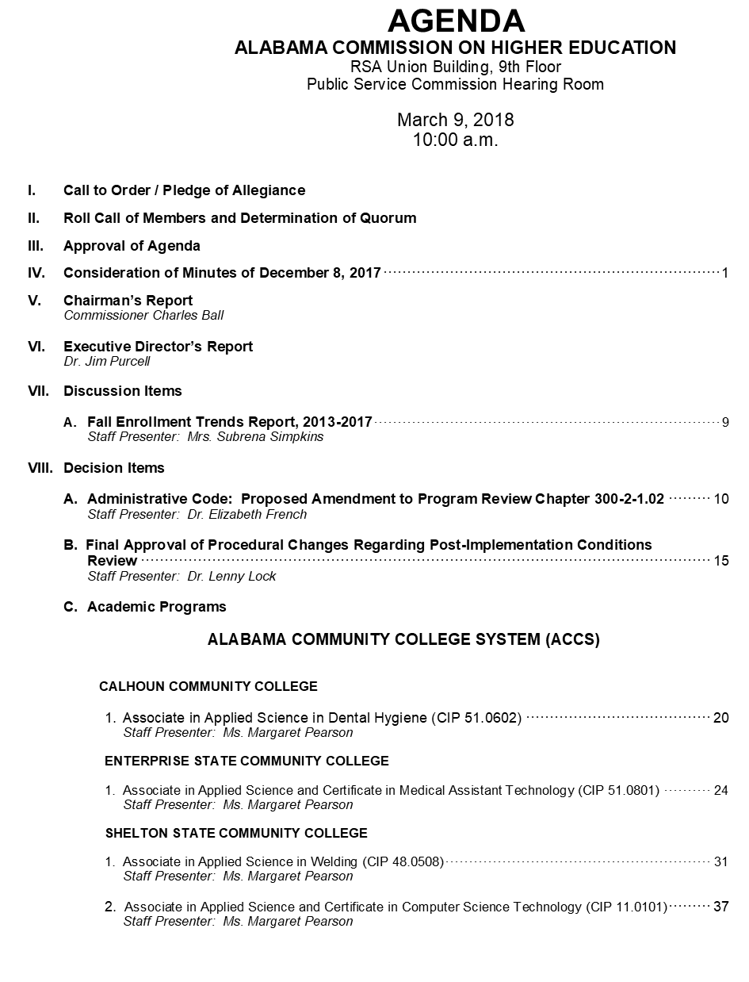
III. APPROVAL OF AGENDA

Slide 5
IV. APPROVAL OF
December 8, 2017

Slide 6
V. CHAIRMAN’S
Report

Slide 7
VI. EXECUTIVE DIRECTOR’S
Report

Slide 9
Section 41-5-14
Periodic examinations and audits of state and county offices, departments, boards, etc.
The books, records, vouchers and accounts of every state and county office, officer, bureau, board, commission, corporation, institution, department and agency shall be examined and audited at least once in every period of two years and more frequently or continuously if that is deemed necessary or desirable by the Chief Examiner.
The audit was conducted in accordance with the auditing standards generally accepted in the USA and the standards applicable to financial audits contained in General Auditing Standards issued by the US Comptroller General, as well as, the requirements of the Dept. of Examiners of Public Accounts.

Slide 10
ACHE AUDIT RESULTS
ACHE WAS RECENTLY AUDITED FOR THREE FISCAL YEARS BY THE EXAMINERS OF PUBLIC ACCOUNTS
FY 2013-2014, FY 2014-2015 & FY 2015-2016
THREE FINDINGS RESULTED FROM THIS AUDIT
NO FINDINGS RELATED TO FINANCES

Slide 11
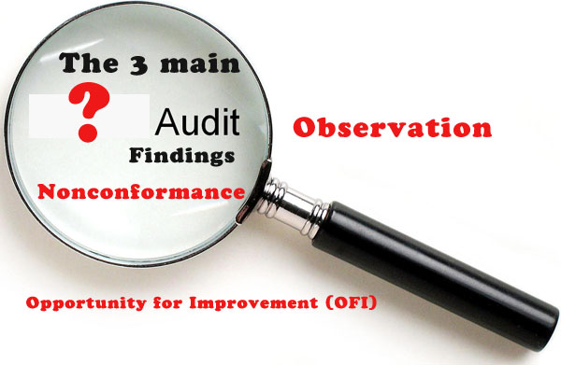

Slide 12
EXAMINERS REPORTED THREE FINDINGS
1) Vacancies of Commissioners MUST BE POSTED on Secretary of State’s Website.
During Audit Period There Were Two Instances Where Vacancies Were Not Listed.
2) Fees Charged by Agencies MUST BE LISTED in Administrative Procedures.
Non-Resident Institutions (NRI) Did Not Have Fees Posted As Required.
Fees were listed on the Application for NRI.
3) Changes to the Administrative Procedures MUST BE
a) Preliminarily approved by the Commission
b) Posted in the Alabama Administrative Monthly for Comments for 35 Days.
c) MUST BE GIVEN FINAL APPROVAL by the Commission after 35 Day Comment Period.
3(c) in this process had not been previously followed.

Slide 14
CORRECTIVE ACTION PLAN FOR AUDIT FINDING
CHANGES HAVE ALREADY BEEN PUT INTO PLACE TO RECTIFY THE AUDITOR’S FINDINGS.
THE COMMISSION WILL BE VOTING ON A DECISION ITEM TODAY CONCERNING OUR ADMINISTRATIVE PROCEDURES WHICH WILL INCLUDE AGENCY FEES CHARGED FOR THE NON RESIDENT INSITUTIONS (NRI).
AT THE DECEMBER 8, 2017 COMMISSION MEETING, THE COMMISSION WAS INFORMED THAT ALL ADMINISTRATIVE PROCEDURE CHANGES WOULD ULTIMATELY BE VOTED ON TWICE BEFORE THEY WOULD BE DEEMED FINAL.
INTERNAL PROCEDURES HAVE BEEN PUT IN PLACE TO ENSURE ALL COMMISIONER’S VACANCIES ARE POSTED ON THE SECRETARY OF STATE’S WEB SITE AS SOON AS THEY BECOME AVAILABLE

Slide 15
Reminder
2018 State Systems GISS
STUDENT SUCCESS, COMPLETION, WORKFORCE
April 9-10, 2018
Executive Center, Alabama Center for Advanced Technology & Training (ACATT)
Lawson State Community College, Birmingham, Alabama

Slide 16
Reminder
Complete College Alabama Kick-off Event
Lawson State Community College
Friday, April 27, 2018
Overview of CCA strategies
Alabama’s Co-requisite Developmental Education Efforts
Jacksonville State University
Wallace –Hanceville
A Better Deal for Returning Adults
15 to Finish
Margaret Gunter

Slide 17
Reminder
Ethics Forms are due to the Ethics Commission on or before April 30, 2018.

Slide 18
Education Trust Fund Budget House Passed $6.6 Billion (Goes to Senate next week)
2.5% cost of living raise for education employees
3% cost of living raise for state employees
Pre-K Program increased $20M, about 25%
Total K-12 Foundation Program increased $115M, about 3%
Community College lines increased $16M, about 4%
Universities increased $39M, about 3.7%
Alabama Student Assistance Program received $4,397,551 (51% increase)
Alabama Student Grant Program received $5,220,970 (17% increase)
Math and Science Teachers Scholarship received $725,000 (123% increase)

Slide 19
Alabama Math and Science Teacher Education Program
House Passed
Secondary math and science teachers
Acute qualified teacher shortages in underserved public school systems
Loan repayment awards:
$7,500 per year (maximum award)
$3,750 per semester worked
Can receive award up to four years
Bill has been referred to Senate F&T Ed. Committee

Slide 20
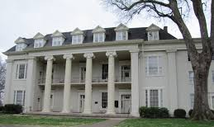
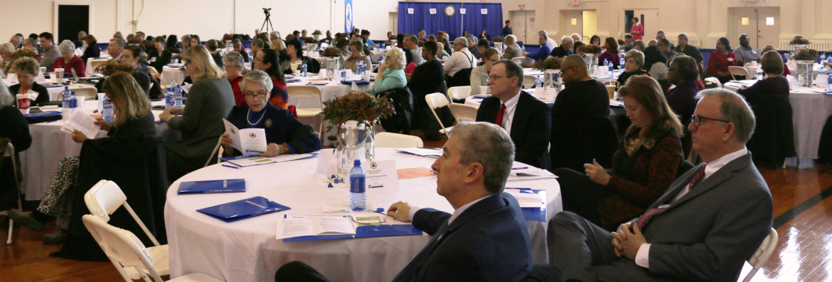
Open Education Resources Workshops
Representative Collins
President Glenn
119 participants
Speakers from University System of Georgia, LSU, UNC Chapel Hill

Slide 21
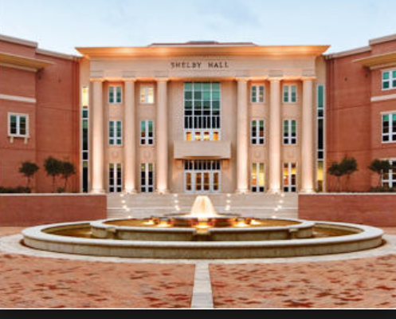
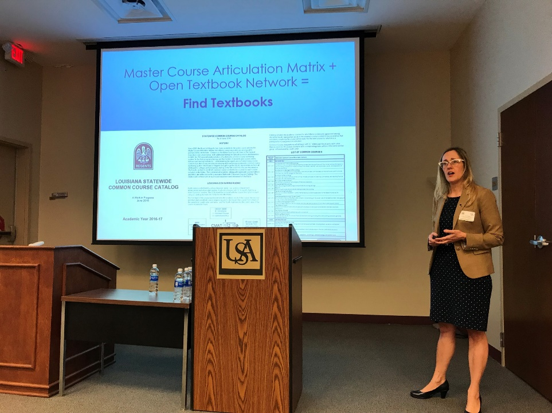
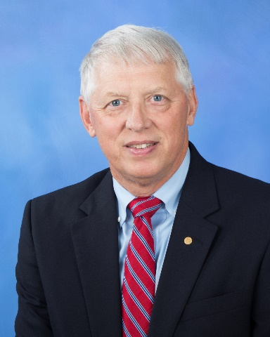
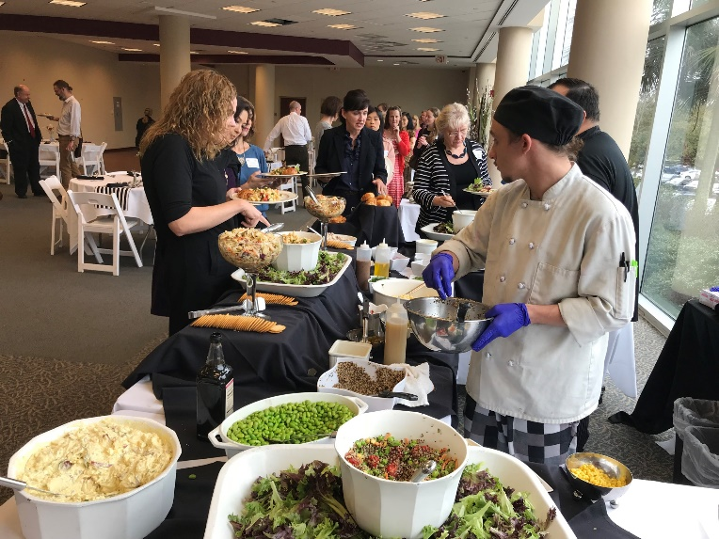
Open Education Resources Workshops
President Waldrop
69 participants
Speakers from LOUIS (LA), LSU, UNC Chapel Hill, and EBSCO

Slide 22
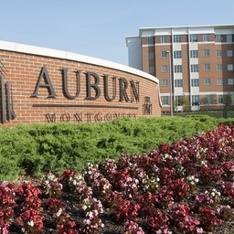
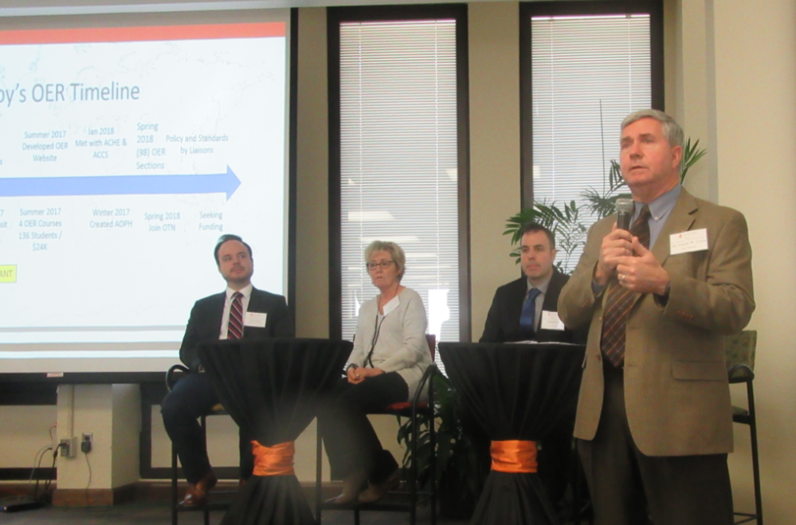
Open Education Resources Workshops
Chancellor Stockton
121 participants
Speakers from University System of Georgia, LSU, University of Minnesota, and EBSCO

Slide 23
OER Rock Stars in Alabama
Annual Savings
$ 334K in cost savings by using OER in all Freshman English and Literature classes
$328K in cost savings by using OER in Math, Electronics and Welding courses
$246K in cost savings in a variety of courses
Developed a repository of OER resources
Ron Leonard, ACHE/NAAL
Vicki Ohlson, ACCS

Slide 24
FAFSA Completion Project Update
15 training sessions across the state for 428 attendees
Ranked 5th in improvement in FAFSA Completion Rates
Alabama is currently 2.5 percentage points ahead of where we were last year.
Kristina Scott, AP
Sean Stevens, ALSDE
Vicki Ohlson, ACCS
Ron Leonard, ACHE/NAAL

Slide 25
FAFSA Completion Project Update
If 60% of the 1,433 additional students who have submitted a completed FAFSA application so far this year receive the average Alabama Pell grant award of $3,737, they will collectively receive more than $3.2 million dollars in federal aid for college this year.

Slide 26
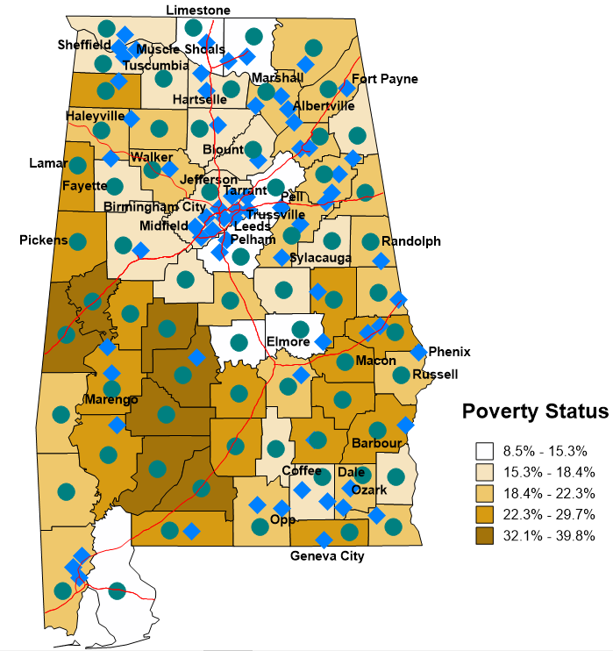
Participating Schools Districts in the
FAFSA Completions Initiative on a Poverty Map of Alabama
The 35 Named Systems on the Map are Participating
Source (Poverty Data): U.S. Census Bureau,
2012-2016 American Community Survey 5-Year Estimates.

Slide 27
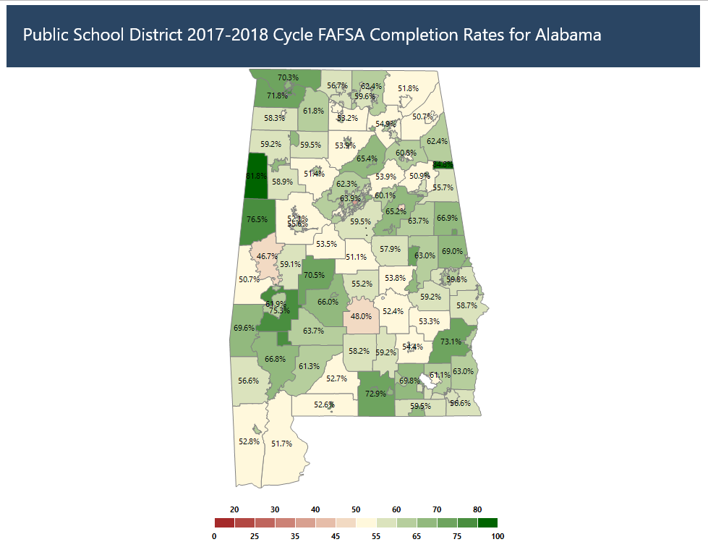

Slide 28
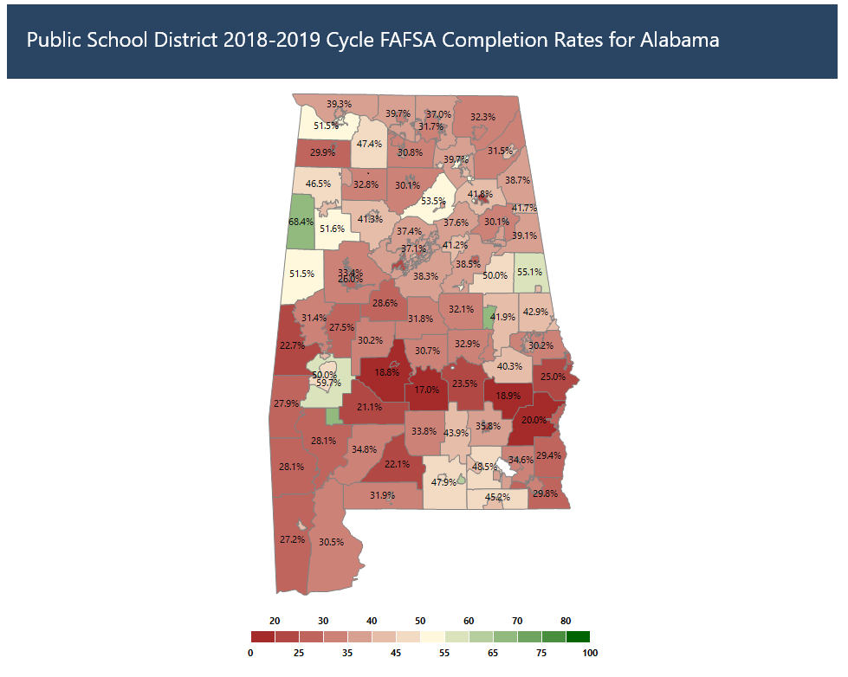
Lamar
Randolph
Marengo

Slide 29
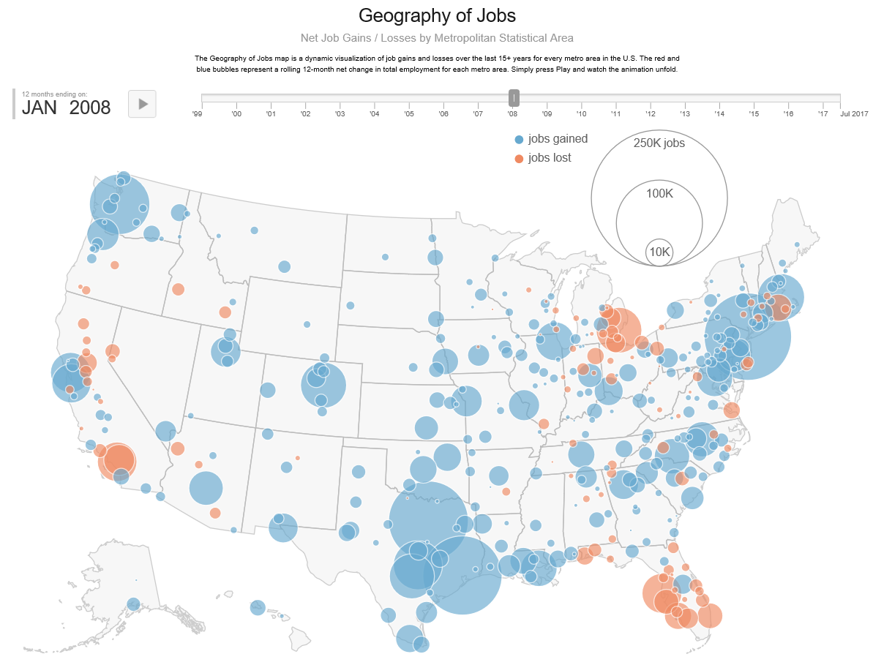

Slide 30
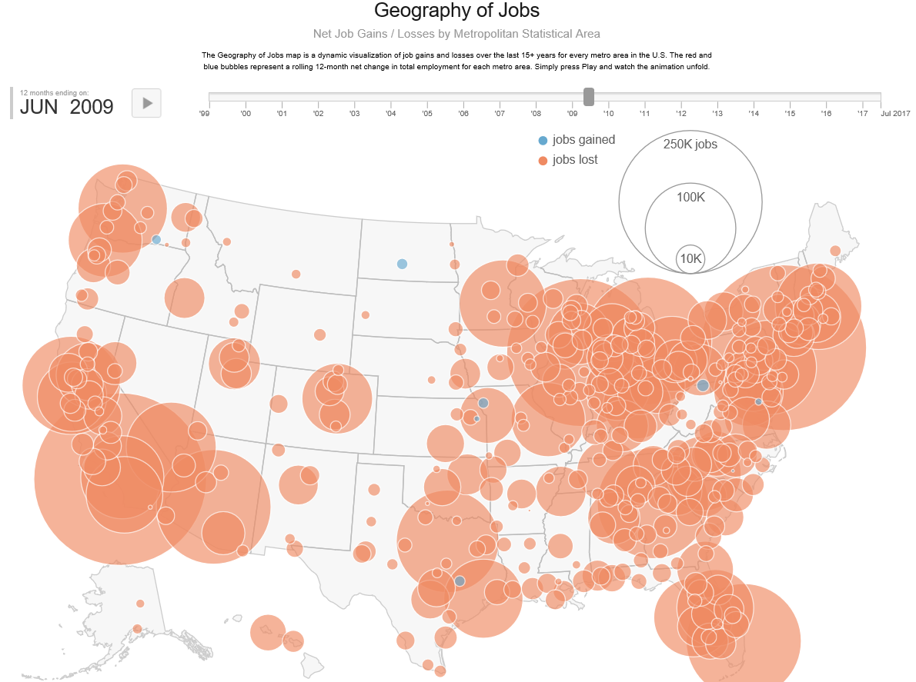

Slide 31
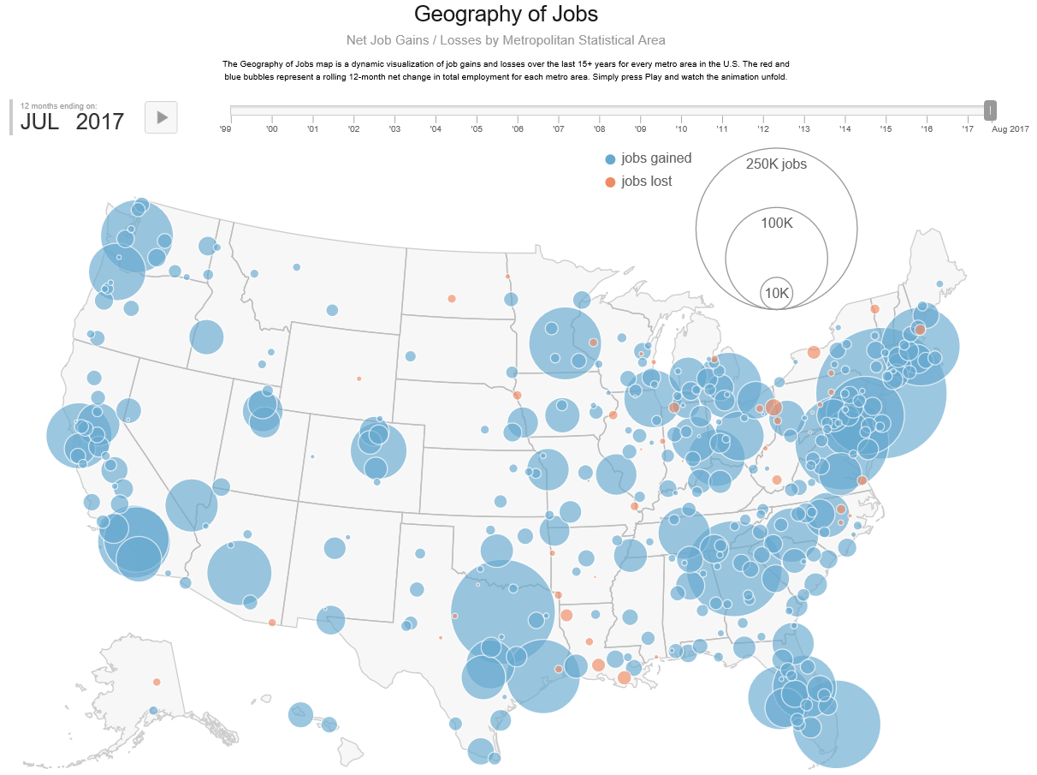

Slide 32
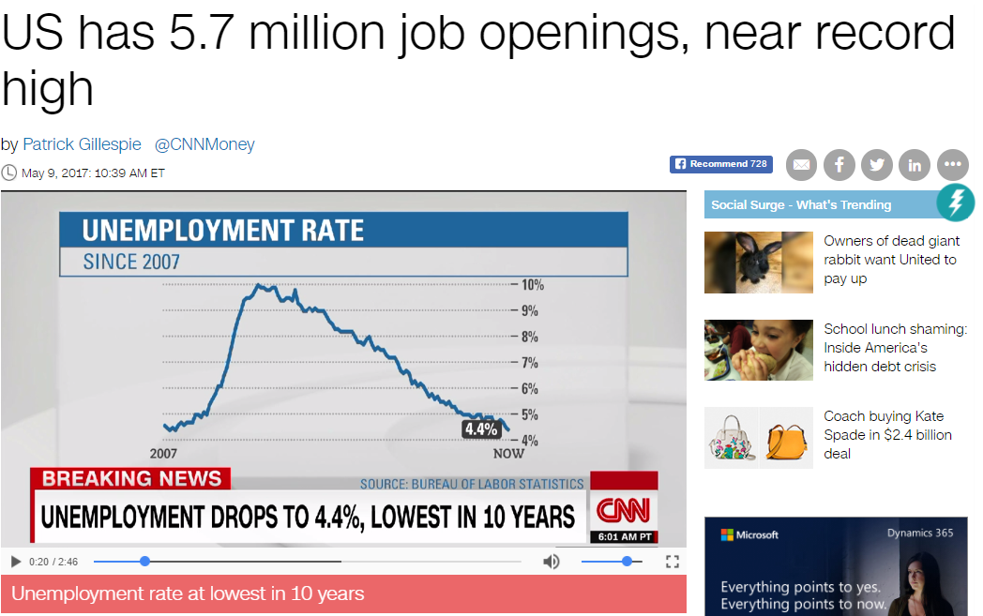
Good news:
Employers are hiring
Bad news:
Not all employers can find the skilled workers they need. Experts say that such a high number of job openings is due partially to a gap between the job skills employers demand and the skills job seekers have.
skills gap … is holding down overall wage growth in the US

Slide 33
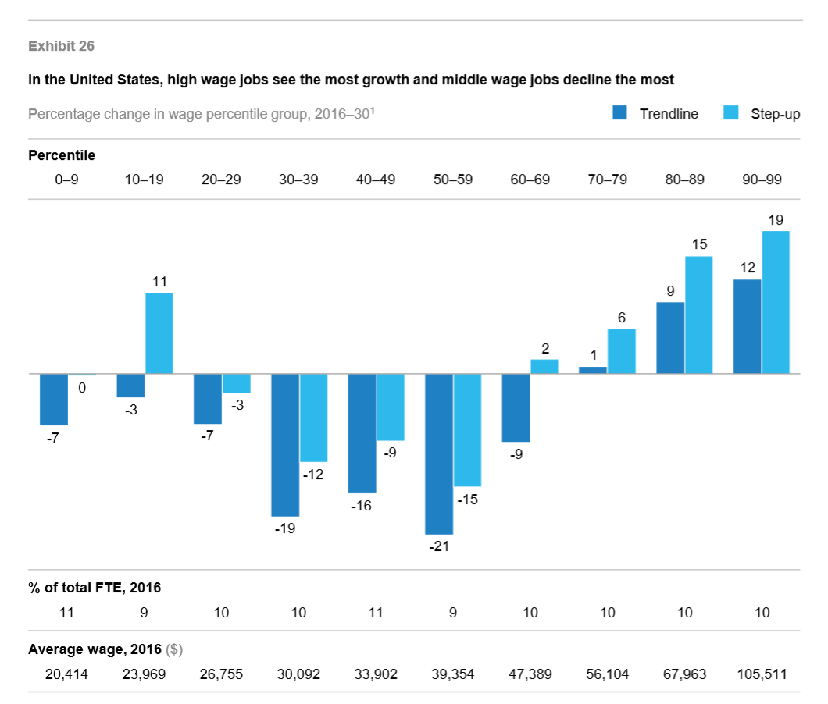
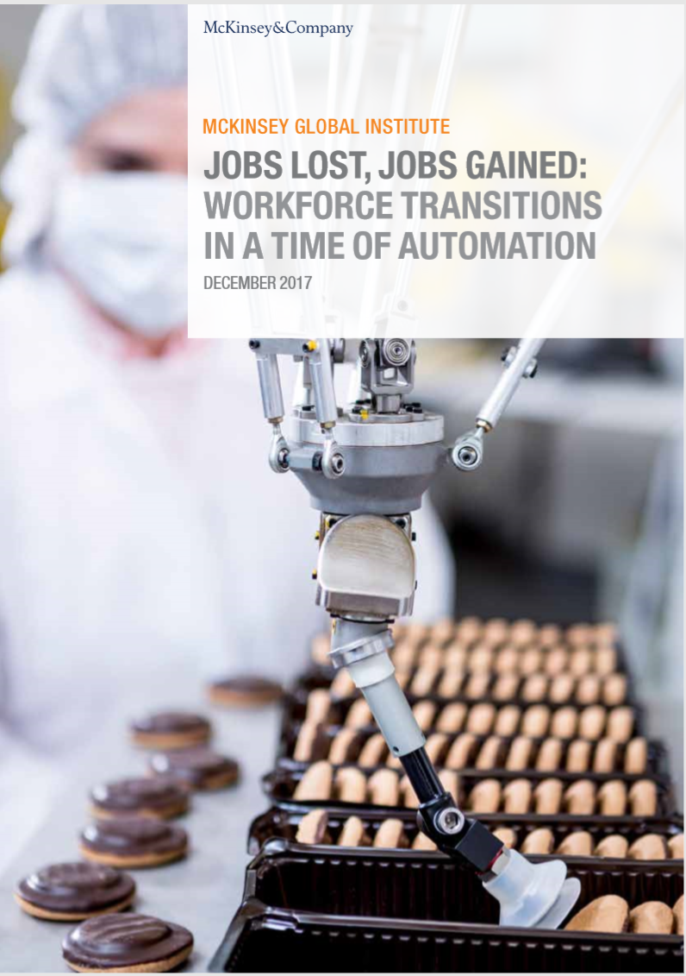
Middle Class
Middle Class Jobs are at greatest risk
Persons we train for mid-level jobs today will need to be training for a higher credentialed job in the near future.

Slide 34
Competing with Robots
“Machines can become our greatest asset or our greatest liability. It’s up to us to decide.”
“Competing WITH robots is far different than competing AGAINST robots. When we add machine skills to the resume of an individual we end up with a far different equation.” By Futurist Thomas Frey
Notes:
With similar stages of mechanization, an equivalent evolution will take us from home-based robots to unusual forms of mobile automation that we control personally.
Competing WITH robots is far different than competing AGAINST robots. When we add machine skills to the resume of an individual we end up with a far different equation.
So the coming decades will be far less about humans competing against machines and far more about how we can leverage them to our advantage.
Machine-based automation will revolutionize our world every bit as much as computers have.
The need for a rapid transitioning skill base where we quickly identify a need and train people to fill it.

Slide 35
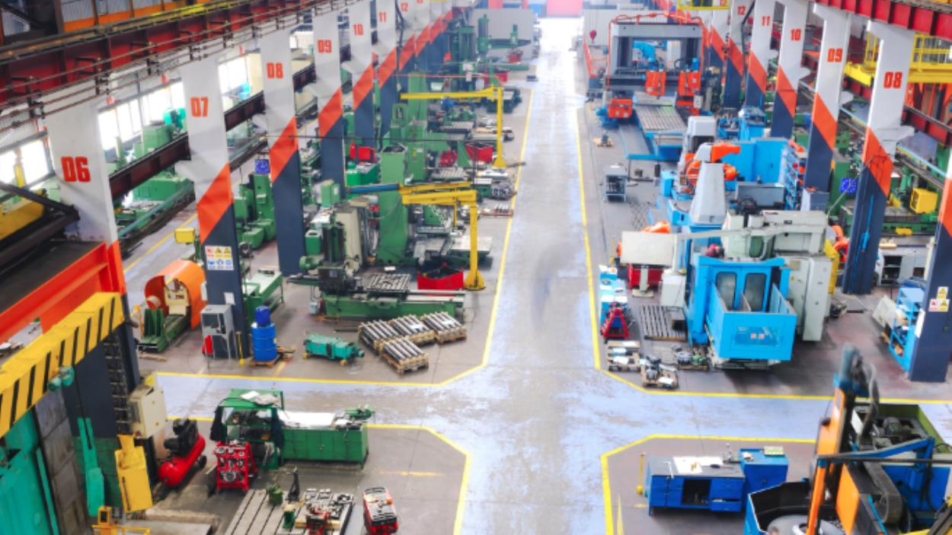
If Schools Don't Change, Robots Will Bring On a 'Permanent Underclass'
“Completely revamp the education system to turn the average students into exceptional ones who can outperform a robot.”
“The jobs that the robots will leave for humans will be those that require thought and knowledge. In other words, only the best-educated humans will compete with machines," Howard Rheingold, an internet sociologist,
Notes:
"told Pew
In other words, if we continue down this path we're on without finding a way to completely revamp the education system to turn the average students into exceptional ones who can outperform a robot, we'll look back on today's income inequality gap and think it was a golden age for the middle class.

Slide 36
Here's How Robots Could Change The World By 2025
“Robotics and artificial intelligence will permeate wide segments of daily life by 2025, with huge implications for a range of industries such as health care, transport and logistics, customer service, and home maintenance.”
By John Mauldin
Notes:
We will adapt to these changes by inventing entirely new types of work, and by taking advantage of uniquely human capabilities.
Self-driving cars, intelligent digital agents that can act for you, and robots are advancing rapidly

Slide 37
How Technology Is Destroying Jobs
Rapid technological change has been destroying jobs faster than it is creating them, contributing to the stagnation of median income and the growth of inequality in the United States.
“…many middle-class jobs are right in the bull’s-eye; even relatively high-skill work in education, medicine, and law is affected.”
By David Rotman
Notes:
Rapid technological change has been destroying jobs faster than it is creating them, contributing to the stagnation of median income and the growth of inequality in the United States.
New technologies are “encroaching into human skills in a way that is completely unprecedented,” McAfee says, and many middle-class jobs are right in the bull’s-eye; even relatively high-skill work in education, medicine, and law is affected.

Slide 38
201260%
58%
It takes two incomes to sustain households today
35%
196025%
How Technology Is Destroying Jobs
By David Rotman

Slide 40
Density of educated/ skilled workers
Access to good schools, colleges, universities
Local leadership
Regional economic development strategies rather than state-wide strategies
Return to city-states
Sparta and Athens
Work ready communities

Slide 41
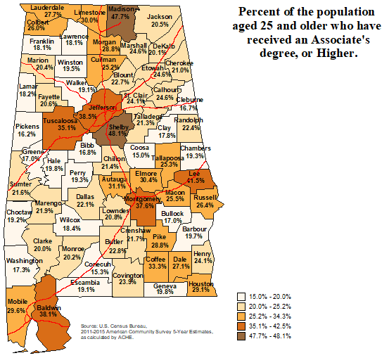
Education
Futurists say that communities with higher levels of educated citizens have the potential of becoming the ‘engines’ that drive a state’s economy—if driven by energetic and innovative leaders.

Slide 42
Priorities for Alabama Public Colleges and Universities:
Improve Access
Enhance Student Success
Enhance STEM Programs
Support Alabama’s Economy and Workforce
Organizational Effectiveness and Efficiency
> Financial Aid, local aid, Support local HS, Summer melt
Rethink Dev Ed, Support transfer of credits,
Alternative ways to earn credits
Financial Aid for STEM students, including
Teacher Ed Science and Math teachers
Expand programs that address needs of Business and Industry
Speedy new-program approval, Easier curricular change process, encourage organizational redesign, accountability and performance funding

Slide 43
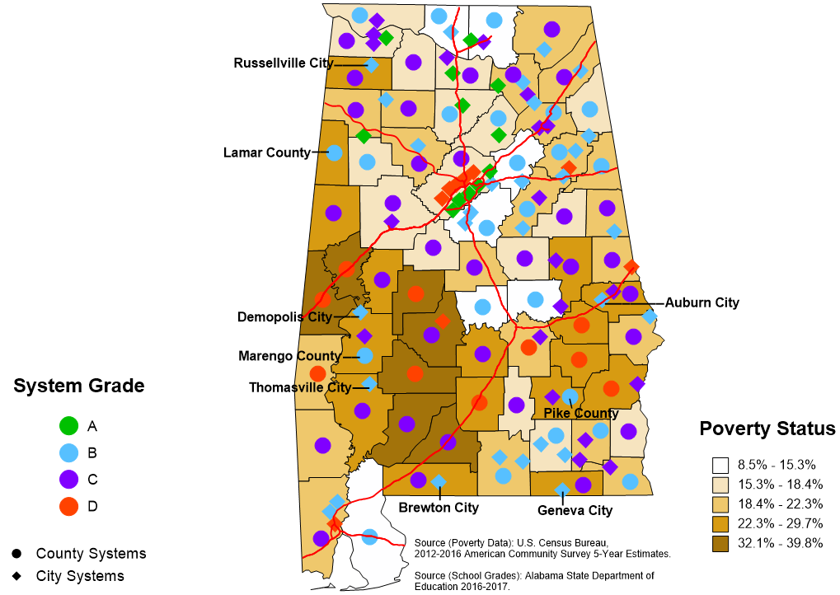
2016-2017 School District Grades Indicated on Alabama Poverty Map
Improve Access
> Financial Aid, local aid, Support local HS, Summer melt
There is a statistically significant relationship between poverty and low performing school districts
137 Systems
12 A’s
52 B’s
54 C’s
19 D’s
Notes:
Correlations
Score Poverty %
Score Pearson Correlation 1 -.487**
Sig. (2-tailed) .000
N 137 137
Poverty % Pearson Correlation -.487** 1
Sig. (2-tailed) .000
N 137 137
**. Correlation is significant at the 0.01 level (2-tailed).

Slide 44
2016-2017 School District Grades Indicated on Alabama Poverty Map
Only “city’ districts made A’s
No “D” districts above this line
No “A” districts below this line
137 Systems
12 A’s
52 B’s
54 C’s
19 D’s

Slide 45
2016-2017 School District Grades Indicated on Alabama Poverty Map
“A” districts exist only in this 125 x 75 mile pentagon.
137 Systems
12 A’s
52 B’s
54 C’s
19 D’s

Slide 46
2016-2017 School District Grades Indicated on Alabama Poverty Map
School districts on the map that are identified are in the poor counties and received a ‘B’.
What makes these districts more successful than other districts in poor counties?
137 Systems
12 A’s
52 B’s
54 C’s
19 D’s

Slide 47
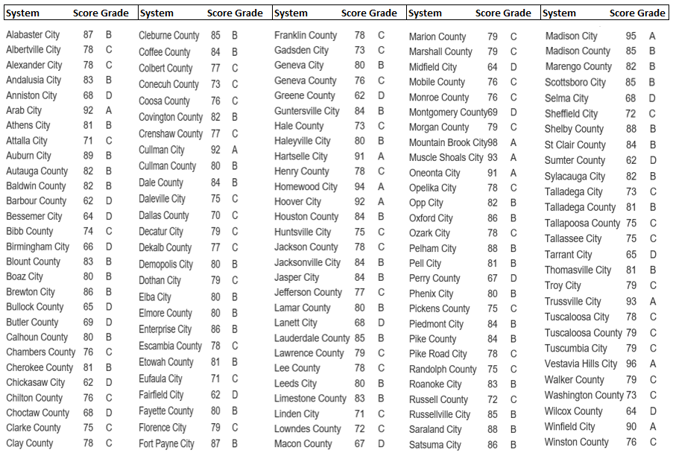

Slide 48
VII. DISCUSSION

Slide 49
Alabama Commission on Higher Education Data Trends Report

Slide 51
Historical Summary of Number of Alabama Public High School Graduates Enrolled in Alabama Public Colleges and Universities the Fall After High School Graduation and Those Taking Remedial Math and/or Remedial English
More HS grads, but public college attendance not increasing at the same pace
Less requiring remediation

Slide 52
Percentage of Alabama Public High School Graduates Enrolled in Alabama Public Institutions the Fall after High School Graduation And Those Taking Remedial Math and/or Remedial English
Percent Enrolled, 2007-2016
Percent Remediated, 2007-2016
Less enrolling
Less requiring remediation

Slide 53
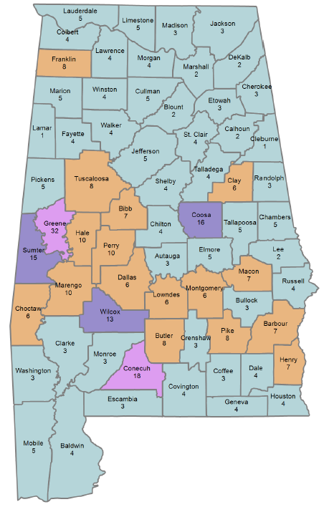
Percent of High School Students Taking Only Remedial English
Alabama counties with the largest number of students who only took remedial English are: Greene county with 32%, and Conecuh County with 18%.

Slide 54
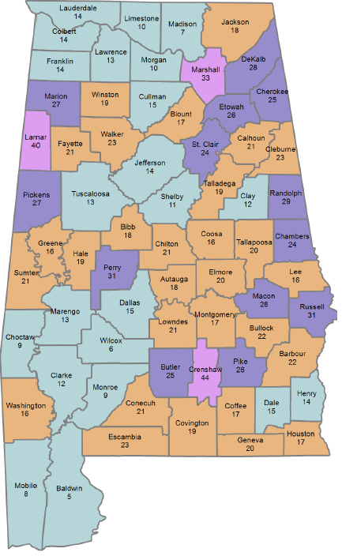
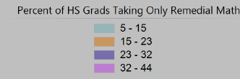
Percent of High School Students Taking Only Remedial Math
Alabama counties with the largest number of students who only took remedial math are: Crenshaw County with 44%, Lamar County with 40% and Marshall County with 33%.

Slide 55
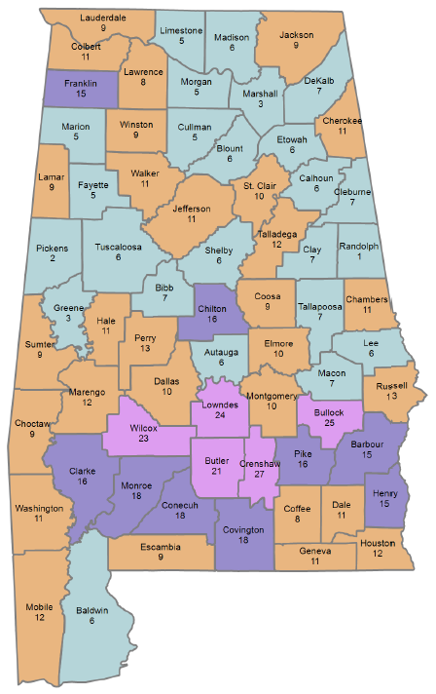
Percent of High School Students Taking Both Remedial English and Math
Alabama counties with the largest number of students who took both remedial English and Math are: Crenshaw county with 27%, Bullock county with 25%, Lowndes county with 24%, Wilcox county with 23%, and Butler county with 21%.

Slide 56
Facts about Change in Alabama High School Graduates
Over the last year, 3.2% increase in the number of high school graduates.
The number of high school students enrolled in Alabama public institutions decreased slightly.
The number of students remediated declined by -5.6% over the past year.

Slide 57
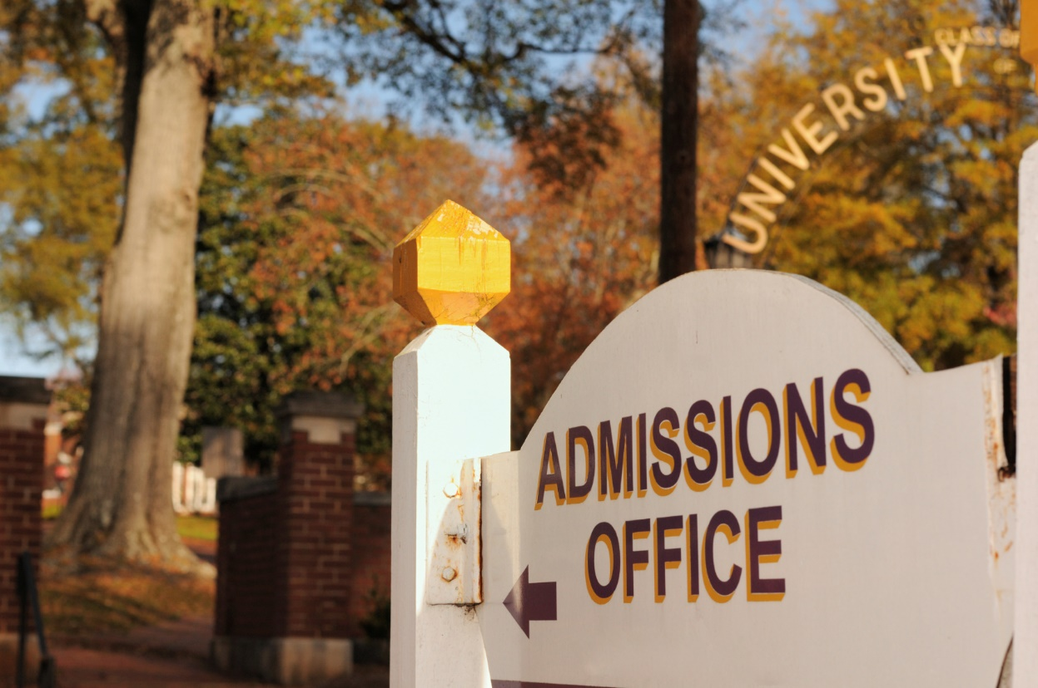
Alabama Fall Enrollment Report
Enrollment Trends at Alabama Colleges & Universities
2013-2017

Slide 58
Total Fall Enrollment by Sector, 2013-2017
Enrollment increased by 11,439 students, an increase of 4.7% over the last 5 years.
Historically, CCs enrollment declines as the economy improves.
Most of the 4-year increases between 2016 and 2017 were related to reporting changes

Slide 59
Percent of Total Fall Enrollment by Sector
More students attending universities
In 2013, 2-year institutions made up 35% of total enrollment, but by 2017 had fallen to 32%. Enrollment for 4-year institutions increased from 65% to 68%.

Slide 60
Percentage of Fall Enrollment by Level
Remained relatively constant

Slide 61
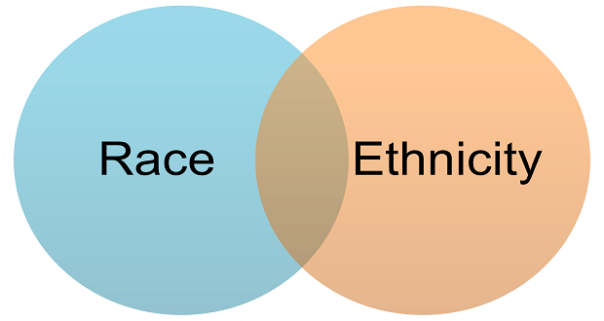
Fall Enrollment by Race/Ethnicity
 | FA 2013 | FA 2014 | FA 2015 | FA 2016 | FA 2017 | 1-Year Change | 5-Year Change
African American, Non-Hispanic | 59,225 | 57,205 | 56,543 | 56,457 | 57,481 | 1.8% | -2.9%
Am Indian or Alaskan Native | 1,740 | 1,686 | 1,638 | 1,586 | 1,574 | -0.8% | -9.5%
Asian | 4,087 | 4,253 | 4,477 | 4,541 | 4,645 | 2.3% | 13.7%
Hispanic | 5,794 | 6,305 | 6,984 | 7,570 | 8,606 | 13.7% | 48.5%
White, Non-Hispanic | 156,246 | 155,758 | 156,693 | 158,067 | 162,017 | 2.5% | 3.7%
Non-Resident Alien | 6,345 | 7,076 | 7,673 | 8,680 | 8,472 | -2.4% | 33.5%
Multiracial Designations | 3,529 | 4,054 | 4,654 | 5,325 | 5,789 | 8.7% | 64.0%
Native Hawaiian/Other Pacific Island | 201 | 193 | 203 | 194 | 212 | 9.3% | 5.5%
Unknown/Not Reported | 5,384 | 5,439 | 4,338 | 4,568 | 5,194 | 13.7% | -3.5%

Slide 62
Today, 57.8% of students enrolled in Alabama public institutions are women, and 42.2% are men. Men and women enrollment over the last 5 years has remained steady.
Remained relatively constant

Slide 63
Enrollment at Alabama Public Two-Year Institutions
Institutions | Fall 2013 | Fall 2014 | Fall 2015 | Fall 2016 | Fall 2017 | 1-Year Change | 5-Year Change
Bevill State Community College | 3,491 | 3,609 | 3,619 | 3,806 | 3,873 | 1.8% | 10.9%
Bishop State Community College | 3,897 | 3,323 | 3,112 | 3,029 | 3,233 | 6.7% | -17.0%
Calhoun Community College | 11,186 | 10,802 | 9,985 | 9,900 | 9,861 | -0.4% | -11.8%
Central Alabama Community College | 1,841 | 1,742 | 1,787 | 1,776 | 1,835 | 3.3% | -0.3%
Chattahoochee Valley Community College | 1,837 | 1,805 | 1,665 | 1,528 | 1,425 | -6.7% | -22.4%
*Coastal Alabama Community College | 6,804 | 6,971 | 7,067 | 7,146 | 7,079 | -0.9% | 4.0%
Drake State Community and Technical College | 1,383 | 1,062 | 996 | 829 | 752 | -9.3% | -45.6%
Enterprise State Community College | 2,333 | 2,011 | 1,882 | 1,755 | 1,779 | 1.4% | -23.7%
Gadsden State Community College | 5,797 | 5,289 | 5,018 | 5,109 | 4,979 | -2.5% | -14.1%
Ingram State Technical College | 514 | 473 | 422 | 449 | 453 | 0.9% | -11.9%
Jefferson State Community College | 8,551 | 8,518 | 8,826 | 8,943 | 8,842 | -1.1% | 3.4%
Lawson State Community College | 3,031 | 3,092 | 3,173 | 3,128 | 3,248 | 3.8% | 7.2%
Lurleen B. Wallace Community College | 1,570 | 1,599 | 1,732 | 1,742 | 1,838 | 5.5% | 17.1%
Marion Military Institute | 418 | 439 | 457 | 425 | 446 | 4.9% | 6.7%
Northeast Alabama Community College | 2,835 | 2,710 | 2,704 | 2,616 | 2,742 | 4.8% | -3.3%
Northwest-Shoals Community College | 3,865 | 3,923 | 3,700 | 3,752 | 3,442 | -8.3% | -10.9%
Reid State Technical College | 518 | 549 | 571 | 489 | 392 | -19.8% | -24.3%
Shelton State Community College | 5,068 | 4,989 | 4,834 | 4,810 | 4,607 | -4.2% | -9.1%
Snead State Community College | 2,295 | 2,258 | 2,456 | 2,321 | 2,220 | -4.4% | -3.3%
Southern Union State Community College | 4,805 | 4,729 | 4,716 | 4,683 | 4,829 | 3.1% | 0.5%
Trenholm State Community College | 1,351 | 1,338 | 1,402 | 1,662 | 1,845 | 11.0% | 36.6%
Wallace Community College Dothan | 4,697 | 4,855 | 4,772 | 4,543 | 4,647 | 2.3% | -1.1%
Wallace State Community College Hanceville | 5,281 | 5,343 | 5,420 | 5,445 | 5,301 | -2.6% | 0.4%
Wallace State Community College Selma | 1,745 | 1,668 | 1,596 | 1,622 | 1,471 | -9.3% | -15.7%

Slide 64
Fall 2017 Enrollment Alabama Public Two-Year Institutions

Slide 65
Enrollment at Alabama Public Four-Year Institutions
Institutions | Fall 2013 | Fall 2014 | Fall 2015 | Fall 2016 | Fall 2017 | 1-Year Change | 5-Year Change
Alabama A&M University | 5,020 | 5,333 | 5,628 | 5,860 | 6,001 | 2.4% | 19.5%
Alabama State University | 6,075 | 5,510 | 5,383 | 5,318 | 4,760 | -10.5% | -21.6%
Athens State University | 3,175 | 3,129 | 3,042 | 3,065 | 3,116 | 1.7% | -1.9%
Auburn University | 24,864 | 25,912 | 27,287 | 28,290 | 29,776 | 5.3% | 19.8%
Auburn University at Montgomery | 5,096 | 5,057 | 4,919 | 4,878 | 4,894 | 0.3% | -4.0%
Jacksonville State University | 8,693 | 8,659 | 8,314 | 8,514 | 8,567 | 0.6% | -1.4%
Troy University | 14,146 | 13,340 | 13,036 | 13,310 | 16,999 | 27.7% | 20.2%
University of Alabama | 34,852 | 36,155 | 37,100 | 37,665 | 38,563 | 2.4% | 10.6%
University of Alabama at Birmingham | 18,591 | 18,723 | 18,362 | 19,550 | 20,933 | 7.1% | 12.6%
University of Alabama in Huntsville | 7,376 | 7,348 | 7,866 | 8,468 | 9,101 | 7.5% | 23.4%
University of Montevallo | 3,066 | 3,073 | 3,033 | 2,800 | 2,717 | -3.0% | -11.4%
University of North Alabama | 6,992 | 6,839 | 7,078 | 7,333 | 7,209 | -1.7% | 3.1%
University of South Alabama | 15,065 | 15,805 | 16,211 | 16,443 | 15,569 | -5.3% | 3.3%
University of West Alabama | 4,427 | 3,989 | 4,032 | 3,986 | 4,646 | 16.6% | 4.9%

Slide 66
Fall 2017 Enrollment Alabama Public Four-Year Institutions

Slide 67
Fall Enrollment by Origin of Students
Fall 2013 thru Fall 2017
Table: Over the last five years, the number of Alabama students decreased -2.1% while students not from
Alabama grew nearly 29%.
 | 2013 | 2014 | 2015 | 2016 | 2017 | 1-yr Change | 5-yr Change
Alabama | 189,095 | 188,190 | 186,875 | 186,998 | 185,076 | -1.0% | -2.1%
Not from Alabama | 53,456 | 53,779 | 56,328 | 59,990 | 68,914 | 14.9% | 28.9%
TOTAL | 242,551 | 241,969 | 243,203 | 246,988 | 253,990 | 2.8% | 4.7%
Percent of Total Enrollment
Between 2013 and 2017, the percentage of non-resident students increased 5% while resident students dropped 5%.

Slide 68
Alabama Public Four-Year Institutions Fall 2017 Resident Enrollment by Institution

Slide 69
Fall Enrollment by Age
 | 2013 | 2014 | 2015 | 2016 | 2017 | 1-Year Change | 5-Year Change
Traditional (Under 25) | 168,099 | 171,228 | 175,642 | 181,148 | 186,333 | 2.9% | 10.8%
Non-Traditional (25 and over) | 74,452 | 70,741 | 67,561 | 65,840 | 67,657 | 2.8% | -9.1%
TOTAL | 242,551 | 241,969 | 243,203 | 246,988 | 253,990 | 2.8% | 4.7%
Percent of Total Enrollment by Age:
 | 2013 | 2014 | 2015 | 2016 | 2017
Traditional (Under 25) | 69.3% | 70.8% | 72.2% | 73.3% | 73.4%
Non-Traditional (25 and Over) | 30.7% | 29.2% | 27.8% | 26.7% | 26.6%
Between 2013 and 2017, the number and percentage of adults attending college declined.

Slide 70
Fall Enrollment by Intensity (Full-time/Part-time Status)
Remained relatively constant
Enrollment increased for both full-time and part-time students.
The proportion of full-time and part-time students enrolled has remained relatively constant over this time period increasing less than one percent.

Slide 71
2016-17 College Completions
Education provides greater opportunity at all levels, but those who complete education beyond high school are better equipped for success in the 21st Century economy.
Alabama Public Colleges and Universities

Slide 72
2013-2017 IPEDS Completions by Award Level
In 2017, Certificates of less than a year made up 10% of credentials produced at our colleges and universities.
Stackable Credentials

Slide 73
2013-2017 IPEDS Completions by Award Level
Relatively slow growth between 2013 and 2017 for credentials at the bachelor’s and higher levels.

Slide 75
Alabama Public Colleges and Universities
IPEDS Completions by Gender
More women are earning degrees than men

Slide 76
Questions & Comments
Mrs. Subrena Simpkins
Director of Research Services
Subrena.Simpkins@ache.Alabama.gov
(334) 242-2753

Slide 77
VIIi. Decision ITEMS

Slide 78
A. Administrative Code: Proposed Amendment to Program Review Chapter 300-2-1-02
The current fee schedule is:
Application for Single Institution - $2,500
Renewal Application for Single Institution - $1,500
Desk Audit Application - $500

Slide 79
B. Final Approval
Procedural Changes Regarding
Post-Implementation Conditions Review

Slide 80
Final Approval of Procedural Changes Regarding Post-Implementation Conditions Review
The preliminary approval of the Procedural Changes regarding Post-Implementation Conditions Review, granted by the Commission on December 8, 2017, was filed with the Legislative Reference Service and subsequently published in Alabama Administrative Monthly as required.
Interested parties had 35 days to comment. No comments were received.
Since there were no comments, the Commission may grant final approval to these proposed changes at its March 9, 2018 meeting.

Slide 81
Final Approval of Procedural Changes Regarding Post-Implementation Conditions Review
Highlights of changes:
The post-implementation period will be seven (7) years (instead of five (5) years) for all levels (one (1) year start-up wherein no data reporting required and a six (6) year monitoring period).
The minimum viability standard rates will be used for degree completions instead of projections. The standards as stated in Code of Alabama, 1975, 16-5-8, are: 7.5 - Associate and Baccalaureate, 3.75 – Master’s, 3.0 – EdS, and 2.25 – Doctorate.
New enrollment projections will be reduced by 25 percent to account for over-estimation.
The unemployment rate will be considered as informational/notification only.
To support more valid post-implementation results, the window will be increased to 30 months (2 ½ years) from the time of Commission approval to implementation, before Commission approval will expire.
The proposed changes will then go into effect 45 days after the changes are certified by the ACHE Executive Director and subsequently filed with the Legislative Reference Service.

Slide 82
C. Academic programs

Slide 83
ALABAMA COMMUNITY COLLEGE SYSTEM (ACCS)

Slide 84
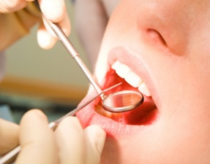
Calhoun Community College
Associate in Applied Science in Dental Hygiene (CIP 51.0602)
Following program approval, CAL will seek accreditation through the Commission on Dental Accreditation (CODA). This process could take anywhere from 12 to 18 months.
CAL conducted a survey of 72 dental offices in seven north Alabama counties. The survey asked dentists how many dental hygienist vacancies they anticipated in their practice over the next three years. A total of twenty-six surveys were returned that indicated that there would be 30 dental hygienist openings in the next three years.

Slide 85
Enterprise State Community College
Associate in Applied Science and Certificate in Medical Assistant Technology (CIP 51.0801)
According to ENT officials, several local healthcare facilities in their service area have expressed the need for the proposed program.
Annual demand has increased in Dale and Geneva counties for Medical Assistants. Both counties are shared between Wallace State Community College (Dothan), Lurleen B. Wallace Community College, and Enterprise State Community College. ENT officials believe the proposed program is not duplicative because of high demand from surrounding counties for Medical Assistants that cannot be met by one institution.

Slide 86
Shelton State Community College
Associate in Applied Science in Welding (CIP 48.0508)
According to the program application, occupational forecast data indicates employers within SHC’s service area will need to fill 149 welding related positions over the next 10 years.
An articulation agreement between SHC and the United Association of Journeymen and Apprentices of Plumbing and Pipe Fitting (United Association) supports the addition of an advanced Welding award. The articulation agreement allows SHC Welding graduates to enter the United Association Apprenticeship training program with advanced placement and pay.

Slide 87
Shelton State Community College
Associate in Applied Science and Certificate in Computer Science Technology (CIP 11.0101)
According to the program application, occupational forecast data indicates employers within SHC’s service area will need to fill 488 computer related positions over the next 10 years.
Data from companies who completed the Community and Business Needs Survey conducted by SHC officials indicate an average annual demand of 49 computer related positions in the institution’s service area.

Slide 88
FOUR-YEAR INSTITUTIONS

Slide 89
Auburn University
Bachelor of Science in Sustainable Biomaterials and Packaging (CIP 03.0599)
According to AU officials, the School of Forestry and Wildlife Science (SFWS) is the only forest-product based program in Alabama that has the faculty and staff to offer the proposed degree program. The SFWS is the home of the Forest Products Development Center, a region-based research cooperative that has access to and can tap into the billion-dollar industry for support, internships and direction of the degree program.
The proposed program curriculum will be supported by faculty from the College of Agriculture and the College of Engineering. The curriculum will be STEM oriented and the first of its kind in the United States.
The curriculum will be unique nationally because it utilizes supporting faculty
across five (5) schools/colleges.

Slide 90
Auburn University
Bachelor of Science in Neuroscience (CIP 26.1501)
The USDOL occupational outlook for medical scientists, such as neuroscientists, expects a 12.9 percent increase in jobs from 2016 to 2026. A need for neuroscientists will continue because they help develop treatments and medicine for mental health.
Currently, there are only seven (7) public universities in the southeastern United States that offer neuroscience as a major compared to 74 public universities in the entire US (9.5 percent).
The proposed neuroscience program would prepare students to perform well on the Medical College Admission Test (MCAT). The new MCAT places emphasis on Psychological, Social, and Biological Foundations of Behavior. Graduates of the program will be in a strong position for careers in health-related sciences.

Slide 91
Auburn University
Bachelor of Arts in Law and Justice (CIP 22.0000)
The Law and Justice degree will utilize the strengths of three different departments at AU (Political Science, Philosophy, and Communications) to create a superior plan of study focused on readiness for law school and other post-graduate study.
The program combines coursework in legal studies and logical reasoning, a required internship, and opportunities to participate in moot court and mock trial activities, along with advising by a dedicated pre-law coordinator to improve student success.
According AU officials, the Law and Justice program will be among the first in the United States with this focus.

Slide 92
Auburn University
Bachelor of Computer Engineering in Computer Engineering (CIP 14.0901)
The program’s primary faculty from Electrical and Computer Engineering and from Computer Science and Software Engineering are experts in the various facets of computer engineering.
The proposed program is the elevation of a current Computer Engineering option within AU’s Bachelor of Electrical Engineering program. Enrollment in the computer engineering option has been steady over the past 5 years, fluctuating around 140 students enrolled per year and averaging 24 graduates a year. Elevating the option to program status will see those enrollment numbers increase to 160-175 students over the next 5 years.

Slide 93
Auburn University
Master of Engineering in General Engineering (CIP 14.0101)
The purpose of the proposed program is to provide an individualized plan of study for practicing engineers to more effectively perform their job and advance their careers.
Courses will be offered through the Graduate Outreach Program at Auburn University with nearly all courses provided via distance technology so students can pursue the degree while working full-time.
AU plans to further engage industry to determine specific courses or combinations of courses that would meet the needs of their employees, so that these courses can be offered within the framework of this degree.
No new funds will be required for the program over the first five years and $2,402,955 will be available over the same period through tuition.

Slide 94
Auburn University
Master of Science in Cybersecurity Engineering (MSCE) in Cybersecurity Engineering (CIP 11.1003)
The degree focuses on the engineering and technical aspects of cybersecurity.
The degree can be completed entirely through distance education, on campus, or a combination of the two.
Auburn University is well-positioned to offer a strong program because it is designated by the NSA as a Center of Academic Excellence in Cyber Defense/ lnformation Assurance Education.
The degree requires no additional courses or faculty, relying instead on refocusing existing courses to emphasize cybersecurity content.
No new funds will be required for the program over the first five years and $1,608,860 will be available over the same period through tuition.

Slide 95
Auburn University
Doctor of Philosophy in Earth System Science (CIP 40.0699)
The proposed graduate PhD degree program in Earth System Science (ESS) is based on the integration of scientific disciplines from five participating colleges and nine academic departments.
Students can choose among various areas of academic specialization (e.g., climate and Earth systems, forestry and wildlife sciences, geosciences and energy, water resources and hydrology, ecosystem and food security, coupled natural and human systems, big data science and engineering, etc.), providing for a curriculum of unusual richness and breadth.
No new funds will be required for the program over the first five years and $1,417,325 will be available over the same period through internal reallocations, extramural funding, and tuition.

Slide 96
Auburn University at Montgomery
Master of Science in Computer Science (CIP 11.0701)
The proposed program will give students specialized preparation in the broad area of Computer Science with four concentrations: a) General Computer Science, b) High Performance Computing, c) Data Analytics, and d) Computer and Cybersystems Security.
There are no other programs at the same degree level in Alabama that utilize the same CIP code used by this proposed program (11.0701).
The new program will promote and encourage research efforts as well as collaboration with local and regional industry and government.
The proposal projected that $698,000 in new funds will be required for the program over the first five years, and that $699,640 will be available over the same period through internal reallocations and tuition.

Slide 97
Troy University
Action on Troy’s Request to the Extend the AA and AS in General Education (Montgomery Campus) CIP 24.0199 to the Troy Campus
Troy’s program listings in the Commission’s Academic Program Inventory are site specific, as stipulated in the Commission’s approval of the consolidation of Troy State University, Troy State University Montgomery, and Troy State University Dothan. The Commission approval further stipulated that “no program not currently offered at a campus may be offered at another campus without the approval of ACHE.”
In 2009, the Commission established a process to review requests for expansion of programs to additional campuses. The process included the following criteria for review.
Evidence of the strength of the current programs.
Need for the Programs.
Adequate Student Demand.
Evidence of adequate resources at the new site.

Slide 98
University of Alabama
Bachelor of Science in Addictions and Recovery (CIP 19.0707)
Graduates will be prepared to work in entry-level positions at nonprofit substance abuse treatment centers and work toward their Alcohol and Drug Counselor (ADC) Certification from the Alabama Alcohol and Drug Abuse Association (AADAA).
The addiction recovery movement has been growing substantially over the last decade. There are over 85 collegiate recovery communities serving students in long-term recovery from addiction in the United States listed with the ARHE, 18 of which are in the Southeastern US, and three of which are in the state of Alabama (UA, UAB, and AU).

Slide 99
University of Alabama at Birmingham
Bachelor of Science in Bioinformatics (CIP 26.1103)
Bioinformatics has recently emerged as an interdisciplinary research area that enables the analysis and interpretation of biological data using computational techniques.
Graduates of the program will be well prepared to assist health professionals in analyzing large-scale datasets resulting from genome sequencing projects, and genome-wide association studies.
There are no other Bioinformatics programs in the state at this time.

Slide 100
University of Alabama at Birmingham
Master of Science Anatomical Sciences Education (CIP Code 26.0403)
The program offers training in Anatomy/Neuroanatomy/Embryology/Histology together with specialized educational courses to train participants to teach at the college level.
The goal is to equip individuals with the skills to teach in the anatomical sciences and thereby help to meet a rapidly growing need for anatomists in multiple health-care focused programs and courses.
No similar programs are offered in Alabama.
No new funds will be required to support the proposed program. A projected total of $264,600 in new funds will be available from tuition.

Slide 101
University of Alabama at Birmingham
Master of Science in Data Science (CIP 11.0401)
The program is intended for students and professionals who wish to acquire skills for solving real-world problems that involve exceptionally large volumes of datasets.
This new degree will give students a unique opportunity to combine their cross-disciplinary interests in data science and other disciplines such as business analytics and cybersecurity and maximize their career prospects.
Birmingham is becoming a business and technological hub of the south, with many startups and a strong demand for combined expertise in computer science and domain knowledge driven particularly by its biomedical and banking economy.
No new funds will be required to support the proposed program. A projected total of $305,100 in new funds will be available from tuition.

Slide 102
University of Alabama at Birmingham
Master of Science in Clinical Pathologist Assistant (CIP 51.1099)
The program will provide students the knowledge, skills and training needed for practice as a clinical pathologist assistant. There are no similar programs at this level in the SREB States.
The proposed curriculum of the program will be delivered in an online format.
This program is unique compared to existing Pathologist Assistant programs because it does not include an anatomic component. The emphasis will be fully on the clinical aspect of the pathology profession.
The proposal projected that a total of $700,000 in estimated new funds will be required to support the proposed program. A projected total of $872,870 in new funds will be available from tuition and internal reallocations.

Slide 103
University of Alabama in Huntsville
Bachelor of Science in Sport and Fitness Management (CIP 31.0504)
The program will provide needed employees for sport-and-fitness related fields. Employment opportunities include athletic directors, sport information directors and staff, fitness administrators and staff, sport marketing, and facilities managers.
The program will complement and expand on the current BS in Kinesiology at UAH.

Slide 104
University of Alabama in Huntsville
Master of Arts in Teaching – Elementary Education (CIP 13.1202)
The program will focus on educating individuals who already possess an undergraduate degree, but wish to earn a graduate degree, while simultaneously achieving initial certification to teach students in kindergarten through sixth grade.
The MAT Elementary Education program has been fully approved by ASBE.
Approximately 13 percent of the total program's courses offered will be provided by distance education.
No new funds will be required to support the proposed program. A total of $173,808 will be available through tuition.

Slide 105
University of Alabama in Huntsville
Master of Science in Applied Behavior Analysis (CIP 42.2814)
The program will provide a unique opportunity to support the education of individuals with behavioral needs.
There is substantive growth potential for a Board Certified Behavior Analyst (BCBA) employment in north Alabama.
More than 80% of the courses offered will be provided by distance education.
The College of Education at UAH has existing undergraduate programs in collaborative teaching (special education) and psychology, which would likely serve as enrollment streams for the program.
The proposal projected that a total of $475,000 in new funds will be required to support the proposed program. A total of $492,464 will be available through internal reallocations and tuition.

Slide 106
University of West Alabama
Master of Arts in Integrated Marketing Communications CIP 09.0199)
The multiple-disciplinary program syncs trends of traditional print, broadcast, web media, and marketing strategies with emerging technologies, such as blogs, websites, podcasts, and social media platforms.
The focus on core technological competencies is supplemented by a foundation in marketing, business, and social science courses.
The proposed program curriculum is unique to the region.
Current employer data suggest that multiple industries have a need for employees with skills offered in the proposed program.
No new funds will be required for the program.

Slide 107
D. INFORMATION ITEMS

Slide 108
D. INFORMATION ITEMS
Implementation of Approved Programs
Summary of Post-Implementation Reports
Implementation of New Short Certificate Programs (Less than 30 Semester Hours)
Changes to the Academic Program Inventory
Implementation of Non-Degree Programs at Senior Institutions
Implementation of Distance Education Programs

Slide 109
7. Extensions and Alterations to Existing Programs of Instruction
1) Alabama State University, Addition of a Concentration in Computational Mathematics to the Existing
BS in Mathematics (CIP 27.0101)
Alabama State University (ASU) has the BS in Mathematics at CIP 27.0101 in the Commission’s Academic Program Inventory. ASU has proposed the addition of a Concentration in Computational Mathematics to the existing program. The program with the concentration will require a total of 121 semester hours. The concentration will consist of 33 semester hours. Budgetary Impact: None.
2) Alabama State University, Addition of a Concentration in Applied Discrete Mathematics to the
Existing BS in Mathematics (CIP 27.0101)
Alabama State University (ASU) has the BS in Mathematics at CIP 27.0101 in the Commission’s Academic Program Inventory. ASU has proposed the addition of a Concentration in Applied Discrete Mathematics to the existing program. The program with the concentration will require a total of 121 semester hours. The concentration will consist of 33 semester hours. Budgetary Impact: None.
3) Alabama State University, Addition of a Concentration in Mathematical Statistics to the Existing BS
in Mathematics (CIP 27.0101)
Alabama State University (ASU) has the BS in Mathematics at CIP 27.0101 in the Commission’s Academic Program Inventory. ASU has proposed the addition of a Concentration in Mathematical Statistics to the existing program. The program with the concentration will require a total of 121-124 semester hours. The concentration will consist of 33-36 semester hours. Budgetary Impact: None.

Slide 110
7. Extensions and Alterations to Existing Programs of Instruction (Cont’d)
4) Auburn University, Addition of an Option in Bioprocess Engineering to the Existing BBE in
Biosystems Engineering (CIP 14.4501)
Auburn University (AU) has the BBE in Biosystems Engineering at CIP 14.4501 in the Commission’s Academic Program Inventory. AU has proposed the addition of an Option in Bioprocess Engineering to the existing program. The program with the option will require a total of 127 semester hours. The concentration will consist of 36 semester hours. Budgetary Impact: None.
5) University of Alabama, Addition of a Concentration in Precision Timing to the Existing MS in
Physics (CIP 40.0801)
The University of Alabama (UA) has the MS in Physics at CIP 40.0801 in the Commission’s Academic Program Inventory. UA has proposed the addition of a Concentration in Precision Timing to the existing program. The program with the option will require a total of 34 semester hours. The concentration will consist of 12 semester hours. Budgetary Impact: None.
6) University of Alabama, Addition of a Concentration in Precision Timing to the Existing PhD
in Physics (CIP 40.0801)
The University of Alabama (UA) has the PhD in Physics at CIP 40.0801 in the Commission’s Academic Program Inventory. UA has proposed the addition of a Concentration in Precision Timing to the existing program. The program with the option will require a total of 72 semester hours. The concentration will consist of 12 semester hours. Budgetary Impact: None.

Slide 111
7. Extensions and Alterations to Existing Programs of Instruction (Cont’d)
7) University of Alabama at Birmingham, Addition of a Concentration in Sports Communication
to the Existing BA in Communication Studies (CIP 09.0101)
The University of Alabama at Birmingham (UAB) has the BA in Communication Studies at CIP 09.0101 in the Commission’s Academic Program Inventory. UAB has proposed the addition of a Concentration in Sports Communication to the existing program. The program with the option will require a total of 120 semester hours. The concentration will consist of 33 semester hours. Budgetary Impact: None.

Slide 112
X. adjournment
The next meeting will be held on June 8, 2018

