Slide 1

Alabama Commission on Higher Education
Commission Meeting
June 8, 2018

Slide 2

CALL TO ORDER and PLEDGE OF ALLEGIANCE

Slide 3

II. ROLL CALL and
QUORUM DETERMINATION

Slide 4

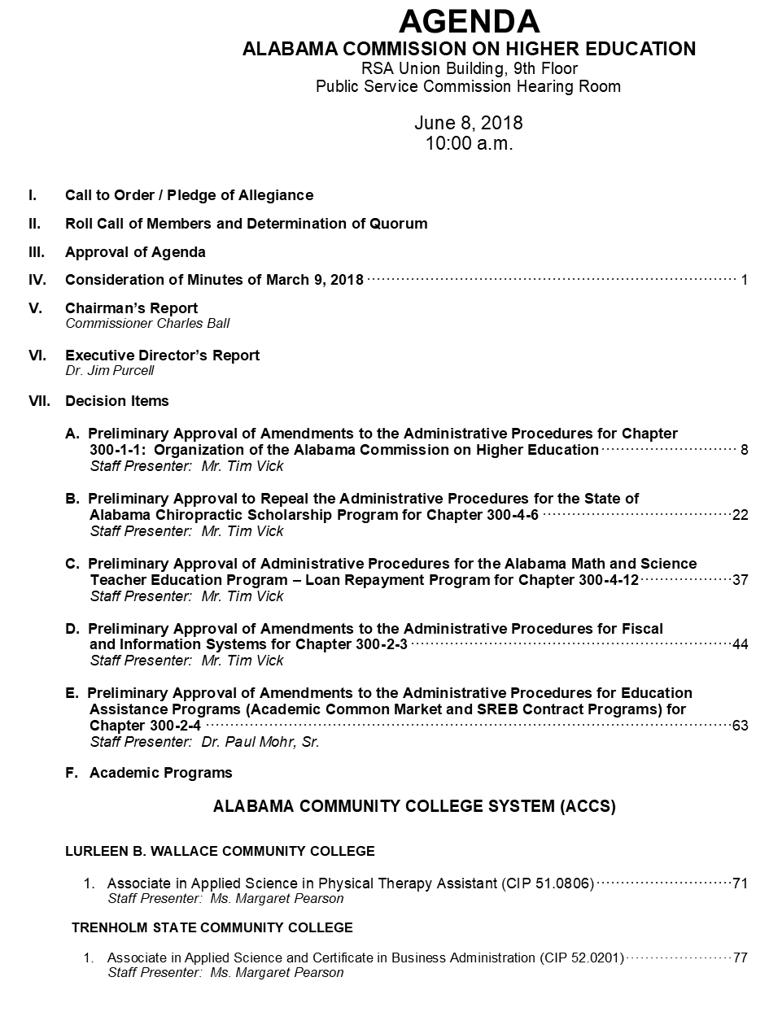
III. APPROVAL OF AGENDA

Slide 5

IV. APPROVAL OF MINUTES
March 9, 2018

Slide 6

V. CHAIRMAN’S
Report

Slide 7

VI. EXECUTIVE DIRECTOR’S
Report

Slide 8
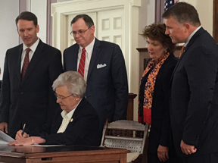
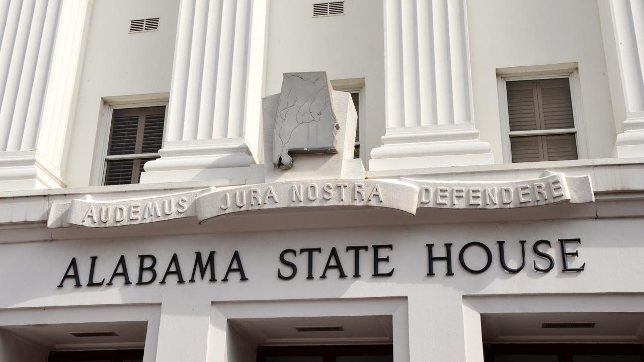
Legislative Session
HB261 Math and Science Teacher Loan Repayment program established and funded.
$6.6 B education budget. This budget goes on record as the second largest amount that the state has funded through the ETF, providing money for projects, programs and pay raises.
K-12 schools received an increase of $146 million, universities will receive an additional $42 million and an $18 million increase will go to community colleges.
Commissioner Norman Crow was confirmed by the Senate in January.
Student financial aid was increased for both the Alabama Student Assistance Program (ASAP) and the Alabama Student Grant Program. ASAP will be funded in 2019 at $4,147,551 as compared to $2,897,551 in 2018. The Grant Program will get $5,020,970, up from the previous year of $4,470,970.

Slide 9

Trustee Conference
Held at Lawson State. Trustees serving on boards from several states attended.
Most ACHE board members participated in a self assessment survey and Chair Ball and Member McGriff attended.
Nearly all of the ACCS board were in attendance.

Slide 10

Complete College Alabama Kickoff Event
Held at Lawson State. Every community college and university and half of the private institutions were represented at the event. Chairman Ball, and Board Members McGriff and Price attended.
Providing a Strong Start
  15 to finish
  Math Pathways
  Corequisite Remediation
Momentum Year – Default students into highly structured academic pathways.
Academic Maps
Redefining Systems to address adult students: Accelerated courses, Year-round enrollment, predictable schedules
Since then, personnel from Bishop and the Mobile Area Education Foundation are to present at national conference in December
Many campus conversations on CCA and one training workshop for staff at a CC.

Slide 11

Assist with making connections with international companies and their families located here in Alabama
Identify education and training needs of these companies
Provide cultural awareness experiences and training for college students

Slide 12
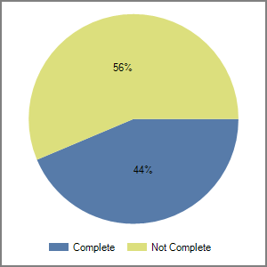
FAFSA Completion Project
Percentage of High School seniors that Completed a FAFSA
56%
44%

Slide 13
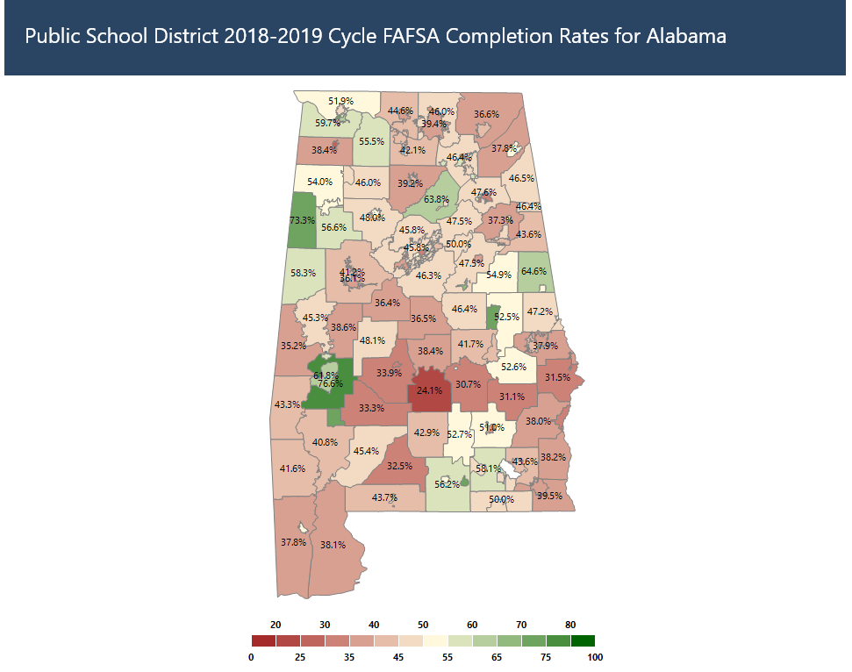
FAFSA Completion Project

Slide 14
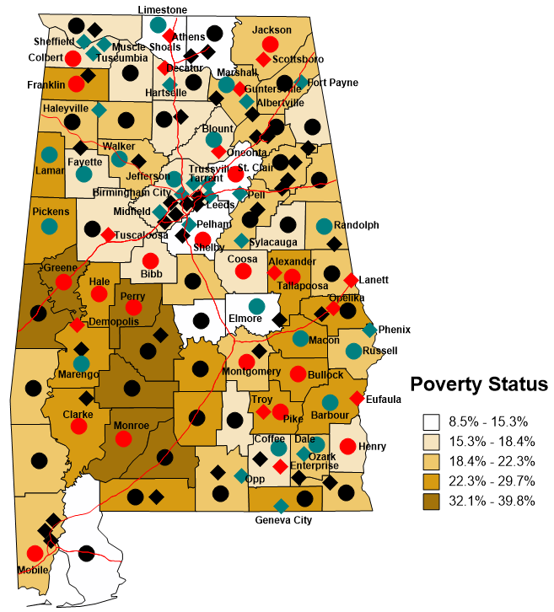
FAFSA Completions Indicated on Alabama Poverty Map
66 Participating systems are named on the map. 1 private school in Birmingham is not shown on map.
Source (Poverty Data): U.S. Census Bureau,
2012-2016 American Community Survey 5-Year Estimates.

Slide 15
Mobile Chosen to Receive up to $40,000
for FAFSA Completion Challenge
NCAN announced it has selected 25 U.S. cities to receive up to $40,000 each for the 2018-19 FAFSA Completion Challenge Grant. Through this project, generously funded by The Kresge Foundation and Great Lakes Higher Education Corporation & Affiliates, NCAN challenges each of the grant recipients to increase their FAFSA completion rates by at least 5 percentage points for the graduating high school class of 2019. In an effort to address equity gaps, this Challenge specifically focuses on cities with current FAFSA completion rates below the national average.
Mobile Area Education Foundation

Slide 16

Summer Melt
When academically successful students that have been accepted into an institution of higher learning decide not to enroll. (Castleman, 2012)
Anywhere from 10 to 40 percent of students presumed to be headed to college fail to matriculate at any postsecondary institution in the fall following high school.
Disproportionately impacts low income, minority students, first generation students
ACHE has been approached by AIR to conduct a study on Summer Melt, specifically the impact of text messaging over the summer on student matriculation.
Multi-state research project
K-12 and Higher Education collaboration.
Application due August.
Research timeline, 2019-2014

Slide 17
OER
RFP for campus OER projects
24 submissions

Slide 18

Accountability is coming
Can be developed by higher education or by legislators
Is coming soon
Opportunity to present our efforts and our needs
Statistical peers
  Common characteristics
  Different measures of success
  Different spending patterns
Idea of parameters
  Helping outliers

Slide 19
Alabama Fiscal Support for Higher Education Per $1,000 of Personal Income, 1961-2016
2016
Alabama currently supports our colleges and universities at 1969 levels!

Slide 20
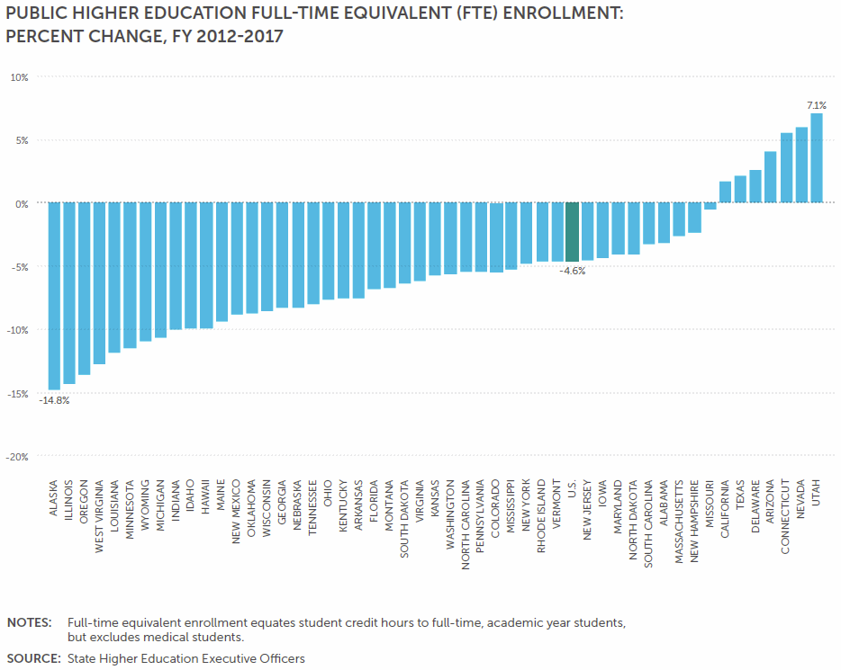

Slide 21
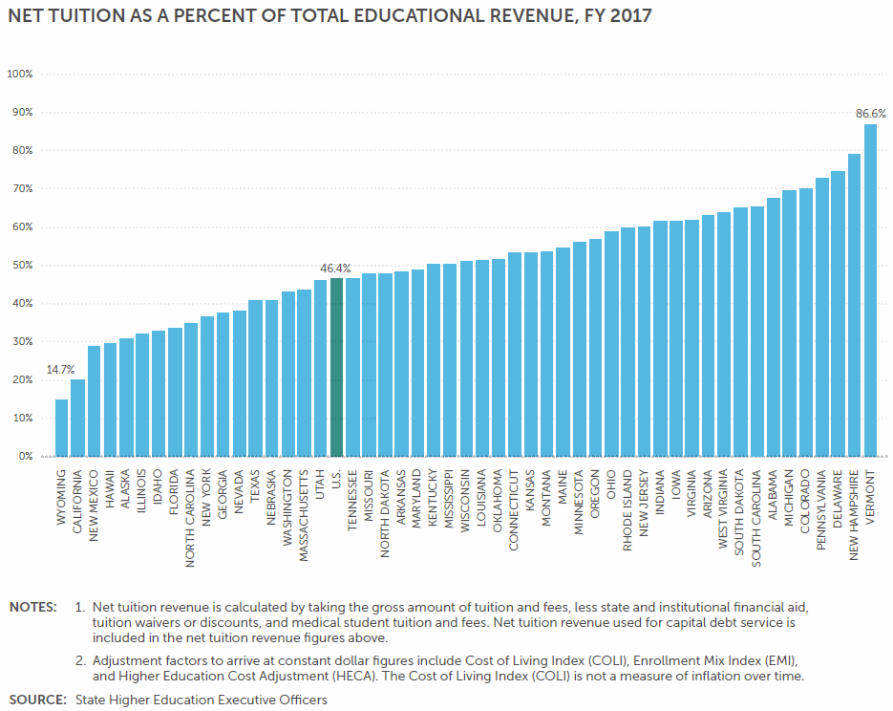
Alabama is 7th in net tuition

Slide 22
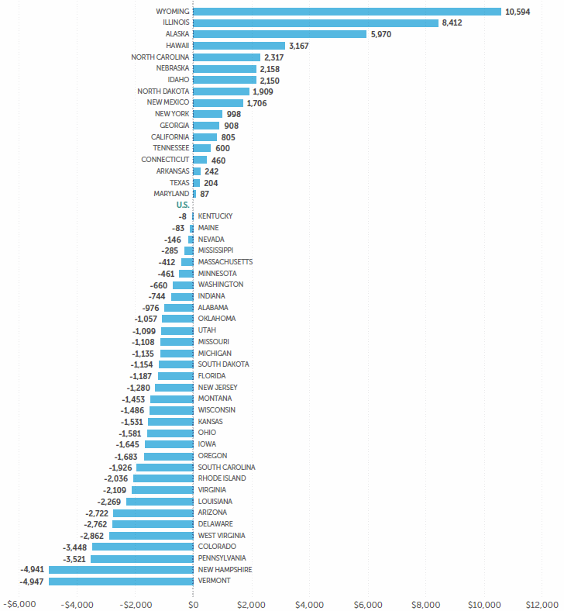
EDUCATIONAL APPROPRIATIONS PER FTE (ADJUSTED):
DIFFERENCE FROM U.S. AVERAGE, FY 2017

Slide 23
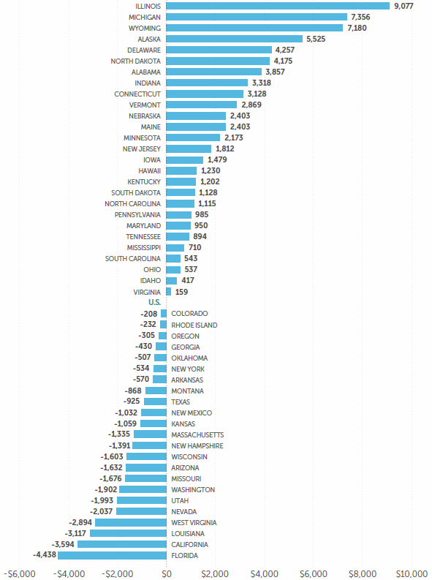
TOTAL EDUCATIONAL REVENUE PER FTE (ADJUSTED):
DIFFERENCE FROM U.S. AVERAGE, FY 2017

Slide 24
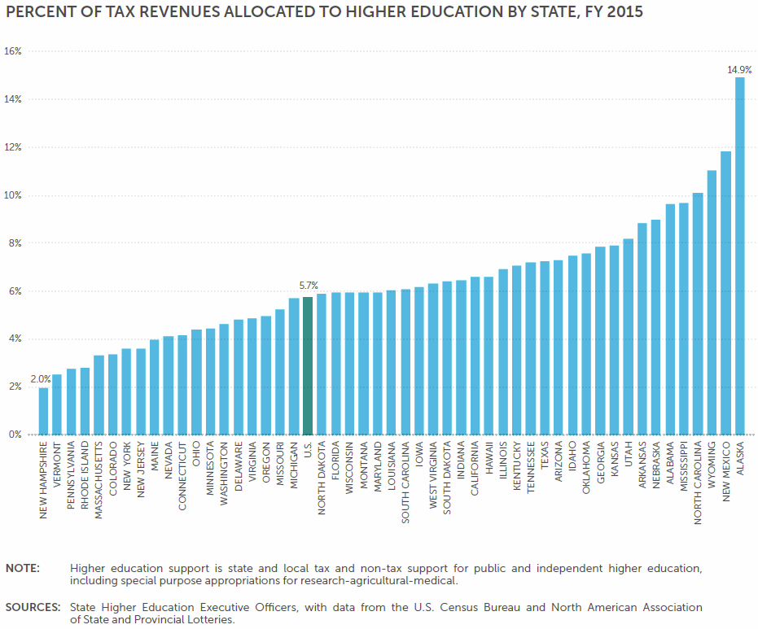

Slide 25
Questions?

Slide 26
VII. Decision ITEMS

Slide 27

Preliminary Approval of Amendments to the Administrative Procedures for Chapter 300-1-1: Organization of the Alabama Commission on Higher Education
Purpose of Action: To eliminate outdated language and to streamline the administrative procedures per Code of Alabama, 1975, Section 41-22-5.2.

Slide 28

Preliminary Approval to Repeal the Administrative Procedures for the State of Alabama Chiropractic Scholarship Program – Chapter 300-4-6
Purpose of Action: This program is no longer operational. It last received a legislative appropriation in FY 2011-12.

Slide 29

Preliminary Approval of Administrative Procedures for the Alabama Math and Science Teacher Education Program – Loan Repayment Program: Chapter 300-4-12
Purpose of Action: The proposed additions to the AMSTEP Administrative Procedures begins the process transitioning the current scholarship program to a loan repayment program. At the end of FY 2018-19, upon approval of the Commission, the scholarship program will no longer be in existence and references to the scholarship program will be deleted from the Administrative Procedures.

Slide 30

Preliminary Approval of Amendments to the Administrative Procedures for Fiscal and Information Systems – Chapter 300-2-3
Purpose of Action: To eliminate outdated language and to streamline the administrative procedures per Code of Alabama, 1975, Section 41-22-5.2.

Slide 31

Preliminary Approval of Amendments to the Administrative Procedures for Chapter 300-2-4: Educational Assistance Programs
Purpose of Action: To eliminate outdated language and to streamline the administrative procedures per Code of Alabama, 1975, Section 41-22-5.2 related to Southern Regional Education Board Programs.

Slide 32
F. Academic programs

Slide 33

ALABAMA COMMUNITY COLLEGE SYSTEM (ACCS)

Slide 34


Lurleen B. Wallace Community College
1. Associate in Applied Science in Physical Therapy Assistant (CIP 51.0806)
According to the program application, Physical Therapy Assistant is a high demand occupation in Alabama, with an annual average salary of over $54,000 a year with 130 average annual openings.
According to the Alabama Department of Labor, job opportunities for physical therapist assistants are expected to grow at a percentage rate of 41 percent from 2014 to 2024.
The American Physical Therapy Association states, “The need for PTAs is expected to increase into the foreseeable future as the U.S. population ages and the demand for physical therapy services grows” (www.apta.org).

Slide 35


Trenholm State Community College
Associate in Applied Science and Certificate in Business Administration (CIP 52.0201)
The proposed Business Administration program will have the following options: Accounting Technology, General Business, Entrepreneurship, Management, and Office Administration Technology.
Projected job openings related to Business Administration indicated 7,800 job openings in TRE’s service area of Montgomery and surrounding counties.
The AAS will require 64 credit hours.

Slide 36














FOUR-YEAR INSTITUTIONS

Slide 37


Auburn University
Alteration of the PhD in Applied Economics (CIP 52.0601)
All changes in award nomenclature at the doctoral level require Commission approval as a substantive change.
An alteration of the program CIP code from 52.0601, Business/Managerial Economics, to 45.0602, Applied Economics. There is no change in the program title.
The change will bring the program CIP code into an alignment that more closely matches the program curriculum and instructional topics and principles within the course of study.
The content and character of the affected program will not be altered. The change is in CIP code only.
AU’s Board of Trustees approved the request at its February 9, 2018 meeting.

Slide 38

Auburn University
Alteration of the PhD in Public Administration and Public Policy (CIP 44.0401)
All changes in award nomenclature at the doctoral level require Commission approval as a substantive change.
Proposed an alteration of the program CIP code from 44.0401, Public Administration, to 45.1099, Political Science and Government. There is no change in the program title.
The proposed change will bring the program CIP code into an alignment that more accurately reflects the breadth of this program of study.
The content and character of the affected program will not be altered. The change is in CIP code only.
AU’s Board of Trustees approved the request at its February 9, 2018 meeting.

Slide 39


Troy University
Bachelor of Science in Health Promotion (CIP 51.0001)
Health promotion occupations teach people about behaviors that promote healthy lifestyles and behaviors. They develop and implement strategies to improve the health of individuals and communities. They work in a variety of settings, including hospitals, nonprofit organizations, government, private business, corporate businesses and gyms.
According to the Bureau of Labor Statistics Occupational Outlook Handbook, 2017 Edition, health promotion providers held about 118,500 jobs in 2016, with 57,570 of those specifically health educators. This was an increase from 99,400 jobs in 2012.

Slide 40

Troy University
2. Bachelor of Arts/Bachelor of Science in Cyber Security (CIP 11.0101)
Projected job openings locally for TROY indicate there will be more than 800 Cyber Security positions open in the next five years.
According to TROY’s program proposal, Cyber Security occupations are on the rise. The US Bureau of Labor Statistics projects cyber security jobs to increase to 18 percent through 2024, which is more than twice the average for all occupations.

Slide 41


University of Alabama
Master of Fine Arts in Dance (CIP 50.0301)
The Masters of Fine Arts (M.F.A) degree in Dance will be the first in Alabama and will develop students' creative, performance, and scholarly work and prepare them for multiple professional destinations as dance artists, administrators, scholars, and teachers.
The graduate program will increase the overall level of technique, choreography and production elements of public performances.
The proposal projected that $162,000 in new funds will be required to support the program. A total of $576,480 will be available through internal reallocations and tuition.

Slide 42

University of Alabama
Master of Science in Human Development and Family Studies (CIP 19.0701)
The proposed program will prepare students for advanced employment as supervisors and/or leaders in a variety of occupations serving children, adults, and families and/or to pursue doctoral study.
Campus faculty have been providing the coursework, and the supervision for the culminating experience for students enrolled in this area of study for more than 20 years.
Three concentrations will be offered to accommodate a wide range of candidate interests: Parent and Family Life Education; Marriage and Family Therapy; and Child Life.
No new funds are estimated to be required to support the proposed program. A total of $1,516,925 will be available through tuition.

Slide 43

University of Alabama
Alteration of the PhD in Educational Administration (CIP 13.0401)
All changes in award nomenclature at the doctoral level require Commission approval as a substantive change.
UA has proposed an alteration of the program title from Educational Administration to Educational Leadership. There is no change in the CIP code.
Brings the program name into alignment by more accurately reflecting the diverse educational needs of administrators in Alabama’s schools today.
The new title represents the broader principles and techniques needed in a variety of educational institutions in the State’s K-12 schools.

Slide 44


University of Alabama /University of Alabama in Huntsville
4. Joint Doctor of Philosophy in Nursing Science (CIP 51.3808)
The primary purpose of the joint program is to: 1) prepare scholars who will advancing science through interprofessional research initiatives and, 2) improve the health of rural and medically underserved populations.
Students will be dually enrolled in the joint program between UA and UAH, where faculty and resources will be shared to deliver a high quality research-based program.
23 percent of the 125 Nursing Ph.D. programs in the U.S. provide online programs. Therefore, this program will meet the preferences and needs of the target population.
The program will be offered online except for annual 5 day on-site summer intensives.
$431,772 in new funds will be required to support the proposed program. A total of $802,608 will be available through tuition, internal reallocations, and extramural sources.

Slide 45


University of Alabama at Birmingham
Master of Science in Engineering Management (CIP 14.9999)
This program is a joint degree between the School of Engineering and the Collat School of Business (CSOB). This partnership is the only joint program serving the need of engineering talent in Alabama — and one of the few joint programs in the nation.
The MSEM will further develop the technical, managerial, and professional capabilities of engineering graduates, preparing them for earlier entry into positions of leadership within a wide variety of industries and organizational types.
50 percent of the total program's courses offered will be provided by distance education.
The CSOB is accredited by the Association to Advance Collegiate Schools of Business (AACSB), and UAB plans to seek AACSB accreditation for this program.
$0 in estimated new funds will be required to support the proposed program. A projected total of $1,665,070 will be available from tuition.

Slide 46

University of Alabama at Birmingham/University of Alabama
Alteration of the Joint EdD in Educational Administration at UA and UAB (CIP 13.0401)
All changes in award nomenclature at the doctoral level require Commission approval as a substantive change.
There is no change in the CIP code and no change in the joint nature of the program.
The joint program is designed for school administrators and teachers who hold Educational Specialist (EdS) and Class AA certification in an instructional, instructional leadership, or instructional support area and who seek to enhance their leadership skill sets.
The proposed change will bring the program name into alignment by more accurately reflecting the diverse educational needs of administrators in Alabama’s schools today.
The content and character of the affected program will not be altered. The change is in title only.

Slide 47


University of North Alabama
Master of Accountancy in Accountancy (CIP 52.0301)
The Master of Accountancy is a program for individuals who wish to have a more thorough knowledge of accounting theory and practice as compared with individuals pursuing an MBA.
These students will be better positioned for work in accountancy, and they will be better equipped to complete certification exams, such as the Certified Public Accountant, Certified Management Accountant, Certified Internal Auditor, and Certified Fraud Examiner.
100% of courses will be offered via traditional face-to-face instruction, and each of those classes is also offered in a distance-learning format.
UNA has a successful MBA with a concentration in accounting taught by highly qualified faculty who are committed to the success of a new accountancy program. The new program will complement the existing MBA with a concentration in accounting.
$50,000 will be required for the program in the first five years, and $1,455,620 will be available over the same period through internal reallocations and tuition.

Slide 48




University of South Alabama
Master of Science in Physical Therapy (CIP 51.2308)
The proposed program is an International Linkage Program between the University of South Alabama and a select group of universities in China. The program will create global linkages, and provide powerful learning experiences through an exchange of students and faculty.
Although the program will be designed to meet the needs of Chinese clinicians, it is anticipated that students from other countries with Master’s-level entry into the rehabilitation sciences may also be interested in the program.
This program will collaborate with Chinese universities for funding programs. Financial Resources, as outlined in the proposal, over its first five years the program have the potential to generate over $850,000 of revenue in excess of the costs of delivery.

Slide 49
University of South Alabama
Master of Science in Physical Therapy (CIP 51.2308)
A significant portion of this revenue will be allocated to support the student, technology, and equipment needs of the Doctor of Physical Therapy program.
No clinical education assignments are made as part of this program and these will be no interference with or impact upon the availability or number of clinical sites to the Doctor of Physical Therapy program or any other clinical training program.
Notification to the Commission on Accreditation in Physical Therapy Education (CAPTE) -CAPTE was informed on May 3, 2018 of USA’s intent to offer this program. Dr. Sandra Wise, Executive Director of CAPTE, responded affirmatively to offering the program

Slide 50


University of West Alabama
Bachelor of Arts in Music (50.0901)
Many schools in UWA’s service area must utilize music teachers without proper certification due to a lack of local music graduates and a limited number of properly trained private teachers.
Churches in UWA’s service area have difficulty locating trained directors, pianists, and other musicians to play at worship services.

Slide 51
G. REQUEST TO AMEND
POST-IMPLEMENTATION CONDITIONS

Slide 52

Troy University
Request to Amend Post-Implementation Conditions: Bachelor of Fine Arts
in Dance (CIP 50.0301)
The request is that an additional two-year review period (2017-18 and 2018-2019) for the program be granted.
In this additional review period, the program will meet a post-implementation condition of 9 annual graduates, revised from the original condition of 8 graduates.
Troy states that there are currently 63 dance majors at the University. This includes a new, first-year (2017-18) dance major class of 19.
Further, Troy has hired two new Dance faculty members (fall 2017).
Troy has also refined the BFA Dance major degree map (2016) to include a progressive order of courses, major requirements, and electives.
The program has also revised course descriptions and listings in its academic catalog.

Slide 53
H. INFORMATION ITEMS

Slide 54
H. INFORMATION ITEMS
University of North Alabama, Implementation of a Dual Degree Program: MBA
in Business Administration and MS in Family Studies
University of South Alabama, Addition of Class B Certification in Health (6-12) and
Physical Education (P-12) (CIP 13.1314)
University of Alabama at Birmingham, Addition of EdS Certification in Teaching
English to Speakers of Other Languages (CIP 13.1401)

Slide 55
H. INFORMATION ITEMS Cont’d
University of Alabama, Implementation of a Dual Degree Program:
Master of Business Administration and Master of Science in Aerospace Engineering and Mechanics
5. Implementation of Approved Programs
6. Summary of Post Implementation Reports
7. Implementation of New Short Certificate Programs (Less than 30 Semester Hours)

Slide 56
H. INFORMATION ITEMS Cont’d
8. Changes to the Academic Program Inventory
9. Implementation of Non-Degree Programs at Senior Institutions
Change in the Name and Establishment of Centers and Departments
11. Extensions/Alterations to Existing Programs of Instruction

Slide 57
VIII. adjournment
The next meeting will be held on September 14, 2018

