Slide 1

Alabama Commission on Higher Education
Commission Meeting
September 14, 2018

Slide 2

CALL TO ORDER and PLEDGE OF ALLEGIANCE

Slide 3

II. ROLL CALL and
QUORUM DETERMINATION

Slide 4

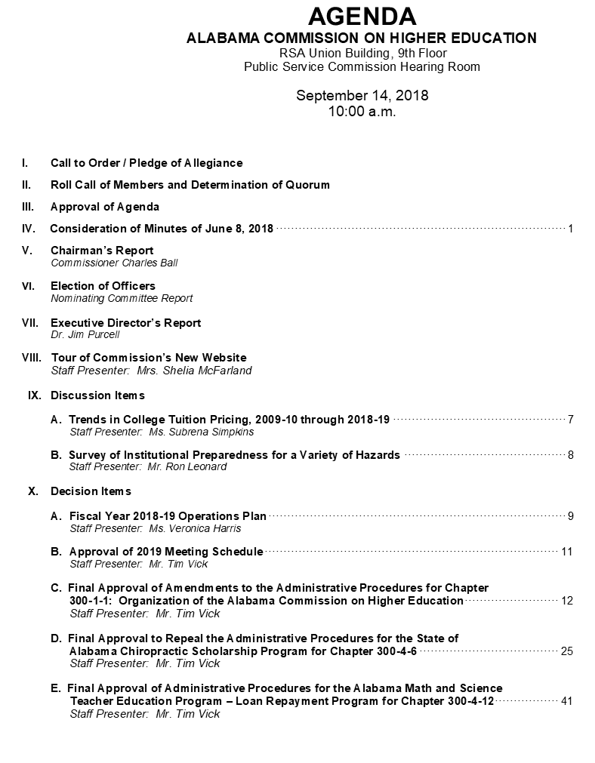
III. APPROVAL OF AGENDA

Slide 5

IV. APPROVAL OF MINUTES
June 8, 2018

Slide 6

V. CHAIRMAN’S
Report

Slide 7
VI. ELECTION OF OFFICERS

Slide 8

VII. EXECUTIVE DIRECTOR’S
Report

Slide 9

Quick Overview:
Alabama Grade-Level Reading Campaign
FAFSA Completion Project Update
Summer Melt Proposal w/ American Institute for Research
Open Education Resource
Tour of ACHE.edu Website
Education Commission of the States - Zeke Perez and Lauren Sisneros
  Financial Aid
  Longitudinal database

Slide 10



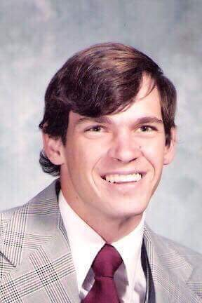
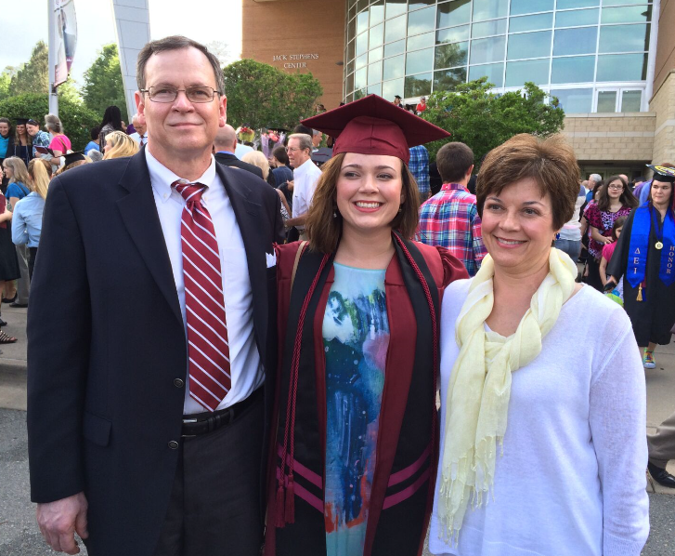
Longitudinal Data System
Living the Dream
AL GI Bill
Practical Fashion Sense
Good Listener
2nd Generation

Slide 11
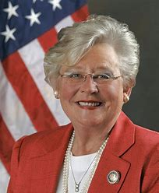
Alabama Grade-Level Reading Campaign
Gov Ivey: "In order to produce a workforce that's capable of attracting new businesses and filling the kind of jobs that we need, we must simply improve the quality of our state's education system," …
“we've got to start today training the workforce of tomorrow.“
The new campaign will focus on school readiness, reducing chronic absenteeism for students and teachers, narrowing the scope of the Alabama Reading Initiative to kindergarten through 3rd grade, and preventing summer learning loss, also called "summer slide.“
more than 17 percent of students were chronically absent during the 2016-2017 school year.
“Today we have only 35 percent of our 3rd graders that are proficient in reading at grade level."

Slide 12
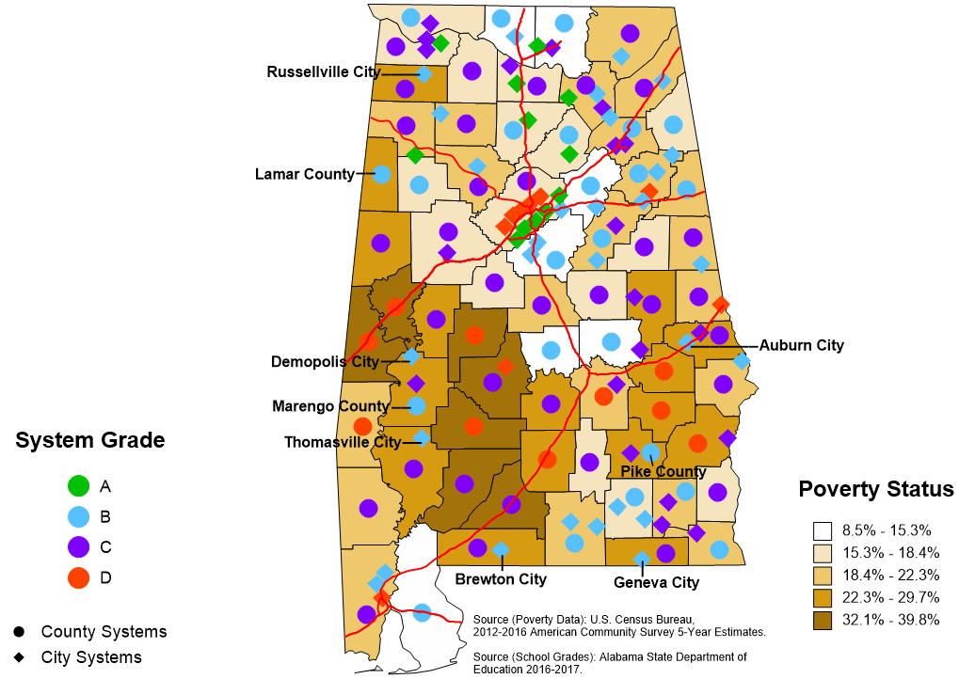
2016-2017 School District Grades Indicated on Alabama Poverty Map
Only “city’ districts made A’s
No “D” districts above this line
No “A” districts below this line
137 Systems
12 A’s
52 B’s
54 C’s
19 D’s
Counties are the dots and the city schools are the diamonds

Slide 13
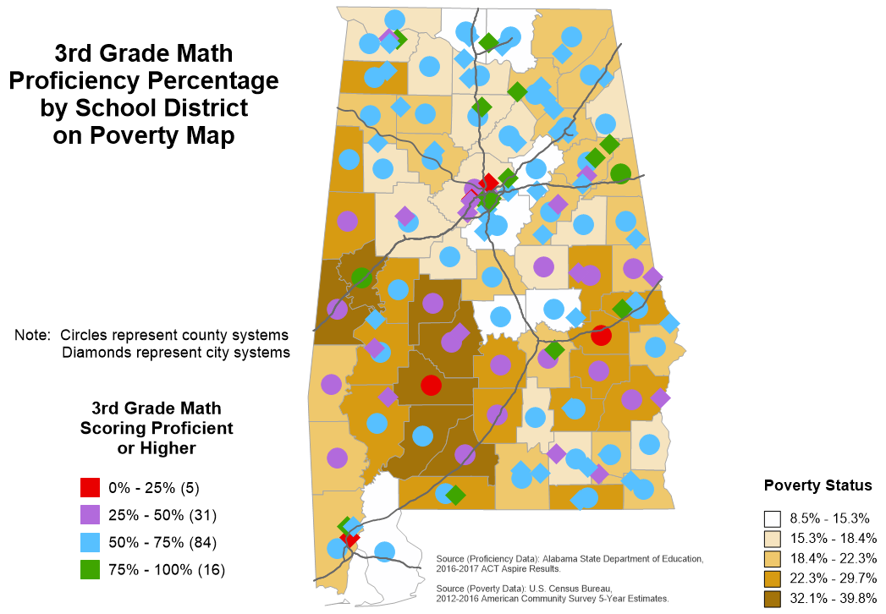
Lake Wobegon: “all the kids above average”

Slide 14
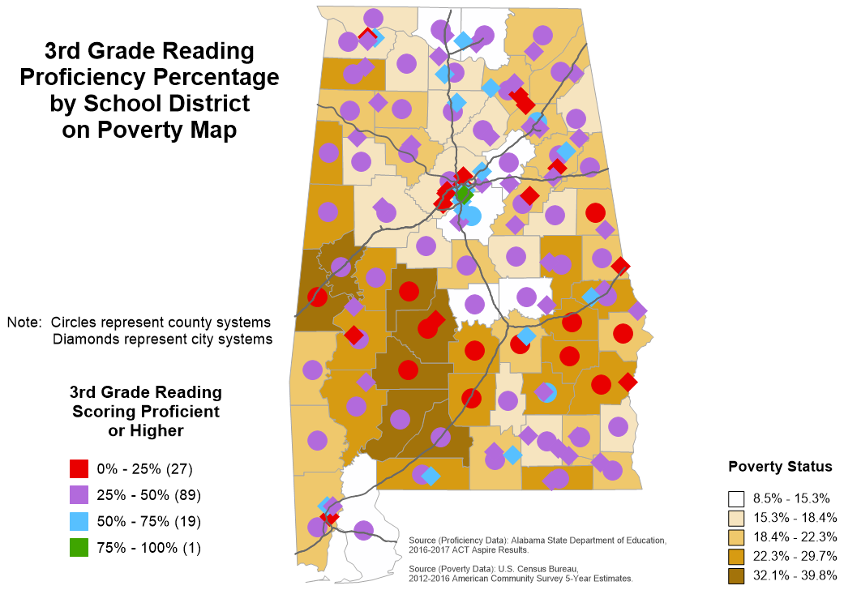
No Lake Wobegon for Reading

Slide 15
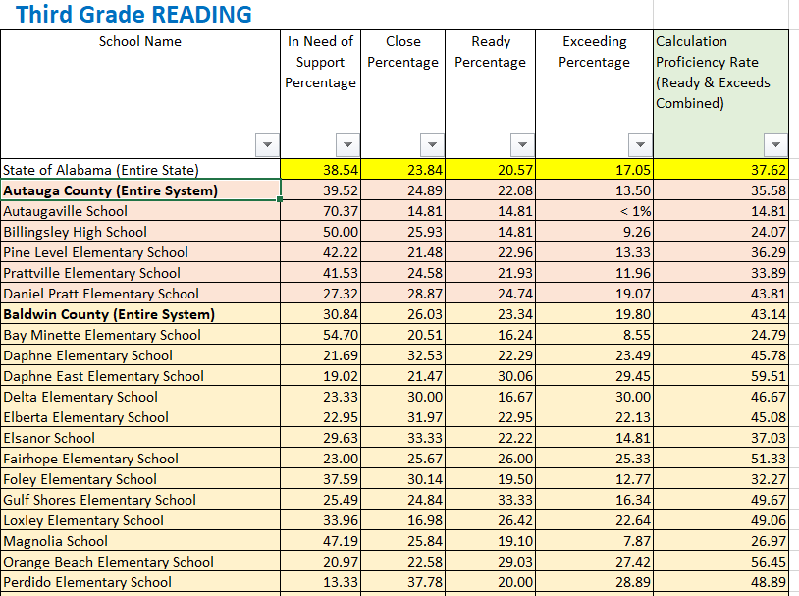

Slide 16



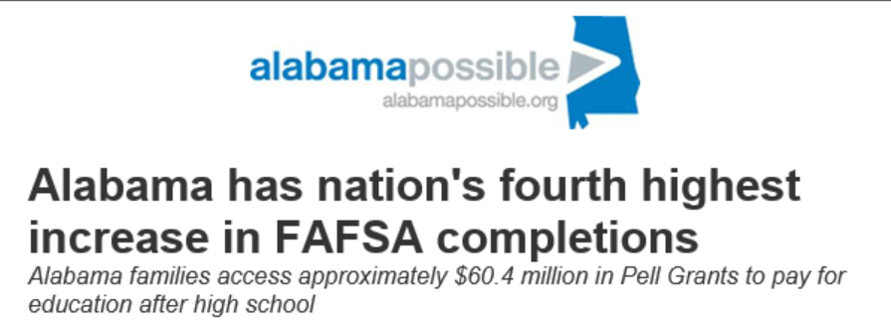
FAFSA Completion Process
Alabama FAFSA completions increased 4.8 percent over last year, while the national average was just 1.9 percent.
As a result, Alabama’s 2018 high school graduates unlocked access to approximately $60.4 million in Pell Grants. Students can use Pell Grants to pay for a broad range of technical and academic programs after high school. The maximum Pell Grant is $6,095/year, and they do not have to be repaid.

Slide 17
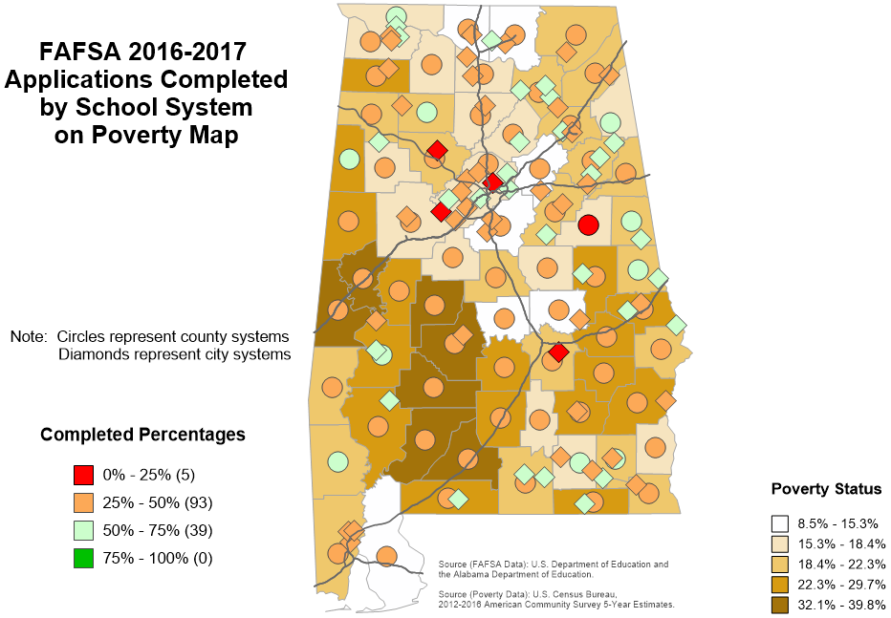

Slide 18
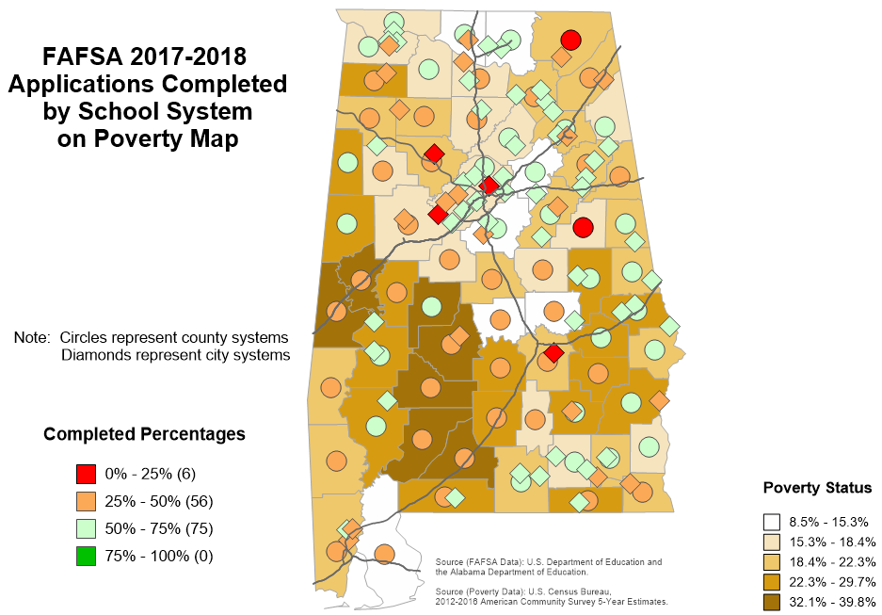

Slide 19
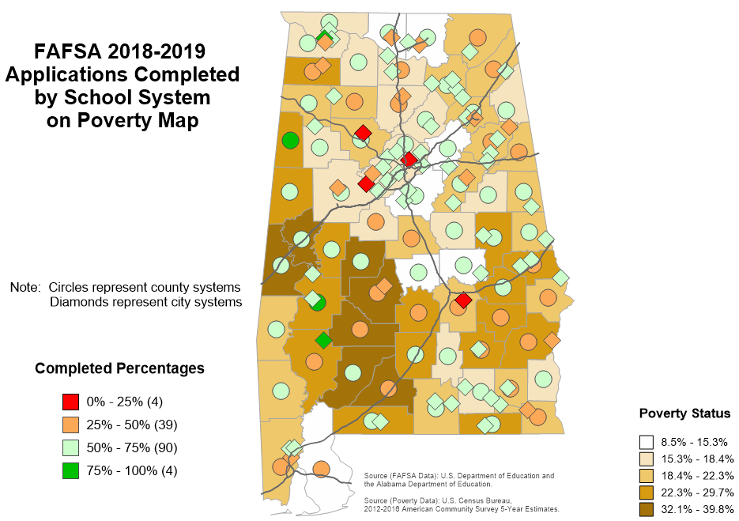

Slide 20
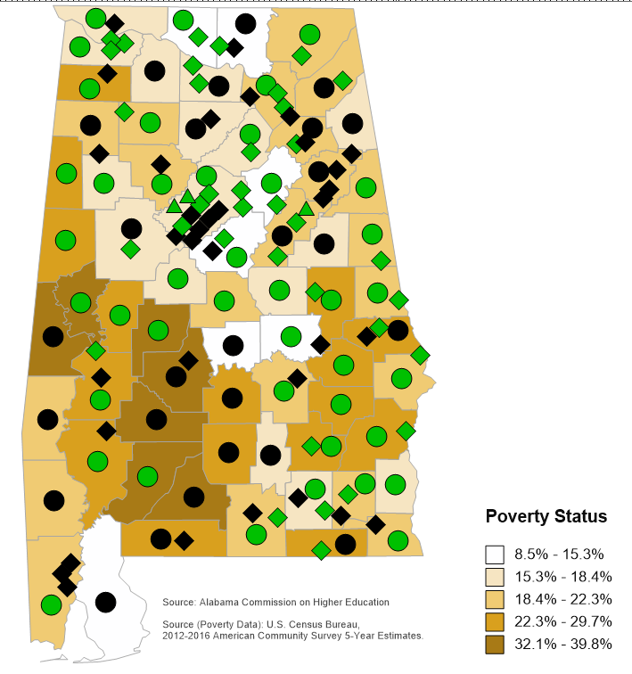
FAFSA Use Agreement
Between ACHE and School Districts
Participants
as of September 7, 2018

Slide 21
Next Steps by ACHE
  Continued promotion of the web application and services.
  More regional demonstrations in collaboration with the Alabama Community College System and Alabama Possible.
  Local training with secondary school systems as requested.
  Refinement of processes and procedures.

Slide 22
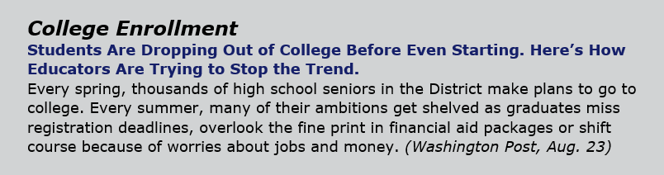
Summer Melt Proposal w/
American Institute for Research
Text messages to prospective students during late Spring and Summer informing them of opportunities to engage with the campus and important deadlines.

Slide 23


2018-2019 ACHE/ACCS OER Grant Program
  Target: high-enrollment general education courses for transfer between institutions
  Priorities:
    Greatest cost savings for students (high ROI)
    Collaboration between 2- and 4-year institutions
  $60,000 in funds for adoption, adaption, and creation of Resources
  Over 30 proposals funded
    Impacting 18,027 students
    Annual projected student savings: $2,059,507

Slide 24
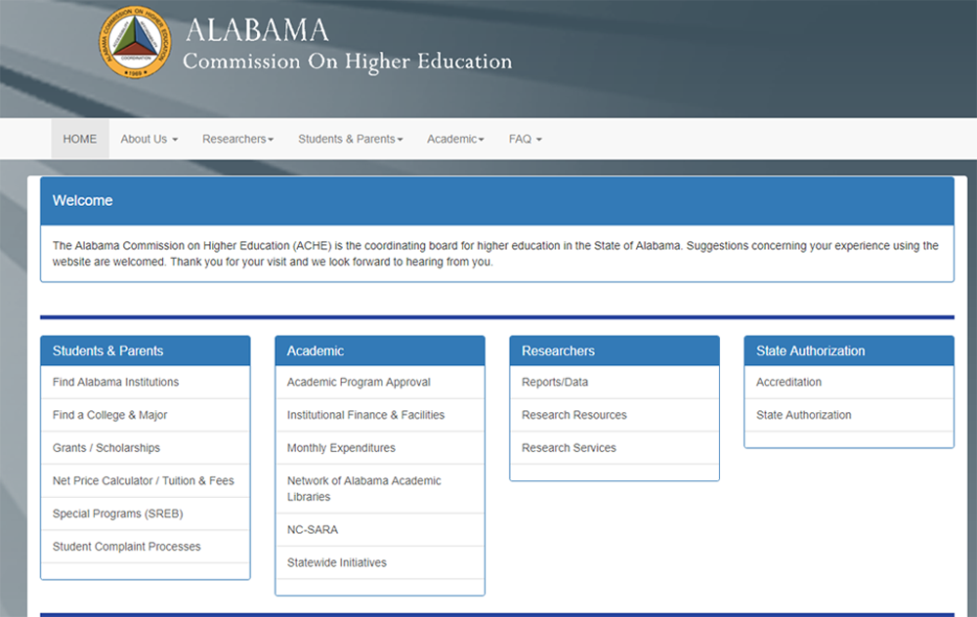
TOUR OF COMMISSION’S
NEW WEBSITE

Slide 25
IX. DISCUSSION ITEMS

Slide 26

Alabama Public Colleges and Universities

Slide 27


Trends in College Pricing
Tuition and Required Fees
Alabama Public Colleges and Universities
2009-10 thru 2018-19
September 14, 2018

Slide 28

RESIDENT TUITION PRICING:
Boards of Trustees of individual institutions are solely empowered to establish tuition and fees.
The undergraduate tuition amounts are based on an annual 30 credit hour load or a flat-rate, and
The graduate tuition amounts are based on an annual 24 credit hour load or a flat-rate.
  The required fees are charges each student is required to pay and does not include course related fees.

Slide 29
NON-RESIDENT TUITION PRICING:
  Legislation provides guidelines for common student classifications and requirements for non-resident tuition rates.
Alabama Statutes, Section 16-64-4(a):
“Each Alabama public institution of higher education shall charge each undergraduate student who is registered as a nonresident a minimum tuition of two times the resident tuition rate charged by that institution. This rate shall be effective for students who register at an institution beginning August 1, 1997. A nonresident graduate student at an institution shall be charged a rate of tuition that is at least at the level of tuition charged to a nonresident undergraduate.”

Slide 30

Alabama Public Colleges and Universities
Banded Tuition:
Undergraduate:
Alabama State University (12 to 18 hours)
Undergraduate and Graduate:
University of Alabama (12 to 16 hours)
University of West Alabama (13 to 17 hours)
No Separate Required Fees Reported: (Fees included in tuition cost)
University of Alabama
University of Alabama at Birmingham

Slide 31
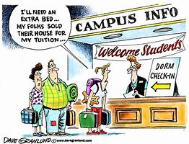

UNDERGRADUATE
RESIDENT AND NON-RESIDENT
BY INSTITUTION

Slide 33
Where Undergraduate Resident Tuition Has Risen Most Sharply at Alabama Public 4-Year Institutions
$5,750 increase
Percent change in annual tuition and required fees over the last decade,
2009-10 to 2018-19
$3,780
increase

Slide 35
One–year percent change at Alabama’s Community Colleges for undergraduate resident tuition has been fairly consistent at 6.8%

Slide 36

Increase of $2,250
Where Undergraduate Resident Tuition Has Risen Most Sharply at Alabama Public
2-Year Institutions
Percent change in annual tuition and required fees over the last decade,
2009-10 to 2018-19
Increase of $1,980
NOTE: Not all 2-year institutions are reflected in the chart, only those
with an increase in tuition of 70% or more.

Slide 37
One–year percent change at Alabama’s Community Colleges for Non-Resident Tuition has remained at a steady increase of 7.5%.

Slide 38


MEDIAN ANNUAL
RESIDENT AND NON-RESIDENT
BY SECTOR

Slide 39
Alabama Commission on Higher Education
Median Annual Resident Tuition & Required Fees
Alabama Public Institutions
$462
$966
$360

Slide 40
Alabama Commission on Higher Education
Median Annual Non-Resident Tuition & Required Fees
Alabama Public Institutions
$948
$1,827
$720

Slide 41
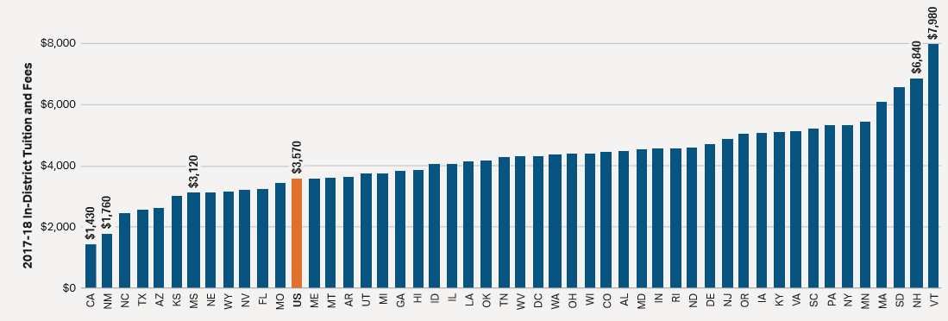
Tuition and Fees by State: Public Two-Year
In 2017-18, average published tuition and fee prices for in-state students at public two-year institutions range from $1,430 in California to $7,980 in Vermont.
ALABAMA in-state tuition and fees $4,490
SOURCE: The College Board

Slide 42
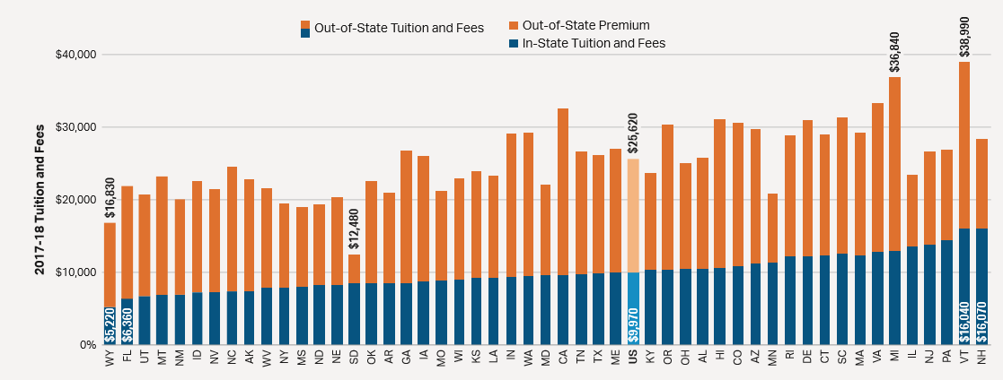
Tuition and Fees by State: Public Four-Year
In 2017-18, average published tuition and fee prices for in-state students at public four-year institutions range from $5,220 in Wyoming to $16,070 in New Hampshire.
ALABAMA
(in-state) $10,530
(out-of-state) $25,760
SOURCE: The College Board

Slide 43


Slide 44

QUESTIONS/COMMENTS
Mrs. Subrena Simpkins
Director of Research Services
(334) 242-2753
subrena.simpkins@ache.edu

Slide 45
B. SURVEY OF INSTITUTIONAL PREPAREDNESS FOR A VARIETY OF HAZARDS

Slide 46
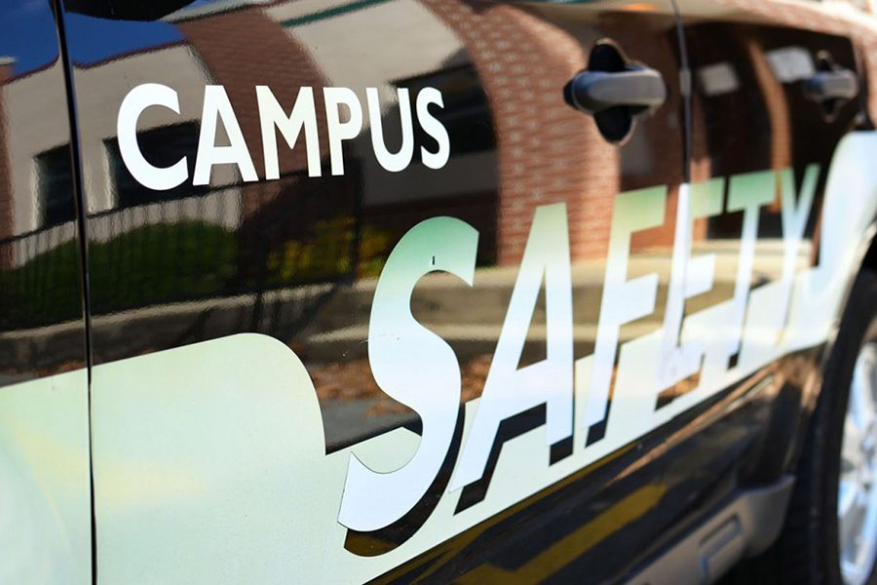
Campus Security Survey
Developed in cooperation with the Alabama Emergency Management Agency
Assess campus preparedness for emergencies
All two-year and four-year institutions responded (39)
Slight variability of responses by institution type

Slide 47
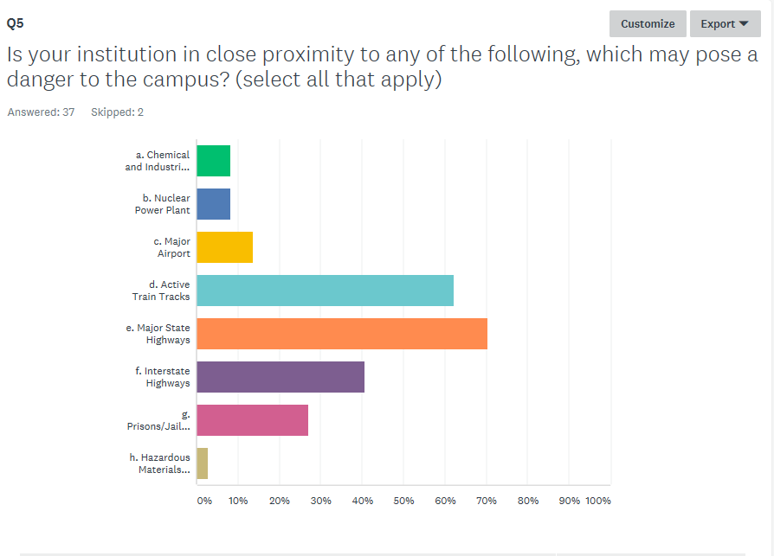
a. Chemical and Industrial Plants
b. Nuclear Power Plant
c. Major Airport
d. Active Train Tracks
e. Major State Highways
f. Interstate Highways
g. Prisons
h. Hazardous Materials Disposal
Sites

Slide 48
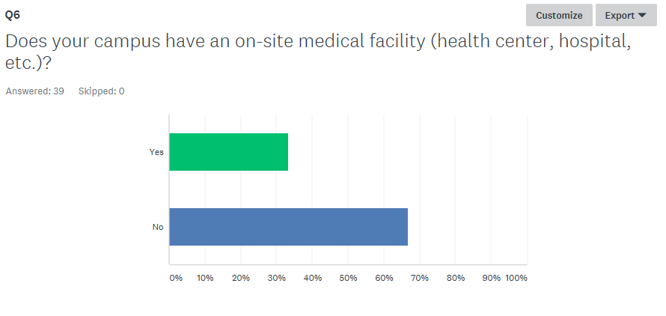

Slide 49
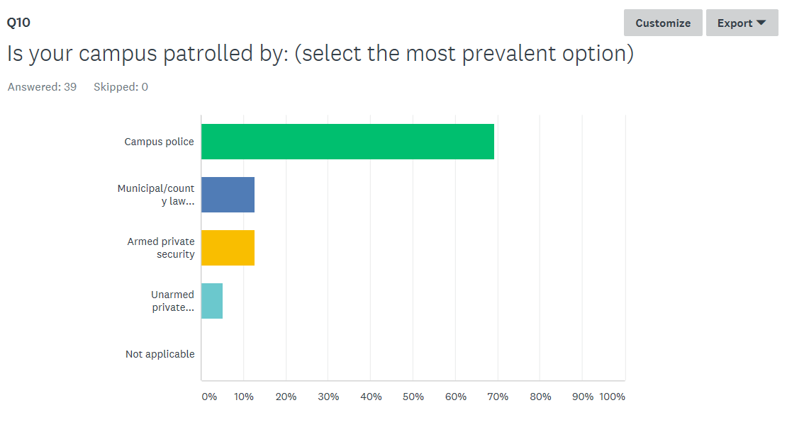

Slide 50
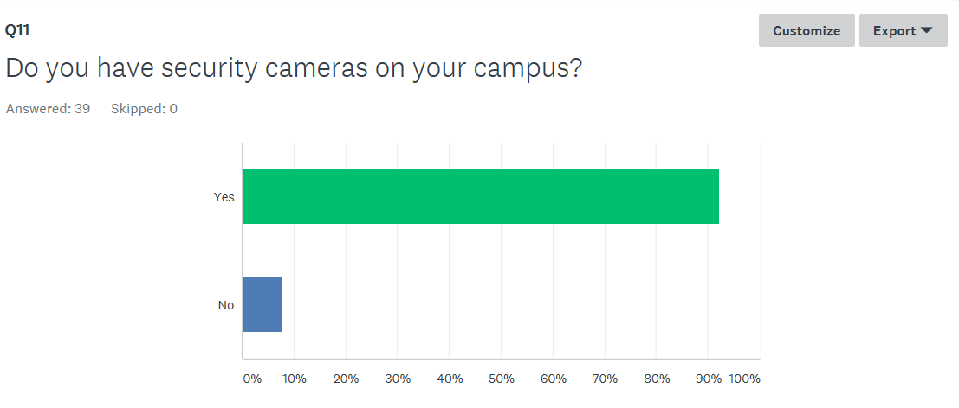

Slide 51
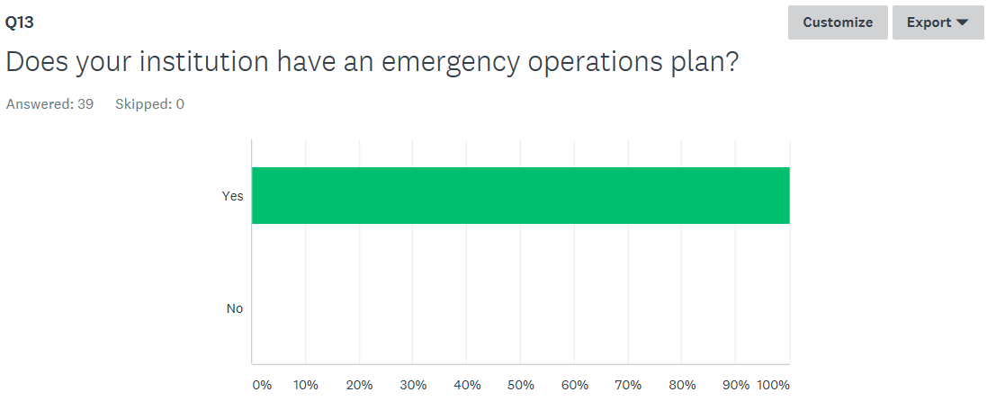

Slide 52
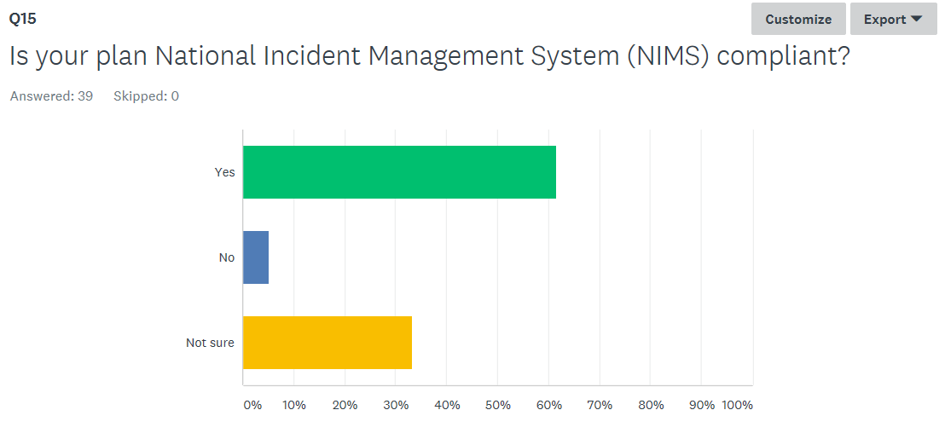
The National Incident Management System (NIMS) is a standardized approach to incident management developed by the Department of Homeland Security.

Slide 53
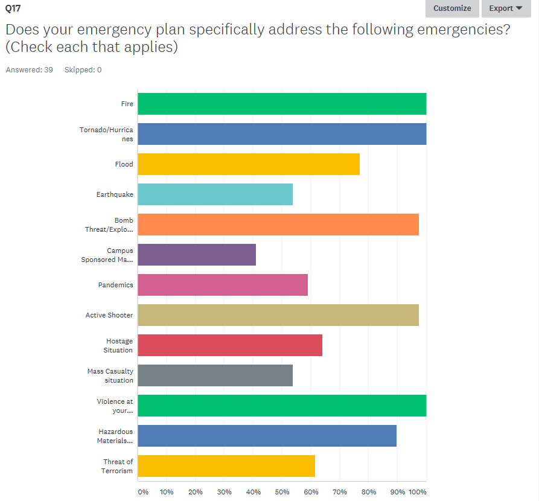
Fire
Tornado/Hurricanes
Flood
Earthquake
Bomb Threat/Explosion
Transport./Accident
Pandemics
Active Shooter
Hostage Situation
Mass Casual. Situation
Violence on Campus
Hazard. Mats. Release
Threat of Terrorism
Notes:
Transport./Accident = Campus Sponsored Mass Transportation/Accident
Mass Casual. Situation = Mass Casualty Situation
Violence on Campus = Violence at your institution (i.e., workplace violence, domestic violence, disruptive individuals)?
Hazard. Mats. Release = Hazardous Materials Release

Slide 54
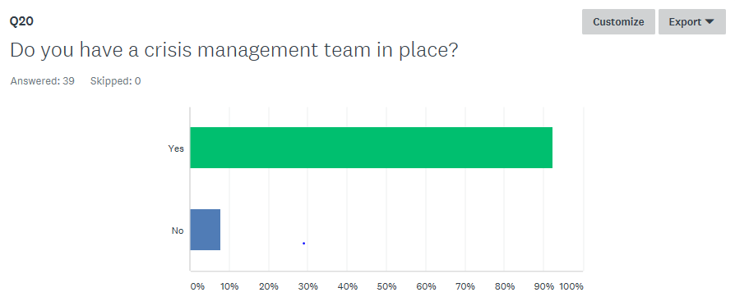

Slide 55
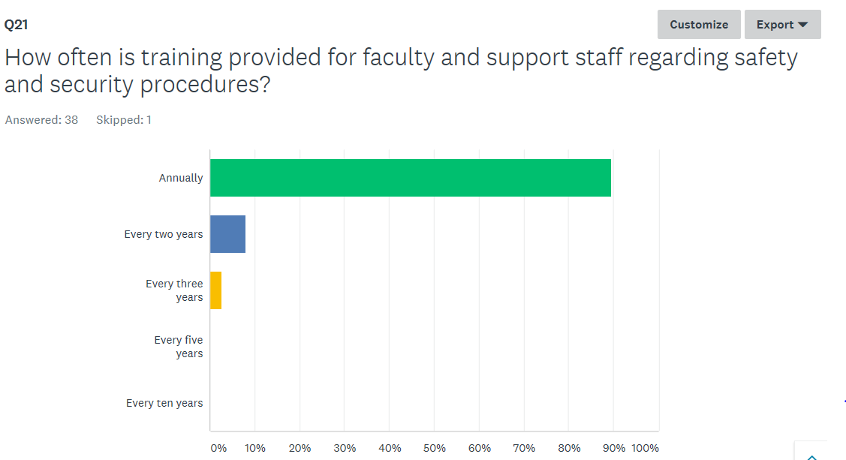

Slide 56
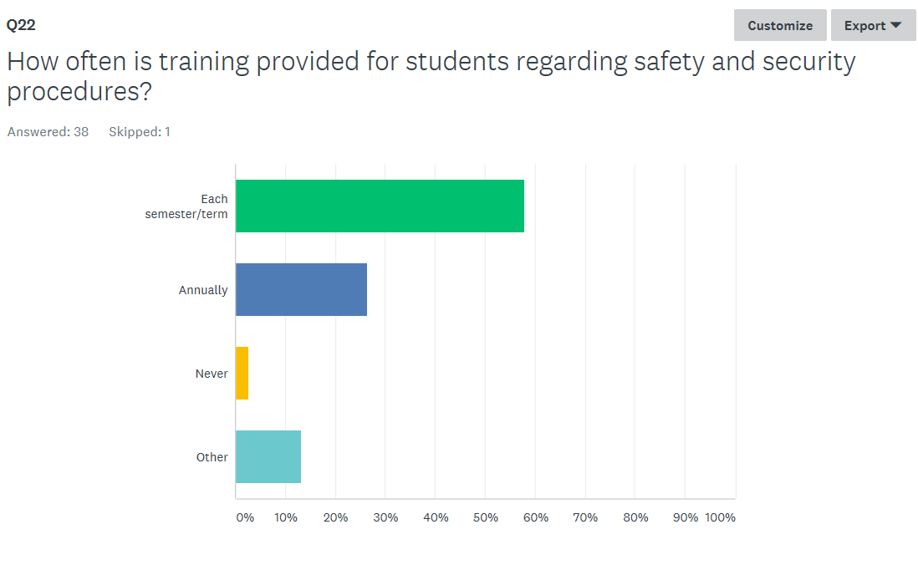

Slide 57
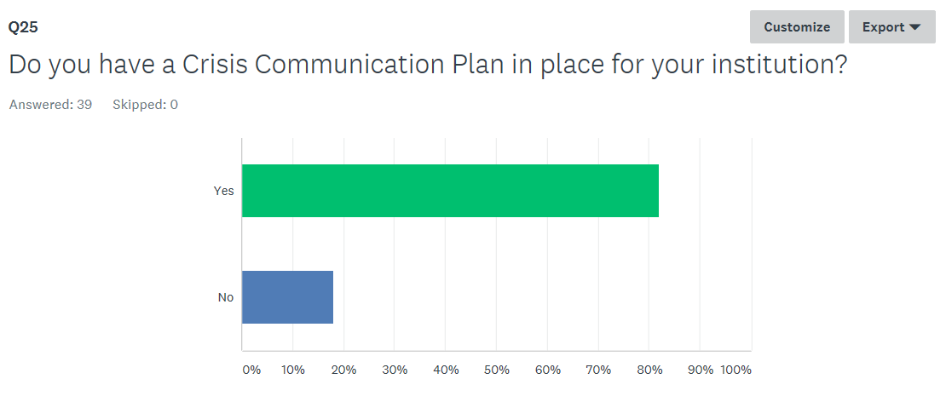

Slide 58
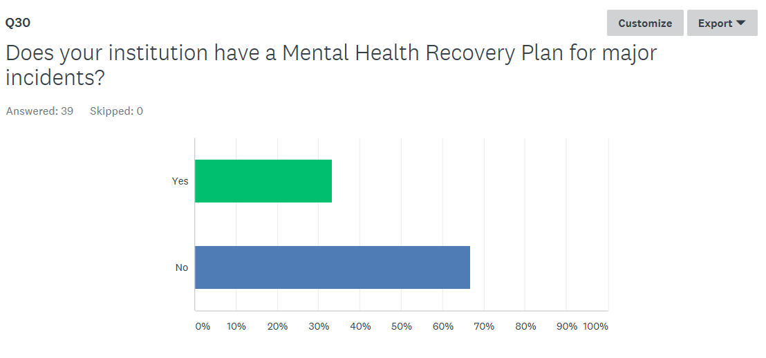

Slide 59
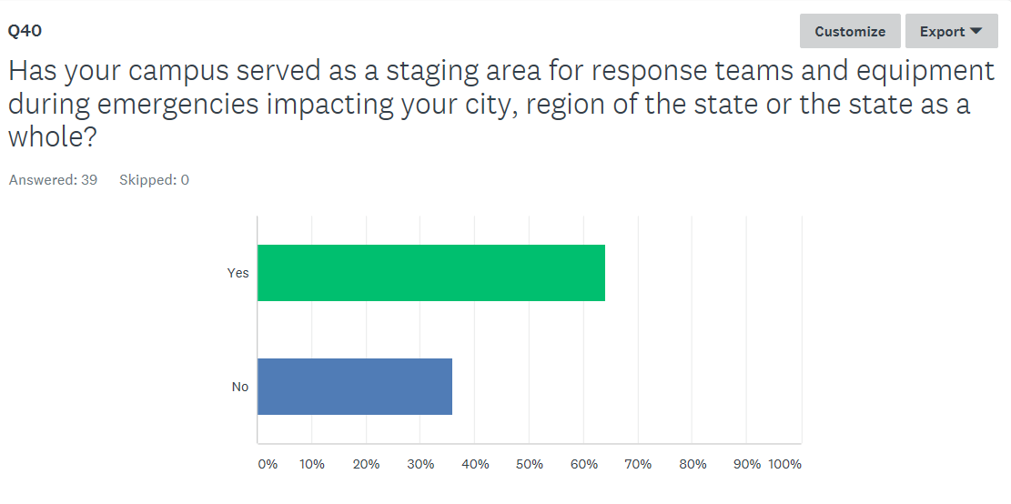

Slide 60
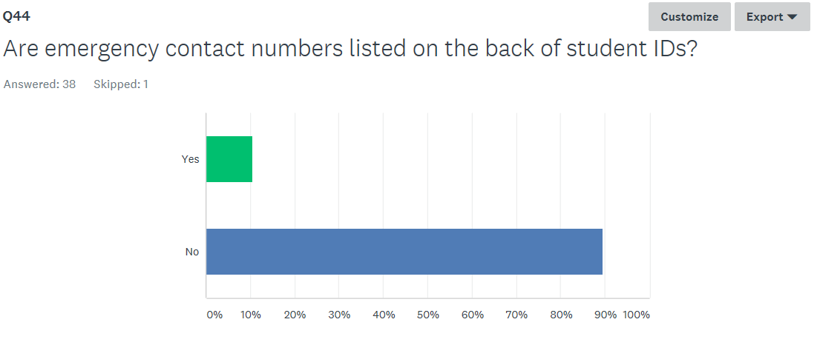

Slide 61
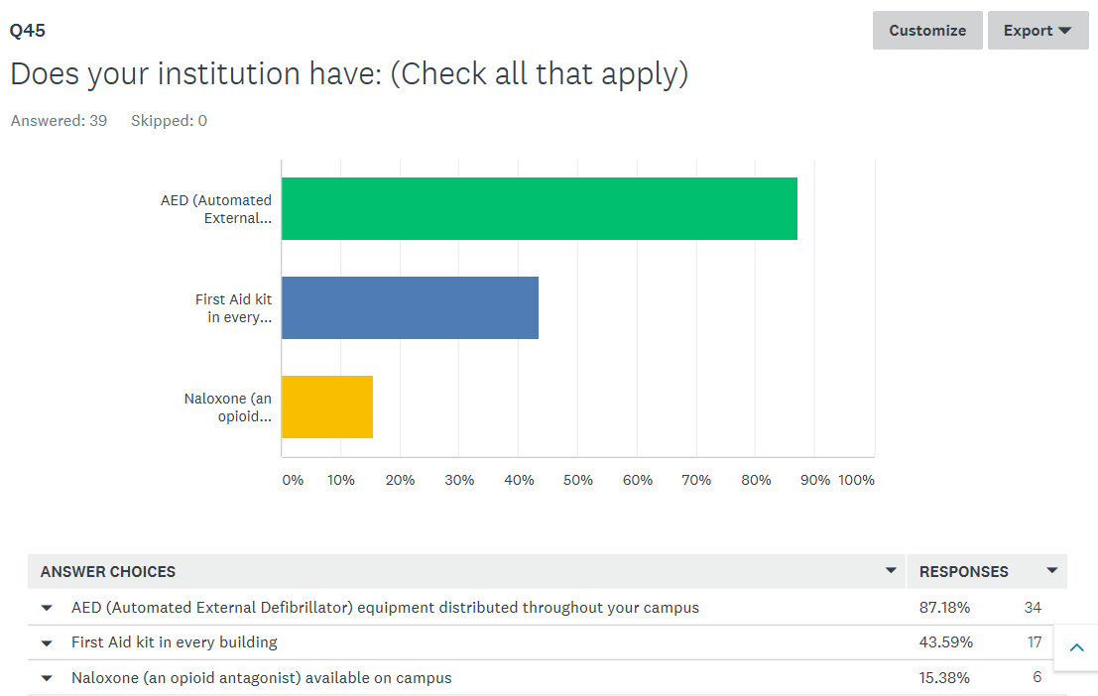

Slide 62
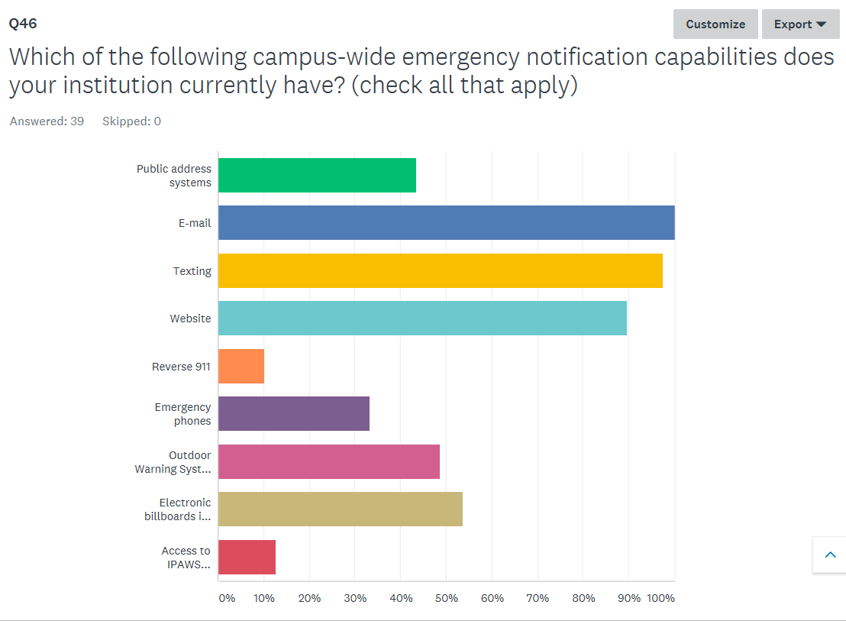

Slide 63
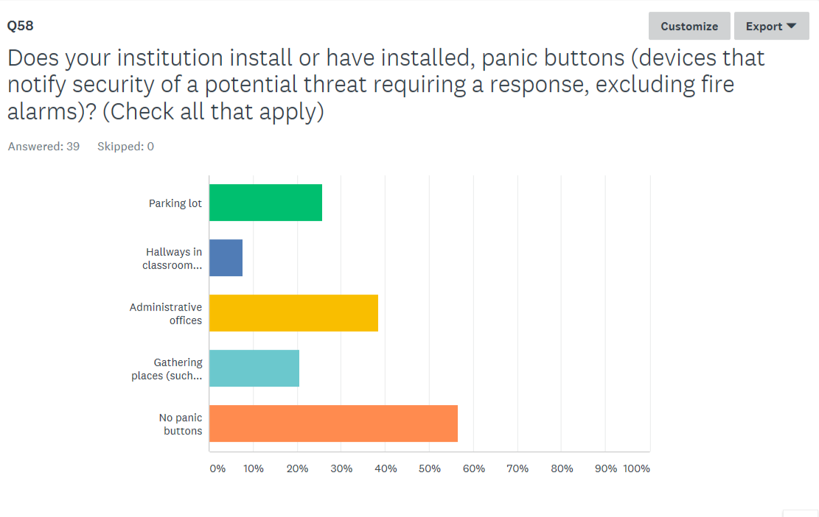

Slide 65
Strengths:
Universities rely almost solely on campus police; but two-year colleges also use mostly campus police, but also rely on private security companies.
Nearly all universities and colleges use security cameras on their campuses.
All campuses surveyed have an emergency operations plan in place.
All but one campus are prepared for a bomb threat/explosion and an active shooter.
All universities and most colleges have a crisis management team in place.
60% of our campuses have served as a staging area for response teams and equipment during emergencies.
The majority of campuses have campus-wide emergency notification capabilities through e-mail, texting and website.

Slide 66
Challenges/Opportunities:
More campuses should seek to be National Incident Management System (NIMS) compliant.
Over 40% of campuses are not prepared for pandemics, hostage and mass casualty situations and the threat of terrorism.
Although the majority of campuses offer annual safety and security training for staff, a handful only conduct training every 2-3 years.
Only 30% of campuses have a mental health recovery plan in place for major incidents.
Less than half of campuses have first aid kits in every building and only 15% are prepared with Naloxone.
The prevalence of panic buttons on campuses is very low. For example, only one-fourth of campuses have panic buttons in parking lots.

Slide 67
For More Information
Campus Security Best Practices:
Alabama Emergency Management Agency (AEMA)
Brian Hastings, Director
    1-205-280-2312
    Info@ema.alabama.gov
    https://ema.alabama.gov/
ACHE Survey of Campus Security:
Ron Leonard, Director of Special Initiatives
    ron.leonard@ache.edu
    334.242.2211

Slide 68
X. Decision ITEMS

Slide 69
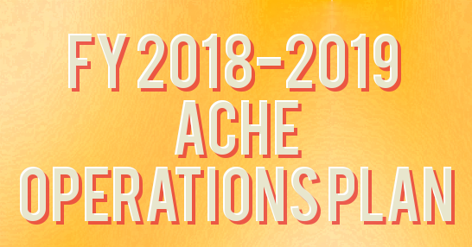

B.

Slide 71
Alabama Commission on Higher Education
Budgetary Facts
The Commission has 25 programs under 5 appropriation units.
This represents nearly a 3.98% increase over the previous year.
For FY 2018-2019 any funds left over from the State Appropriation for the AMSTEP program are non-reverting.
The FY 2018-19 Operations Plan, showing expenditures for each of the fiscal year’s quarters, was submitted to Executive Budget Office (EBO) on July 31, 2018. Any changes made by the Commission can be made through a Operations Plan revision after October 1, 2018.

Slide 72
43%+
12%+
123%+
100%-

Slide 78

B. Approval of 2019 Meeting Schedule
Proposed Meeting Schedule for 2019
March 15, 2019
June 7, 2019
September 13, 2019
December 6, 2019

Slide 79

C. Final Approval of Amendments to the Administrative Procedures for Chapter 300-1-1: Organization of the Alabama Commission on Higher Education
Purpose of Action: To eliminate outdated language and to streamline the administrative procedures per Code of Alabama, 1975, Section 41-22-5.2.

Slide 80

D. Final Approval to Repeal the Administrative Procedures for the State of Alabama Chiropractic Scholarship Program – Chapter 300-4-6
Purpose of Action: This program is no longer operational. It last received a legislative appropriation in FY 2011-12.

Slide 81

E. Final Approval of Administrative Procedures for the Alabama Math and Science Teacher Education Program – Loan Repayment Program: Chapter 300-4-12
Purpose of Action: The proposed additions to the AMSTEP Administrative Procedures begins the process transitioning the current scholarship program to a loan repayment program. At the end of FY 2018-19, upon approval of the Commission, the scholarship program will no longer be in existence and references to the scholarship program will be deleted from the Administrative Procedures.

Slide 82

F. Final Approval of Amendments to the Administrative Procedures for Fiscal and Information Systems – Chapter 300-2-3
Purpose of Action: To eliminate outdated language and to streamline the administrative procedures per Code of Alabama, 1975, Section 41-22-5.2.

Slide 83

G. Final Approval of Amendments to the Administrative Procedures for Education Assistance Programs
(Academic Common Market and SREB Contract Programs)
Chapter 300-2-4
Purpose of Action: To eliminate outdated language and to streamline the administrative procedures per Code of Alabama, 1975, Section 41-22-5.2 related to Southern Regional Education Board Programs.

Slide 84

H. Preliminary Approval of Amendments to the Administrative Procedures for 300-2-1-.02: Review And Approval Or Disapproval Of Proposed Postsecondary Course Offerings In Alabama By Non-Alabama Institutions Seeking State Authorization
Purpose of Action:
The advent of the National Council for State Authorization Reciprocity Agreements (NC-SARA) has drastically reduced the number of institutions that must seek state authorization.
The staff questions the need to review the programs of institutions that are exempt from the licensure process by the Alabama Private School Licensure Law.
Although the Commission is charged to review and approve postsecondary course offerings of Non-Alabama institutions seeking state authorization, it does not have enforcement authority to deny a license should programs be found to be of inadequate quality.
    Failure of HB 374.
Accreditation by a United States Department of Education recognized regional or national accreditation agency is a sufficient indicator of the quality of programs.
The staff questions the need to do any sort of review of non-degree programs and/or non-credit courses, which do not lead to a postsecondary degree.
To address features of the recent court ruling in Capps College case.

Slide 85

Non-Alabama Institution Review - continued
The following process changes also are recommended:
Presently once the Commission approves an off-campus program for a public institution; it does not have to be reviewed again as long as it does not change facilities. Staff proposes that this same practice be put in place for Non-Alabama institutions.
Due to the fact that typically once a program is put in place only minor curricula changes are made, staff believes that it is not necessary to review an institution every two years and recommends that institutional programmatic review be placed on a four-year cycle.

Slide 86

I. Preliminary Approval of Administrative Procedures for
Distance Education
(Chapter 300-2-1-.10)
Purpose of Action: Previously, the Distance Education administrative rules were located in the Fiscal and Information Systems section of the Administrative Procedures (§300-2-3). At the June 8, 2018 meeting of the Commission, references to Distance Education were removed from that section due to the fact that these rules more appropriately should be placed in the Program Review section (§300-2-1)

Slide 87
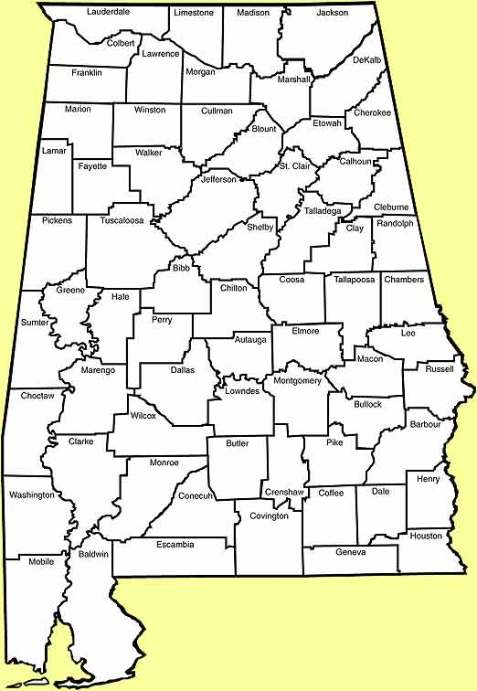
J. Approval of List of School Systems with Critical Teaching Shortages in Math and/or Science for use in the AMSTEP Loan Repayment Program
Alabama Act 2018-504, includes a provision to provide a supplemental loan repayment to qualifying teachers that are teaching in Alabama public school systems that are experiencing an acute shortage of teachers in math and/or science.
The Act further states that the Commission is to consult with the Alabama State Board of Education/Alabama State Department of Education (ALSDE) in developing the list of eligible school systems.
The eligible districts will be based upon a combination of
factors including: economics, geography and documented
teacher shortages in math and/or science.

Slide 88
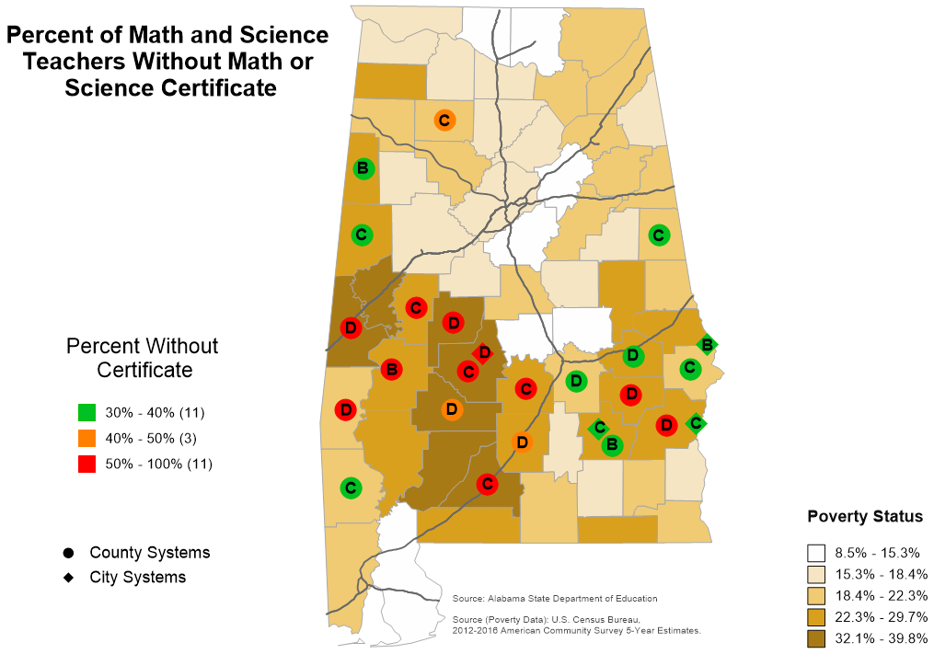

Slide 89
Percent of Teachers Without Math or Science Certificate | School System/Local Educational Agency
83.33% | Perry County
78.95% | Marengo County
66.67% | Lowndes County
66.67% | Sumter County
61.54% | Barbour County
56.52% | Selma City
54.17% | Hale County
53.85% | Conecuh County
50.00% | Bullock County
50.00% | Choctaw County
50.00% | Dallas County
48.39% | Butler County
42.86% | Wilcox County
41.00% | Winston County
Percent of Teachers Without Math or Science Certificate | School System/Local Educational Agency
38.89% | Troy City
38.10% | Macon County
37.50% | Eufaula City
37.04% | Russell County
35.71% | Montgomery County
34.62% | Randolph County
32.00% | Phenix City
31.82% | Pike County
30.77% | Pickens County
30.00% | Lamar County
30.00% | Washington County

Slide 90
K. Academic programs

Slide 91

ALABAMA COMMUNITY COLLEGE SYSTEM (ACCS)

Slide 92

Enterprise State Community College
1. Associate in Applied Science and Certificate in Industrial Maintenance Technology (CIP 47.0303)
The increased adoption of sophisticated manufacturing machinery will require more mechanics and millwrights to keep machines in good working order.
Increased automation, including the use of many computer-controlled machines in factories and manufacturing plants, will raise the demand for machinery maintenance workers.
Projected job openings indicate Industrial Maintenance related jobs have an average annual demand of more than 900 positions in ENT’s service area.

Slide 93














FOUR-YEAR INSTITUTIONS

Slide 94

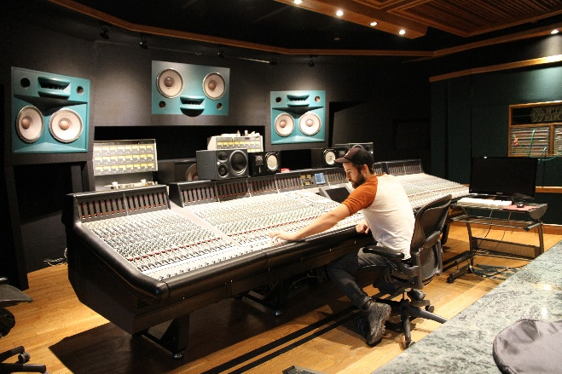
University of Alabama
Bachelor of Science in Musical Audio Engineering (CIP 14.1099)
Audio engineering is integral to advertising, marketing, entertainment, religious institutions of all kinds, performance venues of all kinds, retail establishments, and companies who are both designing and building audio equipment.
The National Association of Schools of Music (NASM) and the Accreditation Board for Engineering Technology (ABET) have recognized the need for training and education in Musical Audio Engineering, and are proactively offering the opportunity for joint accreditation by both agencies for any institutions bringing a qualified program forward.

Slide 95

University of Alabama
2. Bachelor of Science in Computer Engineering in Computer Engineering (CIP 14.0901)
The existing computer engineering option will be elevated to program status, as recommended by the Accreditation Board for Engineering and Technology (ABET).
This particular degree will focus on devices that use a computing core, but are not "computers," such as smart phones, automobiles, and medical equipment.
Courses for the proposed program will come from two existing programs at UA: Electrical Engineering and Computer Science.

Slide 96

University of Alabama
3. Bachelor of Science in Educational Neuroscience (CIP 13.0607)
This program will be the first of its kind. U A can become a pioneering institution in training undergraduate students in educational neuroscience.
The purpose of the program is to provide interdisciplinary training in the learning sciences and in neuroscience, with a strong focus on developing educational interventions using evidence-based learning design strategies.
There is a nation-wide need for scholarly work on what recent neuroscience findings mean for educational practice and policy.

Slide 97

University of Alabama
4. Master of Science in Business Analytics (CIP 52.1302)
The proposed program incorporates coursework in all disciplines that make up the field of analytics (statistics, management information systems, operations research, data mining, and machine learning).
The proposed M.S.B.A. program is designed to provide students with experience working on real analytics problems from a wide spectrum of industries.

Slide 98

University of Alabama
5. Master of Arts in Biological Sciences (CIP 26.0101)
There is no other Master of Arts in Biological Sciences in the state of Alabama.
Graduates of this proposed program can help meet the growing need in the state of Alabama for education professionals who are knowledgeable in the STEM disciplines.

Slide 99

University of Alabama
6. Doctor of Social Work in Social Work (CIP 44.0701)
The proposed program will have the support and resources of a very established and successful School of Social Work which is one of the top 50 Schools of Social Work in the US (out of over 600 social work programs).
The program will be one of the most affordable D.S.W. options in the U.S. The expected tuition is significantly lower than the tuition rates of D.S.W. Programs in surrounding areas, including Florida, Tennessee and Louisiana.

Slide 100

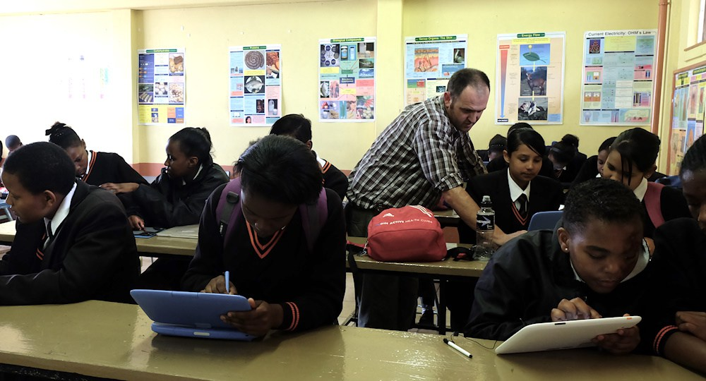
University of Alabama in Huntsville
Master of Arts in Teaching – P-12 Education (CIP 13.1206)
The proposed program would provide an opportunity for graduates with backgrounds in music, kinesiology, exercise science, or related fields to pursue a career focused on teaching students in public and/or private education.
The degree will provide a unique opportunity for individuals with diverse backgrounds to earn a graduate degree while simultaneously achieving initial certification to teach students in multiple concentrations.

Slide 101


University of West Alabama
Bachelor of Science in Health and Physical Education (CIP 13.9999)
Graduates of the proposed program may work in public and private K-12 settings, teach health as a core subject for grades (6-12) and will promote healthy school environments and school-community partnerships.
According to UWA officials, there is a need in the state of Alabama to produce graduates who will provide an integrated set of planned, sequential activities, and services designed to promote physical, cognitive, and social development, as well as health literacy.

Slide 102


University of North Alabama
Bachelor of Science in Applied Health Science (CIP 51.0799)
The proposed program is a unique opportunity for students who would like to seek employment in diverse health care settings (e.g., management roles in hospitals, clinics, physician offices, and public health organizations.
The proposed Health Administration track within the program will be based on a foundation of business, yet inclusive of essential health care concepts such as epidemiology, research, and informatics.

Slide 103
L. EXTENSIONS/ALERATIONS OF EXISTING PROGRAMS

Slide 104

University of Alabama
Alteration of the PhD in Communication and Information Sciences (CIP 09.0102)
All changes in award nomenclature at the doctoral level require Commission approval as a substantive change.
The University of Alabama (UA) currently has the Doctor of Philosophy (PhD) in Communication and Information Sciences at CIP 09.0102 in the Commission’s Academic Program Inventory.
UA has proposed a change in the program CIP code from 09.0102 to CIP 09.0199. There will be no change in the program title.
The proposed change will aid UA’s doctoral graduates who accept faculty positions that are aligned with their areas of study and research.

Slide 105

University of Alabama at Birmingham
2. Alteration of the DSc in Administration-Health Services (CIP 51.0701)
All changes in award nomenclature at the doctoral level require Commission approval as a substantive change.
UAB has proposed a change in the program title from Administration-Health Services to Healthcare Leadership. There will be no change in the program cipcode.
The proposed change will better reflect the curriculum in the program and will be more appealing to the target audience of senior level leaders in healthcare.

Slide 106
M. REQUEST TO AMEND POST-IMPLEMENTATION CONDITIONS

Slide 107

Auburn University
Request to Amend Post-Implementation Conditions: Bachelor of Music (CIP 50.0901)
The request is that an additional two-year review period (2018-19 and 2019-2020) for the program be granted.
In this additional review period, the program will meet a post-implementation condition of a total of 15 graduates for the two years.
AU reports that there were 30 new enrollments in the program in 2015-16 and 2016-17, and those students are likely to graduate over the next two years.
AU states that college and department advising will re-emphasize the distinctive advantages of the Bachelor of Music program.
To enhance the program's appeal to sought-after student-musicians, Auburn's College of Liberal Arts has decided to revise its criteria for some of the scholarships it awards.

Slide 108

University of Alabama in Huntsville
Request to Amend Post-Implementation Conditions: Bachelor of Science in Economics and Computational Analysis (CIP 52.0601)
The request is that an additional two-year review period (2018-19 and 2019-2020) for the program be granted.
In this additional review period, the program will meet a post-implementation condition of a total of 15 graduates for the two years.
In the 2018-19 academic year UAH will have economics faculty visit high schools and community colleges to expose the students to the opportunities in economics and business. When possible UAH will be visiting AP economics classes because those students have already demonstrated an interest in commerce.
UAH is planning a concerted effort to find internship opportunities for economics majors. UAH majors have experience working with data and in the Huntsville area there are opportunities for that skill. UAH’s goal is to ease the students' transition into internships and ultimately into the job market.
UAH states that they have had remarkable success placing their graduates in careers and graduate school. Additionally, UAH states that its graduates have jobs across the country.

Slide 109

N. PUBLIC DRAWING TO DETERMINE THE ORDER OF PAYMENT OF ALABAMA STUDENT GRANT PROGAM (ASGP) FUNDS FOR THE 2018-2019 ACADEMIC YEAR

Slide 110
O. INFORMATION ITEMS

Slide 111
O. INFORMATION ITEMS
Implementation of Approved Programs
Implementation of Distance Education Programs
Summary of Post-Implementation Reports
Implementation of New Short Certificate Programs (Less than 30 Semester Hours)
Changes to the Academic Program Inventory
Implementation of Non-Degree Programs at Senior Institutions
Change in the Name and Establishment of Centers and Departments
University of South Alabama, Addition of Music Certifications to the Existing Master of Music (CIP 50.0901)
Extensions/Alterations to Existing Programs of Instruction

Slide 112
XI. ADJOURNMENT

