Slide 1

Alabama Commission on Higher Education
Commission Meeting
December 7, 2018

Slide 2

CALL TO ORDER and PLEDGE OF ALLEGIANCE

Slide 3

II. ROLL CALL and QUORUM DETERMINATION

Slide 4

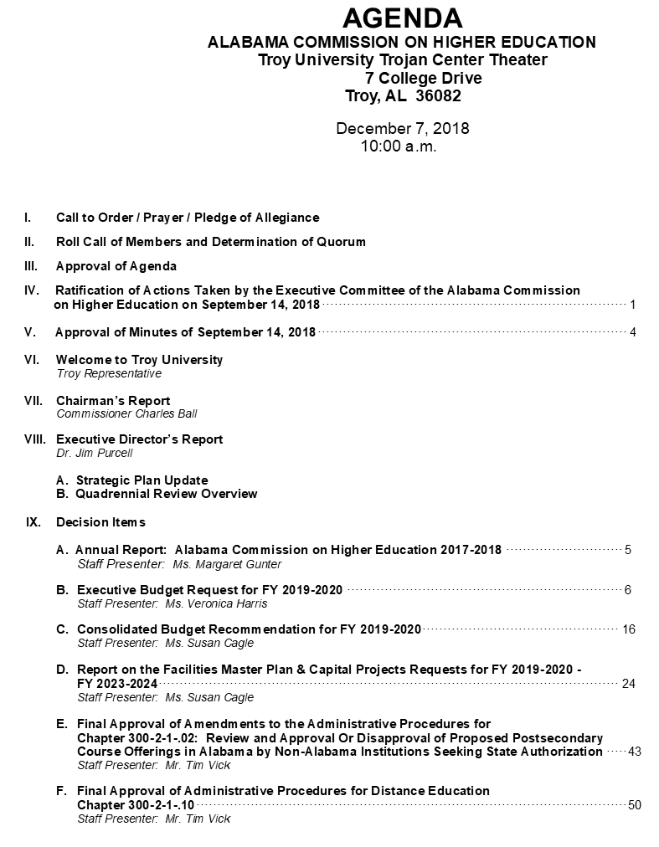
III. APPROVAL OF AGENDA

Slide 5
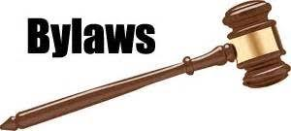
IV. Ratification of the Actions taken by the Executive Committee of the Alabama Commission on Higher Education on September 14, 2018
A quorum was not present at the regularly scheduled September 14, 2018 meeting of the Commission.
The Commission bylaws state, “...there shall be an Executive Committee of the Alabama Commission on Higher Education to consist of the chairman, vice-chairman, and such other commissioners as appointed by the chairman, the number of which shall not exceed four. The Executive Committee is empowered to act on behalf of the Commission between regular scheduled meetings of the Commission with said action being subject to ratification by the full Commission at a regular or special meeting held in accordance with all laws requiring open and public meetings.”

Slide 6

V. APPROVAL OF MINUTES
Approval of Minutes of September 14, 2018

Slide 7
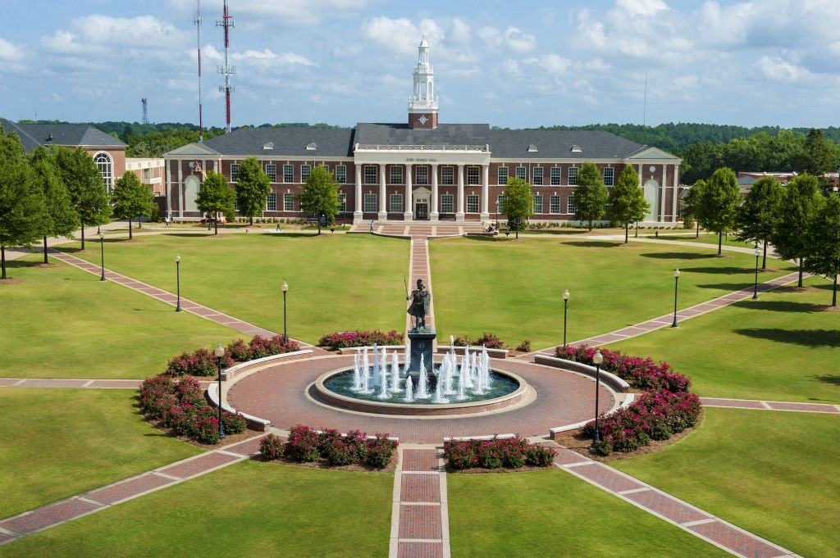
VI. WELCOME TO TROY UNIVERSITY

Slide 8

VII. CHAIRMAN’S
Report

Slide 9

VIII. EXECUTIVE DIRECTOR’S
Report

Slide 10
Strategic Plan Update
Quadrennial Review Overview

Slide 11
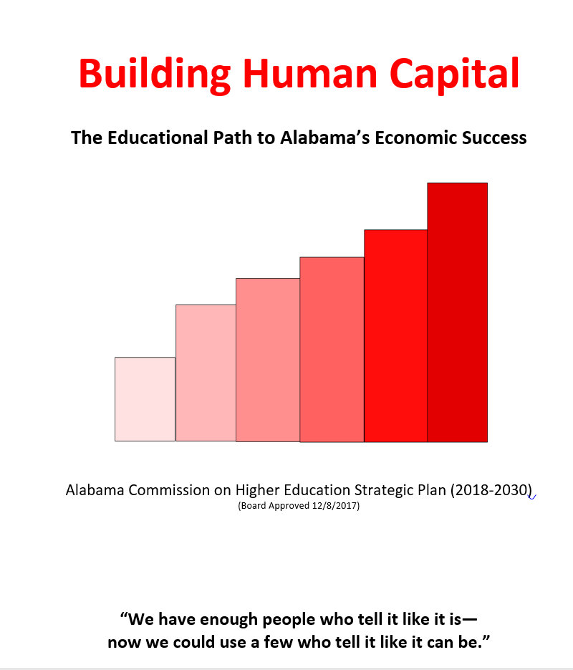
Strategic Plan Update
1. Improving Access
2. Enhancing Student Success
3. Enhancing STEM Programs
4. Developing Alabama’s Economy and Workforce
5. Organizational Effectiveness and Efficiency
Year-one report
Baseline data –start of trend lines
Early Successes

Slide 12
Strategic Plan Update
Improving Access
Increase the number of high school students prepared for college in the institution’s service area | HS Grads, 2017: 18% met or exceeded the four ACT College Readiness Benchmarks in all four subjects tested 53% in English, 24% in math 37% in reading, 24% in science
Increase in enrollment | Fall ‘16 – 246,988 - Fall ‘17 – 253, 990 2.8% increase
Increase in the percentage of high school graduates enrolling in college the next fall term | Down from 48-46% (enrollment in AL public colleges or universities)

Slide 13
Strategic Plan Update
2. Enhancing Student Success
Rethink Developmental Education | Convening of all campuses to discuss students success strategies including developmental education. ACCS developed new criteria for determining course placement.
Fewer students will require remediation | 2015-16 – 7,325 full time/first time students (30%) students enrolled in remedial math and/or English 2016-17 – 6,915 full time/first time students (29%)
Additional students will transfer from community colleges to universities | 2015 transfers – 5,698 2016 transfers – 6,057

Slide 14
Strategic Plan Update
3. Enhancing STEM Programs
Increase the number and quality of secondary teachers in math and science | Act 2018-504 - loan repayment program for secondary math/science teachers
Increase in the number and percentage of STEM graduates | 2015 STEM grads – 8,002 or 16.3% 2016 STEM grads – 8,555 or 16.5% 2017 STEM grads – 8,994 or 16.8%

Slide 15
Strategic Plan Update
4. Developing Alabama’s Economy and Workforce
Increase each higher education institution’s role as a steward of the community in their service area | ACCS (2018-19) $16.6M to expand skills training & career tech ed. Programs. ACHE seeking Human Capital fund to jump start campus efforts (CC and Univ)
Reduction in worker shortages, both regionally and statewide | Statewide ads for vacancies reduced 40% from 2015 to 2017

Slide 16
Strategic Plan Update
5. Organizational Effectiveness and Efficiency
Institutions are funded comparable to the national and regional average | Alabama Colleges receive $976 less per student FTE in state appropriations than the national average State funds increased 3% for 2018-2019 FY
Increase in student applications for state scholarships | All aid programs showed an increase in applications and award amounts
Reduced time for academic program approval and renewal for public and private colleges and universities | Reduce academic program approval timeline from ten months to three months

Slide 17
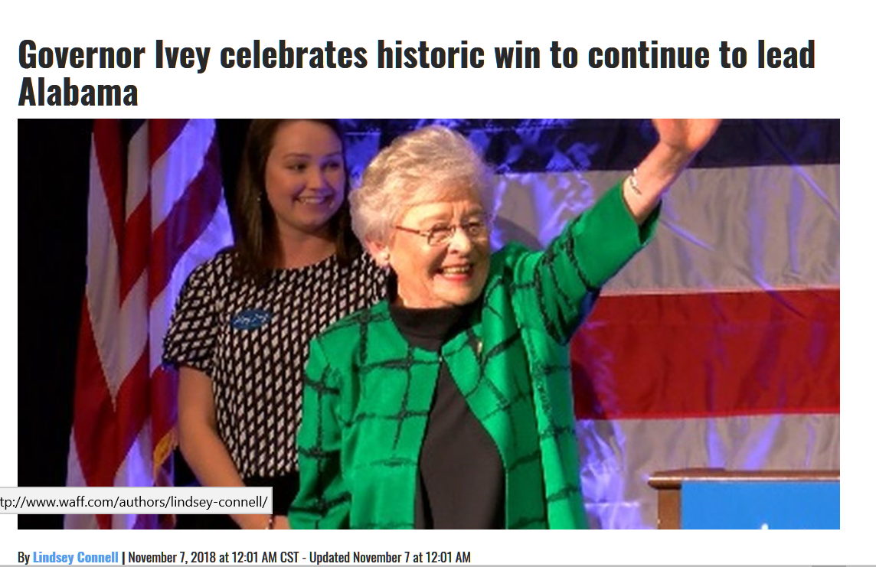
Quadrennial Review Overview
Eleventh Quadrennial Evaluation of the Alabama Commission on Higher Education

Slide 19
Scale of 1-10
non-Alabama institutions

Slide 20
new programs at publics…
non-Alabama institutions
Scale of 1-4
role and scope (mission)

Slide 24
Scale of 1-4
4 = Highly Effective and 1 = Not Effective

Slide 25
Scale of 1-5
5 = Critical and 1 = Not Very Important

Slide 26
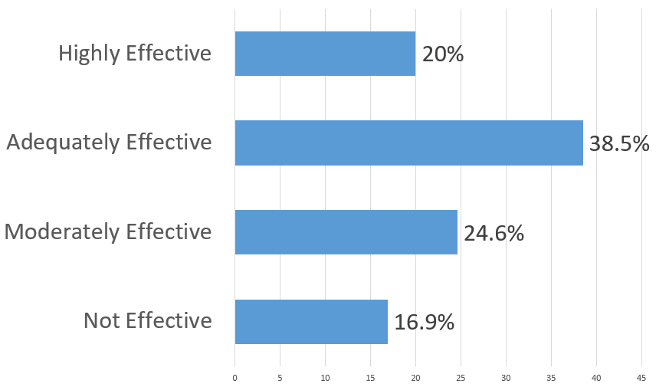
Q9. How would you rate the Commission’s efforts to consistently advance or champion higher education’s strategic plan for 2018-2030 entitled, Building Human Capital: The Educational Path to Alabama’s Economic Success, with all stakeholders: educational leaders, policymakers, the press, and the general public?

Slide 28
Eleventh Quadrennial Review Survey Results
Overall, the survey results mirror prior quadrennial reviews but also showed greater satisfaction with ACHE’s:
Administration of the Statewide Student Database and
Service as an advocate for higher public education. Some of which could be attributed to:
Increased state support
Recent emphasis by ACHE staff to streamline procedures, and a reduction and clarification of ACHE policy.
Increased need-based aid, and scholarships targeting the shortage of math and science teachers.

Slide 29
Eleventh Quadrennial Review Survey Results
The following measures are recommended:
Continue focus on advocacy and coordination of higher education, including affordability and expanding student aid programs.
Expand services to campuses including professional development.
Continue to coordinate with state education and non-education agencies on the development and implementation of the State Longitudinal Data System.
Continue to investigate cost-saving measures for students, i.e., the Free Application for Federal Student Aid (FAFSA) completions and Open-Educational Resources (OER).

Slide 30
IX. Decision ITEMS

Slide 31

Annual Report
Staff Presenter: Ms. Margaret Gunter
2017-2018 Annual Report
Alabama Commission on Higher Education
Ache.edu

Slide 32
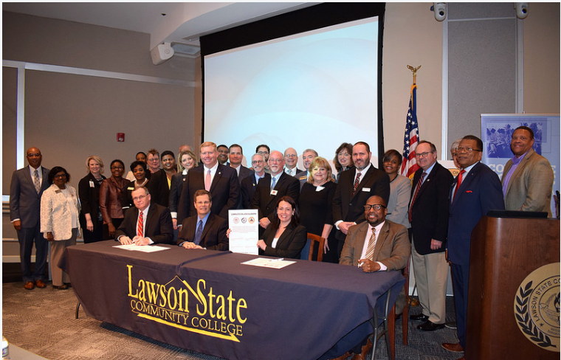
Complete College Alabama compact is signed by higher education participants

Slide 33
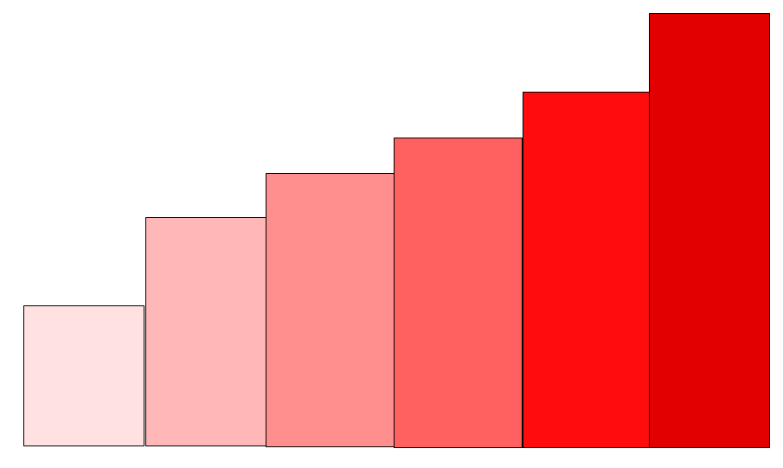
Building Human Capital
The Educational Path to Alabama’s Economic Success
Alabama Commission on Higher Education Strategic Plan (2018-2030) (Board Approved 12/8/2017)

Slide 34
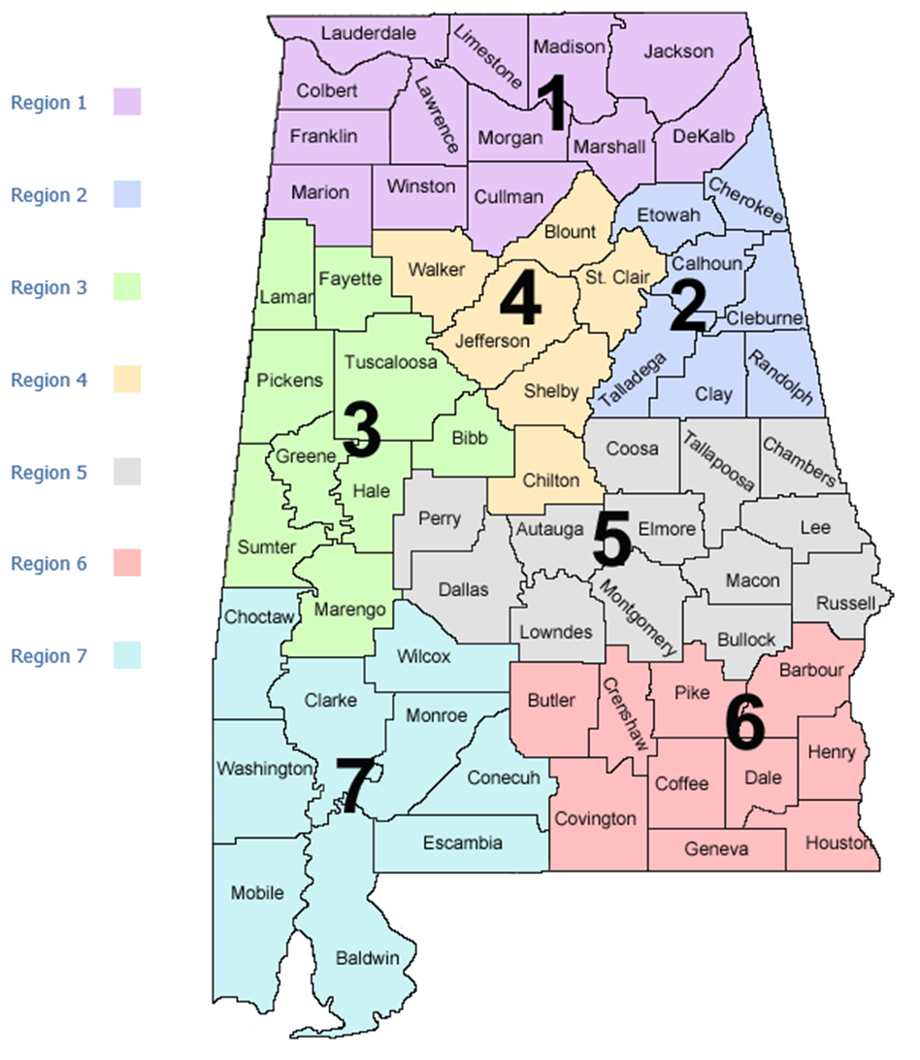
Workforce by Region

Slide 35
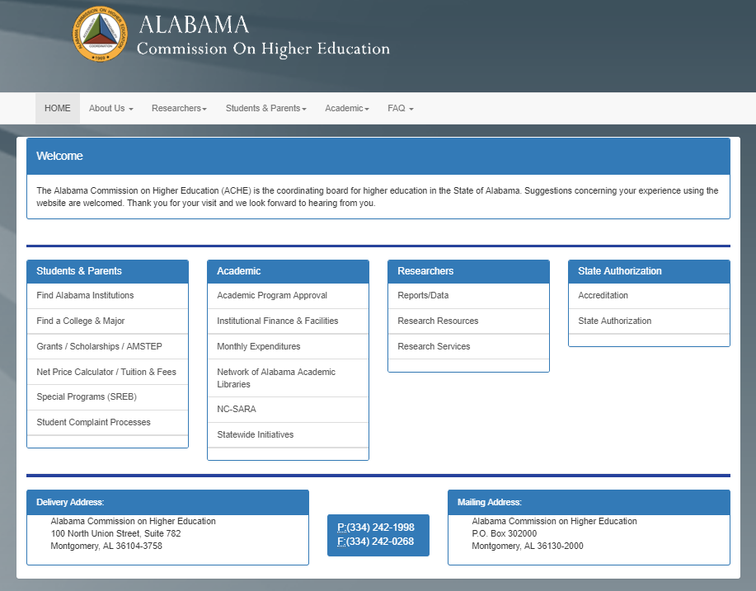

Slide 36
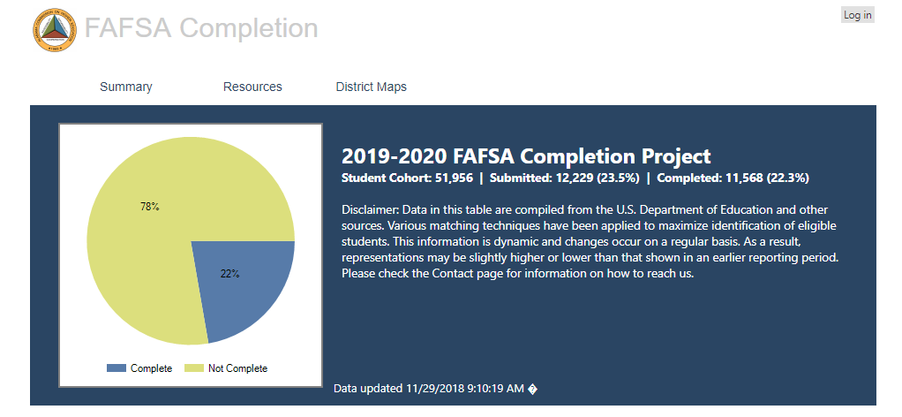

Slide 37


2018-2019 ACHE/ACCS OER Grant Program
Target: high-enrollment general education courses for transfer between institutions
Priorities:
Greatest cost savings for students (high ROI)
Collaboration between 2- and 4-year institutions
$60,000 in funds for adoption, adaption, and creation of Resources
Over 30 proposals funded
Impacting 18,027 students
Annual projected student savings: $2,059,507

Slide 38

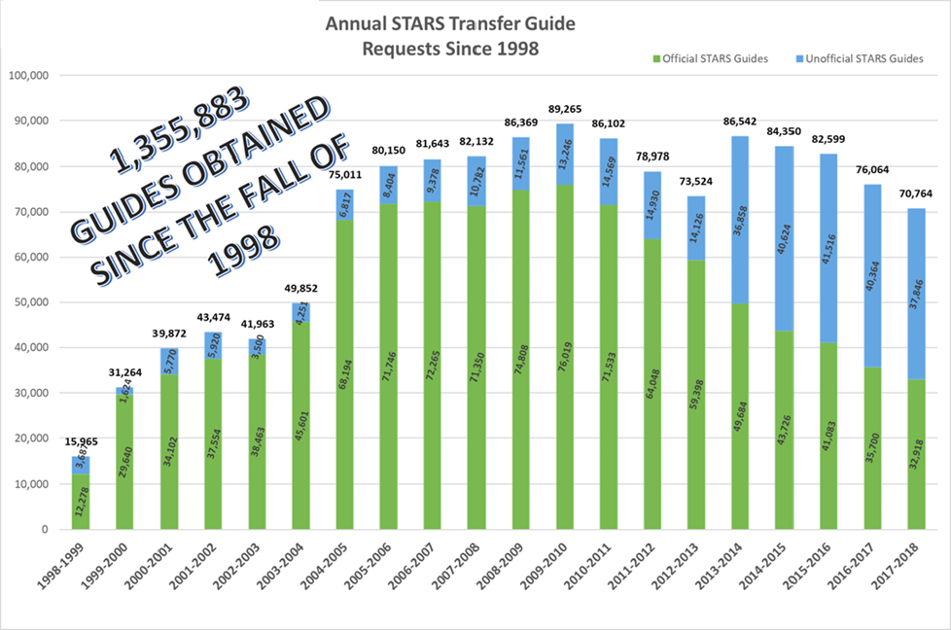

Slide 39
ACHE Title II Federal Funding FY1985 - 2016:*
Fiscal Years | Total Federal Appropriations
1985-1988 | $1,600,778
1989-1994 | $5,461,414
1995-2001 | $4,682,002
2002-2016 | $16,698,060
TOTAL | $28,442,254

Slide 40


Slide 41
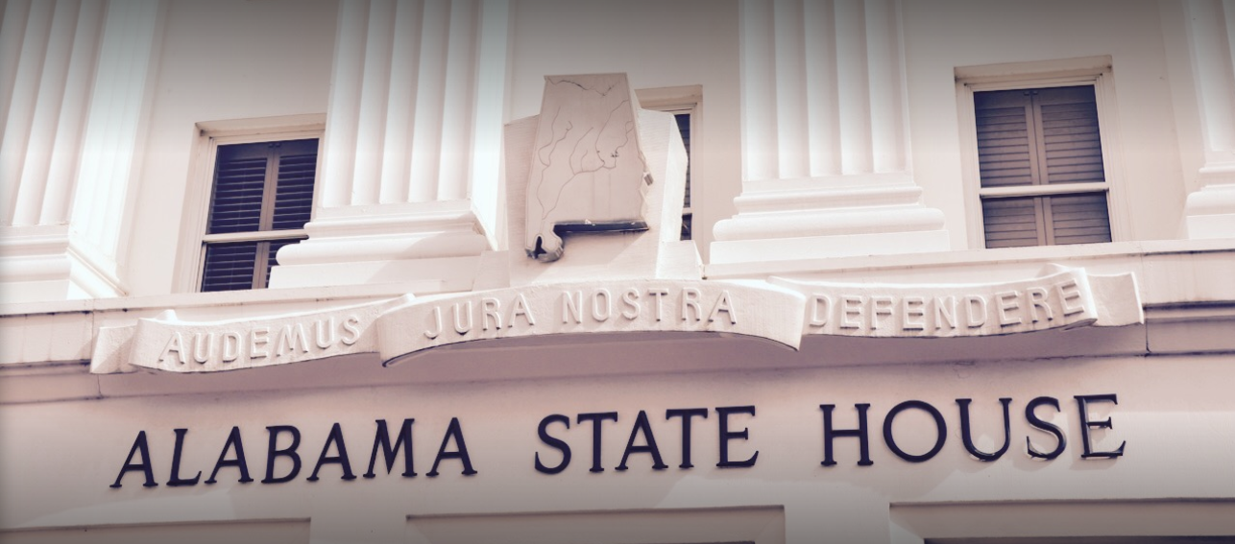

Slide 42
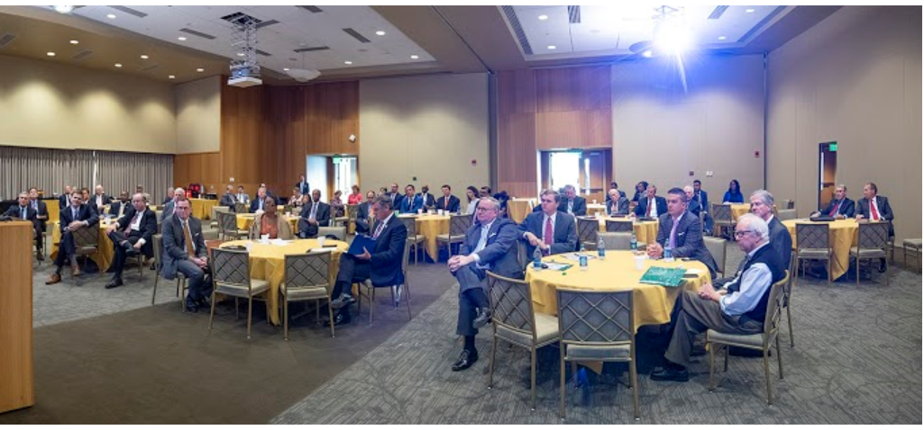

Slide 43
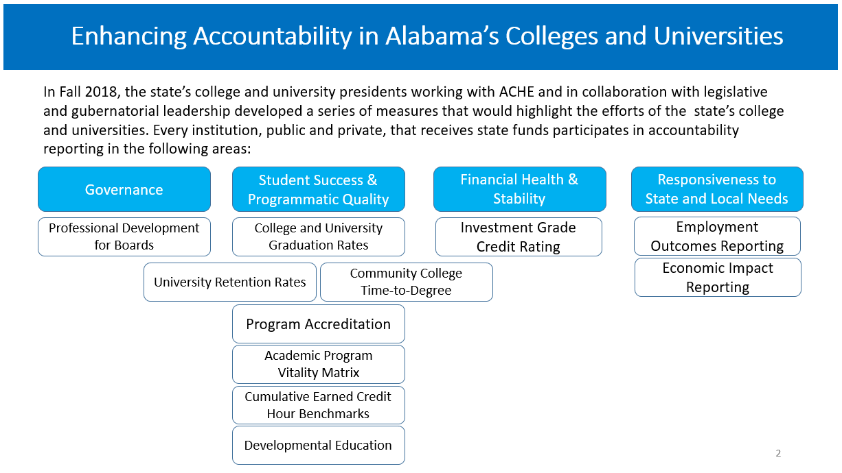

Slide 44
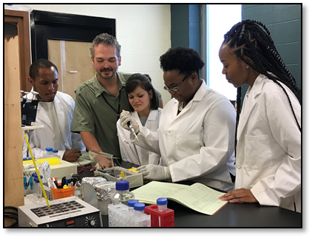

Slide 45
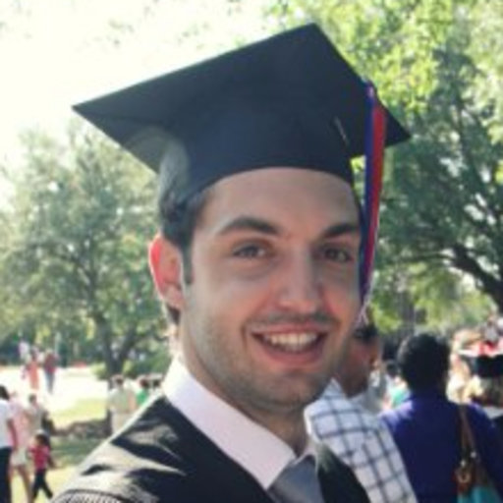
Sebastian Kirmse GRSP Round 11 and 12 Recipient D.Sc. Student and I-Corps National Team Entrepreneurial Lead
“ZT Composites – Towards stronger, tougher, and more conductive carbon fiber composites.”

Slide 46
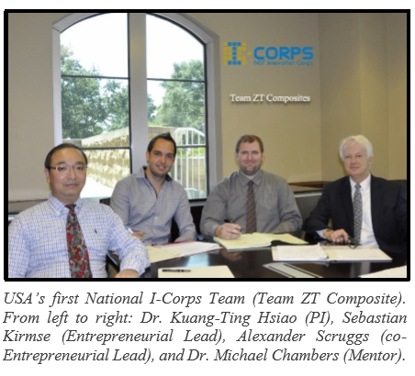

Slide 47

B. Executive Budget Request for FY 2019-2020
Staff Presenter: Ms. Veronica Harris
STATE OF ALABAMA
Department of Finance
STATE AGENCY
BUDGET REQUEST INSTRUCTIONS
Fiscal Year 2020
Kay Ivey
Governor

Slide 48
BUDGET REQUEST SUBMISSION
The Code of Alabama, Title 41, Chapter 19, Section 6 (a) (3) states that, each state agency/department, on the date and in the form and content prescribed by the Department of Finance, shall prepare and forward to the Budget Officer the budget requested to carry out its proposed plans in the succeeding fiscal year.
The Executive Budget Office’s (EBO) due date for the FY 2018-19 budget requests was November 1, 2018.
In order to comply with the designated submission deadline, a draft budget request was submitted to EBO.
Any changes made by the Commission will be submitted through a budget request revision.

Slide 49

Alabama Commission on Higher Education
FY 2019-20 Executive Budget Request
ACHE is requesting a total of $35,944,905 for FY 2019-20, of which $35,508,666 is from state funds.
This represents an overall 12.24% increase over FY 2018-19.
The FY 2019-20 Request contains requests for 26 programs under 5 appropriation units.
This includes one new program: the Human Capital Development Fund.

Slide 50

New Program Request for FY 2019-20
1. Human Capital Development Fund - Funds will be used by the state’s colleges and universities to address critical workforce needs and to expand high-demand, high-wage programs of study. Appropriated funds will be distributed by ACHE among the campuses by competitive requests for proposals (RFP) based on workforce issues determined by the Governor’s Workforce Council.

Slide 51

Planning assumptions used in developing the
FY 2019-20 Executive Budget Request:
Planning and Coordination (Operations and Maintenance)
A 7.32% increase is being requested due to:
Funds are needed to support potential statewide accountability measures. This includes:
Funds to purchase various data sets from the National Student Clearinghouse, and
Funds to support trustee/commissioner professional development activities.
An increase is needed for employee termination costs (retirements).
Increased costs for employer contributions for health insurance.
Increased costs for building operations and rent.
Increases are need to cover increases in Information Service Division (ISD) charges, postage, and telephone services and for Comptroller Office transaction charges.
Increases are needed for subscriptions, software purchases, replacement of computers and printers, UPS/FedEx shipping costs, professional association dues and general office supplies.

Slide 52
Assumptions for Other Programs
Alabama Student Assistance Program: A 27.11% increase is being requested for the state’s need-based student financial aid program. This will bring ASAP to a level matching the amount being requested for the Alabama Student Grant Program.
Police Officers and Firefighters Survivor’s Educational Assistance Program: A 20.45% increase is being requested to ensure that sufficient funds are available to meet statutory obligations. Due to the Rolling Reserve Act, it is extremely difficult to obtain supplemental appropriations

Slide 53
Assumptions for Other Programs, continued
Five (5) percent increases are being requested for the following programs
Alabama Student Grant Program to offset rising tuition costs.
Alabama National Guard Educational Assistance Program to offset rising tuition costs.
Southern Regional Educational Board for increased dues, Academic Common Market activities and for the Minority Doctoral Scholars Program.
Network of Alabama Academic Libraries to offset the rising costs of purchasing library resources.
Articulation and General Studies Committee / Statewide Transfer Articulation Reporting System (AGSC / STARS) to update outdated technology.
Experimental Program to Stimulate Competitive Research to provide more funds for the Graduate Research Scholars program.
Level funding is being recommended for all other items in the budget.

Slide 55
C. Consolidated Budget Recommendation for FY 2019-2020 Staff Presenter: Ms. Susan Cagle

Slide 56

Consolidated Budget Recommendation for FY 2019-2020
Section 16-5-9(b) of the Code of Alabama states that “...The Commission ... shall present to each institution and the Governor and legislature, a single unified budget report containing budget recommendations for the separate appropriations to each of the institutions.”

Slide 57

Consolidated Budget Recommendation for FY 2019-2020
In creating the recommendation, ACHE staff has first attempted to determine an estimate of the basic funding requirements for the State public colleges and universities. This calculation is referred to as the ACHE Standard calculation.
The amount calculated for FY 2019-2020 in the ACHE Standard for the public two- and four-year colleges and universities was $2,968,999,960. This amount is $1.5 billion over the FY 2018-2019 appropriation amount.

Slide 58

Consolidated Budget Recommendation for FY 2019-2020
In developing the Consolidated Budget Recommendation (CBR), there are things that need to considered:
Cap placed on ETF Appropriation Due to the Rolling Reserve Act
Revenue Projections
New Initiatives Being Considered
Split Between Higher Education, K-12, and Other Education Lines
Requested Amounts

Slide 59


Consolidated Budget Recommendation for FY 2019-2020
Funds for Rate Increases
The recommendation is based on the following:
1) TRS retirement rate increase (two and four-year institutions).
2) Fund a rate increase for mandated PEEHIP retirees' health insurance for public senior institutions who do not participate in PEEHIP (all except AAMU, Athens and JSU).
The funds needed to cover the cost of these items for the four and two-year institutions are approximately $2.5 million or an increase of less than 1%.

Slide 60


Consolidated Budget Recommendation for FY 2019-2020
Peer Comparison Adjustment
3) NCHEMS was contracted by ACHE to develop statistical peers for each AL public institution.
Peers based upon similar instructional mission, program mix, student characteristics, Carnegie Classification and degree production.
NCHEMS provided IPEDS data for all institutional peers & AL institutions. Staff used the IPEDS data to make comparisons of state support.
Alabama institutions found to be supported at less than 90% of their peer average were given an adjustment to address the significant variance.
The amount added was less than $9 million or an increase of less than 1%.

Slide 61

Consolidated Budget Recommendation for FY 2019-2020
Across the Board Increases
4) Funds be appropriated so that all institutions receive a five percent (5%) increase over the amount appropriated in FY 2018-2019.
5) Statewide lines were recommended for varying amounts.

Slide 62

Consolidated Budget Recommendation for FY 2019-2020
Increase Recommended for the Universities - $66,102,211
Increase Recommended the Two-Year Colleges - $17,275,099
Increase Recommended the State-Wide Lines - $8,561,758
Total Increase FY 2019-2020 Consolidated Budget Recommendation - $91,939,068

Slide 64
Report on the Facilities Master Plan & Capital Projects Requests for
FY 2019-2020 – FY 2023-2024
Staff Presenter: Ms. Susan Cagle

Slide 65


Report on the Facilities Master Plan & Capital Projects Requests for
FY 2019-2020 - FY 2023-2024
Section 16-5-15 of the Code of Alabama requires that each public college & university annually submit a 5-year facilities master plan to the Commission. Each institution is also required to prioritize its capital requests and to provide a needs assessment for requested projects.
The five years reported are broken into three time segments: Immediate, Intermediate, and Long-Term capital projects.
Immediate projects are defined as those within the first year of the master planning cycle (FY 2020).
Intermediate projects are defined as those within the second year of the planning cycle (FY 2021).
Long-Term projects fall into the last three years of the planning cycle (FY 2022 - 2024).
The projects are further divided into four separate project categories:
New Construction/Acquisition
Renovation and Remodeling
Major Capital Equipment
Deferred Maintenance/Facilities Renewal

Slide 66
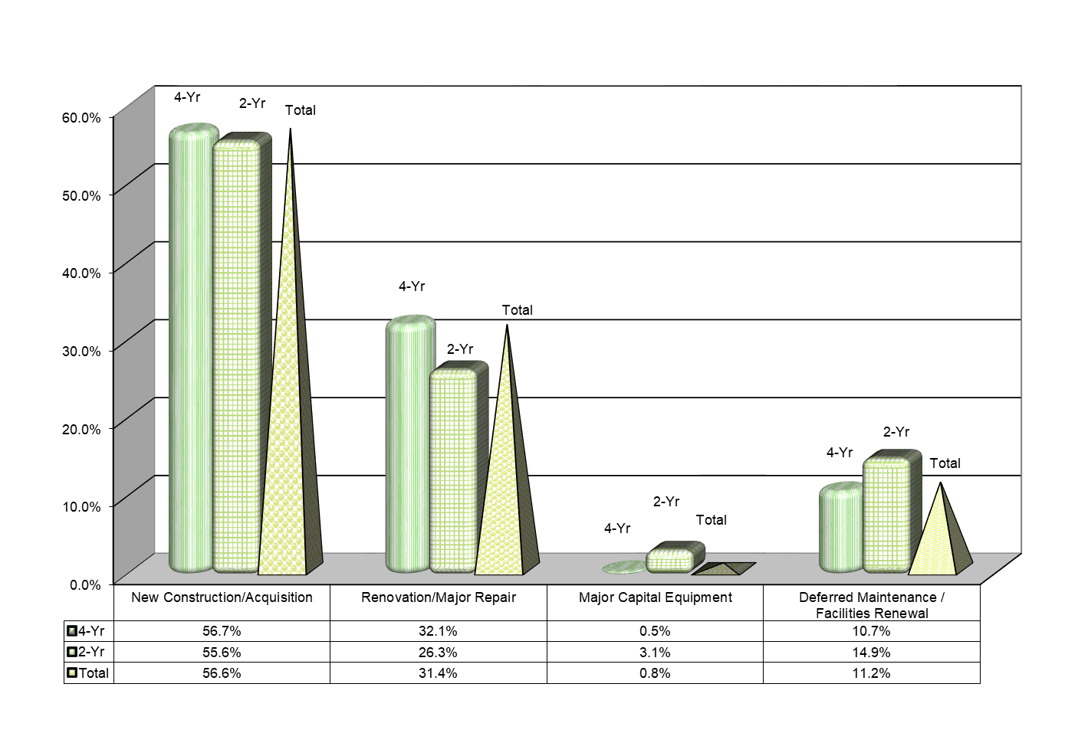
Immediate Capital Requirements Projects by Category
FY 2019-2020
$1,232,340,715 requested in Immediate Capital Projects. 43% of which is for other than New Construction.

Slide 67
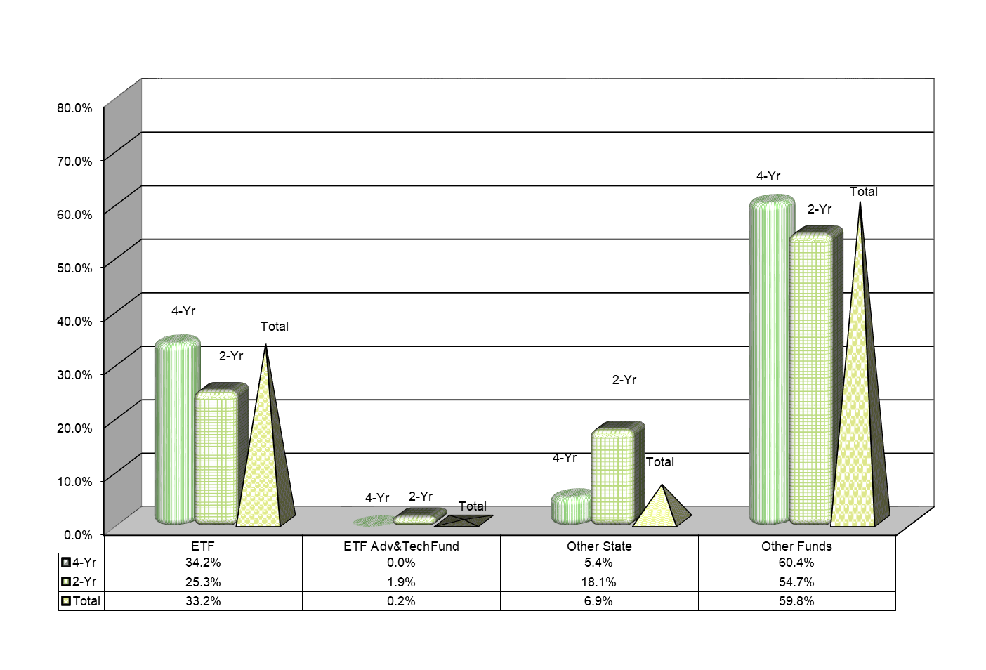
Immediate Capital Requirements Projects by Projected Funding Source FY 2019-2020
$408,612,629 of the requested Immediate Projects are projected to use ETF funds.

Slide 68

Intermediate Capital Requirements Projects by Category
FY 2020-2021
$912,692,191 requested in Intermediate Capital Projects. 50% of which is for other than New Construction.

Slide 69
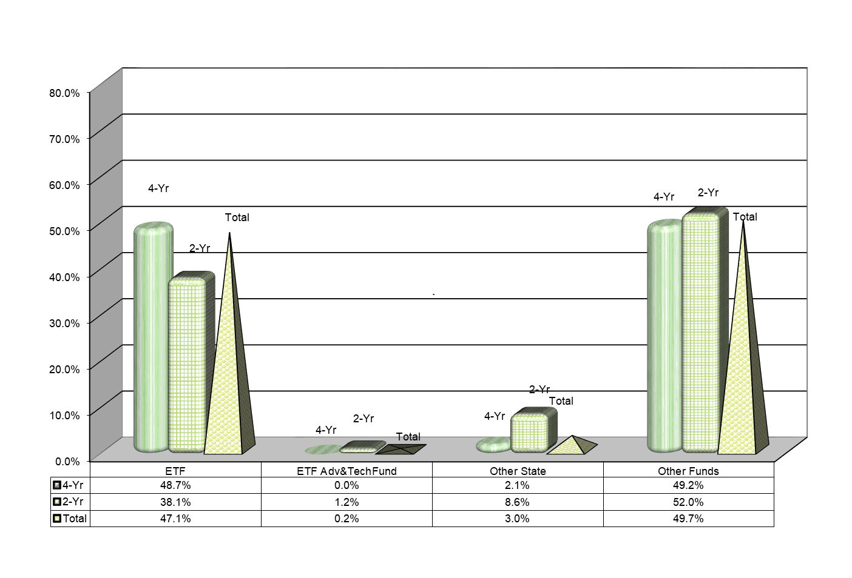
Intermediate Capital Requirements by Projected Funding Source FY 2020-2021
$429,939,758 of the requested Intermediate Projects are projected to use ETF funds.

Slide 70
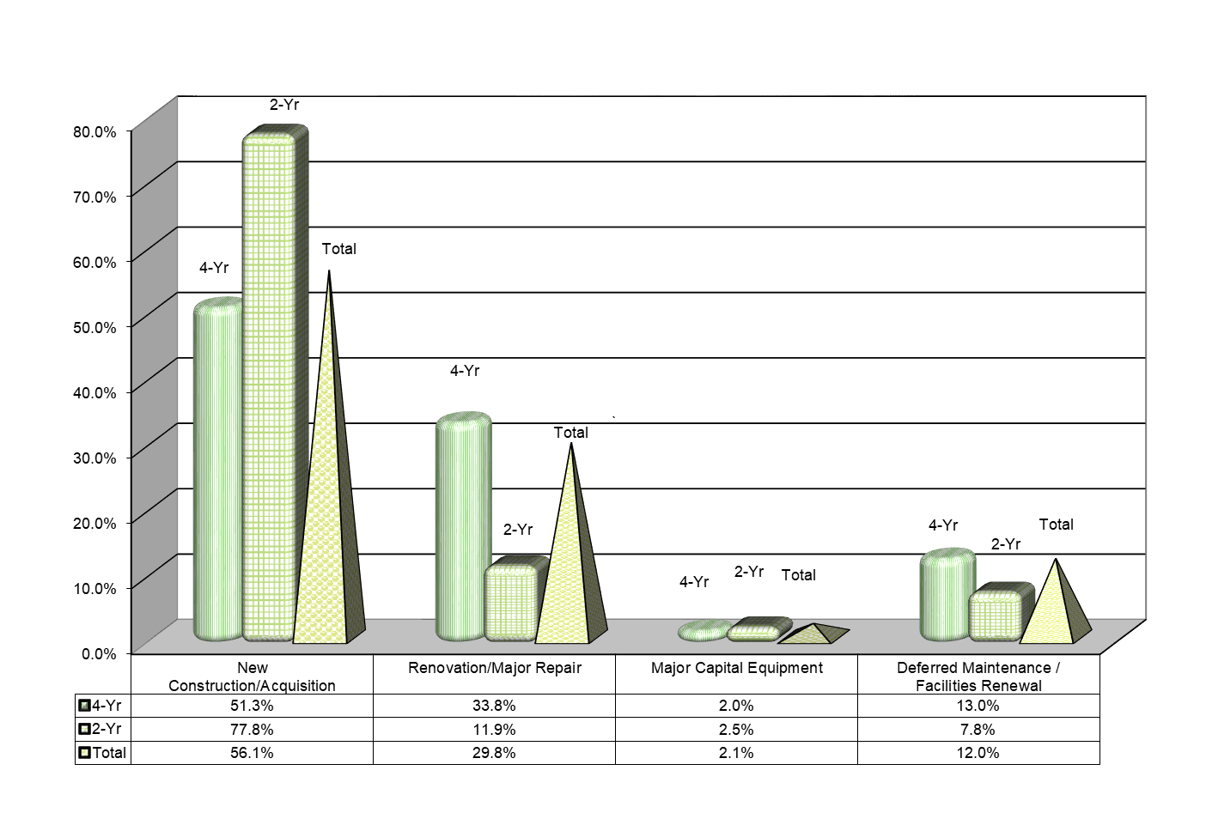
Long-Term Capital Requirements Projects by Category
FY 2021-2022 - 2023-2024
$2,708,464,130 requested in Long-Term Capital Projects. 44% of which is for other than New Construction.

Slide 71
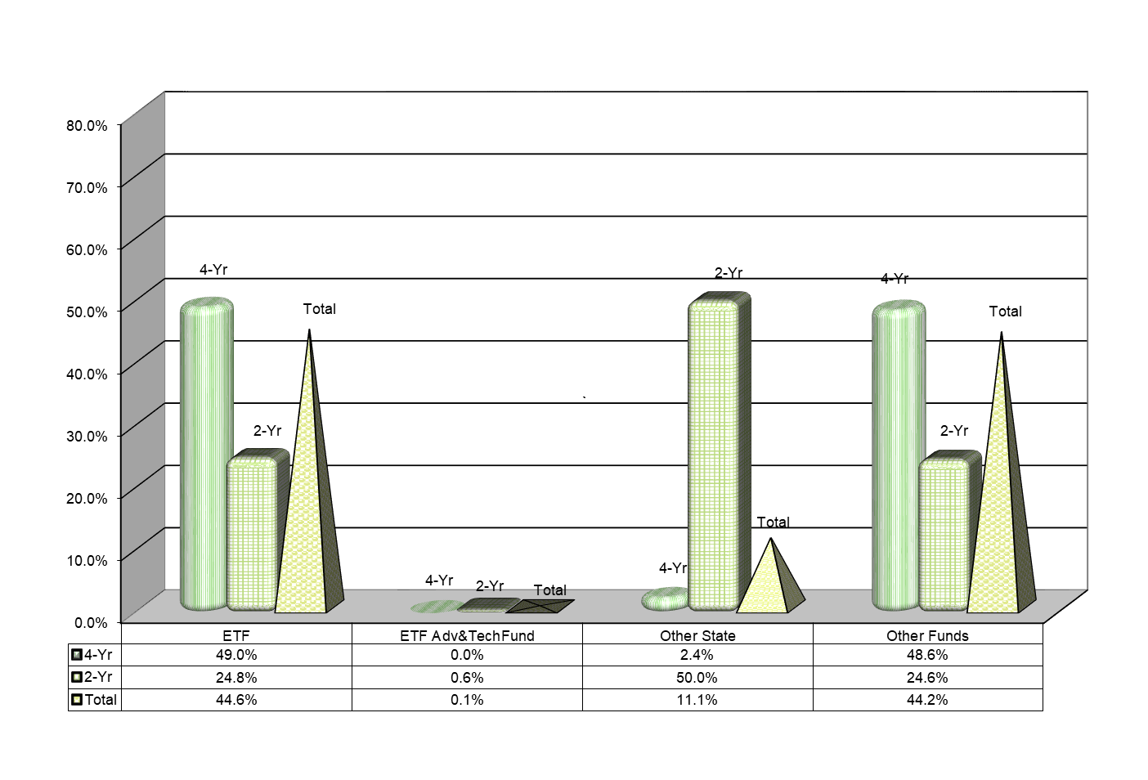
Long-Term Capital Requirements by Projected Funding Source FY 2021-2022 - 2023-2024
$1,208,539,714 of the requested Long-Term Projects are projected to use ETF funds.

Slide 72
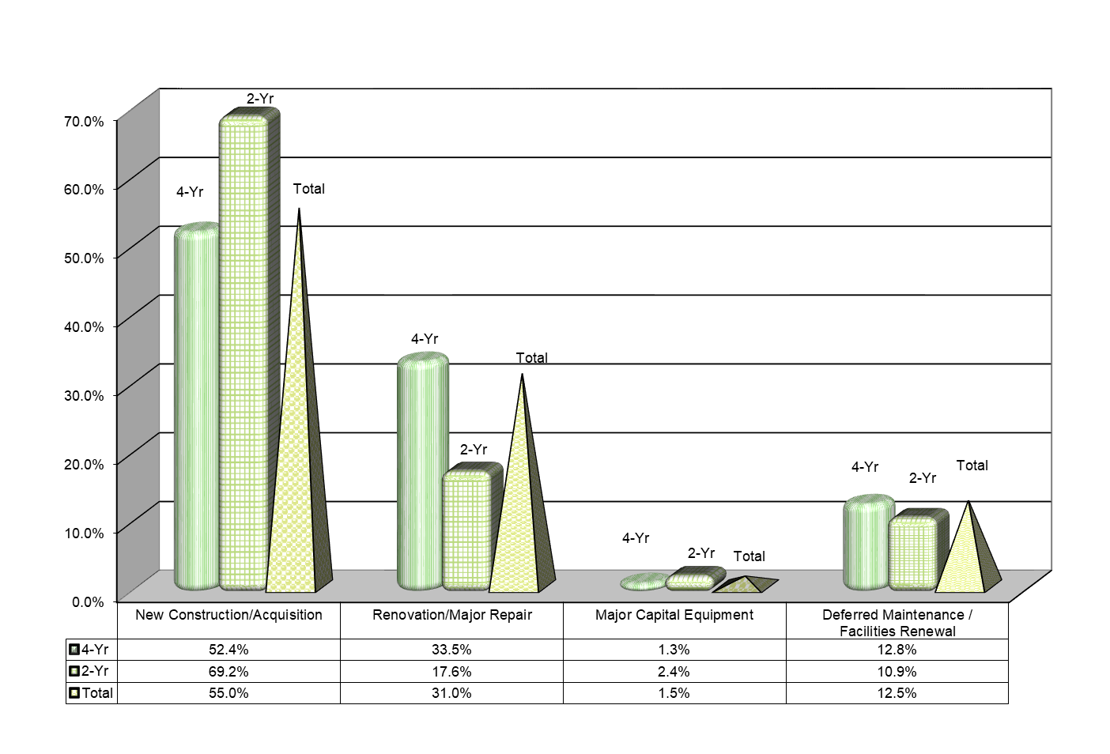
Total Capital Requirements Projects by Category
FY 2019-2020 - 2023-2024
$4,853,497,036 requested in Capital Projects for the 5-Yr period. 45% of which is for other than New Construction.

Slide 73
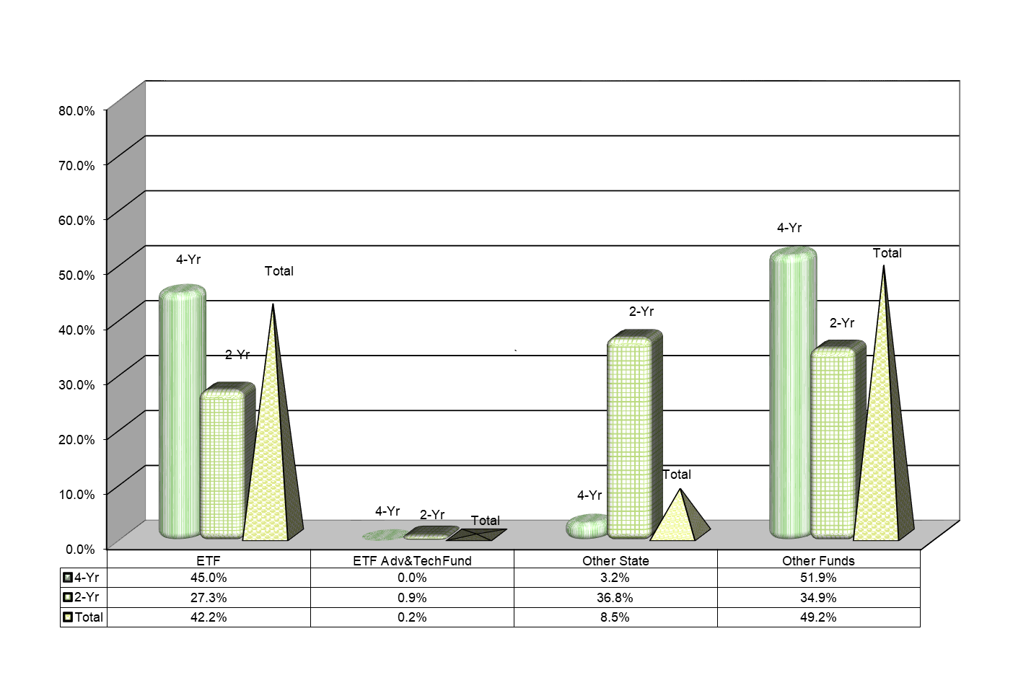
Total Capital Requirements by Projected Funding Sources
FY 2019-2020 - 2023-2024
$2,047,092,101 of the requested Projects for the 5-Year period are projected to use ETF funds.

Slide 74
40% of the buildings being used by the public colleges and universities in Alabama were built between 1960 and 1989. An additional 15% of the buildings were built prior to 1960.

Slide 75


Bond Issues and Debt Service
The State of Alabama does not provide regular funding for capital projects for education; this is true for K-12 as well as Postsecondary Education.
The institutions in Alabama are allowed to float their own bond issues.
The four- and two-year institutions currently have approximately $3.7 billion in bonds outstanding.
The institutions paid approximately $415 million in debt service in the last fiscal year to pay these bonds off. ($388M-4YR / $27M-2YR)
The source of revenue to pay these bonds is usually through tuition or fees that the students pay.

Slide 76

E. Final Approval of Amendments to the Administrative Procedures for 300-2-1-.02: Review And Approval Or Disapproval Of Proposed Postsecondary Course Offerings In Alabama By Non-Alabama Institutions Seeking State Authorization
Purpose of Action:
The advent of the National Council for State Authorization Reciprocity Agreements (NC-SARA) has drastically reduced the number of institutions that must seek state authorization.
The staff questions the need to review the programs of institutions that are exempt from the licensure process by the Alabama Private School Licensure Law.
Although the Commission is charged to review and approve postsecondary course offerings of Non-Alabama institutions seeking state authorization, it does not have enforcement authority to deny a license should programs be found to be of inadequate quality.
Failure of HB 374.
Accreditation by a United States Department of Education recognized regional or national accreditation agency is a sufficient indicator of the quality of programs.
The staff questions the need to do any sort of review of non-degree programs and/or non-credit courses, which do not lead to a postsecondary degree.
To address features of the recent court ruling in Capps College case.

Slide 77

Non-Alabama Institution Review - continued
The following process changes also are recommended:
Presently once the Commission approves an off-campus program for a public institution; it does not have to be reviewed again as long as it does not change facilities. Staff proposes that this same practice be put in place for Non-Alabama institutions.
Due to the fact that typically once a program is put in place only minor curricula changes are made, staff believes that it is not necessary to review an institution every two years and recommends that institutional programmatic review be placed on a four-year cycle.

Slide 78

F. Final Approval of Administrative Procedures for Distance Education (Chapter 300-2-1-.10)
Purpose of Action: Previously, the Distance Education administrative rules were located in the Fiscal and Information Systems section of the Administrative Procedures (§300-2-3). At the June 8, 2018 meeting of the Commission, references to Distance Education were removed from that section due to the fact that these rules more appropriately should be placed in the Program Review section (§300-2-1)

Slide 79

G. Preliminary Approval of Amendments to the Administrative Procedures for Chapter 300-4-3: Alabama Student Grant Program
Staff Presenter: Mr. Tim Vick
The purpose of these amendments are to:
Allow for one-time application
Reduce the number of required proofs of Alabama residency
Clarify certain definitions
Eliminate/replace obsolete language

Slide 80
H. Academic Programs

Slide 81

























ALABAMA COMMUNITY COLLEGE SYSTEM

Slide 82

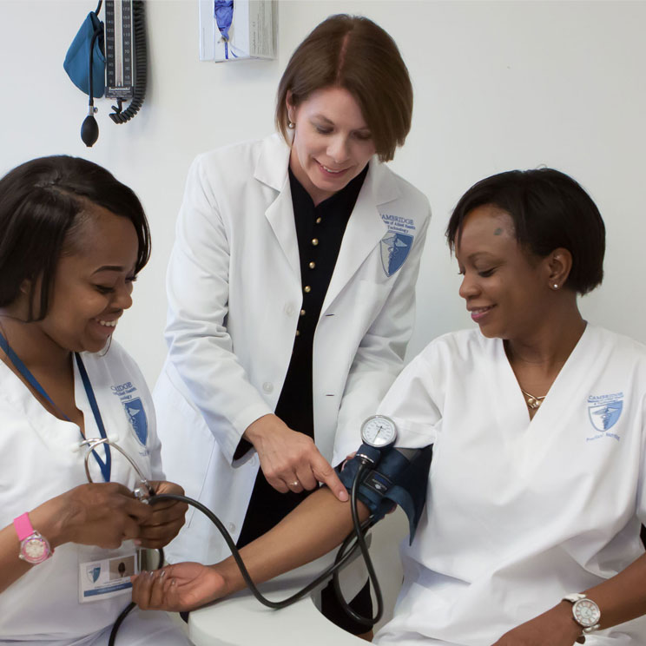
Central Alabama Community College
Associate in Applied Science and Certificate in Medical Assisting Technology (CIP 51.0801)
According to the Occupational Outlook Handbook, the 2017 median pay for Medical Assistants was approximately $32,481 a year or $15.61 an hour.
According to CEN officials, in the fall 2017, twenty-nine applicants were initially placed on the waiting list for admission to the nursing program, and in fall 2016 twenty-six were initially placed on the waiting list. The proposed Medical Assistant Technology program would provide an attractive option for applicants who are not accepted into the nursing program, and for other individuals seeking a healthcare career outside of nursing.

Slide 83

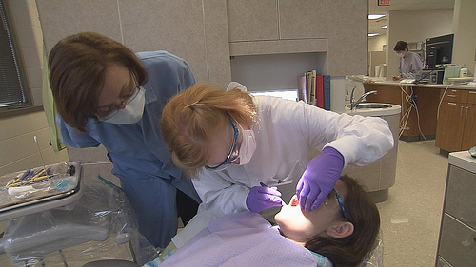
Gadsden State Community College
Associate in Applied Science in Dental Hygiene/Hygienist (CIP 51.0602)
GAD officials will seek accreditation through the Commission on Dental Accreditation (CODA) in order for its graduates to be employed nationwide.
Over the next 7 years, projected job openings indicate a total of 67 Dental Hygiene/Hygienist positions in GAD service area, and 700 job openings around the state.
According to the Occupational Outlook Handbook, the average annual salary for a Dental Hygienist is approximately $44,972.

Slide 84

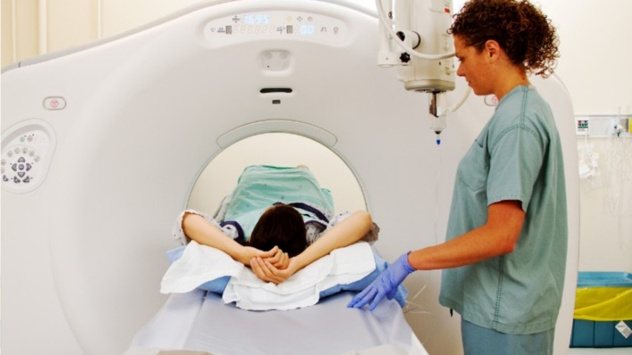
Northwest Shoals Community College
Associate in Applied Science in Radiologic Technology (CIP 51.0911)
According to the program application, demand in the local area is strong and is projected to grow stronger. According to the Director of Imaging Services at Shoals Hospital in Muscle Shoals, radiologic services had to shut down three days a week during fall 2017 due to a lack of personnel.
Local demand for Radiologic Technology technicians will continue as a new hospital is currently under construction in Florence, Alabama that will replace Eliza Coffee Memorial Hospital. There will be an increased need for personnel to staff the new facility.

Slide 85
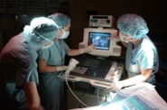
Northwest Shoals Community College
Associate in Applied Science in Diagnostic Medical Sonography (CIP 51.0910)
In Northwest Alabama, demand for diagnostic medical sonographers is strong and is projected to grow. Currently, there are three hospitals within a 10-mile radius of the Muscle Shoals campus; one hospital also has an outpatient imaging center. An additional four hospitals are located within 50 miles of the Muscle Shoals campus. All these facilities utilize diagnostic medical sonographers.
According to the application, a total of six (6) obstetrics and gynecology offices, three (3) cardiology offices, and one (1) vascular center are within a 10 miles radius of the campus which house over 25 healthcare providers.

Slide 86

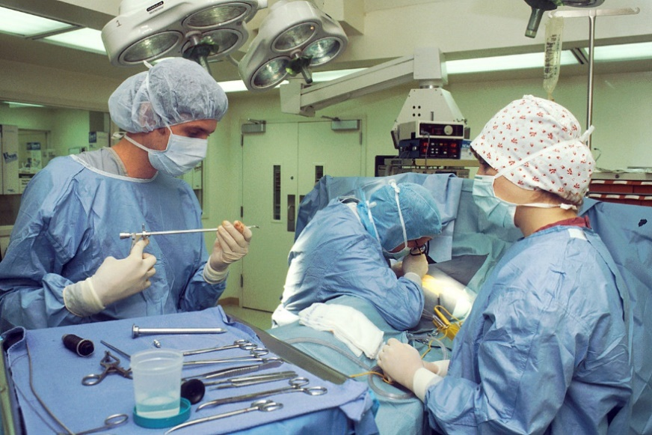
Wallace State Community College
Associate in Applied Science and Certificate in Surgical Technology (CIP 51.0909)
WSD officials have received several letters of support from local area health facilities in support of the program which includes offering clinical space and job training for the proposed program.
According to Occupational Outlook data, the 2017 median pay for Surgical Technologists is $46,310 per year or $22.26 per hour.

Slide 87














FOUR-YEAR INSTITUTIONS

Slide 88

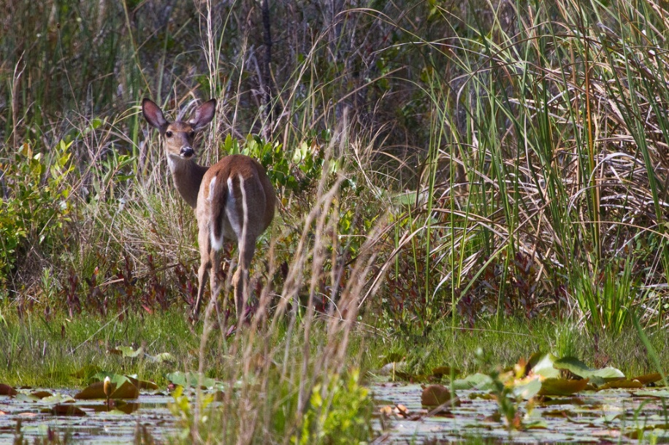
Auburn University
Bachelor of Science in Wildlife Enterprise Management (CIP 03.0207)
The eight tenure-track wildlife faculty of Auburn's School of Forestry and Wildlife Sciences has a strong research program in Wildlife Management and Ecology, with close ties to the network of local, regional and international industries and individuals associated with wildlife and fisheries.
Employment opportunities for graduates of this program will be in outdoor recreation or nature-based tourism, management of outdoor recreation facilities (nonprofit and for-profit), marketing, hunting, fishing, and other natural resource related enterprises.

Slide 89


Auburn University
Bachelor of Science in Biological and Agricultural Technology Management (CIP 01.0106)
Auburn University's College of Agriculture, including the Department of Biosystems Engineering, has been addressing issues in agricultural systems for over 100 years.
Faculty in the Department of Biosystems Engineering train students to manage the systems and technologies needed to produce, transport, store and use natural resources to meet humanity's most fundamental needs such as safe and abundant food, clean water, fiber, and renewable sources of fuel.
There are no similar programs in the state at this time.

Slide 90

Auburn University
3. Bachelor of Science in Philanthropy and Nonprofit Studies (CIP 19.0707)
Auburn's College of Human Sciences is home to the Cary Center for the Advancement of Philanthropy and Nonprofit Studies. The programming offered through the center will provide partnership opportunities for students selecting the proposed program.
Faculty in the Department of Biosystems Engineering train students to manage the systems and technologies needed to produce, transport, store and use natural resources to meet humanity's most fundamental needs such as safe and abundant food, clean water, fiber, and renewable sources of fuel.
There are no similar programs in the state.

Slide 91

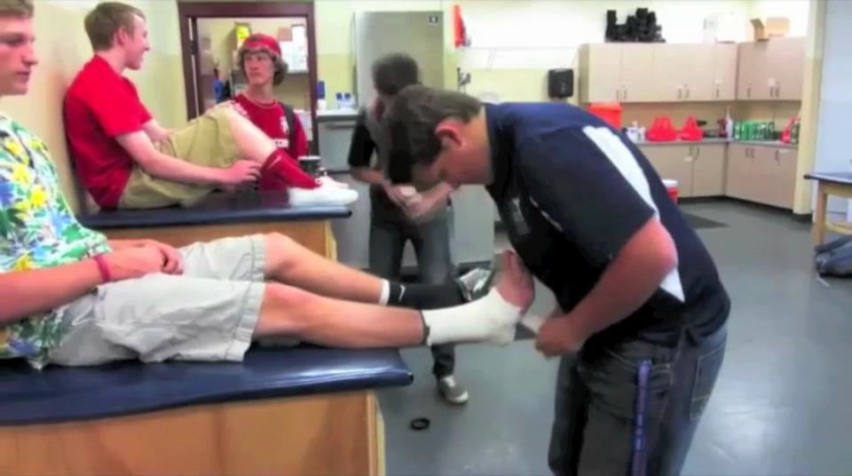
Troy University
Master of Science in Athletic Training (CIP 51.0913)
CAATE Standards for Accreditation of Professional Athletic Training Programs will now require that all professional programs be at the master's degree level with a specific implementation deadline no later than the fall of 2022.
Athletic trainers work in a variety of settings, including high schools, colleges and universities, professional sports, rehabilitation clinics, the military, entertainment, and corporations.
The move to the entry-level master's degree will place athletic trainers on par with other allied health professions.

Slide 92


University of Alabama at Birmingham
Master of Arts in Educational Studies (CIP 13.0101)
The proposed program will draw from existing faculty and courses in the School of Education at UAB. Neither new faculty nor new courses will be needed.
The program will not lead to teacher certification; however, graduates of the program will be prepared to seek employment within the field of education, mainly as teachers or coordinators in private schools or other educational entities, including corporate training and development.

Slide 93


University of Montevallo
Bachelor of Arts/Bachelor of Science in Computer Science (CIP 11.0701)
The Career and College Readiness/Preparation projected job openings indicate 570 jobs related to Computer Science will be available over the next seven years in UM’s service area.
According to the proposal, there is sufficient student demand indicating interest in the proposed program.

Slide 94


University of South Alabama
1. Master of Science in Rehabilitation Sciences – Speech Language Pathology (CIP 51.2314)
The program will help the University of South Alabama meet its commitment to diversity and a global perspective.
The program will increase opportunities for USA’s current undergraduate and graduate students to interact with international students.
The proposed program will increase the number of international collaborations in research, scholarly, and creative activities at USA.

Slide 95

University of South Alabama
2. Master of Science in Rehabilitation Sciences – Occupational Therapy (CIP 51.2314)
The Department of Occupational Therapy has a 46-year history of excellence in producing occupational therapy clinicians.
The proposed program will increase the global dissemination and impact of research and scholarship produced by USA faculty and postdoctoral fellows; increase the diversity of the student body; increase the incorporation of global perspectives into the educational environment; and increase engagement with international businesses and organizations.

Slide 96
O. INFORMATION ITEMS

Slide 97
O. INFORMATION ITEMS
Implementation of Distance Education Programs
Implementation of Non-Degree Programs at Senior Institutions
Implementation of New Short Certificate Programs (Less than 30 Semester Hours)
Change in the Name and Establishment of Centers and Departments
Changes to the Academic Program Inventory
Annual Off-Campus Site Follow-up Report for Academic Year 2017-2018
Extensions/Alterations to Existing Programs of Instruction

Slide 98
XI. ADJOURNMENT

