Slide 1

Alabama Commission on Higher Education
Commission Meeting
March 15, 2019

Slide 2

CALL TO ORDER and PLEDGE OF ALLEGIANCE

Slide 3

II. ROLL CALL and
QUORUM DETERMINATION

Slide 4

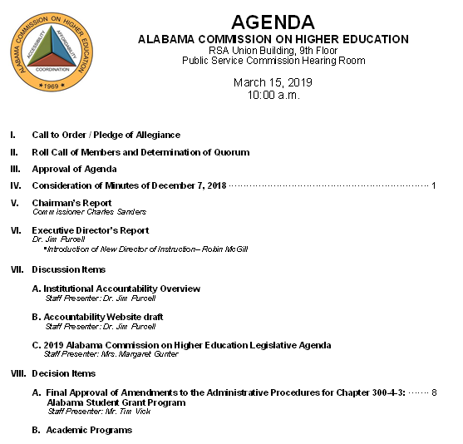
III. APPROVAL OF AGENDA

Slide 5

IV. APPROVAL OF MINUTES
Approval of Minutes of December 7, 2018

Slide 6

V. CHAIRMAN’S
Report

Slide 7

VI. EXECUTIVE DIRECTOR’S
Report

Slide 8

Introduction of New Director of Instruction

Slide 9
Robin McGill, Phd.
Bachelor of Arts in Classics, University of Georgia.
Master of Letters in Classics, University of St. Andrews, Scotland,
Ph.D. in Classical Literature from Brown University, Rhode Island.
Dr. McGill taught literature, language and history at Wheaton College in Norton, Massachusetts.
Currently serving as the Director of Strategic Initiatives at the Rhode Island Office of the Postsecondary Commissioner.
Starts in May as Director of Instruction.

Slide 10
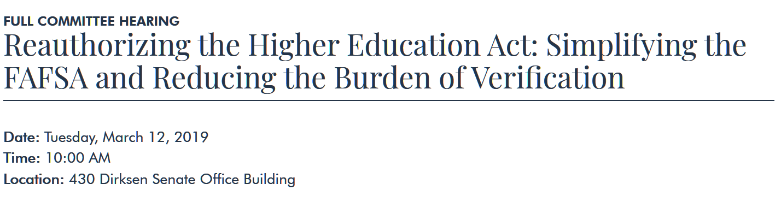
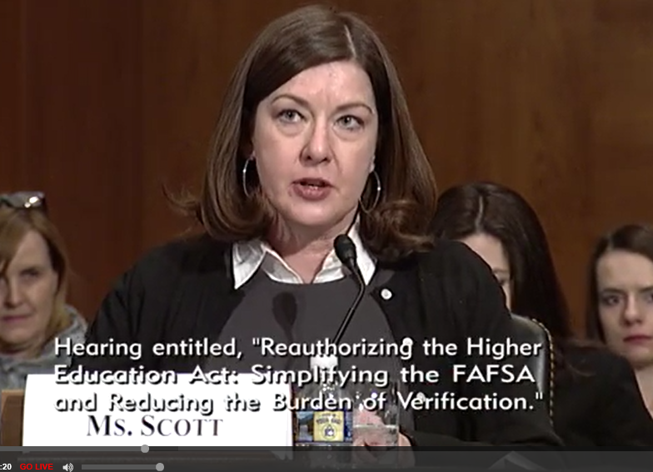

Kristina Scott, Executive Director

Slide 11
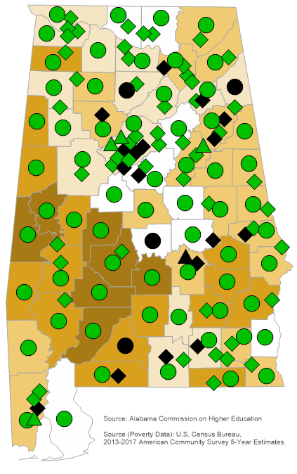



Slide 12
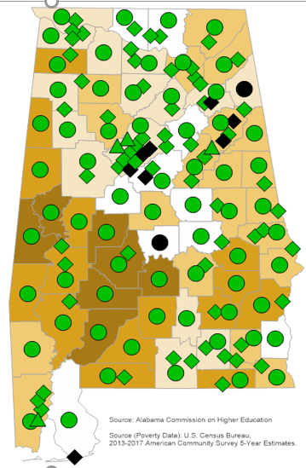

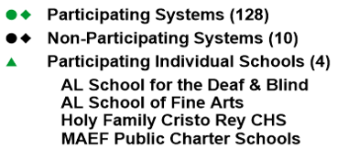

Slide 13



Guided Pathways and Financial Aid Metrics Community of Practice
Dr. Jim Purcell, Executive Director of the Alabama Commission of Higher Education.
Dr. Yardley Bailey, Assistant Vice Chancellor for Academic and Student Affairs and Director of Institutional Research for the University of Alabama System.
Ms. Kelly Birchfield Rich, Director of the Office of Institutional Effectiveness and Research for the Alabama Community College System.
Dr. Matthew Campbell, Senior Institutional Research Analyst, Auburn University.
Mrs. Subrena Simpkins, Director of Research Services, Alabama Commission of Higher Education.
Mr. Nick Moore, Education Policy Advisor, Alabama Governor’s office.

Slide 14

March 8, 2019
27% of Americans think that government funding for higher education has risen since 2009 and 32% said it has stayed the same.
22% believed “grants and loans” have kept pace and 20% believed increased relative to tuition.
Survey conducted by American Public Media and The Hechinger Report
“Further discouraging evidence that there isn’t necessarily a lot of support for increasing funding to public colleges and universities if the public believes they’re already supported in the way they should.” – Kevin McClure of UNC –Wilmington.

Slide 15
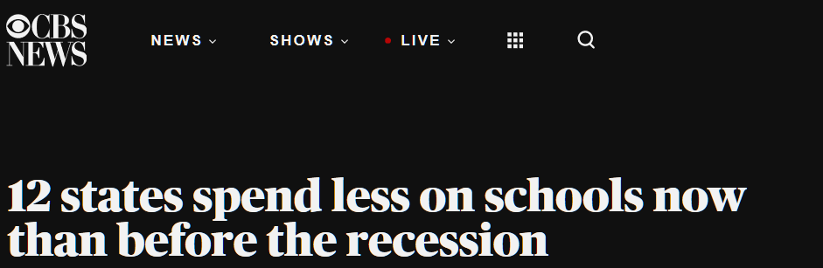
12 states where per-student state funding, adjusted for inflation, declined from 2008 to 2019. Asterisks indicate where teachers went on strike.
Texas: 20 percent,
Oklahoma*: 15 percent
Alabama: 15 percent
Kentucky*: 13 percent
Kansas: 12 percent
Michigan: 9 percent
West Virginia*: 8 percent
Utah: 8 percent
North Carolina*: 7 percent
Arizona*: 6 percent
Mississippi: 3 percent
Idaho: 3 percent

Slide 16

Funding Changes to the
Education Trust Fund
2014 changes reduced the ETF share of “use” taxes. That allows more of that tax revenue to go to the general fund. Now only 47% goes to ETF.
In addition, the new internet tax share of revenue split is 75% to the general fund and 25% to education.
This is the first year that the trust fund revenue (tax) sources will generate revenue at 2008 levels.

Slide 17
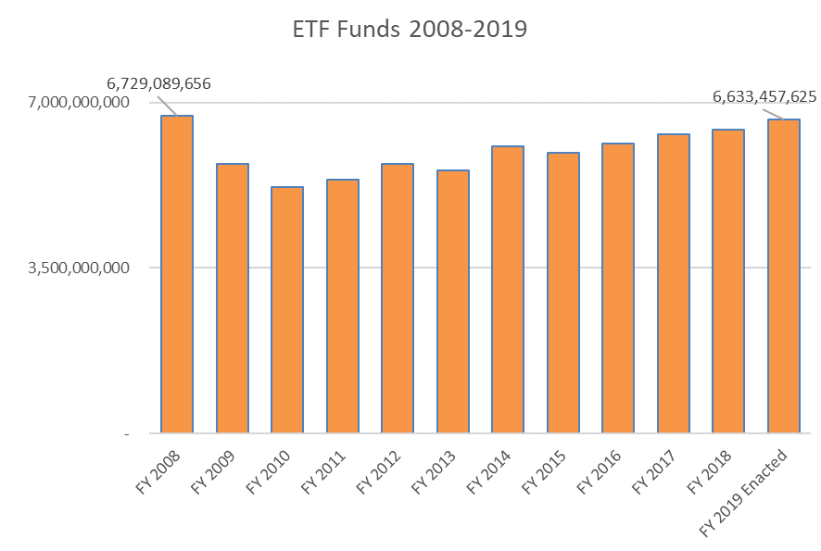
Educational Trust Fund since 2008-2019
Dollars

Slide 18
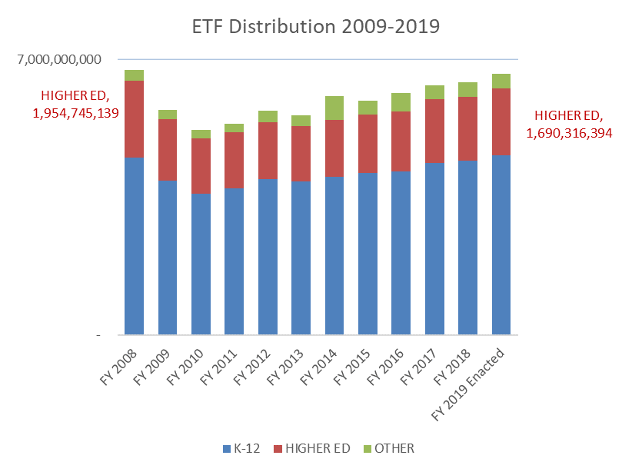
Educational Trust Fund since 2008-2019
Dollars

Slide 19
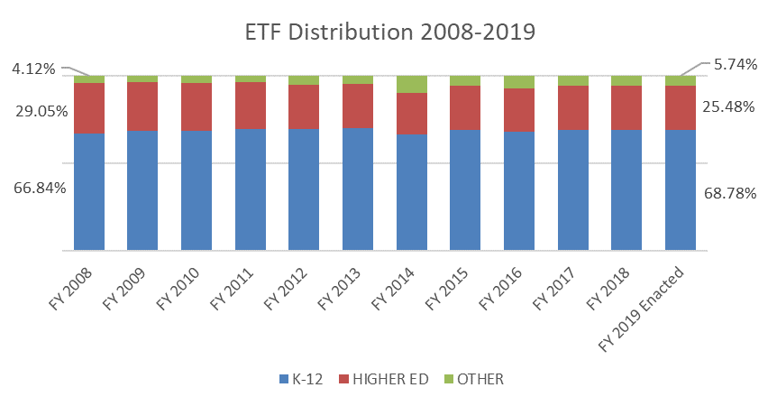
Educational Trust Fund since 2008-2019
Share of Funding

Slide 20
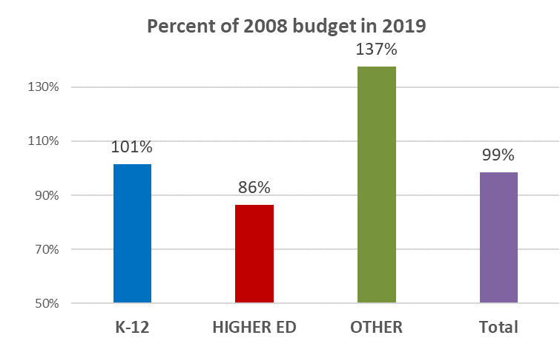
Percent of 2008 Budget received in 2019

Slide 21
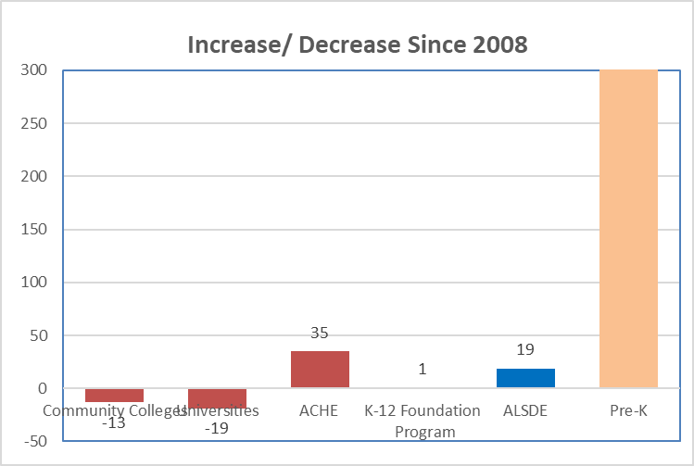
Percentage Increase/Decrease since 2008
798%

Slide 22

Financial Aid
Up $77,6915,940 (225%) since 2008
91% of the increase in financial aid is in Veterans Affairs scholarships (302% increase)
Financial aid is not funding for institutions (Colleges and universities collect tuition and fees regardless of revenue source.)
Does not reduce the need for tuition increases

Slide 23
Where Undergraduate Resident Tuition Has Risen Most Sharply at Alabama Public 4-Year Institutions
$5,750 increase
Percent change in annual tuition and required fees over the last decade,
2009-10 to 2018-19
$3,780
increase

Slide 24
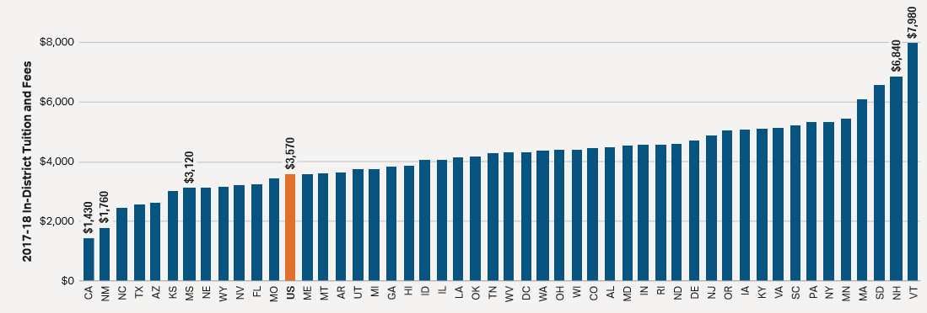
Tuition and Fees by State: Public Two-Year
In 2017-18, average published tuition and fee prices for in-state students at public two-year institutions range from $1,430 in California to $7,980 in Vermont.
ALABAMA in-state tuition and fees $4,490
SOURCE: The College Board

Slide 25
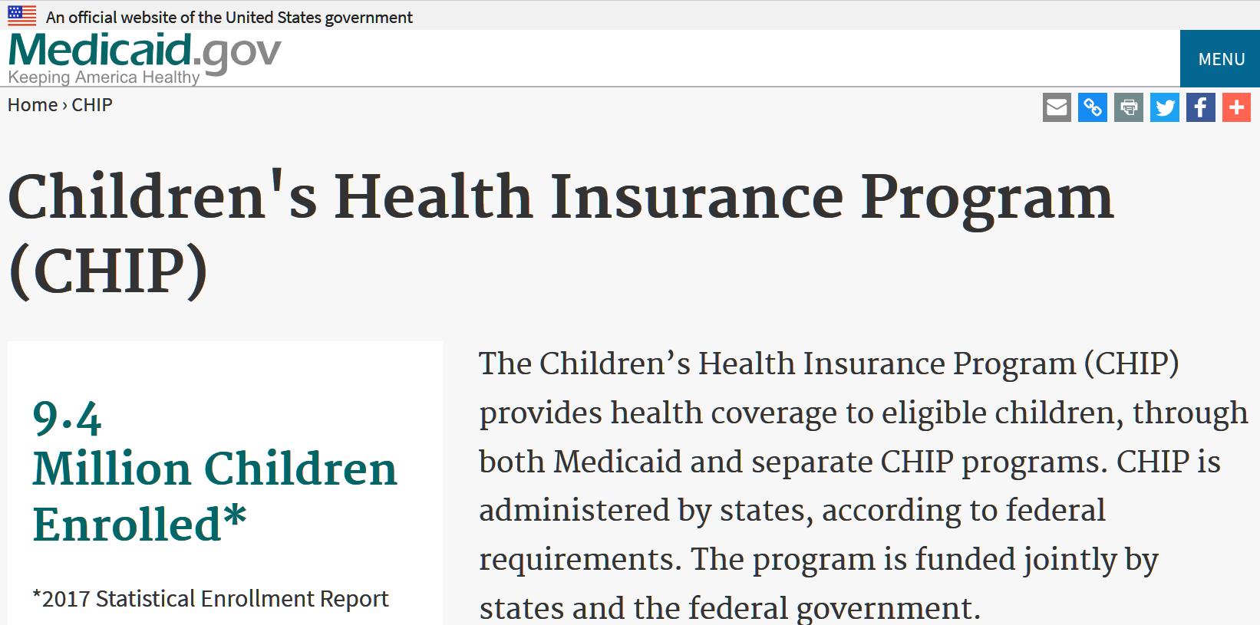

Possible funding Changes
Possibly include CHIP in ETF expenses -- Children Health Insurance Program
  estimated to be $23.4 million this year.
  the estimated cost for CHIP in 2021 will balloon to $64 Million!
84,000 Children in Alabama covered under “ALL Kids”

Slide 26
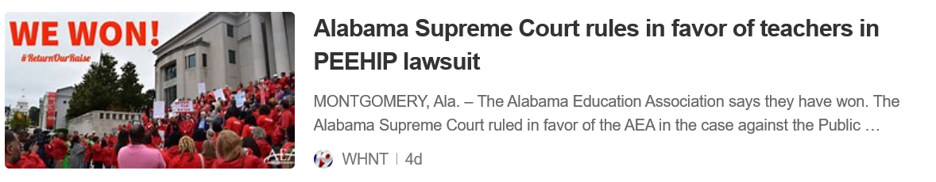
PEEHIP
No impact for FY 2020

Slide 27

A decade behind and counting

Slide 28
Future Reviews by Commissioners

Slide 29
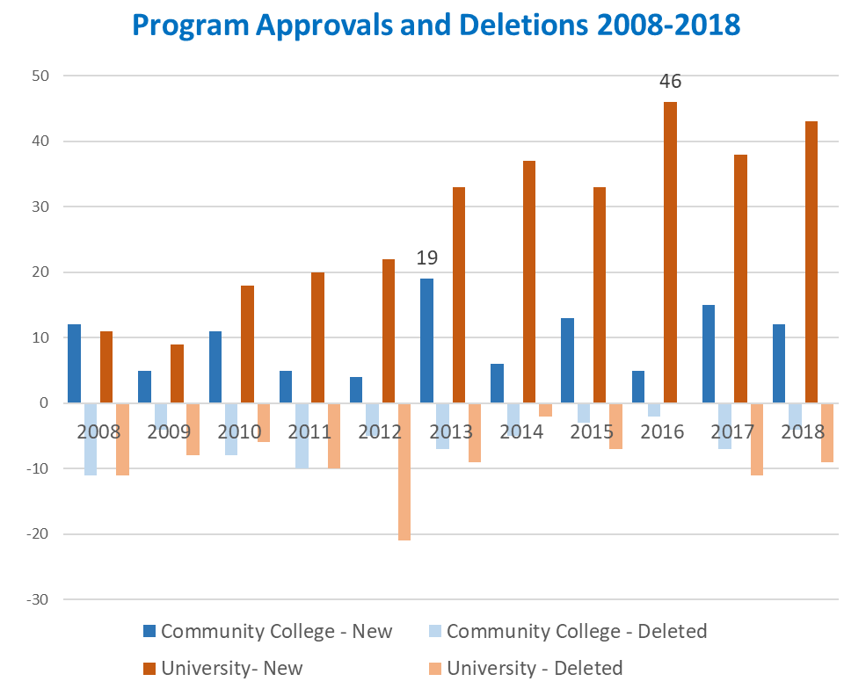
Post-Implementation Review

Slide 30


Consolidated Budget Recommendation for
FY 2019-2020
Peer Comparison Adjustment
NCHEMS was contracted by ACHE to develop statistical peers for each AL public institution.
  NCHEMS provided IPEDS data for all institutional peers & AL institutions. Staff used the IPEDS data to make comparisons of state support.
  Alabama institutions found to be supported at less than 90% of their peer average were given an adjustment to address the significant variance.
  The amount added was less than $9 million or an increase of less than 1%.

Slide 32

Peers: Beauty in the eye of the Beholder
Aspirational
Organizational
Promotional
Statistical
Peers based upon similar instructional mission, program mix, student characteristics, Carnegie Classification and degree production.

Slide 33
Intend to continue including this calculation as a part of the Consolidated Budget Recommendation
Offered campuses opportunities to recommend changes to their “statistical” peers
Timeline:
  Conversations with ACHE staff on peers
  March 1- May 1
  Conference calls with NCHEMS to discuss further May 1 – July 1

Slide 34

VII. Discussion ITEMS

Slide 35
Institutional Accountability Report
Staff Presenter: Dr. Jim Purcell

Slide 36
B. Accountability Website Draft
Staff Presenter: Dr. Jim Purcell

Slide 37
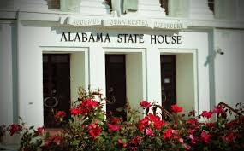
C. 2019 ACHE Legislative Agenda
Staff Presenter: Margaret Gunter
2019 Legislative Session

Slide 38

Education Trust and General Funds
In Good Shape
The ETF appropriation cap for 2020 is $7.1B
ACHE recommends at least 5% for all institutions
Some institutions were recommended to get additional funds based on statistical PEER adjustments

Slide 39


Equalize Financial Aid Programs
Increase:
Alabama Student Assistance Program from $4.1M to $5.2M
Alabama Student Grant Program from $5M to $5.2M

Slide 40
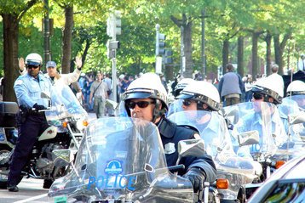
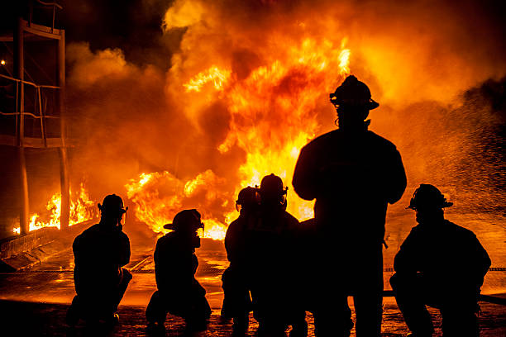
Police Officer’s and Firefighter’s Survivor’s Education Assistance
Proposed an increase in funding from $250,725 to $302,000
A Bill is being considered that will extend benefits to reservists

Slide 41

Alabama National Guard
Recommended an increase in funding from $4.6M to $4.9M
Bill to specify full coverage of tuition and fees

Slide 42

Human Capital Development Fund
Meeting the Demands of the Workplace
Proposes $2M to distributed by competitive RFP among public institutions
Workforce priorities to be determined by the
Governor’s Workforce Council

Slide 43
National Student Clearinghouse Data
Requesting $30,000
Expand data capabilities that would establish a freshman cohort of students in public Alabama higher ed. institutions to track where they graduated within the United States

Slide 44
Economic Opportunity Guarantor Bill
Utility Deposits:
College graduates relocating within Alabama –
State acts as guarantor for utility deposits
Electrical
Gas
Water

Slide 45

Convening of Education Deans Bill
Education deans would meet two times a year
Planning sessions to improve student access and success
Provide an annual report with recommendations to the Legislature

Slide 46
Experimental Program to Stimulate Competitive Research (EPSCOR)
Of the above appropriation, at least up to thirty percent (30%) shall may
be expended for the operations and maintenance of the Alabama Experimental Established Program to Stimulate Competitive Research (Alabama EPSCOR).

Slide 47





Targeted Teacher Recruitment
Hawaii: SB2278 – Teacher Home Assistance Program
Illinois: HB4280 – Growing Future Educators Program
Virginia: SB349 – Changes to provisional license
Alabama: HB261 – Alabama Math and Science Teacher Education Program

Slide 48
Alabama Math and Science Teacher Education Program
Federal Loan Repayment Program for
Qualifying Math or Science Public High School Teachers
$725,000 allocated in 2018-2019 budget
33 teachers applied
27 teachers approved by ALSDE
18 teachers awarded $48,750
3 teachers in “high risk districts” receive an additional $1,250

Slide 49

VIII. Decision ITEMS

Slide 50

A. Final Approval of Amendments to the Administrative Procedures for Chapter 300-4-3: Alabama Student Grant Program
Staff Presenter: Mr. Tim Vick
The purpose of these amendments are to:
  Allow for one-time application
  Reduce the number of required proofs of Alabama residency
  Clarify certain definitions
  Eliminate/replace obsolete language

Slide 51

B. Academic Programs

Slide 52














FOUR-YEAR INSTITUTIONS

Slide 53


Troy University
Request to Amend Post-Implementation Conditions: Bachelor of Arts in Spanish (CIP 16.0905)
The program did not meet post-implementation condition for graduates. The conditions were met for enrollments, employment, and the submission of an overall assessment of the program.
Troy is requesting an additional two-year review period (2018-19 and 2019-20) be granted. In this additional review period, the program will meet a post-implementation condition of 7.5 annual graduates, revised from the original condition of 8 graduates. The institution will submit, no later than September 1, 2020 a post-implementation report demonstrating that the program met the post-implementation conditions for graduates for the specified period.
According to Troy officials, there are currently 30 Spanish majors in the program. These enrollment numbers project additional graduates sufficient to meet or exceed the original graduate projections in the next two years.
Faculty and administration have worked together to refine the Spanish major degree map to include a progressive order of courses with consistent availability. Troy officials have carefully reviewed course descriptions and listings in the school’s academic catalog, and are working together to place increased emphasis on student advisement and degree planning.
The request is for a two-year timeframe extension to achieve the graduation annual average figure of 7.5, revised from the original request of 8 graduates.

Slide 54

Troy University
2. Request to Amend Post-Implementation Conditions: Bachelor of Science in Physics
(40.0801)
The program did not meet post-implementation condition for graduates. The conditions were met for enrollments, employment, and the submission of an overall assessment of the program.
Troy is requesting an additional two-year review period (2018-19 and 2019-20) be granted. In this additional review period, the program will meet a post-implementation condition of 7.5 annual graduates, revised from the original condition of 8 graduates. The institution will submit, no later than September 1, 2020 a post-implementation report demonstrating that the program met the post-implementation conditions for graduates for the specified period.
Troy officials states that the Physics program is highly structured with multiple pre-requisite courses that must be taken in sequence. This structure makes it unlikely that new students in the program will graduate before the fourth year of the program’s existence.
According to Troy officials, based on current enrollments, graduation rates are expected to increase. At present, Troy officials project at least 30 graduates in years six through nine. Additionally, faculty members from the Physics program are working with 40 local high school teachers to increase awareness of STEM programs, which is expected to result in an increase interest in Physics.
The request is for a two-year timeframe extension to achieve the graduation annual average figure of 7.5, revised from the original request of 8 graduates.

Slide 55


University of North Alabama
1. Master of Science in Sport and Recreation Management (CIP 31.0504)
Students in the proposed program will learn to become global leaders who serve in the world of sport and recreation by improving their capabilities in understanding front office management and the business theory behind sports.
The program will be offered 100% online.
Graduates of the proposed program will be able to find employment opportunities as an Athletic Director, Sports Information Director, Sports Personality; Sports Broadcaster, Sports Photographer, and many other occupations related to Sport and Recreation.

Slide 56
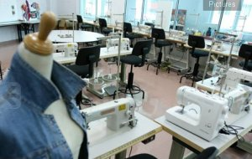
University of North Alabama
2. Bachelor of Science in Fashion Merchandising and Design (CIP 19.0901)
The proposed degree program will prepare students for careers in retail, manufacturing, wholesaling, visual merchandising, marketing, design, styling, and other areas of creative expression in the fashion industry.
The program will have tracks in Fashion Merchandising and Apparel Design.
The program will meet the demand for expected job growth in the fashion industry in the State of Alabama. The Alabama Department of Labor projects approximately 4,000 jobs in the fashion industry in the state by 2026.

Slide 57

University of North Alabama
3. Bachelor of Science in Hospitality and Events Management (CIP 52.0901)
The Bachelor of Science in Hospitality and Events Management is a program for individuals who want a career in the hospitality industry. These students will be better positioned to work in all of the various branches of the hospitality and event planning business, in both front-of-the-house and back-of-the-house, supervisory and management level positions.
Employers in hospitality and event planning value individuals with a formal education in the field since they enter the workforce with both a background of theoretical knowledge and the practical skills required to work in the industry.
According to the Bureau of Labor Statistics, the demand for graduates with the proposed degree is expected to grow as employment of meeting, convention, and event planners is projected to grow 11 percent from 2016-2026, faster than the average for all occupations.

Slide 58

University of North Alabama
4. Bachelor of Fine Arts in Interior Architecture and Design (CIP 04.0501)
The core objective of the proposed Bachelor of Fine Arts program is to prepare well rounded students for entry-level positions in the Architecture and Design industry, including Residential Design, Commercial Design, Hospitality Design, Healthcare Design, Lighting Design, Drafting and Construction Documentation, Interior Architectural Detailing, and Product Representation.
Students who complete the proposed program will be eligible to become a Registered Interior Designer (RID). The Alabama Board for Registered Interior Designers require interior designers to pass the National Council for Interior Design Qualification examination to register as a RID.

Slide 59
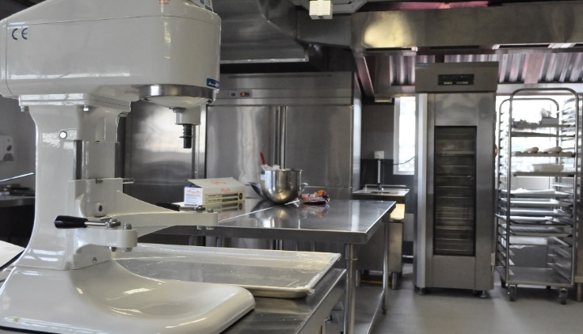
University of North Alabama
5. Bachelor of Science in Culinary Arts Management (CIP 52.0905)
The core objective of the proposed program will be to prepare students to plan, manage, and market themselves in the culinary and/or food service industry. The program will focus on the development of advanced culinary techniques, management and leadership skills, and innovation and entrepreneurship. Graduates of the program will be prepared for successful entry into a variety of service and administrative positions in the culinary and/or food service industry.
There are no other four-year degree programs in the state in the culinary field. The proposed program will provide a unique set of skills for individuals serving and managing food service industries and any related field where food is prepared and served

Slide 60


University of South Alabama
1. Alteration of the Doctor of Business Administration in Business Administration (CIP 52.0201)
University of South Alabama (USA) currently has the Doctor of Business Administration (DBA) in Business Administration (CIP 52.0201) in the Commission’s Academic Program Inventory. USA has proposed a change to the degree nomenclature from Doctor of Business Administration (DBA) to Doctor of Philosophy, (PhD). There is no change in the program title or CIP code.
Business Administration, DBA PhD
The proposed change will (1) better reflect the quantitative research focus and academic preparation graduates receive; (2) enhance the competitiveness of those graduates in the academic marketplace; and (3) augment the program’s credibility to national and international employers.

Slide 61


Auburn University
1. Master of Science in Data Science and Engineering (CIP 11.0802)
The proposed graduate program will prepare students for careers in Data Science and Engineering, where valuable insights are derived from massive amounts of raw data.
The proposed curriculum will offer a balance between statistical theory and computing and engineering application, equipping students with skills and state-of-the-art technologies related to the next generation of large data applications. The degree will focus on the scientific and engineering aspects of large data. According to AU officials, the emphasis on practical science and engineering fits the University's land-grant mission.
Both state government and industry in the state generate huge volumes of data about citizens and customers as part of their daily operations. Data science and engineering offer statistical and computational tools to analyze and derive actionable insights from this data.

Slide 62
C. INFORMATION ITEMS

Slide 63
Implementation of Distance Education Programs
Implementation of Non-Degree Programs at Senior Institutions
Implementation of New Short Certificate Programs (Less than 30 Semester Hours)
Change in the Name and Establishment of Centers and Departments
Changes to the Academic Program Inventory
Annual Off-Campus Site Follow-up Report for Academic Year 2017-2018
Extensions/Alterations to Existing Programs of Instruction
Athens State University, Addition of a Class B Certification in Health Education
(6-12) to the Existing BSEd in Physical Education (CIP 13.1314)

Slide 64
IX. ADJOURNMENT

