Slide 1
Alabama Commission on Higher Education
Commission Meeting
September 13, 2019

Slide 2
CALL TO ORDER and PLEDGE OF ALLEGIANCE

Slide 3
II. ROLL CALL and QUORUM DETERMINATION

Slide 4
III. APPROVAL OF AGENDA
Commission Meeting Agenda of September 13, 2019

Slide 5
IV. CONSIDERATION OF MINUTES
Executive Committee Minutes of June 7, 2019
Commission Meeting Minutes of June 7, 2019

Slide 6
V. CHAIRMAN’S REPORT

Slide 7
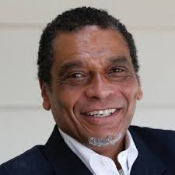
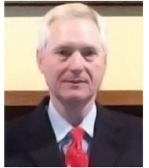
Welcome to New Board Members
Stan Nelson,
Anniston resident, replaces Bill Jones
Rod Scott,
Jefferson County Representative, replaces Charles Ball

Slide 8
Nominating Committee Report
Election of Officers

Slide 9
VI. EXECUTIVE DIRECTOR’S REPORT

Slide 10
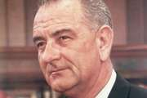
Public Higher Education’s role in Economic Development
President Lyndon Johnson announced the ”Unconditional War on Poverty” in 1964.
He considered the depth and extent of poverty in the country (nearly 20 percent of Americans at the time were poor) to be a national disgrace that merited a national response.
“The cause may lie deeper in our failure to give our fellow citizens a fair chance to develop their own capacities, in a lack of education and training, in a lack of medical care and housing, in a lack of decent communities in which to live and bring up their children.”

Slide 12
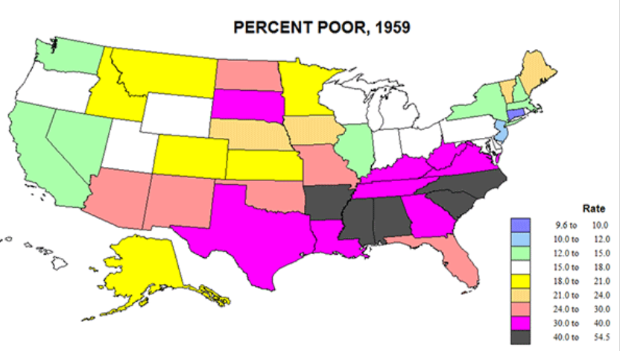

Slide 13
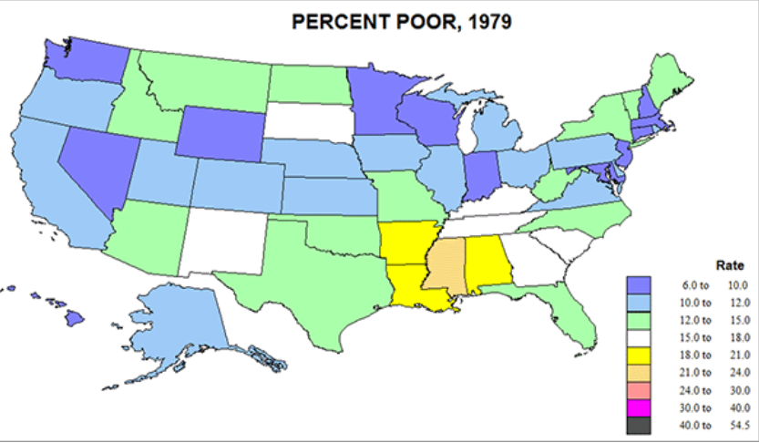

Slide 14
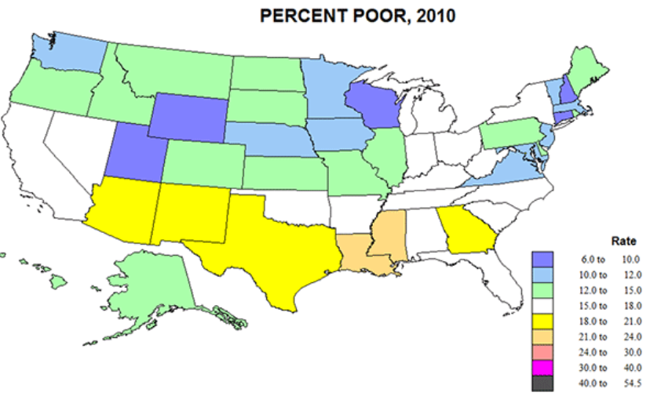

Slide 15
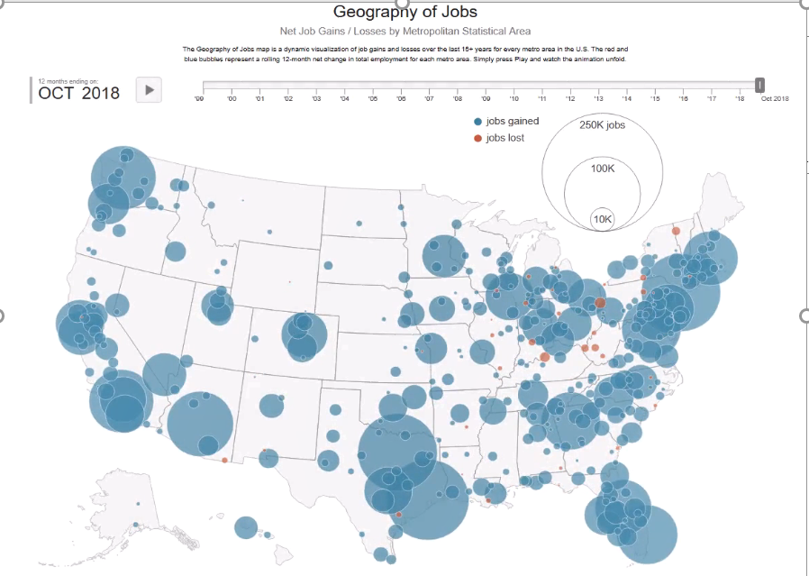

Slide 16
Density of educated/ skilled workers
Alignment of skills to jobs
Access to hospitals
Access to good schools, colleges, universities
Local leadership
Regional economic development strategies rather than state-wide strategies
Return to city-states
Sparta and Athens
Work ready communities

Slide 17
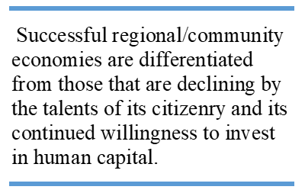

Slide 18
Persistent Poverty Rates of 20% and Above

Slide 19
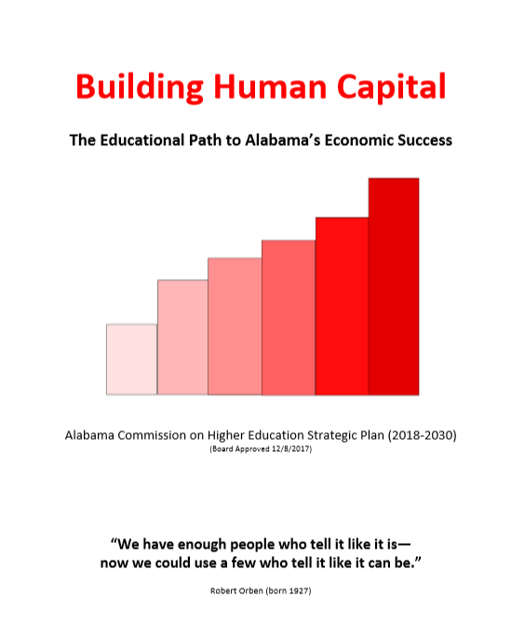
Increase Each Higher Education Institution’s Role as a Steward of the Communities in Their Service Area
Cultivate alliances with local communities and organizations
Collaborate with local communities and existing business and industry on efforts to expand economic growth
Work with foundation and community leaders to provide scholarships to local residents
Work with non-profit and community action groups to identify ways in which college and university expertise and volunteer student labor can be used to address local issues.
2. Identify the Workforce Needs of the State and Region and
Address Them
Develop an annual “human capital development fund” to be utilized to address critical workforce needs and to expand high demand high-wage programs of study
Identify the workforce needs of the state and within the service areas of the colleges and universities and expand programs in high demand for state and regional businesses. . .

Slide 20
2. Identify the Workforce Needs of the State and Region and
Address Them (continued)
Expand existing and potential workers’ opportunities to acquire and/or update their career skills through educational and training pathways that meet occupational demands
Expand the use of Dual Enrollment programs to train more people for the workforce including increasing the number of high school career and technical students enrolled in community colleges
Align higher education programs with labor market information
Study the migration pattern of graduates of Alabama colleges and universities
Actively engage business and industry with colleges and universities regarding workforce development needs and issues
Strengthen partnerships with advisory groups from business and industry to support workforce development.

Slide 21
Education is the key to opportunity in our society. LBJ

Slide 22
VII. Discussion ITEMS

Slide 23
A. Open Educational Resources (OER)

Slide 24
A. Open Education Resources Update
June ACHE Meeting, Qualitative report on OER
Testimonials from Faculty who participated in a pilot project
The ACHE and ACCS partnered to award twenty-three (23) mini-grants to faculty that agreed to offer a specific course using the current textbook, and the same course using some form of OER in the following semester.
Priority given to proposals for courses in the common core of courses such as English, math literature, history and the sciences.
September - the Quantitative results …

Slide 25
Financial Savings
Based on the summary reports from the faculty, the savings produced was $2,059,507.
The cost savings/cost avoidance per student was $228.

Slide 26
OER impact on student performance
The participating community college faculty taught courses using traditional textbooks to 1,699 students in the Fall 2018 semester and then offered the same course to 2,188 students using OER resources in the Spring 2019 semester. Grades were compared.

Slide 27
Findings, Overall
No statistical significant differences were found between courses with the standard textbooks or Open Education Resources.
No harm in using OER and savings.

Slide 28
Findings, Subpopulations
Pell grant recipients showed no statistically significant difference in performance in textbook versus OER courses. Pell students in MTH 112 and HIS 201 did yield statistical significant improvement White students showed a statistically significant difference in performance in courses using OER rather than the standard textbook. Minority students had no statistically significant improvement.
White female Pell recipients had higher grades when taking OER courses in the following subjects in MTH 112 and SOC200.
Black female Pell recipients had higher grades when taking OER courses in BIO101.
Adult Learners were found to have higher grades in courses that used OER than in courses using the standard textbook.
Statistical significance was determined using a Chi-Square with a p value < .05

Slide 29
B. Governor’s Office of Education and Workforce Transformation (GOEWT)

Slide 30
Strong Start, Strong Finish: An Education-to-Workforce Vision for Alabama
Governor Ivey has established a strategic vision for aligning Alabama’s education and workforce programs from pre-k to the workforce to provide for a seamless education-to-workforce continuum for all Alabamians.
Governor Ivey has set a postsecondary education attainment goal of adding 500,000 credential holders to Alabama’s workforce by 2025
and a goal to increase Alabama’s labor force participation rate of 57.6 percent to the national average by 2025.

Slide 34
Additional Credentials needed to be produced to address Workforce Demand needed in 2025
H.S. Diploma | 9,973 | 1%
Some College No Degree | -65,203 | -9%
High-Value Certificate | 130,586 | 18%
Associate | 113,995 | 16%
Bachelor’s | 260,588 | 37%
Master’s | 143,339 | 20%
Professional | 15,695 | 2%
Doctorate | 45,822 | 6%
 | 654,795

Slide 35
If the 500,000 target of credentialed workers is fully addressed by public higher education, it would require a 16% annual increase in degree production every year between now and 2025.
This would double degree production at all of our institutions by 2025.
Desire to do this
Without expanding the current college and university facility footprint
Without increasing the state subsidy for higher education
With a focus on high-demand high-wage programs
With more of a seamless transition between High school, Community Colleges and Universities
Holding higher education institutions accountable for addressing the needs of the state

Slide 36
If the 500,000 target of credentialed workers is fully addressed by public higher education, it would require a 16% annual increase in degree production every year between now and 2025.
This would double degree production at all of our institutions by 2025.
Desire to do this
Without extensively expanding the current college and university facility footprint
Without extensively increasing state support for higher education
With a focus on high-demand high-wage programs
With more of a seamless transition between High School, Community Colleges and Universities
Holding higher education institutions accountable for addressing the workforce needs of the state

Slide 37
Is the 500,000 credentialed workers achievable? Two destinies:
Meet the credentialed workforce target and have the economy that federal data projects for Alabama’s economy:
By educating Alabamians
By in-migration of credentialed workers or a
Combination of the two
OR
Migration of businesses to other states where the desired credentialed workforce is available
AND
Relegate Alabama to being a convenient location for low skilled, low wage workers.
Edward E. Gordon
The Bureau of Labor Statistics assures us that over the long term, labor supply and demand will balance. (page 18)

Slide 38
B. Governor’s Office of Education and Workforce Transformation (GOEWT)
Career Paths from HS through College
CTE that also earns College Credit and an industry credential in HS
Vocational dual enrollment
Expanding enrollment in high-demand, high-wage programs
Apprenticeships/work-based learning
Internships / co-ops,
Stackable credentials,
Micro-credentials
Career Pathways

Slide 39
A New Social Compact Predicated on Human Capital Development
Governor Ivey will submit a new four-year WOIA state plan in February 2020. By braiding federal and state workforce and education funding streams to produce an education-to-workforce pipeline. Alabama’s workforce development system will:
permit entry into an in-demand career pathway for Alabamians in all seasons of life.
Provide multiple entry and exits points for special and disconnected populations,
Create alignment between secondary and postsecondary CTE,
Co-enrollment between adult education and postsecondary CTE.

Slide 40
Eliminating Barriers to Education and Workforce Training for Special Populations
Addressing underserved populations:
Person with disabilities,
Persons from disadvantaged families,
Individuals preparing for non-traditional fields,
Single parents,
Out-of-work individuals,
English Learners,
Homeless,
Persons aged out of foster care,
Youth of active duty military

Slide 41
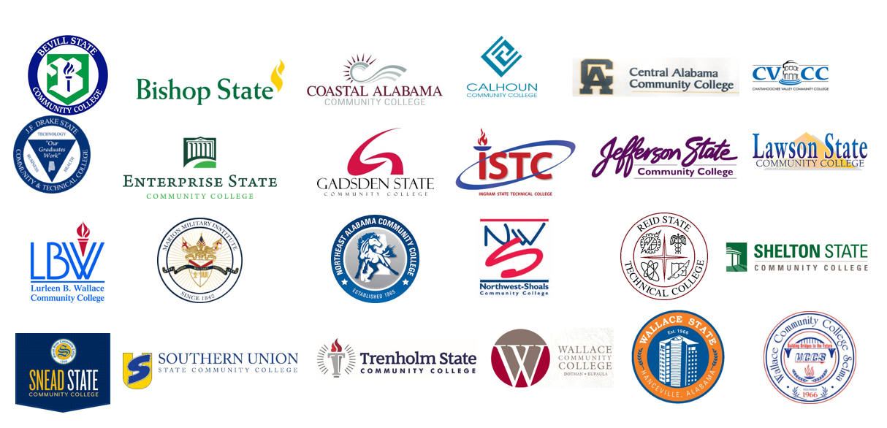
Regional and Campus Meetings

Slide 42
The Healthcare Services Career Pathway
Example career pathway
Career Pathways are easier to design than to implement
only 3% of new CNAs advanced to LPN or RN training
Source: Loprest and Sick (2018), “Career Prospects for Certified Nursing Assistants: Insights for Training Programs and Policymakers from the Health Profession Opportunity Grants (HPOG) Program", report to Office of Planning, Research, and Evaluation, Administration for Children and Families, U.S. Department of Health and Human Services.

Slide 43
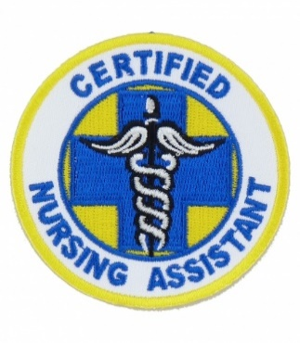
Certified Nursing Assistant Training
Training affordable and accessible to less academically proficient students. Requires only 6th grade level math and English competencies. Usually two/thirds earn the certificate/license.
Demand for CNAs is high and projected to grow by 10% a year for the next 10 years. We have to realize these jobs cannot sustain a family, unless subsidized.
Some of the cause of the demand is that turnover is very high. About one-third stayed in the job for more than 15 months.
Additional basic healthcare certifications help in wages. Add-on credentials are good, but it does not necessarily lead into a job. CNAs had higher average employment rates (8 to 12 percentage points higher) than did pharmacy technicians, phlebotomists, medical assistants, and medical records and health information technicians, all higher-paying occupations than CNA.
The next step on the career ladder can be challenging. CNA training does not really prepare a student to be an LPN or RN.

Slide 44
Throughout history, higher education has been asked to address the social and economic needs of our country. This is one of those times.

Slide 45
C. Initiative Updates
Credential Engine Registry and ACCCP
Lumina Equity Leadership Acceleration Grant
AIR Summer Melt Study

Slide 46
D. ACHE 50th Anniversary

Slide 47
On May 14, 1969 during a called Special Session, the Alabama Legislature passed Act 14, which created the Alabama Commission on Higher Education.

Slide 48
“The report reflects a healthy higher education community dedicated to the service of the people of the state of Alabama.”
Philip A. Sellers Chairman
Alabama Commission on Higher Education 1988-89 Annual Report

Slide 49
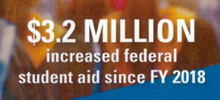
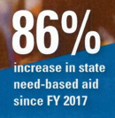
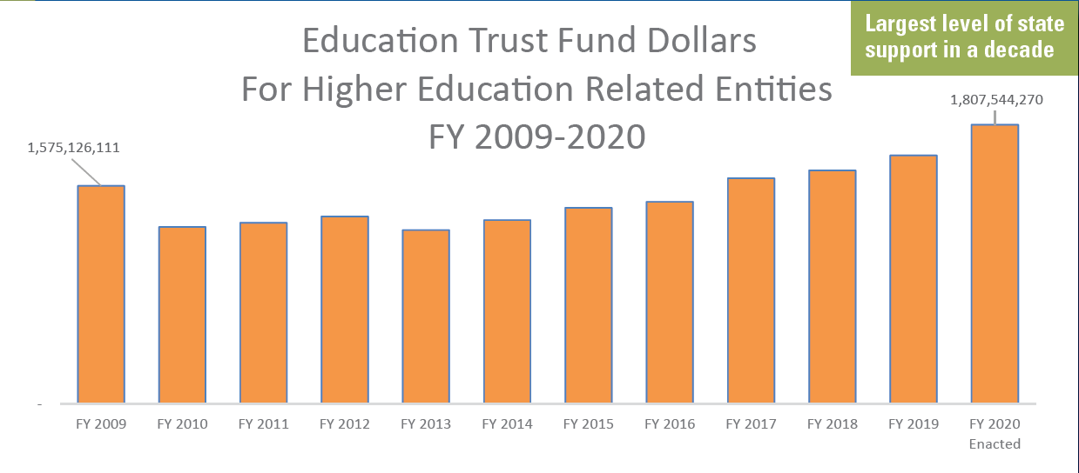
50 Years Later
12 MILLION +
Student Records in Alabama Statewide Student Database

Slide 50
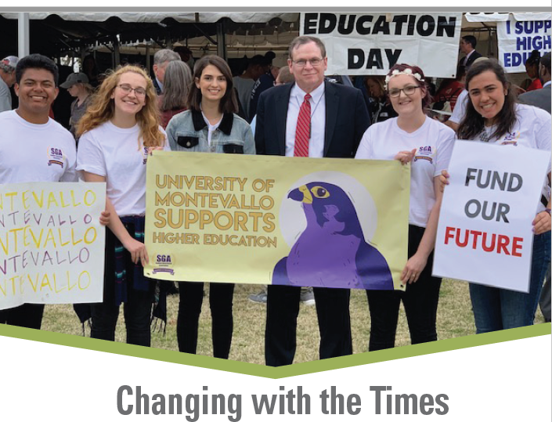
What Lies Ahead

Slide 52
VIII. Decision ITEMS

Slide 53
A. Fiscal Year 2019-20 Operations Plan

Slide 54
ACHE Budgetary Overview
The Commission has 27 programs under 6 appropriation units.
There are three new programs in the FY 2019-20 budget:
Deferred Maintenance Grant Program
Forestry Education Program
Alabama Recruit and Retain Minority Teachers Pilot
The FY 2019-20 budget represents a 28.2% increase over FY 2018-19.
The FY 2019-20 Operations Plan, showing quarterly expenditures, was submitted to Executive Budget Office (EBO) on July 31, 2018. Any changes made by the Commission can be made through a Operations Plan revision after October 1, 2019.

Slide 56
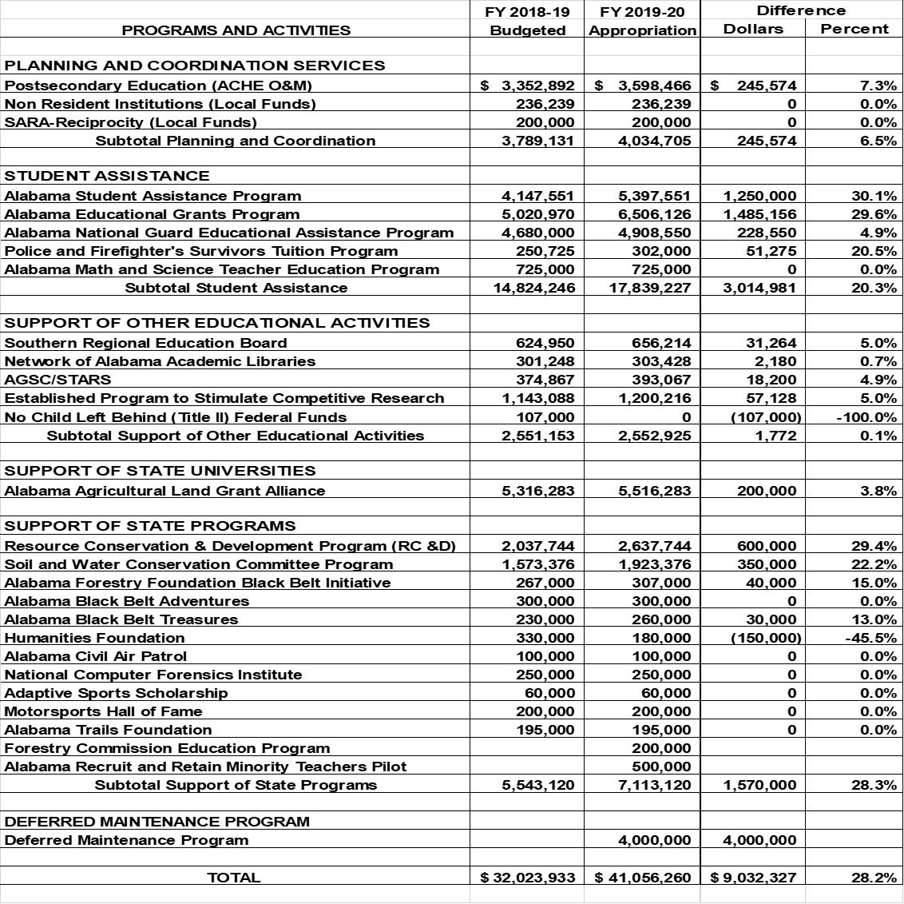

Slide 62
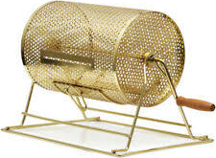
B. Public Drawing to Determine Order of Payment of ASGP Funds for 2019-20
Alabama Student Grant Program (ASGP) provides grants for eligible in-state students attending one of the following private institutions:
Amridge University
Birmingham Southern College
Faulkner University
Huntingdon College
Judson College
Miles College
Oakwood University
Since all funds cannot be disbursed immediately, drawing is needed to determine disbursement order by institution.
Samford University
Spring Hill College
South University - Montgomery
Stillman College
U.S. Sports Academy
University of Mobile

Slide 63
C. Approval of 2020 Meeting Schedule
Proposed Meeting Schedule for 2020
March 13, 2020
June 12, 2020
September 11, 2020
December 11, 2020

Slide 64
D. Preliminary Approval of Amendments to the Administrative Procedures for AMSTEP– Loan Repayment Program: Chapter 300-4-12
Purpose of Action: Alabama Act 2019-389 added Computer Science to the list of teaching fields eligible for inclusion in the Alabama Math and Science Teacher Education Program (AMSTEP).
This item incorporates Computer Science into the existing administrative procedures for AMSTEP.
Computer Science teachers employed in Alabama public schools may receive up to $3,000 per year to apply to federal student loan debt.

Slide 67
High-need districts and teachers who used AMSTEP
Barbour County
Bullock County
Butler County
Choctaw County
Conecuh County
Dallas County
Eufaula City
Hale County
Lamar County
Lowndes County
Macon County
Marengo County
Montgomery County
Perry County
Phenix City
Pickens County
Pike County
Randolph County
Russell County
Selma City
Sumter County
Troy City
Washington County
Wilcox County
Winston County

Slide 68
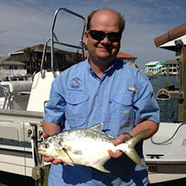
E. Forever Wild Appointment of Board Member
Dr. Sean P. Powers
Southern District appointment: October 1, 2019 – September 30, 2025
Holds Angelia and Steven Stokes Endowed Chair in Environmental Resiliency, Department of Marine Sciences, Univ. of South Alabama
Founded the Marine Conservation and Resource Management Program and has served as a scientific expert for National Oceanic and Atmospheric Administration (NOAA) on Deepwater Horizon Damage Assessment and Restoration
Has published over 120 peer-reviewed scientific articles, many in leading journals such as Science, Ecology, Canadian journal of Fisheries and Aquatic Science and the Public Library of Science publication (PLOS One)

Slide 69
F. Academic Programs

Slide 70
FOUR-YEAR INSTITUTIONS

Slide 71
Alabama State University
1a. Request to Amend Post-Implementation Conditions: Bachelor of Science in Forensic Biology (CIP 43.0111)
Average new enrollment: 73 students per year (met PI condition)
Average program graduates: 5 per year (did not meet PI condition)
ASU is requesting an additional two-year review period
(2019-20 and 2020-21) to meet condition of 7.5 graduates
per academic year.
ASU will submit, no later than September 1, 2021, a post-implementation report, demonstrating that the program met the post-implementation conditions for graduates for the specified period.

Slide 72
University of South Alabama
1b. Request to Amend Post-Implementation Conditions: Master of Music in Music (CIP 50.0901)
Average new enrollment: 4 students per year (did not meet PI condition)
Average program graduates: 3 per year (did not meet PI condition)
USA is requesting an additional two-year review period (2019-20 and 2020-2021) so that they can meet the following conditions:
7.5 new enrollments per academic year; and
3.75 annual graduates.
USA will submit, no later than September 1, 2021, a post-implementation report, demonstrating that the program met the post-implementation conditions for new enrollments and graduates for the specified period.

Slide 73
Auburn University Montgomery
2. Bachelor of Social Work in Social Work (CIP 44.0701)
AUM has an existing pre-social work track, and the new program would extend current coursework to the baccalaureate level.
Another institution voiced concern that the program would duplicate existing offerings.
Staff recommendation to approve based on
Continuing high-demand for social workers throughout the region
Specific focus of AUM curriculum on peace and justice issues.

Slide 74
Alabama A&M University
3a. Master of Science in Mechanical Engineering (MSME) in Mechanical Engineering (CIP 14.1901)
The proposed MSME program will help address demand for mechanical engineers with advanced training in Alabama and the Huntsville area.
The proposed program will also address the acute shortage of minority engineers, including African American and female mechanical engineers, with advanced degrees.

Slide 75
Alabama A&M University
3b. Master of Science in Electrical Engineering (MSEE) in Electrical Engineering (CIP 14.1001)
Graduates help fill regional and national demand for electrical engineers with advanced degrees.
The proposed program will also address the acute shortage of minority engineers, including African American and female mechanical engineers, with advanced degrees.

Slide 76
Alabama A&M University
3c. Bachelor of Arts in Visual Art
The proposed program will utilize existing courses, faculty, facilities, equipment, and art materials, and is designed to replace the existing BS program in General Art (CIP 50.0702).
The program’s focus on immersive, studio-based experience will make graduates more competitive candidates for admission to Master’s of Fine Arts programs as compared with the existing program.

Slide 77
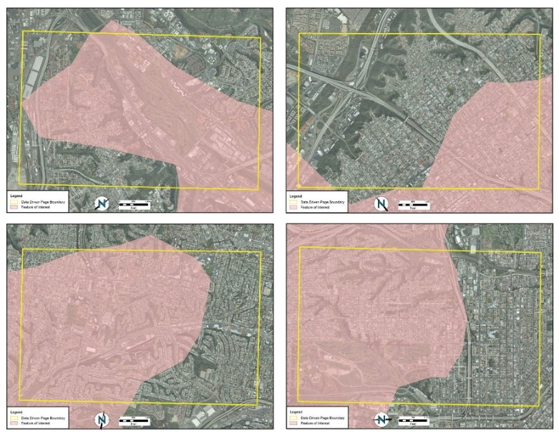
Troy University
4a. Bachelor of Science in Geographic Information Sciences
There is a strong demand for graduates with GIS capabilities.
Students graduating from this program will have a thorough and comprehensive knowledge and skills in handling various geospatial technologies and analytics. In addition, students will conduct real-world GIS applications under the supervision of GIS professionals and/or faculty members.

Slide 78
Troy University
4b. Master of Science in Applied Behavior Analysis (CIP 42.2814)
As of January 2019, there are only 233 Licensed Behavior Analysts in the state of Alabama, not nearly enough to serve the needs of the state.
Graduates of the proposed program will meet the criteria for taking the examination to become a Board Certified Behavior Analyst (BCBA). The BCBA certification is required for licensure in Alabama and most other states.

Slide 79
Troy University
4c. New Off-Campus Sites
TROY plans to offer courses in American Sign Language at the following new off-campus sites beginning in fall 2019:
Birmingham Resource Center, Birmingham, Alabama (Jefferson County)
Huntsville Regional Center, Huntsville, Alabama (Madison County)
Commission approval is required because both sites are outside of TROY’s service area. Consent is not required from UAB or UAH since neither institution offers comparable courses.

Slide 80
University of Alabama
Master of Science in Management Information Systems (MIS) (CIP 52.1201)
Bureau of Labor Statistics data projects 500 openings in Alabama in occupations related to MIS, and combined graduates from existing programs do not fulfill the need for master’s-level professionals.
UA officials conducted a student demand survey of 150 current and past MIS undergraduate students. Of the 110 responses, 97 percent indicated interest in pursuing the proposed program within the next five years.

Slide 81
University of Alabama at Birmingham
6a. Master of Science in Health Services Research (CIP 51.9999)
The proposed program is embedded within the existing PhD in Administration – Health Services (CIP 51.0701) and will not require any additional courses, faculty, or administration.
The proposed program would help meet the demand for Health Services Researchers by ensuring that graduates have the requisite knowledge to conduct research on the health services industry and skills to fill open positions or to serve as consultants if recruited into academic positions.

Slide 82
University of Alabama at Birmingham
6b. Master of Arts in Cultural Heritage Studies (CIP 30.1202)
The Birmingham metro area has a density of institutions and organizations involved in cultural heritage and preservation locally and regionally, and there is an increasing need for professionals with expertise in cultural heritage studies and cultural heritage administration.
Student enrollment in UAB’s current course offerings in cultural heritage studies indicates growing demand for advanced training in archival, museological, and digital preservation of global and local heritage.

Slide 83
University of North Alabama
Executive Doctor of Business Administration (EDBA) in Business Administration (CIP 52.0201)
The proposed program would become the first doctorate-level program at UNA.
There are currently no other EDBA or DBA programs in the state of Alabama or within a 200-mile radius of Florence.
UNA’s College of Business maintains accreditation with the Association to Advance Collegiate Schools of Business (AACSB), the main accrediting body for the field of business, and has faculty and resources to deliver an Executive Doctorate in Business Administration.

Slide 84
University of Montevallo
8a. Bachelor of Science in Early Childhood Education (CIP 13.1210)
With the expansion of early childhood education in Alabama, there will be an increased demand for highly qualified teachers certified to teach grades P-3.
The proposed program builds on UM’s existing resources with the Family Consumer Science program and NAEYC accredited UM Child Study Center and Elementary Education programs.
The proposed program will lead to a Class B certificate in Early Childhood Education (Grade P-3).

Slide 85
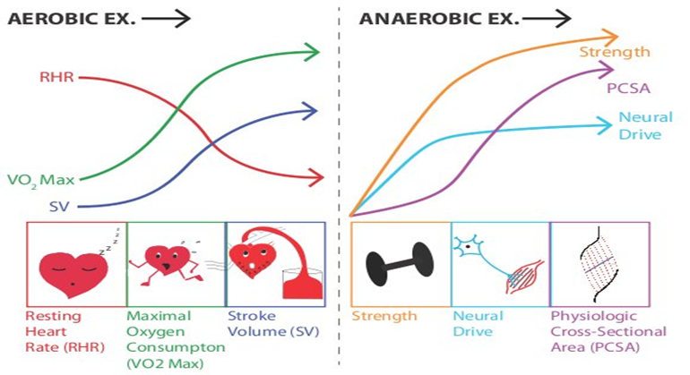
University of Montevallo
8b. Master of Science in Exercise Science (CIP 31.0505)
Exercise science occupations are projected to grow by 13 percent nationwide, and those employed in related occupations such as exercise physiologists typically have master’s-level training.
The proposed program will have a focus on strength and conditioning and will be one of two graduate programs in the state recognized by the National Strength and Conditioning Association (NSCA).
The University of Montevallo has demonstrated sufficient student demand based on current enrollments in its BS program in Exercise and Nutrition Science.

Slide 86
G. INFORMATION ITEMS
Distribution of 2019-2020 Alabama Student Assistance Program (ASAP) Funds
University of South Alabama: New Exempt Off-Campus Site
Wallace State Community College (Selma): New Exempt Off-Campus Site
Implementation of Non-Degree Programs at Senior Institutions
Changes to the Academic Program Inventory
Implementation of New Short Certificate Programs (Less than 30 Hours)
Extensions/Alterations to Existing Programs of Instruction
Change in the Name and Establishment of Centers and Departments
Summary of Post-Implementation Reports

Slide 87
H. ADJOURNMENT

