Slide 1

Alabama Commission on Higher Education
Commission Meeting
December 6, 2019

Slide 2

CALL TO ORDER and PLEDGE OF ALLEGIANCE

Slide 3

II. ROLL CALL and
QUORUM DETERMINATION

Slide 4

III. APPROVAL OF AGENDA
Commission Meeting Agenda of December 6, 2019

Slide 5

IV. CONSIDERATION OF MINUTES
Commission Meeting Minutes of September 13, 2019

Slide 6

V. CHAIRMAN’S REPORT

Slide 7
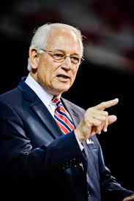

Recognition of Dr. Jack Hawkins, Jr.
Troy University celebrates Chancellor’s 30 years of service

Slide 8

VI. EXECUTIVE DIRECTOR’S REPORT

Slide 9
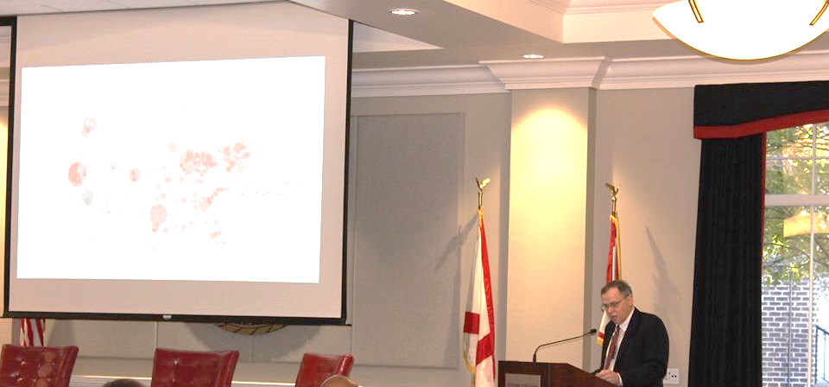

Preparing Alabamians for the World of Work
Building Alabama’s Rural Workforce System
The Summit on Rural Workforce Development University of West Alabama

Slide 10
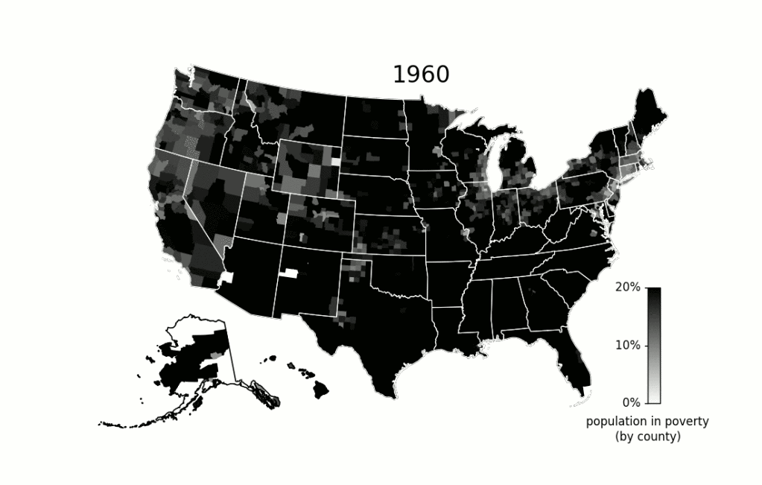
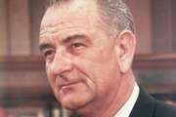
        President Johnson’s ”Unconditional War on Poverty” in 1964

Slide 11
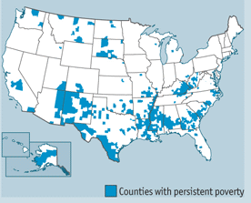
Persistent Poverty Rates of 20% and Above

Slide 12
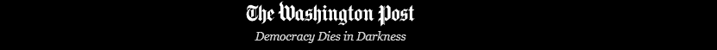
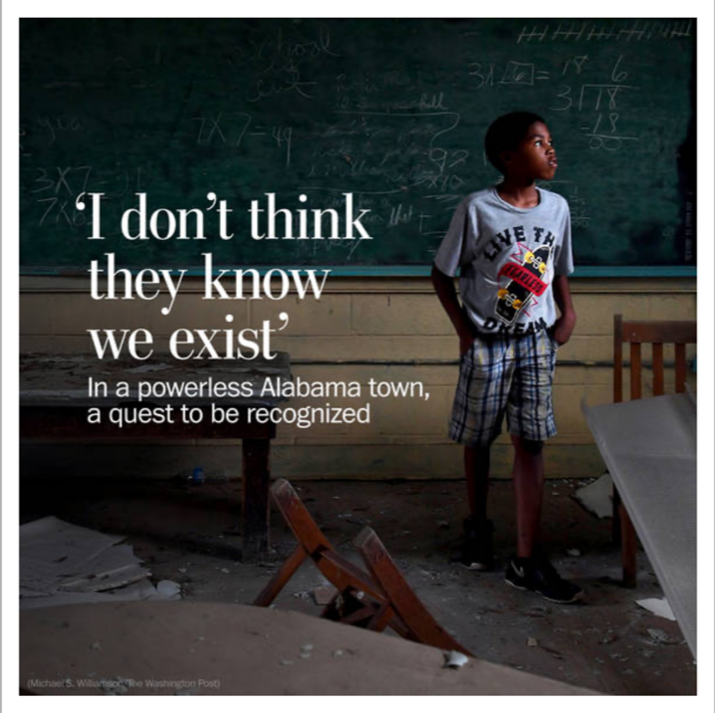
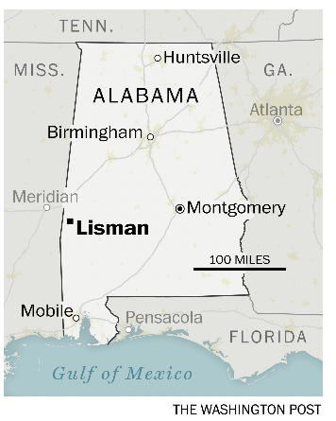
October 12, 2019
Choctaw County
No jobs
Closed school
Not listed as an opportunity zone

Slide 13
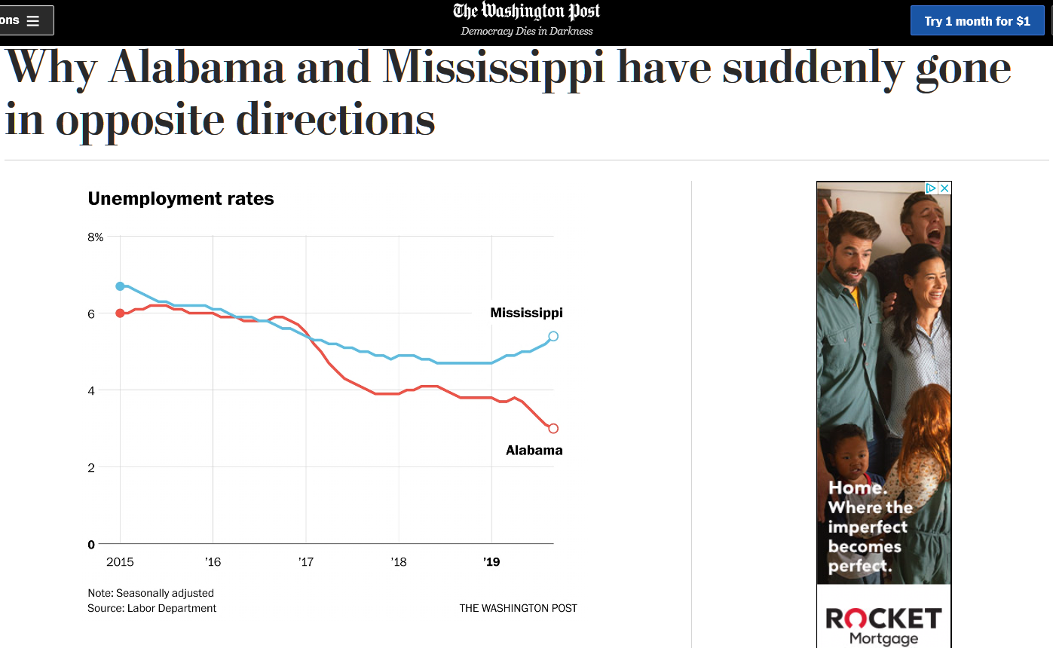
November 9, 2019

Slide 14
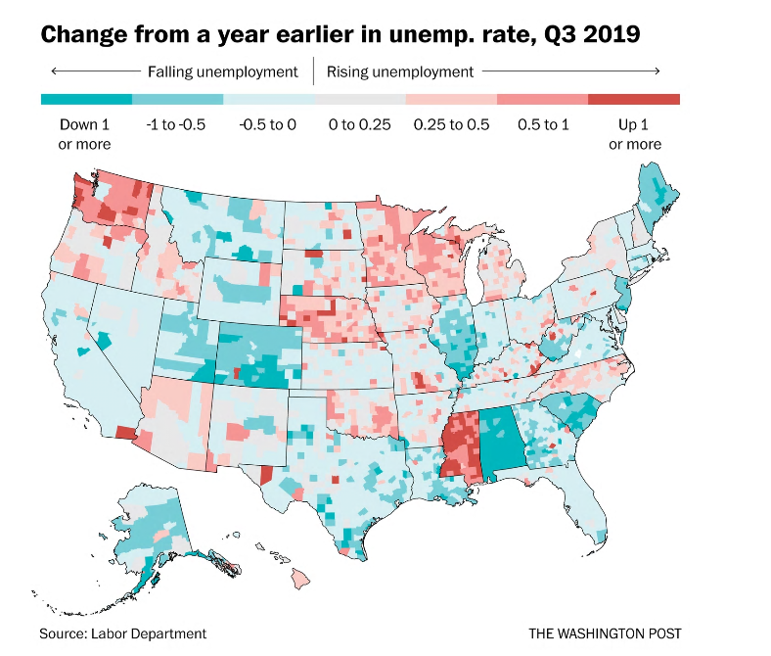
November 9, 2019

Slide 15
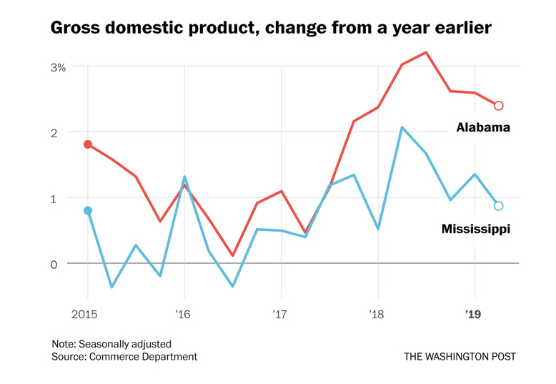
November 9, 2019
Alabama, on the other hand, diversified beyond low-skilled manufacturing… It now ranks near the top in its reliance on higher-paid, but still trade-sensitive, manufacturing jobs.
Mississippi relies more on low-wage versions of these production jobs than does any other state…

Slide 16

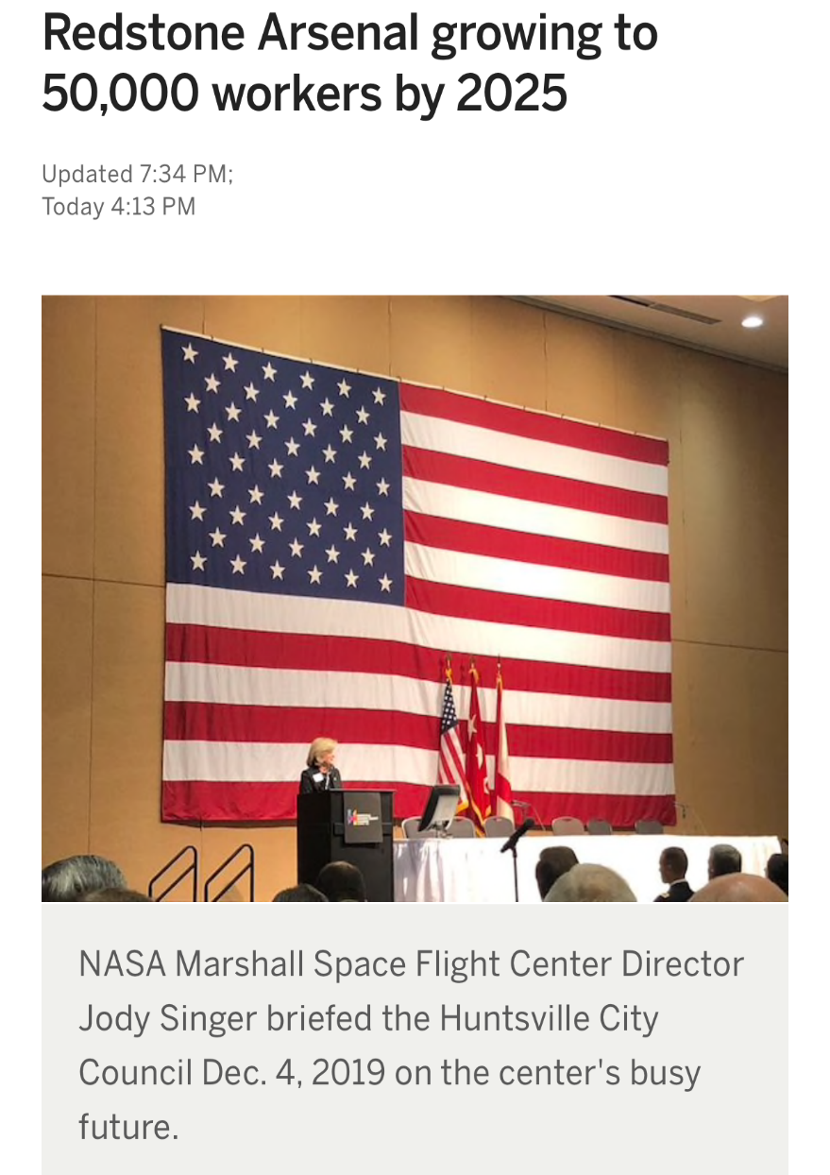

Alabama has cultivated different industries, notably aerospace and automobiles, and ended up with an economy that differs from its neighbor’s in significant ways.
12/4/2019
In addition, Alabama’s … more urbanized. The Birmingham metropolitan area has twice as many people as Mississippi’s Jackson, and that’s before we’ve even counted Huntsville.

Slide 17
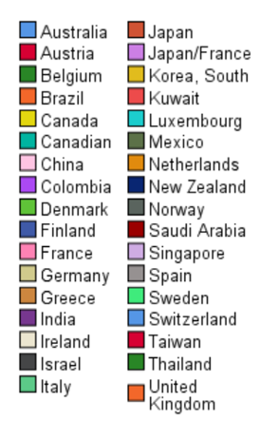

Impact of International Investment in Alabama (461 Locations)
S Korea and Japan account for 30% of these businesses.

Slide 18
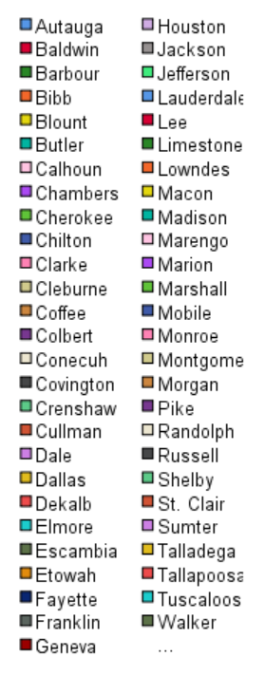
56 of 67 (84%) of counties host International businesses
Percent

Slide 19
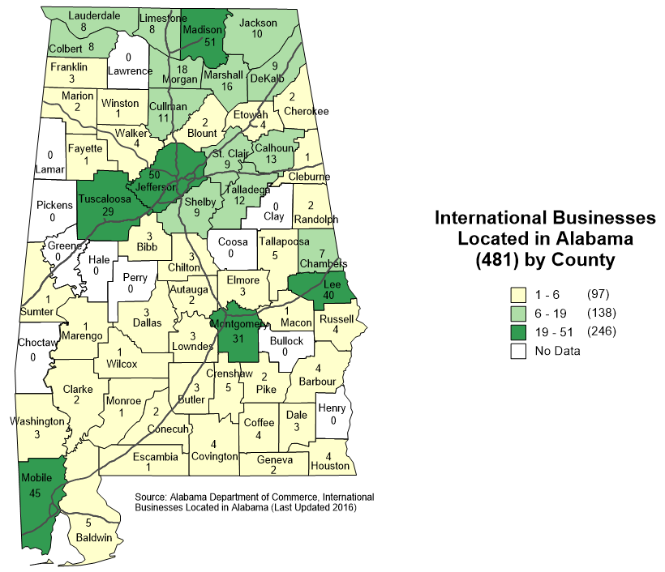
Lisman

Slide 20

Automation technologies promise to deliver major productivity benefits…
Beginning to reshape the American workplace, and this evolution will become more pronounced in the next decade.
Some occupations will shrink, others will grow, and the tasks and time allocation associated with every job will be subject to change.
The challenge will be equipping people with the skills that will serve them well, helping them move into new roles, and addressing local mismatches.

Slide 21


Impact on Communities
Local economies across the country have been on diverging trajectories for years, and they are entering the automation age from different starting points.
Our analysis of 315 cities and more than 3,000 counties shows that the United States is a mosaic of local economies with widening gaps between them.
Regional economic development strategies rather than state-wide strategies
  Return to city-states
  Sparta and Athens

Slide 22
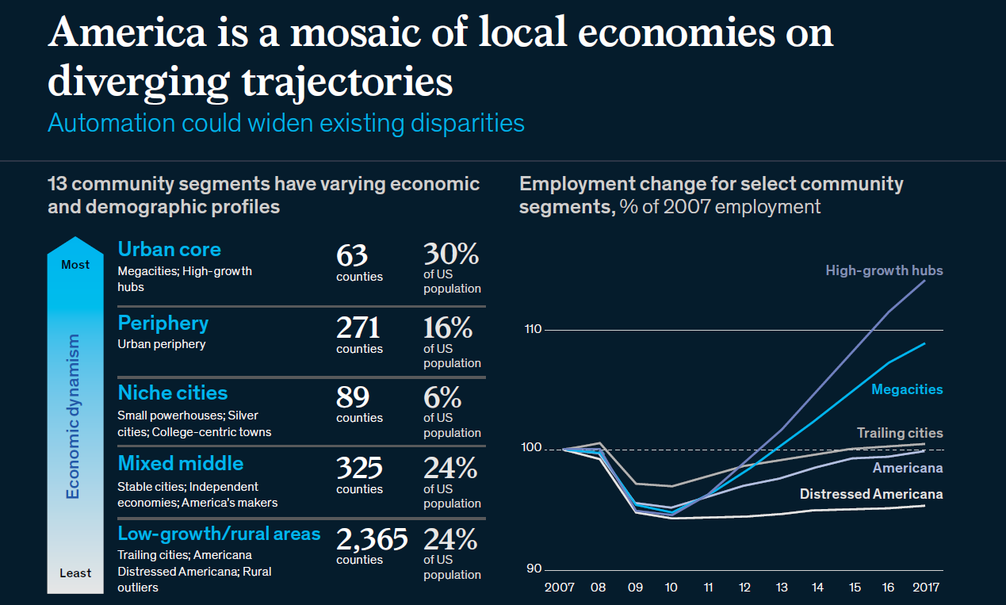

Slide 23
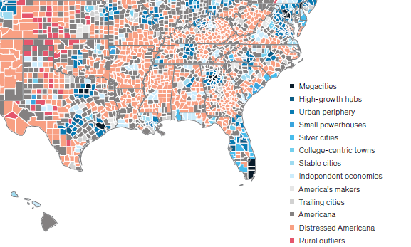
Stable Cities: Birmingham
Independent Economies: Huntsville, Auburn and Montgomery
America’s Makers: Tuscaloosa
Trailing Cities: Mobile

Slide 24
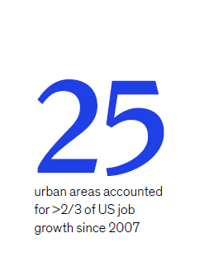
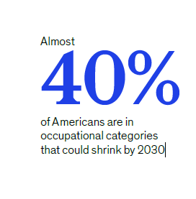
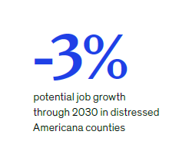
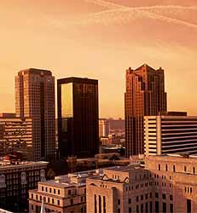
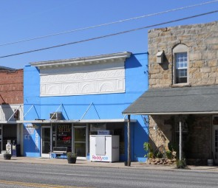


Slide 25

What about the future?

Slide 26
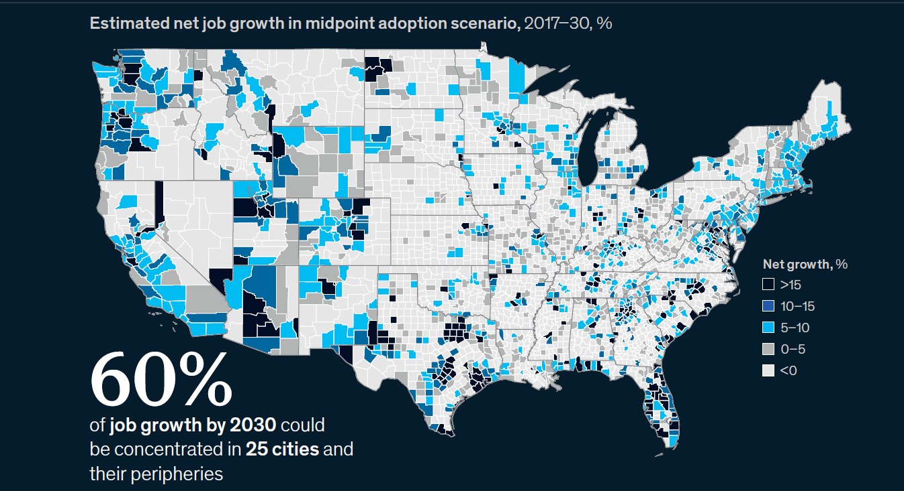

Slide 27
Rightsizing local economies so that the quality of life within a community can be sustained.
Optimizing the impact of economic growth in cities that are experiencing growth.

Slide 28
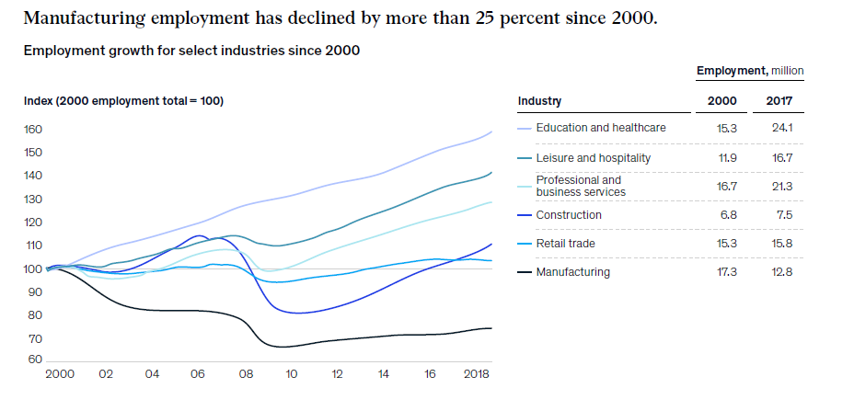

Slide 29
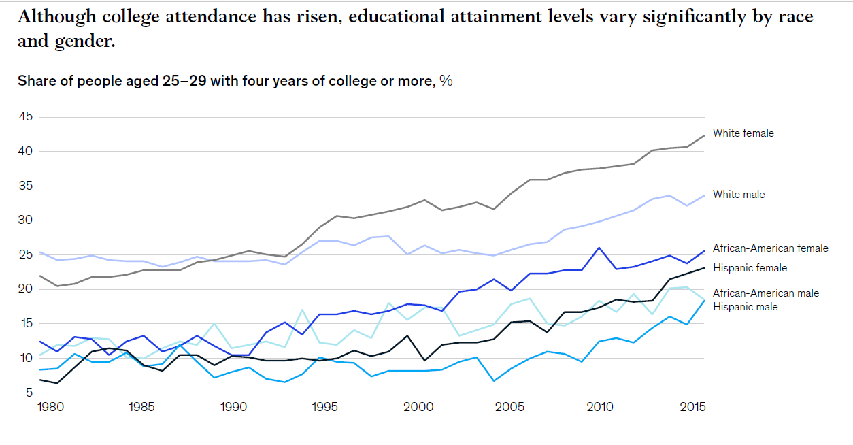
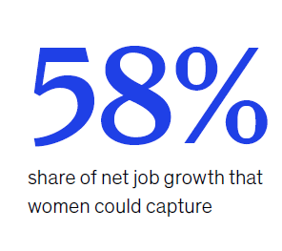




Slide 30

Local business leaders, policy makers, and educators will need to work together to chart a new course
Retraining workers and provide lifelong learning
Creating tailored economic development strategies to boost job creation
Supporting workers in transition
Charting new career pathways. Using industry credentials to signal skills.
Companies do not see a clear business case for investing in training workers who can take their newfound skills and leave
They will hire based on a person’s existing skills/credentials
Elected officials also have reticence about paying for training
Prefer loan forgiveness programs or supplemental pay rather than scholarships

Slide 31
Exacerbating Factors to Employment
Part of the solution could involve more people moving to where the jobs are. But the mobility of the US workforce has waned over the last 25 years. The rate of households moving across county or state lines has declined by nearly half since 1990.
Rationalizing occupational licensing requirements is another way to improve mobility. One quarter of occupations now require workers to obtain state-mandated licenses, up from about 5 percent in the 1950s, and the requirements often vary from state to state.
Wage differentials dampen the potential impact of automation in rural areas as automation adoption is dependent on local wage rates. In areas with lower wages, employers have less of an incentive to adopt new technologies.

Slide 32
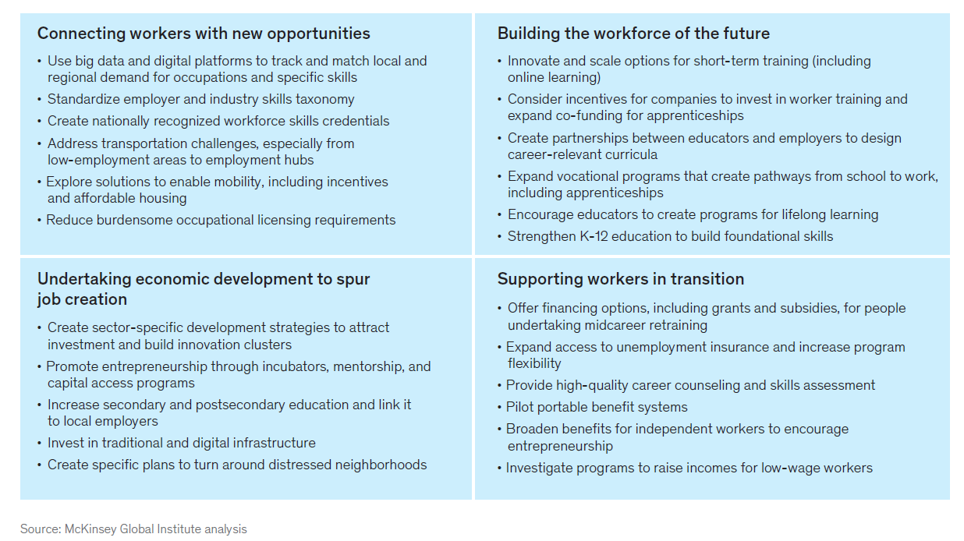

Slide 33

VII. Discussion ITEMS

Slide 34

Initiatives to Address Teacher Shortages

Slide 35

Overview of Alabama’s Teacher Shortage
In Alabama, 30% of all classrooms are being taught by teachers teaching out of field, having neither a major nor a minor in the field.
Only 523 secondary first-time teaching certificates were issued in Alabama in the 2017-18 school year.
Alabama has more than 1700 secondary teachers with emergency certificates or teaching out of field.
Since 2010, there has been a 40% decrease in students entering teacher education programs.
Each year 8% of teachers leave the profession.
Source: Report to Alabama Board of Education, August 2019.

Slide 36
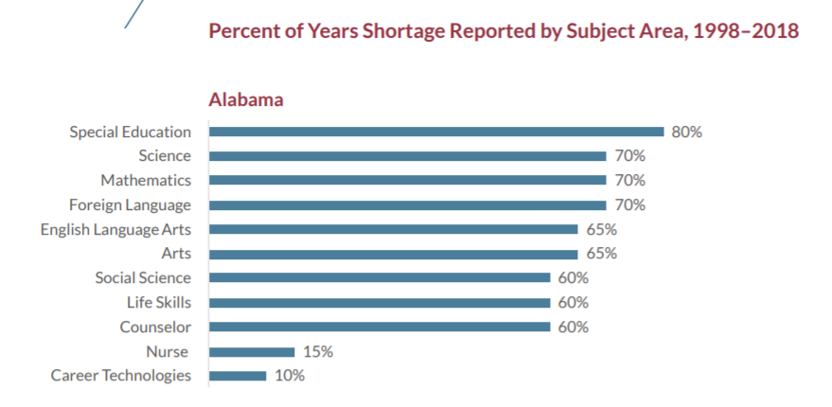

Overview of Alabama’s Teacher Shortage
Source: Bellwether Education Partners analysis of federal education data (January 2019).

Slide 37

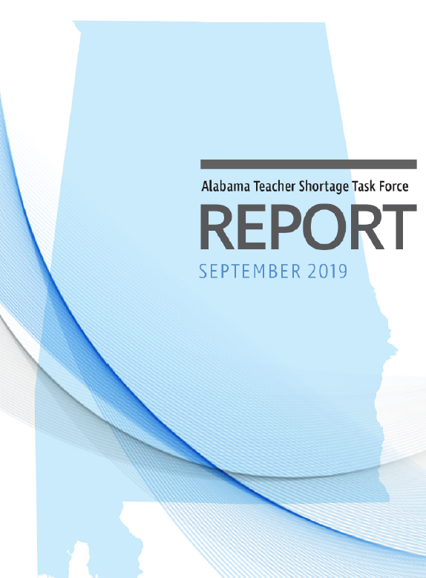
Teacher Shortage Taskforce
Led by ALSDE and comprising superintendents across the state and representatives from education associations.
            Aim of developing short-term and long-term recommendations to increase quantity and quality
            Met from January—July 2019 and produced recommendations in September that focused on two areas:
              1. Recruitment
              2. Retention

Slide 38


Teacher Quantity Quality Roundtable
Facilitated by SREB, with aim of carrying on work done by taskforce
Comprised of 20 reps from education associations, districts, colleges of education, ACHE, ACCS, Governor’s Office, Legislature
Six meetings scheduled between September 2019 and July 2020
Preliminary focus area around improving certification process and alignment with needs

Slide 39


Advisory Council for Excellence in STEM (ACES)
Tasked with formulating a plan to positively shape STEM education across the state.
Comprised of 78 leaders from across the state, including K-12 and undergraduate education, as well as industry and community leaders.
Identified 6 priority areas:
    STEM Exploration and Discovery
    Numeracy and STEM Fluency
    Pre-Service Educator Preparation
    In-Service Educator Development
    Career Pathways
    STEM Coordination Across Alabama

Slide 40


Alabama Recruit and Retain Minority Teachers
Program included in FY 2020 ETF Appropriation
$500,000 to be distributed equally to Alabama A&M and Athens State
Purpose to recruit, train, and mentor minority teacher candidates
Response to underrepresentation of teachers of color as compared with population: (Jones and Toma, 2018)
  Most teachers of color employed in only ¼ of AL districts, largely concentrated in Black Belt region
  Another ¼ of districts had 5 or fewer African American teachers across all schools

Slide 41




Alabama-Korea Pilot Teacher Ed Program
Conceived of as STEM Surplus Supplies STEM Shortage (5S Project), potential for national model
AL has sent 2 delegations to Korea to meet with KMOE and interested Korean colleges of education
Proposed pilot would enroll Korean educators in joint master’s program with AL institution
All public IHEs invited to participate in design and delivery of program

Slide 42

VIII. Decision ITEMS

Slide 43

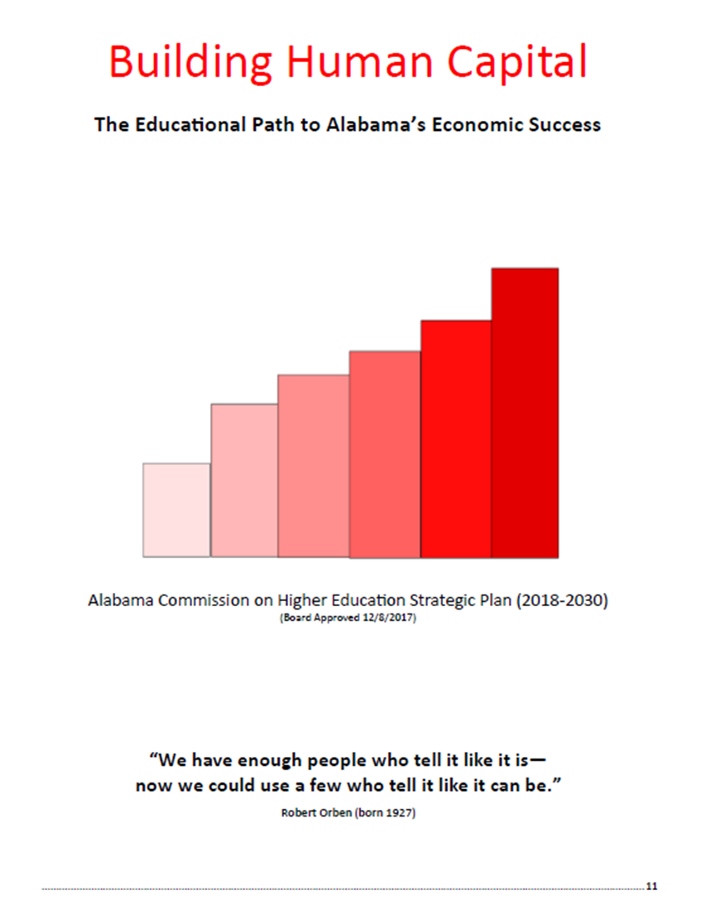
A. 2018-19 ACHE Annual Report

Slide 44
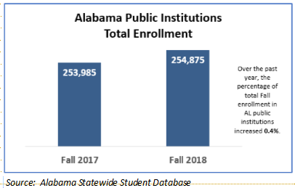
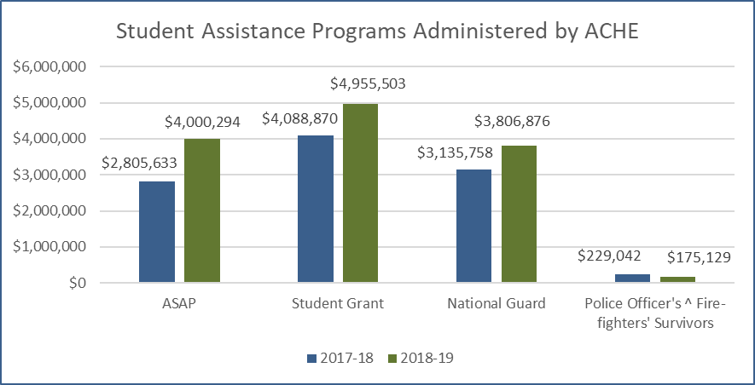
Priority One: Improving Access
Enrollment is Up
Source: Alabama Statewide Student Database
Significant Increase in State Aid
Source: ACHE Actual Expenditures (2017-18 & 2018-19)

Slide 45
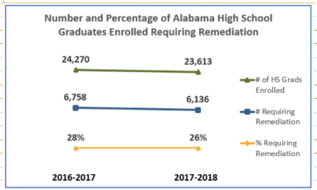
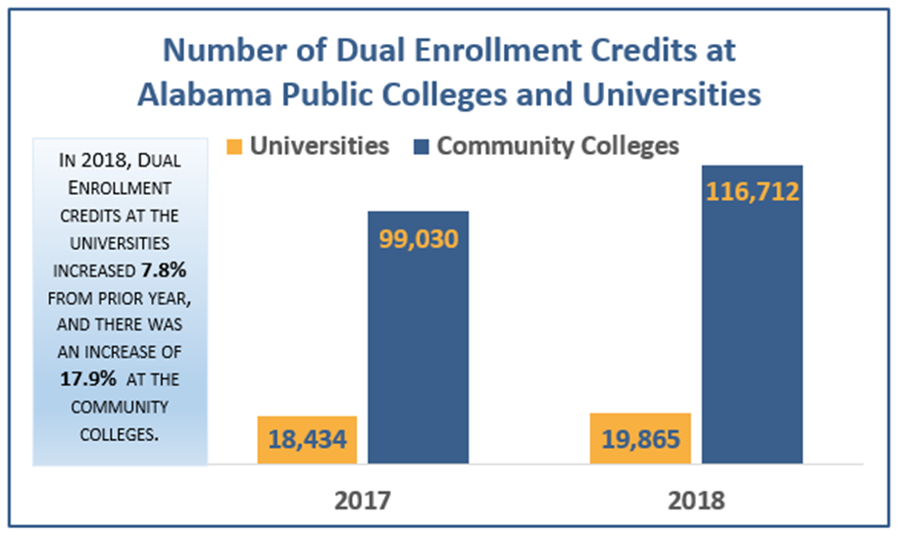
Priority Two: Enhancing Student Success
Decline in % and # of students remediated
Source: Alabama Statewide Student Database
Alabama High School Feedback Report
Dual Enrollment Increased
Source: Southern Regional Education Board (SREB) Data Exchange Survey

Slide 46
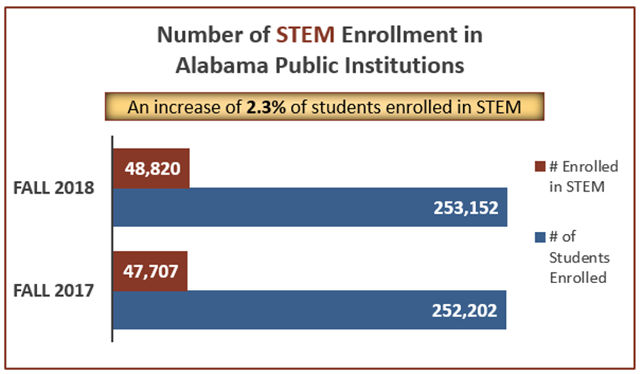
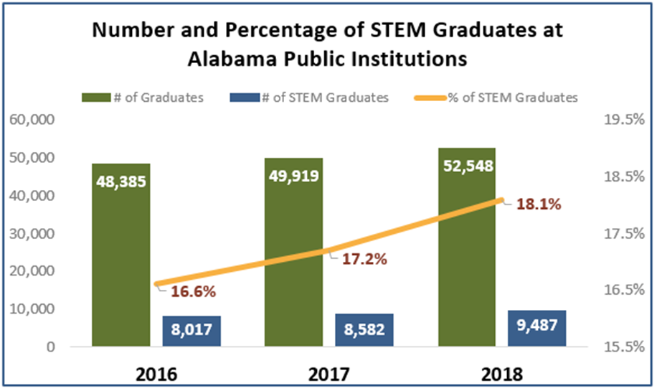
Priority Three: Enhancing STEM Programs
Stem Enrollment is Up
STEM Graduates Increased

Slide 47
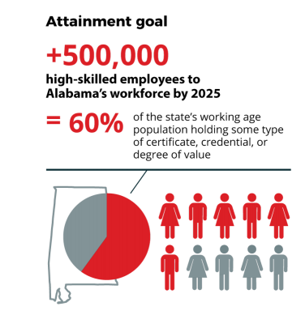



Priority Four: Developing Alabama’s
Economy and Workforce
3

Slide 48
2018- 2019 Degrees Awarded at Alabama Community Colleges and Universities
Degree Production increased by 9% from 2018 to 2019, but the degree production level is below the 16% year-over-year increase needed through 2025 to meet projected demand

Slide 49
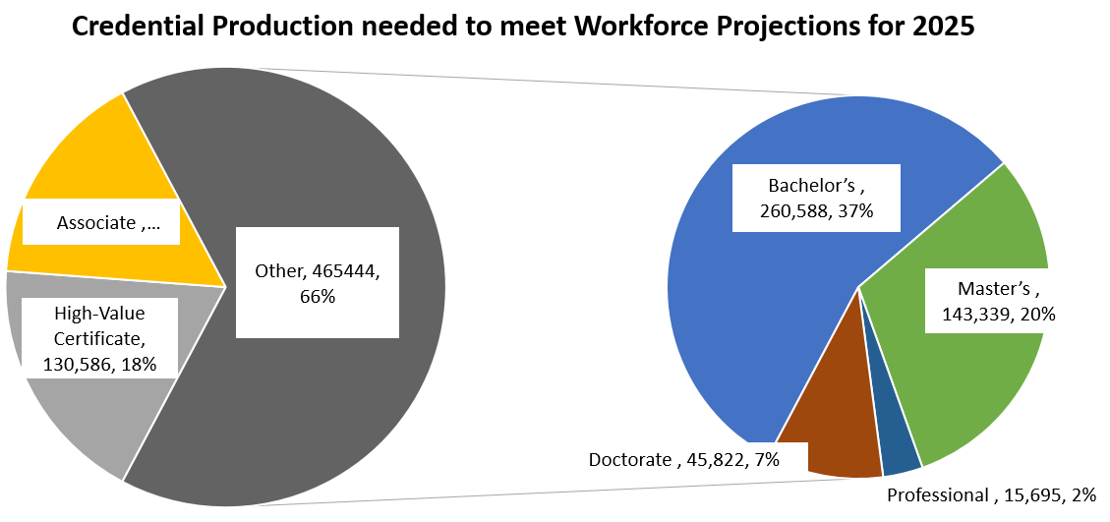
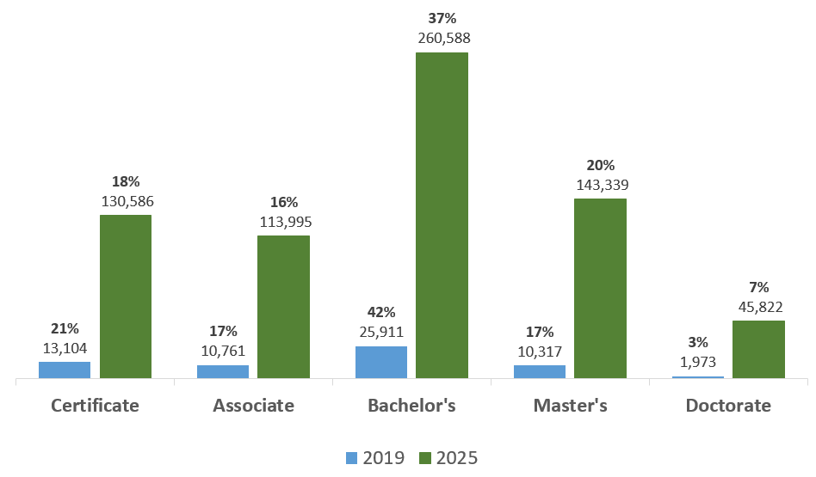
2019 Credential Production Compared to 2025 Workforce Projections
Mix of degrees produced somewhat parallels Workforce projections
*
*Certificate’s include: Undergraduate and Graduate Certificates.

Slide 50
ACHE Summary of 2018-2019 Top 5 Completions by Major and Level for All Public Institutions
(Total Number of Completions at All Public Institutions was 62,066)*

Slide 51
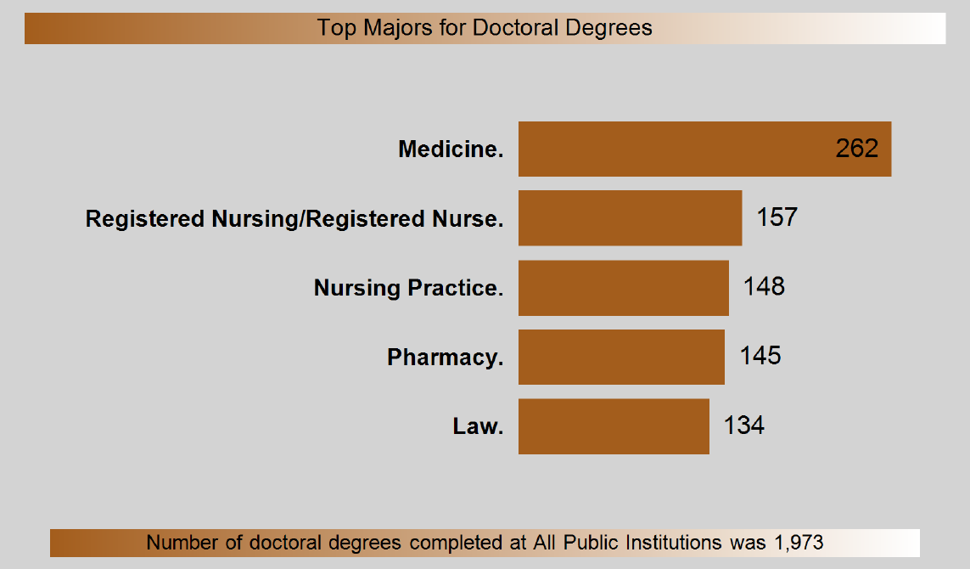

Slide 52
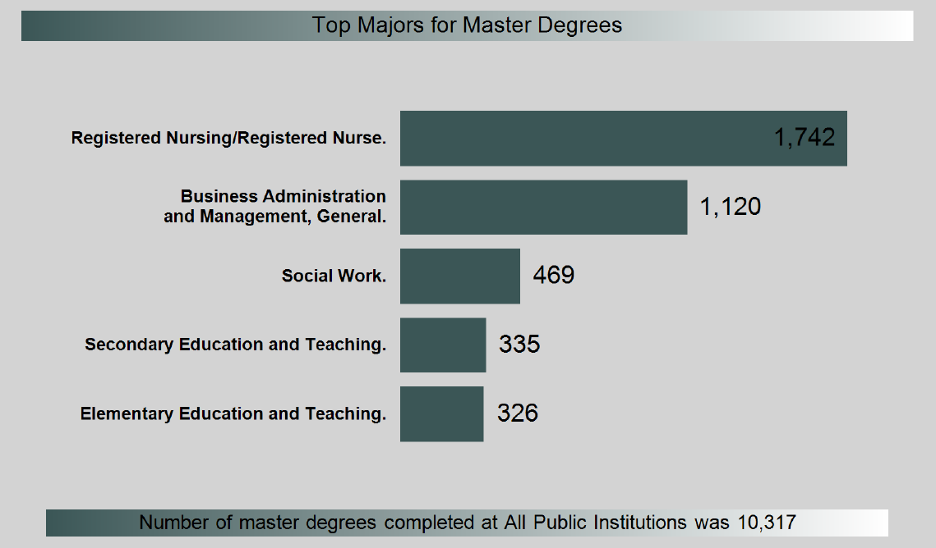

Slide 53
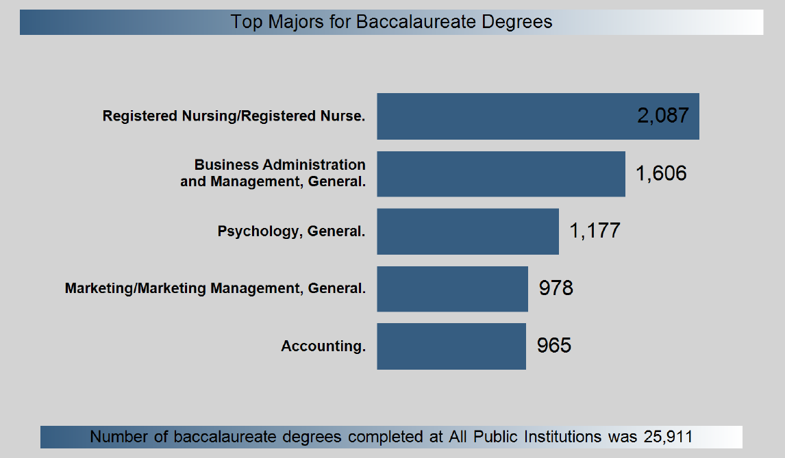

Slide 54
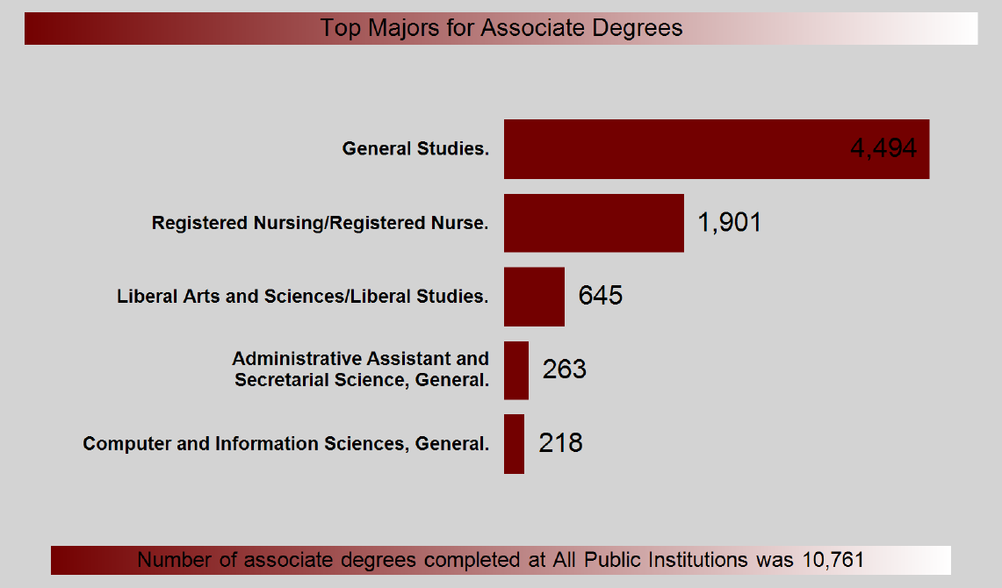

Slide 55
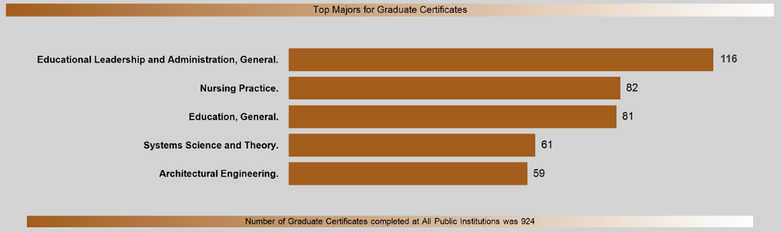
ACHE Summary of 2018-2019 Top 5 Certificate Completions by Major for All Public Institutions
(Total Number of Certificates at All Public Institutions was 13,104)
Top Majors for Graduate Certificates

Slide 56
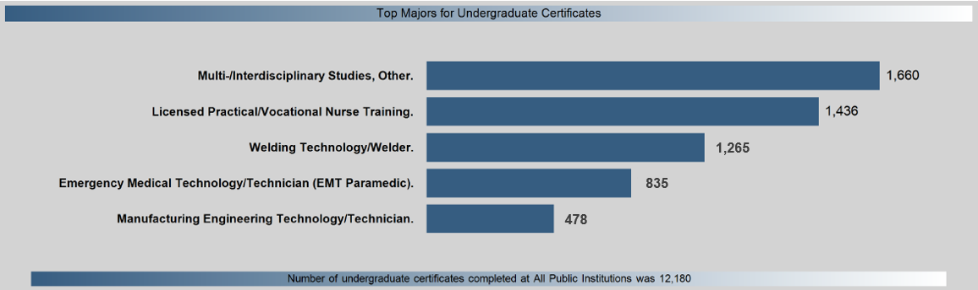
Top Majors for Undergraduate Certificates

Slide 57
Priority Five: Organizational Effectiveness and Efficiency

Slide 58
Priority Five: Organizational Effectiveness and Efficiency
Increased degree production even with reduced state support

Slide 59

DRAFT

Slide 60
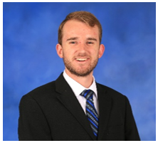
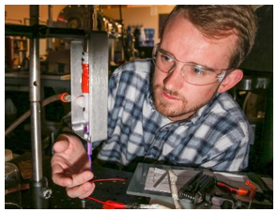
AL ESPCoR:
Ryan Gott
Bowling Green, Kentucky native
Received B.S. and M.S. degrees in Aerospace Engineering (UAH)
Pursuing Ph.D. in Aerospace Systems Engineering (UAH)
Work includes the development of several novel plasma devices and the treatment of a variety of plants, water, and other biomaterials

Slide 61



The Power of Plasma
Ryan Gott
University of Alabama in Huntsville
PhD Candidate
GRSP Rounds 13 and 14 Recipient
ACHE Meeting
December 6th, 2019, Montgomery, AL

Slide 62










CPU2AL
“Connecting the Plasma Universe to Plasma Technology in Alabama”
  $20 Million NSF Track I Research Grant
  Focused on studying and developing plasma technologies to benefit AL
  Provides outreach to K-12 to stimulate STEM interest
  Connects students to industry through internship programs
  Interested in commercialization to develop the plasma industry in AL

Slide 63
Graduate Research Scholars Program
ALEPSCoR GRSP
  Provides funding and support to strengthen and enhance research at AL universities
  Addresses the economic need for highly trained STEM professionals
  Promotes the growth of emerging technologies in the state
GRSP supports my endeavors of building plasma technologies for water purification and plant treatment
  Funded the last two years of my PhD work
  Plan on continuing this research and commercialization in Huntsville

Slide 64
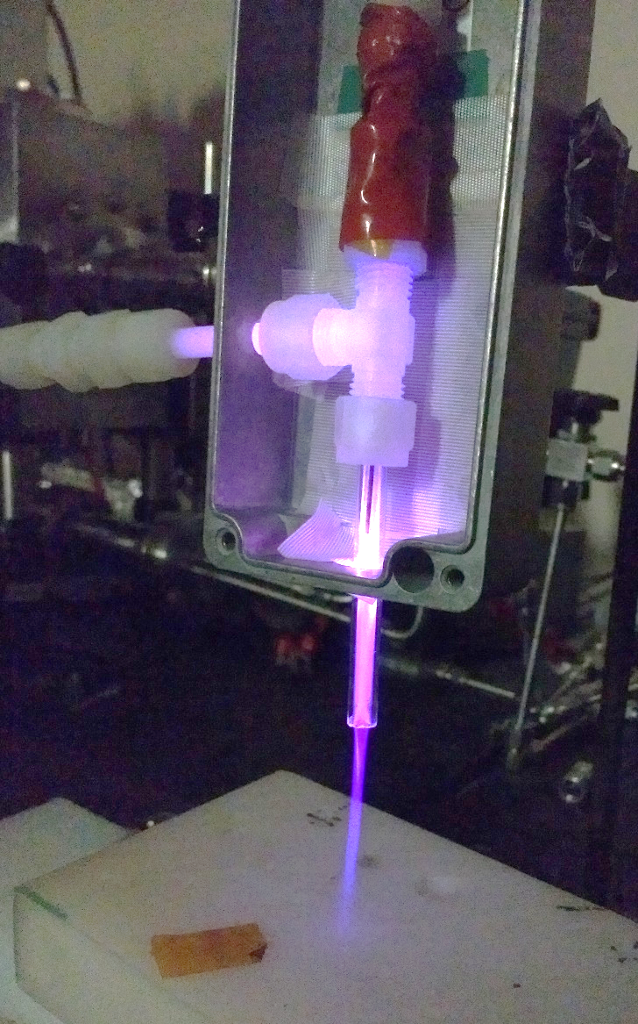




What is Plasma?
Solid->Liquid->Gas->Plasma

Slide 65
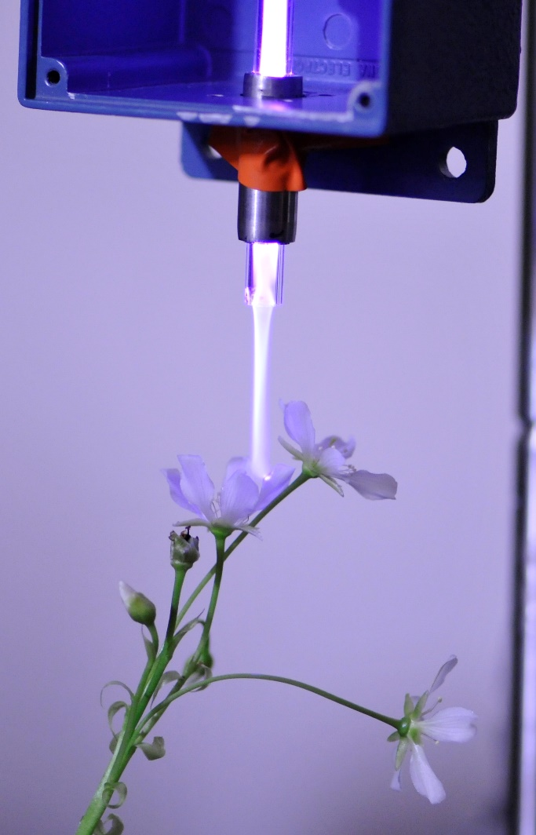
Why Plasma?
Plasma Treatment can improve the quality and use of various materials:
Food
  Disinfection of chicken skin and beef
Plants
  Venus Flytraps, turmeric, cabbage, basil, pumpkin seeds
Water
  Purification and disinfection
Medical Equipment
  Disinfection

Slide 66
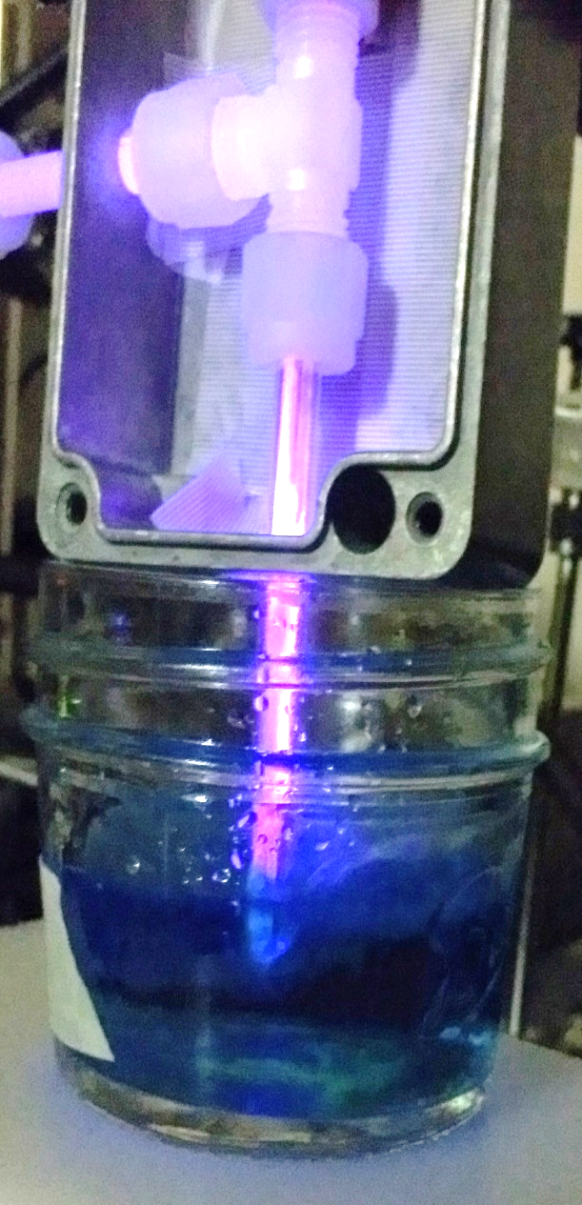


Technology
Plasma Sheet
  Widens surface area of plasma
Plasma Ring
  Allows for 360º degree treatment
Atmospheric Pressure Plasma Jet (APPJ)

Slide 67




Applications
Food disinfection and water treatment are eventual goals
Current technology allows for seed, plant, and seedling/rhizome treatment
  Enhanced growth speeds and sizes
  Increased seed production
Water
Examples:
Rhizomes
Seeds
Poultry

Slide 68




Agricultural Applications
Untreated
Treated
(Post flowering)
Change in appearance not from plasma

Slide 69



Antibacterial Applications
E. coli plates exposed to low temperature plasma
1 min
30 sec
5 min
2 min
Plasma Exposure
Gas Only Control
Low temperature plasma can effectively kill C. albicans colonies
With Rob McFeeters, UAH, Chemistry
Notes:
E. coli, bacteria, cause of a variety of illnesses.
Time course shows killing of organism → susceptible to low exposure time (30 seconds)
Low temperature plasma can effectively kill C. albicans colonies
(also kills established growth with decreased efficacy (takes longer exposure) - data not shown)

Slide 70


Plasma-Water Treatment
Treatments were effective in removing Methylene Blue Dye
Plasma can remove PFAS and other contaminants that are not removable by traditional methods
Great for use in Space!
  Simple
  Reusable
  No Filters

Slide 71

Conclusions
Plasma technologies are advancing thanks to GRSP and CPU2AL
There is a market for this technology in the state
  Agricultural
  Medical
  Space
We’re just getting started!

Slide 72
Acknowledgments
This material is based upon work supported by the NSF EPSCoR RII-Track-1 Cooperative Agreement OIA-1655280 and by AL EPSCoR Graduate Research Scholars Program Rounds 13 and 14 funding.
Special thanks to Brandon Williams, Manvith Amara, Declan Brick, Marisa Thompson, and Brandon Staton for their assistance on this research.

Slide 73
Questions?
Thank you!

Slide 74

B. Distribution of Deferred Maintenance Grant Funds
Staff Presenter: Ms. Susan Cagle

Slide 75


Deferred Maintenance Grant
$4M was appropriated during 2019 regular legislative session for a Deferred Maintenance Program.
Administration of funds was placed with ACHE.
$750,000 maximum amount for maintenance on existing structures—no new construction.
Program requires a dollar-for-dollar match to be paid by the institution receiving the grant.

Slide 76

Deferred Maintenance Grant
86 projects submitted (45 university & 41 two-year college)
Total amount requested $19,708,250
Project selection made by Deferred Maintenance Grant Committee: Commissioner Buntin, Commissioner Nelson,
Dr. Jim Purcell, Tim Vick, and Susan Cagle.
Due to limited amount of funds Committee concentrated
on projects that were categorized by the institutions as
  Classroom/ instructional purpose
  Health and safety concerns
Of the 52 projects marked as classroom/instruction, 38 projects were reported to have at least one health or safety concern

Slide 77
Deferred Maintenance Grant

Slide 78

C. Executive Budget Request for FY 2020-21
STATE OF ALABAMA
Department of Finance
STATE AGENCY
BUDGET REQUEST INSTRUCTIONS
Fiscal Year 2021
Kay Ivey
Governor

Slide 79
BUDGET REQUEST SUBMISSION
The Code of Alabama, Title 41, Chapter 19, Section 6 (a) (3) states that, each state agency/department, on the date and in the form and content prescribed by the Department of Finance, shall prepare and forward to the Budget Officer the budget requested to carry out its proposed plans in the succeeding fiscal year.
The Executive Budget Office’s (EBO) due date for the FY 2020-21 budget requests was November 1, 2019.
In order to comply with the designated submission deadline, a draft budget request was submitted to EBO.
Any changes made by the Commission will be submitted through a budget request revision.

Slide 80

Alabama Commission on Higher Education
FY 2020-21 Executive Budget Request
ACHE is requesting a total of $70,091,786 for FY 2020-21, of which $69,655,547 is from state funds.
This represents an overall 70.7% increase over FY 2019-20.
The FY 2020-21 request contains requests for 27 programs under 6 appropriation units.
This includes requests for five new programs.

Slide 81
New Program Requests for FY 2020-21
  1) Career Promise – ($2,500,000) This program would provide funds for a pilot project that would fund high school students of Temporary Assistance for Needy Families (TANF) / Supplemental Nutrition Assistance Program (SNAP) families to fully participate in dual enrollment technical programs at a community or technical college that lead to an industry and postsecondary credential in a career field that is in high demand in the region. The federal government will award matching funds (50%) for this activity based upon prior year state funding.
  2) College Promise – ($5,000,000) This program would provide funds for a pilot project designed to financially support individuals from TANF/SNAP families to return to college and complete a degree. The federal government will award matching funds (50%) for this activity based upon prior year state funding.

Slide 82
New Program Requests for FY 2020-21 (continued)
3) Higher Education Transformation Fund – ($10,000,000) This program would provide funds to expand academic and technical programs that directly lead to careers in high demand in the state. Colleges and universities will respond to a competitive Request for Proposals (RFP) to address specific workforce shortages as identified by the Governor’s Office of Education and Workforce Transformation (GOEWT).
4) Performance Funding – ($10,000,000) This program would reward colleges and universities that show improvement in performance, especially in degree production and other measures of student success. In the first year, each institution will receive a proportional amount of their prior year appropriation to establish interventions that improve performance. In future years, receipt of funds will be based upon performance.
5) Support of Alabama College Network – ($60,000) This program would provide support to the Alabama College Network, which is designed to support efforts for getting adults to begin or return to college to obtain a degree.

Slide 83

Planning assumptions used in developing
the FY 2020-21 Executive Budget Request:
Planning and Coordination (Operations and Maintenance) 5.0% increase due to:
An increase is needed for employee termination costs (retirements).
Increased costs for building operations and rent.
Increases are need to cover increases in Information Service Division (ISD) charges, postage, and telephone services and for Comptroller Office transaction charges.
Increases are needed for subscriptions, software purchases, replacement of computers and printers, UPS/FedEx shipping costs, professional association dues and general office supplies.
Increases are needed for the purchasing student data for Alabama residents attending out-of-state institutions from the National Student Clearinghouse and for Comptroller Office transaction charges.

Slide 84
Planning Assumptions for Other Programs, continued
Five percent (5%) increases are being requested for the following programs to offset increased operating costs and in some instances to offset rising tuition:
  1. Alabama Student Assistance Program
  2. Alabama Educational Grant Program
  3. Alabama National Guard Educational Assistance Program
  4. Police Officer and Firefighter’s Survivors Educational Assistance Program
  5. Alabama Math and Science Teacher Education Program
  6. Southern Regional Educational Board
  7. Network of Alabama Academic Libraries
  Articulation and General Studies Committee / Statewide Transfer Articulation
  Reporting System (AGSC / STARS)
  9. Experimental Program to Stimulate Competitive Research (EPSCoR)
Level funding is being recommended for all other items in the budget.

Slide 85

These new statewide initiatives, while small $ in relation to the overall higher budget (less than 2%), are designed to be transformational in impact

Slide 87

D. Consolidated Budget Recommendation for FY 2020-2021
Staff Presenter: Ms. Susan Cagle
Section 16-5-9(b) of the Code of Alabama states that “...The Commission ... shall present to each institution and the Governor and legislature, a single unified budget report containing budget recommendations for the separate appropriations to each of the institutions.”

Slide 88

Consolidated Budget Recommendation for
FY 2020-2021
In creating the recommendation, ACHE staff first attempted to determine an estimate of the basic funding requirements for Alabama’s public colleges and universities.
This calculation is referred to as the ACHE standard calculation.
The amount calculated for FY 2020-2021 in the ACHE Standard for the public two- and four-year colleges and universities was $2,972,212,593. This amount is $1.4B over the FY 2019-2020 appropriation amount.

Slide 89

Consolidated Budget Recommendation for
FY 2020-2021
In developing the Consolidated Budget Recommendation (CBR), the following need to be considered:
Cap placed on ETF Appropriation due to the Rolling Reserve Act
Revenue projections
New initiatives being considered
Split between higher education, K-12, and other education lines
Requested amounts

Slide 90

Consolidated Budget Recommendation for
FY 2020-2021
Funds for Rate Increases
The CBR is based around the following considerations:
1) Rate increase for mandated PEEHIP retirees' health insurance for public senior institutions who do not participate in PEEHIP (all except AAMU, Athens and JSU) (+$3,029,672)
2) Peer Comparison Adjustments (+$10,514,497)
3) Five percent (5%) increase over the amount appropriated in FY 2019-2020 (+$77,648,227)
4) Statewide line items for varying amounts (+$29,954,775)

Slide 91

Consolidated Budget Recommendation for
FY 2020-2021
Increase Recommended for the Universities - $72,926,726
Increase Recommended the Two-Year Colleges - $18,265,670
Increase Recommended the Statewide Lines - $29,954,775
Total CBR Increase FY 2020-2021 - $121,147,171

Slide 93

E. Report on Facilities Master Plan & Capital Projects Requests for FY 2020-21– FY 2024-25
Staff Presenter: Ms. Susan Cagle

Slide 94

Report on the Facilities Master Plan & Capital Projects Requests for FY 2020-21 – FY 2024-25
Section 16-5-15 of the Code of Alabama requires that each public college & university annually submit a 5-year facilities master plan to the Commission. Each institution is also required to prioritize its capital requests and provide a needs assessment for requested projects.
Projects are broken into three time segments:
Immediate projects fall within the first year of the master planning cycle (FY 2021).
Intermediate projects fall within the second year of the planning cycle (FY 2022).
Long-Term projects fall into the last three years of the planning cycle (FY 2023 - 2025).
The projects are also classified into four separate project categories:
New Construction/Acquisition
Renovation and Remodeling
Major Capital Equipment
Deferred Maintenance/Facilities Renewal

Slide 95


Immediate Capital Projects Requests FY 2020-2021
Over $1.2 billion requested
44% of the requested funds for other than new construction
40% or over $500 million are projected to use ETF funds

Slide 96


Total Five-Year Capital Projects Requests
FY 2020-2021 – 2024-2025
For the five-year period that this report covers:
Over $5 billion is projected as needed for proposed projects
Almost $3 billion for other than new construction
58.6% were projected to come from either ETF or other state-related funds

Slide 97

38% of the buildings being used by the public colleges and universities in Alabama were built between 1960 and 1989. An additional 13% of the buildings were built prior to 1960.

Slide 98

Bond Issues and Debt Service
The State of Alabama does not provide regular funding for capital projects for education; this is true for K-12 as well as Postsecondary Education.
The institutions in Alabama are allowed to float their own bond issues.
The four- and two-year institutions currently have approximately $3.7 billion in bonds outstanding.
The institutions paid approximately $304 million in debt service in the last fiscal year to pay these bonds off. ($271M-4YR / $33M-2YR)
The source of revenue to pay these bonds is usually through tuition or fees that the students pay.

Slide 99

F. Final Approval of Amendments to the Administrative Procedures for AMSTEP– Loan Repayment Program
Purpose of Action: Alabama Act 2019-389 added Computer Science to the list of teaching fields eligible for inclusion in the Alabama Math and Science Teacher Education Program (AMSTEP).
This item incorporates Computer Science into the existing administrative procedures for AMSTEP.
Computer Science teachers employed in Alabama public schools may receive up to $3,000 per year to apply to federal student loan debt.

Slide 100

G. Academic Programs

Slide 101














FOUR-YEAR INSTITUTIONS

Slide 102


Auburn University
1a. Master of Science in Educational Research, Measurements and Evaluation (CIP 13.0603)
Graduates of the program will be able to seek employment as instructional coordinators, market research analysts, statisticians, and survey researchers, for which there is strong demand throughout the state and region within the field of education.
No similar master’s-level programs exist in the state, though comparable programs are offered elsewhere.

Slide 103


Auburn University
1b. Bachelor of Arts in International Studies in Liberal Arts (CIP 24.0199)
The proposed program serves a need for graduates to demonstrate global competencies related to the study of international economies, cultures, and languages.
High enrollments in coursework related to the major demonstrate an existing demand for a baccalaureate degree option.

Slide 104

Auburn University
1c. Doctor of Philosophy in Building Construction (CIP 14.0401)
The proposed program extends AU’s current undergraduate and graduate program offerings in Building Construction to the doctoral level.
AU has demonstrated strong student enrollment in its current Master of Science in Building Construction, which enrolls 30-40 students each year, as well as in the three related graduate certificate programs, which draw in an additional 30-40 students.
Employer demand for expert building construction professionals is projected to grow by more than 11% through 2026, and the program will supply graduates to fill this need.

Slide 105


University of Alabama
2. Bachelor of Science in Cyber Security (CIP 11.1003)
The proposed Cyber Security program will meet the standards required for accreditation through Accreditation Board for Engineering and Technology Computing Accreditation Committee.
The information sector is among the fastest growing nationwide. Graduates of the proposed program will be able to seek employment as information security analysts, as well as other related occupations across public and private sector industries.

Slide 106


University of Alabama in Birmingham
Bachelor of Science in Engineering in Engineering Design (CIP 14.0101)
Employer demand for individuals with interdisciplinary training in engineering is strong, especially for small- to medium-sized industry firms. There is growing student demand for interdisciplinary, bachelor's-level programs in general engineering, and no similar programs currently exist in the state.
The program proposed program will meet the standards for ABET accreditation and will incorporate key learning objectives identified by the American Society of Engineering Education.

Slide 107


University of South Alabama
4a. Bachelor of Science in Business Administration in Supply Chain and Logistics Management (CIP 52.0203)
Relative to other supply chain-related programs in the state, the proposed program will have a port management component that allows it to leverage the advantages of location linkages to the Alabama Port Authority.
USA currently offers a supply chain management concentration within its existing Marketing major, and this program would expand the offerings into a full baccalaureate degree.

Slide 108

University of South Alabama
4b. Alteration of the Doctor of Science (DSc) in Systems Engineering (CIP 14.2701)
The change from DSc to PhD will not entail any additional resources or curricular changes, and is primarily intended to enhance graduates’ competitiveness in the marketplace.
Consistent with PhD programs in Systems Engineering nationwide, the DSc program in Systems Engineering at USA is delivered with a strong academic and applied research focus.

Slide 109


University of West Alabama
Associate of Science in Tutorial Mathematics (CIP 27.0101)
Graduates of the proposed Associate of Science program will be prepared to enter the workforce in franchise mathematics tutoring centers, university and community college mathematics learning centers, or commercial online mathematics tutoring centers. These graduates will also be prepared for employment as K-12 mathematics teacher assistants.
Coursework in the proposed associate-level program have strong transferability to baccalaureate programs, especially in mathematics.

Slide 110

























ALABAMA COMMUNITY COLLEGE SYSTEM

Slide 111

Bevill State Community College
6. Associate in Applied Science and Certificate in Advanced Manufacturing (CIP 15.0613)
This new degree program incorporates five semester hours of
technical apprenticeship training as part of its curriculum in
order to meet the needs of local employers.
Local manufacturers such as Bolzoni, NTN-Bower, Weyerhaeuser, Phifer Wire, Lavender Welding, Steel Dust Recycling, Wilson Machining, OxBodies, and Yorozu have all expressed an interest in partnering with BEV to support the proposed program.

Slide 112

Bishop State Community College
7a. Associate in Applied Science in Airframe Technology (CIP 47.0607)
The proposed program will prepare students for FAA certification.
According to the program application, the average hourly earnings for Aircraft Mechanics and Service Technicians with airframe endorsements is $31.69 an hour.

Slide 113

Bishop State Community College
7b. Associate in Applied Science in Power Plant Technology (CIP 47.0608)
There are numerous aerospace employers within a 60-mile radius of BIS’s Mobile campus, including United Technologies, Segers Aero Corporation, Airbus Military, Continental Motors, ST Aerospace, Star Aviation, PHI Helicopter Inc., Southern Avionics, and the new Airbus Final Assembly Line.
Employment of Avionics Technicians is projected to show an 8% growth in jobs, with an average hourly earnings of $33.73/hr.

Slide 114

Bishop State Community College
7c. Associate in Applied Science in Avionics Technology (CIP 47.0609)
Graduates of the program will be prepared to take the Federal Communications Commission (FCC) General Radiotelephone Operator License examination.
A 2+2 agreement with Auburn University’s College of Business in Professional Flight Management and Aviation Maintenance Management is currently in development.

Slide 115


Shelton State Community College
8. Associate in Applied Science and Certificate in Advanced Manufacturing (CIP 15.0613)
Employer demand within Shelton’s service area is high, with over 500 production-related positions to be filled annually.
Industry partners in Region 3 reported a combined workforce of over 3,500 individuals employed in a manufacturing related occupation.

Slide 116

9. Request to Amend Post-Implementation Conditions
Drake State Community and Technical College
Associate in Applied Science in Nursing-ADN (CIP 51.3801)
Program met enrollment condition.
Program produced only 5.5 graduates per year on average, short of the required 7.5 graduates.
Drake State is requesting that an additional two-year review period (2019-20 and 2020-2021) for the program be granted to achieve the graduation annual average figure of 7.5.

Slide 117

9. Request to Amend Post-Implementation Conditions
b. Lawson State Community College
Associate in Applied Science and Certificate in Hospitality Services Management (CIP 52.0999)
The program did not meet enrollment or graduate conditions due to delayed implementation.
Lawson requests an additional three-year review period in order to meet the following conditions:
  10 new enrollments per year on average
  7.5 graduates per year on average.

Slide 118


9. Request to Amend Post-Implementation Conditions
c. Alabama State University
Doctor of Philosophy in Educational Leadership, Policy and Law (CIP 13.0401)
Program met new enrollment condition, but fell short of required graduates with only 2 reported (2.25 needed).
ASU requests an additional two-year review period in order to meet the following condition:
  That the program achieve the graduation annual average figure of 2.25, as required by statute.

Slide 119


9. Request to Amend Post-Implementation Conditions
d. Athens State University
Bachelor of Science in Information Assurance (CIP 52.1201)
That an additional three-year review period (2019-20, 2020-21, and 2021-22) for the program be granted to achieve the graduation annual average figure of 7.5, revised from the original request of 10 graduates.
ATSU officials note that three additional years for implementation will enable them to show greater progress for part-time students (61% of students in the major are part-time), as well as see an enrollment boost due to recent faculty hires.

Slide 120


9. Request to Amend Post-Implementation Conditions
e. Auburn University Montgomery
Bachelor of Science in Computer Science (CIP 11.0701)
That an additional two-year review period (2019-20 and 2020-2021) for the program be granted to achieve the graduation annual average figure of 7.5, revised from the original request of 8 graduates.
According to AUM officials, a significant percentage of students accepted into the BS in Computer Science program lack the prerequisite knowledge to take Structured Programming I. This inadequate preparation for college-level classes leads to a slower progression to graduation and contributes to low graduation numbers.

Slide 121


9. Request to Amend Post-Implementation Conditions
f. Troy University
Master of Science in Biomedical Sciences (CIP 26.9999)
That the number of required new enrollments be reduced from the original condition of 33 to the current performance level of 17.4. Therefore, that the program be deemed to have met post-implementation conditions and that no further reporting will be necessary.
As a master’s-level program, TROY’s MS in Biomedical Sciences has exceeded the mandated minimum requirement of 3.75 graduates, having produced 6 graduates on average during the post-implementation period. Since the current average new enrollments (17.4) nearly is triple the average graduates, it is clear that there are enough new enrollments to sustain the program in the long run. Therefore, ACHE staff is recommending that program be deemed viable based on its performance during the post-implementation period.

Slide 122

9. Request to Amend Post-Implementation Conditions
g. University of Alabama at Birmingham
Bachelor of Fine Arts in Musical Theatre (CIP 50.0601)
That an additional three-year review period (2018-19, 2019-20, and 2020-2021) for the program be granted to achieve graduation annual average figure of 7.5, revised from the original request of 8 graduates .
According to UAB officials, initial recruitment for the program did not align with the timing of many theatre festivals regional and national auditions, and UAB was unable to attract as many students as expected during the first year.

Slide 123

H. INFORMATION ITEMS

Slide 124
INFORMATION ITEMS
University of South Alabama: New Exempt Off-Campus Site
Bishop State Community College: New Exempt Off-Campus Site
Jacksonville State University: New Exempt Off-Campus Site
Implementation of Non-Degree Programs at Senior Institutions
Changes to the Academic Program Inventory
Implementation of New Short Certificate Programs (Less than 30 Semester Hours)
Implementation of Distance Education Programs
Extensions/Alterations to Existing Programs of Instruction
Annual Off-Campus Site Follow-Up Report for Academic Year 2018-2019
Change in the Name and Establishment of Centers and Departments
Summary of Post-Implementation Reports

Slide 125
9. Summary of Post-Implementation Reports
a. Programs that met post-implementation conditions
i. Alabama A&M University, MS in Communications Specialist (CIP 09.0199)
ii. Alabama A&M University, BS in Sport Management (CIP 31.0504)
iii. Alabama State University, MSW in Social Work (CIP 44.0701)
iv. Auburn University, BS in Global Studies in Human Sciences (CIP 19.9999)
v. Auburn University at Montgomery, MEd in Special Education (CIP 13.1001)
vi. Auburn University at Montgomery, MEd in Kinesiology (CIP 31.0505)
vii. Auburn University at Montgomery, BS in Kinesiology (CIP 31.0505)
viii. Auburn University at Montgomery, EdS in Special Education (CIP 13.1001)
ix. Auburn University at Montgomery, MEd in Instructional Technology (CIP 13.0501)
x. Auburn University at Montgomery, BS in Special Education (CIP 13.1001)
xi. Jacksonville State Univ, BS in Education Collaborative K-6, 6-12, Special Ed. (CIP 13.1001)
xii. Troy University, MSW in Social Work (CIP44.0701)
xiii. Troy University, MSS in Social Science (CIP 45.0101)
xiv. Troy University, BFA in Dance (CIP 50.0301) [Second Report]

Slide 126
9. Summary of Post-Implementation Reports
a. Programs that met post-implementation conditions (cont’d)
xv. University of North Alabama, MS in Family Studies (CIP 19.0704)
xvi. University of South Alabama, BS in Hospitality and Tourism Management (CIP 52.0901)
xvii. Lawson State Community College, AAS/Cert in Culinary Arts (CIP 12.0503)
xviii. Drake State Community and Technical College, AAS in Welding (CIP 48.0508)
xix. Enterprise State Community College, AAS in Legal Assistant/ Paralegal (CIP 22.0302)
xx. Snead State Community College, AAS/Cert in Applied Business (CIP 52.0201)
xxi. Wallace State Community College (Selma), Cert in Patient Care Technician (CIP 51.1614)

Slide 127
Summary of Post Implementation Reports
b. Programs that did not meet post-implementation conditions
i. Alabama State University, PhD in Ed. Leadership, Policy, and Law (CIP 13.0401) – Extension requested
ii. Athens State University, BS in Information Assurance (CIP 52.1201) – Extension requested
iii. Auburn University at Montgomery, BS in Computer Science (CIP 11.0701) – Extension requested
iv. Troy University, MS in Biomedical Science (CIP 26.9999) – Modification requested
v. University of Alabama at Birmingham, BFA in Musical Theatre (CIP 50.0601) – Extension requested
vi. Calhoun Community College, AAS in Salon and Spa Mngt. (CIP 12.0412) – Deletion
vii. Drake State Community & Technical College, AAS in Nursing-ADN (CIP 51.3801) – Extension requested
vii. Lawson State Community College, AAS/ Cert in Hospitality Services Management (CIP 52.0999) – Extension requested
ix. Reid State Technical College, AAT in Health Information Technology (CIP 51.0707) – Deletion

Slide 128
H. ADJOURNMENT

