Slide 1
Alabama Commission on Higher Education
Commission Meeting
March 13, 2020

Slide 2
CALL TO ORDER and PLEDGE OF ALLEGIANCE

Slide 3
II. ROLL CALL and QUORUM DETERMINATION

Slide 4
III. APPROVAL OF AGENDA
Commission Meeting Agenda of
March 13, 2020

Slide 5
IV. CONSIDERATION OF MINUTES
Commission Meeting Minutes of December 6, 2019

Slide 6
V. CHAIRMAN’S REPORT

Slide 7
VI. EXECUTIVE DIRECTOR’S REPORT

Slide 8
Coronavirus (COVID-19)
Provide updates on guidance to the Campuses (Alabama Department of Health, US Dept of Ed, SHEEO)
Develop a contingency plan for ACHE operations

Slide 9
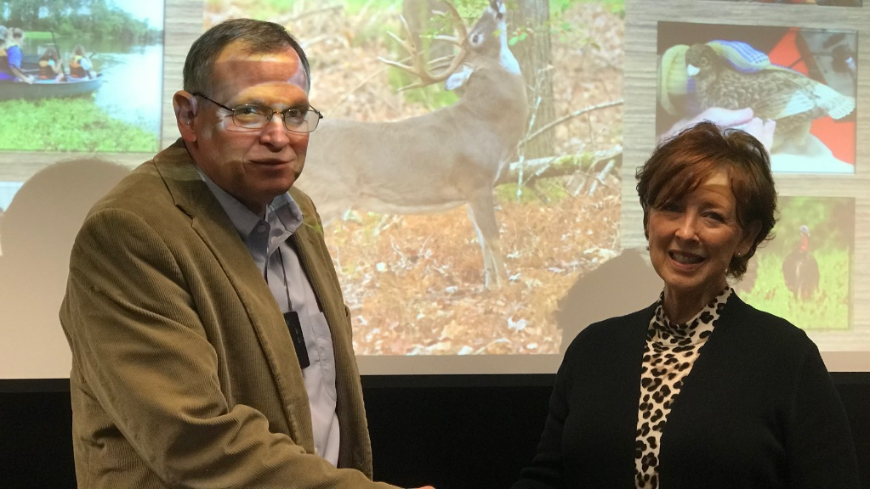
Black Belt Adventures
Pam Swanner, Project Director Alabama Black Belt Adventures Association

Slide 10
Black Belt Treasures
Larry Turner

Slide 11
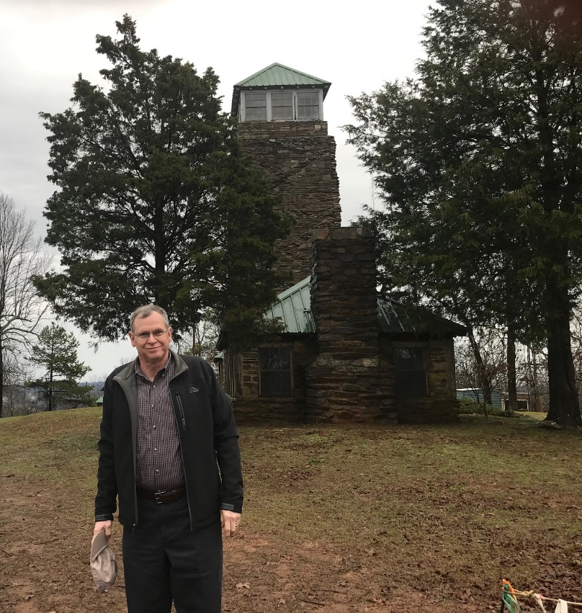
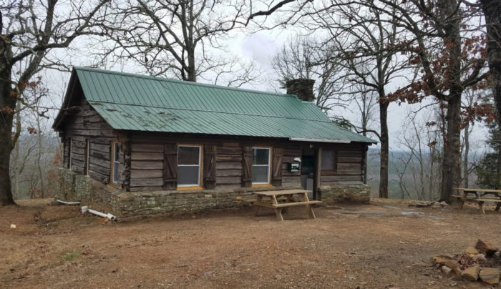
Alabama Trails Commission
Dr. M.J. Eberhart; aka Sunny; aka Nimblewill Nomad

Slide 12
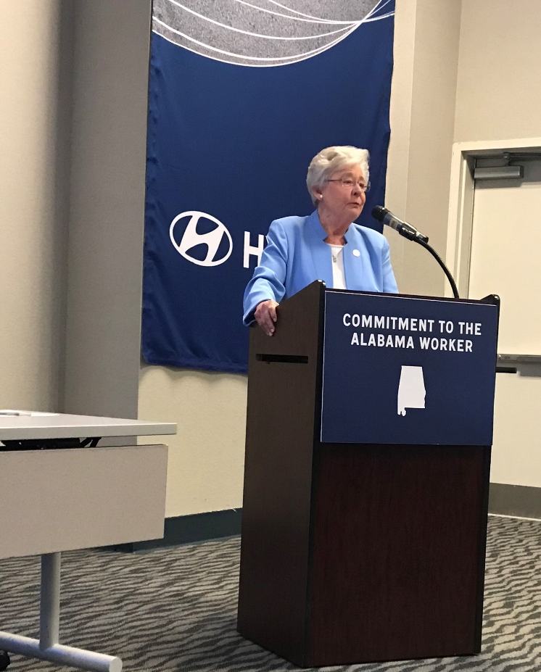
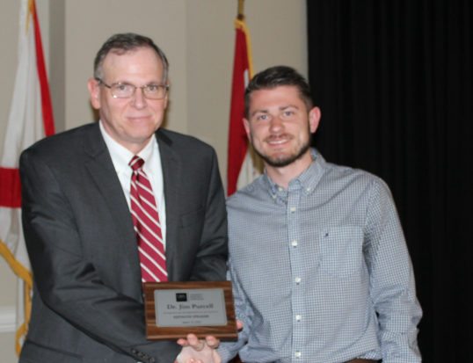
Other Travels
Connecting the Triad
US Secretary of Education Betsy DeVos
Alabama Committee on Credentialing and Career Pathways
Amy Price
2020 ACHIEVE Student Success Conference
UWA University Research Symposium

Slide 13
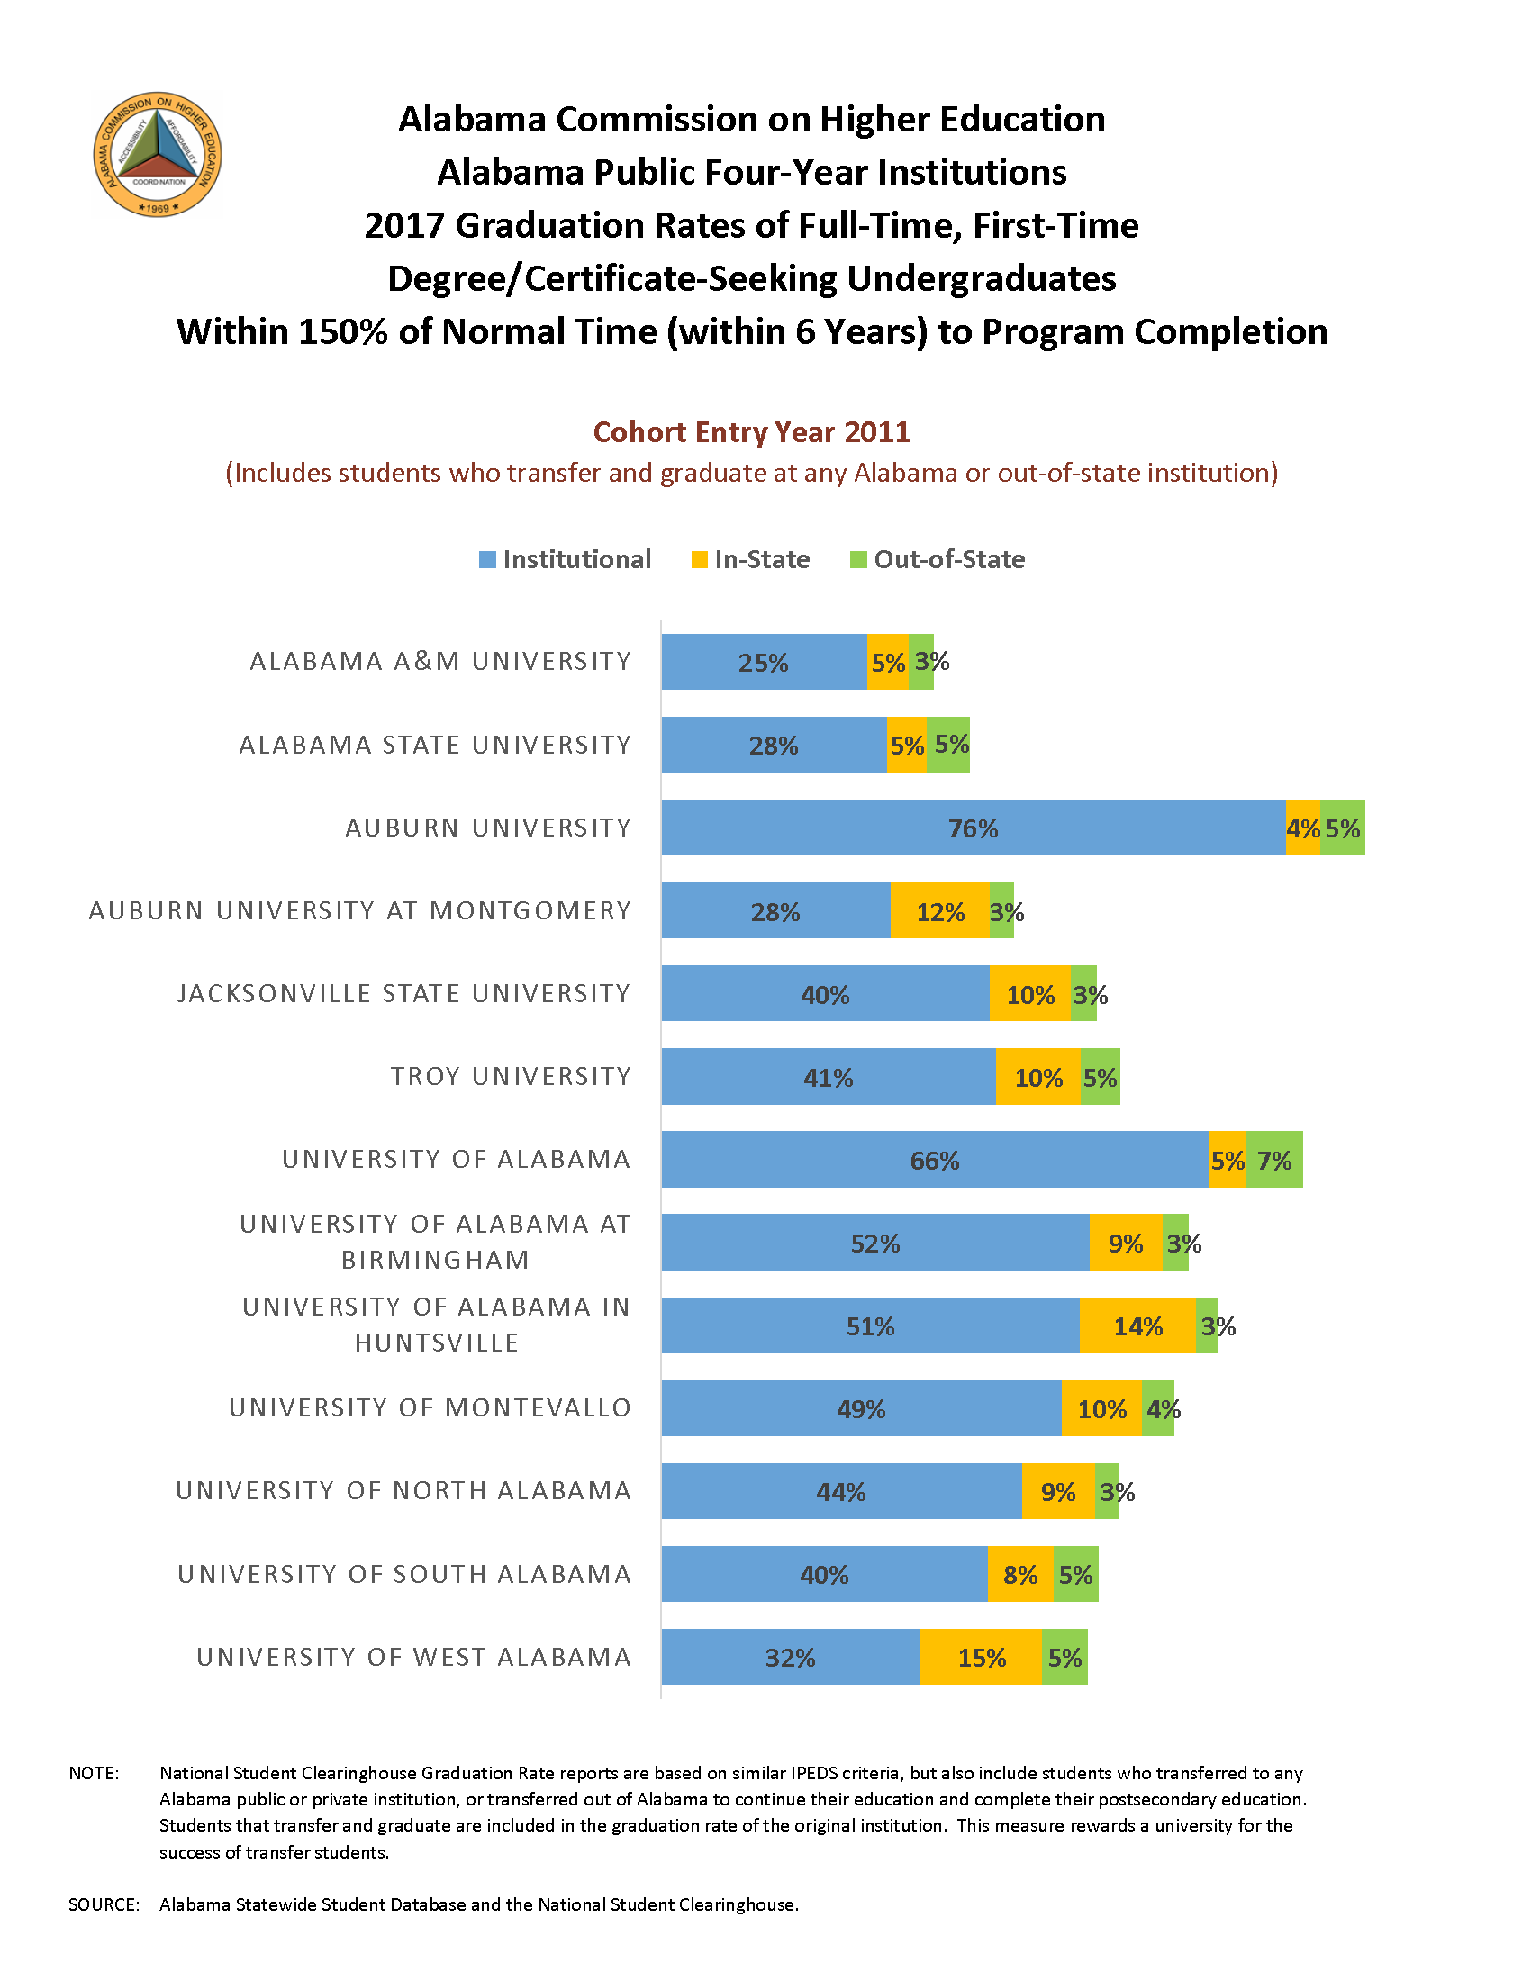

Slide 14
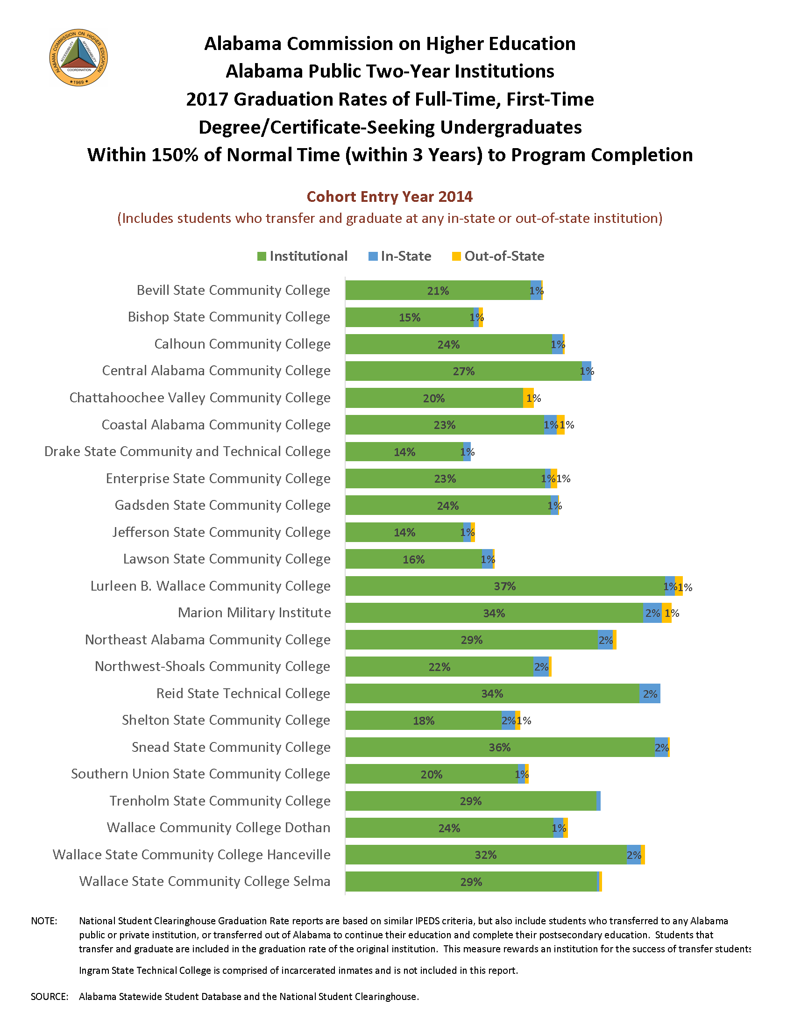

Slide 15
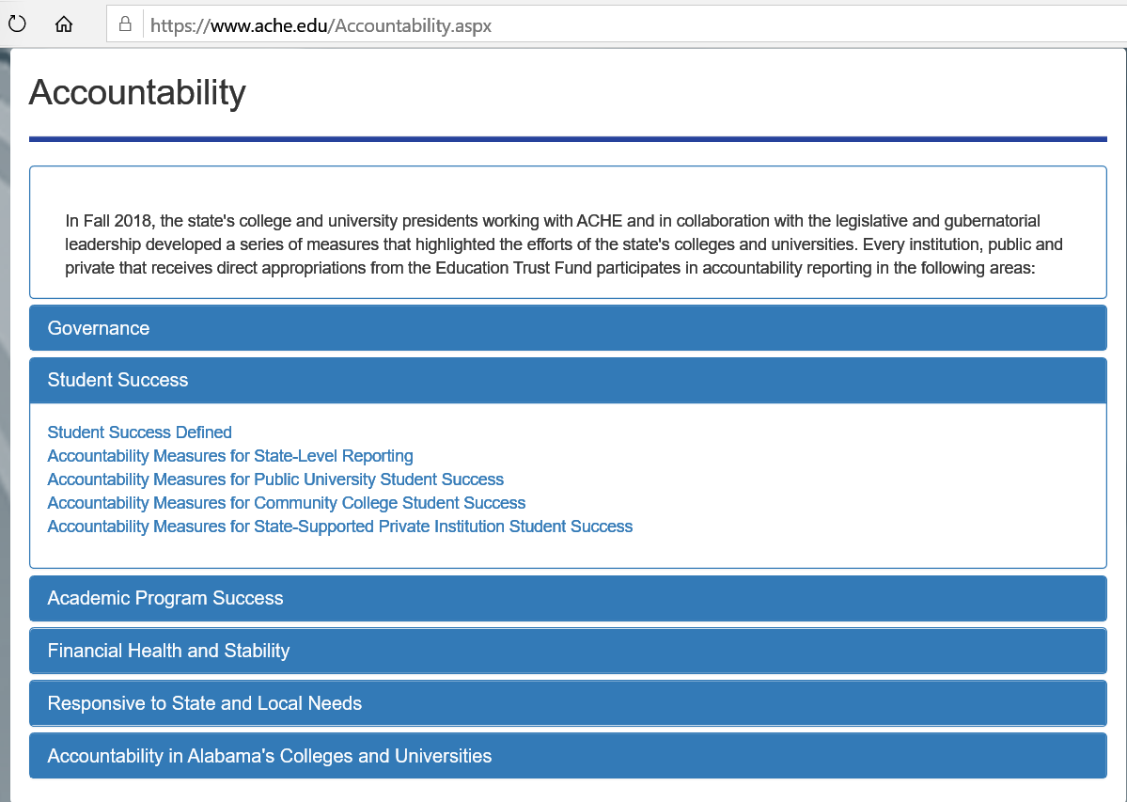

Slide 16
Employment Outcomes Report

Slide 19
40% Increase
26% Increase

Slide 22
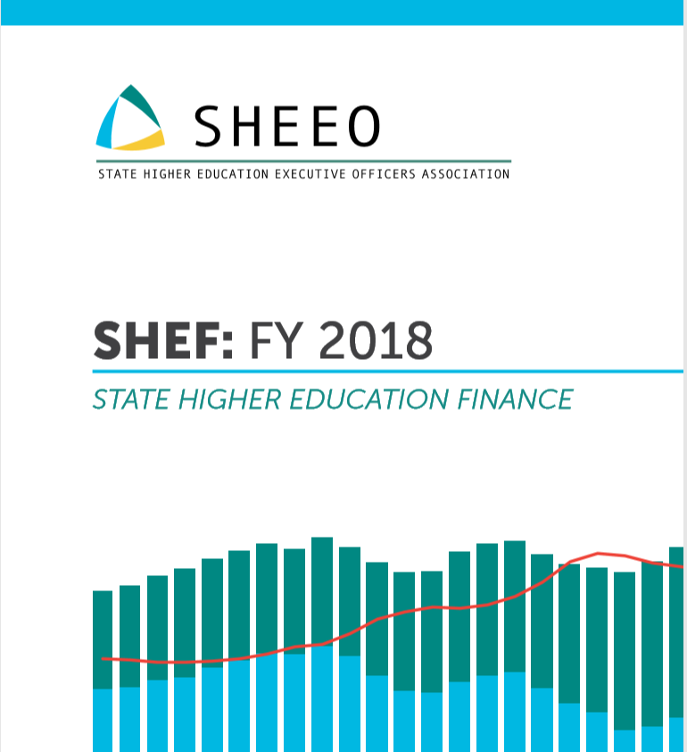

Slide 23
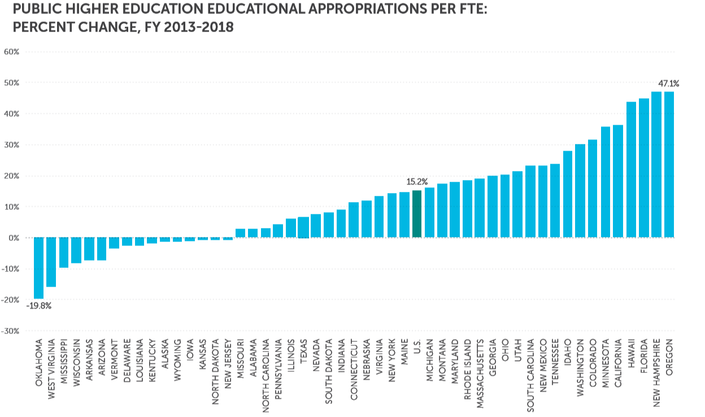

Slide 24
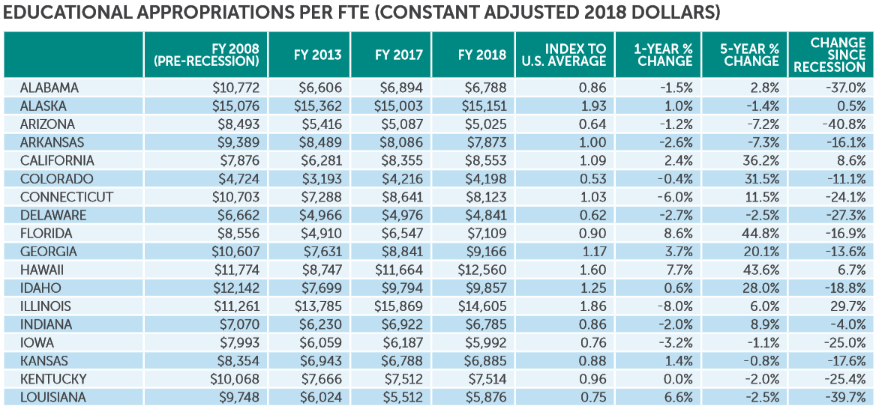

Slide 25
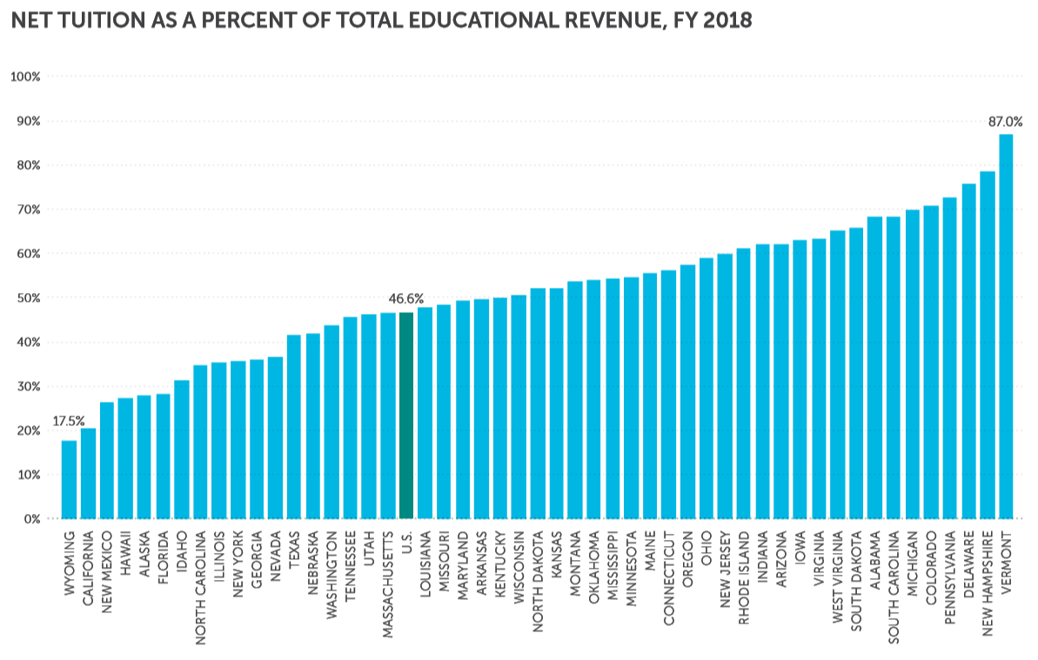
Tuition generates 68% of Educational Revenue for Alabama Public Institutions
Alabama is 8th highest in tuition revenue in the US

Slide 26
Alabama’s Tuition revenue increased nearly twice the national average (per FTE)

Slide 28
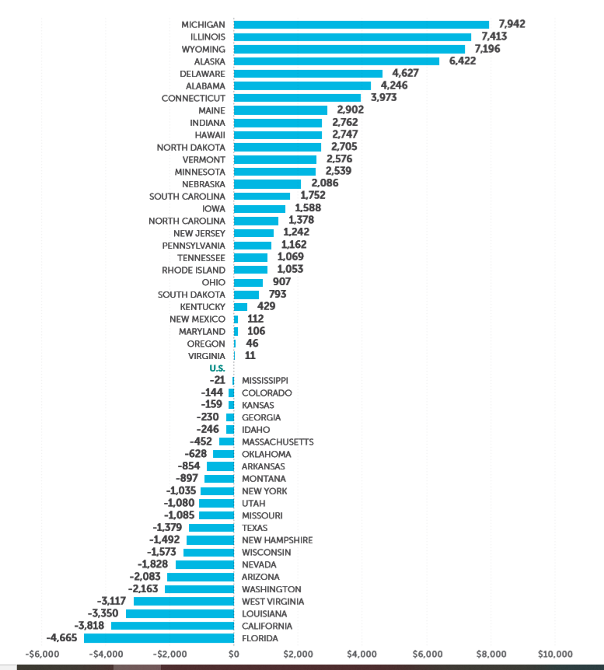
TOTAL EDUCATIONAL REVENUE PER FTE (ADJUSTED) - DIFFERENCE FROM U.S. AVERAGE, FY 2018
Alabama is 6th highest in total E&G revenue

Slide 29
VII. Discussion ITEM

Slide 30
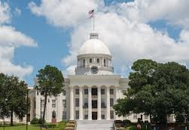
Governor’s Proposed Higher Education Budget
Governor Ivey’s FY 2020-21 budget proposal is now in the hands of lawmakers and it looks positive for higher education.
The two-year colleges are recommended to receive an additional $20,639,993 (6.31%) and the universities an additional $80,603,234 (6.7%).
Dual enrollment is recommended to receive an extra $5 million and an additional $4.2 million is identified for prison education.
The governor is asking the legislature to fund a two-percent pay raise for state employees and a three- percent increase for all Pre-K through community college teachers. *
ACHE received additional O&M funds to cover the employee pay raises.

Slide 31
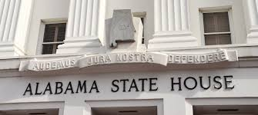
Other Legislation of Importance to Higher Education
SB242 –$1.25 billion education bond bill for capital needs on campuses has passed the Senate Finance & Taxation committee.
$120,050,879 – two-year colleges
$217,824,121 – universities
HB368- AMSTEP revisions have been given a favorable report by the House Ways & Means committee. They include broadening the eligibility requirements for math, science and computer science teachers to receive state funds for the repayment of federal student loans.

Slide 32
More Legislative News
HB293 – passed the House to create the Alabama STEM Council. The ACHE executive director, or his designee, will serve on the Council which will be part of the state’s workforce efforts.
HB392 – assigned to the House Ways & Means committee. The bill will incorporate eligibility changes to the Police Officer’s & Firefighter’s Survivors Educational Assistance Program (POFSEA) that is administered by ACHE. It will allow for a dependent, natural or adopted under 21 years of age, at the time of total disability of law enforcement/firefighter/rescue squad members, to be eligible for a scholarship.

Slide 33
VIII. Decision ITEMS

Slide 34
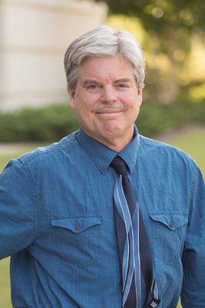
A. Forever Wild Appointment of Board Member
Dr. James B. McClintock, PhD
Central District appointment: June 2, 2020 – September 30, 2023
Endowed university professor of Polar and Marine Biology, University of Alabama at Birmingham
Over 275 scientific publications, primarily focusing on Antarctic marine chemical ecology, including studies of the impacts of rapid climate change and ocean acidification on Antarctic marine algae and invertebrates.
Research funded through National Science Foundation (NSF) and featured in National Geographic and on NPR and the Weather Channel.

Slide 35
B. Academic Programs

Slide 36
FOUR-YEAR INSTITUTIONS

Slide 37
Athens State University
1. Change of Instructional Role
Athens State University’s organizing statute and mission focus on serving the upper-division needs of the state’s transfer students, along with implementation of strategic graduate programs.
Since 2016, Athens State University has successfully implemented three master’s-level programs: MS in Global Logistics & Supply Chain Management (CIP 52.0203); MA in Religious Studies (CIP 38.0201); and MEd in Career and Technical Education (CIP 13.1319).
In June 2016, Athens State University received approval from its regional accrediting body, the Southern Association of Colleges and Schools Commission on Colleges (SACSCOC), to award graduate degrees as a Level III (master’s-granting) institution.

Slide 38
Jacksonville State University
2. Bachelor of Arts in Film (CIP 50.0602)
The BA in Film program is intended to support the state’s growing film industry and efforts to attract filmmakers through the Film Incentives Act of 2009.
JSU’s purchase of Longleaf Studios, a local production company, in 2019 will enable students to gain hands-on experience in a studio setting. In addition, the internship requirement will provide students with networking and skill-building opportunities within the degree program that will further assist in ensuring their successful career path.

Slide 39
University of Alabama at Birmingham
3a. Bachelor of Science in Cancer Biology (CIP 44.0701)
Through the O'Neal Comprehensive Cancer Center and associated clinical and laboratory facilities, UAB already offers doctoral-level coursework in Cancer Biology to students in its Graduate Biomedical Sciences and MD programs. The proposed BS program would enable students to specialize earlier in their academic careers.
The proposed new program would be the only one of its kind in the United States to train undergraduate students specifically in Cancer Biology, and is therefore likely to attract highly motivated students.

Slide 40
University of Alabama in Birmingham
3b. Bachelor of Science in Entrepreneurship (CIP 52.0701)
The proposed program expands existing undergraduate coursework to a full major in Entrepreneurship and will fall under the Collat College of Business at UAB’s accreditation through the Association to Advance Collegiate Schools of Business (AACSB).
In Alabama, small businesses employ approximately 775,829 people, which account for 47.5 percent of Alabama's private workforce, and entrepreneurial ventures continue to attract new business investment in the state. Graduates of this program will be well-prepared for emerging and evolving industries.

Slide 41
University of North Alabama
4a. Master of Science in Applied Manufacturing Engineering (CIP 14.3601)
Alabama has strong industry sectors in both engineering and manufacturing, and the program will provide advanced training in engineering and manufacturing business sciences related to manufacturing technologies that are active in Alabama.
The program will be accredited by ABET, with additional quality assurance from Quality Matters, which will make it a prominent program both regionally and nationally.

Slide 42
University of North Alabama
4b. Master of Social Work (CIP 44.0701)
Demand for licensed master social workers remains high, even with existing MSW programs offered at several public institutions in Alabama. The proposed program will help address a shortage of licensed master social workers in the state and region.
UNA currently delivers a Bachelor of Social Work degree, and they have the faculty and resources to expand the program to the master’s level and earn accreditation from the Council on Social Work Education (CSWE).

Slide 43
University of North Alabama
4c. Doctor of Philosophy in Exercise and Health Promotion (CIP 31.0505)
UNA has demonstrated its ability to deliver the proposed program based on strong faculty background, existing offerings at the master’s level (MS Health and Human Performance, CIP 31.9999), and ties with the UNA Center for the Study of Exercise Science and Health Promotion.
Demand for PhDs in Exercise Science and Health Promotion remains high in academic settings, as undergraduate enrollments in Kinesiology and related programs continue to grow, without an adequate supply of faculty.
This Photo by Unknown Author is licensed under CC BY-NC-ND

Slide 44
University of West Alabama
Doctor of Business Administration in Rural Business
The program will provide a strategic benefit to the region and the state by supporting new and existing businesses in rural communities.
The program is designed to develop a network of certified rural business consultants, transformational leaders, entrepreneurs, and managers with specific skills in rural business start-up, sustainment, and growth locally, regionally, and nationally.
The proposed program has garnered strong support from external stakeholders throughout the state.

Slide 45
ALABAMA COMMUNITY COLLEGE SYSTEM

Slide 46
Lawson State Community College
6. Associate in Applied Science and Certificate in Radiology Technology (CIP 51.0911)
Radiology technologists continue to be in demand within the healthcare industry, and the University of Alabama at Birmingham (UAB) has approached LAW to partner in developing a pipeline to meet demand for radiology technologists in the Birmingham area.
The average annual salary for radiology technologists in
Alabama ranges from $41,620 for positions in
Montgomery to $50,650 in Huntsville.

Slide 47
7. Request to Amend Post-Implementation Conditions
Alabama A&M University
Bachelor of Science in Entrepreneurship (CIP 52.0701)
The program did not meet the post-implementation condition for graduates.
Alabama A&M University (AAM) has requested an extension of three years to achieve the graduation annual average figure of 7.5. AAMU officials cite the delay in implementing the program, along with the short post-implementation period, as factors meriting the extension period.

Slide 48
C. INFORMATION ITEMS

Slide 49
INFORMATION ITEMS
Auburn University Montgomery: New Exempt Off-Campus Site
Implementation of Non-Degree Programs at Senior Institutions
Changes to the Academic Program Inventory
Implementation of New Short Certificate Programs (Less than 30 Semester Hours)
Extensions/Alterations to Existing Programs of Instruction
Change in the Name and Establishment of Centers and Departments
Summary of Post-Implementation Reports

Slide 50
7. Summary of Post-Implementation Reports
Programs that met post-implementation conditions
i. University of Alabama – Bachelor of Science in Architectural Engineering (CIP 14.0401)
ii. University of Alabama - Bachelor of Science in Environmental Engineering (CIP 52.0701)

Slide 51
Summary of Post Implementation Reports
Programs that did not meet post-implementation conditions
i. Alabama A&M University, Bachelor of Science in Entrepreneurship (CIP 52.0701)

Slide 52
D. ADJOURNMENT

