Slide 1
Alabama Commission on Higher Education
Commission Meeting
June 12, 2020

Slide 2
CALL TO ORDER and PLEDGE OF ALLEGIANCE

Slide 3
II. ROLL CALL and QUORUM DETERMINATION

Slide 4
III. APPROVAL OF AGENDA
Commission Meeting Agenda of
June 12, 2020

Slide 5
IV. CONSIDERATION OF MINUTES
Commission Meeting Minutes of March 13, 2020

Slide 6
V. CHAIRMAN’S REPORT

Slide 8
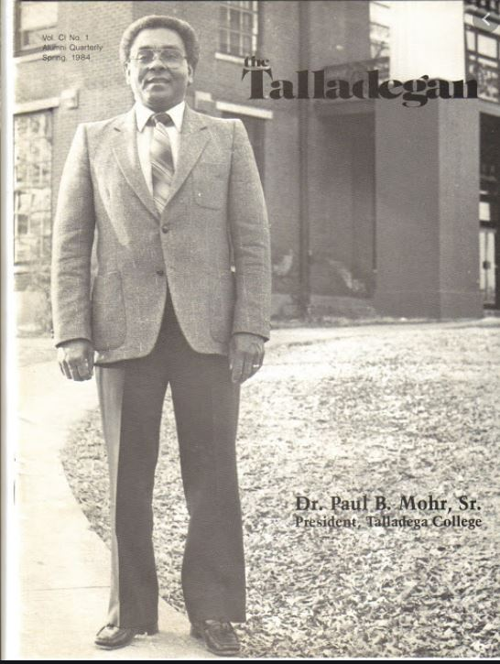
Retirement of Paul Mohr
30 Years of services for ACHE:
July 17, 1989 through May 31, 2020
Recognized leader among the Southern Regional Education Board’s Minority Doctoral Scholars Program. Alabama ranks first among SREB states with 143 scholars who have earned their Ph.D.
Served as the Commission liaison to the Alabama Virtual Library, EPSCoR and the Alabama School of Math and Science.
Had a distinguished career prior to coming to ACHE, including serving as President of Talladega College from 1983-1988.

Slide 9
Appointment of Nominating Committee

Slide 10
VI. EXECUTIVE DIRECTOR’S REPORT

Slide 11
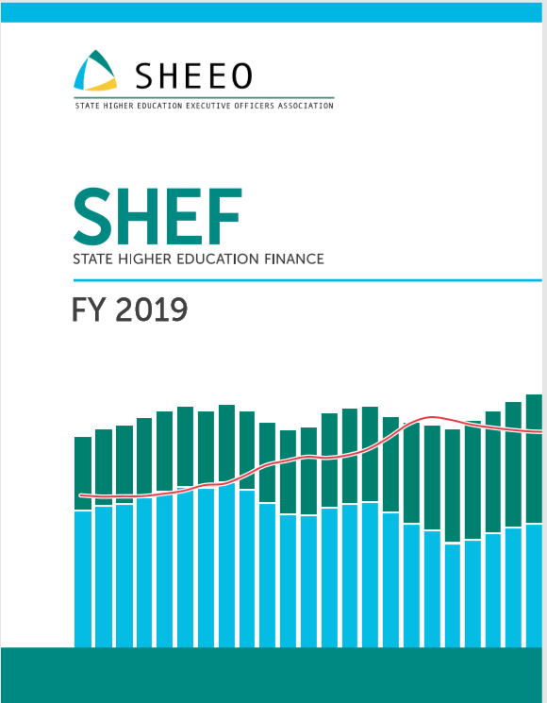

Slide 12
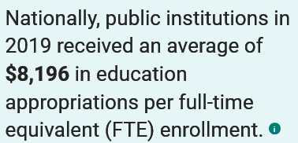
$7,031
2019
USA
2019
Alabama

Slide 13
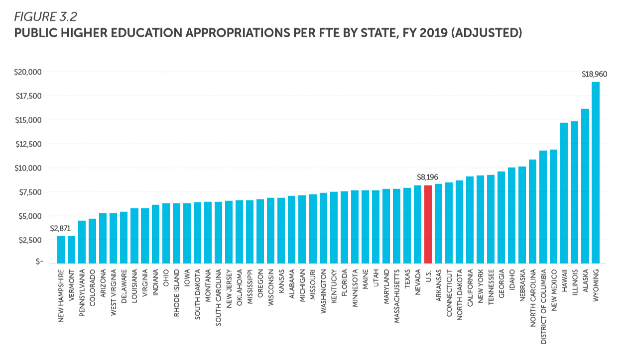
$7,031

Slide 15
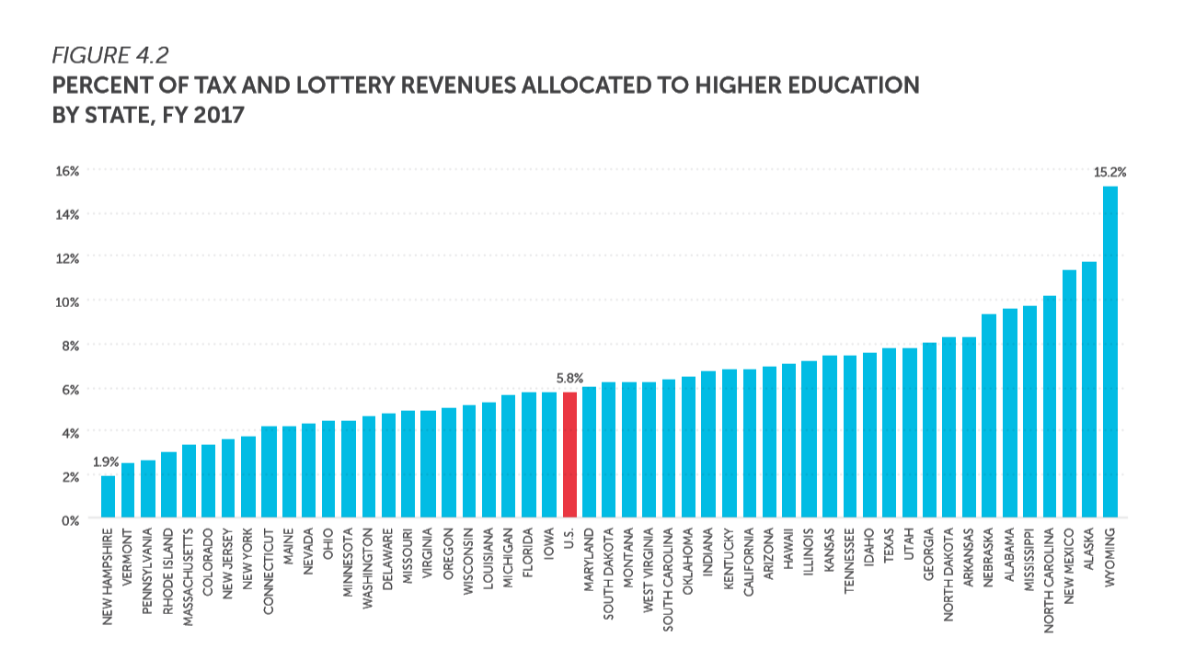
While Alabama receives less in state support, it receives a larger share of state revenue than most states. (Ranked 6th)
9.6%

Slide 16
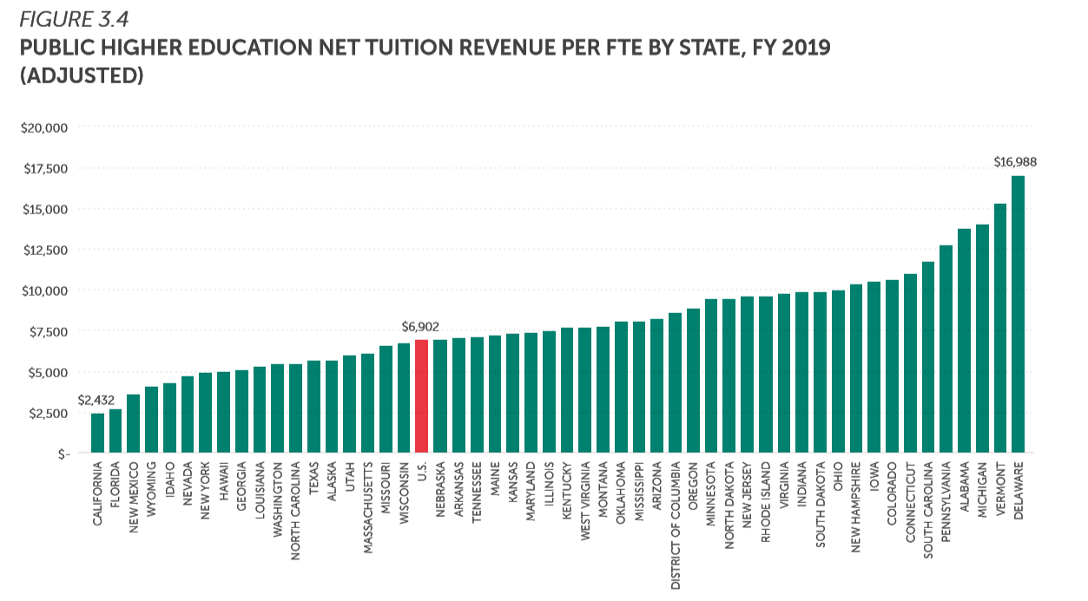
Alabama has the 4th highest tuition revenue in the country …
twice as high as the U.S average.
$13,775

Slide 17
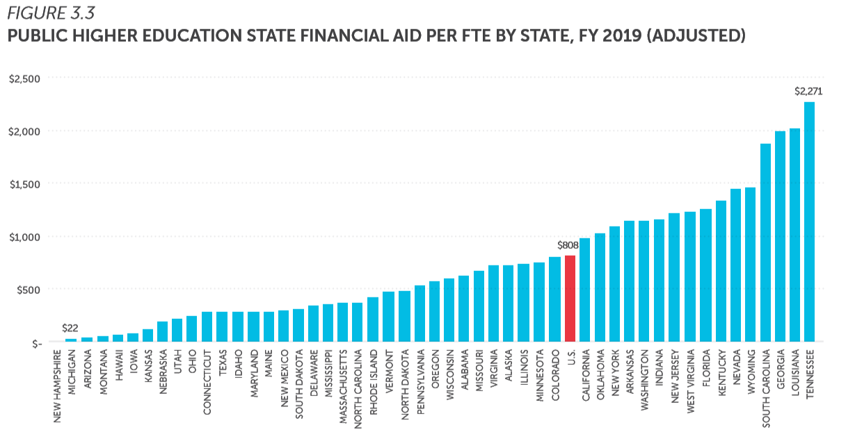
Financial Aid is money for students and not a direct support to institutions
Alabama has the 4th highest net tuition revenue in the country, but is ranked 24th in financial aid.
In Alabama, the largest financial aid programs are for veterans and their families.
Alabama is the nation’s fifth poorest state.
$621

Slide 18
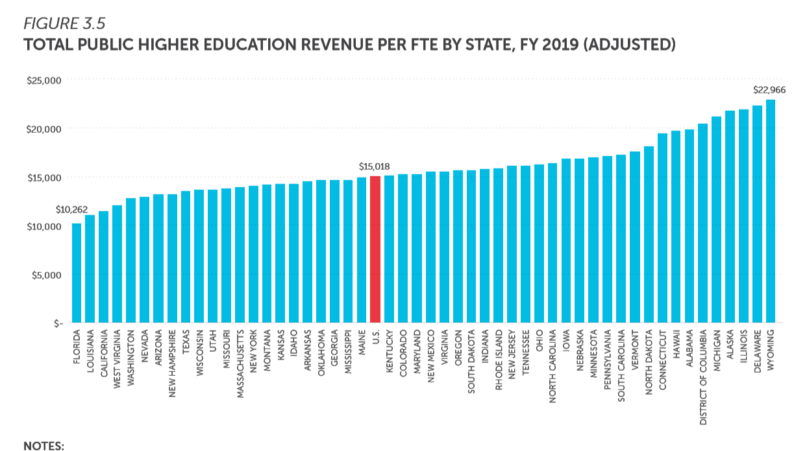
Tuition, fees and state appropriations combined
Alabama has the 4th highest net tuition revenue in the country, and is ranked 7th in overall revenue.
$19,844

Slide 19
Funding Higher Education at 1968 levels
Sources: Grapevine (1961-1979), SHEEO (1980-2018)

Slide 20
VII. Discussion ITEMs

Slide 21
2020 Legislative Update

Slide 22
AL Act 2020-169 (ETF Budget)
$7.2 billion Education Budget Passed
Public Two-Year Colleges –increased appx. $7.7 million (+2.22%)
Public Four-Year Universities – increased appx. $38 million (+3.13%)

Slide 23
Student Assistance
Program | FY 2016-17 ETF | FY 2017-18 ETF | FY 2018-19 ETF | FY 2019-20 ETF | FY 2020-21 ETF | Difference FY 2017 to FY 2021 | % Change FY 2017 to FY 2021
AL Student Grant Program | 4,470,970 | 4,470,970 | 5,020,970 | 6,506,126 | 7,006,126 | 2,535,156 | 56.7%
AL Student Assistance Program | 2,897,551 | 2,897,551 | 4,147,551 | 5,397,551 | 5,897,551 | 3,000,000 | 103.5%
AL Recruit and Retain Minority Teachers Pilot (AAM & ATSU) |  |  |  | 500,000 | 700,000 | 700,000 | na
Total | 7,368,521 | 7,368,521 | 9,168,521 | 12,403,677 | 13,603,677 | 6,235,156 | 84.6%

Slide 24
FY 2020-21 New ACHE Line Items
A-KEEP Education and Teacher Recruitment Partnership - $100,000
Birmingham Promise Scholarship Program - $750,000

Slide 25
Birmingham Promise Scholarship
$750,000 new ACHE budget item
A public-private partnership
United Way of Central Alabama
City of Birmingham
Birmingham City Schools

Slide 26
FY 2019-20 Supplemental Funds for
Best & Brightest STEM Pilot Program
Best and Brightest STEM Pilot Program shall pay the student loan debt of recent STEM graduates that relocate to the City of Decatur and Marengo County
$120,000 shall be for the City of Decatur
$120,000 shall be for Marengo County
Qualifications:
Must have a STEM degree from an AL four-year institution of higher education
Cannot be a resident of the subject county at the time of application
Pilot program shall be no more than five years
Amount available per graduate shall be $3,000 annually

Slide 27
AL Act 2020-167 (Education Bond Issue)
Issued through the AL Public School & College Authority (APSCA)
State’s largest capital improvement investment in history
Total amount $1.25B
K-12 $912,125,000
Two-Year Colleges $120,050,879
Universities $217,824,121

Slide 28
AL Act 2019-396 (Freedom of Speech and Expression)
Legislation passed in 2019 becomes effective July, 1 2020.
Requires state two-year and four-year colleges and universities to protect and uphold free speech rights for students, faculty and staff and to provide a course of action for violations.
Boards of trustees of each public institution of higher education will be required to prepare an annual report detailing the actions over a 12-month period ending July 31.
First report will be submitted September 1, 2021 and will be published on ACHE website.

Slide 29
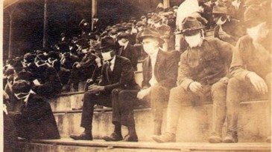
The Impact of COVID-19 on the Future Operations of Community Colleges and Universities
Dr. Jim Purcell and Dr. Robin McGill
Presentation adapted from presentation for the National Education Finance Academy (originally to be held in Birmingham, but converted to an online event in April 2020).

Slide 30
Overnight – All online
A lot of changes all at once!
Study of Undergraduate Students and Information Technology, 2019
85% of lower division and 78% of upper division faculty currently only teach in-person
March 20, 2020
68% of students only taking in-person classes
Training faculty on how to teach online
Synchronous learning is when classes occur on set schedules and time frames. All students must be online at that exact time in order to participate in the class.
Asynchronous classes let students complete their work on their own time.
Figuring out what to do with courses and labs that are hands on
How to engage student discussion
Faculty/student conferences
Submitting homework
Taking Tests

Slide 31
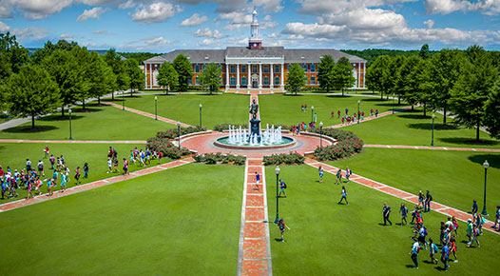
The good news
What we said publicly:
The scary part:
We did it! We are all online! Yeah Us!
We are online, but some of it isn’t pretty
What we whispered privately:
The system is overloaded. Some students cannot connect from home.
Student complaining about grades and tuition refunds.
Some faculty not savvy with technology… nor possess a demeanor suitable for the internet.
What are we going to do about required labs, practicums, clinicals?
What about federal requirements for seat time, clock hours and the limit of online courses for international students on campus?
What about students with disabilities?
Students and staff being locked out of classes and meetings using free internet video conferencing platforms.

Slide 32
Elsewhere on Campus…
Housekeepers deep cleaning campus facilities.
CFOs lamenting over the potential loss of tuition/fee revenue for the upcoming terms –definitely for the Summer term, but what will we do if Fall enrollment crashes and burns?
Should we get/increase our access to short-term credit? Do we have a furlough plan? Should we go ahead and sweep departmental budgets? Do we need to use this moment to “right-size” our campus operations and vision?
Business office fielding questions about refunds to students for dorms and meal plans. Those institutions supplementing their budgets with auxiliary unit income may be asking—
Do we really need to refund students because we sent them home? What does the contract say? Where will get the money? Let’s kick the can down the road and just give them a credit toward next year’s cost … if they come back. Just refund seniors –because if not, they will be angry alumni.

Slide 33
Elsewhere on Campus…
Administrators trying to figure out the CARES Act. What part of this financial hit can we reimburse from the CARES Act funding? “Why no rules?” Then when the rules come, “Why those rules?”
Which student expenses can be covered? How do we distribute? How do we decide which students are most needy? How do we document? Do we have access to funding from other CARES Act money? What about the Governor’s Emergency Education Fund?
Health Program Staff responding to requests from the state and local hospitals for medical supplies and equipment. Documenting gifts and equipment loans.
Individual faculty, students, and staff making personal protective equipment.
Campus social organizations giving food and supplies to local food pantries.
Counseling Centers addressing mental health issues of students and staff.

Slide 34
Elsewhere on Campus…
Admissions offices re-selling the institution and the residential experience. Thinking how to handle graduation and then conduct orientation online. Adjusting admission deadlines, and admission and scholarship criteria.
Academics re-thinking schedules for Summer and Fall. And faculty training. Ending faculty searches and possibly rescinding job offers.
Researchers checking to see what research is impacted by the virus.
What federal grant contracts are suspended? Deadline extensions?
Lobbyists alerting Governors and legislators of the need for increases in state support for institutions and student financial aid.

Slide 35
ACHE Guidance to Campuses
Faculty, staff, students, parents, and the public will want to know detailed information regarding institutional plans for delivering instruction and protecting the health and wellbeing of everyone on campus.
Concise and clear communication will be key to helping constituents determine to what extent they want to engage with institution(s). The following points are essential for public communication:
plan for repopulation of the campus (phased process)
plan for monitoring health conditions to ensure the detection of infection
plan for containment to prevent the spread of the disease, if detected
plan for pivoting campus operations in the event that it becomes necessary, either because of an outbreak on campus or another statewide order from the Governor.
Some iteration of these plans regarding COVID-19 should be posted directly to institution’s web page.

Slide 36
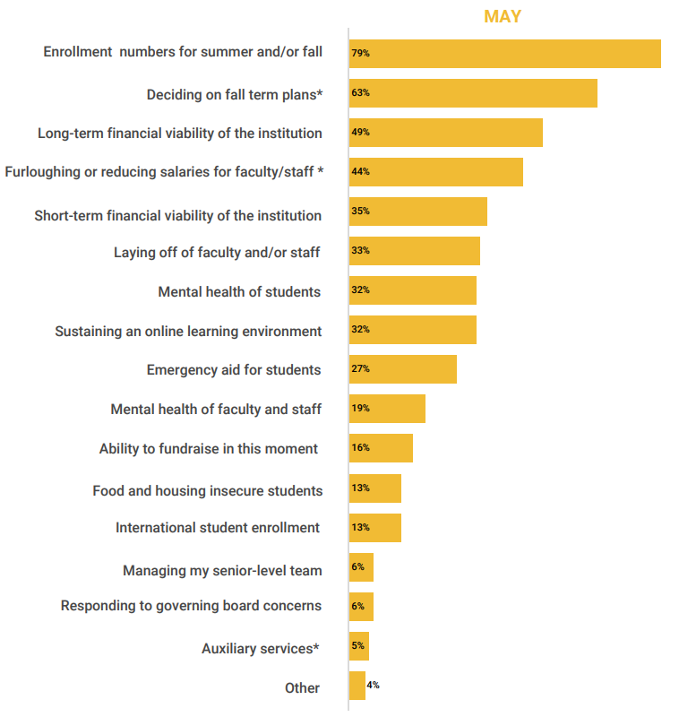
Elsewhere on Campus…
n = 310
President’s Office
When asked to select the top 5 issues deemed to be most pressing:
Note the concern for financial issues

Slide 37
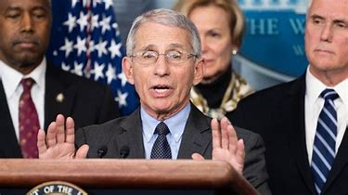
In an interview on NBC's Meet the Press, Anthony Fauci said those with "underlying conditions" are "overwhelmingly" more likely to have complications if they catch the coronavirus.
The underlying financial conditions of many campuses will cause complications.

Slide 38
The unsustainable financial situation of many campuses must be an important consideration for state policy makers and campus leaders seeking to address the current financial crisis for colleges.

Slide 39
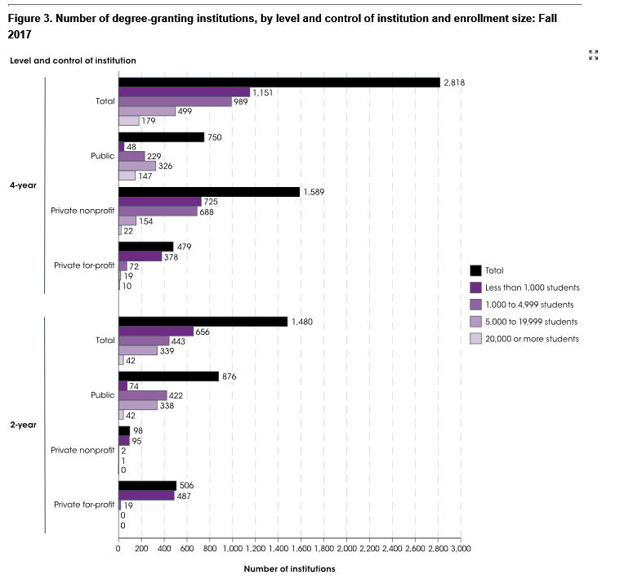
Degree Granting Institution by Enrollment Size --Fall 2017
Risk-factors for Closure, Merger, Change of Control
Enrollment <1000
Private
Disproportionate institutional debt
Lack of reserves
Cash flow issues
Accreditation issues
Disengaged alumni
Residential campus w/ auxiliary debt
Small online presence
Traumatic events
Heavy tuition discounts
Low-income students
40% of 4-year and 44% of 2-year colleges have less than 1,000 Students
This is an attempt to identify underlying conditions that put campuses at risk. Size is the biggest factor, but a combination of several of these other factors can threaten larger institutions and require significant organizational change and repositioning.

Slide 40
Meanwhile…
student needs are changing
Students and families are in a tough situation with 69% feeling some economic stress because of the pandemic.

Slide 41
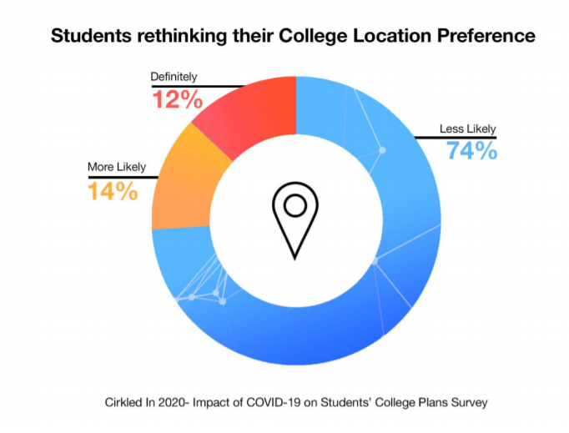
Meanwhile…
student needs are changing
Students may end up going to college closer to home. Will impact institutions reliant on out-of-state students.

Slide 42
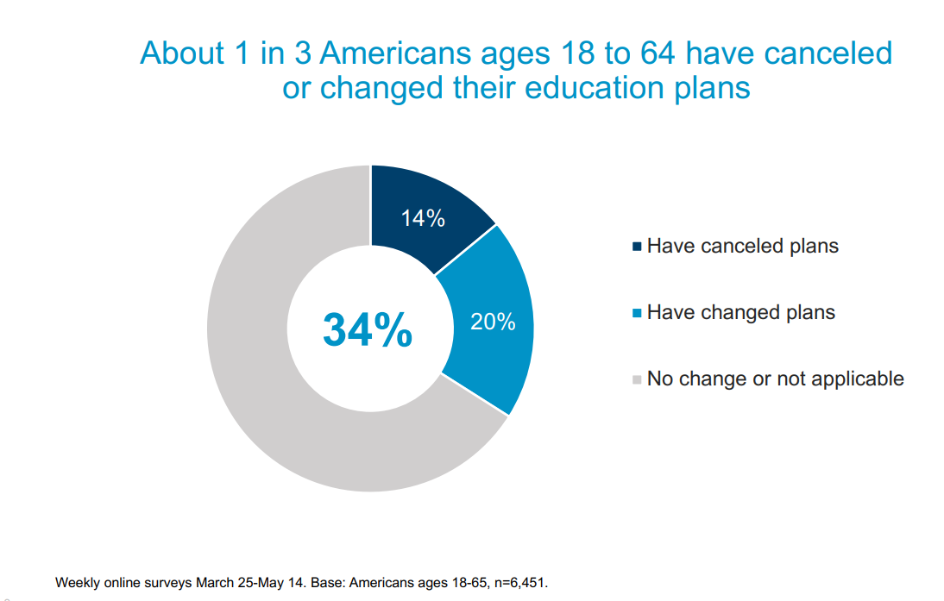
Meanwhile…
student plans are changing
Students who planned to pursue higher education are cancelling or delaying their studies.

Slide 43
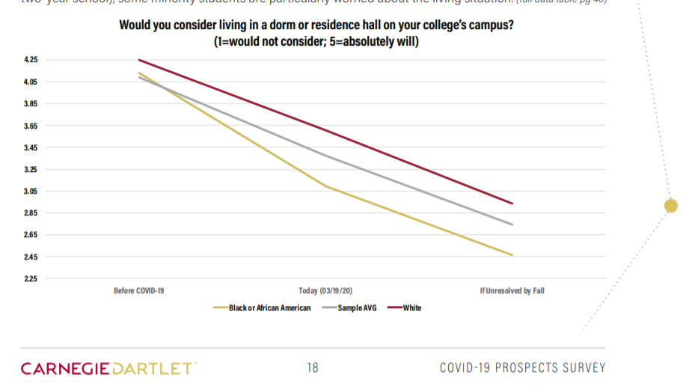
Meanwhile…student preferences are changing
Students are not as enamored of living in densely occupied/ communal housing as they were before COVID-19.
Many residence hall operations are based upon occupancy rates of 90% or greater. Debt/ mortgage payments on dormitories can be very high.

Slide 44
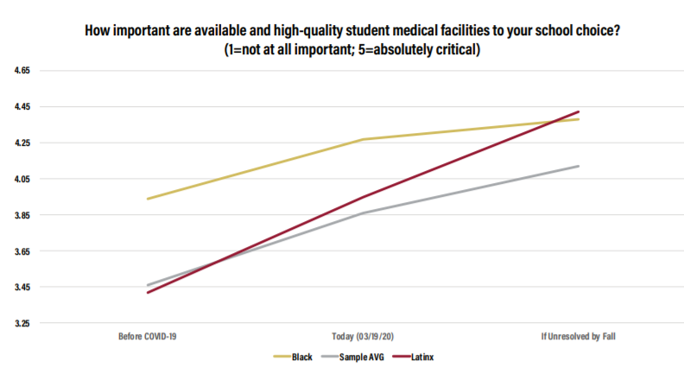
Meanwhile…student preferences are changing
Concern about access to good health care will affect decisions on where to go to college.

Slide 45
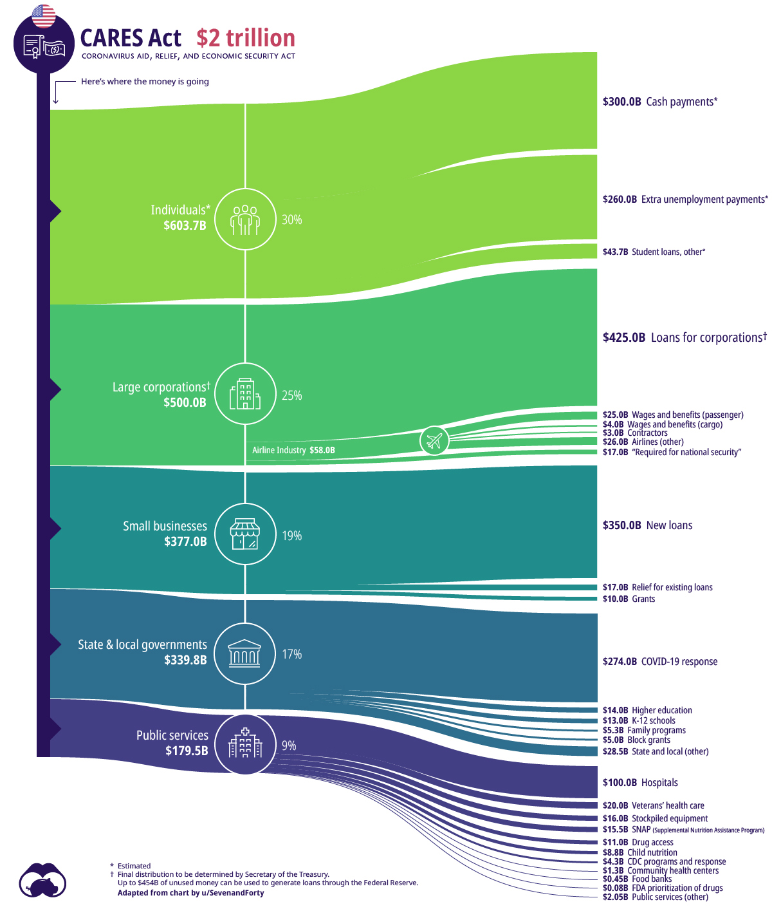
Some relief from the feds
$44B deferred student loans = 0.19%
The support for colleges and their students is only a small part of the federal effort to address the crisis.
$14B for H. Ed = 0.06%

Slide 46
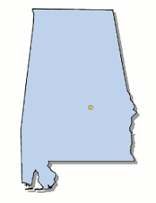
CARES Act Higher Education Relief Funds
for Alabama IHEs
US Department of Education – Estimates as of June 8, 2020
Alabama Sector | Student Aid | Institutional Portion | HBCU/MSI/ Other | Total
4-yr Public (n=14) | $55,727,984 | $55,727,976 | $32,317,062 | $143,773,022 (52.5%)
2-yr Public (n=24) | $27,725,128 | $27,725,120 | $23,117,013 | $78,567,261 (28.7%)
Private (n=16) | $11,155,319 | $11,155,311 | $19,478,637 | $41,789,267 (15.3%)
For-profit (n=14) | $4,950,890 | $4,950,883 | $0 | $9,901,773 (3.6%)
Total (n= 68) | $99,559,321 | $99,559,290 | $74,912,712 | $274,031,323
For some campuses, their allocation cannot even fully cover costs associated with refunds for spring-term housing and meal plans. The loss of revenue from enrollment in future semesters is a major concern.

Slide 47
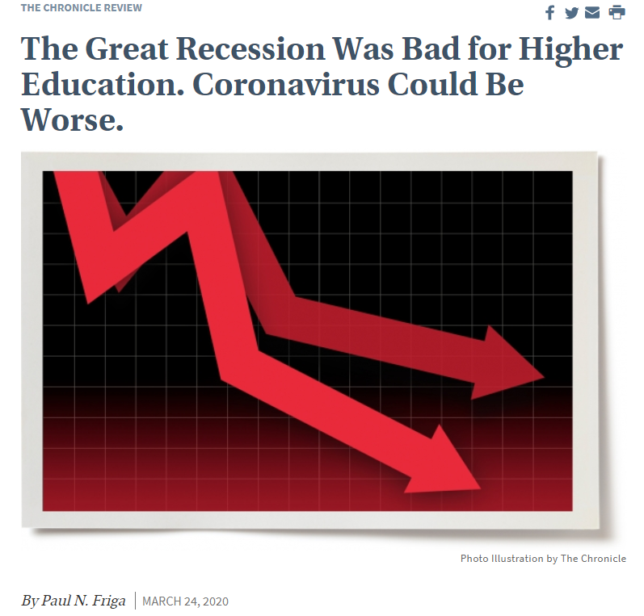

Slide 48
Looking ahead…
In any journey, it is the finish that defines whether it is a tragedy or an American success story.
The context is about preparing for the long game … and the possible necessity of short-term sacrifice.

Slide 49
Impacts likely to vary by selectivity and innovation
The next 5 slides show how innovation and selectivity impact the success for institutions.
Innovative
The willingness to innovate will be the key to success of institutions in the post COVID-19 era.
Pioneering institutions
Cutting-edge institutions
Not Selective
Selective
At-risk institutions
Prestige
institutions
Less selective and less innovative institutions are at greater risk.
Immobile

Slide 50
What makes an institution innovative?
We identified two important ways that institutions can innovate:
Changes to instructional delivery models
Changes to instructional content
The current and future workplace is more digital, and students enter/ exit education and employment more frequently. Learning is more modular and stackable in a more structured format and has established relationships with employers. Institutions that frame their instruction to include fundamental digital skills have become more popular with students and employers.

Slide 51
Impacts of COVID crisis for cutting-edge institutions
These institutions are highly selective and are known for their innovation. Their innovation attitude helps the institutions to evolve as the world changes. There is always strong student demand to attend these institutions in-person and online; therefore, they will likely meet enrollment/financial projections. If worse comes to worse, they could make admissions less selective and enroll additional students.
Innovative
Disruptor institutions
Cutting-edge institutions
Selectivity
Selective
At-risk institutions
Prestige
institutions

Slide 52
Impacts of COVID crisis for prestige institutions
Innovative
These institutions are highly selective, but risk-averse and therefore, less innovative. Because of reputation, strong student demand will continue. These institutions will likely meet enrollment and financial projections. If worse comes to worse, they could make admissions less selective and enroll additional students.
Disruptor institutions
Cutting-edge institutions
Not Selective
Selective
At-risk institutions
Prestige
institutions
Immobile

Slide 53
Impacts of COVID crisis for at-risk institutions
Innovative
These institutions have minimal admission standards and are particularly innovative in education delivery or content. Students attending these institutions are very susceptible to economic conditions. Because these institutions admit most applicants, many will experience enrollment declines post COVID-19.
If worse comes to worse, institutions will be restructured, academic programs will close, mergers will occur and some institutions will close.
Disruptor institutions
Cutting-edge institutions
Not Selective
Selective
At-risk institutions
Prestige
institutions
Immobile

Slide 54
Impacts of COVID crisis for pioneering institutions
Innovative
Pioneering institutions
Cutting-edge institutions
Not Selective
Selective
These instructional entities may have minimal admission standards, but their level of innovation in educational delivery and content provides them with a business model that will work in an unstable economic situation. As a collective, these institutions attract students that seek credentials that have value in the workplace and do not place value in the institutional name brand. They will become more attractive to the currently employed or recently unemployed that are finding the need to up-skill their current credentials.
At-risk institutions
Prestige
institutions
Immobile

Slide 55
As a result of COVID 19, students are preferring online.
54% Online

Slide 56
Looking beyond COVID…
A third of current workers are realizing that their current job is less stable and that they need additional education to get into a better financial situation.

Slide 57
BUT…Pivot to What?

Slide 58
Pivot to What?
More nimble and resilient organization
Extensive use of distance learning in instruction
offer asynchronous instruction for informational courses
implement self-paced competency-based learning when possible
enhance opportunities for virtual student-to-faculty interaction
Create incentives for faculty to teach more students
with opportunities to share revenues
with greater schedule flexibility
Expand portfolio of offerings
meta majors
micro-credentials
These ideas are a few ways to pivot to a business model that is more sustainable.

Slide 59
Building Communities and Local Economies
Density of educated/ skilled workers
Alignment of skills to jobs
Access to good schools, colleges, universities
Local leadership
Regional economic development strategies rather than state-wide strategies
Return to city-states
Sparta and Athens
Work ready communities
Institutions that position themselves to serve the local economy will benefit from steady enrollment and a reason for continuous innovation.

Slide 60
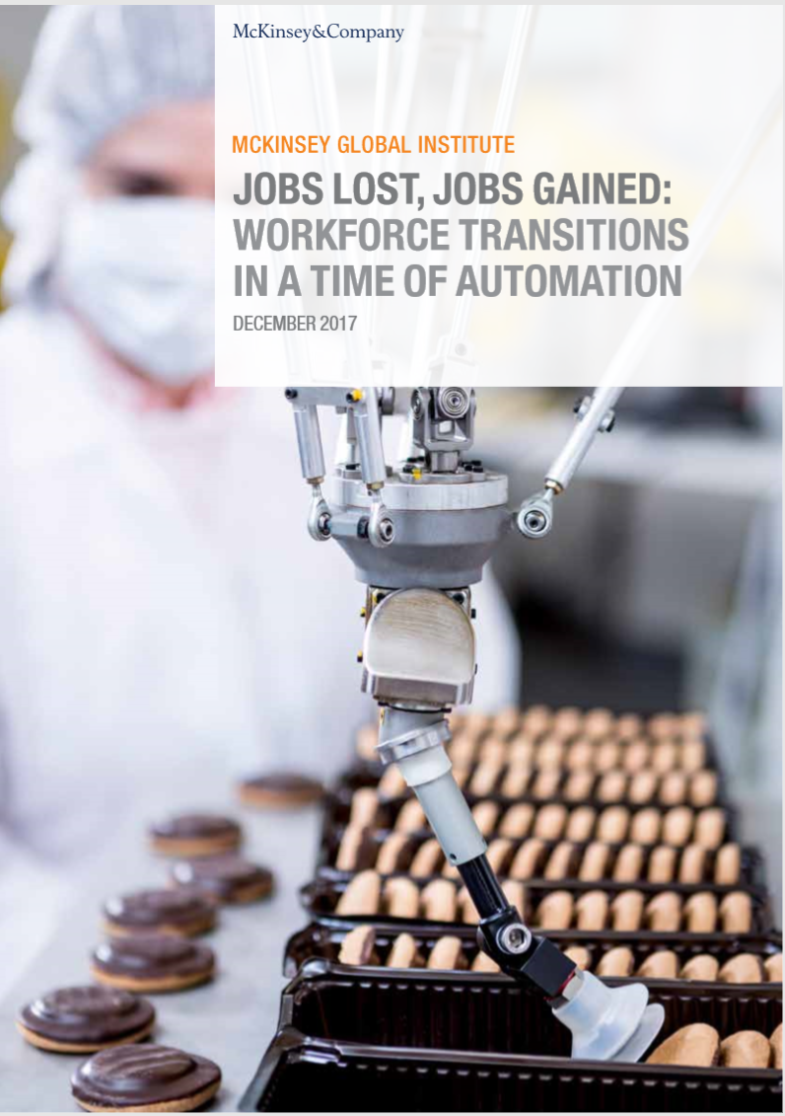
Predicting the Future of Work (pre-COVID)
The current educational requirements of the occupations that may grow are higher than those for the jobs displaced by automation.
If displaced workers are not reemployed quickly, countries will face rising unemployment and depressed wages
Globally, up to 375 million workers may need to switch occupational categories by 2030, with 166 million of those in the US.
Lest we forget, technology was challenging communities and institutions prior to the pandemic. The pace of automation, may increase as the density of workers proves problematic.

Slide 61
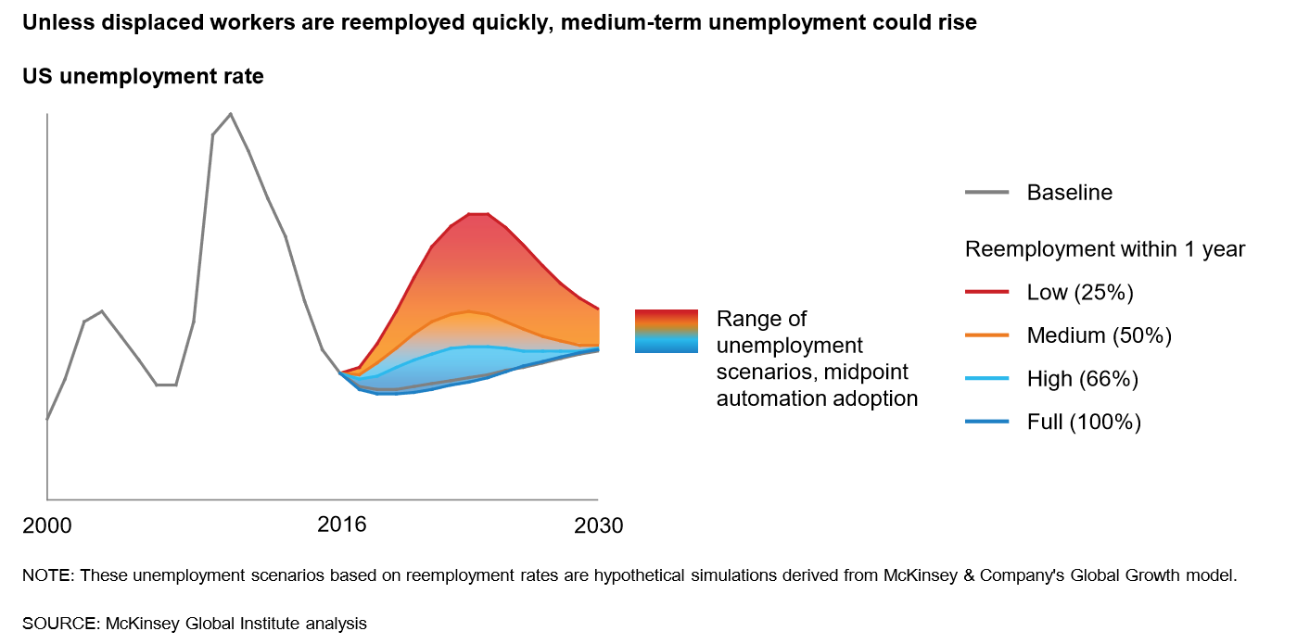
Higher education still needs to focus on retooling the US workforce for an automated workplace.

Slide 62
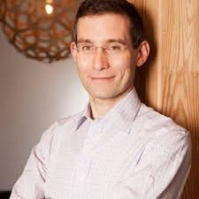
“For those interested in the ‘future of work,’
we can recognize a lot of what we’ve been worried about playing out today in this crisis,
but a lot faster and at an even more massive
scale than any of us could have imagined.
The impetus, as it turns out, wasn’t necessarily automation…it was a virus.”

Slide 63
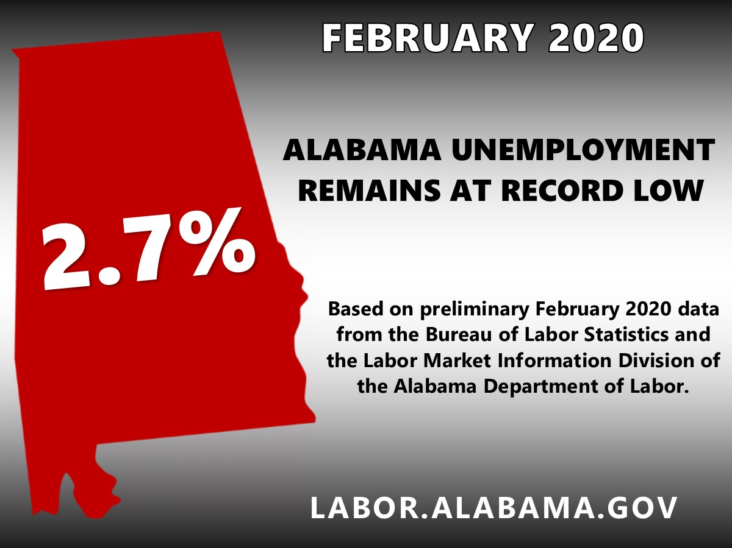
BY APRIL 2020…
Unemployment rates across the southeast

Slide 64
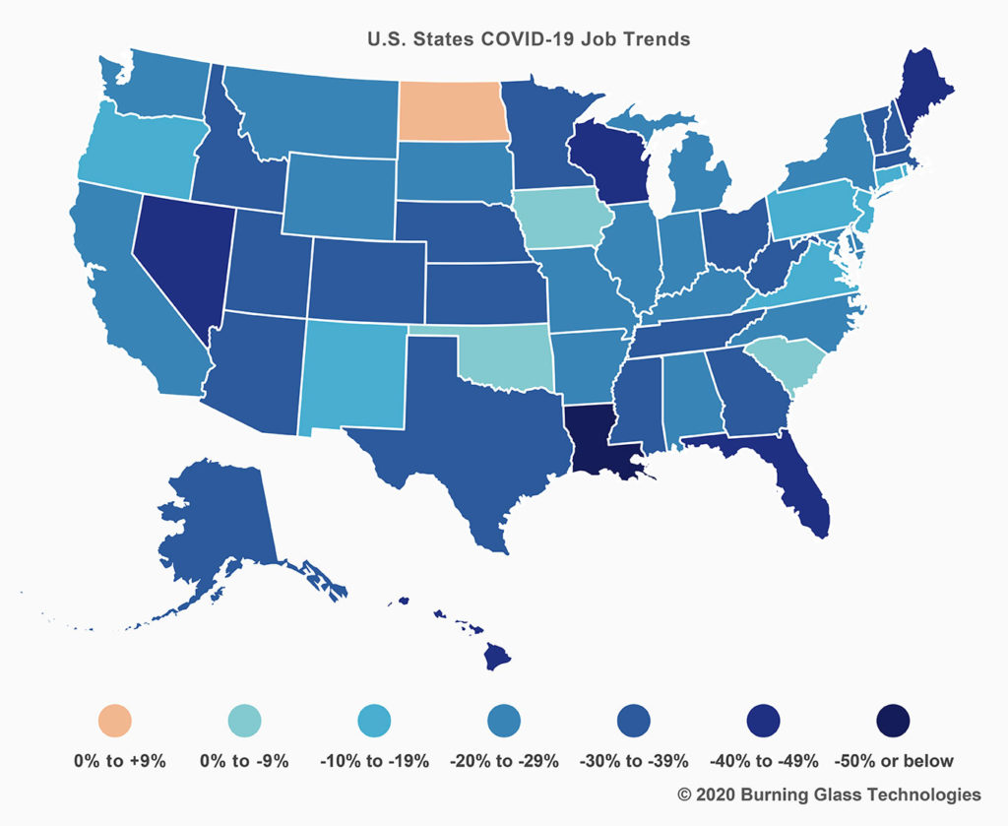
Early trends in job posting data show that the greatest decline in hiring occurred in states most dependent on tourism, manufacturing, and other “vulnerable” industries.
% change in # of jobs posted, March 2 to March 23, 2020

Slide 65
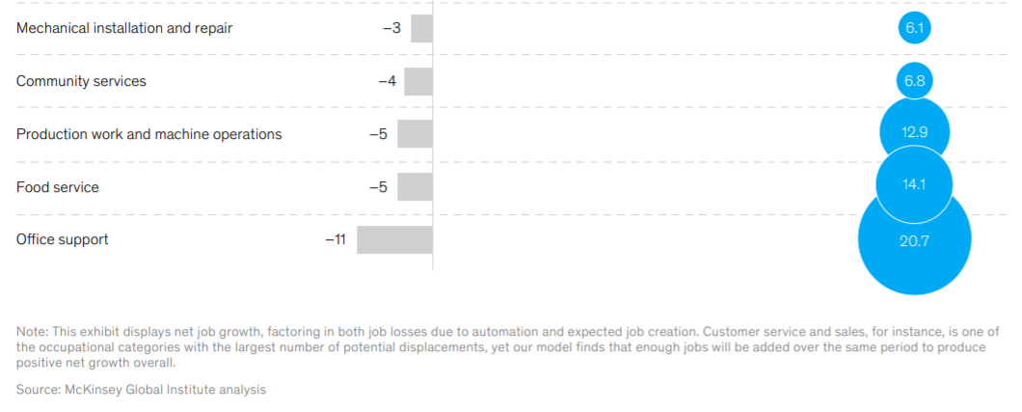
So what could the future of work look like now?
One scenario based on vulnerability to automation: LOSSES
Similar to current job losses
The key point here is that the job losses caused by COVID 19 are in the sectors where automation is projected to reduce jobs anyway. While office support staff do not show immediate declines for COVID 19, they are likely to decline as organizations streamline their operations.

Slide 66
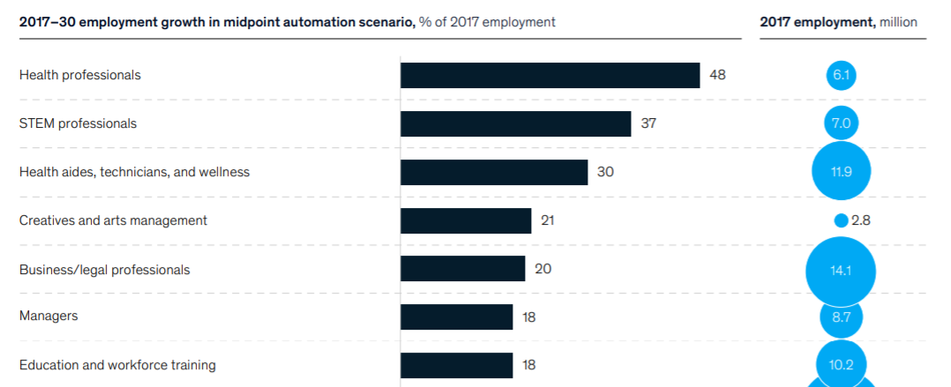
So what could the future of work look like now?
One scenario based on vulnerability to automation: GAINS
This chart show projected job growth through 2030 and during the transition to an automated workplace. Note that most of these categories are in higher demand because of COVID-19.

Slide 67
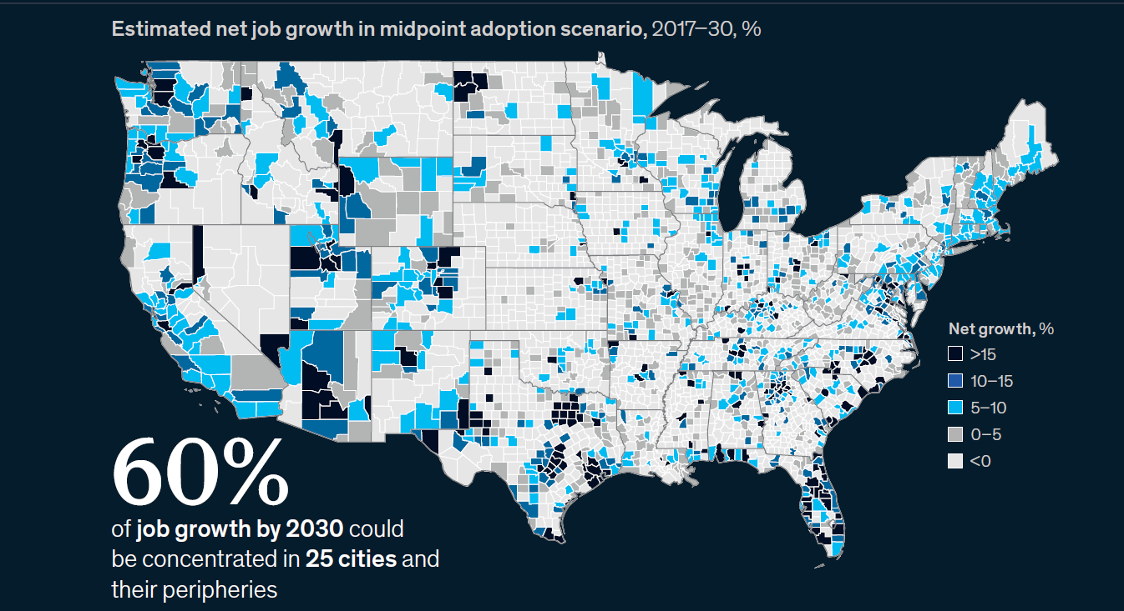
This chart projects job growth through 2030 as a part of global automation. Because of the pandemic, there is now less certainty where job growth will occur.
Job growth will be localized.

Slide 68
This is not a one-time thing
This chart shows 20 years of employment growth and decline. Economic issues have been a part of the US landscape for years.
College and university leaders need to respond to COVID-19 in a manner that helps their institutions become more resilient to inevitable economic disruptions and capable of serving their students and communities in difficult times.
Click enter to start the graphic. Blue bubbles are jobs gained, and orange are jobs lost.

Slide 69
At the end of WWII, the U.S made a bold decision to invest in the future of its economy by providing $1.9 billion annually to the education of returning veterans of the war. This commitment to human capital helped enable the WWII generation to become the “greatest generation.”
Possibly, your community’s greatest generation is at the (more virtual) schoolhouse door waiting for the opportunity to propel it into the global economy.

Slide 70
VIII. Decision ITEMS

Slide 71
A. Academic Programs

Slide 72
FOUR-YEAR INSTITUTIONS

Slide 73
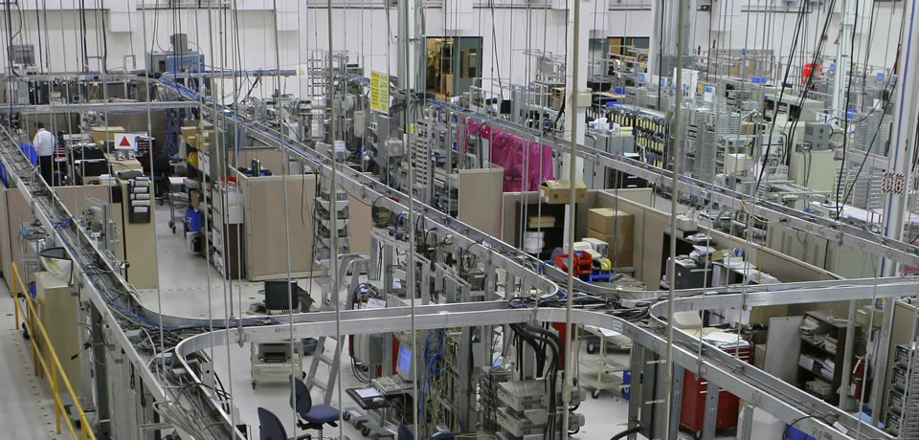
Athens State University
1a. Bachelor of Science in Advanced Manufacturing Management (CIP 52.0205)
The proposed program will provide a clear pathway for associate’s-level graduates of the FAME program or other comparable AAS programs to pursue bachelor’s degrees and advance their careers to the management level.
The proposed program grows out of ATSU’s strengths in Operations Management, Management of Technology, and Global Logistics and Supply Chain Management and builds upon an existing minor in Advanced Manufacturing Management.
The proposal includes letters of support from
manufacturing employers in ATSU’s service area who
offer tuition assistance and career development
programs to employees who are looking to advance
their professional careers in manufacturing management.

Slide 74
Athens State University
1b. Bachelor of Science in Occupational Health and Safety Management (CIP 51.2206)
Numerous employment opportunities are available in the field of occupational health and safety management across multiple industries, including Risk Manager, Safety Administrator, Safety Consultant, Safety Director, Safety Engineer, Safety Specialist, Safety Manager, Compliance Officer, and similar positions.
The proposal includes letters of support from manufacturing
employers in ATSU’s service area who offer tuition assistance
and career development programs to employees.
The proposed program builds upon ATSU’s existing programs in Management of Technology and Human Resource Management, as well as Public Safety and Health Administration. The program will expand existing occupational health and safety coursework to a full undergraduate major.

Slide 75
Auburn University
2a. Master of Science in Hospitality Management
(CIP 52.0901)
Auburn already delivers a master’s-level program in Hotel and Restaurant Management as an option within its MS in Nutrition (CIP 30.1901). The proposed program would replace this option with a stand-alone program and would not require any curricular changes or additional resources to deliver.
The proposed stand-alone MS program is one of two programs
in Alabama, and one of a few such programs in the nation.
The Advisory Board of the Hospitality Management Program at Auburn University and its industry partners solidly support the establishment of the independent graduate programs in Hospitality Management.
This Photo by Unknown Author is licensed under CC BY-ND

Slide 76
Auburn University
2a. Doctor of Philosophy in Hospitality Management
(CIP 52.0901)
Auburn already delivers a doctoral-level program in Hotel and Restaurant Management as an option within its PhD in Nutrition (CIP 30.1901). The proposed program would replace this option with a stand-alone program and would not require any curricular changes or additional resources to deliver.
The proposed PhD program in Hospitality Management would
be the only such PhD program in Alabama and one of a very few
such programs in the nation. Auburn’s current configuration as
an option within the PhD in Nutrition is highly ranked in the field,
and moving to a free-standing program will enhance recruitment
and make graduates more attractive to industry and academic employers.
This Photo by Unknown Author is licensed under CC BY-ND

Slide 77
Auburn University
2c. Master of Science in Child Life (CIP 19.0706)
The proposed program includes significant practical and internship
experience and prepares graduates for certification as Child Life Specialists.
Common employment opportunities for Certified Child Life Specialists include children's hospitals, pediatric units in regional hospitals, sibling centers, camps for medically fragile children, wish-granting facilities, advocacy centers and homeless shelters. Demand for these occupations is expected to grow especially in the wake of the current public health and economic crisis.
The proposed stand-alone MS program in Child Life is not
offered by any other institution in Alabama, and Auburn
University has research and instructional strengths in this area
to deliver the program successfully.
This Photo by Unknown Author is licensed under CC BY-SA-NC

Slide 78
Jacksonville State University
3. Master of Science in Geographic Information Science and Technology (CIP 45.0702)
JSU’s Department of Chemistry and Geosciences currently offers graduate and undergraduate coursework in GIS, and has the faculty and laboratory facilities to deliver such a program.
According to the US labor statistics, the expected
growth rate for GIS workers is between 20-29 %
over the next 10-15 years. A GIS degree will equip
students for a job in a rapidly expanding field with
higher-than-average salaries.

Slide 79
University of Alabama
Master of Science in Athletic Training in Athletic Training (CIP 51.0913)
The University of Alabama currently offers a Bachelor of Science in Athletic Training (BSAT), which prepares graduates to sit for the entry-level Athletic Trainer Certification Examination.
The accreditation agency for Athletic Training has determined
that the professional degree for Athletic Training must be at the
graduate level to be eligible to sit for the certification examination,
and has advised baccalaureate programs not to admit, enroll or
matriculate students after the start of fall term 2022.
UA’s existing program has strong enrollment and completion rates, and the MSAT is expected to continue enrolling students at the same rates.

Slide 80
University of Alabama at Birmingham
5a. Master of Arts in Interdisciplinary Graduate Studies
(CIP 30.9999)
The proposed MAIGS program is designed to blend distinct areas of expertise needed to compete for and advance within contemporary careers.
The program is designed to attract part-time students,
particularly working professionals who may be looking to
upskill. Given the format of stacking graduate certificates
into a master’s degree, the MAIGS may appeal to new
populations who may otherwise not seek post-
baccalaureate educational opportunities. This aim aligns
with regional and state workforce development goals.
This Photo by Unknown Author is licensed under CC BY-NC-ND

Slide 81
University of Alabama at Birmingham
5a. Master of Science in Interdisciplinary Graduate Studies
(CIP 30.9999)
The proposed MSIGS program is designed to blend distinct areas of expertise needed to compete for and advance within contemporary careers.
The program is designed to attract part-time students,
particularly working professionals who may be looking to
upskill. Given the format of stacking graduate certificates
into a master’s degree, the MSIGS may appeal to new
populations who may otherwise not seek post-
baccalaureate educational opportunities. This aim aligns
with regional and state workforce development goals.
This Photo by Unknown Author is licensed under CC BY-NC-ND

Slide 82
University of Alabama at Birmingham
5c. Master of Science in Higher Education Administration
(CIP 13.0406)
The program will support current and future higher education administrators in meeting their own professional advancement goals, as well as responding to employment needs within the local, state and regional area with potential to also recruit nationally due to a face-to-face and online delivery model.
The program proposal included support letters from community college officials from the Birmingham area.
This Photo by Unknown Author is licensed under CC BY-NC-ND

Slide 83
University of Alabama at Birmingham
5d. Doctor of Philosophy in Neuroengineering (CIP 14.9999)
Neuroengineering is an emerging discipline with the potential to advance medical treatment, research, and education. The proposed PhD program will train students at the intersection of neuroscience and engineering/computer science and will meet a growing need both in academia and in industry for professionals with this interdisciplinary training.
UAB has a track record of close collaboration
between its School of Medicine and its
School of Engineering.
Only a few other institutions offer Neuroengineering as a focus within their PhD programs in Biomedical Engineering, and none exist in Alabama, aside from UAB’s own related PhD in Biomedical Engineering (CIP 14.0501).
This Photo by Unknown Author is licensed under CC BY
This Photo by Unknown Author is licensed under CC BY-NC-ND

Slide 84
University of South Alabama
6a. Master of Science in Systems Engineering (CIP 14.2701)
USA already delivers a PhD program in Systems Engineering, and the proposed master’s program will be a feeder into the doctoral program, and also will provide training for professionals seeking to advance their careers in industry.
With Mobile as a hub for advanced manufacturing and complex engineering in the southern part of the state, the MSSE program will address an unmet regional need for master’s-level professionals in systems engineering.
The program proposal includes letters of support from
regional employers, including Airbus, Gulf States Engineering,
and Hargrove Engineers and Constructors.

Slide 85
University of South Alabama
6b. Master of Science in Rehabilitation Science in
Audiology (CIP 51.2314)
The Department of Speech Pathology and Audiology at USA has operated graduate programs in speech-language pathology and audiology over 36 years, and has the resources necessary to deliver the proposed program.
The program will primarily enroll clinicians from China, as student learning outcomes are geared toward professional competencies needed outside the US. USA operates two similar programs in Rehabilitation Sciences (Occupational Therapy and Speech Pathology).
The proposed program will not be delivered using state funds.

Slide 86
Request to Amend Post-Implementation Conditions
7. Alabama A&M University
Bachelor of Science in Animal Bio-Health Sciences (CIP 01.9999)
The program did not meet the post-implementation condition for graduates.
Alabama A&M University (AAM) has requested a two-year extension to achieve the graduation annual average figure of 7.5. AAM officials cite the delay in implementing the program, along with the short post-implementation period, as factors meriting the extension period.
Bachelor of Science in Animal Bio-Health (CIP 01.0199) | Avg New Enrollments | Average Graduates
Required | 13 | 7.5
Reported | 28.8 | 5.7

Slide 87
H. INFORMATION ITEMS

Slide 88
INFORMATION ITEMS
Implementation of Distance Education Programs
Implementation of Non-Degree Programs at Senior Institutions
Implementation of New Short Certificate Programs (Less than 30 Semester Hours)
Changes to the Academic Program Inventory
Change in the Name and Establishment of Centers and Departments
Extensions/Alterations to Existing Programs of Instruction
Summary of Post-Implementation Reports

Slide 89
7. Summary of Post-Implementation Reports
Programs that met post-implementation conditions
Alabama A&M University
Master of Science in Kinesiology (CIP 31.0505)
University of Alabama in Huntsville
Bachelor of Science in Secondary Education (CIP 13.1205)
Programs that did not meet post-implementation conditions
i. Alabama A&M University, Program: Bachelor of Science in Animal
Bio-Health Sciences (CIP 01.0999) – Extension requested

Slide 90
D. ADJOURNMENT

