Slide 1
Alabama Commission on Higher Education
Commission Meeting
September 11, 2020

Slide 2
CALL TO ORDER and PLEDGE OF ALLEGIANCE

Slide 3
II. ROLL CALL and QUORUM DETERMINATION

Slide 4
III. APPROVAL OF AGENDA
Commission Meeting Agenda of
September 11, 2020

Slide 5
IV. CONSIDERATION OF MINUTES
Commission Meeting Minutes of June 12, 2020

Slide 6
V. CHAIRMAN’S REPORT

Slide 7
VI. ELECTION OF OFFICERS

Slide 8
VII. EXECUTIVE DIRECTOR’S REPORT

Slide 9
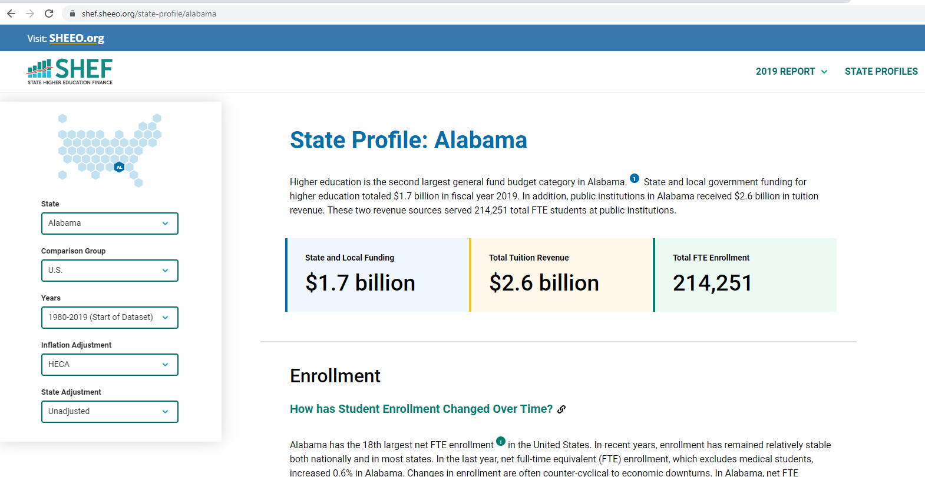
Comparing Alabama to the Nation

Slide 10
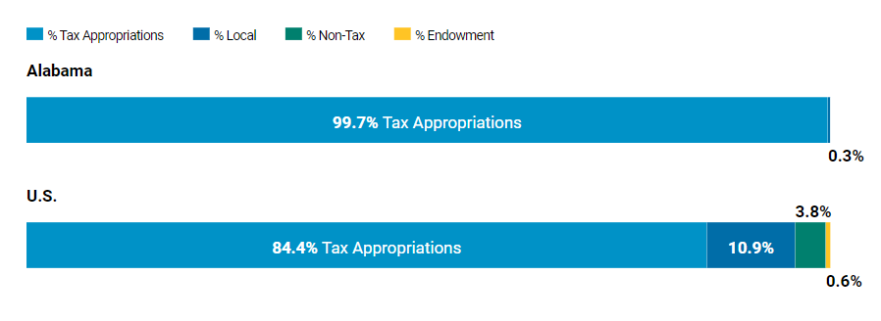
Comparing Alabama to the Nation
State and Local Funding
Alabama has only a trace of local support for their postsecondary institutions.
Other sources for institutional support like a lottery and endowments are also absent.
In 2019, public institutions in Alabama had $6,001 in education appropriations per FTE, approximately 73% of the U.S. average.

Slide 11
Comparing Alabama to the Nation
Per-Student Education Appropriations Over Time
2008
1986
Education appropriations per FTE in Alabama have decreased 5.4% since 1980.
In 2019, public institutions in Alabama had $6,001 in education appropriations per FTE, approximately 73% of the U.S. average.

Slide 12
Comparing Alabama to the Nation
Per-Student Tuition Revenue Over Time
Alabama has seen an average annual 4.4% increase in net tuition since 1980.
In 2019, Alabama had $11,757 in net tuition revenue per FTE, approximately 1.7 times the U.S. average.

Slide 13
Comparing Alabama to the Nation
Total Education Revenue
Total education revenue per FTE in Alabama has increased 95.8% since 1980.
Alabama public institutions in 2019 had, on average, $16,937 in total revenue per FTE, approximately 10% higher than the national average.

Slide 14
Rightsizing Institutions: Managing Growth or Strategic Retrenchment

Slide 15
Overview of Presentation
A Perfect Storm: Converging Forces Re-Shaping Higher Education
Mission Critical
Expenditures
Funding: Constraints and Opportunities
Enrollment Management
Efficiencies (Facilities, Faculty and Staff to Student Ratios)
Program Mix: Winners and Losers
Additional Strategies for Moving Ahead

Slide 16
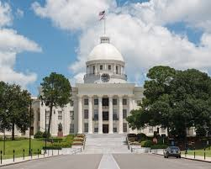
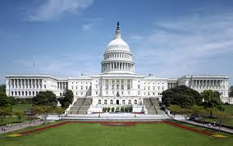
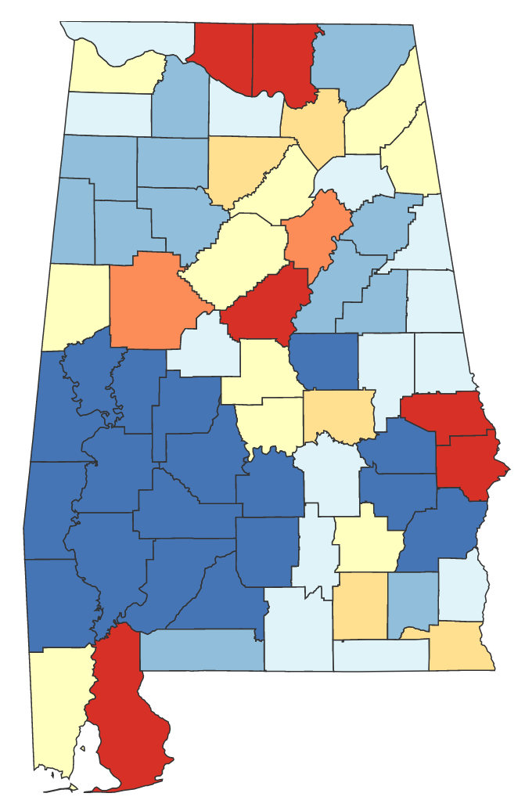
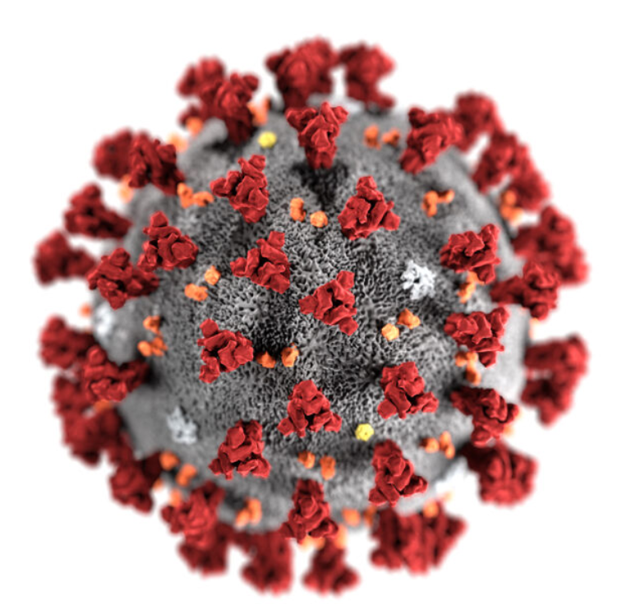
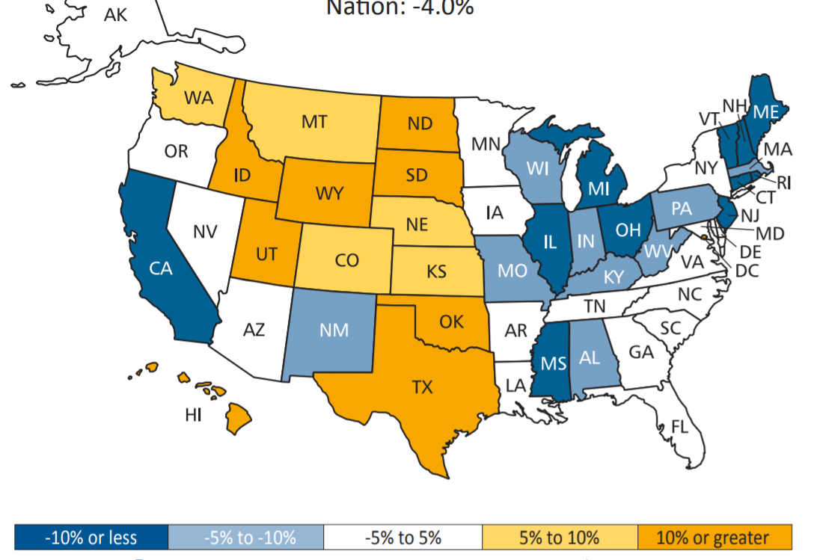
A Perfect Storm: Converging Forces
Our institutions
Technological Innovations
Demography
Competition for Students
COVID 19
Decreasing Federal/State/Local Support & Rising Tuition

Slide 17
A Perfect Storm: Converging Forces
Our institutions
Technological Innovations
Demography
Competition for Students
COVID 19
Decreasing Federal/State/Local Support & Rising Tuition

Slide 18
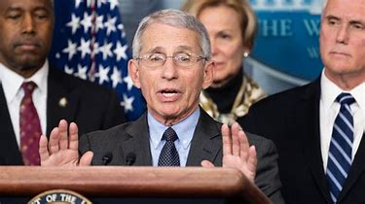
A Perfect Storm: Converging Forces
In an interview on NBC's Meet the Press, Anthony Fauci said those with "underlying conditions" are "overwhelmingly" more likely to have complications if they catch the coronavirus.
The underlying financial conditions of many campuses will cause complications.

Slide 19
A Perfect Storm: Converging Forces
The unsustainable financial situation of many campuses must be an important consideration for state policy makers and campus leaders seeking to address the current financial crisis for colleges.

Slide 20
How do you respond?

Slide 21
First Step is to take a deep breath, and contemplate on the mission of the institution
What is mission critical?
What matters…
and what doesn’t?
Viktor Frankl (paraphrased):
Be not so concerned with the how, but on the why. For once you know the why, the how shall surely come.
Mans’s Search for Meaning (1946)

Slide 22
First Step is to take a deep breath, and contemplate on the mission of the institution
Is the current mission, in fact, the mission?
Is the current mission merely survival?
Is survival alone a valid mission?
Before COVID 19, what would you have changed about the institution to make it better?
Are there activities that the institution participates in that are good things, but are not mission critical that need to be reconsidered?

Slide 23
Quantify What is Mission Critical
Post activities from a list. Closer to the bulls eye means the activity is more mission critical.
Reach general agreement among campus leaders.
Add concentric circles and assign a value.
0 thru -1
>0
1

Slide 24
Second step: Have on hand the FACTS to further the conversation
Revenue and expenditures trends
Long-term debt and sources for payment
Enrollment trends
Student support revenue streams and mission value
Facility utilization
Academic program viability
Auxiliary revenue
Alumni support (or lack thereof)
Reserve funds and uses
Opportunities for revenue – short and long-term
Employee information
Per-credit-hour versus FTE tuition rate

Slide 25
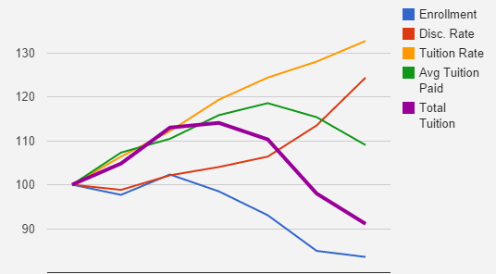
Chart things out so relationships can be understood and known
Review for revenue and expenditures trends.
Look at long-term debt and sources for payment.
Share with senior leadership and the board.

Slide 26
Understand your Demography
If your institution’s enrollment comes from these light blue counties, expect enrollment declines if status quo strategies continue.
Counties in red are showing strong growth and should be prioritized in recruitment.
Look for HS specifics that align with your institution’s mission.

Slide 27
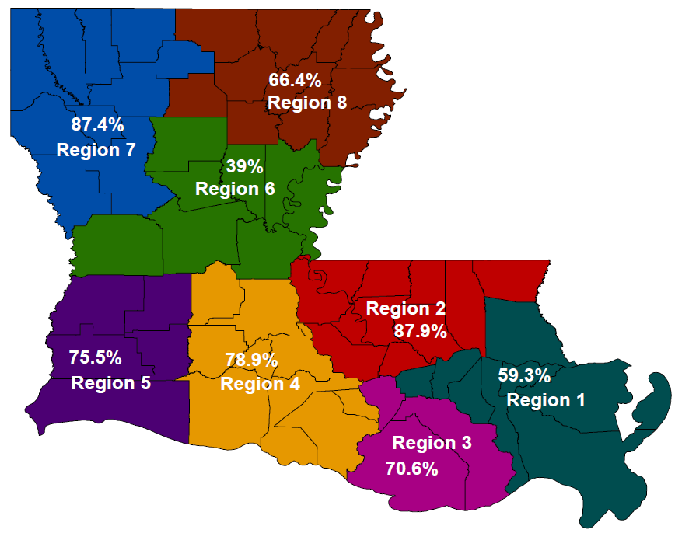
Making Enrollment Management Work: Utilizing State-Level Data to Inform Recruiting
Where do students in your region go to college?
Students in Louisiana attend their local (regional) community college or university, except…

Slide 28
See where the anomalies are: Compare your expenditures to other institutions’
Student-focused expenditures
Your Institution
Other IHE 1
Other IHE 2
Other IHE 3
Other IHE 4
Other IHE 5
Other IHE 6
Other IHE 7
Other IHE 8
Other IHE 9
Other IHE 10
Other IHE 11
Other IHE 12
Other IHE 13
Source: NACUBO, Expenditures by function

Slide 29
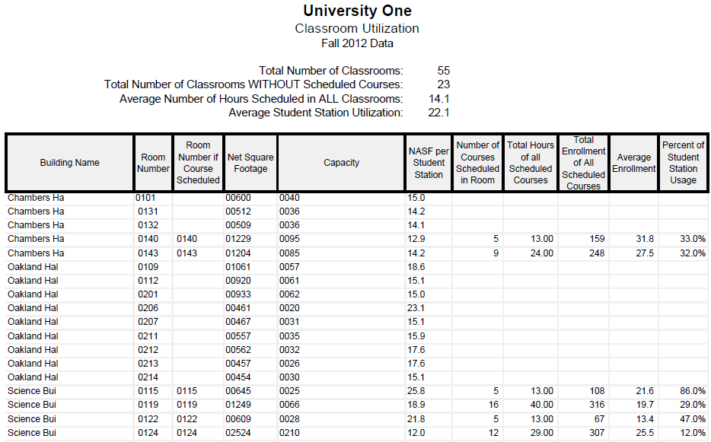
Efficiencies: Facility Utilization
42% of your classrooms are not used, Could they be classified differently and used by another unit?
Need a better fit between room capacity and course enrollment

Slide 30
Efficiencies: Facility Utilization
Utilization of Classrooms and Laboratories
by Time of Day
Class Labs
Classrooms
Day Time
(5:00a till 4:59p)
Night Time
(5:00p till 4:59a)
Night Time
Night Time
Day Time
Day Time

Slide 31
Analyzing Program Mix
+1
Shows Promise
Successful
Problem Child
Stars
Example: ‘MODIFIED’
BCG MATRIX
II
III
Mission Critical
I
IV
Dawgs
Cash Cows
Poor Performers
Older projects
-1
+1
$
$
Effectiveness
Left → Right based on Size of Net Revenue, Size of Oval based on Size of Total Cost
Up → Down based on Mission Alignment

Slide 32
Analyzing Program Mix
Large budgets are visually bigger and more difficult to move
+1
Gov/Soc
English
Foreign Lang.
Math
Biology
Example: ‘MODIFIED’
BCG MATRIX
Art
Mus/Theatre
His/Geo
Chem.
II
III
Mission Critical
Pyschology
Econ/Fin
I
IV
Info/Sys
Mus Therapy
Marketing
Spec. Ed/Admin.
Early Ch Ed
Mid Gr Ed
Management
Adult Health
Healthcare Sys
HPER
Accounting
Fam. Health
Foundations Ed
-1
Effectiveness
1
Left → Right based on Size of Net Revenue, Size of Oval based on Size of Total Cost
Up → Down based on Mission Alignment

Slide 33
Analyzing Program Mix
Efficient
Higher enrollments
Exciting
+1
Early childhood and
Middle grades Education
Example: ‘MODIFIED’
BCG MATRIX
II
III
Mission Critical
Middle Grades education
I
IV
Early Childhood education
Inefficient
Low enrollments
Not exciting
-1
1
Effectiveness
Left → Right based on Size of Net Revenue, Size of Oval based on Size of Total Cost
Up → Down based on Mission Alignment

Slide 34
Build a (New) Plan
Based on what these analyses show,
Decide on priorities
Decide on easy reductions
Discuss collateral damage to any change
Athletics
Program closings
Moving offerings to new locations/online
Early retirements, furloughs and staff reassignments

Slide 35
Bottom Line
There is a specific ‘fix’ for every institution.
Right-sizing places emphasis on refitting an institution with its mission and goals, its students, and the community it serves.
It is when the institution veers from its purpose that it becomes more susceptible to “the slings and arrows of outrageous fortune.”

Slide 36
VIII. Discussion ITEMs

Slide 37
Alabama COVID-19 Student Impact Survey Results

Slide 38
Survey Overview
Purpose: To understand students’ experiences during a global pandemic, including access to technology, barriers to learning, potential impacts on enrollment, and preferences for continuing enrollment in fall 2020
Partners: The Alabama Commission on Higher Education (ACHE) Mobile Area Education Foundation (MAEF) Institute for Higher Education Policy (IHEP)

Slide 39
Methodology and Responses
Survey distributed by 16 participating institutions between June 15th and June 30th
Survey sent only to returning undergraduate students (not grad students, entering freshman, or graduated students)
Survey had only 15 questions, with 4 of those being demographic
Over 11,000 responses received, after duplicates and other non-responsives removed
Overall response rate of 13.8%

Slide 40
16 Institutions Participated
2-year Institutions
Bishop State Community College
Coastal Alabama Community College
Drake State Community and Technical College
Lawson State Community College
LBW Community College
Shelton State Community College
Snead State Community College
4-year institutions
Alabama A&M
Auburn University at Montgomery
Jacksonville State University
Troy University
University of Alabama
University of Alabama at Birmingham
University of Montevallo
University of North AL
University of West AL

Slide 41
Demographics

Slide 42
Demographics

Slide 43
Demographics

Slide 44
Demographics
Ethnicity | # | %
Asian | 321 | 2.85
Black or African American | 3370 | 29.89
Latino or Hispanic | 325 | 2.88
Native American Indian or Alaska Native | 74 | 0.66
Native Hawaiian or Pacific Islander | 16 | 0.14
White | 6357 | 56.39
Multiple ethnicities | 390 | 3.46
Unknown | 16 | 0.14
Prefer not to answer | 356 | 3.16

Slide 45
33% of respondents do not have high-speed internet at home.
Internet access
What kind of internet connection do you have at home?

Slide 46
Black respondents were less likely to report having access to broadband internet at home.
Internet access
What kind of internet connection do you have at home? – by race/ethnicity
43.4%

Slide 47
Black respondents were more likely to report having *no internet* connection at home.
Internet access
What kind of internet connection do you have at home? – by race/ethnicity
6.4%

Slide 48
COVID-19 Impact
What are the factors that affected respondents’ ability to attend class online or complete assigned work?
Nearly 60% of students were able to fulfill academic obligations in the spring.

Slide 49
Technology Access
What Type of Technology Devices Do Students Have at Home?

Slide 50
Supports Requested
What Supports Would Help Students to Reenroll in the Fall?

Slide 51
Health Measures Requested
What Measures Would Influence Students’ Decision to Return to Campus in the Fall?

Slide 52
Expanding Broadband Access: ADECA Programs (September 3, 2020)
Alabama COVID-19 Student Impact Survey (August 17, 2020)
Food Resources: End Child Hunger County Food Guides (July 30, 2020)
SNAP Accessibility and Participation for College Students (July 23, 2020)

Slide 53
IX. Decision ITEMS

Slide 54
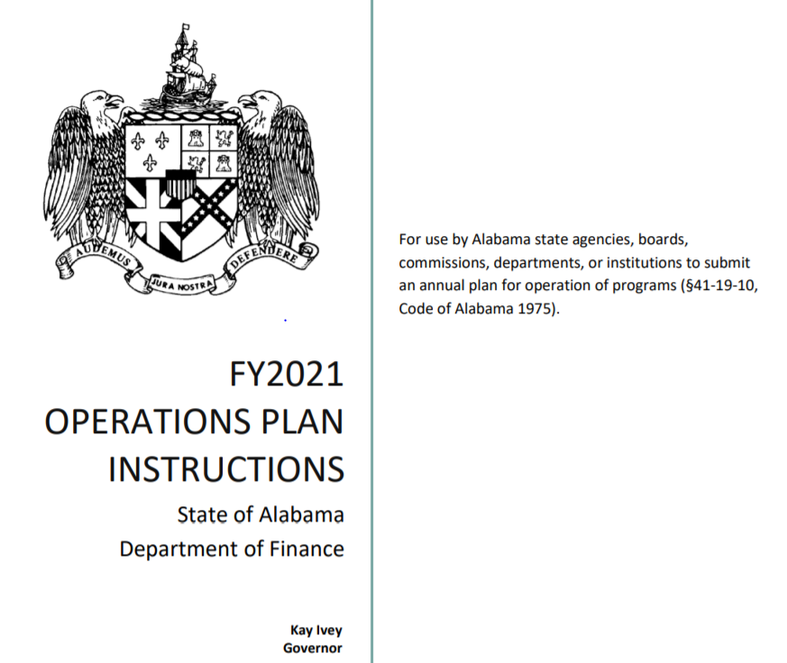
A. Fiscal Year 2020-21 Operations Plan

Slide 55
Alabama Commission on Higher Education
FY 2020-21 Budgetary Overview
The Commission has 31 programs under 5 appropriation units.
There are two new programs in the FY 2020-21 budget:
Birmingham Promise Scholarship Program
AKEEP – Education and Teacher Recruitment Partnership
The FY 2020-21 budget represents a -4.3% decrease over the previous fiscal year.
The FY 2020-21 Operations Plan, showing expenditures for each of the fiscal year’s quarters, was submitted to Executive Budget Office (EBO) on July 31, 2020. Any changes made by the Commission can be made through a Operations Plan revision after October 1, 2020.

Slide 57
(continued)

Slide 63
Any Questions?

Slide 64
B. Approval of 2021 Meeting Schedule
Proposed Meeting Schedule for 2021
March 12, 2021
June 11, 2021
September 10, 2021
December 10, 2021

Slide 65
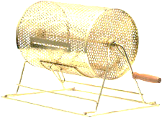
Public Drawing to Determine Order of Payment of ASGP Funds for 2020–21
Alabama Student Grant Program (ASGP) provides grants for eligible in-state students attending one of the following private institutions:
Amridge University
Birmingham Southern College
Faulkner University
Huntingdon College
Judson College
Miles College
Oakwood University
Since all funds cannot be disbursed immediately, drawing is needed to determine disbursement order by institution.
Samford University
Spring Hill College
South University - Montgomery
Stillman College
U.S. Sports Academy
University of Mobile

Slide 66
D. Academic Programs

Slide 67
ALABAMA COMMUNITY COLLEGE SYSTEM

Slide 68
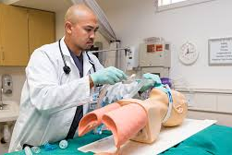
Bishop State Community College
1a. AAS in Respiratory Care Therapist (CIP 51.0908)
Respiratory care therapists continue to be in high demand, especially in the wake of the COVID-19 public health crisis, and the proposal includes letters of support from potential employers for developing a pipeline to meet demand for respiratory care therapists in the Gulf Coast region.
The proposed program will be accredited by the Commission on Accreditation for Respiratory Care (CoARC) and will prepare students for certification through the National Board for Respiratory Care and state licensure
through the Alabama State Board of Respiratory Therapy.
The Respiratory Care Therapist program will provide an
alternative track for students who are not admitted into
BIS’s nursing or physical therapy programs.

Slide 69
Bishop State Community College
1b. AAS in Medical Laboratory Technician (CIP 51.1004)
Medical laboratory technicians continue to be in high demand, especially in the south Alabama area. Currently, the nearest medical laboratory technician program is offered at Mississippi Gulf Coast CC.
The proposal includes letters of support from potential
employers for developing a pipeline to meet demand for
medical laboratory technicians in the Gulf Coast region.
The proposed program will be accredited by the National Accrediting Agency for Clinical Laboratory Sciences (NAACLS) and will prepare students for certification through the American Society for Clinical Pathology (ASCP).
The Medical Laboratory Technician program will provide an alternative track for students who are not admitted into BIS’s nursing or physical therapy programs.

Slide 70
FOUR-YEAR INSTITUTIONS

Slide 71
University of Alabama
2a. EdD in Curriculum and Instruction (CIP 13.0301)
The proposed program is the result of consolidating two established EdD programs (Elementary Education and Secondary Education). With an extensive faculty roster, UA’s Department of Curriculum and Instruction will not require any additional resources to deliver the proposed program.
There continues to be strong demand for scholarly practitioners in the field of education, and the proposed program offers greater flexibility for those choosing to pursue an EdD.

Slide 72
University of Alabama
2b. PhD in Curriculum and Instruction (CIP 13.0301)
The proposed program is the result of consolidating two established PhD programs (Elementary Education and Secondary Education). With an extensive faculty roster, UA’s Department of Curriculum and Instruction will not require any additional resources to deliver the proposed program.
There continues to be strong demand for educational researchers with specific knowledge in a curriculum area, such as mathematics education, English/ language arts education, reading education, social sciences education, foreign language education, or science education.

Slide 73
University of North Alabama
3. BFA in Cinematic Arts and Theatre (CIP 50.0501)
The proposed program combines UNA’s existing offerings in Theatre and Cinematic Arts into a single program, and curriculum will be aligned with accreditation standards through the National Association of Schools of Theatre (NAST).
Enrollment within existing offerings remains high,
and student demand is projected to grow with the
integrated program.
This Photo by Unknown Author is licensed under CC BY-ND

Slide 74
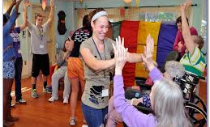
University of South Alabama
4. BS in Recreational Therapy (CIP 51.2309)
USA currently offers a Therapeutic Recreation Concentration within its existing BS in Sport Management and Recreation Studies (CIP 31.0101). The proposed program would replace this concentration with a stand-alone degree and would not require any additional resources to deliver.
USA’s existing concentration has a high student
demand, with over 25 students graduating per year.
The proposed program is designed to meet the certification requirements required by the National Council for Therapeutic Recreation Certification (NCTRC). Upon completion of the academic requirements of the program, including a clinical internship, students will be eligible for credentialing as a Certified Therapeutic Recreation Specialist (CTRS).

Slide 75
University of West Alabama
5. BS in Human Performance Comprehensive (CIP 31.0599)
The proposed program combines components from UWA’s existing baccalaureate programs in Physical Education, Exercise Science, Athletic Training, and Sport Management, and will not require any additional resources to deliver.
The proposed program will fulfill existing student demand for
a more flexible, interdisciplinary option within UWA’s School of
Health Science and Human Performance, demand which is
currently being met with the BS/BA in Interdisciplinary Studies.

Slide 76
Athens State University
6. MS in Strategic Leadership and Business Analytics (CIP 52.0213)
The proposed program responds to a growing need for professionals who are able to analyze complex datasets and make strategic decisions based on findings.
The proposed program includes a capstone experience that entails a hands-on leadership project within a sponsoring organization. Additionally, students will earn professional certifications in Advanced Leadership and Executive Leadership through the National Society of Leadership and Success (NSLS).
The proposed program will serve primarily part-time students who are working professionals, and most of the coursework will be delivered online.

Slide 77
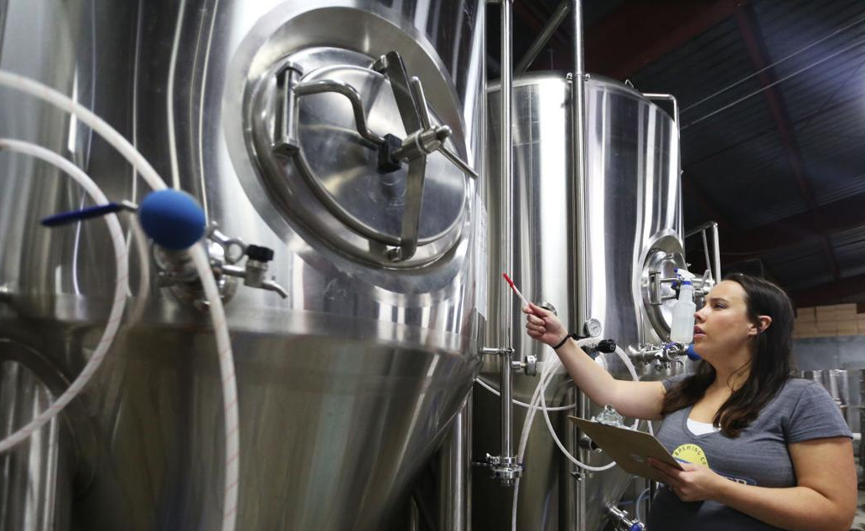
Auburn University
7a. MS in Brewing Science and Operations (CIP 01.1003)
Auburn launched the Graduate Certificate in Brewing Science and Operations in 2014, and enrollment remains high, with graduates indicating a strong interest in continuing their studies at the MS level.
The craft brewing industry continues to grow in
Alabama and throughout the southeast, with
increasing demand for trained personnel. Of
the 52 students that have graduated from Auburn’s
Graduate Certificate Program in Brewing Science,
90% either work in the field entrepreneurially as
owner/operators, as Head Brewers, or in distribution.
This Photo by Unknown Author is licensed under CC BY-ND

Slide 78
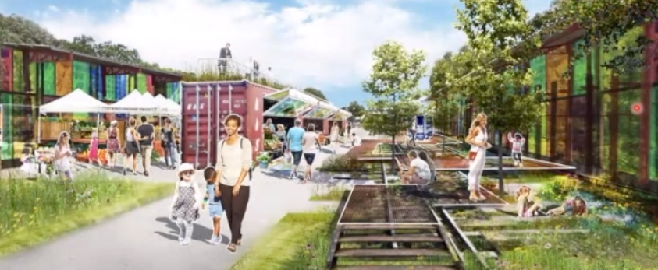
Auburn University
2a. Bachelor of Landscape Architecture (CIP 04.0601)
The proposed BLA program would be the only one of its kind at the undergraduate level in the State of Alabama, and development of this program will enable Alabama to retain students who may otherwise pursue training elsewhere.
Enrollments within the existing BS in Environmental Design and Master of Landscape Architecture (MLA) programs remain high, indicating that there is sufficient demand to support this program along with existing offerings.
Recent graduates of AU’s MLA program have
achieved employment rates of 100% within
six months of graduation. Graduates of the
undergraduate program should be equally
attractive to potential employers.
This Photo by Unknown Author is licensed under CC BY-ND

Slide 79
Request to Amend Post-Implementation Conditions
7. Alabama State University
BS in Biomedical Engineering (CIP 14.0501)
The program did not meet the post-implementation condition for graduates.
ASU has requested a three-year extension to achieve the graduation annual average figure of 7.5. ASU officials cite the delay in implementing the program, along with the short post-implementation period, as factors meriting the extension period.
BS in Biomedical Engineering (14.0501) | Avg New Enrollments | Average Graduates
Required | 7 | 7.5
Reported | 13.2 | .5

Slide 80
E. INFORMATION ITEMS
1. Distribution of 2020-21 Alabama Student Assistance Program (ASAP) Funds
Implementation of Distance Education Programs
Implementation of Non-Degree Programs at Senior Institutions
Implementation of New Short Certificate Programs (Less than 30 Semester Hours)
Changes to the Academic Program Inventory
Change in the Name and Establishment of Centers and Departments
Reid State Technical College, New Exempt Off-Campus Site: Lurleen B. Wallace Community College – Greenville Campus
Extensions/Alterations to Existing Programs of Instruction
Summary of Post-Implementation Reports

Slide 81
9. Summary of Post-Implementation Reports
Programs that met post-implementation conditions
Auburn University at Montgomery: BS in Environmental Science (CIP 03.0104)
Auburn University at Montgomery: BS in Medical Laboratory Science (CIP 51.1005)
Auburn University at Montgomery: Master of Accountancy (CIP 52.0301)
University of Alabama at Birmingham: MS in Biomedical and Health Sciences (CIP 26.0102)
University of Alabama in Huntsville: BS in Kinesiology (CIP 31.0505)
University of Alabama in Huntsville: MS in Space Science (CIP 40.9999)
University of Alabama in Huntsville: PhD in Space Science (CIP 40.9999)

Slide 82
9. Summary of Post-Implementation Reports
Programs that met post-implementation conditions (cont’d)
University of Alabama in Huntsville: MSM in HR Management (CIP 52.0201)
University of Alabama in Huntsville: MS in Supply Chain and Logistics Management (CIP 52.0203)
University of Alabama in Huntsville: MS in Management Science and Business Analytics (CIP 52.1301)
University of South Alabama: PhD in Computing (CIP 11.0101)
Programs that did not meet post-implementation conditions
Alabama State University: BS in Biomedical Engineering (CIP 14.0501) –
Extension requested

Slide 83
F. ADJOURNMENT

