Slide 1

Funding Request for Higher Education

Slide 2
Commission on Higher Education Responsibilities
Aggregate information and conduct research about colleges and universities that informs state policy on Pre K-12 education, higher education and the workforce.
Prepare budget recommendations for the public community colleges and universities
Develop and implement the statewide strategic plan for postsecondary education
Approve new academic programs, and make recommendations about existing programs of study at public community colleges and universities
Approve new units of instruction and off-campus instruction sites for the public community colleges and universities
Review the facilities master plans of the public colleges and universities and identify their new construction, deferred maintenance and renovation needs.
Administer state-sponsored financial aid programs for students attending public and private colleges.

Slide 3
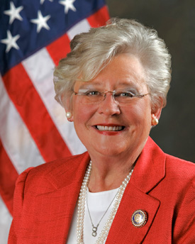


Strong Start, Strong Finish:
An Education-to-Workforce Vision for Alabama
Governor Ivey has established a strategic vision for aligning Alabama’s education and workforce programs from pre-k to the workforce to provide for a seamless education-to-workforce continuum for all Alabamians.
Governor Ivey has set a postsecondary education attainment goal of adding 500,000 credential holders to Alabama’s workforce by 2025
and a goal to increase Alabama’s labor force participation rate of 57.6 percent to the national average by 2025.

Slide 4
2/3 of new jobs in Alabama will require a University degree
1/3 of needed credentials can be earned at Alabama’s Community Colleges

Slide 5
+10%
-19%

Slide 6
+27%
Notes:
27%
21%

Slide 7
+32% since 2014
UAH
JSU
UNA
AAMU
AUM
UWA
ASU
Athens
UM
Notes:
73489736

Slide 8
Calhoun
Jeff State
Coastal*
Gadsden
Hanceville

Slide 9
Only one University has a significant level of dual enrollment activity
(Jacksonville State University @ 9.5%)

Slide 10
Organizational Effectiveness and Efficiency
Increased degree production even with reduced state support
57% increase in productivity on 87% of the 2008 college and university ETF support

Slide 11
State Support for Higher Education is still below pre-recession levels (2008)
Higher Ed is Funded at 95% of the 2008 budget
Institutions at 87%
Approach to Budgeting Postsecondary Education
Two-pronged approach:
Foundational Support – supporting existing operations
Transformational Support –new initiatives that target state priorities
  Increase labor force participation rate
  Adding 500,000 credential holders to Alabama’s workforce by 2025

Slide 12
Foundational Support
$77,648,227 increase over the previous year. Provides a 5% increase for for all colleges and universities. (Represents 4% of total HE budget)
$3,029,672 increase for adjustments related to employee benefits. (Represents less than 1/4% of total HE budget)
$10,514,497 for equity adjustments for institutions funded significantly below institutions with similar role, scope and missions. (Represents 1/2% of total HE budget)
$2,394,775 for adjustments to existing statewide lines --land grant alliance (AALGA), EPSCOR, Libraries (NAAL), financial aid. (Represents less than 1/4% of total HE budget)

Slide 13
Transformational Support -$27,560,000
Increase Alabama’s labor force participation rate of 57.6 percent to the national average by 2025.
  1) Career Promise – ($2,500,000) This program would provide funds for a pilot project that would fund high school students of Temporary Assistance for Needy Families (TANF) / Supplemental Nutrition Assistance Program (SNAP) families to fully participate in dual enrollment technical programs at a community or technical college that lead to an industry and postsecondary credential in a career field that is in high demand in the region. The federal government will award matching funds (50%) for this activity based upon prior year state funding.
  2) College Promise – ($5,000,000) This program would provide funds for a pilot project designed to financially support individuals from TANF/SNAP families to return to college and complete a degree. The federal government will award matching funds (50%) for this activity based upon prior year state funding.
Transformational support items are found as new statewide initiatives in the ACHE budget

Slide 14

Transformational Support (continued)
adding 500,000 credential holders to Alabama’s workforce by 2025
3) Higher Education Transformation Fund – ($10,000,000) This program would provide funds to expand academic and technical programs that directly lead to careers in high demand in the state.
Colleges and universities will respond to a competitive RFP to address specific workforce shortages as identified by the Governor’s Office of Education and Workforce Transformation (GOEWT).
Target identified workforce needs
Expand programs that can most effectively and efficiently address that specific need
Address regional or statewide need
One-time allocation to support a sustainable effort
Open to proposals from colleges or universities
Transformational support items are found as new statewide initiatives within the ACHE budget

Slide 15

Transformational Support (continued)
adding 500,000 credential holders to Alabama’s workforce by 2025
4) Performance Funding – ($10,000,000) This program would reward colleges and universities that show improvement in performance.
Funds would support the existing CC performance-funding effort and a university sector performance funding construct.
HCM Strategist is working with universities to see if agreement can be made on measures, incentives, timeline, etc.
ACHE has also proposed a university performance rubric that could be utilized:
              In FY20-21, each university would receive a proportional amount of funds to establish on-campus efforts to improve student success.
              In future years, receipt of funds will be based upon performance on retention, graduation, degree production and two institutional specific measures associated with their institutional missions.
Transformational support items are found as new statewide initiatives within the ACHE budget

Slide 16
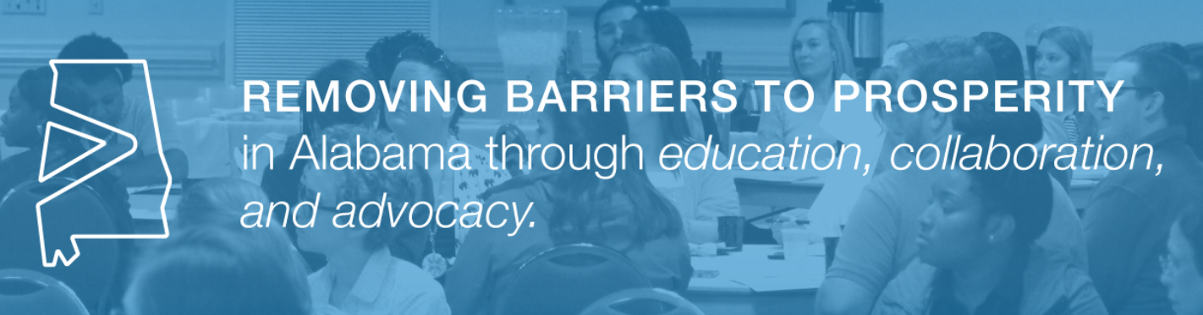
Transformational Support (continued)
adding 500,000 credential holders to Alabama’s workforce by 2025
5) Support of Alabama College Network – ($60,000) This program would provide support initiatives that help adults begin or return to college to obtain a degree.
Helping our current working population gain the knowledge, skills and credentials necessary to compete for jobs in the modern economy.
Project is a collaboration with Alabama Possible.
Transformational support items are found as new statewide initiatives within the ACHE budget

Slide 17

New Funds Request for FY 2020-2021
Increase Recommended for the Universities - $72,926,726
Increase Recommended for the Two-Year Colleges - $18,265,670
Increase Recommended for the Statewide Lines - $29,954,775
Total CBR Increase FY 2020-2021 - $121,147,171
The proposed increase is 6.8% over the prior year budget from $1,781,976,325 to $1,903,123,496

Slide 21
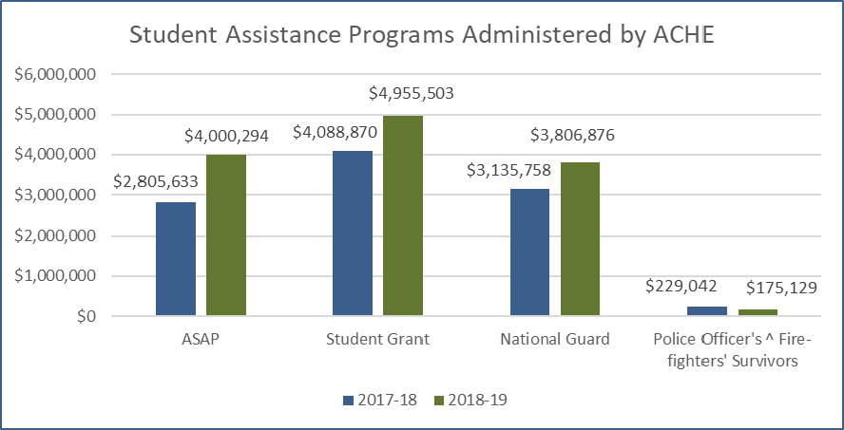

Slide 22
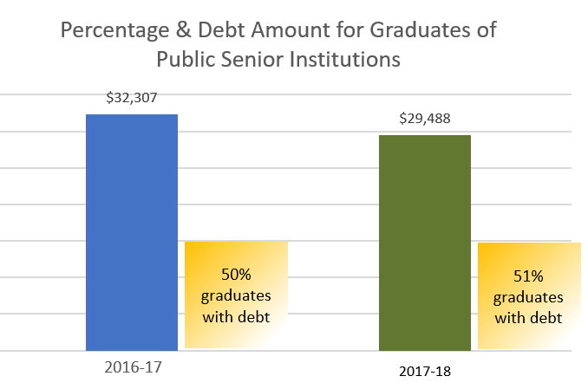
Source: College InSight

