Slide 1

Alabama Commission on Higher Education
Commission Meeting
March 12, 2021

Slide 2


CALL TO ORDER, PRAYER, AND PLEDGE OF ALLEGIANCE

Slide 3

II. ROLL CALL and
QUORUM DETERMINATION

Slide 4

III. APPROVAL OF AGENDA
Commission Meeting Agenda of
March 12, 2021

Slide 5

IV. CONSIDERATION OF MINUTES
Commission Meeting Minutes of December 11, 2020

Slide 6

V. CHAIRMAN’S REPORT

Slide 7
Susan Cagle, Retirement and Resolution

Slide 8
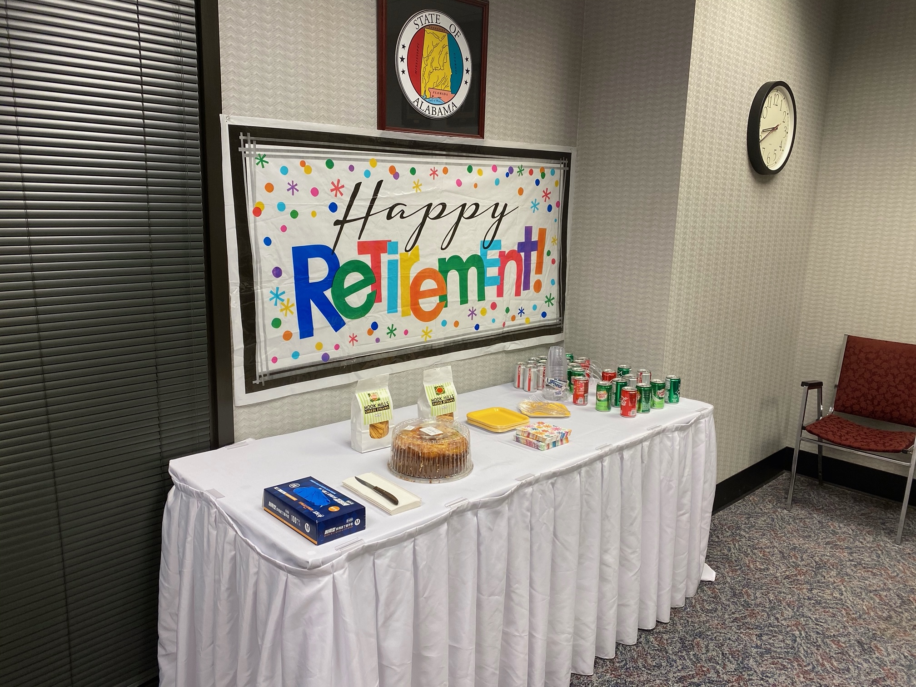

Slide 9
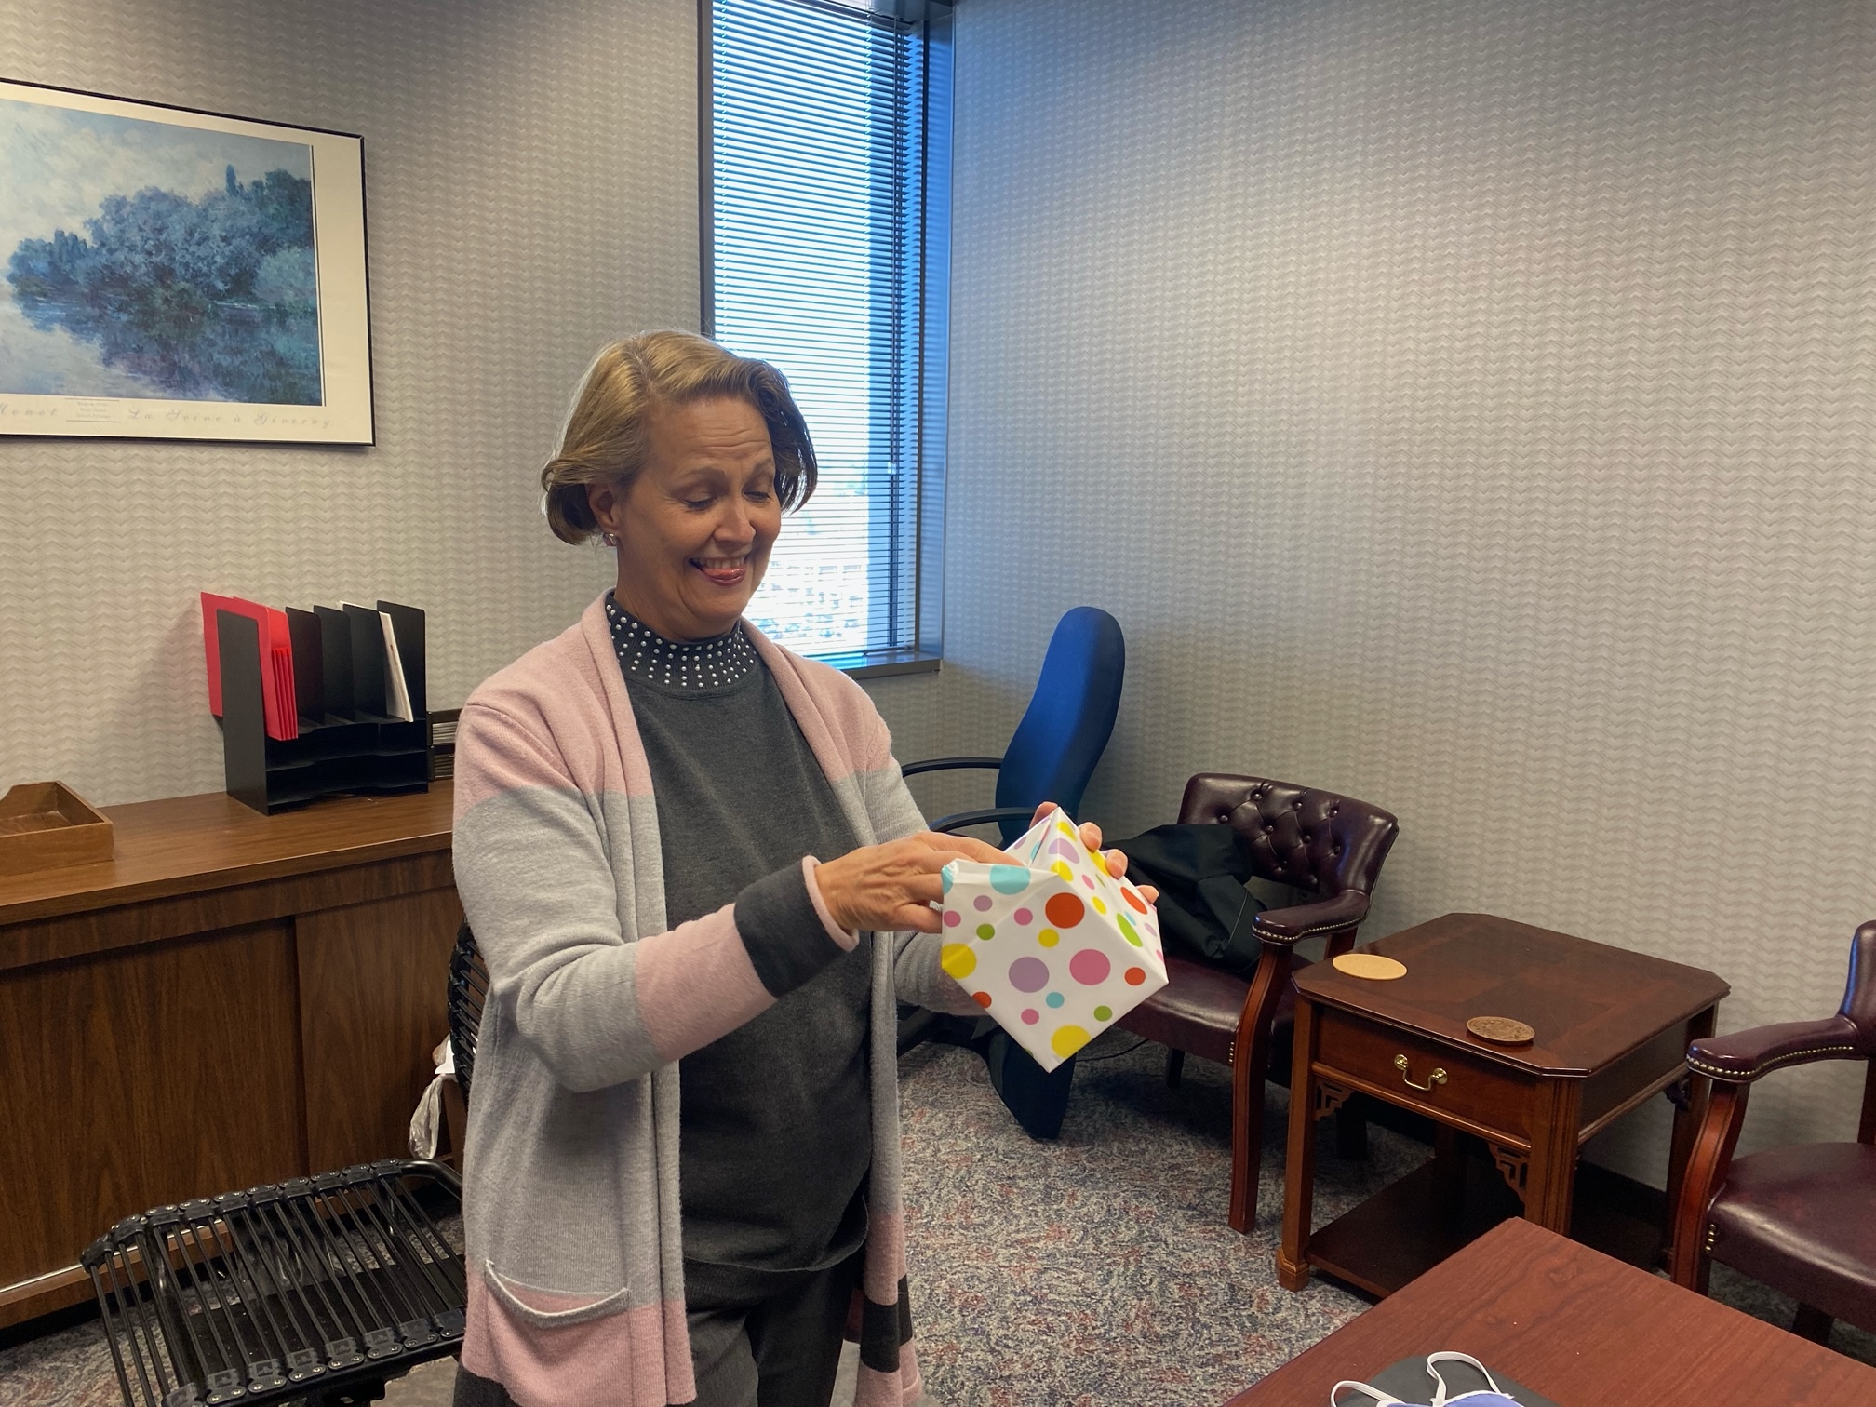
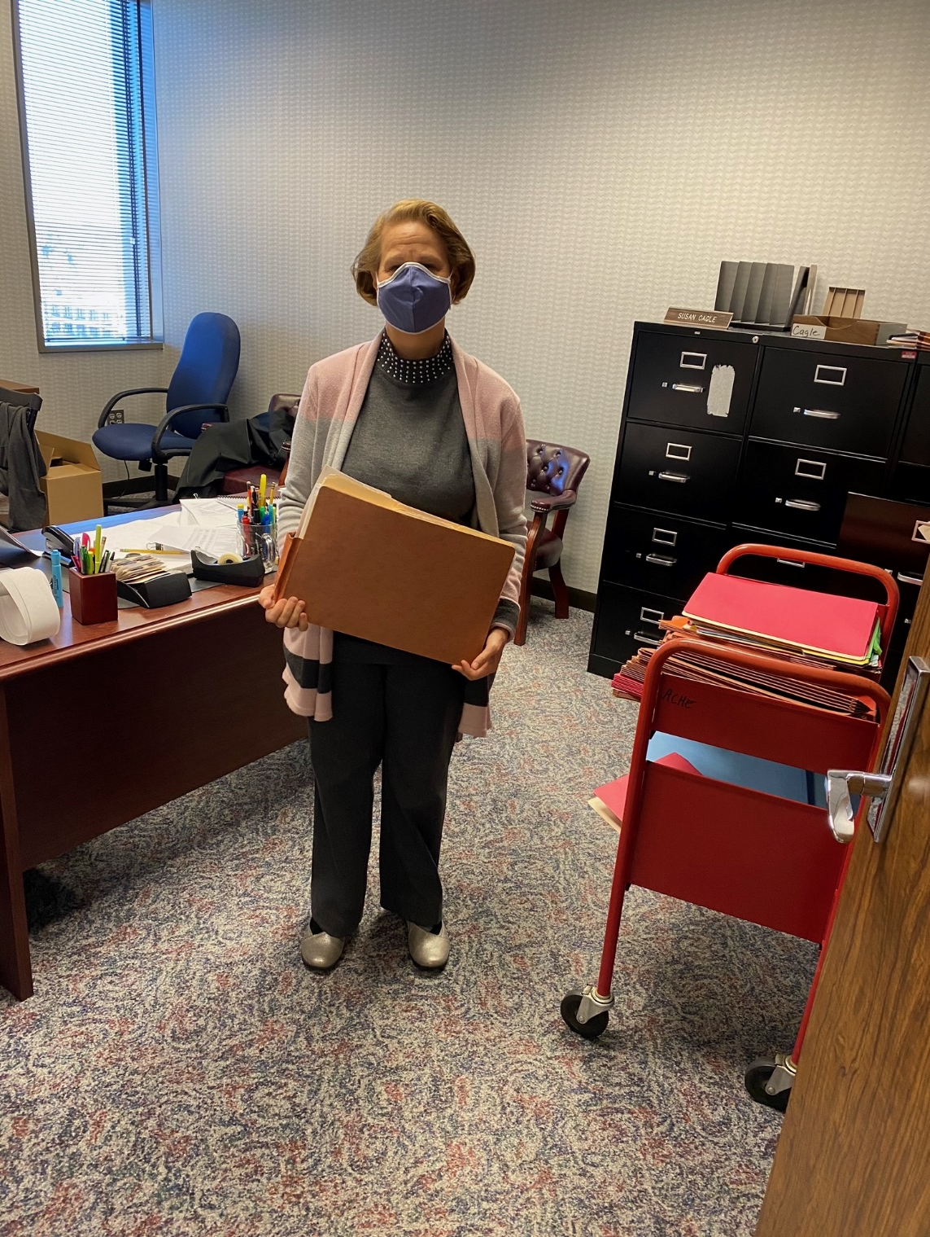

Slide 10

VI. EXECUTIVE DIRECTOR’S REPORT

Slide 11

Please welcome
Jamarcus White
Information Specialist
ACHE IT Department
Jamarcus recently graduated from AUM with a Computer Information Systems major. During his internship with ACHE he routinely proved himself with superior technical skills and knowledge. We are pleased to welcome him to the ACHE Team!

Slide 12

Automation technologies promise to deliver major productivity benefits…
Beginning to reshape the American workplace, and this evolution will become more pronounced in the next decade.
Some occupations will shrink, others will grow, and the tasks and time allocation associated with every job will be subject to change.

Slide 13
The Challenge:
equipping people with the skills that will serve them well,
helping them move into new roles,
and addressing local mismatches.

Slide 14
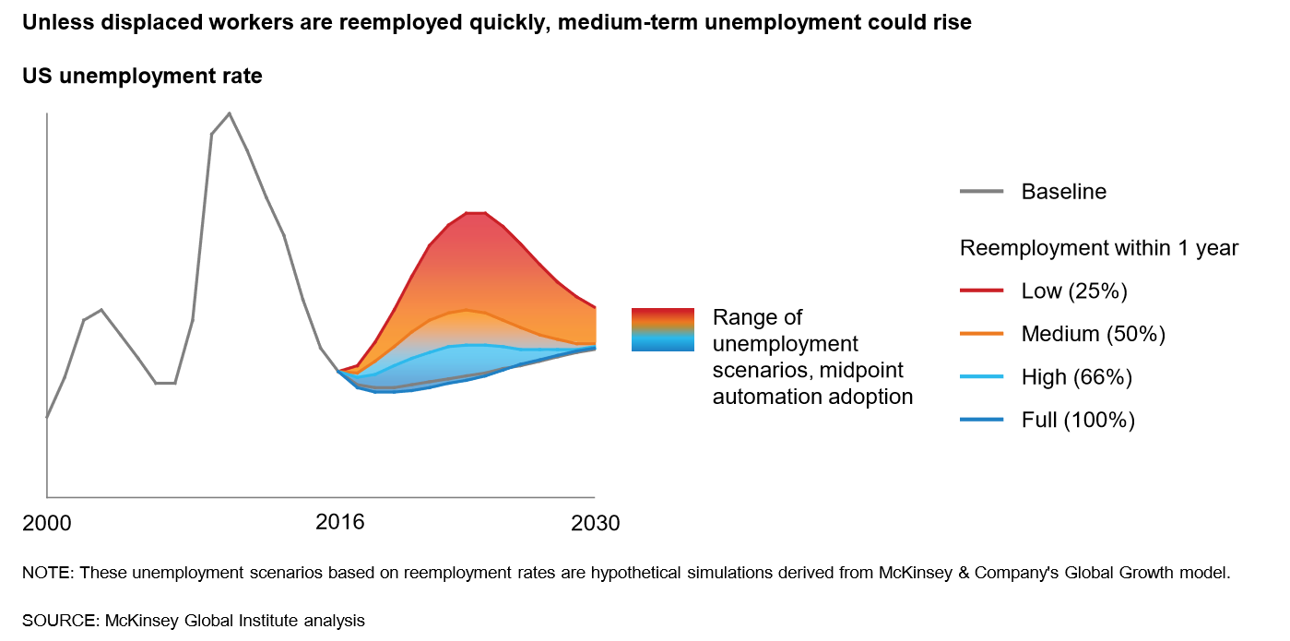
We can adapt and make the transition less problematic or not adapt and thing will go to hades in a handbasket.

Slide 15

VII. DISCUSSION ITEMS

Slide 16

The Pandemic’s Dual Threat
for Vulnerable Workers
Presented by: Ms. Meagan Crowe, CNP

Slide 17


Meagan Crowe, CNP
Former Policy Analyst at the Southern Regional Education Board
Current Senior Research and Policy Analyst at the Southern Education Foundation

Slide 18
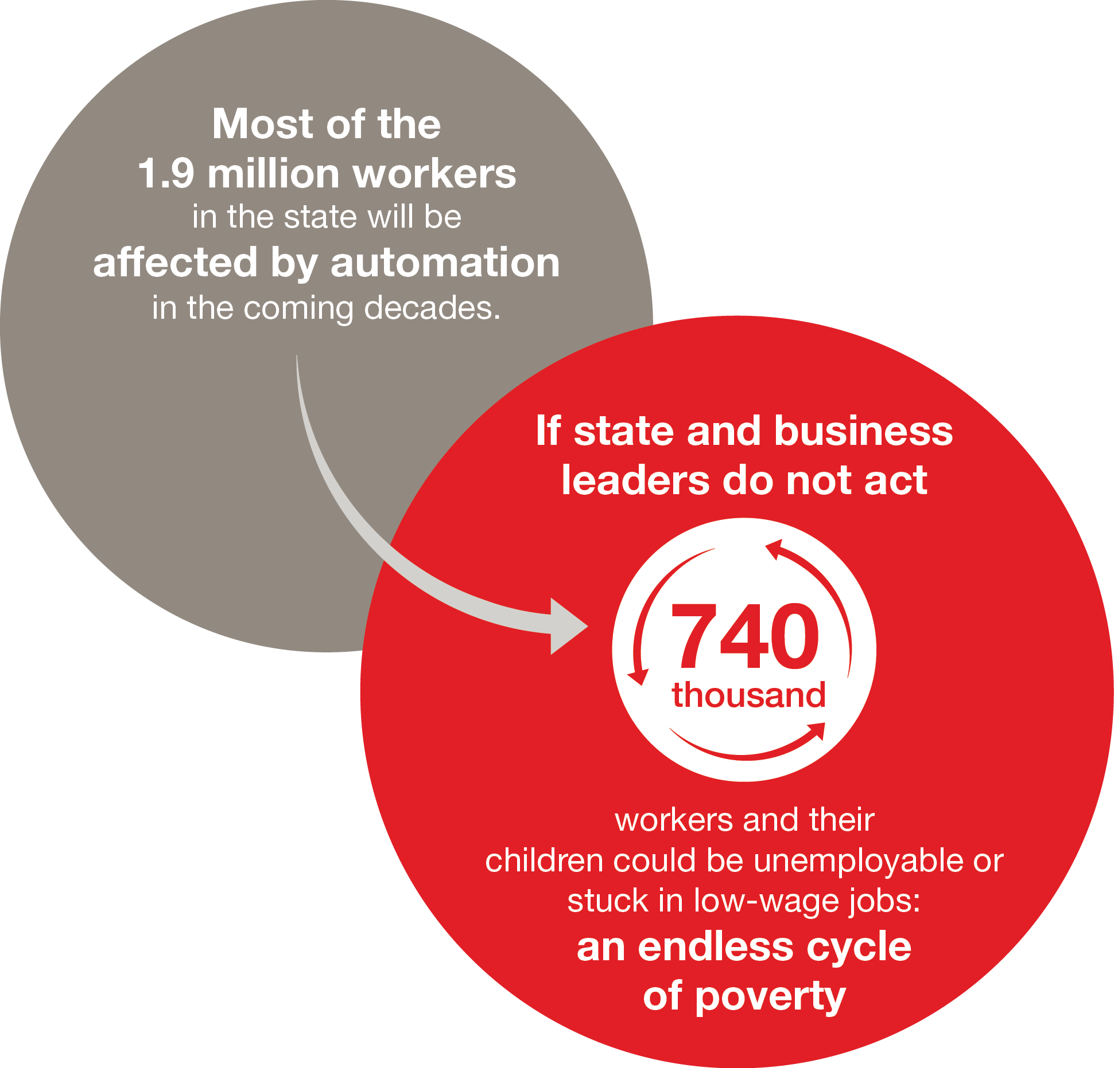
Pre-Pandemic
Alabama, 2014-2030

Slide 19
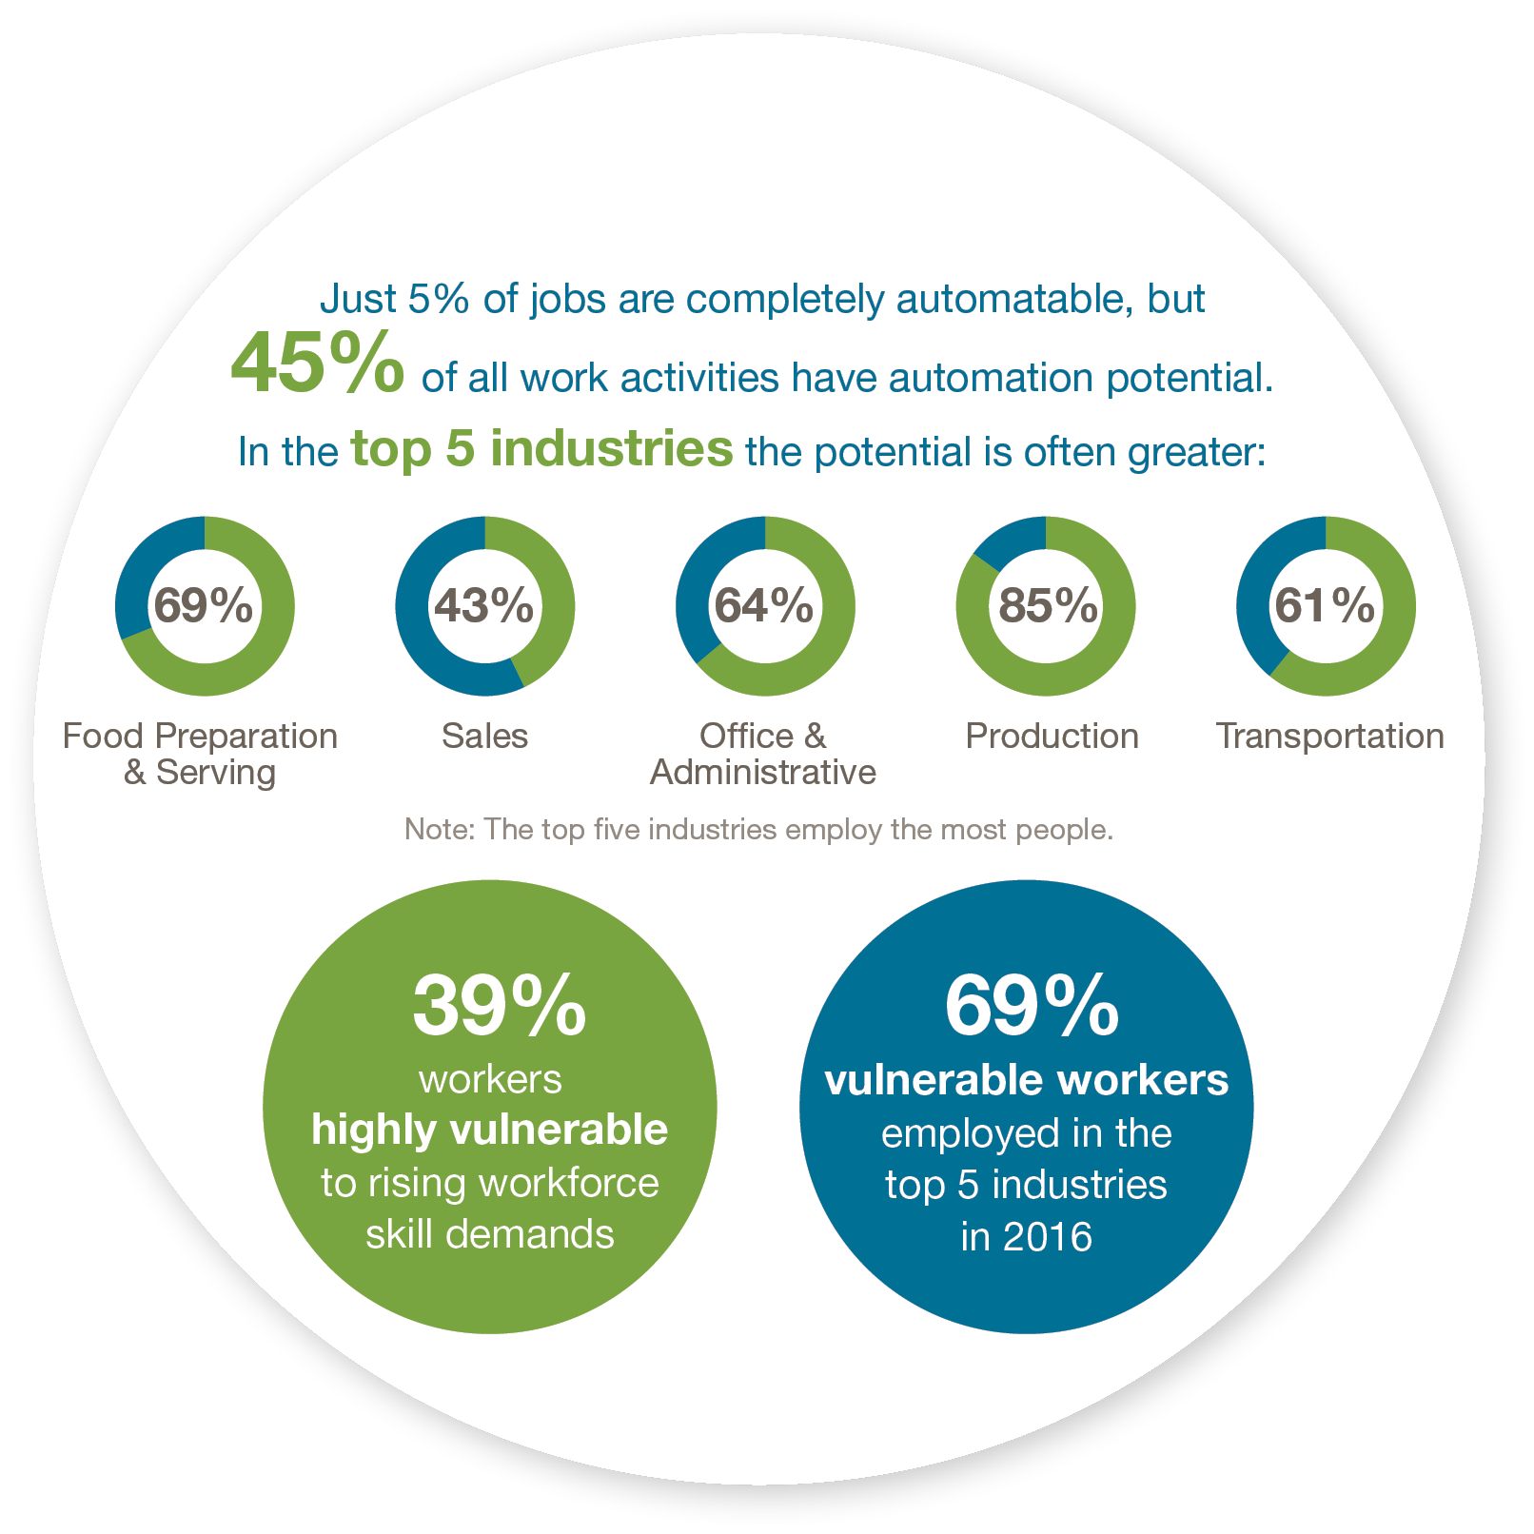
Pre-Pandemic
Alabama, 2014-2030

Slide 20
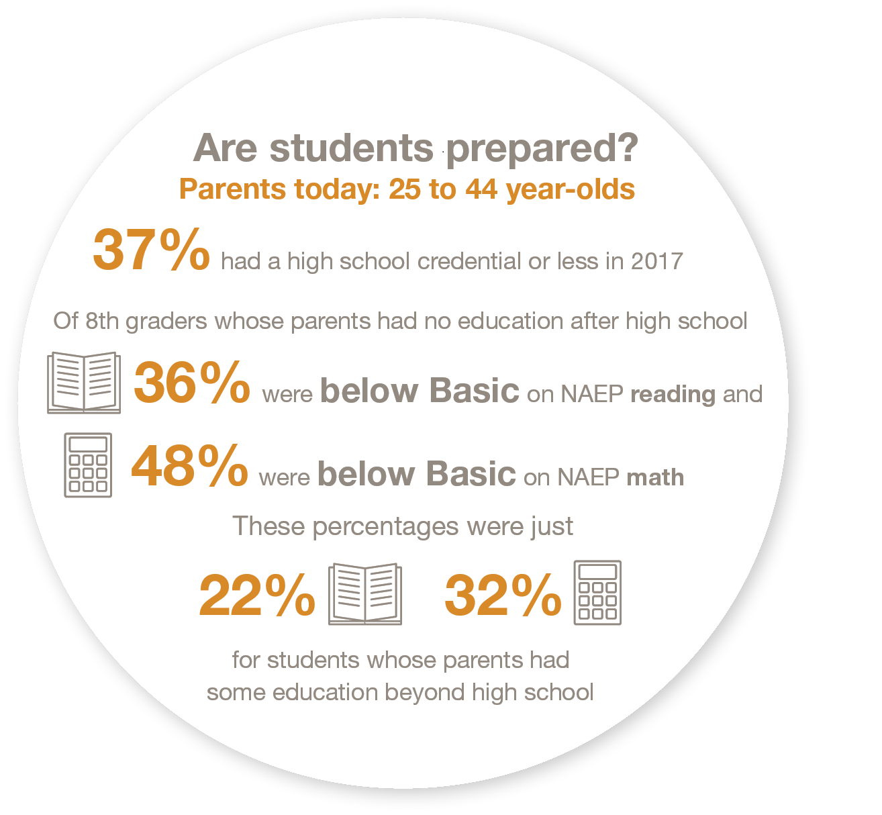
Pre-Pandemic
Alabama, 2014-2030

Slide 21
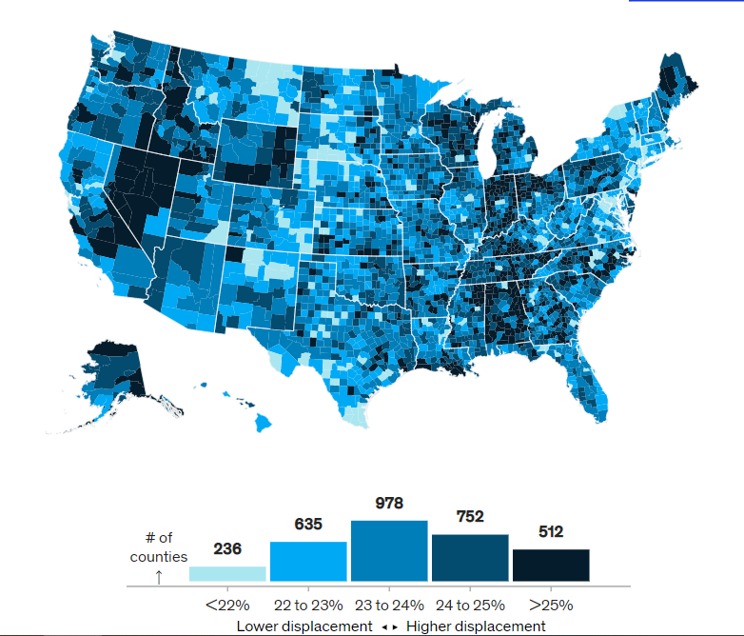
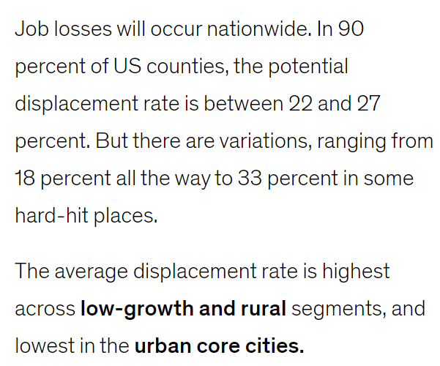
Pre-Pandemic Displacement Projections

Slide 22
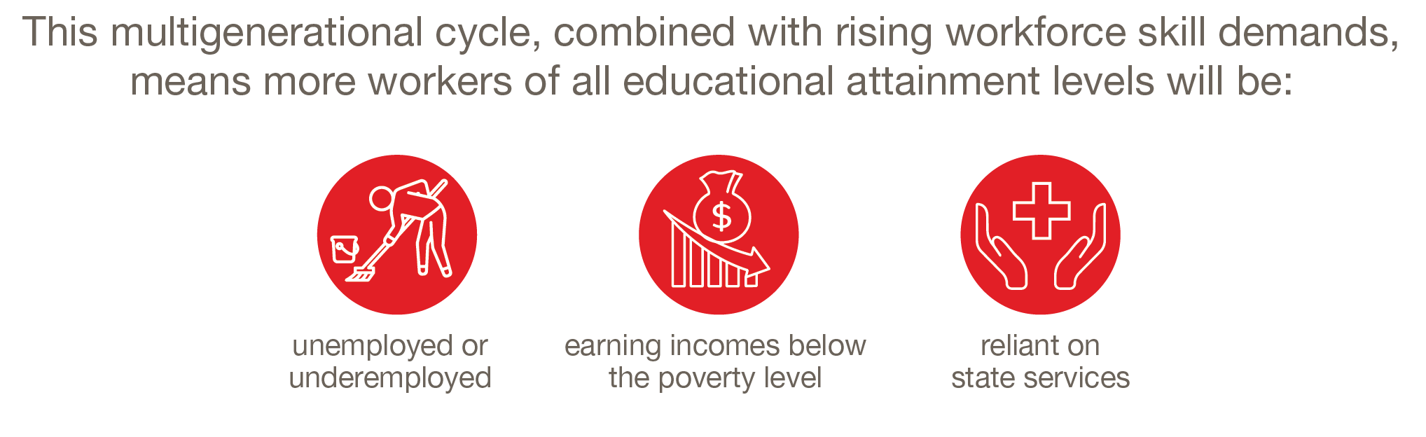
Residents of rural communities and those with the least educated populations will be the most impacted.
Notes:
This is automation potential of work activities based on 2016 employment data/2017 analysis from McKinsey & Company. This is the potential automation of work activities by industry. Ex: From the previous slide, 69% of activities in the food prep industry are automatable at all. If we realized just half of that automation (so a midpoint rate of adoption) then 34% of activities would be automated over the total period (2014-2030). But we’ve already been automating for 5 years and we’re condensing the last 10 years (2020-2030) into 5. So, 23% of food prep activities could be automated between 2020 and 2025.

Slide 23
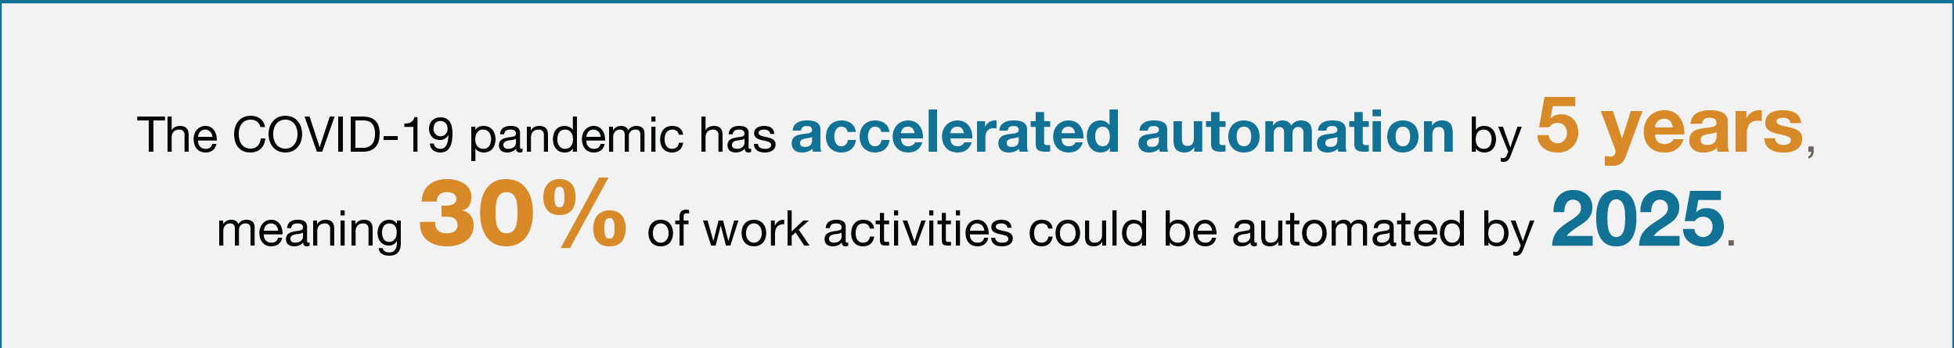
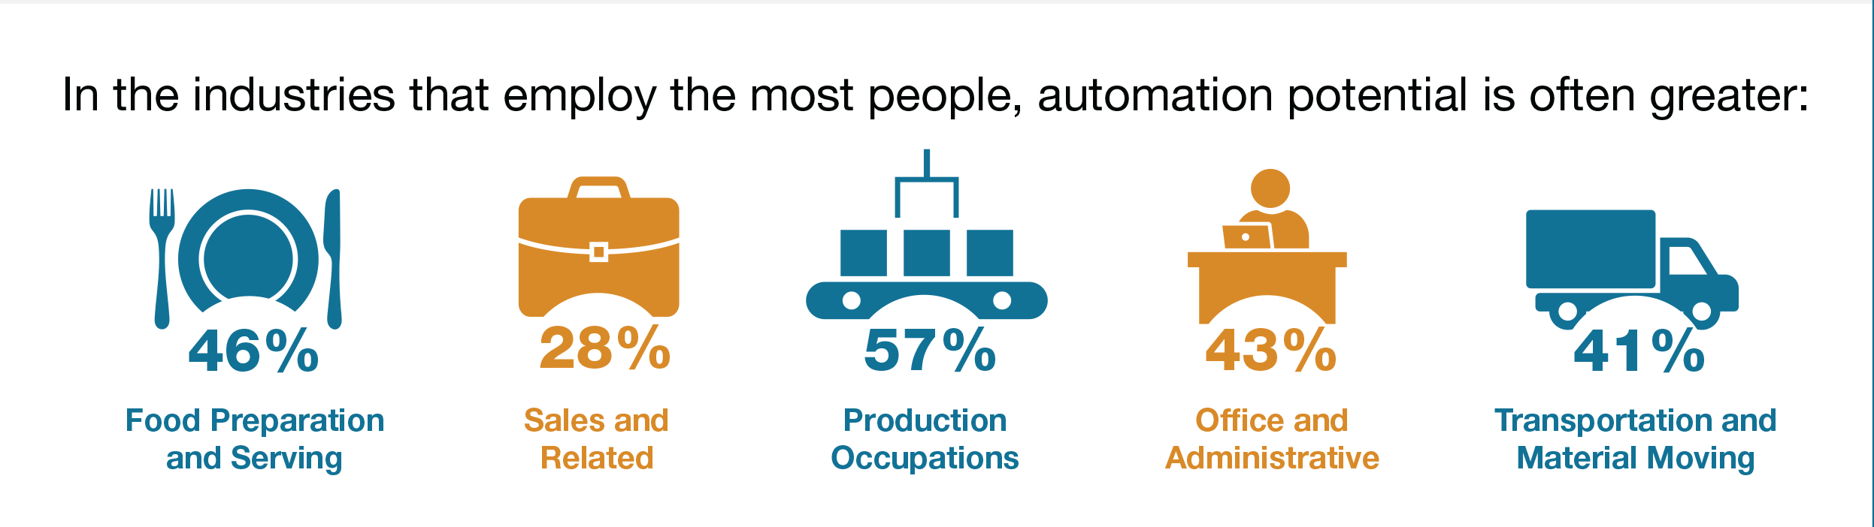
Notes:
-McKinsey Company + others, they say in the early (8) weeks of the pandemic/shutdowns, digital adoption advanced 5 years.

Slide 24

Notes:
This is automation potential of work activities based on 2016 employment data/2017 analysis from McKinsey & Company. This is the potential automation of work activities by industry. Ex: From the previous slide, 69% of activities in the food prep industry are automatable at all. If we realized just half of that automation (so a midpoint rate of adoption) then 34% of activities would be automated over the total period (2014-2030). But we’ve already been automating for 5 years and we’re condensing the last 10 years (2020-2030) into 5. So, 23% of food prep activities could be automated between 2020 and 2025.

Slide 25

Active employees
Alabama, May 2019

Slide 26
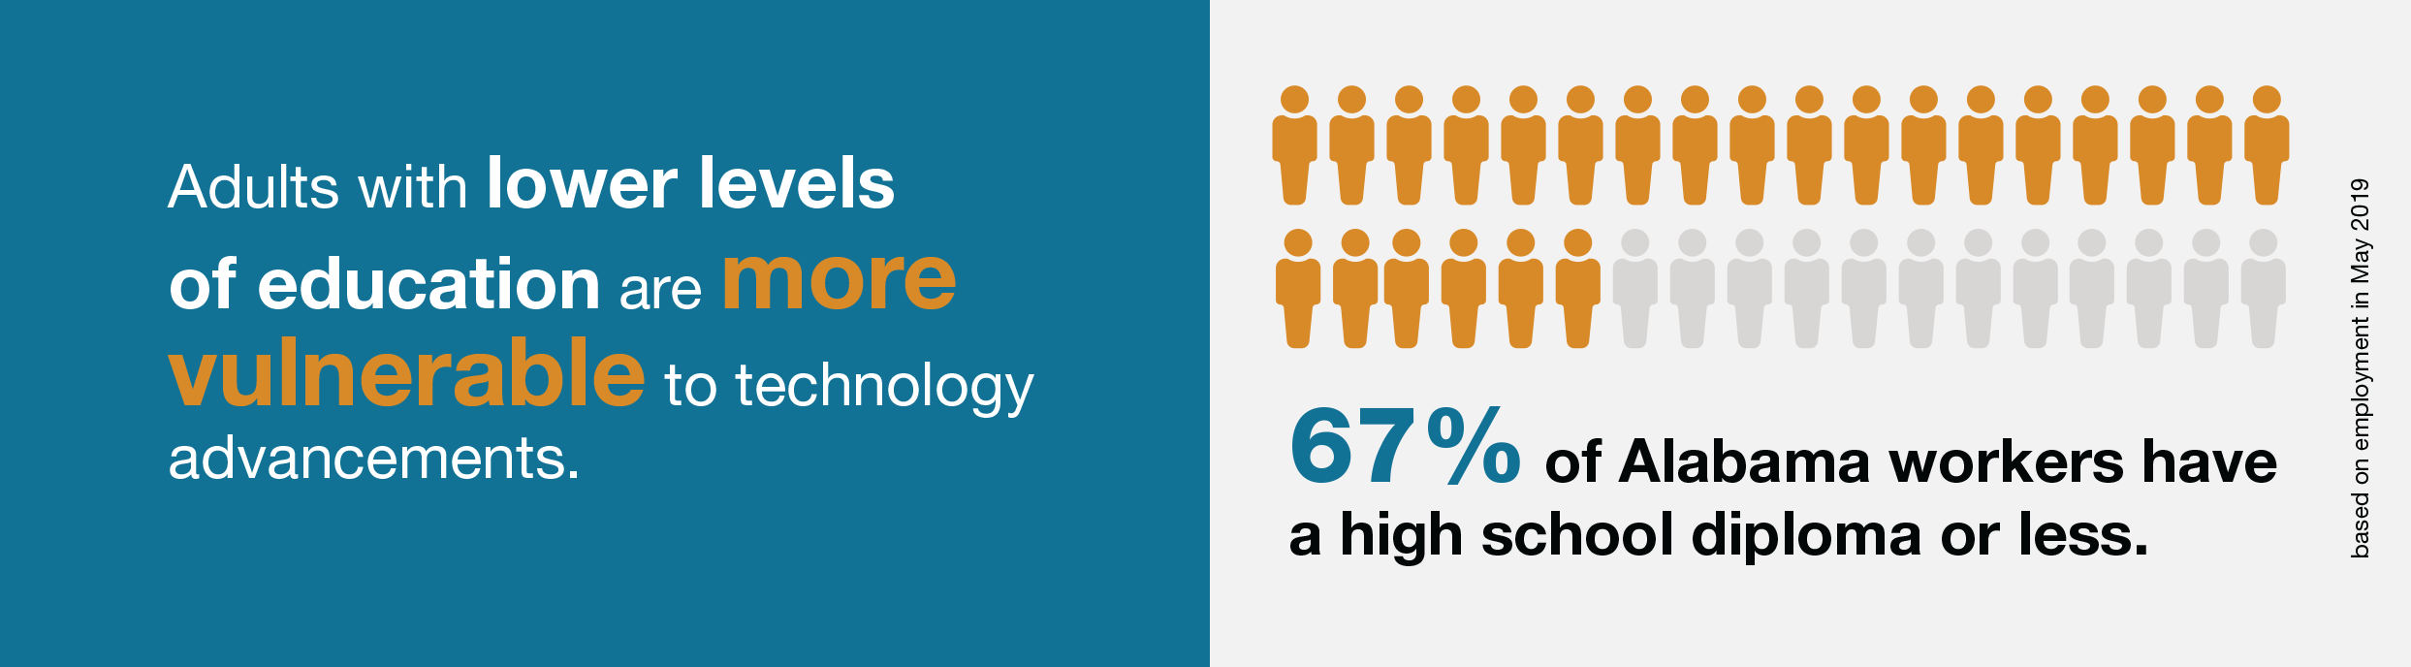
Active employees
Alabama, May 2019
Notes:
Remember that 1.5 million low-skilled adults were likely to be unemployable or stuck in low wage jobs by 2030. Now, almost 1.3 million full-time positions could go away by 2025.

Slide 27
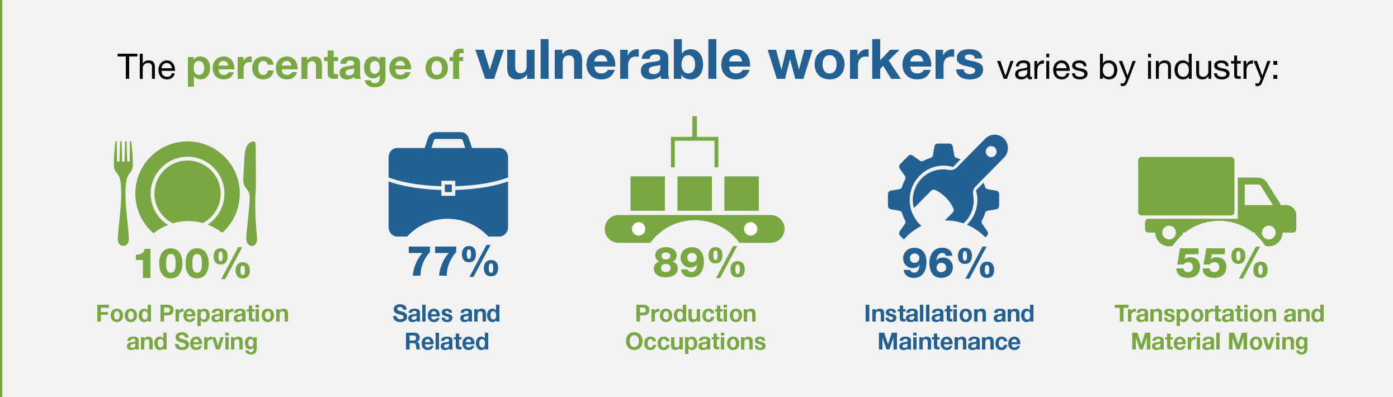
Active employees
Alabama, May 2019
Notes:
So, by industry, this is the percentage workers that are vulnerable to unemployment, layoffs, dropping out of the labor force, etc. during the pandemic as a percentage of each industry. When I look at “at-risk” workers in just the top-five employing industries, they make up one-third of the TOTAL current (most recent data is from May 2019) workforce. 45% of GA’s total workforce are considered at risk due to the pandemic.

Slide 28
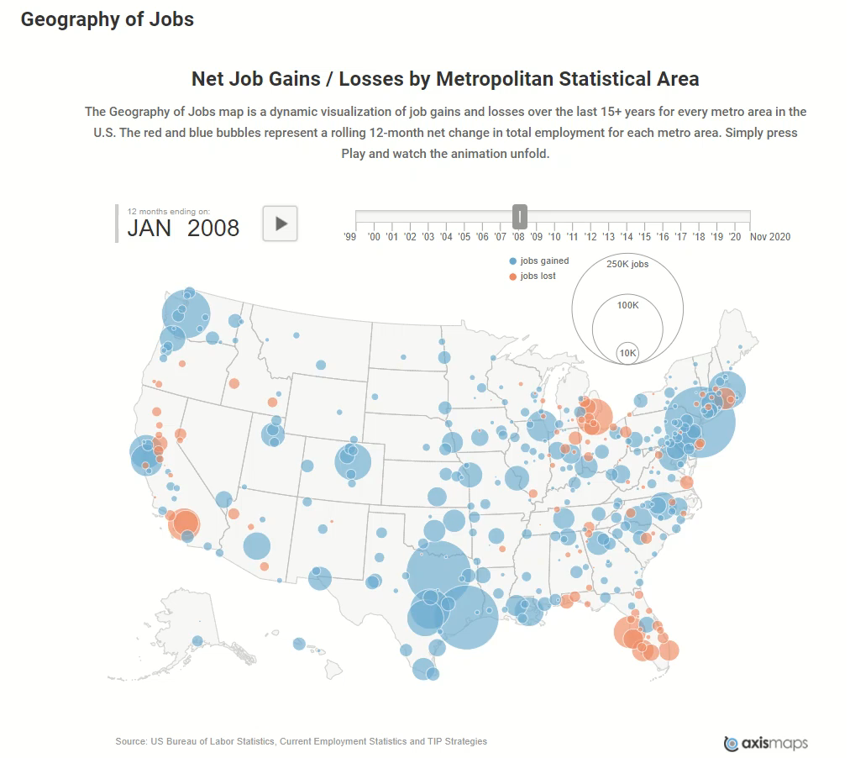
Economic Update

Slide 29
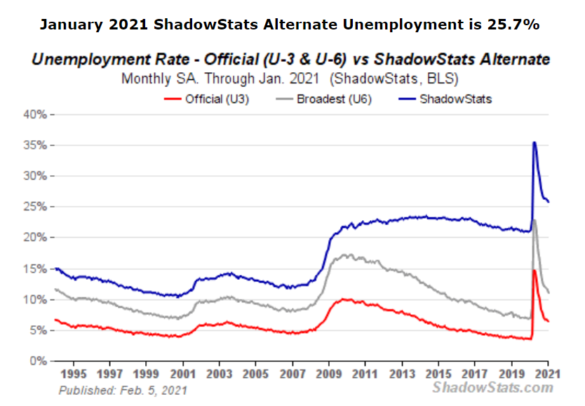

Slide 30

There is real urgency for students to earn postsecondary degrees and credentials.
The educational requirements for growing occupations are higher than those for the jobs displaced by automation.
If displaced workers are not reemployed quickly, countries will face rising unemployment and depressed wages

Slide 31

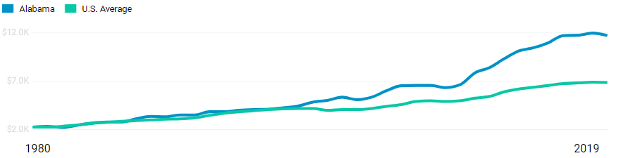
College Affordability
Comparing Alabama to the Nation
Per-Student Tuition Revenue Over Time
Alabama has seen an average annual 4.4% increase in net tuition since 1980.
In 2019, Alabama had $11,757 in net tuition revenue per FTE, approximately 1.7 times the U.S. average.

Slide 32
College Affordability
Alabama In the middle of the pack.
Tied with FL, SC, TX

Slide 33
College Affordability
Alabama tied for third highest with Mississippi

Slide 34
College Affordability
Significantly higher than other states in the SREB Region

Slide 35

Report: Fewer High School Students Went Straight to College
By Madeline St. Amour, December 10, 2020
New data from the National Student Clearinghouse Research Center show that nearly 22 percent fewer students from the Class of 2020 went to college immediately after high school this fall compared to the Class of 2019, according to a news release from the center.
The overall immediate college enrollment rate fell from 35.3 percent to 27.7 percent, a drop that is 10 times greater than the decline between 2018 and 2019.
Graduates of low-income high schools saw a nearly 30 percent drop in college enrollment, compared to a 17 percent drop for those at high-income high schools.

Slide 36
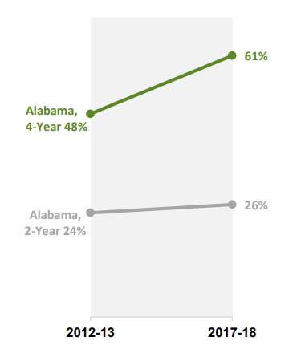
Percentage of Income Required for Median Tuition and Fees at Public Institutions for Families Making Less Than $30,000
College Affordability
The Community College System should be commended for maintaining affordability.
Do we want our public universities to limit access based on a price that is out of reach for many of our students?
Does a business model that requires high levels of loans and other student aid make sense for Alabama’s universities? For Alabama’s citizens?

Slide 37
Recommended Strategies
Pandemic/ Automation
Work with local business and industry on their automation strategies
Expand programs that address workforce needs –especially those resulting from automation
Seek state support designated for programs that produce graduates for high-demand/high-wage jobs
Create micro-credentials that help graduates illustrate their preparation for careers in the modern economy.
College Affordability
Expand the state’s need-based financial aid program
Review institutional scholarship packaging strategies and revise to optimize affordability for more students.
Commit to limited tuition hikes until Alabama’s affordability is more inline with other states.

Slide 38
SREB Contacts
Jeff Gagné, Ph.D.
Director of Policy Analysis, SREB
Jeff.Gagne@SREB.org
(404) 879-5604
Meagan Crowe, CNP
Former Policy Analyst, SREB
Senior Research and Policy Analyst, SEF
MCrowe@southerneducation.org
(404) 991-6777

Slide 39






Credential Registry, Competency Frameworks,
and In-Demand Occupations
Presented by: Dr. Robin McGill

Slide 40

Alabama’s Credential Registry
Intended to promote transparency around credentials for consumers and employers.
Supports the work of the ACCCP and become the clearinghouse for the Compendium of Valuable Credentials.
Publishes information on Alabama’s credentials to the national Credential Finder database.
Supported by a grant from Credential Engine and housed at the Alabama Commission on Higher Education (ACHE).

Slide 41

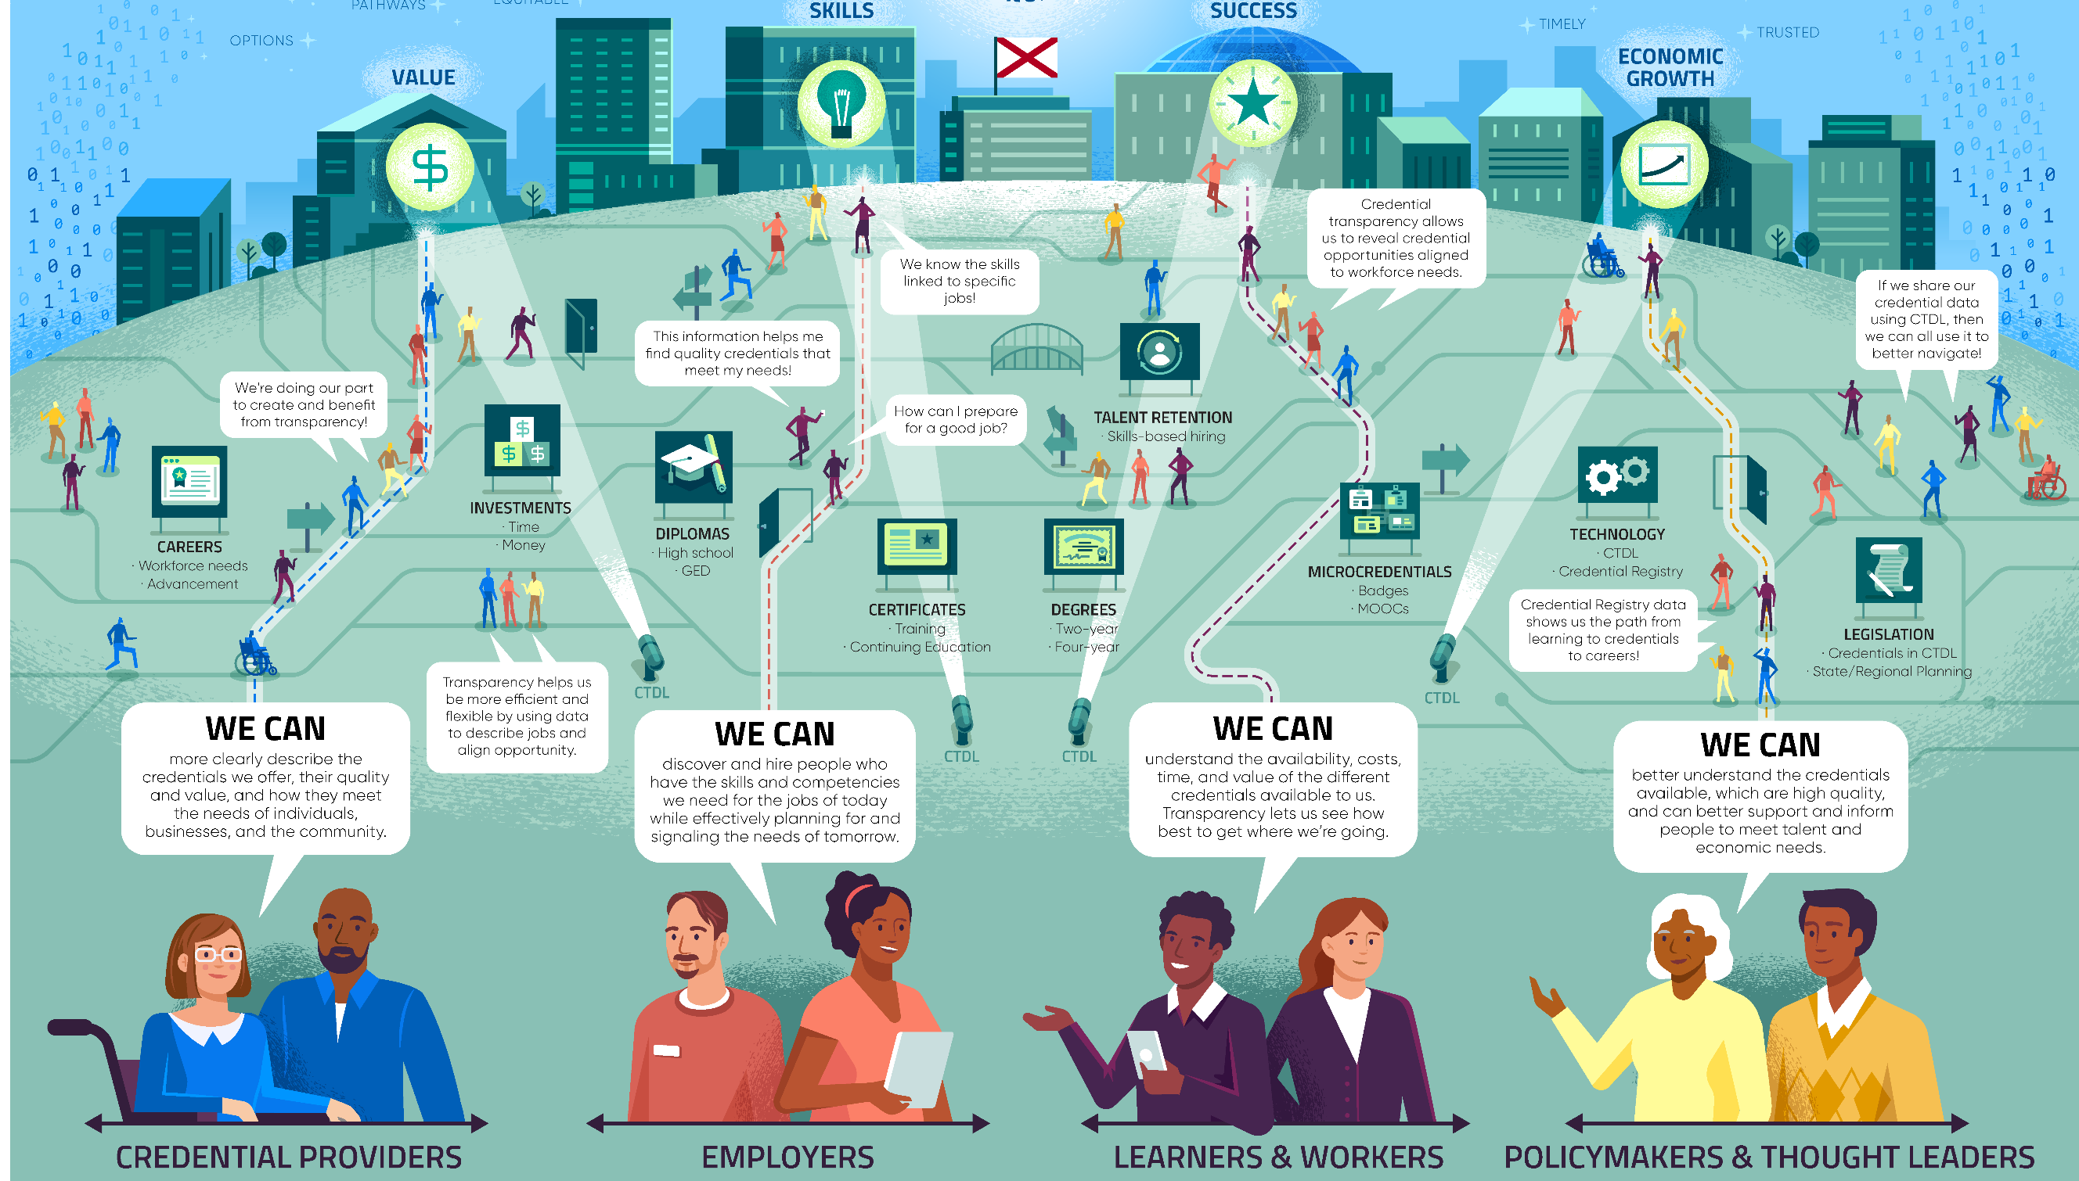

Slide 42
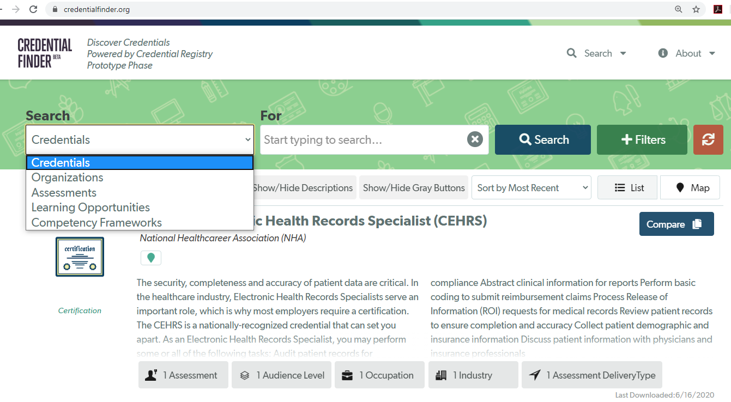
CredentialFinder.org

Slide 43
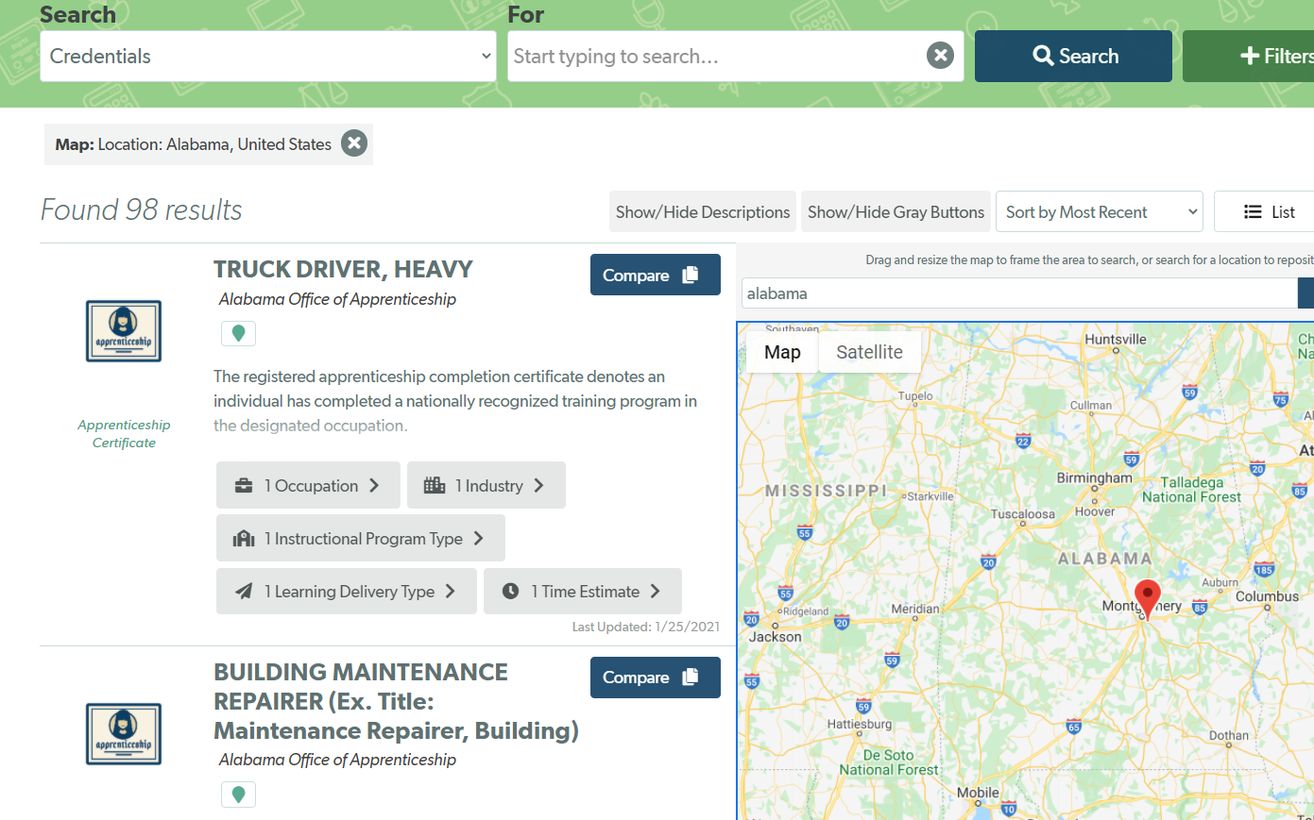

Slide 44
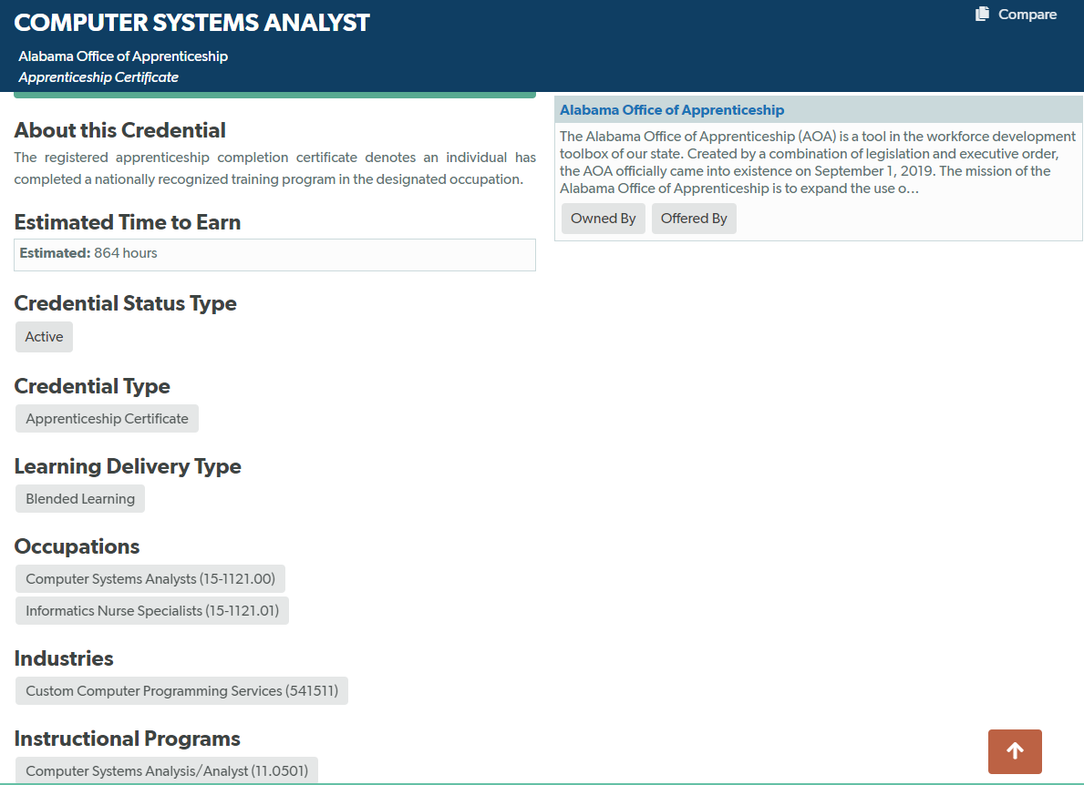

Slide 45
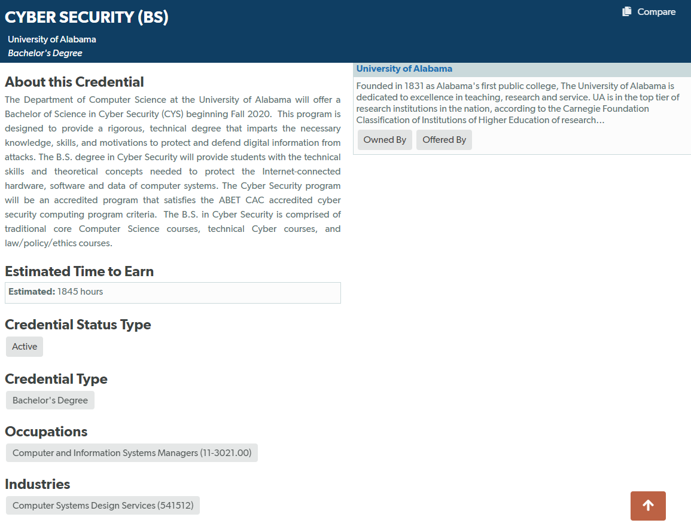

Slide 46
What’s Next?
Transitioning registry to credentials.alabama.gov (March 2021)
Launching infrastructure for ACCCP Technical Advisory Committees to review credentials in their cluster (March 2021)
Developing the initial Compendium of Valuable Credentials (June 2021)
Developing competency builder tool (Summer 2021)

Slide 47
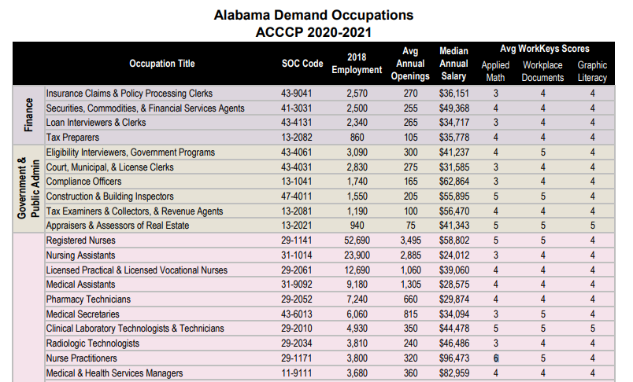
Available at ache.edu
Developed by ADOL
Includes 232 “In-Demand” occupations, based on ACCCP criteria

Slide 48
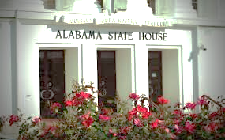
2021 ACHE Legislative Agenda
Presented by: Mrs. Margaret Gunter

Slide 49
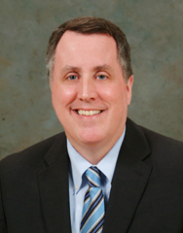
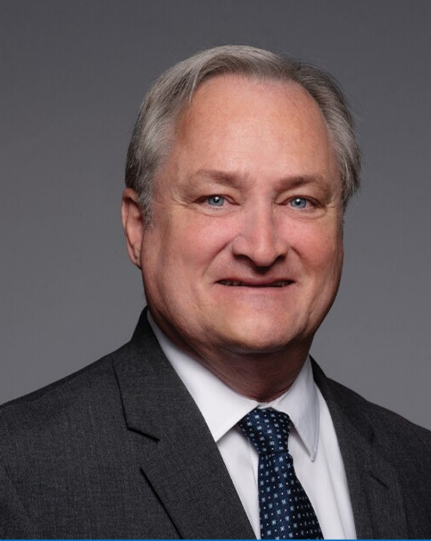
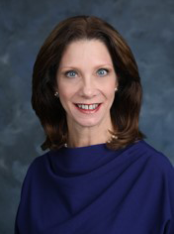
Commissioners Receive Senate Confirmation
Norman Crow
Paul W. Kennedy
Ann Forbes Sirmon

Slide 50

Education Budget
Increases for higher ed. recommended in Governor’s budget – Apx. 7% increase for state universities and 9.5% increase for Community College System
Education budget is anticipated to be the largest on record at $7.65B, a $440M increase over last year

Slide 51

HB424
Alabama Student Grant Program
Increases the cap on the Alabama Student Grant Program for Alabama students attending an approved accredited independent college or university in the state
Students are currently eligible for $1,200 per academic year
Would increase the amount to $3,000 per academic year

Slide 52
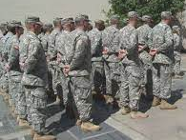
SB216 –
Alabama National Guard Education
Assistance Program
Extend tuition reimbursement for dually or concurrently enrolled high school/college students
Tuition would be reimbursed based on actual cost instead of the average tuition rate of the public universities
Set the cap for private college tuition reimbursement at the rate of the public institution with the highest tuition and instructional fee rates
ANGEAP would become the first-payer instead of the last-payer after all other sources of revenue have been factored in
Short certificates, long certificates, and associate degrees are
considered "stackable undergraduate credentials" which may
be used to obtain a baccalaureate degree. This would make the
baccalaureate degree the “first degree”

Slide 53



HB153 –
Police Officer’s & Firefighter’s Survivor Educational Assistance Program
Expands eligibility requirements
Allows dependent natural child under the age of 21 born after death or any dependent child under the age of 21 who is adopted after total disability was declared, to be eligible for a scholarship
Educational Assistance

Slide 54


HB175 –
Alabama Math and Science Teacher Education Program
(AMSTEP)
Broadens the eligibility requirements for participants
in the loan forgiveness program
Includes middle-level school teachers
Reduces teaching load from full-time to 3/4
Includes teachers living out-of-state who teach in Alabama
Includes individuals issued the Alabama Bachelor’s Level Professional
Educator Certificate in math, science or computer science to participate
in AMSTEP upon completion of alternative certification program

Slide 55

Alabama Workforce Council Committee on Credential Quality and Transparency
Establishes a standing committee of the Alabama Committee on Credentialing and Career Pathways to set transparency and quality policies and rubrics
Focuses on non-degree/non-credit credentials that are supported by WIOA and Perkins federal funding streams
Provides information in an accessible database for students,
job seekers and employers to learn about credentials and competencies as they relate to education and workforce programs

Slide 56

SB46 –
Medical Marijuana
A Consortium for Medical Cannabis Research would be established to award grants to entities for research relating to cannabis and medical cannabis
The initial member institutions would consist of public and private four-year colleges and universities within the state
ACHE would appoint the designees no later than January 1, 2022

Slide 57

IX. Decision ITEMS

Slide 58

A. Academic Programs
Staff Presenters: Dr. Robin McGill and
Ms. Kristan White

Slide 59

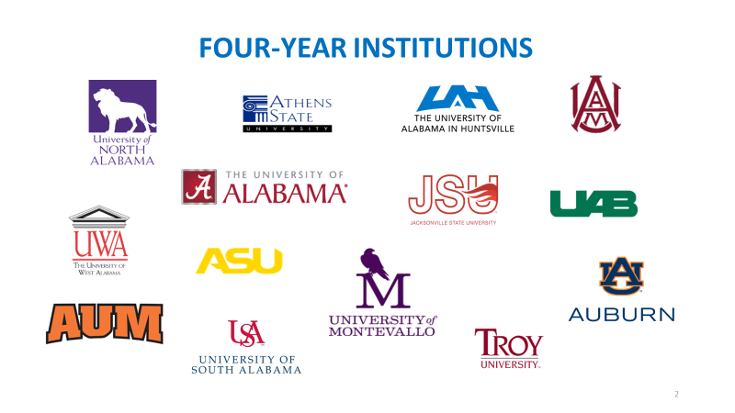

FOUR-YEAR and TWO-YEAR INSTITUTIONS

Slide 60

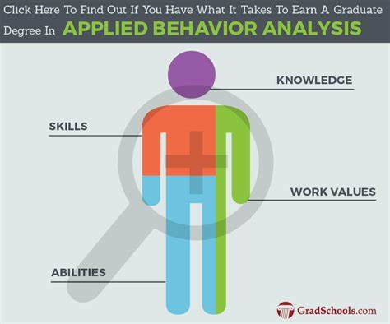
Auburn University
1a. Master of Science in Applied Behavior Analysis
(CIP 42.2814)
The proposed program will replace an existing option in AU’s MS in General Psychology (CIP 42.0101). Creating a standalone degree will make the program more viable for specialized accreditation.
Data for AU’s existing Applied Behavior Analysis option shows that the program regularly exceeds the number of new enrollments and graduates required to meet viability standards.
The Bureau of Labor and Statistics projects 22% employment
growth for Applied Behavior Analysts between 2018 and 2028.
This Photo by Unknown Author is licensed under CC BY-ND

Slide 61
Motion, Decision Item A-1a:
That the Commission approve Auburn University’s proposal to offer a Master of Science in Applied Behavior Analysis.

Slide 62

Auburn University
2a. Master of Development Practice in Development Practice
(CIP 30.2001)
Currently, there is no MDP or similar program offered in Alabama, and the proposed program will help fill a global need for individuals trained in sustainable development issues, including hunger, poverty, humanitarian aid, and social policy.
Student demand for the program is strong, based on higher than expected enrollments in AU’s existing BS in Global Studies in Human Sciences (GSHS) program, which will be a major feeder for the proposed MDP.
This program will utilize existing interdisciplinary faculty and
courses currently being taught for other graduate programs,
and therefore, no new resources will be required for implementation.
This Photo by Unknown Author is licensed under CC BY-ND

Slide 63
Motion, Decision Item A-2a:
That the Commission approve Auburn University’s proposal to offer a Master of Development Practice in Development Practice.

Slide 64
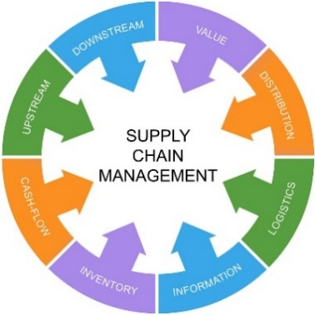
Auburn University
3a. Master of Science in Supply Chain Management
(CIP 52.0203)
Alabama’s growth in global manufacturing has increased demand for supply chain professionals. Graduates of the proposed program will be prepared for employment as logisticians and as transportation, storage, and distribution managers, both occupations that appear on the State’s In-Demand Jobs list.
The proposed program extends AU’s 12-hour Graduate Certificate in Supply Chain Management Innovation (CIP 52.0203) to a full master’s degree program.
This program will require no new funds as it will utilize existing faculty and resources.
This Photo by Unknown Author is licensed under CC BY-ND

Slide 65
Motion, Decision Item A-3c:
That the Commission approve Auburn University’s proposal to offer a Master of Science in Supply Chain Management.

Slide 66

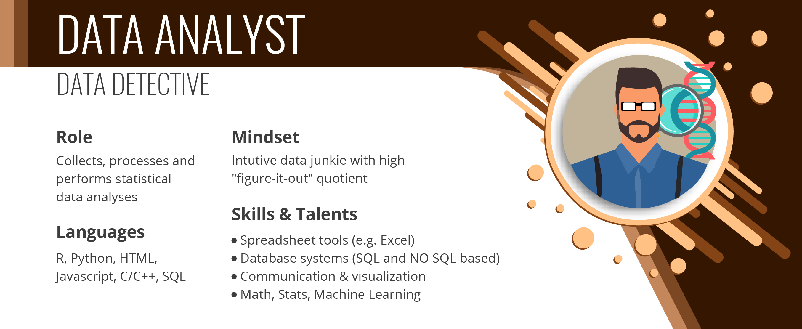
Troy University
2. Bachelor of Science in Business Administration
in Data Analytics (CIP 52.1301)
The proposed BSBA program will expand an existing concentration within the BSBA in Global Business (CIP 52.1101) into a standalone degree program in Data Analytics, and as such, will not require any additional resources to implement.
Coursework for the proposed program will be offered both in-person and online, allowing more flexibility for professional students.
The field of business data analytics is rapidly growing, and the program is designed to prepare graduates to seek employment in high-demand occupations, including management analysts, operations research analysts, and marketing analysts.
66
This Photo by Unknown Author is licensed under CC BY-ND

Slide 67
Motion, Decision Item A-2:
That the Commission approve Troy University’s proposal to offer a Bachelor of Science in Business Administration in Data Analytics.

Slide 68

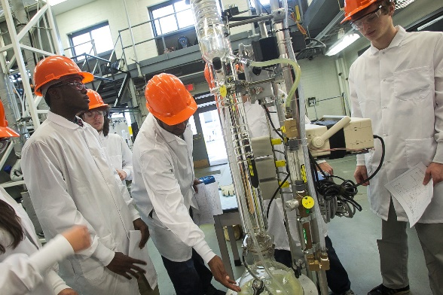
University of South Alabama
3a. Doctor of Philosophy in Chemical and Biomolecular
Engineering (CIP 14.0702)
The USA PhD in Chemical and Biomolecular Engineering is distinct from the other current degrees offered in the state as it offers a unique interdisciplinary track structure that builds on USA’s strengths across a variety disciplines that incorporate biomolecular applications.
The program will prepare graduates for careers as chemical and environmental engineers, both of which are in-demand occupations in Alabama.
The program will support the growth of interdisciplinary engineering research in the Gulf Coast area, which has typically been limited.

Slide 69
Motion, Decision Item A-3a:
That the Commission approve The University of South Alabama’s proposal to offer a Doctor of Philosophy in Chemical and Biomolecular Engineering.

Slide 70
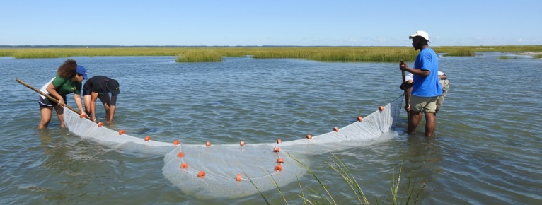
University of South Alabama
3b. Establishment of a New Unit of Instruction:
School of Marine and Environmental Sciences
The new School will be situated within USA’s College of Arts and Sciences and will initially be comprised of the Department of Marine Sciences and select interdisciplinary programs that focus on marine, coastal, and environmental studies. It will include the following degree programs:
  PhD in Marine Sciences (CIP 30.0101), offered by the
  Department of Marine Sciences
  MS in Marine Sciences (CIP 30.0101), offered by the Department of Marine Sciences
  MS in Marine Conservation and Resource Management (CIP 03.0205), offered by the Department of Marine Sciences
  MS in Environmental Toxicology (CIP 26.1006), currently offered by the Graduate School

Slide 71
Motion, Decision Item A-3b:
That the Commission approve The University of South Alabama’s establishment of the School of Marine and Environmental Sciences.

Slide 72

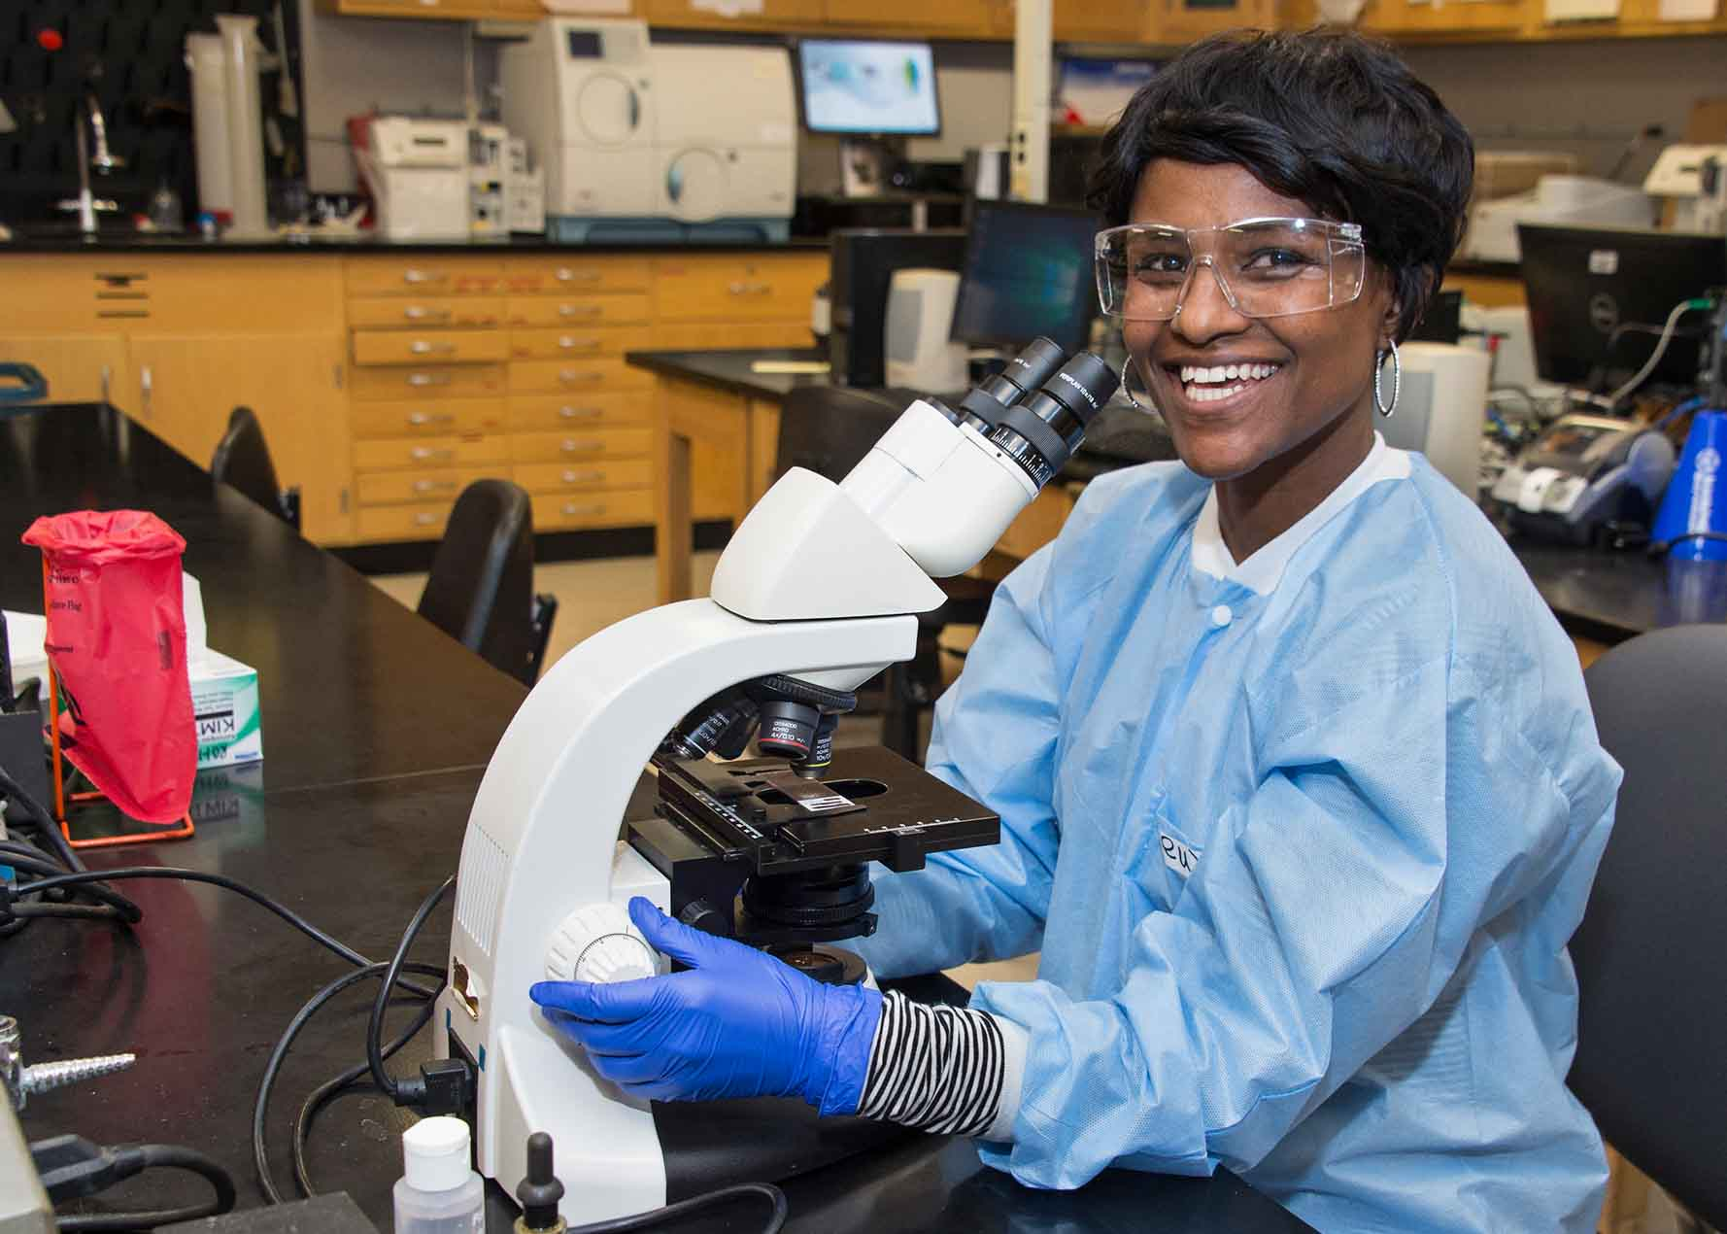
Shelton State Community College
4. AAS in Medical Laboratory Technician (CIP 51.1004)
The proposed program meets a demonstrated industry need for Medical Laboratory Technicians in Workforce Region 3 (West AlabamaWorks), as well as throughout the State.
This proposal includes letters of support from the following potential clinical site partners and future employers: DCH Regional Medical Center, Fayette Medical Center, Greene County Health System, Hale County Hospital, Taylorville Family Medicine, and Tuscaloosa Internal Medicine.

Slide 73
Motion, Decision Item 4:
That the Commission approve the Shelton State Community College’s proposal to offer an Associate of Applied Science in Medical Laboratory Technician.

Slide 74


University of North Alabama
5a. Bachelor of Business Administration in Data Analytics
(CIP 52.1301)
The proposed BBA program in Data Analytics will replace UNA’s existing BBA in Economics (CIP 52.0601), and will repurpose existing faculty and resources without need for additional expenditures.
The field of business data analytics is rapidly growing,
and the program is designed to prepare graduates to seek
employment in high-demand occupations, including
management analysts, operations research analysts, and marketing analysts.
This proposal includes letters of support from the Shoals Chamber of Commerce and the Shoals Business Incubator. UNA has also discussed future support with The Malone Family Foundation.

Slide 75
Motion, Decision Item A-5a:
That the Commission approve The University of North Alabama’s proposal to offer a Bachelor of Business Administration in Data Analytics.

Slide 76
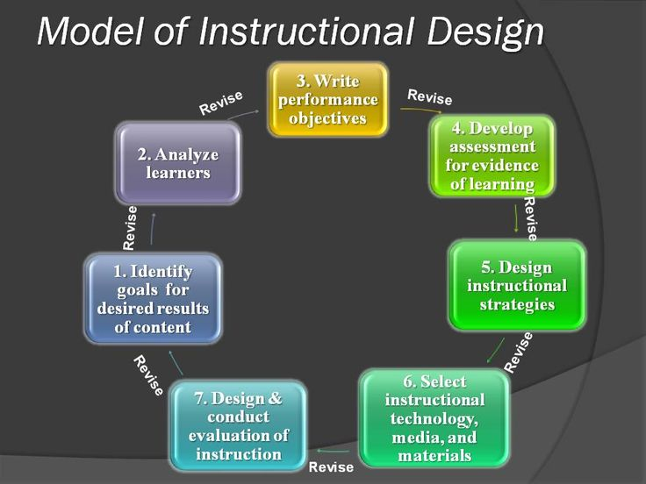
University of North Alabama
5b. Master of Science in Instructional Technology
and Design (CIP 13.0501)
The proposed MS program extends coursework from UNA’s existing graduate certificate/micro-credential in Instructional Technology and Design to a full degree program, and therefore, will require few additional resources to implement.
The proposed program is designed to prepare graduates for employment as Instructional Coordinators and Training and Development Specialists, both of which appear on the 2021 Statewide List of In-Demand Occupations.
This proposal includes letters of support from potential employers recognizing industry need in the area of instructional design.

Slide 77
Motion, Decision Item A-5b:
That the Commission approve The University of North Alabama’s proposal to offer a Master of Science in Instructional Technology and Design.

Slide 78


Athens State University
6a. Bachelor of Science in Education in Elementary Education and English for Speakers of Other Languages (ESOL) K-6 (CIP 13.1401)
Over the past ten years, Alabama has seen a more than 200% increase in the number of English learners enrolled in public schools. This growth has increased the demand for educators trained in English Language Learning/ESOL.
This proposed degree is designed for graduates to achieve ALSDE Class B Certification in both Elementary Education and ESOL.
The proposal includes letters of support from local education agencies (LEAs) attesting to the need for ESOL educators and expressing their interest in partnering on program placements.
78

Slide 79
Motion, Decision Item A-6a:
That the Commission approve Athens State University’s proposal to offer a Bachelor of Science in Education in Elementary Education and English for Speakers of Other Languages (ESOL) K-6.

Slide 80


Athens State University
6b. Master of Science in Strategic Human Resource Management
(CIP 52.1001)
The proposed program will expand ATSU’s existing BS in Human Resource Management (CIP 52.1001) to the graduate level and will require very few additional resources to implement.
The proposed program will prepare graduates for employment in occupations included on the 2021 Statewide List of In-Demand Occupations.
Graduates will be prepared to sit for professional certifications offered through the Society for Human Resource Management (SHRM), as well as other professional organizations.
80

Slide 81
Motion, Decision Item A-6b:
That the Commission approve Athens State University’s proposal to offer a Master of Science in Strategic Human Resource Management.

Slide 82


Athens State University
6b. Bachelor of Science in Nursing (CIP 51.3801)
ATSU’s current offering of undergraduate courses in healthcare management and leadership means that only four new courses need to be created to align with requirements for BSN curricula as established by the Commission on Collegiate Nursing Education.
There are ten BSN programs in the Academic Program Inventory under CIP 51.3801, including two RN to BSN programs in the North Alabama area. However, given the demand for such programs and the presence of out-of-state and for-profit entities in the marketplace, additional programs may be justified.
ATSU’s proposal includes five letters of support from
local education institutions and healthcare providers.
The letters attest to the need for additional BSN programs
and the alignment of ATSU’s curriculum with standards for specialized accreditation.
82

Slide 83
Motion, Decision Item A-6c:
That the Commission approve Athens State University’s proposal to offer a Bachelor of Science in Nursing.

Slide 84
Request to Amend Post-Implementation Conditions
7a. University of North Alabama BS/BA in Earth Systems Sustainability (CIP 30.3301)
The program did not meet the enrollment condition, nor did it meet the minimum graduate requirement of 7.5 annual graduates on average.
UNA has requested an extension of three years to achieve the average new enrollment and graduate figures. The post-implementation report noted that changes in program leadership after implementation negatively impacted program growth. UNA has plans to expand program delivery to include online components, expand communications and recruitment efforts, and strengthen community-based and employer-based partnerships.
BS in Earth Systems Sustainability (30.3301) | Avg New Enrollments | Average Graduates
Required | 7 | 7.5
Reported | 4.75 | 2.5

Slide 85
Motion, Decision Item A-7a:
That the Commission approve The University of North Alabama’s request to amend post-implementation conditions for the Bachelor of Arts/Bachelor of Science in Earth Systems Sustainability.

Slide 86
Request to Amend Post-Implementation Conditions
7b. University of North Alabama, MA in Public History (CIP 54.0105)
The program did not meet the average graduates condition.
UNA has requested an extension of two years to produce an average number of graduates at or above the state required minimum of 3.75. Based on program performance in the first five years, UNA’s Department of History has developed a plan for revising the curriculum, extending experiential learning partnerships with public history centers across the North Alabama region, and enhancing recruitment.
MA in Public History (54.0105) | Avg New Enrollments | Average Graduates
Required | 5 (3.75 w/ 25% reduction) | 3.75
Reported | 4.3 | 3.0

Slide 87
Motion, Decision Item A-7b:
That the Commission approve The University of North Alabama’s request to amend post-implementation conditions for the Master of Arts in Public History.

Slide 88

B. INFORMATION ITEMS
1. Implementation of Non-Degree Programs at Senior Institutions
Implementation of New Short Certificate Programs (Less than 30 Semester Hours)
Changes to the Academic Program Inventory
Extensions/Alterations to Existing Programs of Instruction
Jacksonville State University, New Exempt Off-Campus Site: Longleaf Building
Summary of Post-Implementation Reports

Slide 89
6. Summary of Post-Implementation Reports
Programs that met post-implementation conditions
Athens State University: MS in Global Logistics and Supply Chain Management (CIP 52.0203)
Auburn University: BM in Music (CIP 50.0901)

Slide 90
6. Summary of Post-Implementation Reports
b. Programs that did not meet post-implementation conditions
University of North Alabama: BA/BS in Earth Systems Sustainability (CIP 30.3301) – Extension requested
University of North Alabama: MA in Public History (CIP 54.0105) – Extension Requested

Slide 91
Motion, Decision Item B:
That the Commission accept the information items as presented.

Slide 92
G. ADJOURNMENT

