Slide 1

Alabama Commission on Higher Education
Commission Meeting
June 11, 2021

Slide 2


CALL TO ORDER, PRAYER, AND PLEDGE OF ALLEGIANCE

Slide 3

II. ROLL CALL and
QUORUM DETERMINATION

Slide 4

III. APPROVAL OF AGENDA
Commission Meeting Agenda of
June 11, 2021

Slide 5

IV. CONSIDERATION OF MINUTES
Commission Meeting Minutes of March 12, 2021

Slide 6

V. CHAIRMAN’S REPORT

Slide 7

VI. EXECUTIVE DIRECTOR’S REPORT

Slide 8
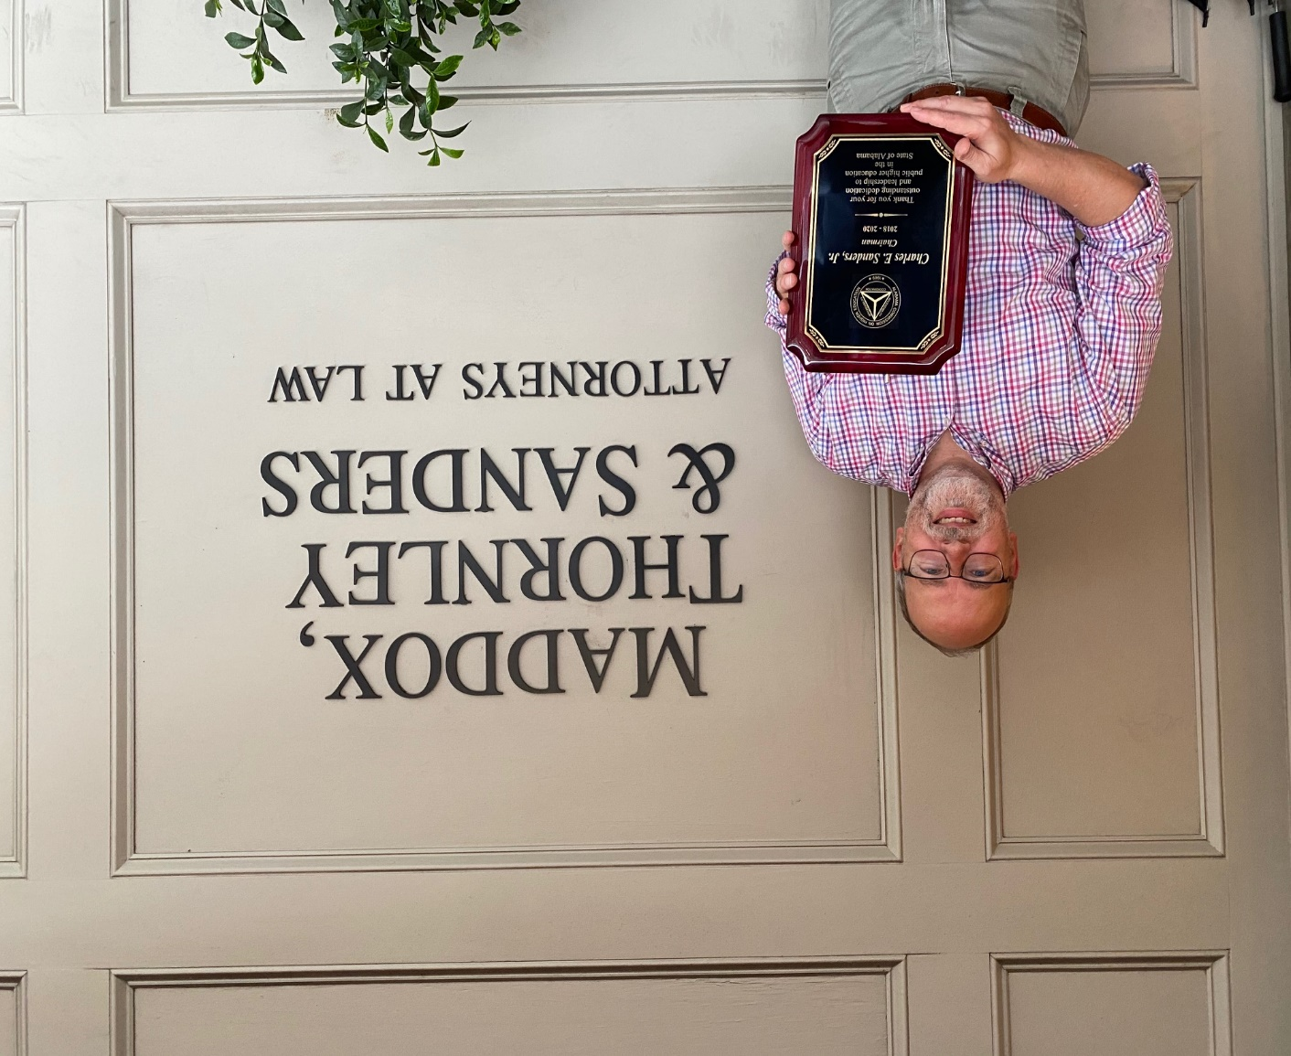

Transitions
Interim Senate Resolution

Slide 9
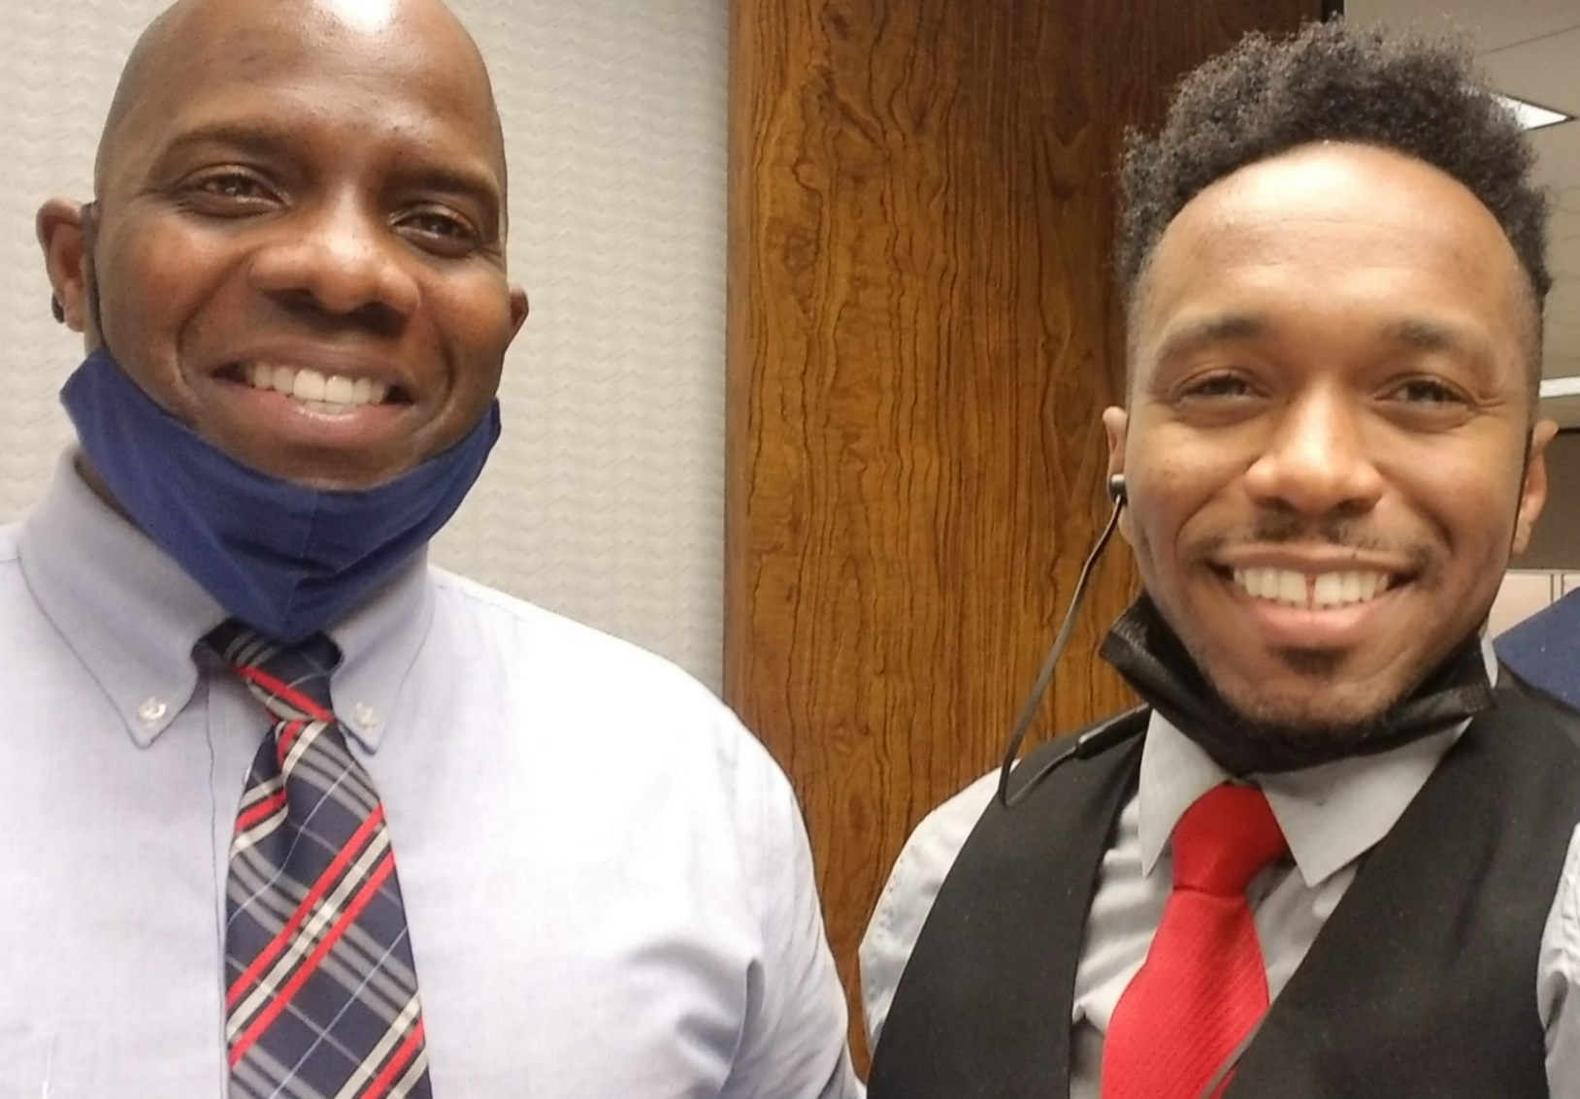
Transitions and New Hires
Loss of 250 Years of agency knowledge and expertise thought retirement since 2019
Michael Clemons
Network Administrator
Jamarcus White
Information Technology Specialist

Slide 10
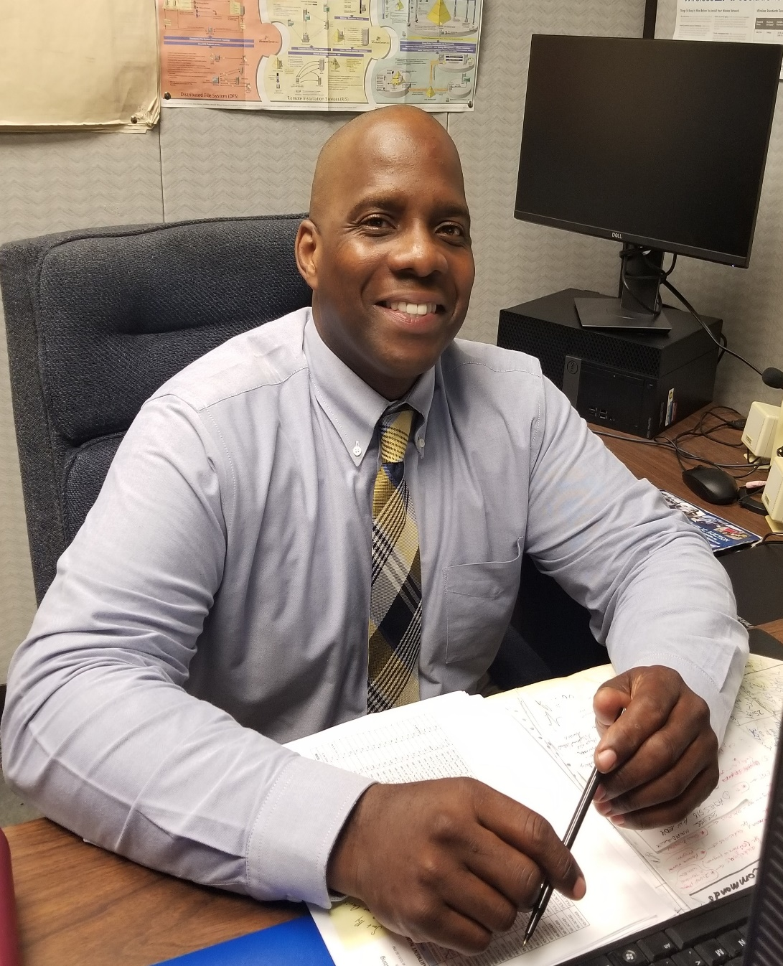
Michael Clemons
Network Administrator

Slide 11
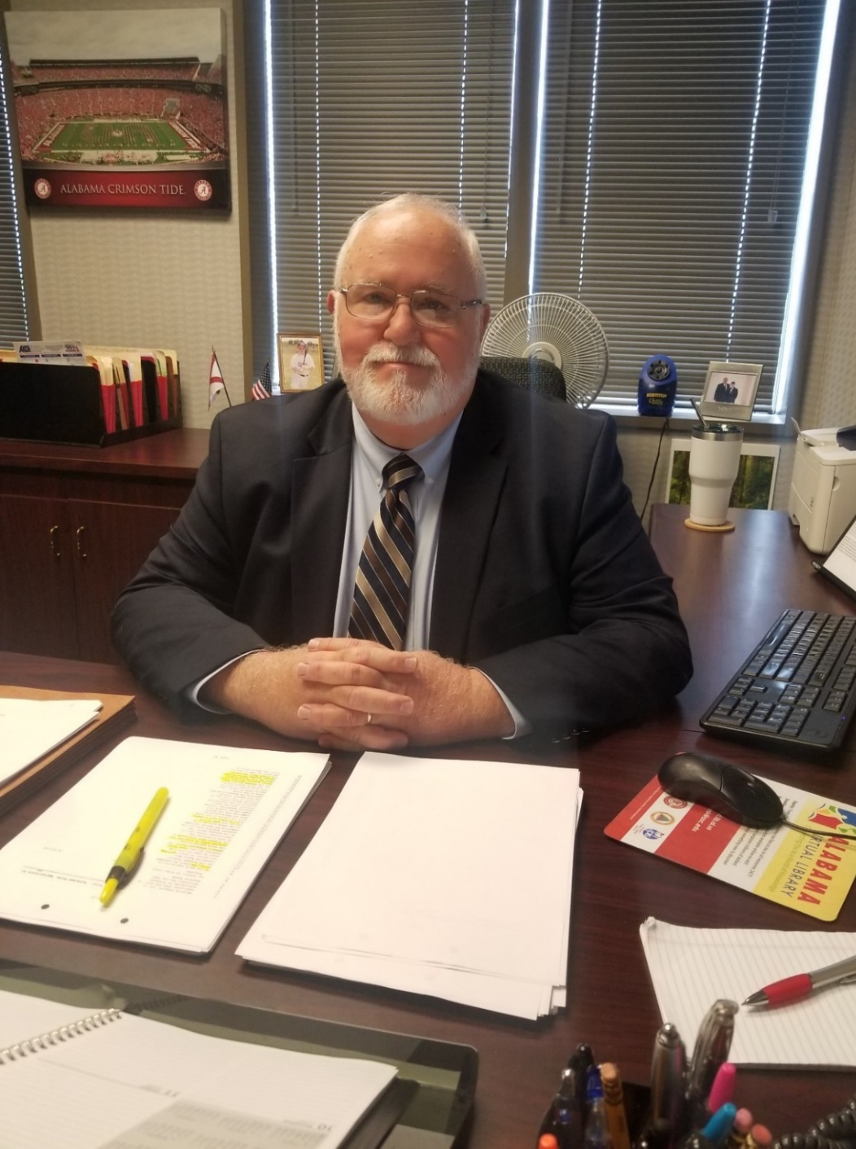
Tim Vick
Director of Operations and Information Services

Slide 12
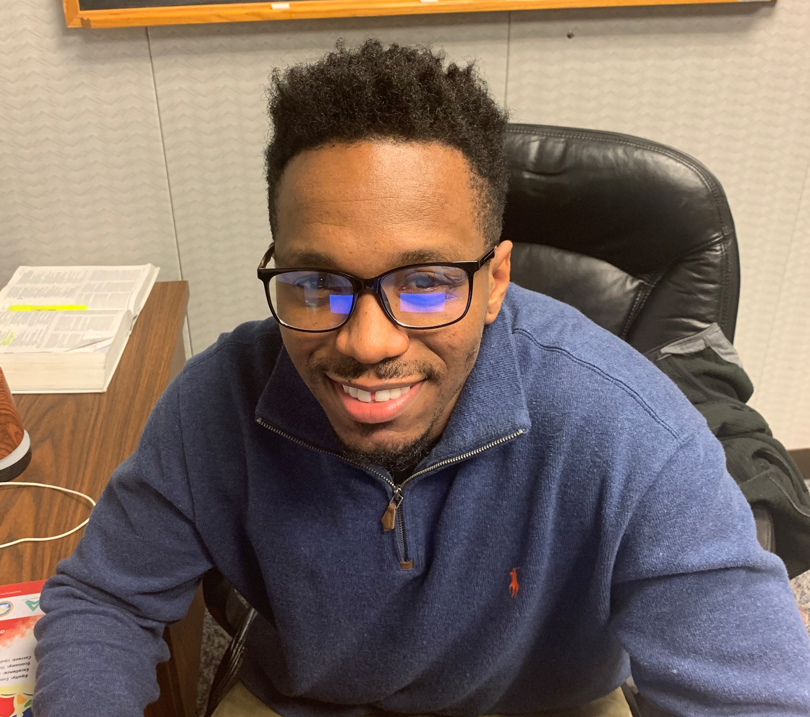
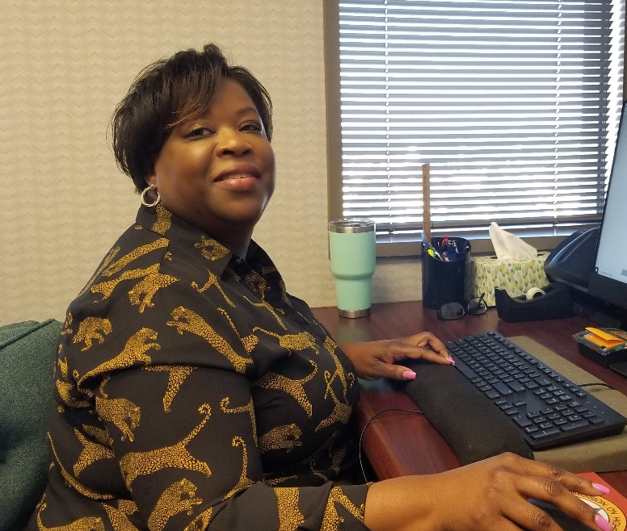
Please welcome
Artcola Pettway
Grants & Scholarship Assistant
Artcola has a undergraduate degree from ASU in Accounting and graduate degree in Public Administration from AUM. Previously Artcola served in the financial aid and bursar’s office at ASU for a total of seven years.

Slide 13
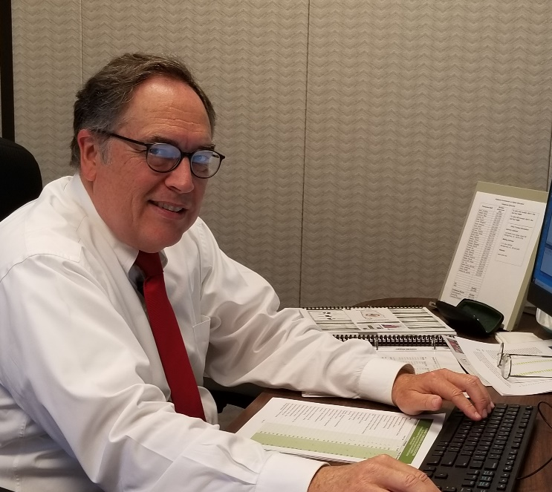
Please welcome
Jason Head
Research Analyst for Research Services
Jason has a undergraduate degree from UA in Finance, and an undergraduate degree in Computer Science and a MBA from UAB. Previously Jason worked in Institutional Research at UAB for 7 years and prior to that worked in IT for Regions Bank and BellSouth.

Slide 14
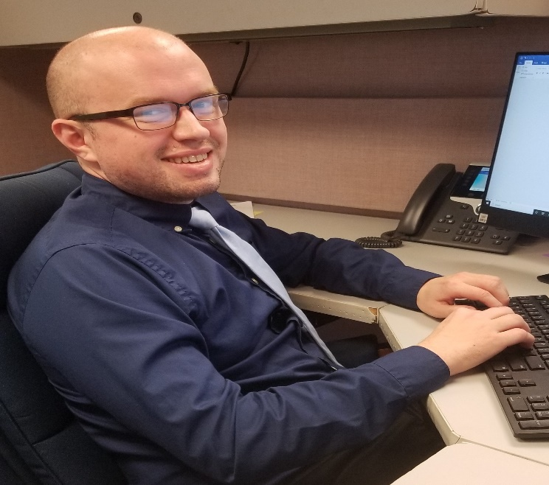
Please welcome
David Caddell
Programmer
David has undergraduate degrees in Journalism from Troy and Computer Information Systems from UAH. David finished up his classes at the end of April and began work at ACHE on May 1.

Slide 15
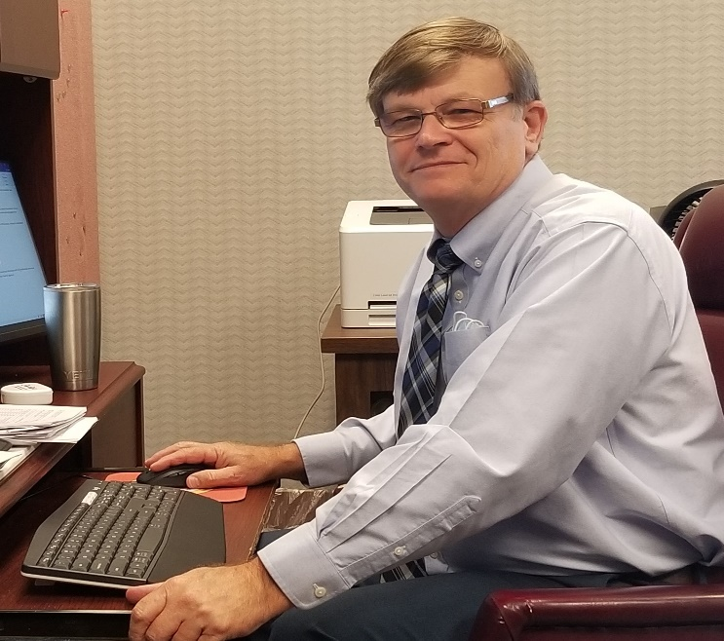
Please welcome
Julian Rogers
Assistant Director of
Institutional Finance and Facilities
Julian has an undergraduate degree in Business Management from AUM. After a career with the US Post Office and serving as the Postmaster in Uniontown, Julian worked in the Executive Budget Office for 7 years where one of his responsibilities was university budgeting.

Slide 16
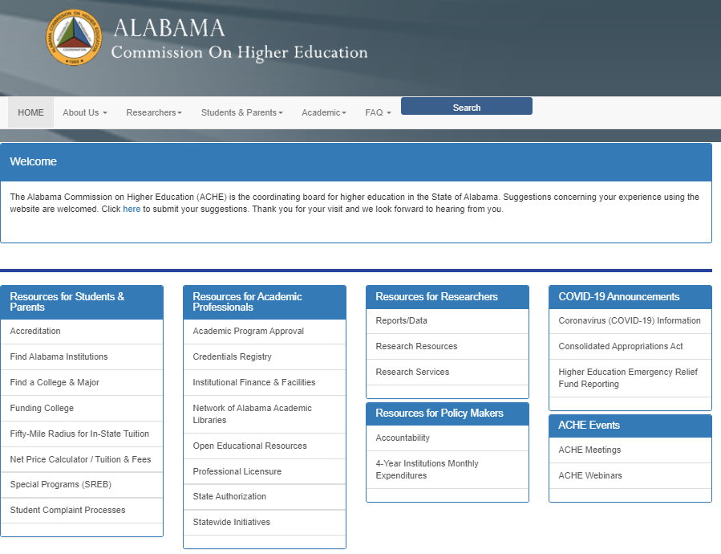
Webinars and Weblinks
https://ache.edu/
Posted on the ACHE Website
Employment Outcomes for Education Majors
Integrating Art into STEM Education
Upcoming Webinar Events
Retain Alabama Survey (June 24th Noon)
Employment Outcomes for Social Work Majors
Educator Attrition Survey

Slide 17

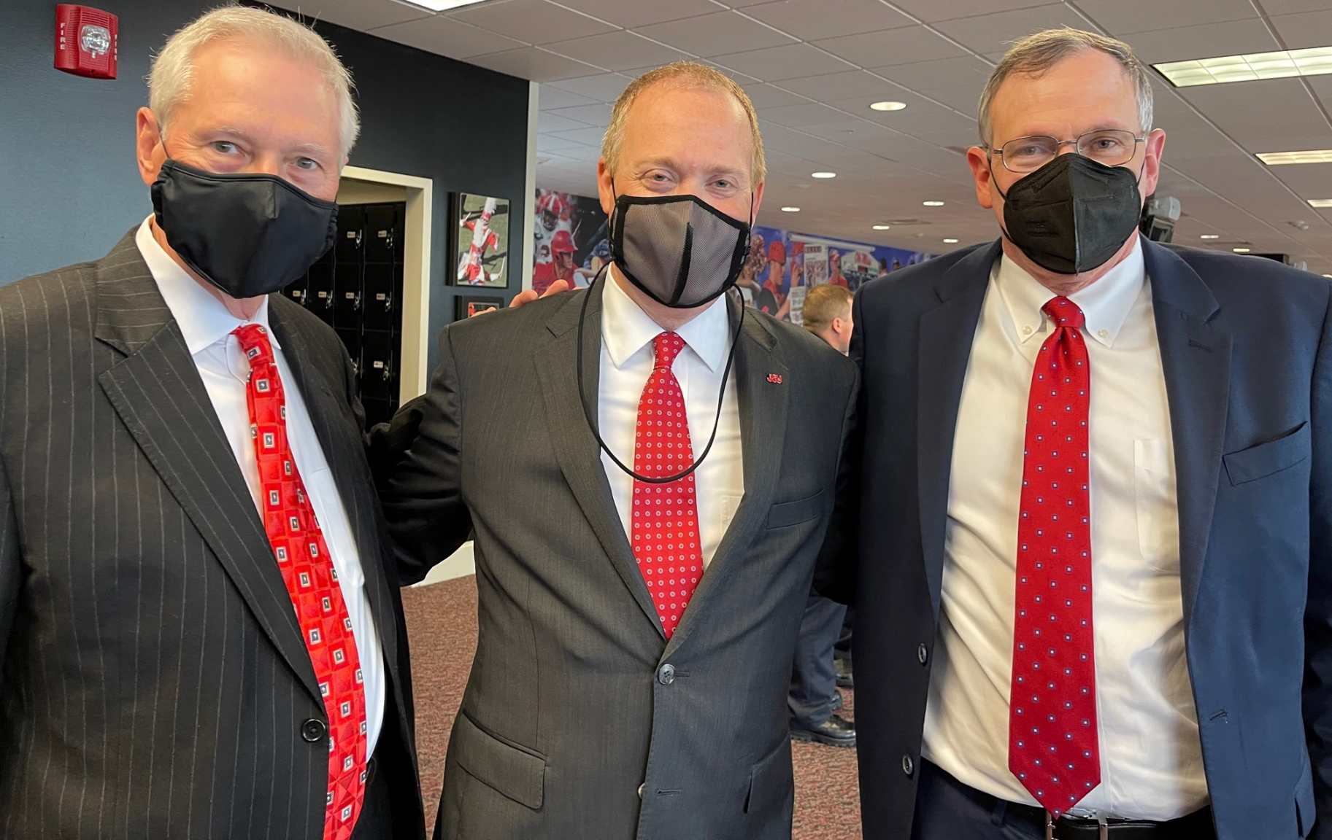
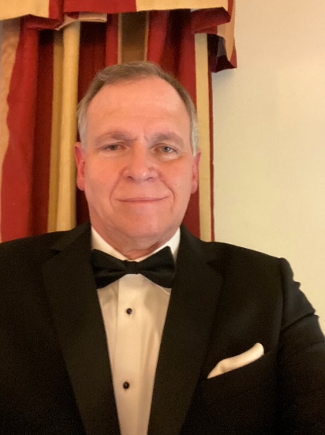
Pics from the Inauguration of Dr. Don C. Killingsworth, Jr. as President of JSU
Commissioner Nelson and Jim Purcell visiting with President Killingsworth

Slide 18
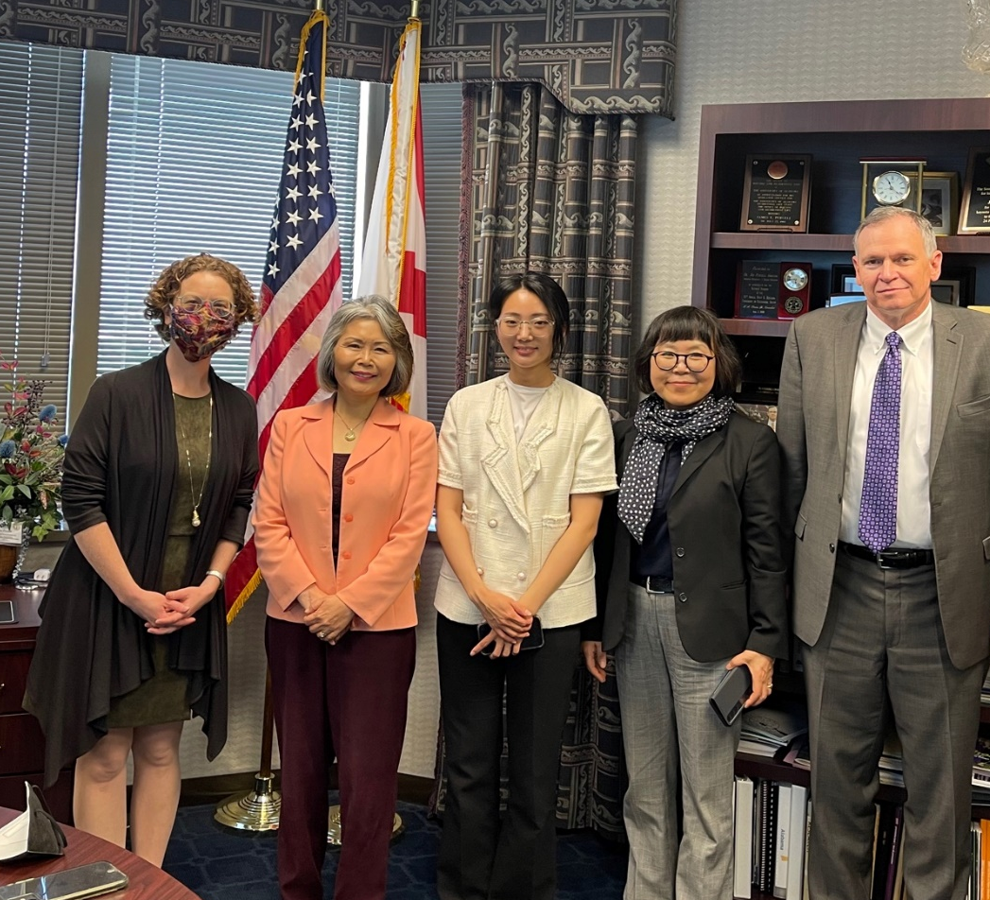


Visit from Dr. HaeAe Seo, Director of GTU (Global Teachers University) Program of Pusan National University (South Korea) regarding AKEEP’s Math and Science teacher initiative.
PNU signed a MOU with the University of North Alabama for a 1+1 M.Ed. program
First students will arrive January 2022.

Slide 19

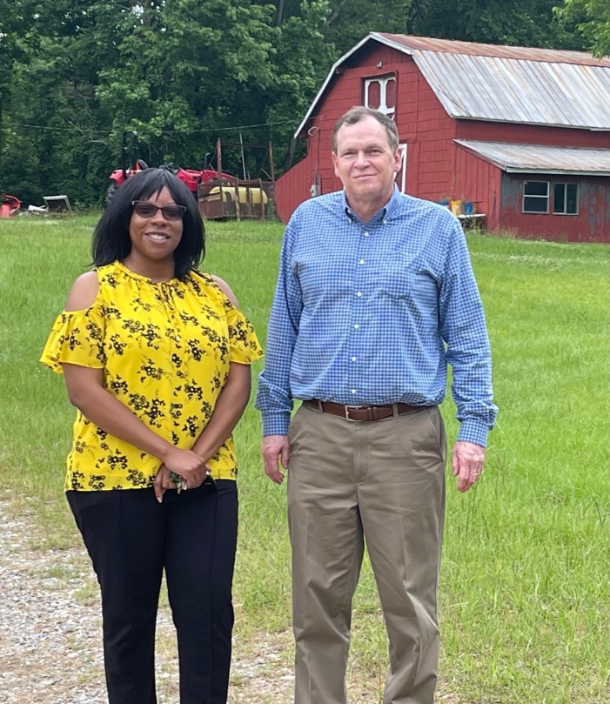
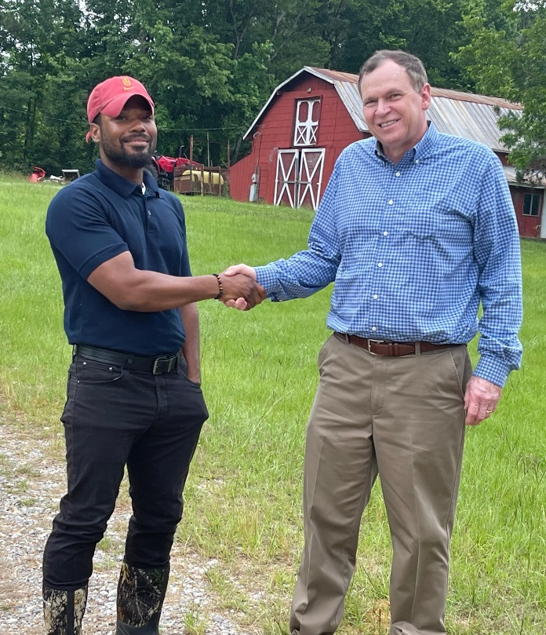
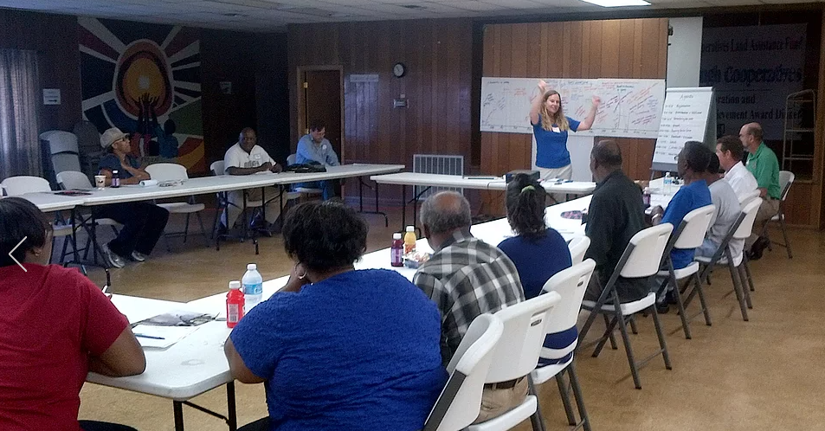
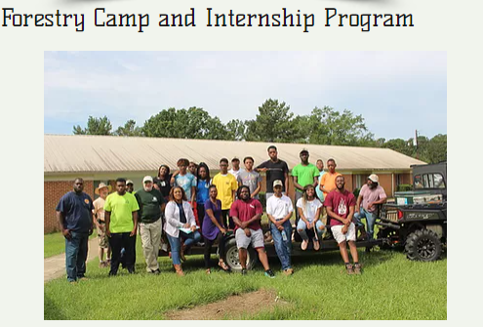
Pamela Madzima, Coordinator of State Association of Cooperatives
Andre Carter, Coop Development Specialist

Slide 20


EDPA President, Greg Barker and Jim Purcell
celebrating Retain Alabama partnership

Slide 21
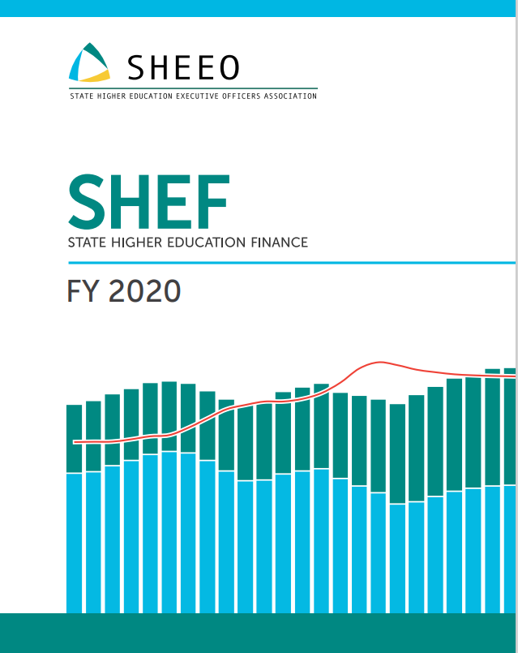

Slide 22
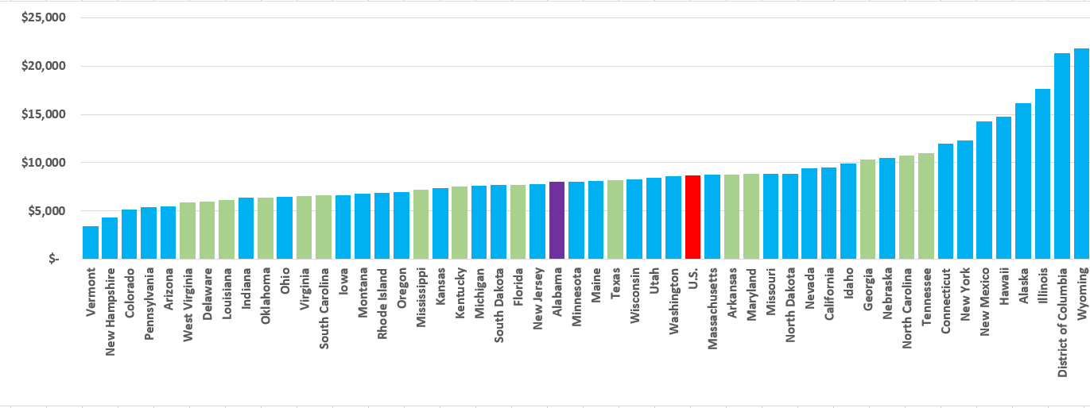
FIGURE 3.2
PUBLIC HIGHER EDUCATION APPROPRIATIONS PER FTE BY STATE, FY 2020 (ADJUSTED)
Alabama appropriates less per FTE than the national average, and less than neighboring states, Georgia and Tennessee, but more than Florida and Mississippi.
Index to U.S. Average
$21,802
0.93
$8,023
$8,636
$3,387

Slide 23
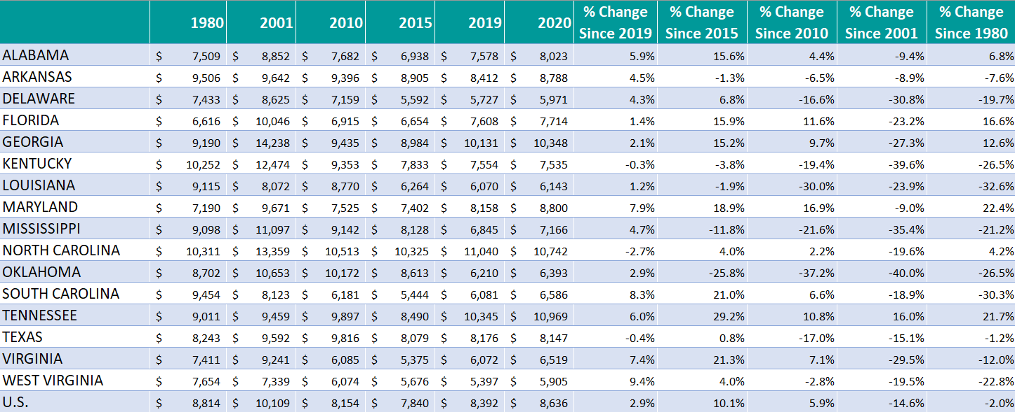
TABLE 3.2
PUBLIC HIGHER EDUCATION APPROPRIATIONS PER FTE BY STATE,
FY 1980-2020 (CONSTANT ADJUSTED DOLLARS)

Slide 24
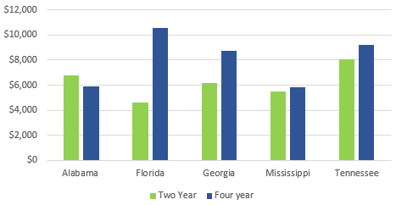
Sector Level Differences in State Appropriations
Education appropriations in Alabama differ by institutional sector:
two–year institutions received $6,773 in education appropriations per FTE in 2020 (83% of the U.S. average)
while four–year institutions received $5,928 (71% of the U.S. average).

Slide 25
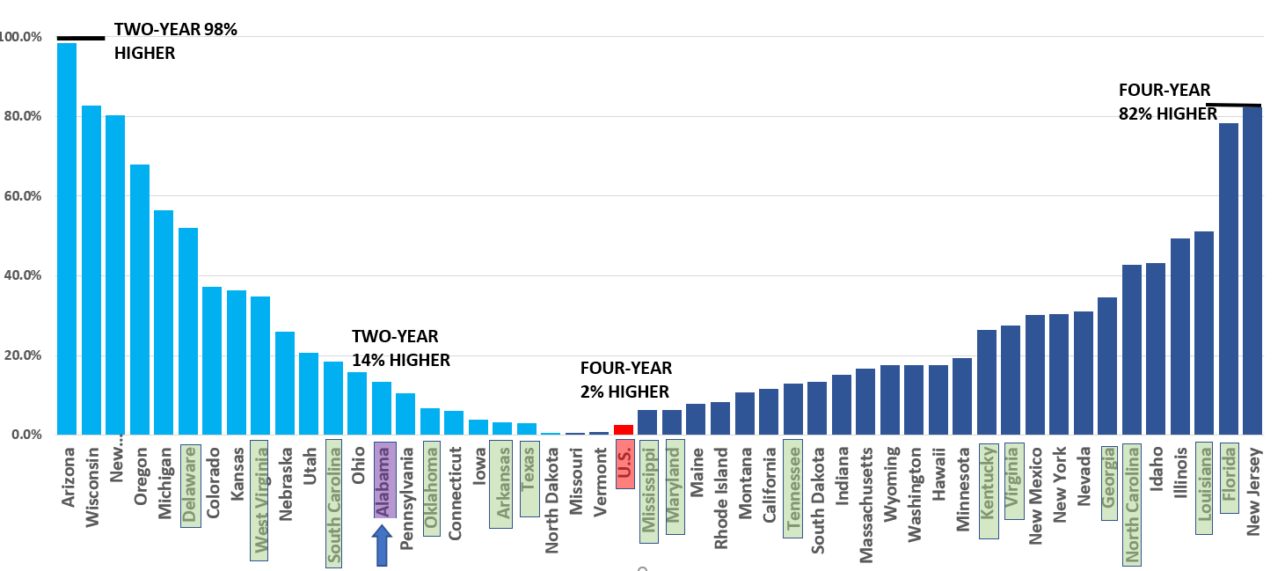

FIGURE 3.2A
PERCENT DIFFERENCE IN TWO-YEAR AND FOUR-YEAR PUBLIC HIGHER EDUCATION APPROPRIATIONS PER FTE BY STATE, FY 2020

Slide 26
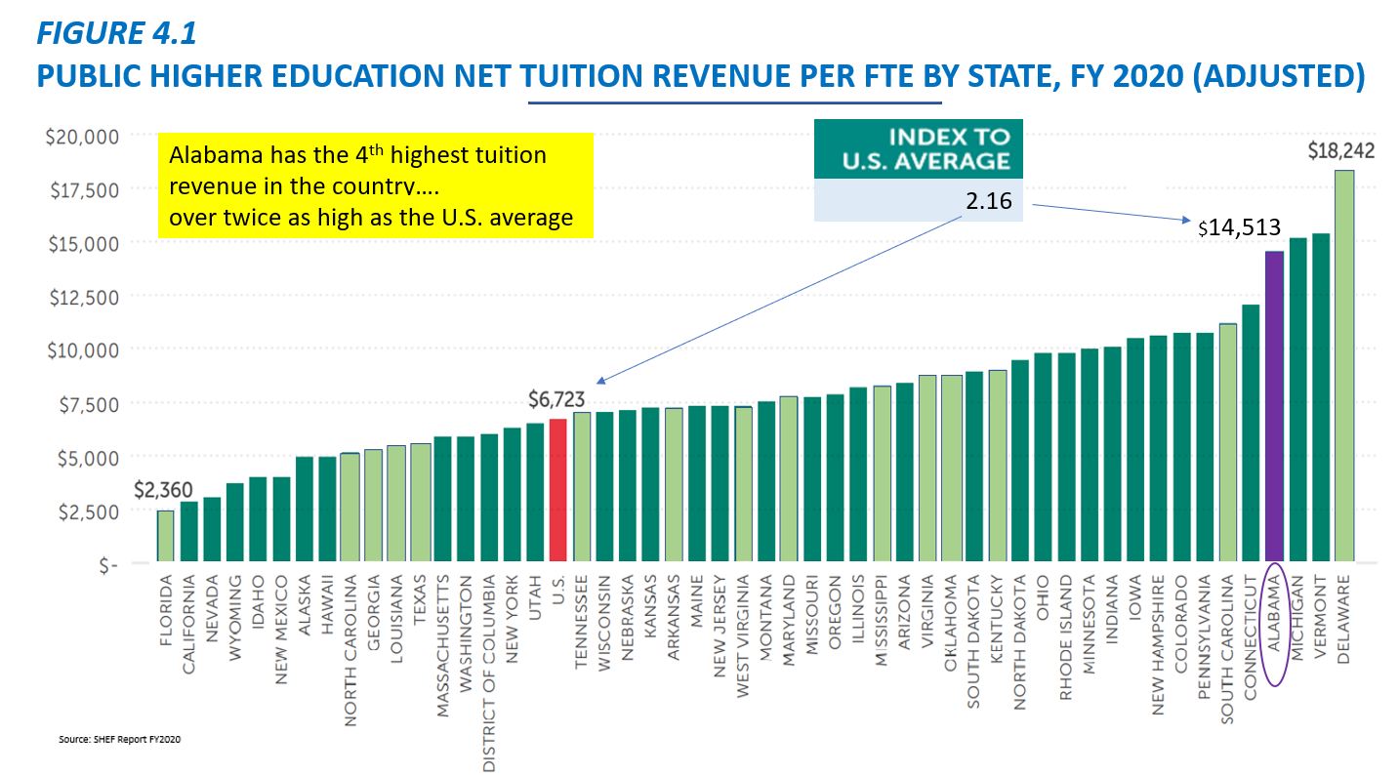

Slide 27
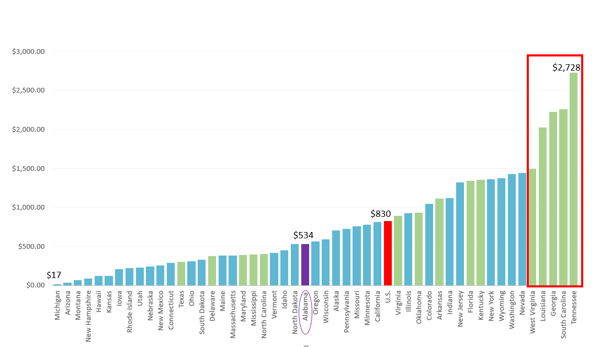

FIGURE 3.3
PUBLIC HIGHER EDUCATION STATE FINANCIAL AID PER FTE BY STATE, FY 2020 (ADJUSTED)
Financial Aid is money for students and not a direct support to students
Alabama has the 4th highest net tuition revenue in the country, but is ranked 26th in financial aid.
In Alabama, the largest financial aid programs are for veterans and their families.
0.64

Slide 28
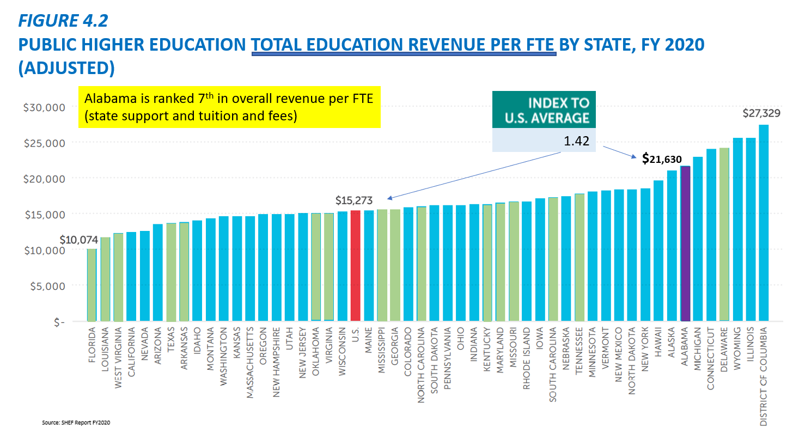

Slide 29
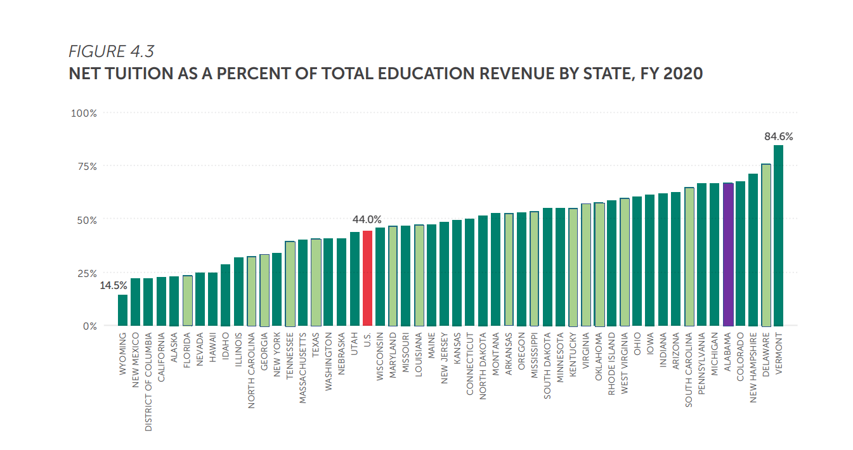

Student Share
FIGURE 4.3
NET TUITION AS A PERCENT OF TOTAL EDUCATION REVENUE BY STATE, FY 2020
With 67.1% of Higher Education’s total revenue being dependent on tuition, Alabama is 50% higher than the national average.
1.52
67.1%

Slide 30
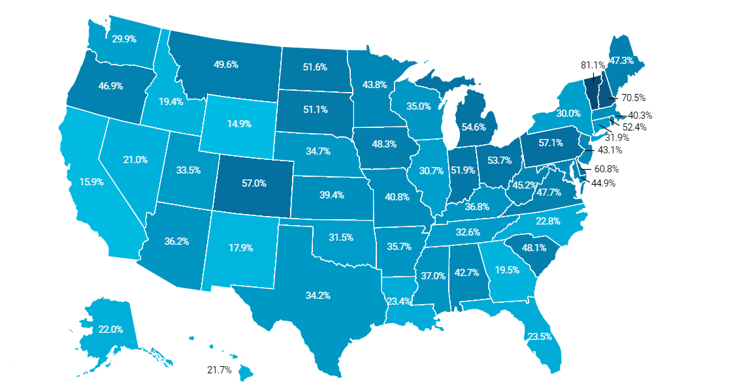
Map of Student Share 2008

Slide 31

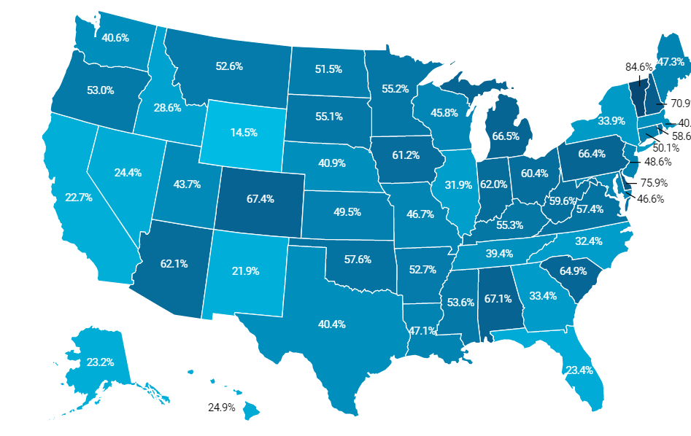
Map of Student Share 2020
Since 2008, Alabama’s student share has increased from 42.7% to 67.1%

Slide 32
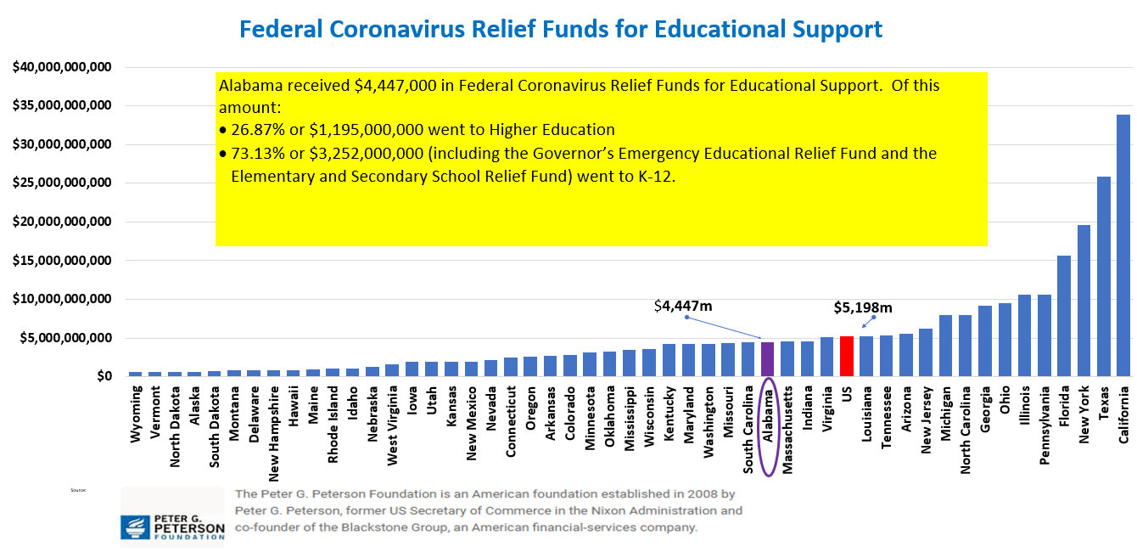
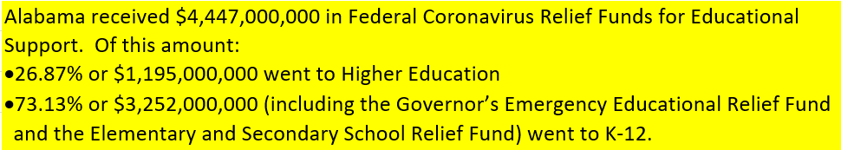

Slide 33
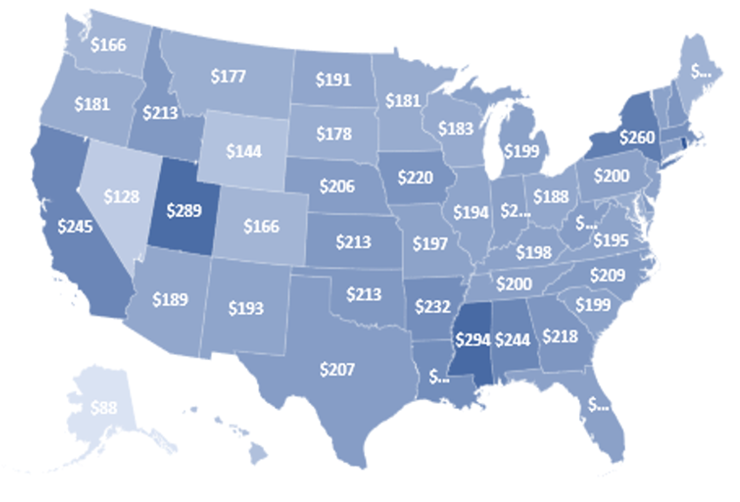

Federal Coronavirus Relief Per Capita Funding for Higher Education
The largest states often received the largest disbursements within each program. However, the amount disbursed per capita can vary by state, with such variances depending on the specific COVID-19 relief program because each one includes a different set of criteria for how the money is allocated.

Slide 34
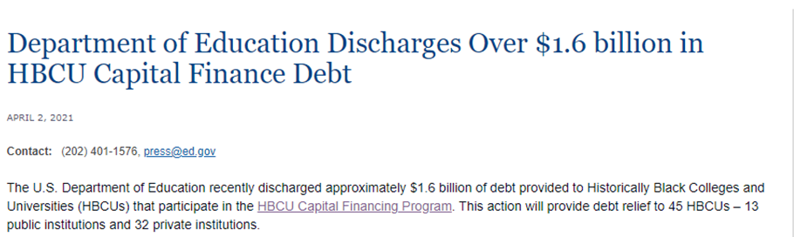
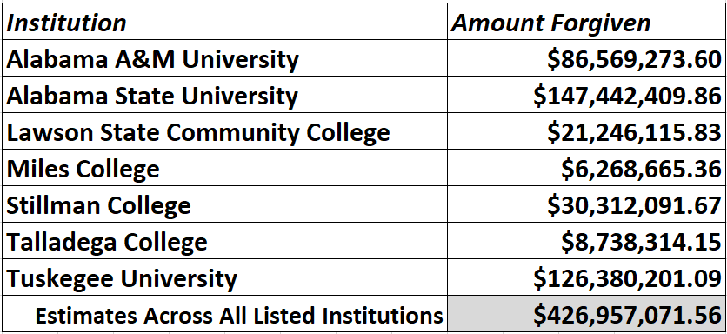
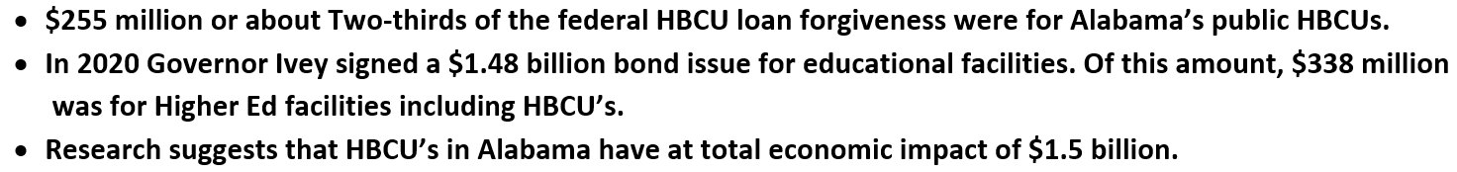
edpolicy. ua.edu

Slide 35

VII. DISCUSSION ITEMS

Slide 36
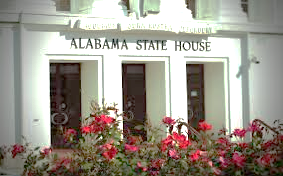
2021 ACHE Legislative Session
Presented by: Mrs. Margaret Gunter

Slide 37

Largest Education Budget in State History
$7.7 Billion
(Act 2021-342)
October 1st - FY 2021-22 education budget takes effect
Alabama Community College System – 9.81% increase
State Universities – appx. 7.18% increase
2% pay raise for teachers and state employees

Slide 38

Paying Down the Cost of College
Alabama Student Assistance Program – 23.39% increase = $7,277,225
Alabama Student Grant Program – 3.87% increase = $7,277,225
Police Officer’s/Firefighter’s Survivor
Educational Assistance Program – 47.25% increase = $ 444,700
Alabama National Guard Educational
Assistance Program – 6.19% increase = $5,212,335
Alabama Math and Science Teacher
Education Program – 3.00% increase = $ 746,750
Birmingham Promise Scholarship $ 750,000
Program –

Slide 39





New Items in ACHE Budget
USS Alabama Battleship - $150,000
Alabama HBCU Consortium - $650,000
Retain Alabama - $800,000
Industry Credential Directory - $100,000

Slide 40



FY 2021-22 Supplemental Budget
$200,000 – Alabama Trails Foundation
$270,000 – Best and Brightest STEM Program
$135,000 – Marengo County
$135,000 – Decatur, Alabama
– $100,000
– $100,000

Slide 41

FY 2021-22 Unexpended Funds
September 30, 2021 deadline
Unexpended funds will be re-appropriated to state agencies and not reverted to state treasury

Slide 42

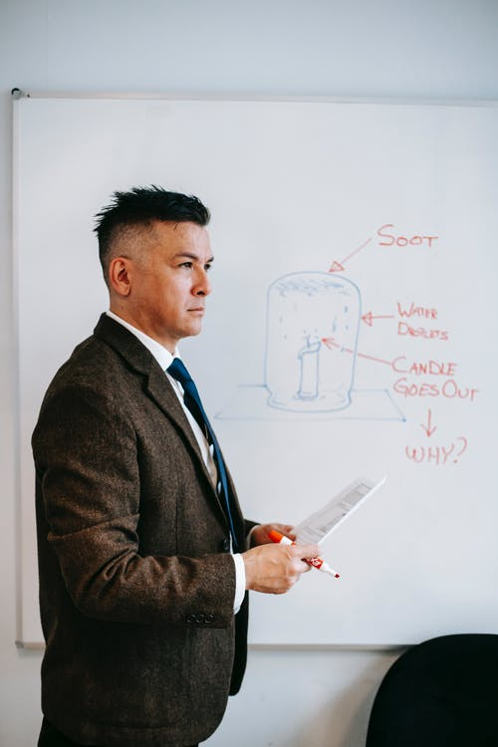
Alabama Math and Science Teacher Education Program (Act 2021-389)
2018 – First AMSTEP bill for math and science teachers
passed
2019 – Computer science teachers were added
2020 – Eligibility requirements for participants
were expanded, but passage was interrupted
by the Covid -19 pandemic
2021 – Bill was signed into law by Gov. Ivey that will
allow more qualifying teachers to participate
in the loan forgiveness program

Slide 43
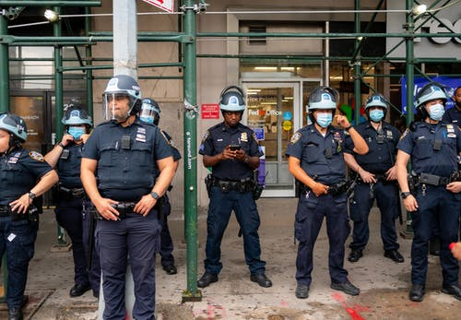

Police Officer’s and Firefighters Survivor
Educational Assistance Program
(Act 2021-425)
Expands the eligibility requirements for the grant program.
Allows a dependent natural child under 21 born after death, or any dependent child under 21 adopted after total disability was declared, to be eligible for the funds that will cover tuition, fees, books and supplies

Slide 44

Alabama Student Grant Program
(Act 2021-442)
Available only to students at an eligible independent Alabama college or university
Cap has been increased from $1,200 per academic year to $3,000

Slide 45
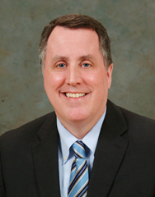
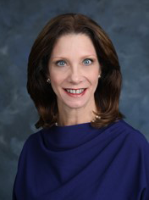
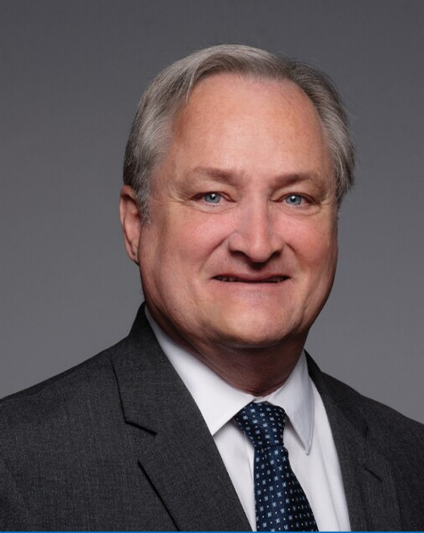
Commissioners Confirmed
Norman Crow
District 7
Ann Forbes Sirmon
District 1
Paul W. Kennedy
District 4

Slide 46



Name, Image and Likeness (NIL) for Student-Athletes
(Act 2021-227)
On April 20th, Alabama became the 10th state to enact name, image, and likeness legislation for student athletes
Takes effect next month, only when the NCAA redefines the types of payments a student can receive while an athlete.
Student-athletes at Alabama colleges and universities will be allowed to receive compensation for their names, images, and likenesses at market value
Establishes an Alabama Collegiate Athletics Commission

Slide 47


Medical Marijuana
(Act 2021-450)
Consortium for Medical Cannabis Research established to award grants for research relating to cannabis and medical cannabis
Membership shall include HudsonAlpha Institute for Biotechnology, Southern Research Institute and public and private four-year colleges and universities within the state
ACHE will appoint designees no later than January 1, 2022

Slide 48



Bills That Did Not Pass
Open Meetings
HB558
Expanded participation by governmental bodies in meetings by electronic communication
Biliteracy
HB498
State Seal of Biliteracy
High school graduates who demonstrated an indicated level of proficiency in English
At least one other world language, including American Sign Language

Slide 49

See You Later
Special Session(s)
Distribution of federal COVID-19 relief funds
Prisons
Gambling
Redistricting of legislative and congressional districts based on new census data

Slide 50

VIII. Decision ITEMS

Slide 51
A. Preliminary Approval of Amendments to the Administrative Procedures for the Alabama Math and Science Teacher Education Program – Loan Repayment Program
Staff Presenter: Tim Vick

Slide 52


Preliminary Approval of Amendments to the Administrative Procedures for the Alabama Math and Science Teacher Education Program –
Loan Repayment Program
During the 2021 Legislative Session, Alabama Act 2021-389 was passed. This Act made several modifications to the AMSTEP program.
Changes were aimed at broadening the eligibility requirements for participants by:
Reducing an applicant’s math, science or computer science teaching load from having to be full-time to 3/4ths of courses taught;
Including middle-level school teachers;
Including individuals teaching in Alabama, but residing in other states;
Including teachers who graduated from a regionally accredited college or university in another state who are certified to teach math, science or computer science in another state, once they are certified to teach in Alabama. These individuals may or may not reside in Alabama;
Allowing individuals issued the Alabama Bachelor’s Level Professional Educator Certificate in math, science or computer science to participate in the program upon completion of alternative certification program (Class B) as outlined in the Code of Alabama, 1975, Section 16-23-3;
Allowing teachers in a school which has been designated as a “failing” school to qualify for supplemental funds that currently are only available to teachers who are employed in the “acute” shortage systems;
Clarifying that teachers in charter schools are eligible, but not for the supplement aimed at acute shortage eligibility.
Also, Sections 300-4-12-.01 through .06 are being repealed. The AMSTEP Scholarship Program is no longer operational, so procedures related to that program are no longer necessary.

Slide 53
B. Preliminary Approval of Amendments to the Administrative Procedures for the Alabama Student Grant Program
Staff Presenter: Tim Vick

Slide 54

Preliminary Approval of Amendments to the Administrative Procedures for the Alabama Student Grant Program
During the 2021 Legislative Session, Alabama Act 2021-442 was passed. This Act made several modifications to the ASGP program. The major changes are:
The annual maximum award was raised from $1,200 to $3,000.
Language was added related to dissemination of information about the program.

Slide 55
C. Preliminary Approval of Amendments to the Administrative Procedures for the Police Officers and Firefighters Survivors Educational Assistance Program
Staff Presenter: Tim Vick

Slide 56



Preliminary Approval of Amendments to the Administrative Procedures for the Police Officers and Firefighters Survivors Educational
Assistance Program
During the 2021 Legislative Session, Alabama Act 2021-425 was passed.
This Act changed the eligibility criteria for natural and adopted dependents under age 21 of police officers, firefighters, volunteer firefighters and rescue squad members who are declared totally disabled.
Another change proposed by staff, creates a new rule that allows the Chairman of the Tuition Eligibility Board to approve or reject an application after the Board has held its annual meeting.

Slide 57
D. Approval of an Amendment to the Administrative Policies for the Alabama Teacher Recruitment Incentive Program
Staff Presenter: Tim Vick

Slide 58

Approval of an Amendment to the Administrative Policies for the Alabama Teacher Recruitment Incentive Program
The Alabama Teacher Recruitment Incentive Program (ATRIP) was created by the legislature by Alabama Act 2007-361. The initial appropriation was $2,725,000. The program eventually was suspended because of lack of funding due to the advent of the Great Recession.
The initial appropriation was sufficient to fund one cohort of recipients (122 recipients). Approximately one-half of the 122 recipients actually made it into the classroom. The rest went into repayment either to ACHE or a collection agency beginning in 2012.
The ATRIP enabling statute did not address the possibility of settlement offers, nor was this potential action addressed in the administrative procedures for the program.
RECOMMENDATION: That the Commission approve an amendment to the ATRIP policy which would allow the Executive Director to accept a settlement offer of 70% on an outstanding balance.

Slide 59

E. Academic Programs
Staff Presenters: Dr. Robin McGill and
Mrs. Kristan White

Slide 60














FOUR-YEAR INSTITUTIONS

Slide 61

Athens State University
Bachelor of Science in Homeland and Corporate
Security (CIP 43.0301)
Labor market analysis for Limestone, Madison, and Morgan Counties, indicates that employment growth in homeland and corporate security related occupations is projected to increase by 14% over the next decade. These projections have also been corroborated by a focus group of regional security professionals, including FBI officials at Redstone Arsenal.
The Academic Program Inventory does not include any other baccalaureate programs at the same level and CIP.
This program will prepare students to sit for professional certifications
offered through the American Society for Industrial Security International
(ASIS) and the Global Society of Homeland Security Professionals (GSHSP).
The proposal includes letters of support from the Madison Police Department, Alabama Pardons and Parole Board, Columbia College at Redstone Arsenal, and Calhoun Community College.
This Photo by Unknown Author is licensed under CC BY-ND

Slide 62
Motion, Decision Item E-1:
That the Commission approve Athens State University’s proposal to offer a Bachelor of Science in Homeland and Corporate Security.

Slide 63


Jacksonville State University
2a. Master of Science in Education in Mathematics
Education Leadership: Mathematics Specialist (K-5) (CIP 13.1399)
The ALSBE has authorized the development of this program based on the need for master’s-level math specialists for grades K-5.
JSU’s math specialist program is patterned after the
reading specialist program that has resulted in improved
literacy skills for Alabama’s elementary students.
This proposal includes letters of support from the following schools and districts: Attala City Schools, Fort Payne City Board of Education, Talladega City Schools, Piedmont City School District, Roanoke City Board of Education, and Anniston Middle School.
This Photo by Unknown Author is licensed under CC BY-ND

Slide 64
Motion, Decision Item E-2a:
That the Commission approve Jacksonville State University’s proposal to offer a Master of Science in Education in Mathematics Education Leadership: Mathematics Specialist (K-5).

Slide 65


Jacksonville State University
2b. Bachelor of Science in Education in Computer Science
Educator (6-12) (CIP 13.1321)
This program will support the State’s strategic goals for STEM education and computer science education and help ensure there is an adequate pipeline of certified computer science educators.
The ALSBE has authorized the development of this program
as the first to prepare candidates for Class B certification
in Computer Science Education.
A survey of administrators in JSU’s service area showed that over 80% of respondents would need to hire at least one computer science educator in the near future. In addition, the proposal includes a letter of support from the Roanoke City Schools attesting to the great need for computer science educators.
This Photo by Unknown Author is licensed under CC BY-ND

Slide 66
Motion, Decision Item E-2b:
That the Commission approve Jacksonville State University’s proposal to offer a Bachelor of Science in Education in Computer Science Educator (6-12).

Slide 67


Jacksonville State University
2c. Bachelor of Science in Education in Middle-Level
General Science (4-8) (CIP 13.1316)
The ALSBE has authorized the development of this program as the first to prepare candidates for Class B Certification in Middle-Level General Science (4-8).
The proposed degree is designed to help address the
ongoing teacher shortage in STEM teaching fields.
The proposal includes seven letters of support from local education agencies attesting to the need for middle-level educators and expressing their interest in partnering on program placements.
67
This Photo by Unknown Author is licensed under CC BY-ND

Slide 68
Motion, Decision Item E-2c:
That the Commission approve Jacksonville State University’s proposal to offer a Bachelor of Science in Education in Middle-Level General Science (4-8).

Slide 69
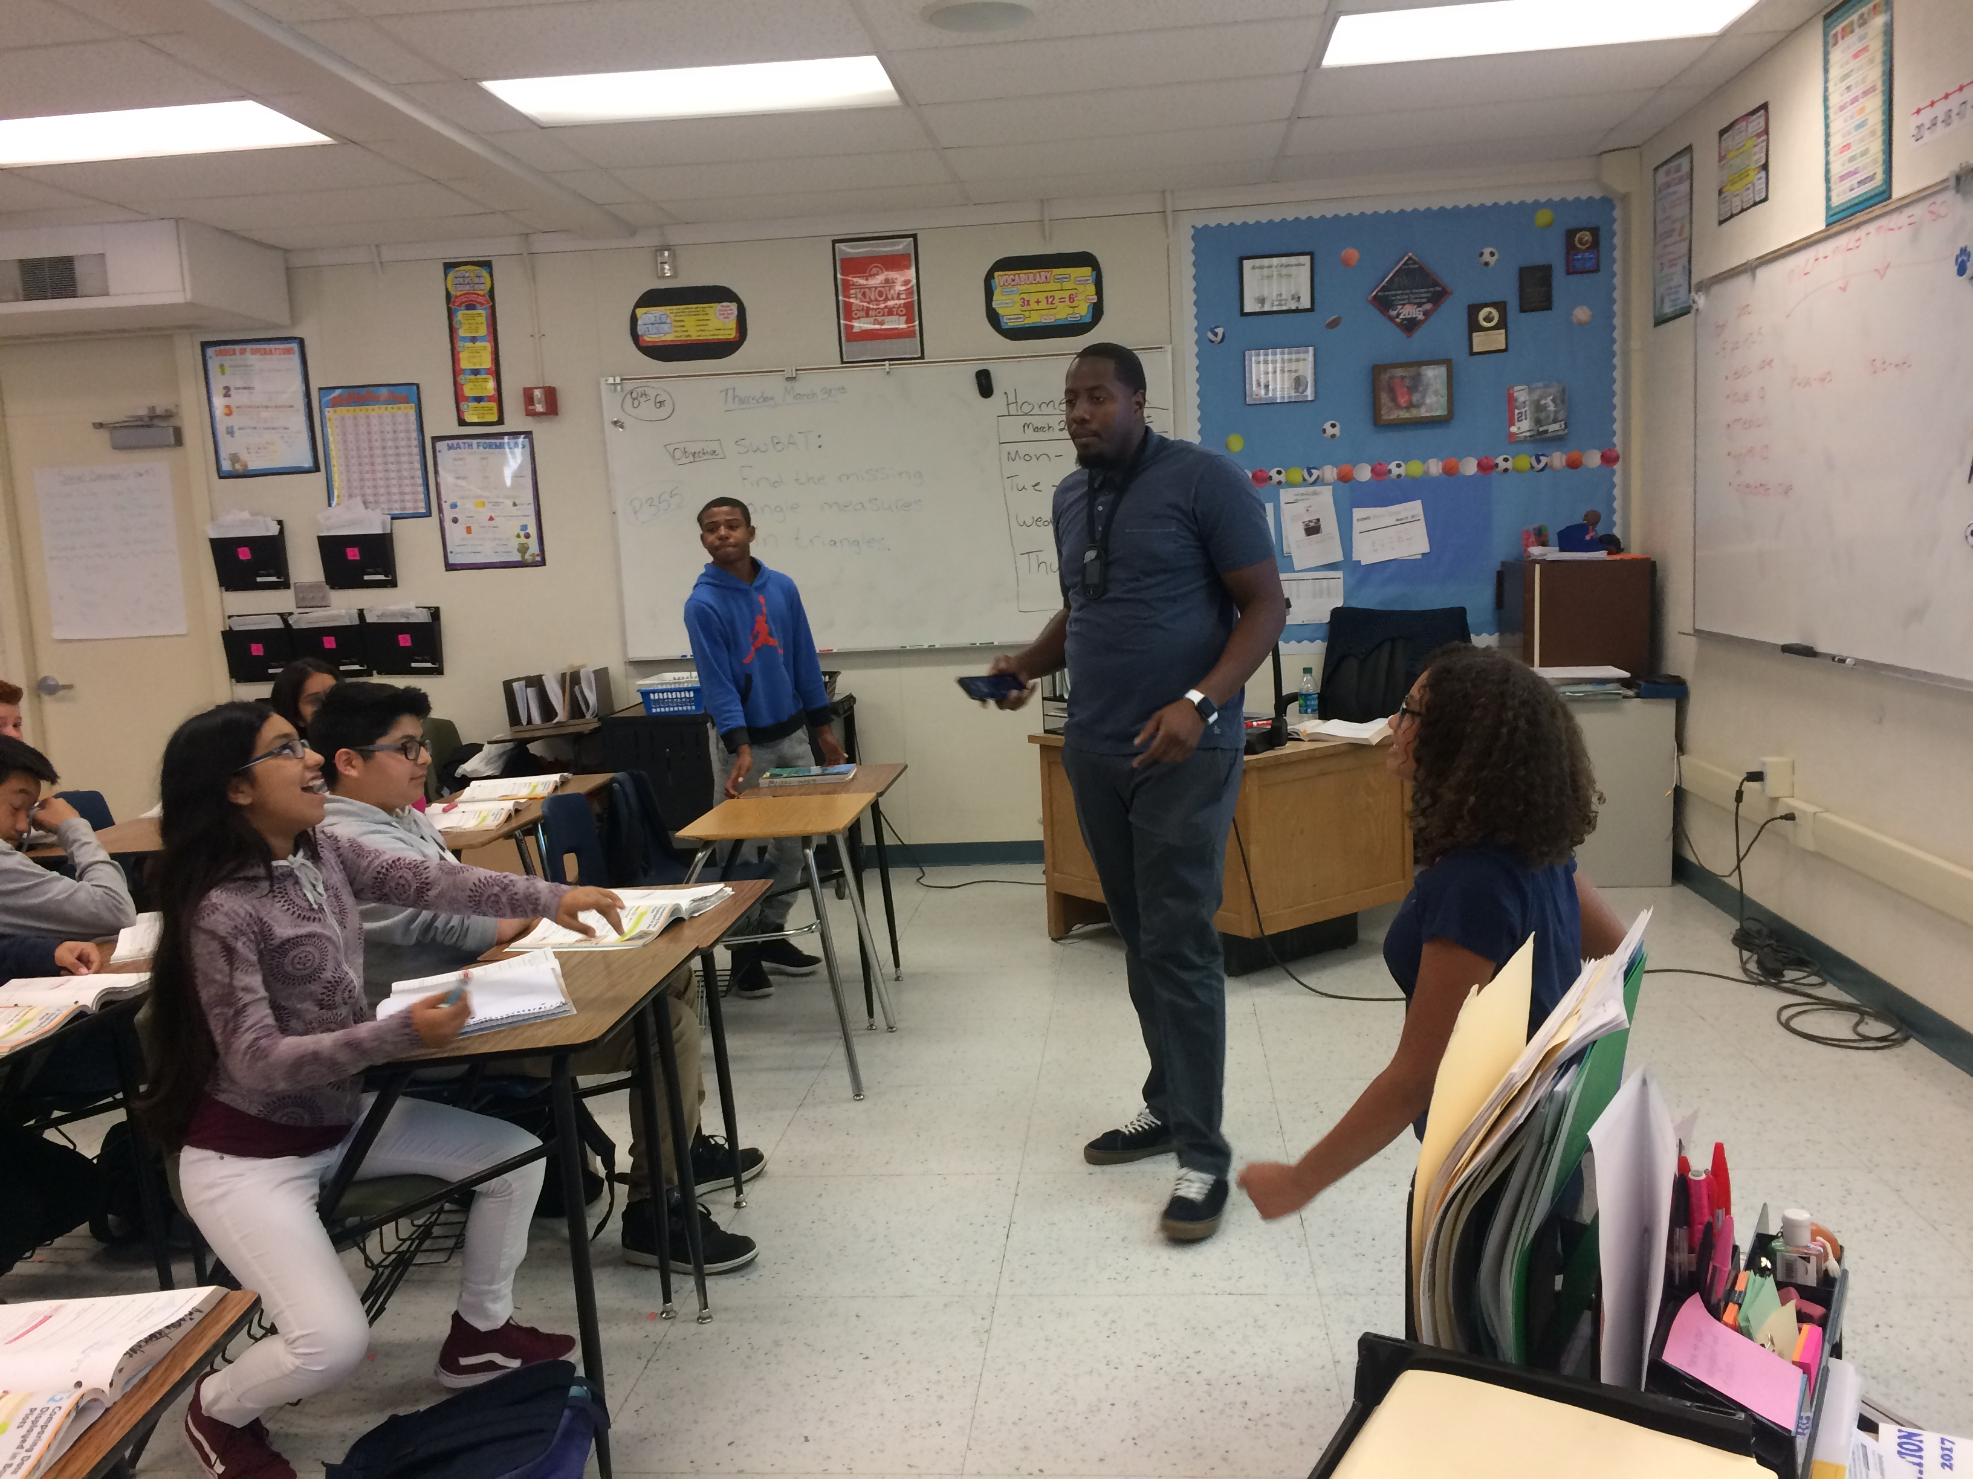
Jacksonville State University
2d. Bachelor of Science in Education in Middle-Level
Mathematics (4-8) (CIP 13.1311)
The ALSBE has authorized the development of this program as the first to prepare candidates for Class B Certification in Middle-Level Mathematics (4-8).
The proposed degree is designed to help address the
ongoing teacher shortage in STEM teaching fields.
The proposal includes seven letters of support from local schools attesting to the need for middle-level educators and expressing their interest in partnering on program placements.

Slide 70
Motion, Decision Item E-2d:
That the Commission approve Jacksonville State University’s proposal to offer a Bachelor of Science in Education in Middle-Level Mathematics (4-8).

Slide 71
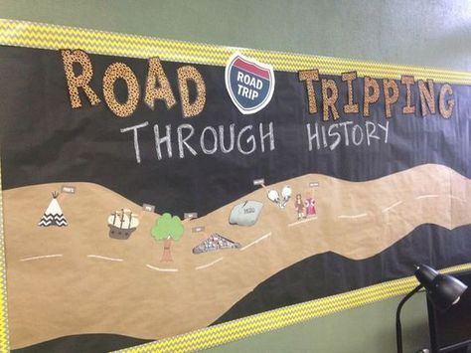
Jacksonville State University
2e. Bachelor of Science in Education in Middle-Level General
Social Studies (4-8) (CIP 13.1318)
The ALSBE has authorized the development of this program as the first to prepare candidates for Class B Certification in Middle-Level General Social Studies (4-8).
The proposed degree will positively impact the
ongoing teacher shortage and public-school
need for middle-level teachers.
The proposal includes seven letters of support from local education agencies attesting to the need for middle-level educators and expressing their interest in partnering on program placements.

Slide 72
Motion, Decision Item E-2e:
That the Commission approve Jacksonville State University’s proposal to offer a Bachelor of Science in Education in Middle-Level General Social Studies (4-8).

Slide 73

Jacksonville State University
2f. Bachelor of Science in Education in Middle-Level English
Language Arts (4-8) (CIP 13.1305)
The ALSBE has authorized the development of this program as the first to prepare candidates for Class B Certification in Middle-Level English Language Arts (4-8).
The proposed degree is designed to help address the
ongoing teacher shortage in Alabama’s public schools,
especially in the middle grades.
The proposal includes seven letters of support from local education agencies attesting to the need for middle-level educators and expressing their interest in partnering on program placements.

Slide 74
Motion, Decision Item E-2f:
That the Commission approve Jacksonville State University’s proposal to offer a Bachelor of Science in Education in Middle-Level English Language Arts (4-8).

Slide 75


University of Alabama
3. Bachelor of Science in Manufacturing Systems
Engineering (CIP 14.3601)
The proposed program is designed to prepare graduates for industrial leadership positions in manufacturing and automotive companies across Alabama, including Mercedes Benz U.S. International, Inc.; Hyundai Motor Manufacturing Alabama; Boeing; Lockheed Martin; Raytheon; and Airbus.
Students will have the option to complete the
degree either in-person or online, which will
enable working students to earn their degree
while remaining employed in industry.
The proposed program is designed to retain engineering majors who are interested in manufacturing and operations management.

Slide 76
Motion, Decision Item E-3:
That the Commission approve The University of Alabama’s proposal to offer a Bachelor of Science in Manufacturing Systems Engineering.

Slide 77


University of Alabama in Huntsville
4a. Doctor of Philosophy in Chemistry (CIP 40.0599)
The UAH PhD in Chemistry (CIP 40.0599) is an innovative research doctorate with three pathways: academic, entrepreneur, and executive. The entrepreneur and executive pathways have been developed to align with the needs of business and industry for advanced professionals in chemicals.
The chemicals industry is Alabama’s second largest,
with over $2 billion in annual exports. There are more
than 200 chemical companies in the state, with at least
30 companies in the vicinity of UAH.
The program proposal includes letters of support from the following partners: Daikin America, CFRDC, Southern Methodist University/NSF, Jacksonville State University, Martin Luther University (Germany), UAH Invention to Innovation Center (12C), Alabama Space Grant Consortium, and the UAH Propulsion Research Center.

Slide 78
Motion, Decision Item E-4a:
That the Commission approve The University of Alabama in Huntsville’s proposal to offer a Doctor of Philosophy in Chemistry.

Slide 79
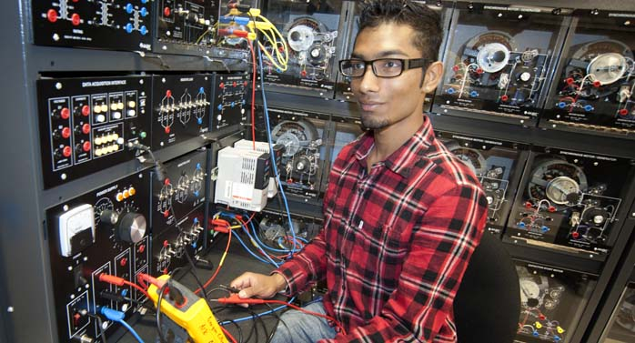
University of Alabama in Huntsville
4b. Bachelor of Science in Engineering Technology
(CIP 15.0000)
BS in Engineering Technology graduates will be employable in a number of areas including field engineer, test engineer, engineering technician, designer, drafter, information technology, and management.
This program will offer a pathway for students that
may be interested in engineering and technology careers but
prefer a more application-based option with lower math and
physics requirements than the typical engineering curriculum.
The program will pursue specialized accreditation through the Engineering Technology Accreditation Commission of the Accreditation Board for Engineering and Technology (ABET), and it has the support of UAH’s College of Engineering.

Slide 80
Motion, Decision Item E-4b:
That the Commission approve The University of Alabama in Huntsville’s proposal to offer a Bachelor of Science in Engineering Technology.

Slide 81
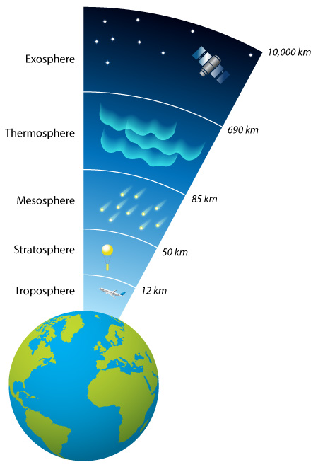
University of Alabama in Huntsville
4c. Master of Science in Atmospheric and Earth Science
(CIP 40.9999) – Substantive Extension/Alteration
Atmospheric Science and Earth Science are housed within the same department at UAH, and the proposal notes that instructional content of both disciplines includes the same physical principles.
The structure of the consolidated program and its concentrations will
not require changes to the essential character or objectives of the
existing programs.
A number of current and former MS students have already pursued
interdisciplinary Atmospheric-Earth Sciences topics, and so the
structure of the consolidated degree is based on existing practice.

Slide 82
Motion, Decision Item E-4c:
That the Commission approve The University of Alabama in Huntsville’s request for substantive modification to its MS in Atmospheric and Earth Science.

Slide 83


University of West Alabama
5. Master of Science in Sport Management (CIP 31.0504)
UWA currently offers graduate coursework in sport management as part of its existing MBA program. The School of Health Sciences and Human Performance has the faculty, facilities and technology in place to support the proposed MS without additional investment.
The proposed program will prepare graduates for employment as coaches/scouts and as marketing managers, both of which appear on the 2021 Statewide In-Demand Occupations List.

Slide 84
Motion, Decision Item E-5:
That the Commission approve The University of West Alabama’s proposal to offer a Master of Science in Sport Management.

Slide 85

























ALABAMA COMMUNITY COLLEGE SYSTEM

Slide 86

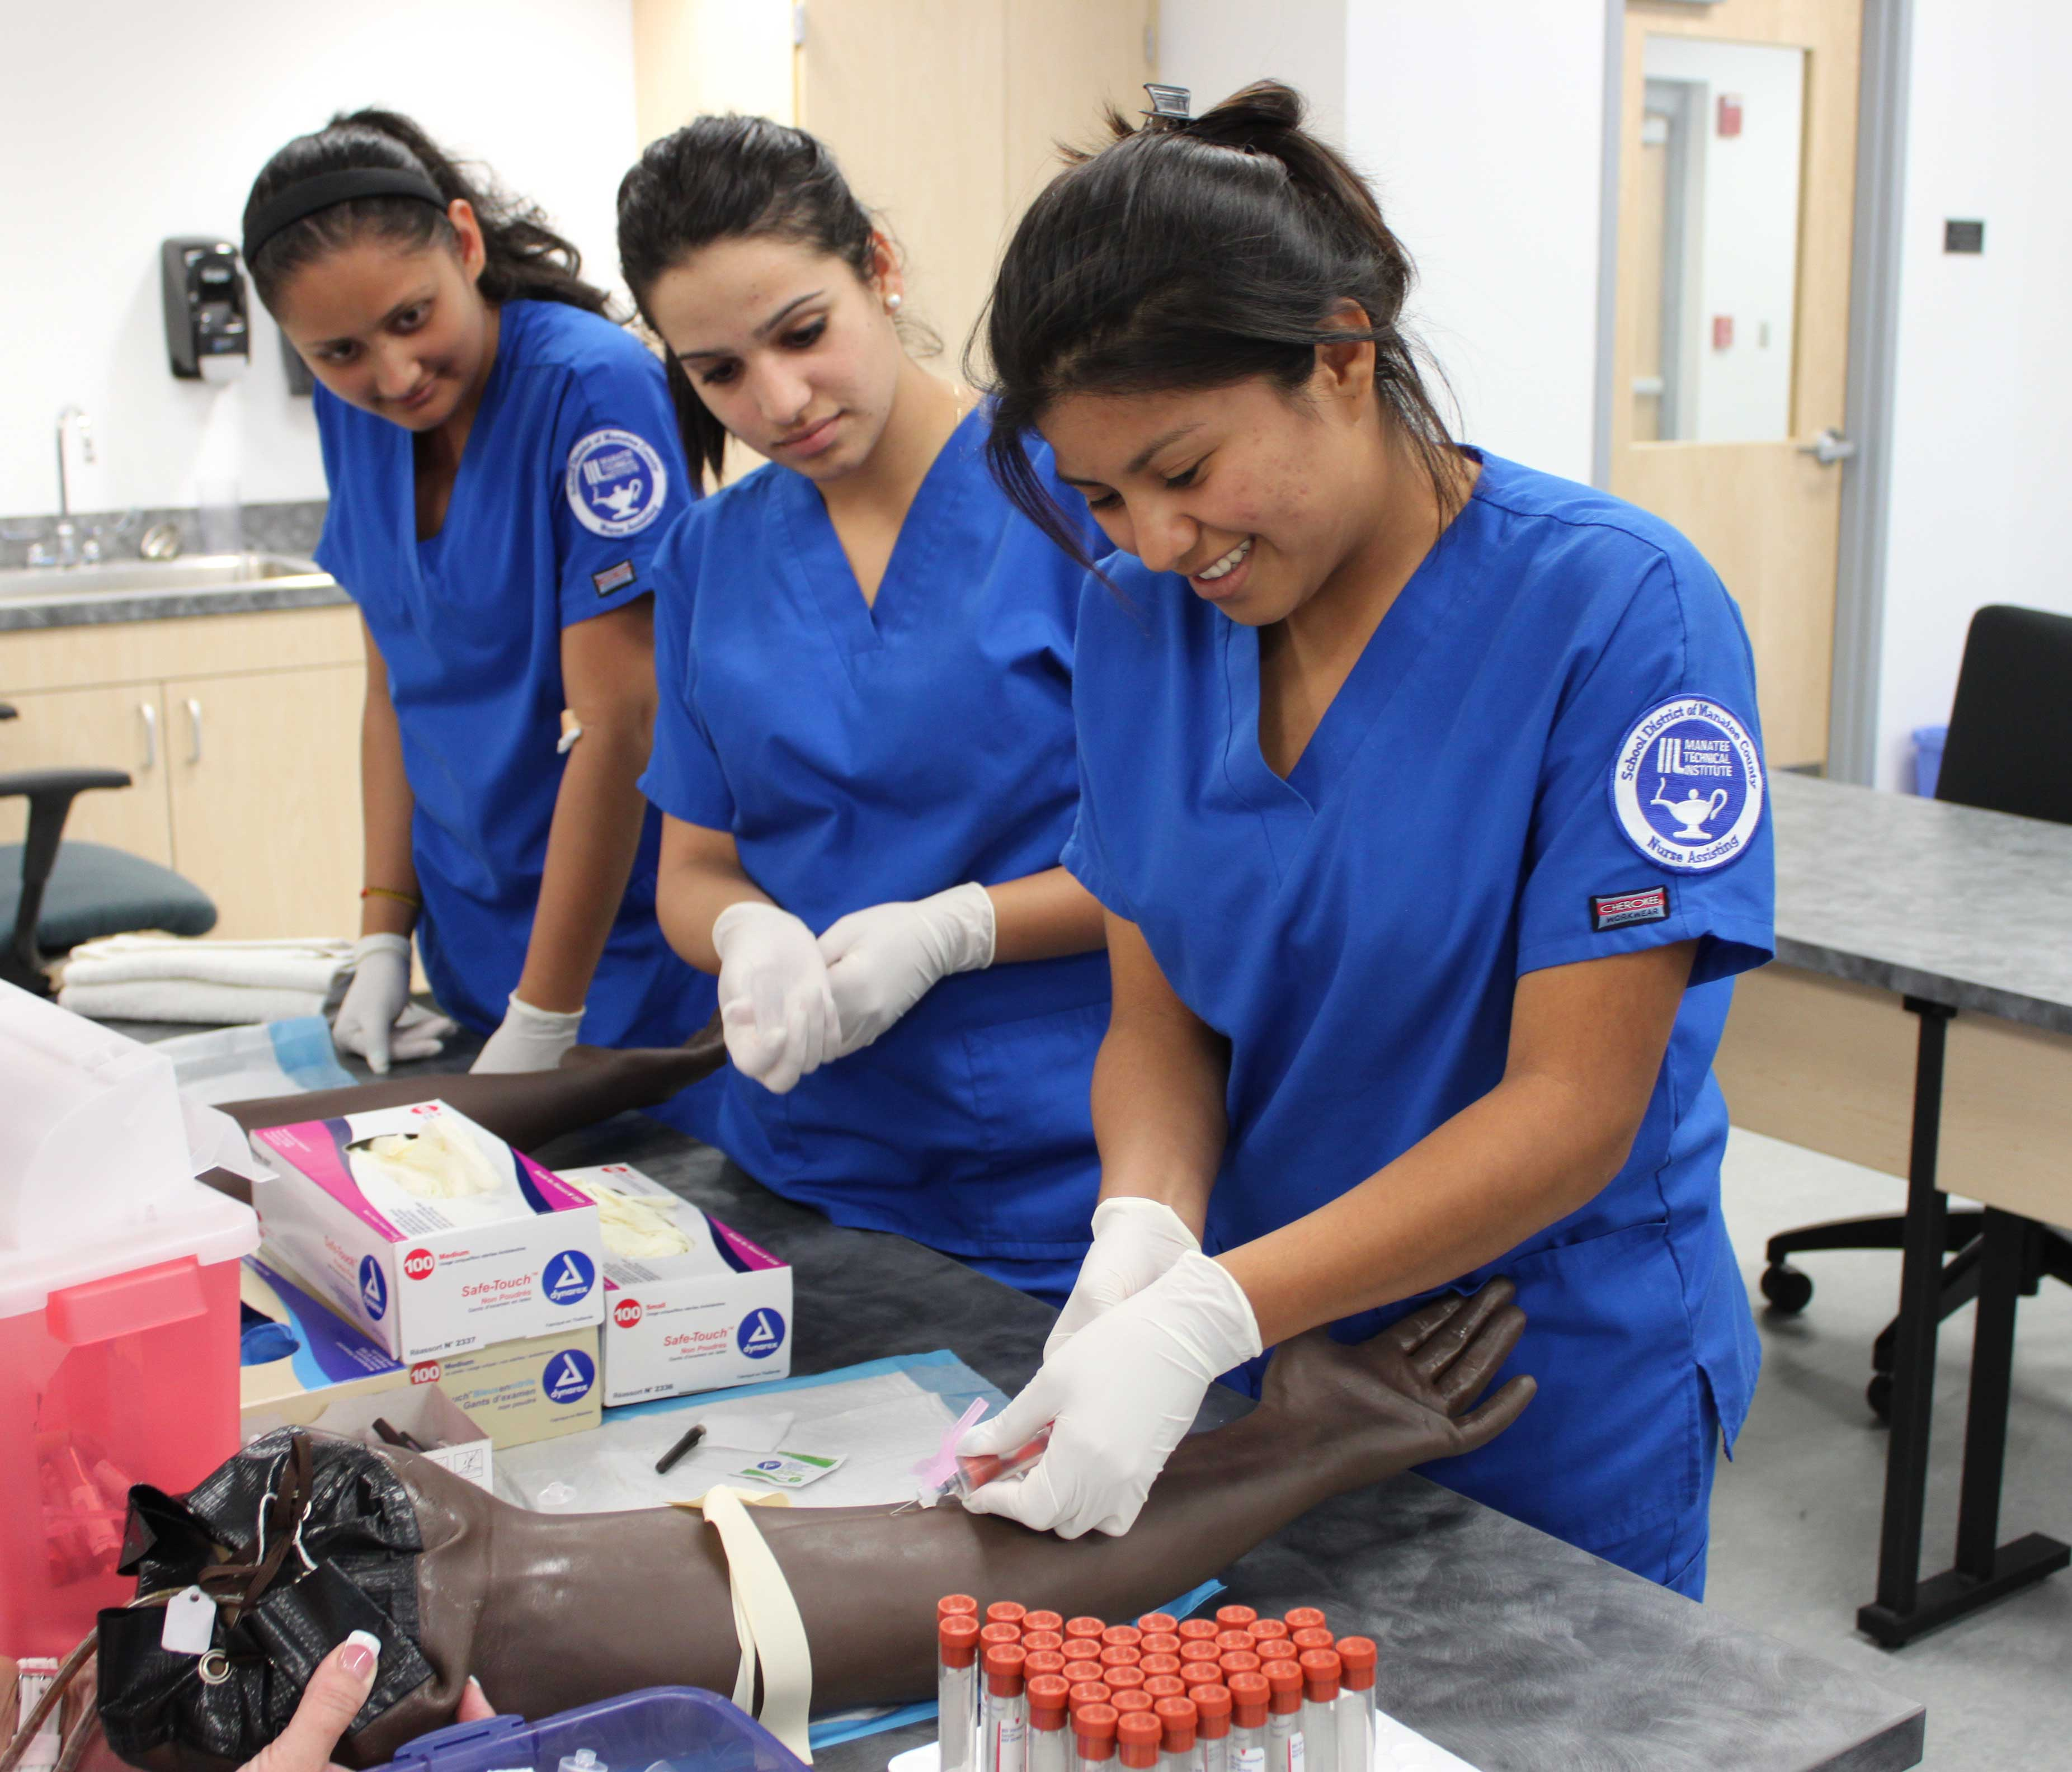
Drake State Community & Technical College
6. Certificate in Patient Care Technician (CIP 51.3902)
This program will help meet industry demand for nursing assistants, which appear on Alabama’s Statewide In-Demand Occupations List.
The proposed program provides an alternative pathway
for students not admitted to DRA’s nursing program.
This proposal includes letters of support from the following
potential clinical site partners and future employers:
Huntsville Hospital, Huntsville Health and Rehab, LLC,
and Central North Alabama Health Services, Inc.

Slide 87
Motion, Decision Item E-6:
That the Commission approve the Drake State & Technical Community College’s proposal to offer a Certificate in Patient Care Technician.

Slide 88


Enterprise State Community College
7. Associate in Applied Science in Digital Arts (CIP 50.0102)
The proposed AAS program will prepare graduates for digital multimedia jobs, including as graphic designers, which are on the 2021 Statewide In-Demand Occupations List.
This proposal includes letters of support from the following potential future employers: WTVY-TV News4, Enterprise Career and Technology Center, and Durden Outdoor Displays, Inc.

Slide 89
Motion, Decision Item E-7:
That the Commission approve the Enterprise State Community College’s proposal to offer an AAS in Digital Arts.

Slide 90


Northeast Alabama Community College
8. Associate of Applied Science and Certificate in Building Construction (CIP 46.0415)
Carpenters, electricians, and plumbers, pipefitters, and steamfitters are included on the 2021 Statewide In-Demand Occupations List, with a projected 4.5% job growth within a 40-mile radius of the college between 2020-2025.
Alabama currently has only one other Building Construction AAS degree at Lawson State Community College. This program will offer additional options in plumbing, electrical, HVAC, and masonry.
This proposal includes eight letters of support from the following
potential work-based learning site partners and future employers:
Lambert Contracting, Earnest Pruett Center of Technology,
Lambert, Inc., Builders Supply Company, Inc., SAM Construction,
P&C Construction, Mr. Rooter Plumbing, and Tolar Construction.

Slide 91
Motion, Decision Item E-8:
That the Commission approve the Northeast Alabama Community College’s proposal to offer an AAS and Certificate in Building Construction.

Slide 92

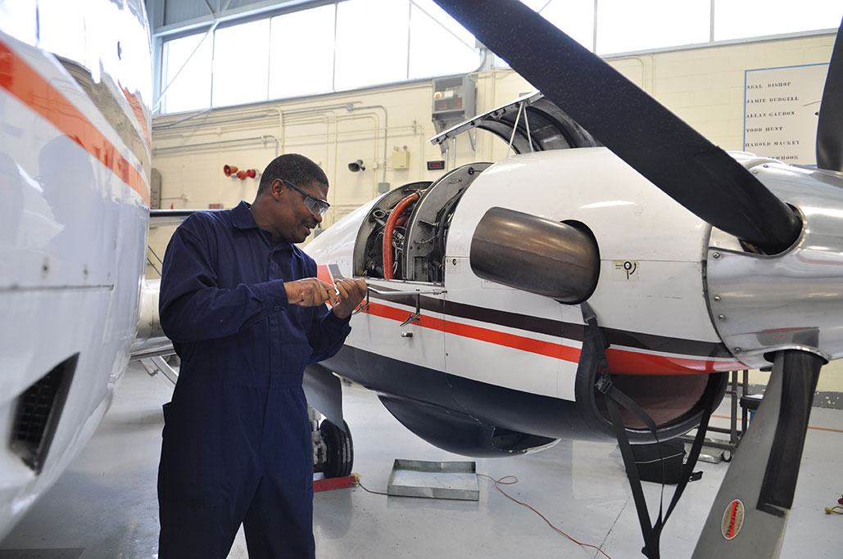
Southern Union State Community College
9. Associate of Applied Science and Certificate in Aviation Maintenance Technology (CIP 47.0607)
The program is designed to prepare graduates for employment as aircraft mechanics and service technicians, which are included on the 2021 Statewide In-Demand Occupations List.
SOU has developed the program in partnership with Auburn University to meet their needs for qualified technicians to support the Auburn University Regional Airport.

Slide 93
Motion, Decision Item E-9:
That the Commission approve the Southern Union State Community College’s proposal to offer an AAS and Certificate in Aviation Maintenance Technology.

Slide 94


Wallace State Community College - Selma
10. Certificate in Heating, Ventilation, Air Conditioning,
and Refrigeration (HVACR) (CIP 47.0201)
The proposed program is intended to prepare graduates for employment as HVACR mechanics and installers, which are included on the 2021 Statewide In-Demand Occupations List.
This program will serve students seeking HVACR
training in the Black Belt region.
This proposal includes two letters of support from potential employers: Gaddy Electric and Plumbing, and Anderson Plumbing, Heating and Electric.

Slide 95
Motion, Decision Item E-10:
That the Commission approve the Wallace State Community College - Selma’s proposal to offer a Certificate in Heating, Ventilation, Air Conditioning, and Refrigeration (HVACR).

Slide 96
Request to Amend Post-Implementation Conditions
11a. Alabama State University MA in History (CIP 54.0101)
The program did not meet the enrollment condition, nor did it meet the minimum graduate requirement of 3.75 annual graduates on average.
ASU has requested an extension to produce an average number of graduates at or above the state required minimum of 3.75. ASU projects dramatic enrollment growth in the program, driven by the addition of a new concentration in public history, partnerships with prominent public history organizations in the Montgomery area, and the addition of a fully online version of the curriculum.
MA in History (54.0101) | Avg New Enrollments | Average Graduates
Required | 4 | 3.75
Reported | 1 | 1

Slide 97
Motion, Decision Item E-11a:
That the Commission approve Alabama State University’s request to amend post-implementation conditions for the Master of Arts in History.

Slide 98
Request to Amend Post-Implementation Conditions
11b. University of North Alabama, BS in Geographic Information Science (CIP 45.0702)
The program did not meet the condition for average new enrollments, even with a 25% reduction from the proposed number as allowed by ACHE policy.
UNA has requested that the original post-implementation condition be modified to reflect the actual enrollment achieved over the first five years and that the BS in GIS be deemed a viable program going forward. ACHE staff is recommending approval of the request based on the following rationale:
  The program has demonstrated its viability by
  producing well over the required minimum of
  graduates per year.
  Except for the first year the program was launched,
  new enrollments have continued to exceed 7.5
  Students per year, indicating that there is a
  sustainable pipeline of students.
BS in Geographic Information Science (45.0702) | Avg New Enrollments | Average Graduates
Required | 26 (19.5 w/ 25% reduction) | 7.5
Reported | 14.25 | 13.25

Slide 99
Motion, Decision Item E-11b:
That the Commission approve The University of North Alabama’s request to amend post-implementation conditions for the Bachelor of Science in Geographic Information Science.

Slide 100
Troy University
12. Consolidated Program Inventory
In June 2005, the Commission approved the administrative and institutional consolidation of Troy State University, Troy State University Montgomery, and Troy State University Dothan to form a single institution, Troy University, with instructional sites in Troy, Phenix City, Montgomery, and Dothan.
Troy has requested that its program listings in the Academic Program Inventory be revised to reflect a unified set of programs, with updated program titles and CIP codes where appropriate. Site approval information will be retained in ACHE’s database, but not in the program title.

Slide 101
Motion, Decision Item E-12:
That the Commission approve Troy University’s proposal to consolidate their program inventory.

Slide 102

F. INFORMATION ITEMS
1. Implementation of Distance Education Programs
Implementation of New Short Certificate Programs (Less than 30 Semester Hours)
Changes to the Academic Program Inventory
Non-Substantive Extensions/Alterations to Existing Programs of Instruction
University of South Alabama, New Exempt Off-Campus Site: Theodore High School, Theodore, AL
Updates to Units of Instruction, Research, Public Service, and Administration
Implementation of Non-Degree Programs at Senior Institutions
Summary of Post-Implementation Reports

Slide 103
6. Summary of Post-Implementation Reports
Programs that met post-implementation conditions
Snead State Community College: AAS in Industrial Technician (Industrial Systems Technology) (CIP 47.0303)
University of Alabama in Huntsville: MA in Teaching (CIP 13.1205)
University of North Alabama: BA in Spanish (CIP 16.0905)

Slide 104
6. Summary of Post-Implementation Reports
b. Programs that did not meet post-implementation conditions
Alabama State University: MA in History (CIP 54.0101) – Extension requested
University of North Alabama: BS in Geographic Information Science (GIS) (CIP 45.0702) – Modification Requested

Slide 105
Motion, Decision Item F:
That the Commission accept the information items as presented.

Slide 106
G. ADJOURNMENT

