Slide 1

Alabama Commission on Higher Education
Commission Meeting
September 10, 2021

Slide 2


CALL TO ORDER, PRAYER, AND PLEDGE OF ALLEGIANCE

Slide 3

II. ROLL CALL and
QUORUM DETERMINATION

Slide 4

III. APPROVAL OF AGENDA
Commission Meeting Agenda of
September 10, 2021

Slide 5

IV. CONSIDERATION OF MINUTES
Commission Meeting Minutes of June 11, 2021

Slide 6

V. CHAIRMAN’S REPORT

Slide 7

VI. ELECTION OF OFFICERS

Slide 8

VII. EXECUTIVE DIRECTOR’S REPORT

Slide 9
New ACHE Staff Members

Slide 10
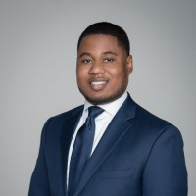
Dr. Nicholas Bolden, Visiting Associate Director for Organizational Development
Nicholas Bolden has an undergraduate degree from Auburn University in Political Science, an MPA from Troy University, and a Doctorate from Auburn University in Public Administration and Policy. He is a tenured professor at Columbus State University (Georgia) in the Politics, Philosophy, and Public Administration Department and recently served as a program evaluator for the Alabama Department of Commerce (AIDT) to determine the effectiveness of work-based learning experiences in Alabama.
Nicholas was hired this summer to assist the Alabama HBCU Consortium in writing a grant and evaluating the professional development needs of member institutions. He will continue to work for ACHE on a part-time basis to develop strategic plans for several new initiatives. He is from Mt. Vernon, Alabama and currently resides in Columbus, Georgia.

Slide 11
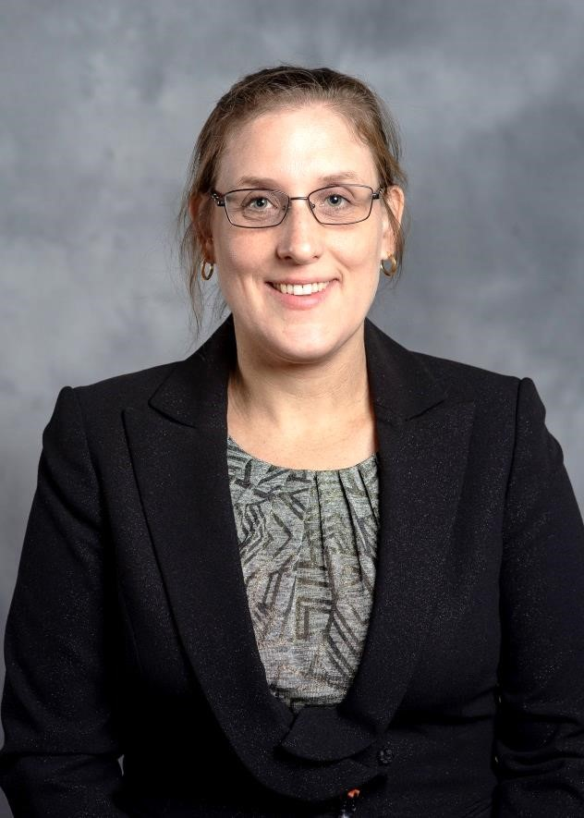
Bryn Bakoyéma, Visiting Research Associate
Bryn Bakoyéma earned bachelor’s degrees from North Carolina State University in Agronomy and Multidisciplinary Studies, and a master’s degree from Indiana University in Cultural Anthropology. She is currently a PhD student in Educational Leadership, Policy, and Law at Alabama State University while serving full-time as the Director of Institutional Research at ASU.
Her expertise is in statistical analysis. Two of her projects “Exploring Career Choices for Education Bachelor’s Graduates” and “Assessing Student Intentions to Remain In-State Post Graduation” will be presented at the Southern Association of Institutional Research conference in October. Bryn is originally from North Carolina and currently resides in Montgomery.

Slide 12
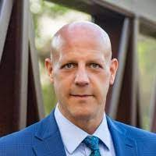
Dr. Patrick Kelly, Visiting Research Officer
Patrick Kelly has an undergraduate degree from UAB and a master’s degree and PhD from the University of Louisville. He previously served as the Vice President for the National Center for the Management of Higher Education Systems for 17 years. Prior to that he worked for the Kentucky Council on Postsecondary Education as the Senior Associate Director for Information and Research. Dr. Kelly’s expertise in data analytics, especially in the areas of education and the economy, align well with several ACHE initiatives. Patrick is from Trussville.

Slide 13
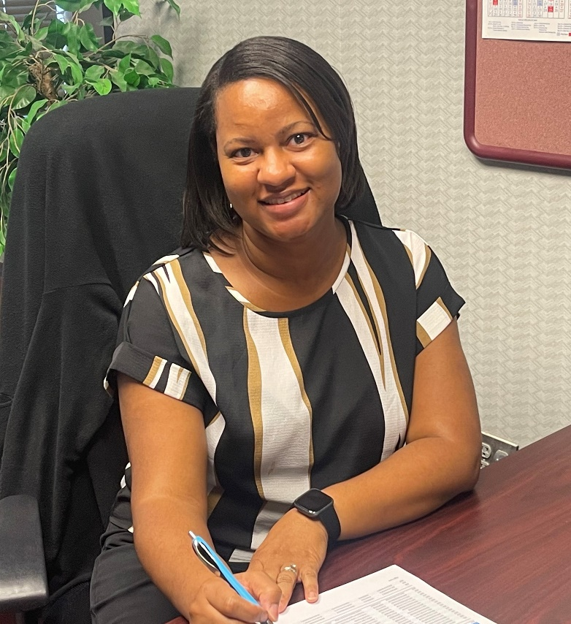
Latonya Knight, Staff Accountant
Latonya has an undergraduate degree from AUM in Accounting and a master’s degree in Human Resources Management from Troy University. She previously served for 12 years as a Business Office Manager for the Father Purcell Memorial Exceptional Children Center. Latonya is from and still resides in Montgomery.

Slide 14
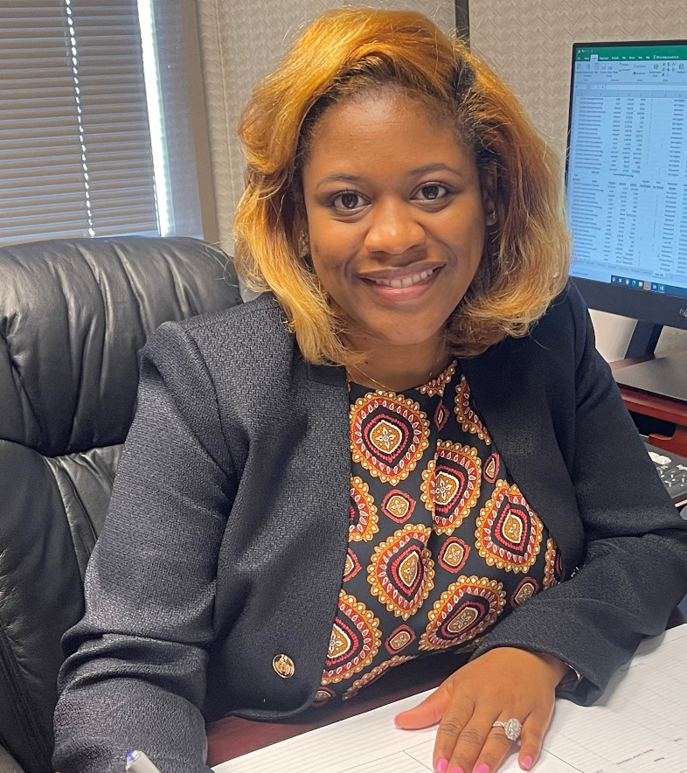
Takena Jones, Grant and Scholarship Associate
Takena Jones has an undergraduate degree from UAB in Psychology. She previously served for 8 years as the Senior Financial Aid Officer/VA Certifying Official at South University. Prior to that, she served for 4 years in a similar position for Fortis College. Takena is from and still resides in Montgomery.

Slide 15
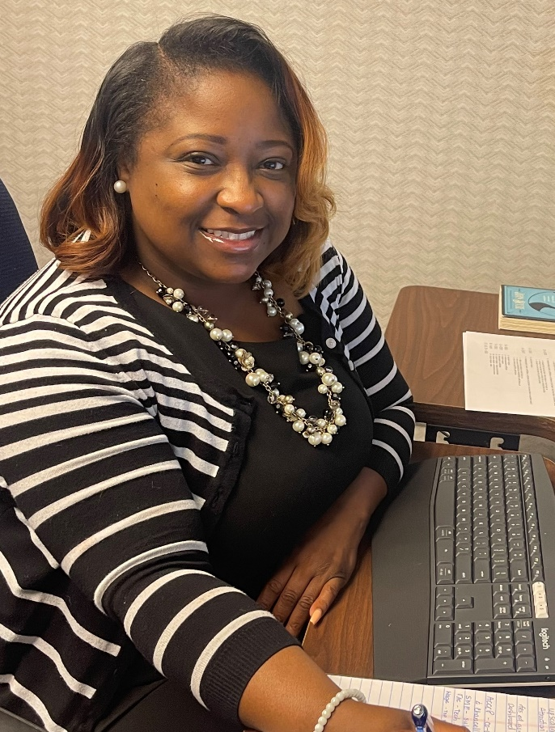
Lakerri Gill, Credential Registry Specialist
Lakerri Gill has an undergraduate degree from Amridge University in Business Administration. She previously served as an Admissions Clerk at Ingram State Technical College for 17 years. Her experience with academic and technical programs aligns well with the Credential Registry project that seeks to document the wide range of credentials in the state and help support the Governor’s goal of adding 500,000 skilled workers to the workforce by 2025. Lakerri is from and still resides in Wetumpka.

Slide 16
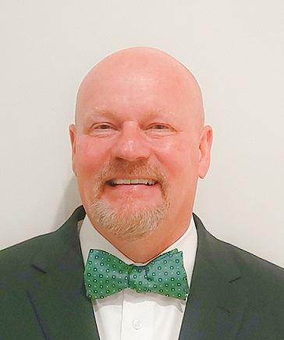
Dr. Jim Hood, Deputy Director of
Financial and Information Systems
Jim Hood has master’s degrees in business and education from Delta State University and a PhD from the University of Mississippi. Previously, Jim served as the Assistant Commissioner for Strategic Research with the Mississippi Institutions of Higher Learning for over 20 years. He also worked as Assistant Executive Director for Research and Effectiveness with the Mississippi Community College Board. Dr. Hood’s experiences with research, analytics, and information systems align well with several current and future ACHE initiatives. He is originally from Cleveland, Mississippi and currently resides in Pike Road.

Slide 17
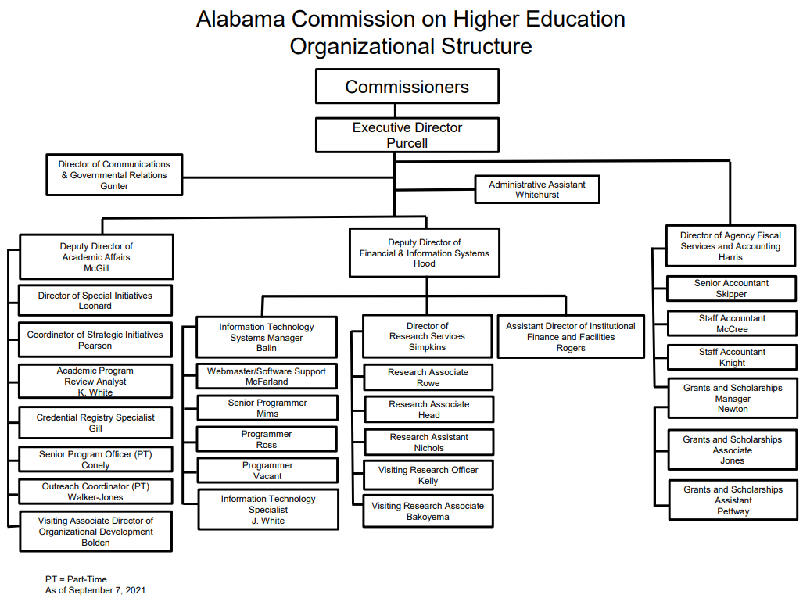

Slide 18

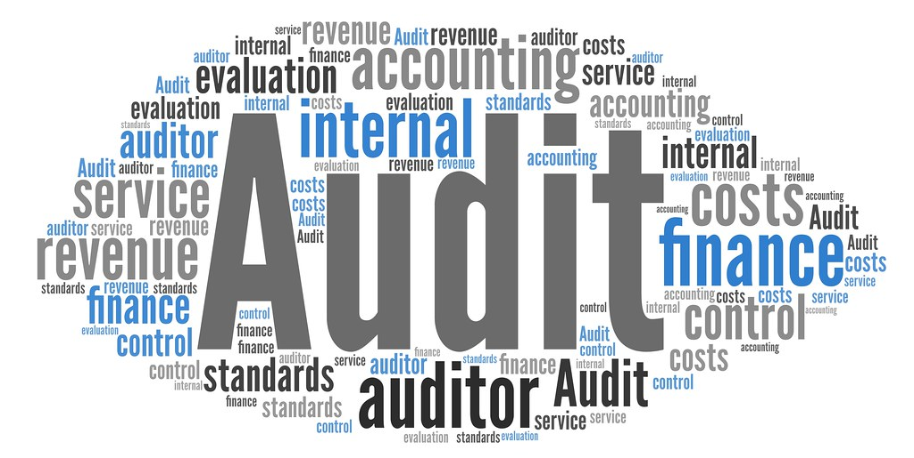
ACHE Audit 2016-2020
Completed
One finding: Relates to the Commission not notifying the Secretary of State of vacancies on the Commission. This finding was reported in the prior examination as Finding 2016-002.

Slide 19
Census/Economic Update for Alabama

Slide 20
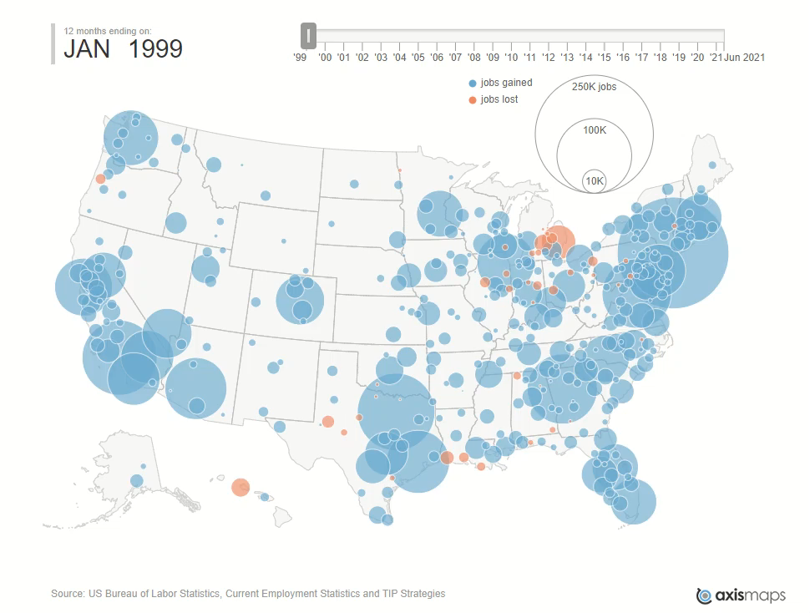

Slide 21


Density of educated/ skilled workers
Alignment of skills to jobs
Access to good schools, colleges, universities
Access to quality healthcare
Local leadership
Regional economic development strategies rather than state-wide strategies
  Return to city-states
  Sparta and Athens
Work-ready communities

Slide 22

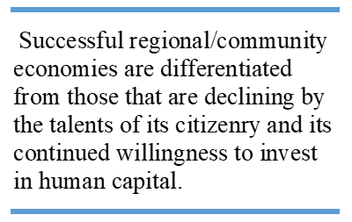

Slide 23
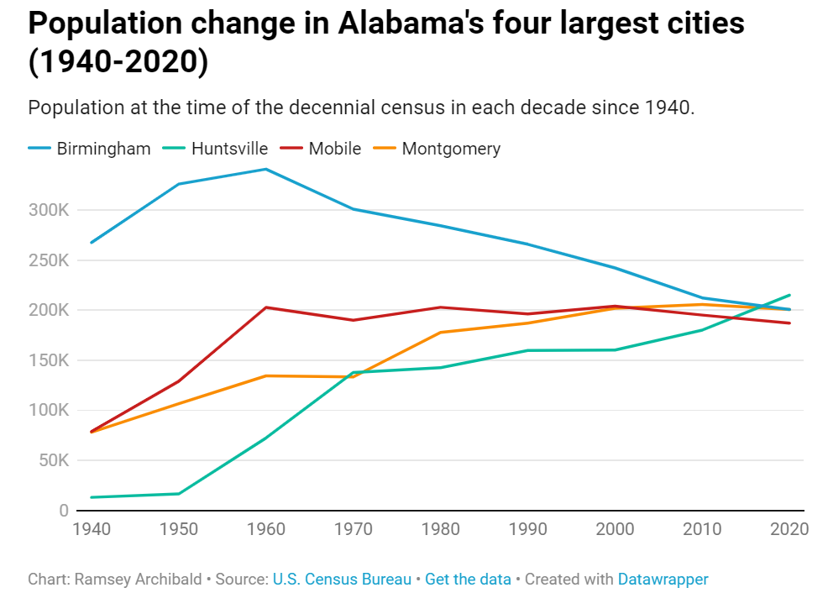
Huntsville has exhibited exponential growth since 1940 and now is Alabama’s largest city

Slide 24
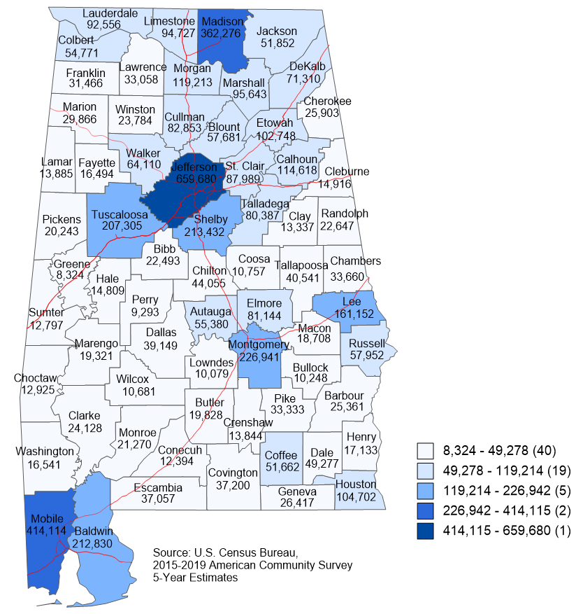
Population
Total
Population (2019)
You can only have a density of educated workers where there is a density of people.
Coloring uses the Jenks natural breaks classification method which is a data clustering method designed to determine the best arrangement of values into different classes. This is done by seeking to minimize each class's average deviation from the class mean, while maximizing each class's deviation from the means of the other classes.

Slide 25
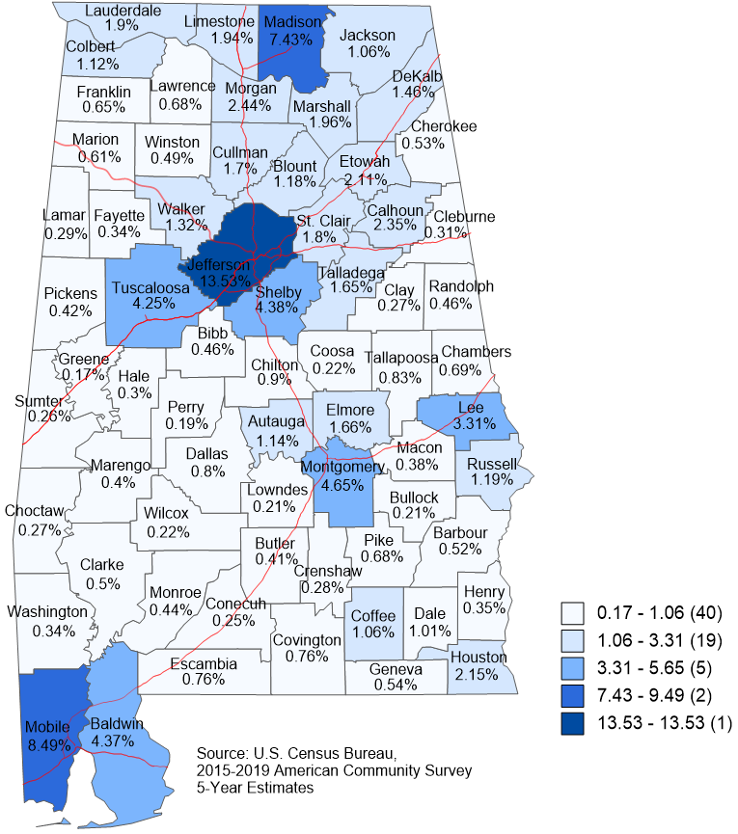
Population
Percent of the Total State Population (2019)
1/2 of all Alabamians live in 8 counties
70% live in the upper half of the state.

Slide 26
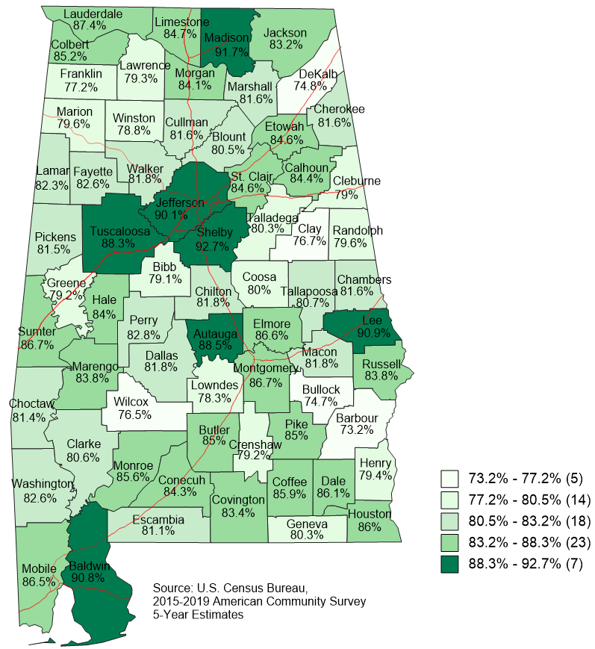
Education
Percent of the population aged 25 and older who have received a high school degree or higher (2019)
Futurists say you can only have a successful modern economy with educated people.
A high school diploma will not guarantee access to living wage jobs.
1/4 of adults in these counties do not have a HS Diploma (3)
1/5 of the adults in these counties do not have a HS Diploma (12)

Slide 27
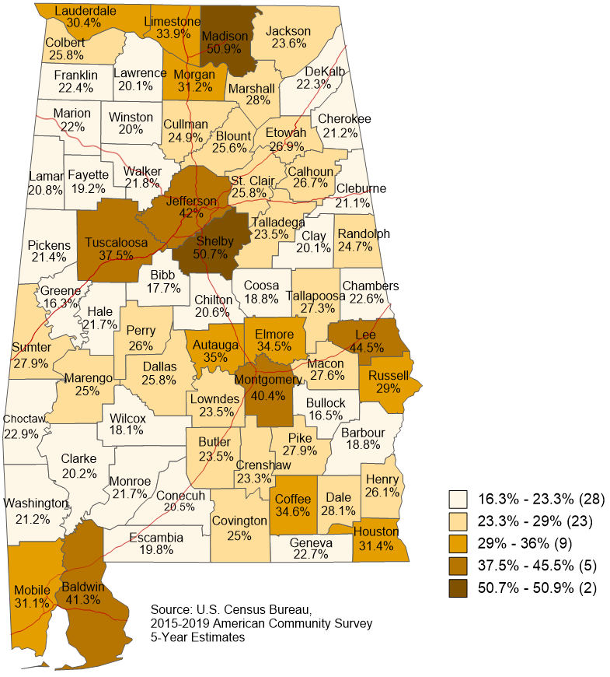
Education
Percent of the population aged 25 and older who have received an associate degree or higher (2019)
Futurists say you can only have a successful modern economy with educated people.

Slide 28
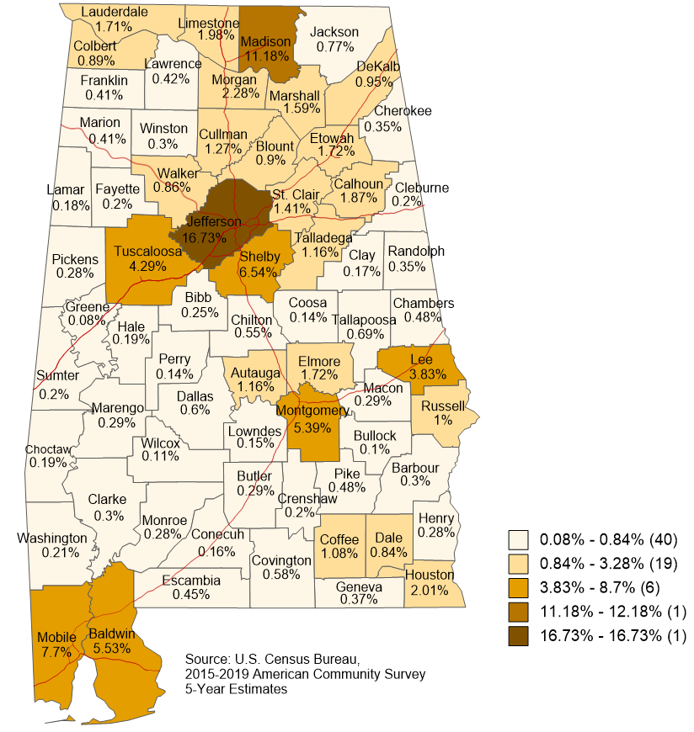
Education
Percent of the state population aged 25 and older who have received an associate degree and higher
(2019)
1/4 of the state’s degree holders live in two counties
1/3 of the state’s degree holders live in five counties
2/3 of the state’s degree holders live in nine counties

Slide 29
Education Pipeline

Slide 30

Strengthening the Education Pipeline

Slide 31
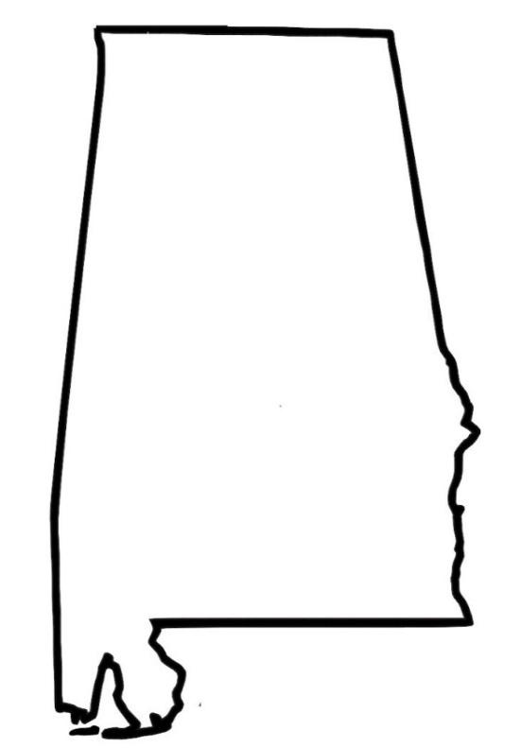
2009-10 Alabama 9th Graders’ Progression Into High School and College and Into Work
100%
Employed in Alabama 5 years after graduation
Fall 2013 Alabama College
Students
71% = 2,186
68.8%
51% = 4,102
36.4%
33.1%
26.3%
13.6%
18.3%
5.2%
58,939
40,576
21,442
19,525
15,473
10,786
3,080
8,045
9th Grade
Enrollment
High School
Grads
Enrolled Directly Into
College
First-time
Full-time
Degree
Seeking
Cohort
Retained After
1 Year
Graduated Within 6 Years
With
Associate
Degree*
With
Bachelor’s
Degree*
*Figures include students earning both associate and bachelor’s degrees.

Slide 32
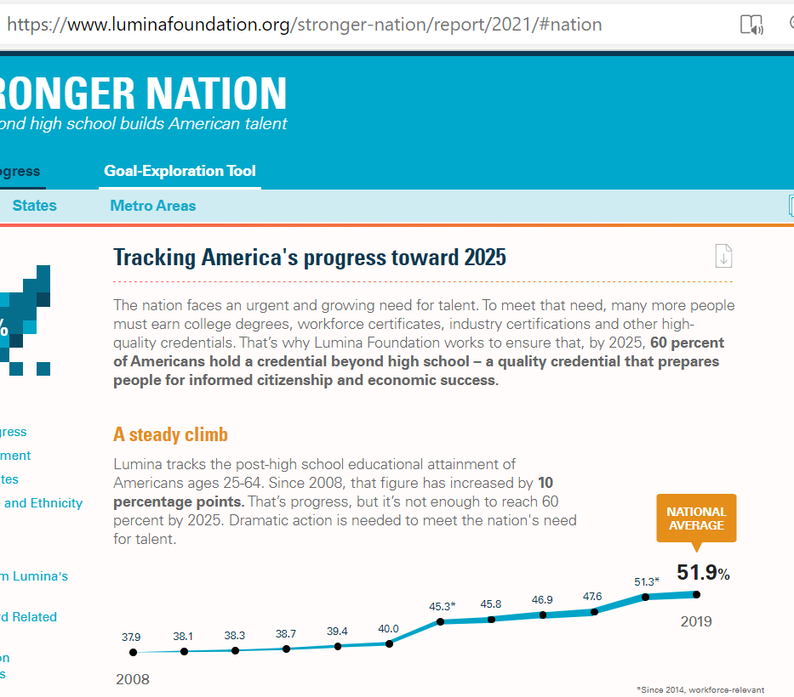
Alabama also has a goal of 60%

Slide 33
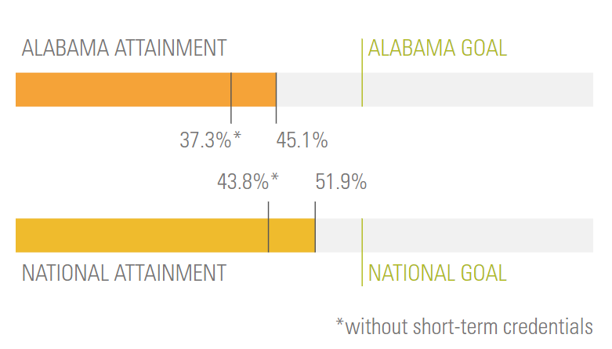
Progress 2008-2019
60%
Increase of 7.8%
Growth of 21%
Increase of 8.1%
Growth of 18%

Slide 34
New and Enhanced Initiatives for 2021-22

Slide 35

Contact info, Major, Residence halls, need Financial Aid, interests
Select up to 3 publics and 3 privates
https://www.surveymonkey.com/r/aloptin

Slide 36
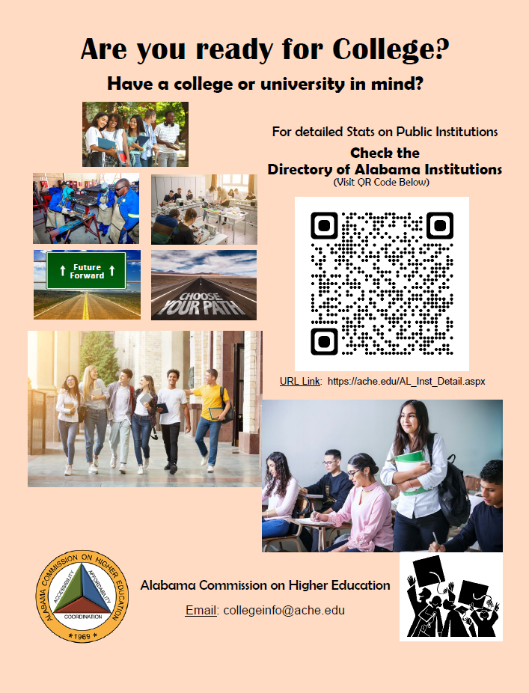
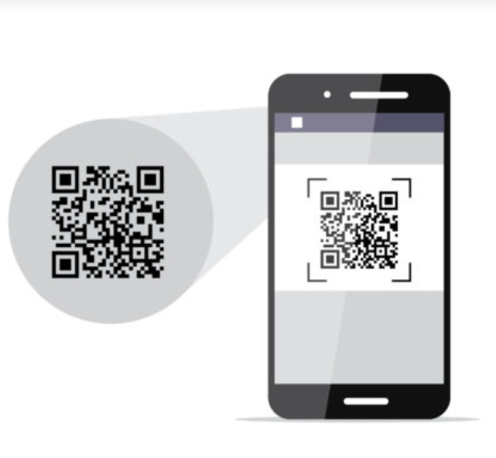
Consumer Information on Campuses

Slide 37
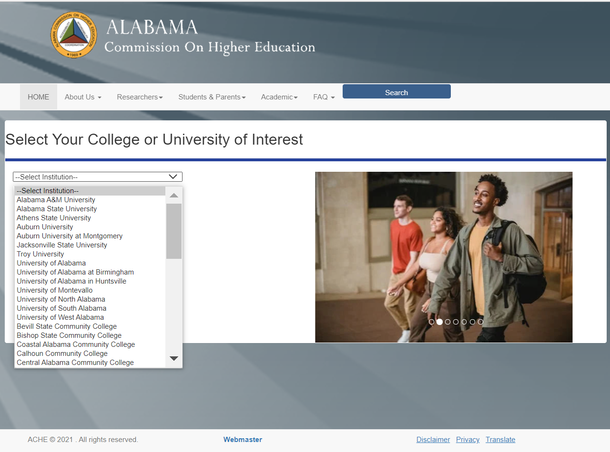

Slide 38
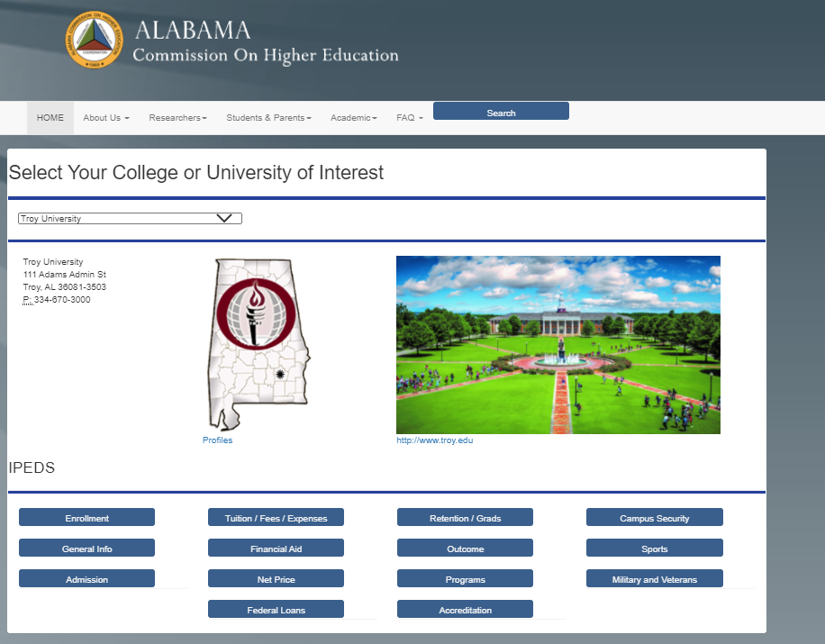

Slide 39
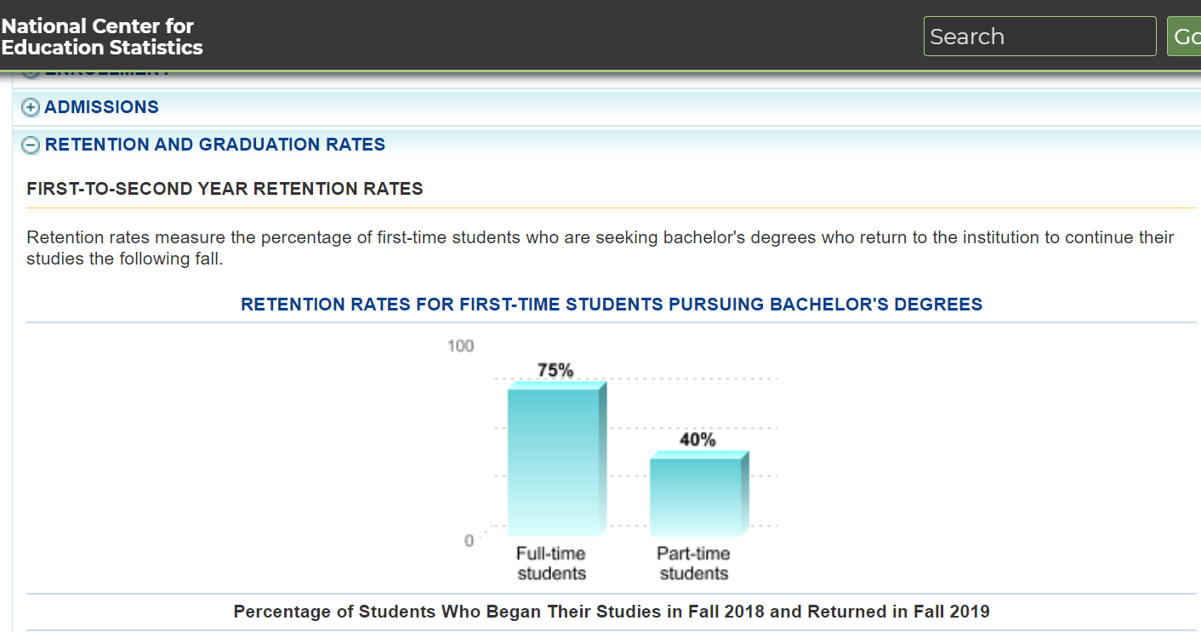

Slide 40
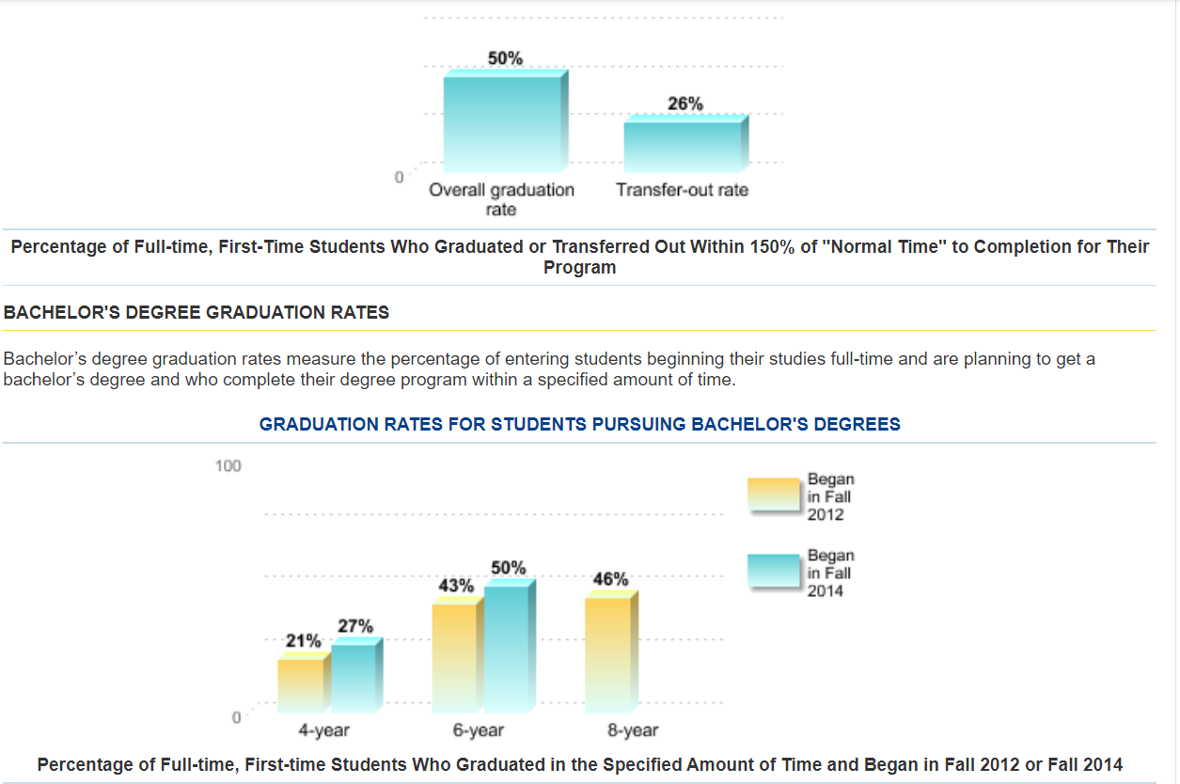

Slide 41

Paying for College Guide Book
Response to legislation to make high school students aware that there is state financial aid for private colleges
Paying_for_College_with_Student_Financial_Aid (ache.edu)

Slide 42
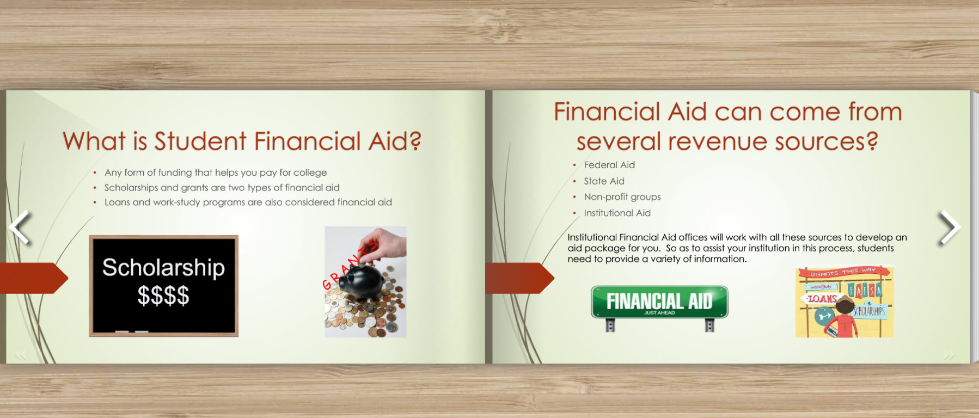

Slide 43
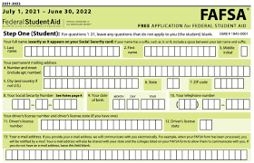

FAFSA Completion Project in Partnership with ALSDE
  FAFSA completion is a requirement for Alabama public high school students effective with the May 2022 high school graduating class (allows a parental waiver and a superintendent waiver)
  ACHE is engaging in this State Board of Education initiative because ACHE is the only agency in the state authorized to connect to the federal FAFSA database and see individual data for all Alabama students.

Slide 44

FAFSA Completion Project in Partnership with ALSDE
Currently only about 55% of HS seniors apply for the FAFSA.
Moving the participation needle from the 55% range to nearly 100% is a daunting challenge and will require, not only much effort by Career Coaches, Counselors, high school faculty and other district staff, but also ACHE, and the colleges and universities.
FAFSA participation ranges from an 82% completion rate in the Marengo County school district to 41% in the Russell County school district.

Slide 45
FAFSA Completion Project in Partnership with ALSDE
  Develop a centralized software application and related services to assist students in the correction of errors.
  Reduce the duplicative campus efforts to address errors and requests for verification of certain information.
  Shorten the FAFSA processing timeline.
Software will go live October 1 (first day students can apply for FAFSA 22-23)
Software bells and whistles by the end of December
Funded through GEERS 2 Funds ($1,100,000)

Slide 46





Process Flow Diagram
Process Flow Diagram
Oracle
Compares/Matches data to see who has completed the FAFSA
ED Connect
ACHE Downloads Federal FAFSA Data
Sends participation and status reports by Schools and Districts
Repeat process as needed.
Reports
Federal FAFSA Database
AL Dept. of Education
Submits student data to ACHE
Student Applies for Federal Financial Aid using the FAFSA
School Districts and High Schools
Authorized staff work with Students
Identifies and works to correct errors and assist with verifications
Feedback Loop

Slide 47

Bridge Programs
The transition to college from high school has always been difficult for students, but complications resulting from COVID protocols have added to transition issues. A mix of academic, social, financial, and emotional factors impact the ability of students to successfully transition.
Competitive RFP
Support the enhancement and expansion of college and university summer bridge programs that help students with the transition to college
GEERs 2 Funds $1,500,000
Up to $100,000 per approved proposal

Slide 48

VIII. DISCUSSION ITEMS

Slide 49

Retain Alabama

Slide 50
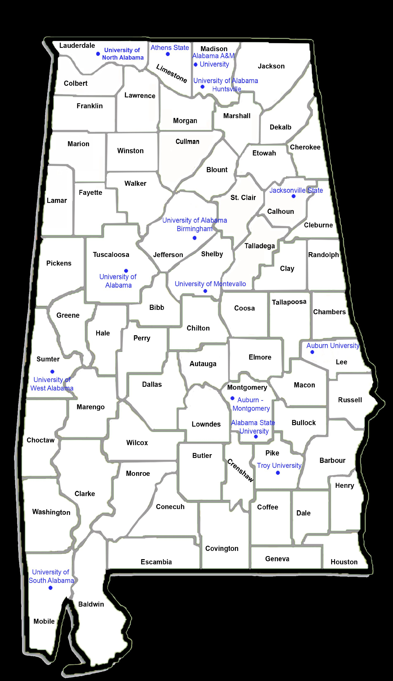
THE RETENTION PROBLEM
Forbes has ranked Alabama the nation’s third worst at retaining its college graduates.
Although 2 out of 3 in-state students are in the workforce one year after graduation, the retention of recent Alabama graduates is low compared to other states.
Source: The Wall Street Journal
Forbes Magazine
StrategyWise Innovation & Entrepreneurship Report for EDPA
Notes:
A combination of low unemployment, sluggish population growth and a comparatively low percentage of college graduates has contributed to a skills gap in Alabama, highlighting the critical need for talent to drive future economic growth. Without a dedicated and focused effort to build the state’s talent base, Alabama will have a shortage of nearly 300,000 skilled workers by 2040.

Slide 51

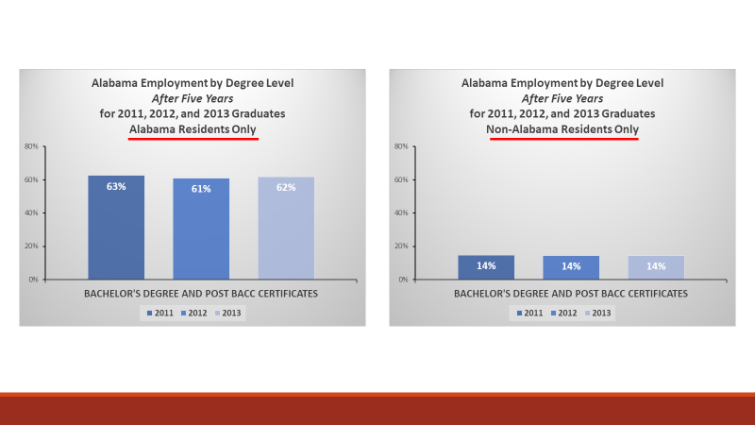
Retain Alabama is an initiative developed in response to the 2020 Employment Outcomes Report

Slide 53
Excerpt for the 2021-22 ETF Budget:
The Retain Alabama pilot will provide digital marketing strategies targeting soon-to-be college graduates; promotional materials about opportunities; and other strategies to retain Alabama College graduates.

Slide 54


Retain Alabama
Survey Results
2021

Slide 55
ACHE Team
Michael A Walker-Jones, Ed.D.
Community & Policy – Outreach Coordinator
Kristan C. White
Academic Program Analyst
Robin McGill, Ph.D.
Director Instruction /Special Projects
Bryn Bakoyema
Guest Researcher
Jim Purcell, Ed.D.
Executive Director

Slide 56
Purpose of Retain Alabama Survey
To collect information from bachelor’s degree students attending an Alabama 4-year public university about:
Impressions of the State of Alabama
Interest in working and living in Alabama after graduation
Influences for major/career decisions

Slide 57














Survey Design & Development
Collaboration with 14 public universities
Discussions with legislative representatives & Governor’s staff

Slide 58
Survey Administration
Coordinated by ACHE
Administered to students by their universities
Included sophomores, juniors, and seniors
Open from February 8 – March 26, 2021
Total responses = 8,208
Response rate = 9%

Slide 59
5 Parts of the Survey
Inspiration for Selected Major
Alabama Regions Visited
Regions with Highest Positive Rating
Intentions to Stay in Alabama After Graduation
Impressions of Alabama vs. Importance

Slide 60
Inspiration for Major

Slide 61
Inspiration for Major by Gender
Curriculum greatest inspiration for all students;
Job prospects more of an inspiration for men;
Family 3rd greatest inspiration for students

Slide 62
Inspiration for Major by Gender (cont.)
These items were the least influential.
Increased opportunities for vocationally related extra-curricular activities and work-based learning may increase interest in particular majors.

Slide 63
View of
Alabama Regions

Slide 64
Top Regions Visited
 | AL Residents | Non-Residents | Females | Males
Birmingham | ✓ | ✓ | ✓ | ✓
Huntsville | ✓ | ✓ | ✓ | ✓
Gulf-Shores/ Orange Beach | ✓ |  | ✓

Slide 65
Regions with Highest Positive Ratings
Across all demographic variables
(gender, race, STEM, residency)
#1 – Birmingham
#2 – Huntsville

Slide 66
Staying in Alabama
After Graduation

Slide 67
Staying in Alabama: all respondents
Target Audience for the Retain Alabama Initiative.

Slide 68
Stay in Alabama by Residency Status*
 | AL Resident | Non-Resident
Yes | 42.5% | 17.2%
Maybe | 40.9% | 47.4%
No | 16.7% | 35.4%
* Statistically significant difference

Slide 69
Stay in Alabama by Race/Ethnicity*
White students expressed a greater interest in staying in Alabama than minority students.
 | AAPI | AA | Hisp | Other Min | White
Yes | 18% | 27% | 26% | 28% | 37%
Maybe | 58% | 50% | 52% | 45% | 40%
No | 23% | 23% | 22% | 27% | 23%
* Statistically significant difference

Slide 70
Stay in Alabama by Student Age*
As expected, adult learners expressed a greater interest in staying in Alabama.
 | Traditional (≤ 24) | Non-Traditional (≥ 25)
Yes | 29% | 45%
Maybe | 46% | 36%
No | 25% | 19%
* Statistically significant difference

Slide 71
Stay in Alabama by Expected Graduation Year*
Students nearer to graduation were more likely to express an interest in staying in Alabama.
 | 2021 | 2022 | 2023+
Yes | 39% | 34% | 27%
Maybe | 35% | 47% | 50%
No | 26% | 21% | 23%
* Statistically significant difference
Communicating to students throughout their time in college is needed.

Slide 72
Stay in Alabama by STEM-Related Status*
Non-STEM students expressed a greater interest in staying in Alabama.
 | STEM-Related | Non-STEM Related
Yes | 26% | 37%
Maybe | 48% | 41%
No | 26% | 22%
* Statistically significant difference

Slide 73
Stay in Alabama by Major Category*
 | Arts & Comm | Business | Education | Health Science | Human Services | Public Admin, Safety, Law | STEM majors **
Yes | 23% | 35% | 53% | 40% | 30% | 24% | 25%
Maybe | 45.5% | 43% | 32% | 42% | 45% | 45% | 48%
No | 31.5% | 22% | 15% | 18% | 25% | 31% | 27%
Most likely to stay
Most likely to leave
* Statistically significant difference
** STEM-Related students (from previous slide) are found in STEM, education, and health science majors)

Slide 74
Impressions of
Alabama vs. Importance

Slide 75
Impression & Importance Items
OVERALL | Alabama as a place to live | CAREER | Job opportunities
 | Alabama as a place to work |  | Salary
 | Overall image or reputation |  | Employer-provided benefits
COMMUNITY | Friendliness of the people |  | Potential for career advancement
 | Acceptance towards people of diverse backgrounds |  | Opportunities to continue education
 | Opportunities to practice my faith | ENTERTAINMENT | Variety of dining options
 | Proximity to family |  | Access to cultural events/concerts
SOCIAL & ECONOMIC | Public safety |  | Access to sporting events (local/college/pro)
 | Social awareness environment |  | Access to healthy/outdoor
 | Political environment |  | The state's natural environment
 | Cost of living |  | Weather/temperate climate

Slide 76
Impression
Importance

Slide 77
Impression
Importance

Slide 79
Impression
Importance

Slide 80
Largest Negative Gaps Between
Impressions & Importance
For these items, importance was much higher than impressions, resulting in negative gaps.
Improving impressions for these items may help keep graduates in Alabama.
Item | Gap
1. Salary | -1.43
2. Acceptance of people of diverse backgrounds | -1.24
3. Job opportunities | -1.15
4. Potential for career advancement | -1.10
5. Employer provided benefits | -1.06
6. Political environment | -0.96
7. Social awareness environment | -0.96
8. Public safety | -0.87
Career
Social & Economic

Slide 81
Impression Differences by Demographics
AL Residents have better impressions than Non-Residents for 17 items (except weather)*
AL Residents and Non-Residents have same low impressions of salary, open to diverse people, & political environment
STEM higher impressions than Non-STEM: natural environment, access to outdoors, salary, cost-of-living*
Males have better impressions than Females for diversity, political environment, friendliness, safety, salary, cost of living*
White students have better impressions than Non-White students for all items*
* Statistically significant difference

Slide 82
Differences by Race/Ethnicity
Variability in positive impressions
Negative impressions common
 | Top 3 (Positive) AL Impressions | Bottom 3 (Negative) AL Impressions
Asian American/ Pacific Islander | Natural environment Friendliness Access to outdoors | Political environment Access to cultural events/ concerts Salary
African American | Educational opportunities Opportunities to practice faith Proximity to family | Political environment Salary Acceptance of diverse people
Hispanic | Natural environment Cost of Living Access to outdoors | Political environment Acceptance of diverse people Social awareness environment
Other Minority | Access to outdoors Cost of Living Friendliness | Political environment Social awareness environment Acceptance of diverse people
White | Natural environment Access to outdoors Friendliness | Political environment Social awareness environment Salary

Slide 83
Recommendations
Develop more work-related experiences in Alabama high schools, particularly related to STEM fields.
Promote the state, particularly for out-of-state students, to influence the large percentage of students indicating ‘may stay in Alabama’.
Delve deeper into specifics of what’s driving and how to change course on negative impressions: salaries, political environment, acceptance of diverse people, and social awareness.

Slide 84
Recommendations (cont.)
Alabama 4-year universities, in partnership with local and regional businesses, should increase exposure and outreach about career opportunities in Alabama to students before their senior year.
  Provide resources to show students what Alabama has to offer and information about living/working various regions of the state.
  Further embed work-based learning into curricula across all program areas.
  Support more frequent career fairs and recruitment opportunities bringing together students and employers.

Slide 85


Next Steps
A partnership between EDPA, ACHE, and our 14 public universities has been established to continue the Retain Alabama initiative.
Our goal is to increase the number of university graduates who live and work in Alabama.
The EDPA is a private, non-profit organization funded by more than 60 Alabama companies, whose mission is to attract and retain world-class talent across a broad spectrum of interests and industries, support both industry and innovative/emerging companies, expand existing businesses, and be the trusted source for insights for key drivers and stakeholders for economic development.

Slide 86

Retain Alabama
Discussion and Questions

Slide 87

VIII. Decision ITEMS

Slide 88


A. Final Approval of Amendments to the Administrative Procedures for the Alabama Math and Science Teacher Education Program –
Loan Repayment Program
During the 2021 Legislative Session, Alabama Act 2021-389 was passed. This Act made several modifications to the AMSTEP program.
Changes were aimed at broadening the eligibility requirements for participants by:
Reducing an applicant’s math, science or computer science teaching load from having to be full-time to 3/4ths of courses taught;
Including middle-level school teachers;
Including individuals teaching in Alabama, but residing in other states;
Including teachers who graduated from a regionally accredited college or university in another state who are certified to teach math, science or computer science in another state, once they are certified to teach in Alabama. These individuals may or may not reside in Alabama;
Allowing individuals issued the Alabama Bachelor’s Level Professional Educator Certificate in math, science or computer science to participate in the program upon completion of alternative certification program (Class B) as outlined in the Code of Alabama, 1975, Section 16-23-3;
Allowing teachers in a school which has been designated as a “failing” school to qualify for supplemental funds that currently are only available to teachers who are employed in the “acute” shortage systems;
Clarifying that teachers in charter schools are eligible, but not for the supplement aimed at acute shortage eligibility.
Also, Sections 300-4-12-.01 through .06 are being repealed. The AMSTEP Scholarship Program is no longer operational, so procedures related to that program are no longer necessary.
Preliminary approval of the proposed amendments to this rule was granted by the Commission on Friday, June 11, 2021. The proposed changes were filed with the Legislative Services Agency on June 15, 2021 and published in Alabama Administrative Monthly on June 30, 2021. Interested parties had until August 9, 2021 to comment. No comments were received.
Should the Commission grant final approval to these proposed changes, the certified changes will be filed with the Alabama Procedures Office on September 14, 2021 and will go into effect on November 22, 2021.

Slide 89
Motion, Decision Item A:
That the Commission approve the proposed Amendments to the Administrative Procedures for the Alabama Math and Science Teacher Education Program – Loan Repayment Program.

Slide 90

B. Final Approval of Amendments to the Administrative Procedures for the Alabama Student Grant Program
During the 2021 Legislative Session, Alabama Act 2021-442 was passed. This Act made several modifications to the ASGP program. The major changes are:
The annual maximum award was raised from $1,200 to $3,000.
Language was added related to dissemination of information about the program.
Preliminary approval of the proposed amendments to this rule was granted by the Commission on Friday, June 11, 2021. The proposed changes were filed with the Legislative Services Agency on June 15, 2021 and published in Alabama Administrative Monthly on June 30, 2021. Interested parties had until August 9, 2021 to comment. No comments were received.
Should the Commission grant final approval to these proposed changes, the certified changes will be filed with the Alabama Procedures Office on September 14, 2021 and will go into effect on November 22, 2021.

Slide 91
Motion, Decision Item B:
That the Commission approve the proposed Amendments to the Administrative Procedures for the Alabama Student Grant Program.

Slide 92



C. Final Approval of Amendments to the Administrative Procedures for the Police Officers and Firefighters Survivors Educational
Assistance Program
During the 2021 Legislative Session, Alabama Act 2021-425 was passed.
This Act changed the eligibility criteria for natural and adopted dependents under age 21 of police officers, firefighters, volunteer firefighters and rescue squad members who are declared totally disabled.
Another change proposed by staff, creates a new rule that allows the Chairman of the Tuition Eligibly Board to approve or reject an application after the Board has held its annual meeting.
Preliminary approval of the proposed amendments to this rule was granted by the Commission on Friday, June 11, 2021. The proposed changes were filed with the Legislative Services Agency on June 15, 2021 and published in Alabama Administrative Monthly on June 30, 2021. Interested parties had until August 9, 2021 to comment. No comments were received.
Should the Commission grant final approval to these proposed changes, the certified changes will be filed with the Alabama Procedures Office on September 14, 2021 and will go into effect on November 22, 2021.

Slide 93
Motion, Decision Item C:
That the Commission approve the proposed Amendments to the Administrative Procedures for the Police Officers and Firefighters Survivors Educational Assistance Program.

Slide 94

D. Approval of 2022 Meeting Schedule
Proposed Meeting Schedule for 2022
March 11, 2022
June 10, 2022
September 9, 2022
December 9, 2022

Slide 95
Motion, Decision Item D:
That the Commission approve the proposed 2022 ACHE Commission Meeting schedule.

Slide 96

E. Fiscal Year 2021-22 Operations Plan

Slide 97
Alabama Commission on Higher Education
FY 2021-22 Budgetary Facts
The Commission has 32 programs under 5 appropriation units.
There are four new programs in the FY 2021-22 budget.
  The Alabama Credential Registry
  Retain Alabama
  The Historically Black College and University Consortium
  USS Alabama Battleship
The FY 2021-22 budget represents a 16.76% increase over the previous fiscal year’s budget.
The FY 2021-22 Operations Plan, showing expenditures for each of the fiscal year’s quarters, was submitted to the Executive Budget Office (EBO) on July 30, 2021. Any changes made by the Commission can be made through an Operations Plan revision after October 1, 2021.

Slide 104
Motion, Decision Item E:
That the Commission approve the ACHE Fiscal Year 2021-2022 Operations Plan.

Slide 105
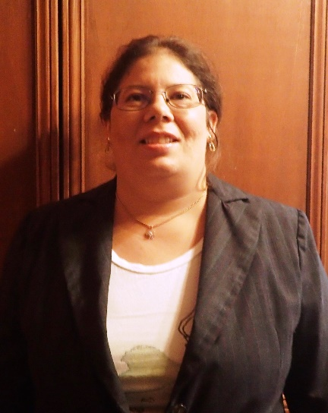

F. Forever Wild Appointment of Board Member
Dr. Heather Howell
Northern District appointment: October 1, 2021 – September 30, 2027
Development of criteria for Fisheries Management and Aquaculture in Agriculture program
Assisted in the development of a Minor in Fisheries at Alabama A&M University
Extensive research in terrestrial and aquatic wildlife ecology, botany and aquaculture systems integration and engineering
Authored numerous scientific articles and presented on various topics: The Salmon of Knowledge: Engaging Students in STEM Through Hands-On Fisheries and Wildlife Activities

Slide 106
Motion, Decision Item F:
That the Commission approve the appointment of Forever Wild Board Member, Dr. Heather Howell.

Slide 107










G. Public Drawing to Determine the Order of Payment of Alabama Student Grant Program (ASGP) Funds
for the 2021-2022 Academic Year
SOUTH UNIVErSITY-MONTGOMERY

Slide 108

H. Academic Programs
Staff Presenters: Dr. Robin McGill and
Mrs. Kristan White

Slide 109

FOUR-YEAR INSTITUTIONS

Slide 110

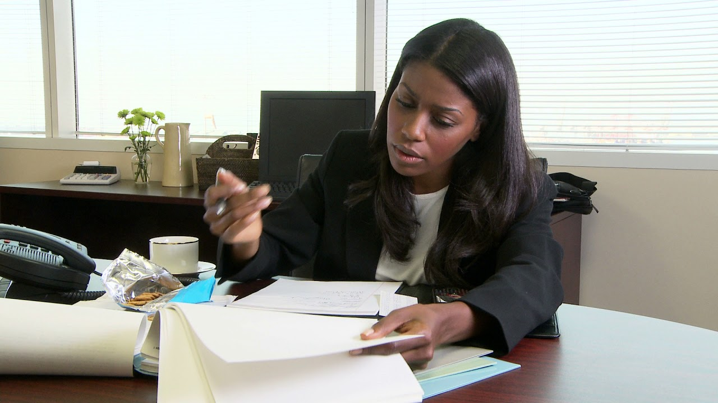
Alabama State University
Master of Business Administration in Business
Administration (CIP 52.0201)
Demand for MBA graduates remains strong, given the need for management analysts, market research analysts, and other business professionals.
ASU’s Percy J. Vaughn, Jr. College of Business Administration currently offers five baccalaureate programs and one graduate program (Master of Accountancy) and maintains specialized accreditation through the Accreditation Council for Business Schools and Programs (ACBSP).
ASU is one of two public universities in Alabama
that does not include an MBA program among its
standard offerings.
This Photo by Unknown Author is licensed under CC BY-ND

Slide 111
Motion, Decision Item H-1:
That the Commission approve Alabama State University’s proposal to offer a Master of Business Administration in Business Administration.

Slide 112

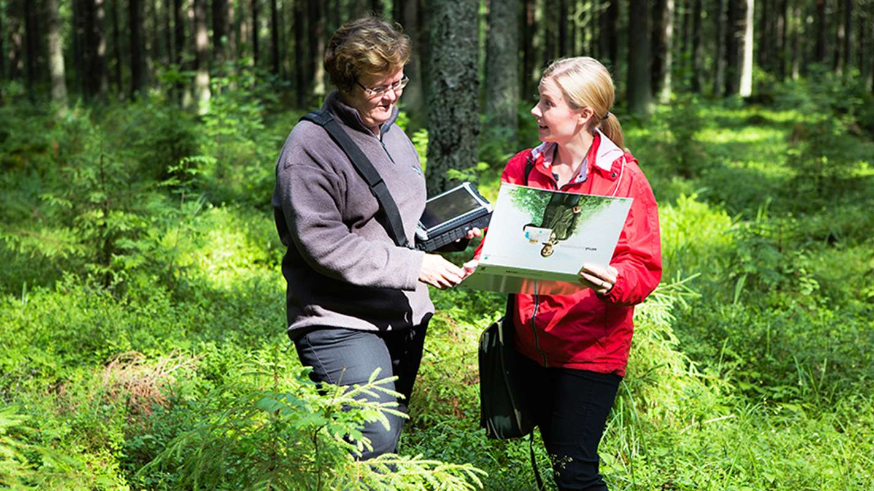
Auburn University
Master of Science in Forest Business and
Investment (CIP 03.0510)
The proposed MS degree is designed to fill a critical industry need for professionals cross-trained in forestry resources and business, given the continued importance of the forestry sector to Alabama’s economic growth.
Forestry is a key component of AU’s land-grant mission, and there are no other programs similar to the proposed degree offered in Alabama.
Coursework for the program will be offered 100% online
allowing more flexibility for professional students.
This proposal includes four letters of support from employer
partners attesting to the need for this program.
This Photo by Unknown Author is licensed under CC BY-ND

Slide 113
Motion, Decision Item H-2:
That the Commission approve Auburn University’s proposal to offer a Master of Science in Forest Business and Investment.

Slide 114


Jacksonville State University
3. Bachelor of Science in Computer Information
Systems (CIP 11.0401) – Substantive Modification
Jacksonville State University (JSU) is proposing to modify the CIP code for its BS in Computer Information Systems from CIP 11.0101, which is shared with the BS in Computer Science, to CIP 11.0401 (Information Science/Studies), which better describes the content of the degree.
Consistent with Commission policy, the proposed substantive modification pertains to a program that has already been in existence and does not require any additional funding to deliver in its modified form.
This Photo by Unknown Author is licensed under CC BY-ND

Slide 115
Motion, Decision Item H-3:
That the Commission approve Jacksonville State University’s request for substantive modification to its Bachelor of Science in Computer Information Systems.

Slide 116


University of Alabama
4a. Bachelor of Fine Arts in Graphic Design (CIP 50.0401)
UA currently offers coursework in graphic design within its existing BFA in Studio Art program (CIP 50.0702), with a concentration in digital media. The proposed program will elevate the concentration to a standalone BFA and will not require any additional resources to implement.
While a number of Alabama institutions offer coursework and/or concentration areas in graphic design, only one other institution offers a standalone degree in graphic design.
The 2021 Statewide In-Demand Occupations List includes graphic
designers (SOC 17-1024) among the top in-demand occupations
for the Arts/AV industry cluster.
As part of the work based learning and collaborative training, the program will continue to partner with local businesses and non-profit organizations throughout Alabama and the region to enhance their branding efforts with strategic design applications.

Slide 117
Motion, Decision Item H-4a:
That the Commission approve The University of Alabama’s proposal to offer a Bachelor of Fine Arts in Graphic Design.

Slide 118

University of Alabama
4b. Master of Arts in Interdisciplinary Studies (CIP 30.0000)
The proposed MA in Interdisciplinary Studies will allow students to blend distinct areas of expertise needed to compete for and advance within contemporary careers. The program is designed to attract part-time students, particularly working professionals who may be looking to upskill.
The option of stacking graduate certificates into a master’s degree may appeal to new populations who may otherwise not seek post-baccalaureate educational opportunities. This aim aligns with regional and state workforce development goals.
The proposed program offers flexibility within UA’s existing
graduate offerings and will not require any additional
resources to deliver.

Slide 119
Motion, Decision Item H-4b:
That the Commission approve The University of Alabama’s proposal to offer a Master of Arts in Interdisciplinary Studies.

Slide 120

University of Alabama
4c. Master of Science in Interdisciplinary Studies (CIP 30.0000)
The proposed MS in Interdisciplinary Studies will allow students to blend distinct areas of expertise needed to compete for and advance within contemporary careers. The program is designed to attract part-time students, particularly working professionals who may be looking to upskill.
The option of stacking graduate certificates into a master’s degree may appeal to new populations who may otherwise not seek post-baccalaureate educational opportunities. This aim aligns with regional and state workforce development goals.
The proposed program offers flexibility within UA’s existing
graduate offerings and will not require any additional
resources to deliver.

Slide 121
Motion, Decision Item H-4c:
That the Commission approve The University of Alabama’s proposal to offer a Master of Science in Interdisciplinary Studies.

Slide 122

University of Alabama
3d. Bachelor of Science in General Business
(CIP 52.0101) – Substantive Modification
The University of Alabama (UA) is proposing to modify the CIP code for its BS in General Business from CIP 52.0201, which is shared with the BS in Management, to CIP 52.0101 (Business/Commerce, General), which better describes the content of the degree. Consistent with Commission policy, the proposed substantive modification pertains to a program that has already been in existence and does not require any additional funding to deliver in its modified form.
This Photo by Unknown Author is licensed under CC BY-ND

Slide 123
Motion, Decision Item H-4d:
That the Commission approve University of Alabama’s request for substantive modification to its Bachelor of Science in General Business.

Slide 124

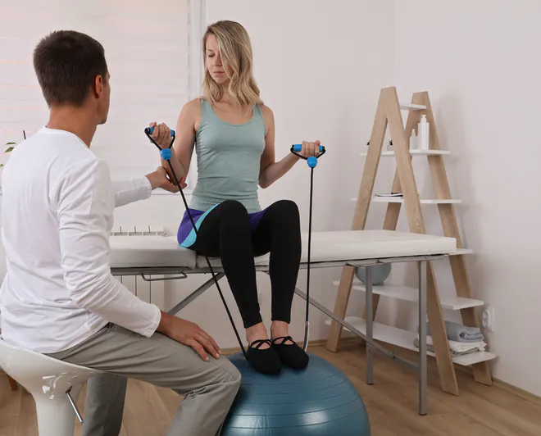
University of Alabama in Huntsville
5a. Master of Science in Kinesiology (CIP 31.0505)
MS in Kinesiology is designed to prepare graduates for in-demand occupations as coaches/scouts and exercise trainers, with a focus on sports science.
The proposed program will build on UAH’s existing BS
in Kinesiology that continues to exceed enrollment and
graduate expectations since its initial start in 2015.
This proposed program is designed to prepare graduates for professional certification through the National Strength and Conditioning Association (NSCA), and the proposal includes a letter of support attesting to alignment with NSCA standards.

Slide 125
Motion, Decision Item E-5a:
That the Commission approve The University of Alabama in Huntsville’s proposal to offer a Master of Science in Kinesiology.

Slide 126

University of Alabama in Huntsville
5b. Doctor of Philosophy in Applied Experimental
Psychology (CIP 42.2813)
The Huntsville area has seen major growth in manufacturing and information industries that will increase demand for professionals trained in Applied Experimental Psychology.
The online asynchronous and face-to-face delivery models
will make this degree easily accessible to both working and
traditional students.
Faculty in UAH’s Department of Psychology have a successful track record of attracting extramural funding, and several existing funders have indicated their willingness to increase funding once a doctoral program is established.
The program proposal includes two letters of support from industry professionals attesting to the need for doctoral-level Psychology graduates trained in Human Factors and Psychology/Law.

Slide 127
Motion, Decision Item H-5b:
That the Commission approve The University of Alabama in Huntsville’s proposal to offer a Doctor of Philosophy in Applied Experimental Psychology.

Slide 128


University of South Alabama
6a. Bachelor of Arts in Journalism (CIP 09.0499)
The proposed BA in Journalism will expand a current concentration in the BA in Communication into a full program, utilizing existing faculty, courses, and facilities.
The proposed program will provide more specialized coursework specific to journalism, and better prepare graduates for careers in the field.

Slide 129
Motion, Decision Item H-6a:
That the Commission approve The University of South Alabama’s proposal to offer a Bachelor of Arts in Journalism.

Slide 130


University of South Alabama
6b. Bachelor of Arts in Advertising and Public Relations
(CIP 09.0900)
The proposed BA in Advertising and Public Relations will expand
an existing concentration within the BA in Communication into a
full program, utilizing existing faculty, courses and facilities.
The program will provide more specialized coursework specific to advertising and public relations and better prepare graduates for careers in the field.
The proposal contains four letters of support from the following local employers: Lewis Communications, Threaded Fasteners, Dollar General Corporation, and the Mobile County License Commission.

Slide 131
Motion, Decision Item H-6b:
That the Commission approve The University of South Alabama’s proposal to offer a Master of Arts in Advertising and Public Relations.

Slide 132

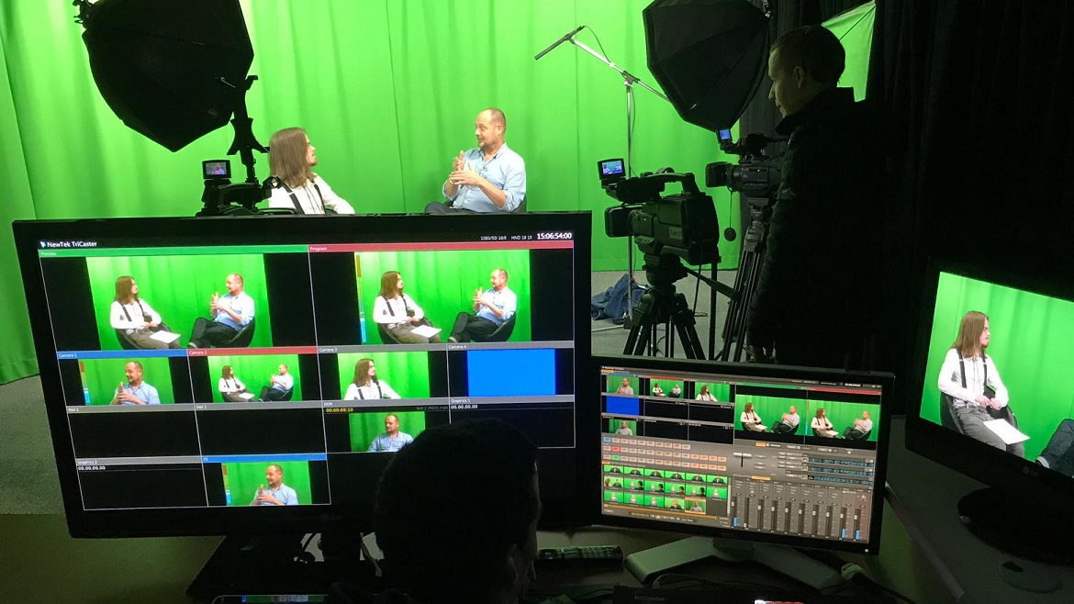
University of South Alabama
6c. Bachelor of Arts in Digital Film and Television Production
(CIP 50.0602)
The proposed BA in Digital Film and Television Production will expand an existing concentration within the BA in Communication into a full program, utilizing existing faculty, courses and facilities.
The program will provide more specialized coursework
specific to film and production and better prepare
graduates for careers in the field.
The proposal contains several letters of support from local employers and supporters, including one pledging to establish an endowed scholarship for students in the proposed program.

Slide 133
Motion, Decision Item H-6c:
That the Commission approve The University of South Alabama’s proposal to offer a Bachelor of Arts in Digital Film and Television Production.

Slide 134

























ALABAMA COMMUNITY COLLEGE SYSTEM

Slide 135


Drake State Community & Technical College
7a. Associate of Applied Science and Certificate in
Child Development (CIP 19.0708)
This program will help meet high industry demand for childcare workers who are trained and certified, as this is a high turnover occupation.
DRA’s service area is experiencing significant growth due to big businesses like Mazda Toyota and Google Fiber, among others, creating new opportunities for day care workers and preschool teachers.
This proposal includes two letters of support from the Excel Academy (industry partner) and UAH College of Education (higher education partner).

Slide 136
Motion, Decision Item H-7a:
That the Commission approve the Drake State and Technical Community College’s proposal to offer an Associate of Applied Science and Certificate in Child Development.

Slide 137

Drake State Community & Technical College
7b. Associate of Applied Science and Certificate in
Building Construction Technology (CIP 46.0415)
This program will help meet high industry demand for construction trades workers and laborers, which appear on Alabama’s Statewide In-Demand Occupations List.
The College’s service area is experiencing significant
growth due to big businesses like Mazda Toyota and
Google Fiber, among others, creating new jobs.
This proposal includes letters of support from the following industry partners and future employers: Lee Company, Turner Construction, and Alabama Associated General Contractors.

Slide 138
Motion, Decision Item H-7b:
That the Commission approve the Drake State and Technical Community College’s proposal to offer an Associate of Applied Science and Certificate in Building Construction Technology.

Slide 139

I. INFORMATION ITEMS
Distribution of 2021-2022 Alabama Student Assistance Program (ASAP) Funds
Implementation of Non-Degree Programs at Senior Institutions
Implementation of New Short Certificate Programs (Less than 30 Semester Hours)
Changes to the Academic Program Inventory
Non-Substantive Extensions/Alterations to Existing Programs of Instruction
Updates to Units of Instruction, Research, Public Service, and Administration
Summary of Post-Implementation Reports

Slide 140
7. Summary of Post-Implementation Reports
Programs that met post-implementation conditions
Gadsden State Community College: AAS in Salon and Spa Management (CIP 12.0412)
Jacksonville State University: MS in Instructional Technology
(CIP 13.0501)
Shelton State Community College: AAS in Auto Mechanics
(CIP 47.0604)
University of South Alabama: MS in Sport Management
(CIP 31.0504)

Slide 141
7. Summary of Post-Implementation Reports
b. Programs that did not meet post-implementation conditions
None

Slide 142
Motion, Decision Item I:
That the Commission accept the information items as presented.

Slide 143
J. ADJOURNMENT

