Slide 1

Alabama Commission on Higher Education
Commission Meeting
December 10, 2021

Slide 2


CALL TO ORDER, PRAYER, AND PLEDGE OF ALLEGIANCE

Slide 3

II. ROLL CALL and
QUORUM DETERMINATION

Slide 4

III. APPROVAL OF AGENDA
Commission Meeting Agenda of
December 10, 2021

Slide 5

IV. CONSIDERATION OF MINUTES
Commission Meeting Minutes of September 10, 2021

Slide 6

V. CHAIRMAN’S REPORT

Slide 7

VI. EXECUTIVE DIRECTOR’S REPORT

Slide 8
New Program Requests for FY 2022-23 (1 of 3)
FAFSA Completion ($500,000)
FAFSA completion will be a requirement for Alabama public high school graduates as of May 2022.
ACHE is engaged in this State Board of Education initiative because it is the only agency in the state authorized to connect to the federal FAFSA database and see individual data for all Alabama students.
Using $1,100,000 in COVID/GEER funds, technological supports were put in place to assist students and families in completing the FAFSA - specifically with the correction of errors.
It also supports campus efforts to address errors and requests for verification of certain information prior to a May graduation date.
The software application and related services also provide progress reports for the career coaches, counselors, high school faculty and other district staff in assisting students with the application process. There is an annual $500,000 licensing cost associated with this initiative.

Slide 9
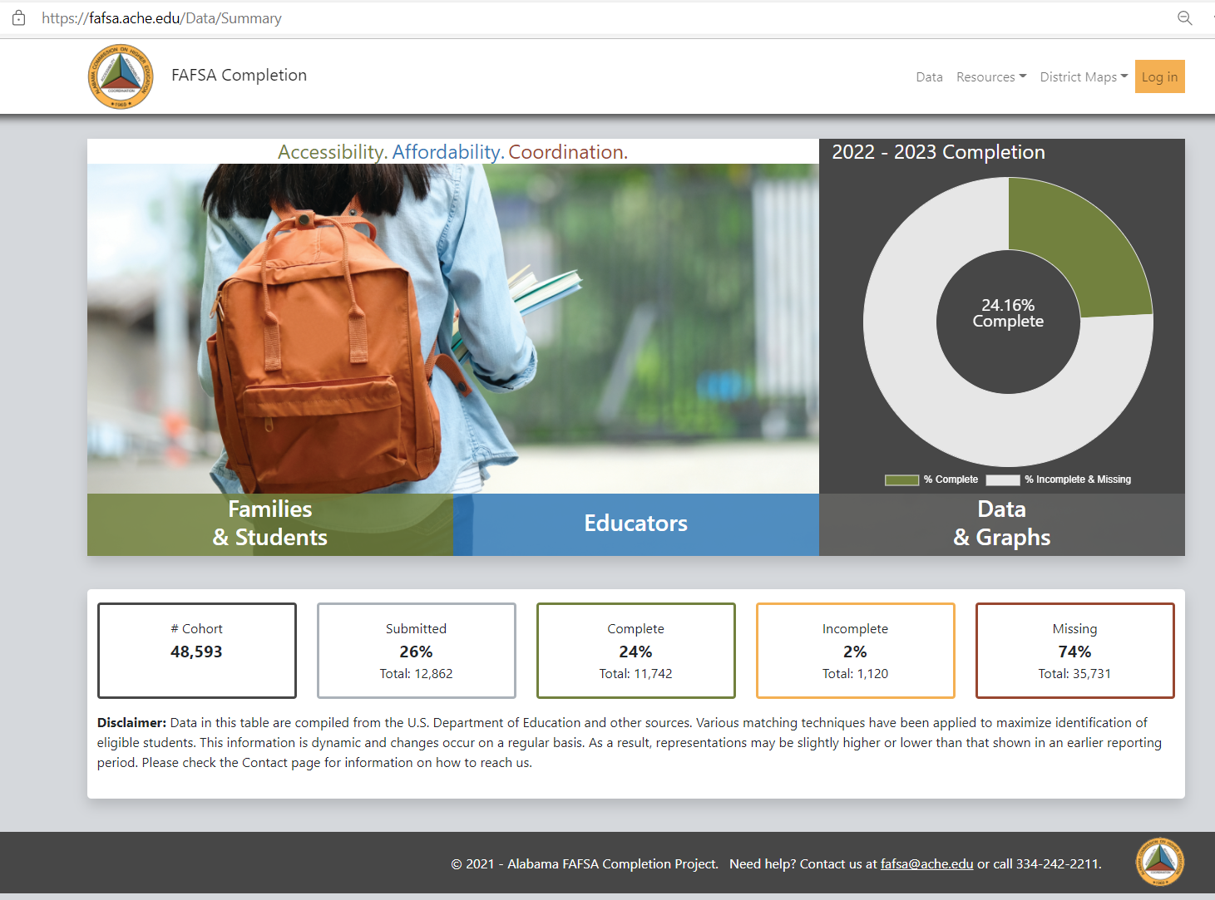

Slide 10
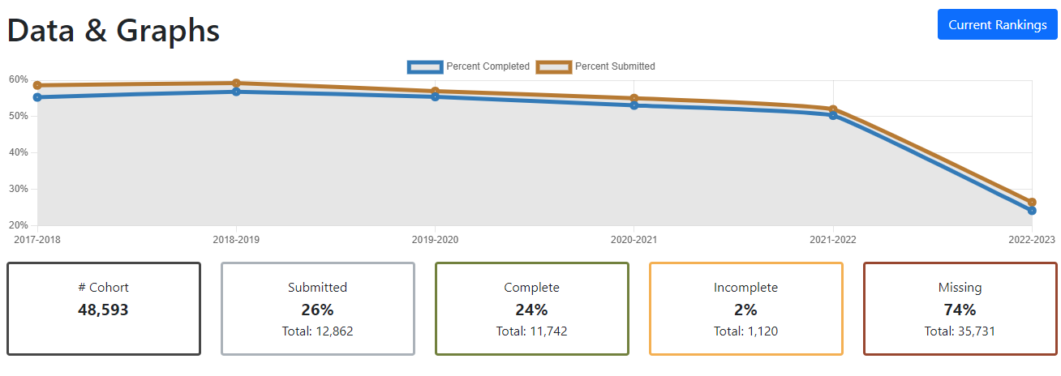

Slide 11
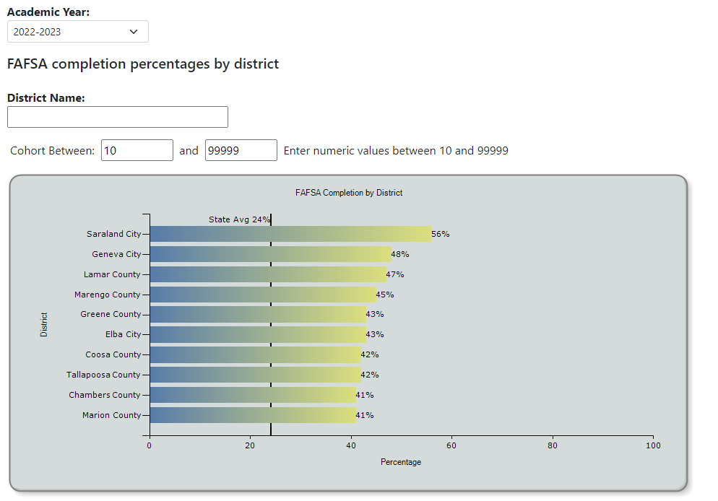
District Ranking

Slide 12
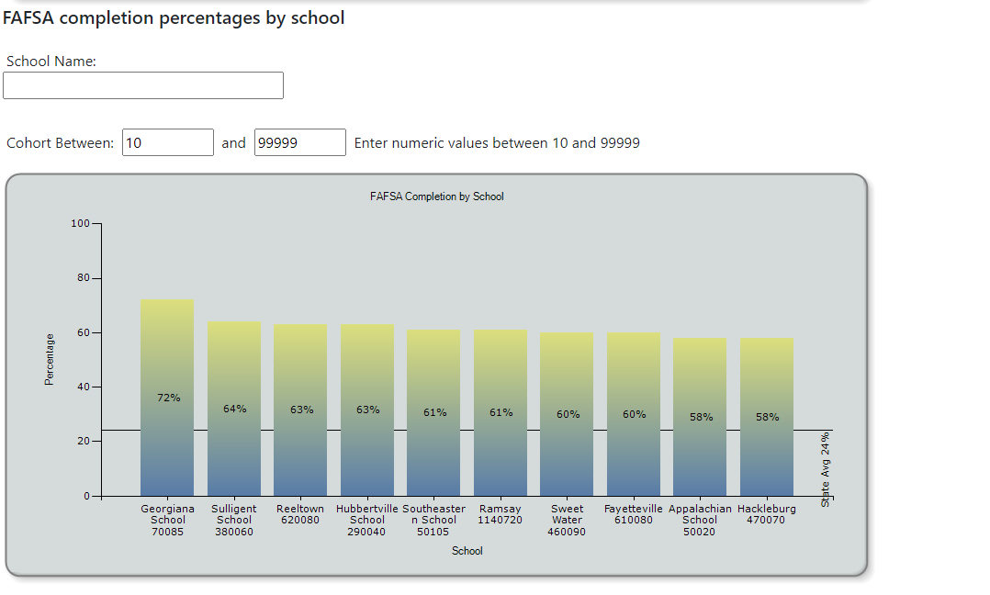
School Rankings

Slide 13
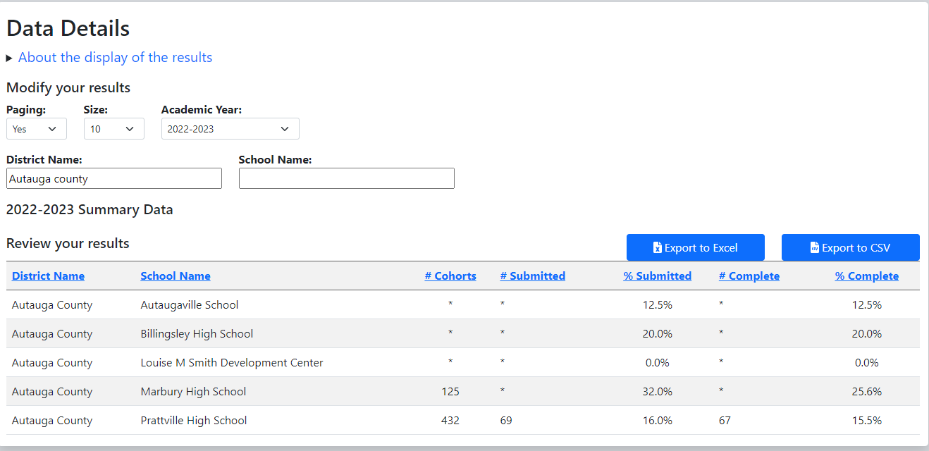

Slide 14
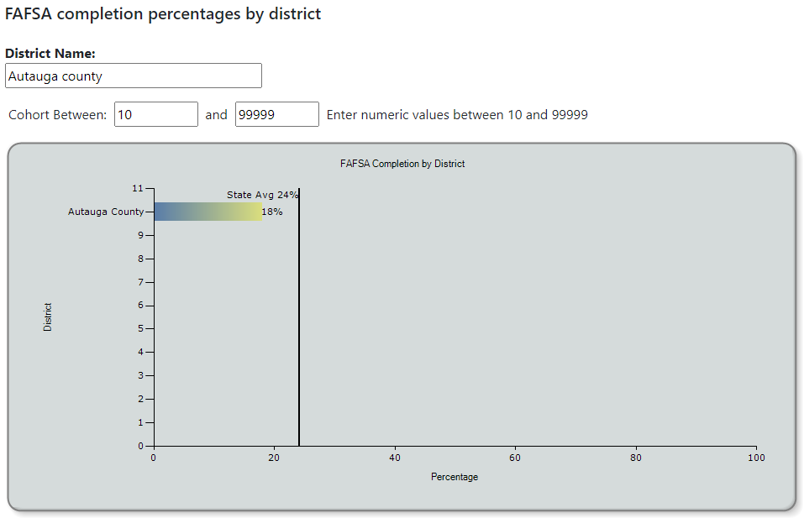

Slide 15
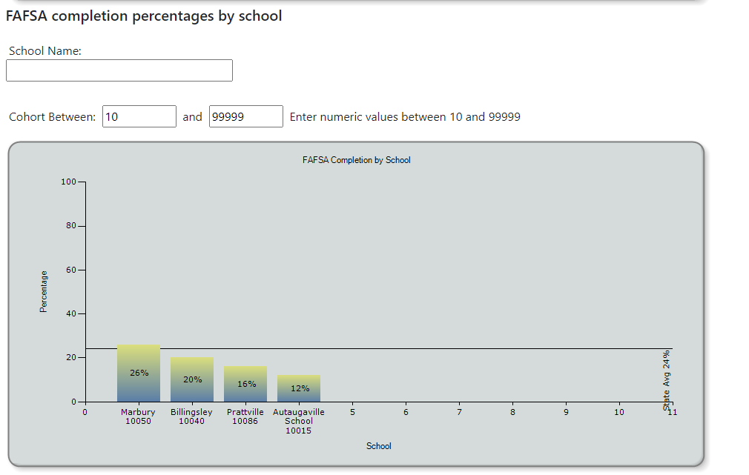

Slide 16





Process Flow Diagram
Process Flow Diagram
Oracle
Compares/Matches data to see who has completed the FAFSA
ED Connect
ACHE Downloads Federal FAFSA Data
Sends participation and status reports by Schools and Districts
Repeat process as needed.
Reports
Federal FAFSA Database
AL Dept. of Education
Submits student data to ACHE
Student Applies for Federal Financial Aid using the FAFSA
School Districts and High Schools
Authorized staff work with Students
Identifies and works to correct errors and assist with verifications
Feedback Loop

Slide 17

New Program Requests for FY 2022-23 (2 of 3)
Gaining Early Awareness and Readiness (GEAR UP) ($2,500,000)
ACHE has been asked to assume responsibility for the statewide aspect of this federal matching grant program currently administered by UAB. GEAR UP provides multi-year grants to states and partnerships to provide services.
GEAR UP is designed to increase the number of low-income students who are prepared to enter and succeed in postsecondary education.
GEAR UP grantees serve an entire cohort of students beginning no later than the seventh grade and follow the cohort through high school.
GEAR UP funds can also be used to provide college scholarships to low-income students.

Slide 18
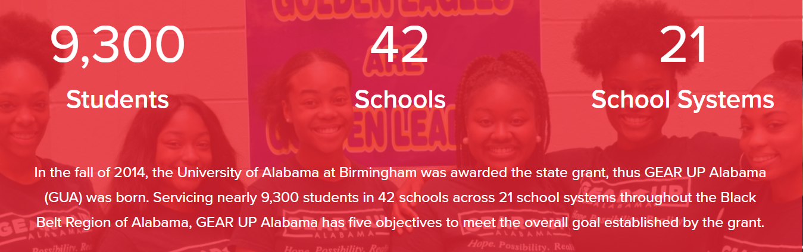

Slide 19
New Program Requests for FY 2022-23 (3 of 3)
Higher Education Micro-Credential Fund ($1,000,000) The Higher Education Micro-Credential Fund will support the development of short-term certificates at the state’s universities that lead to industry recognized credentials. Alabama’s 2021 Talent Development Strategic Plan highlights the importance of industry-validated, short-term credentials that can be articulated with degree programs, which are commonly known as “micro-credentials.” This fund will support four-year institutions in developing innovative micro-credential programs that advance their missions and support state strategic goals for talent development.
ACCS received funding to support the development of micro-credentials at their institutions in their 2021-22 budget.
These educational vignettes can be incorporated into existing academic programs or serve as a stand-alone credential available to persons seeking to enhance their work skills.

Slide 20
Assumptions for Other Existing Programs
5% for Student Assistance
5% for other Educational Activities
Most State Programs are held at prior year appropriations, except for:
  AKEEP, 50% increase ($49,473) to support their initiative to help address Alabama’s Teacher shortage in Math and Science.
  The first cohort of licensed teachers from South Korea are now being enrolled in graduate schools in Alabama and will soon have teaching experiences in participating school districts.
  HBCU Consortium 12% ($82,500) increase to support professional development opportunities for member institution staff.

Slide 21

VIII. DISCUSSION ITEMS

Slide 22

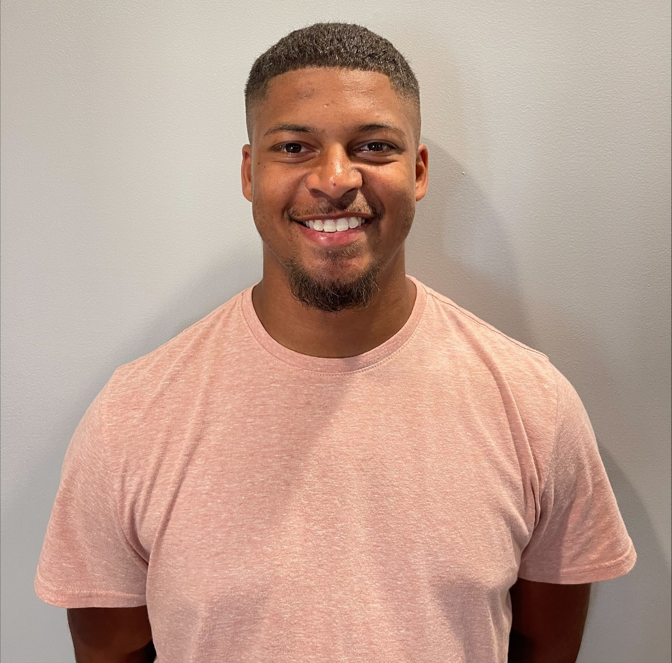
Jacob Orr
Men of Kennis
Athens State University launched the Men of Kennis program in Spring 2020 through funding from the Alabama legislature. The program is designed to support men of color on their path to becoming teachers in Alabama.

Slide 23

Men of Kennis @ Athens State University
Alabama Recruit & Retain Minority Teachers Program

Slide 24

Today’s Education Crisis
Despite students of color representing more than half the student population, Black males make up only
2% of the teacher workforce.
Lack of Diversified Teacher Workforce!

Slide 25
Men of Kennis @ Athens State University
Academically rigorous program designed to produce high-quality teachers who:
Have a GPA of 2.5 or higher
Enroll in 12 semester hours each semester
Agree to teach in Alabama for 2 years
Receive $10,000 scholarship split between Fall, Spring and Summer Semesters

Slide 26
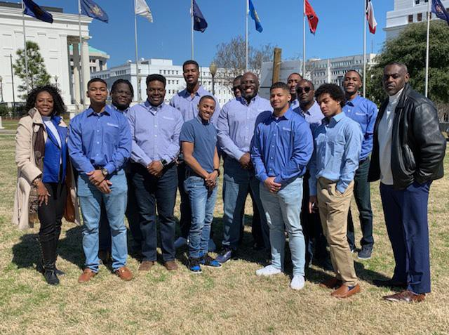
Men of Kennis @ Athens State University
Cohort Model Includes:
Program Orientation
Monthly Professional Development
Peer Mentor Opportunities
Progress Monitoring & Support

Slide 27
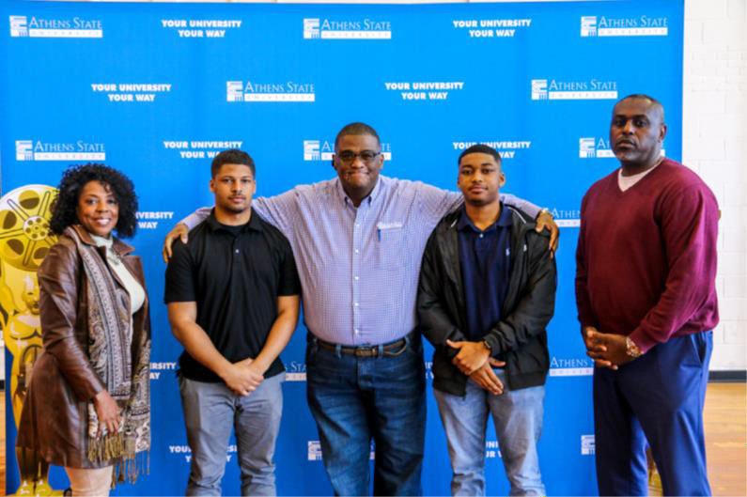
Men of Kennis @ Athens State University
Reduce the gap between students and teachers of color
Recruit & retain men of color as K-12 teachers
Increase diversity at multiple points across teacher pipeline
  Early Childhood
  Elementary
  Postsecondary

Slide 28
Men of Kennis @ Athens State University
Minority Students
Perform better academically
-- math and reading
Increase likelihood of graduating from
high school and considering college
Drop-out risk reduced by 39%
Fewer disciplinary issues
Fewer absences
More positive views of schooling
Better test scores
White Students
Valuable perspective of backgrounds
Disrupt one-sided portrayals of the world and offer invaluable insight
Positive perception of black men
  Knowledge experts
Humanize subjects such as racism
and inequalities

Slide 29
Men of Kennis @ Athens State University
THANK YOU
FOR YOUR CONTINUED SUPPORT!

Slide 30
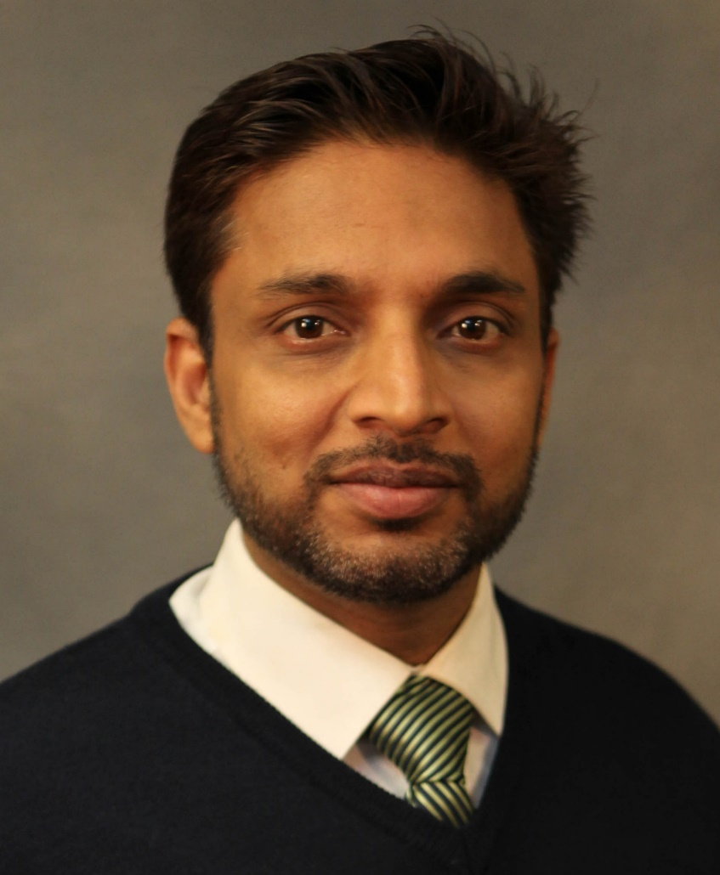


Dr. Shaik Zainudddin
Associate Professor, Materials Science and Engineering
Tuskegee University
Alabama EPSCoR Graduate Research Scholars Program Tuskegee Campus Coordinator
“GRSP and Its Impact: My Alabama Career Story”

Slide 31
Alabama Commission on Higher Education, Dec. 10, 2021
GRSP and it’s Impact: My Alabama Career Story
Shaik Zainuddin, Ph.D.
Associate Professor, Department of Materials Sci. & Engg.
Tuskegee University, Alabama
Goal 1: Alabama EPSCoR Graduate Research Scholars Program (GRSP) was established by the state of AL to attract and keep the best and brightest minds in high tech EPSCoR fields by providing graduate support for the EPSCoR students.
Goal 2: Alabama EPSCoR (ALEPSCoR) is designed to strengthen Alabama research capabilities to:
      Bring in more federal research dollars
      Develop new high-tech research capabilities and companies

Slide 32
Career Ladder
PI/Co-PI of Funded Grants: ($23,600,000, PI-3.6 M)
8 book chapters, 72 peer reviewed journals/conference papers, and 53 presentations
Involved and mentored over 150 minority Graduate, Undergraduate and Community College students from institutions in Alabama and neighboring states
Associate Professor, Materials Science and Engineering, Tuskegee University, AL. 2018-Present
Assistant Professor, Materials Science and Engineering, Tuskegee University, AL. 2012-2017
Research Assistant Professor, Materials Science and Engineering, Tuskegee University, AL. 2010-2011
Research Associate, Materials Science and Engineering, Tuskegee University, AL. 2009-2010
Services at Tuskegee University
1. Director of Research Experience for Undergraduates in Materials Science Engineering Program, 2. Director of Minor in Materials Science and Engineering Program (2019-Present), 3. Director of Nanomechanical and Tribological Labs
Graduate Council Member
GRSP Campus Coordinator
Internal Review Board (IRB) Member
Red Team Member
Graduate Student Chair and Committee Member
Graduate Studies and Research Committee Member, College of Engineering
Faculty Award Selection Committee Member, College of Engineering
President: Sigma Xi (Tuskegee University Chapter)
Ph.D., Materials Science & Engineering, Tuskegee University, Alabama, USA. 2009

Slide 33
Professional Services Outside Tuskegee University
Scientific Committee Member- NANOStruc Conference, 2012-present
Associate Editor, Academic Journal of Material Sciences, 2016-Present
Consultant: King Khaled University, Abah, Kingdom of Saudi Arabia.
Editorial Advisory and Board Member of 5 Journals
Proposal Reviewer: National Science Foundation, Qatar National Research Fund (QNRF)
Reviewer of 12 National and International Journals
ASME Topic Organizer/ Co-Organizer
ASME/ICCM Session Chair and Organizer
Coordinator: JAR, T-CAM
Judge: ERN, JAR, LSAMP
Selected as a STEM 2022 Modern Day Technology Leader, BEYA STEM Conference, Feb 17-19, 2022, Washington, DC.

Slide 34
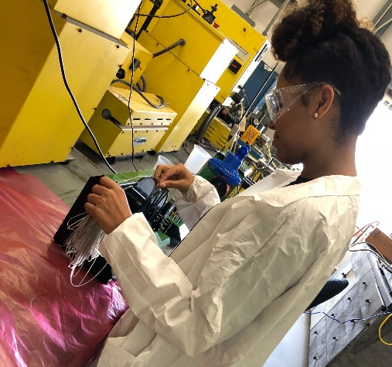
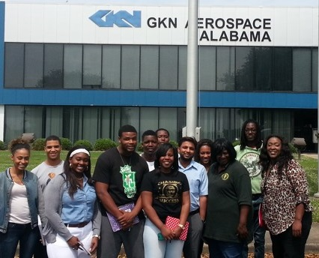
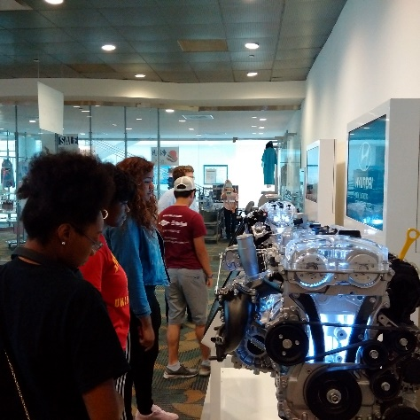
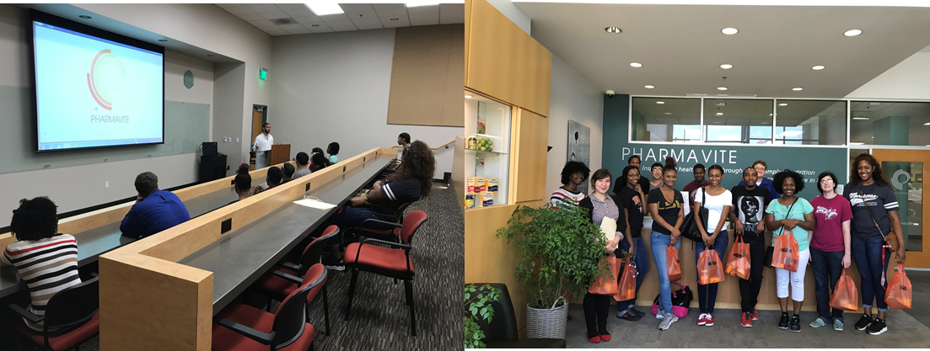
Director- Research Experience for Undergraduates in NanoBio Materials Science and Engineering (2013-Present)- NSF REU Grant
Goal is to recruit students from four-year institutions and community colleges in Alabama and neighboring states, and prepare/motivate them to pursue higher studies and/or join STEM workforce
Talladega College
Oakwood College
Faulkner community college
Lawson State Community College
Stillman College
Bishop State Community College
Alabama A&M University
Tuskegee University
Albany State University
Hyundai Manufacturing Plant
Program Activities
Ten-week Summer Research Experience
Research Course
Preparation for the Graduate Record Examination (GRE)
Field Trips to Alabama Industrial Sites
Presentations in Conferences/Meetings

Slide 35
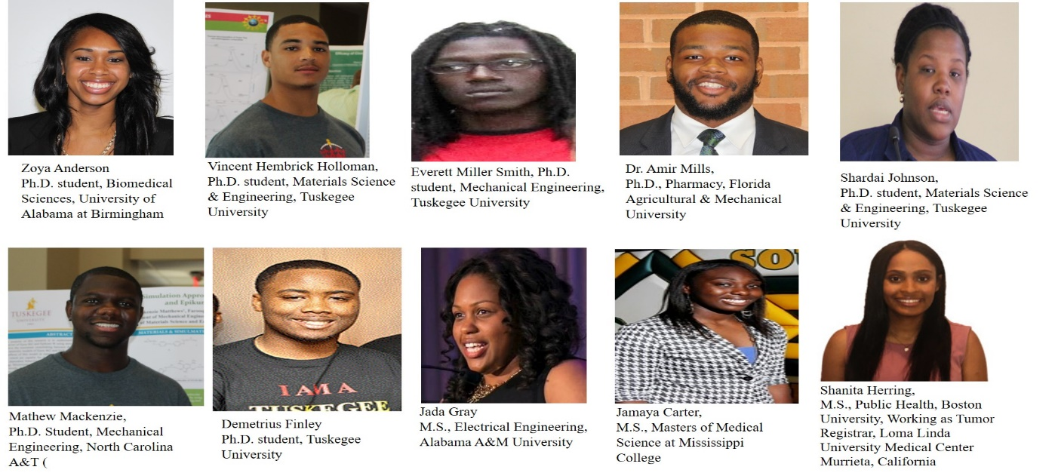
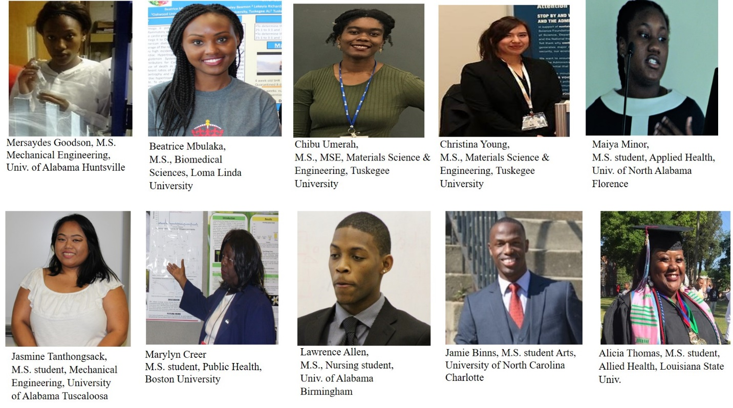
92 AA students participated (43% males and 57% females)
117 presentations in national and international conferences, 3 book chapter, 27 peer reviewed journal and conference papers, received internship in national laboratories, won several awards and fellowships.
15 students have joined/completed Tuskegee University graduate programs and more than 34 students have completed/pursuing M.S./Ph.D. programs at other institutions

Slide 36
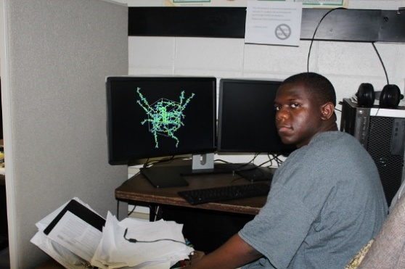
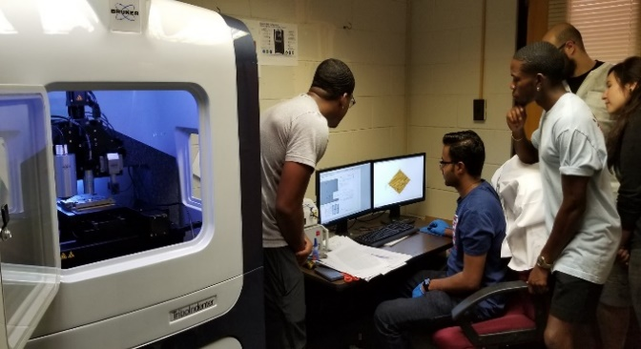
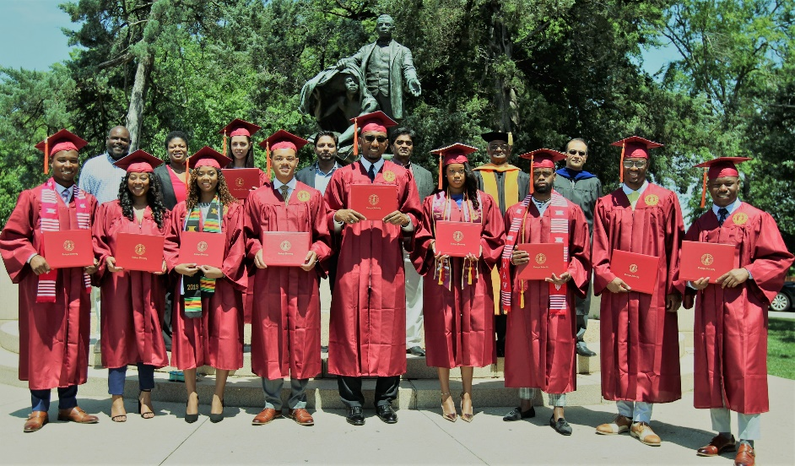
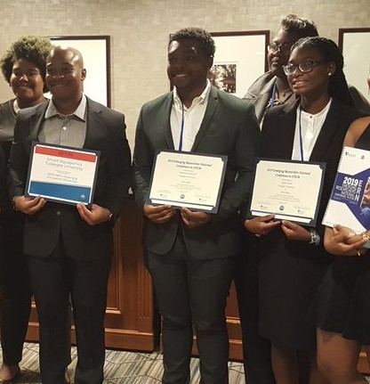
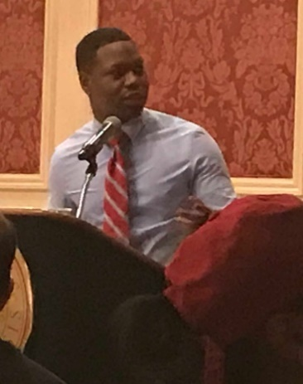
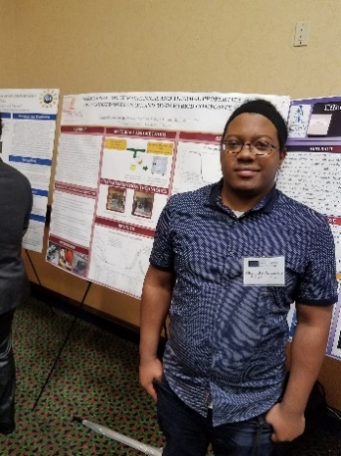
Director-Minor in Materials Science and Engineering (NSF Implementation & TIP Grants)
STEM students from Mechanical, Aerospace and Chemical Engineering, Biology, Chemistry, Physics and Agriculture are involved in hands-on research projects on novel and advanced materials besides taking courses specifically designed as per the market demand in this program.
Receiving a Minor in MSE certificate beside major B.S. degree have add feathers to students career and made them more competitive for the much needed diverse workforce in STEM areas besides motivating them to pursue graduate studies.
To date, 41 students have completed Minor in MSE (9 are pursuing M.S. studies and 32 have joined STEM workforce), and 21 are currently enrolled in this program.
Students working, presenting and receiving awards
First batch of students receiving Minor in MSE on May 9, 2019

Slide 37
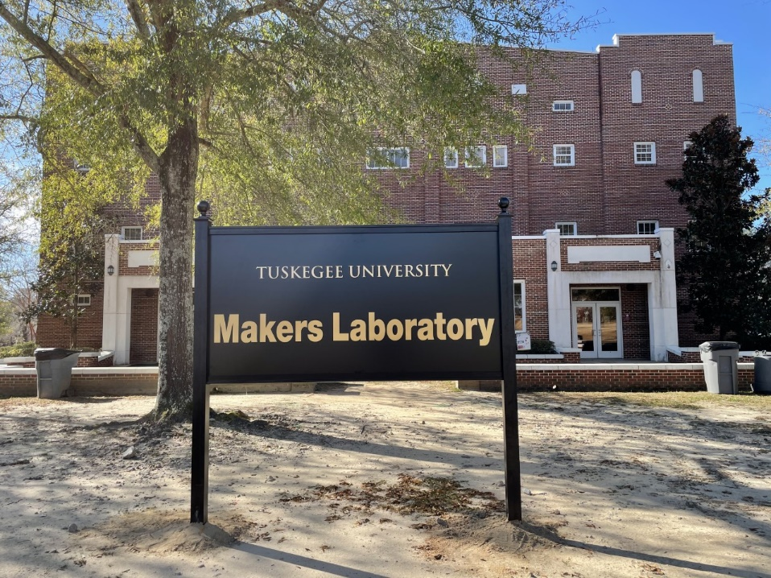
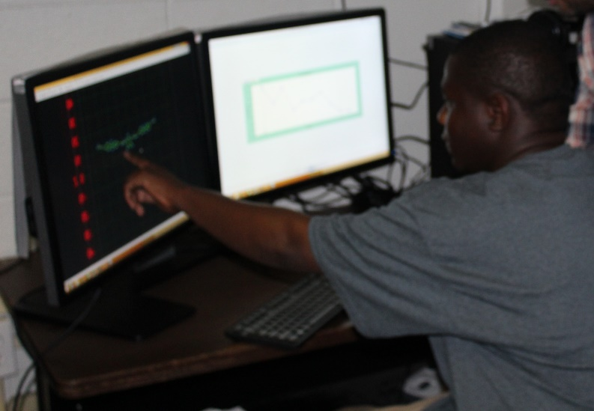
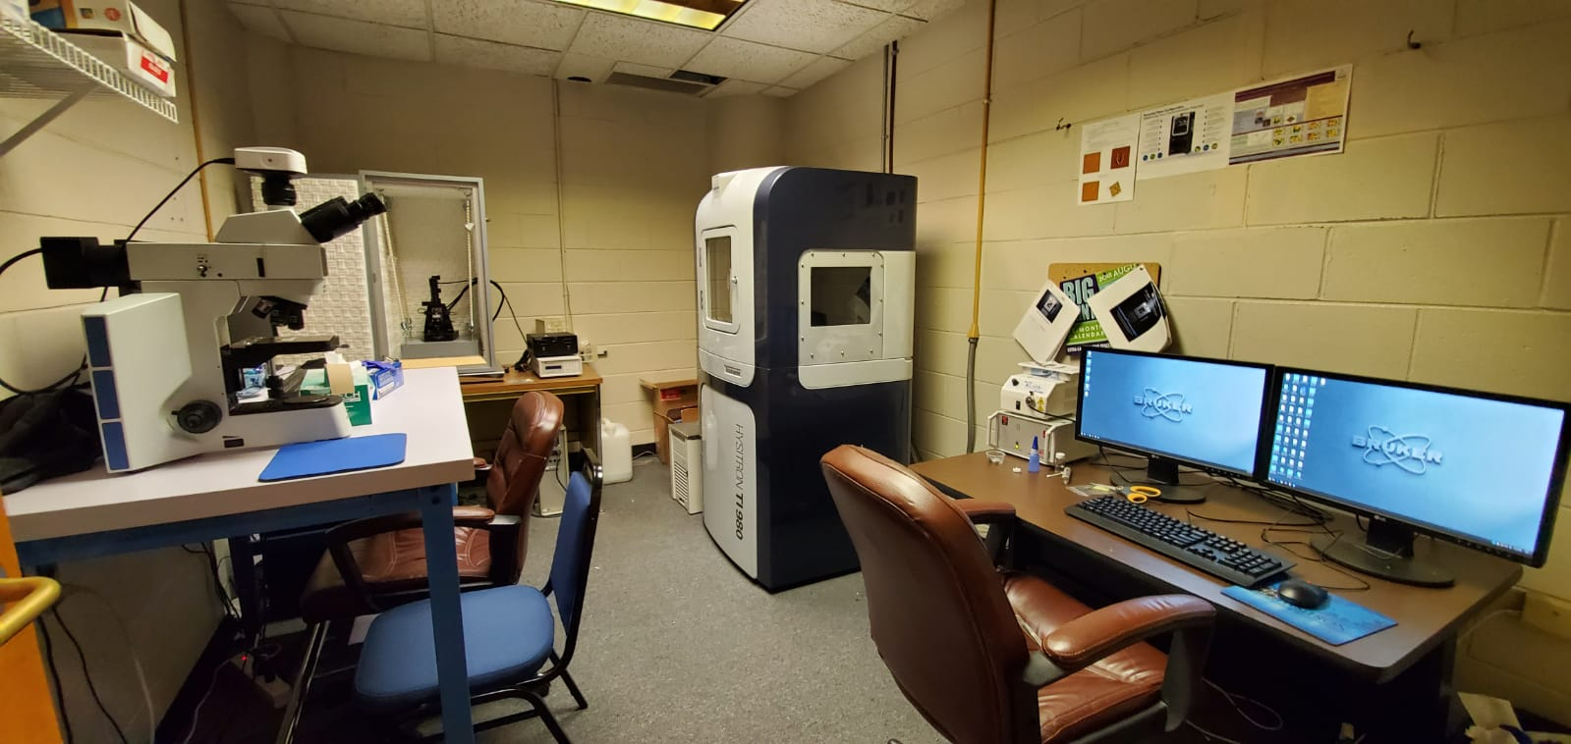
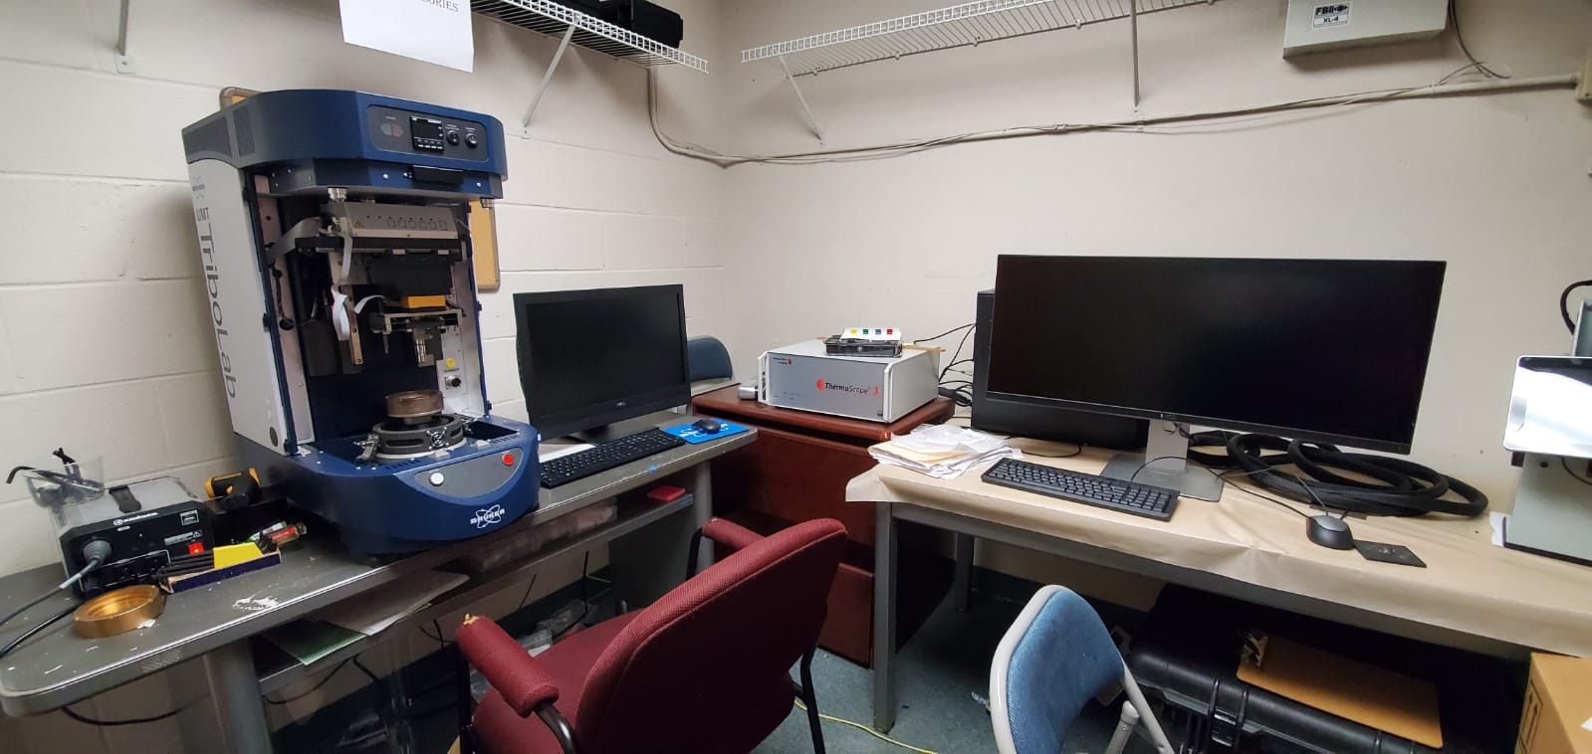
Developed and Established New Research Areas & Labs at TU (NSF MRI, TIP and Implementation Grants)
MAKERS Lab & MAKERS Course
Computational Mechanics
Nanomechanics and Testing
Tribology
Computational Lab
Atomic force microscopy
Ti-980 Triboindenter
Optical microscopy
Nanomechanical analyzer systems
Tribology Lab
Nanomechanics Lab

Slide 38
Other Major Projects in the Department of MSE at TU
NSF CREST: Center for Sustainable Lightweight Materials
NSF-PREM: Partnership for Research and Education in Multiferroic Polymer Nanocomposites Between Tuskegee University and University of Nebraska-Lincoln
NSF ALABAMA- EPSCoR: RII Track-1: CPU2AL: Connecting the Plasma Universe to Plasma Technology in Alabama
NSF RISE: Enhancement of Research Capability and Development of Early Career Faculty at Tuskegee University

Slide 39
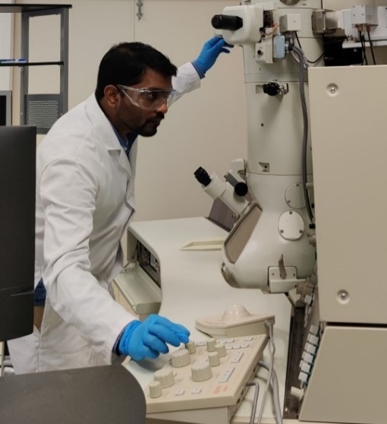
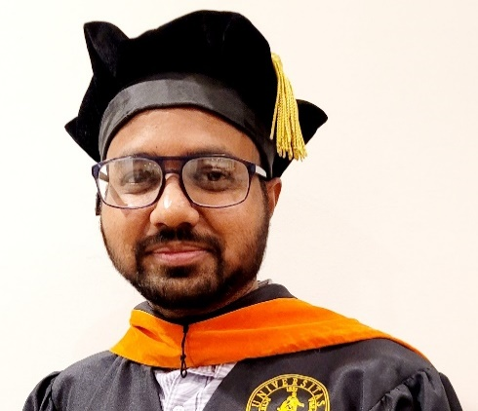
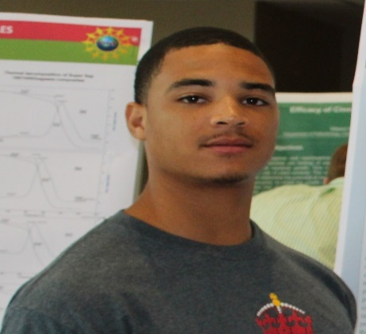
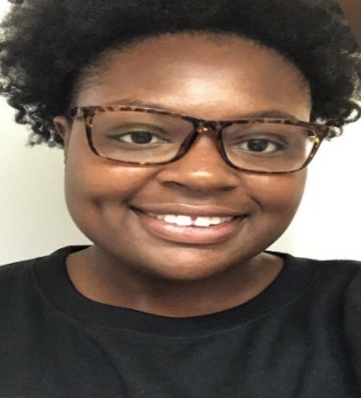
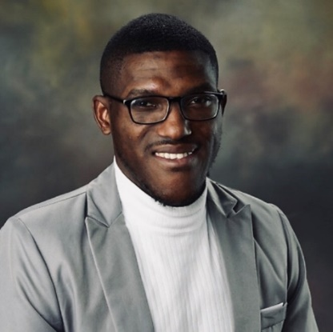
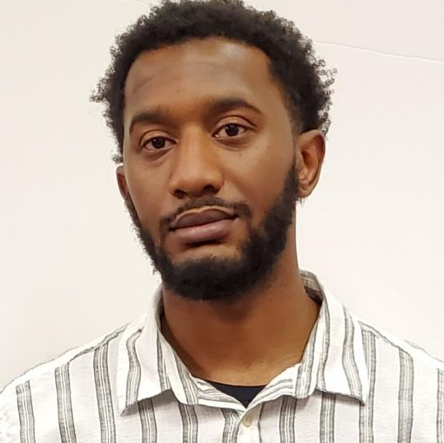
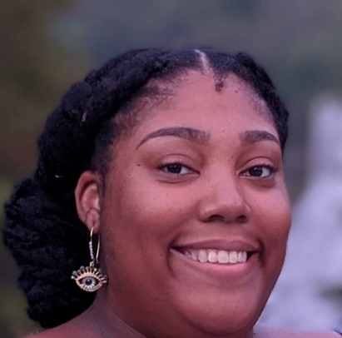
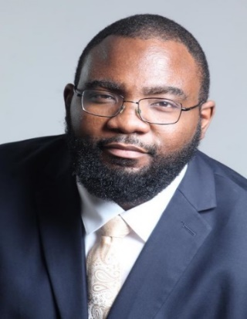
As of December 2021, GRSP has supported the achievement of an estimated 73 M.S. and 221 Ph.D. degrees.
Recent GRSP TU recipient pursuing career in Alabama
Dr. Farooq Syed, Ph.D. 2020
Development Engineer, R&D,
SiO2 Materials Science, Auburn AL
Dr. Vincent Hembrick Holloman, Ph.D. 2021
R&D Engineer, Evonik, Birmingham AL
Dr. Zaheeruddin Mohammed, Post-Doc, TU
Current TU GRSP Students(2020-21)
Erin Nicole-Smith,
Ph.D. student, MSE
Richard Harry,
Ph.D. student, MSE
Azizi J. Turner,
Ph.D. candidate, MSE
Amber Kinnebrew,
Ph.D. student, MSE
Lyndon Smith,
Ph.D. student, MSE

Slide 40
Acknowledgements
Alabama Commission on Higher Education
Alabama EPSCoR- Graduate Research Scholars Program (GRSP)
National Science Foundation
Everyone else involved directly/in-directly with this effort

Slide 41
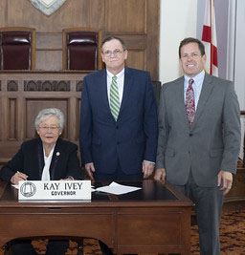
Largest Education Budget in State History
$7.7 Billion
(Act 2021-342)
Changes in eligibility requirements –
  AMSTEP (Act 2021-389) &
  Police Officer’s and Firefighter’s Survivor
  Educational Assistance Program (Act 2021-425)
L to R - Governor Kay Ivey,
ACHE Executive Director Jim Purcell, ACHE Chairman Charles Buntin
at bill signing

Slide 42

Alabama’s Credential Registry
https://credentials.ache.edu/
Are You Ready For College?
Complete College Alabama
https://ache.edu/InstEffectiveness.aspx
Freedom of Speech
https://ache.edu/Freedom_of_Speech.aspx
New Academic Program Approvals
2020-21 - 53 new programs of study were approved
Up more than 20% from the prior year

Slide 43

VIII. Decision ITEMS

Slide 44

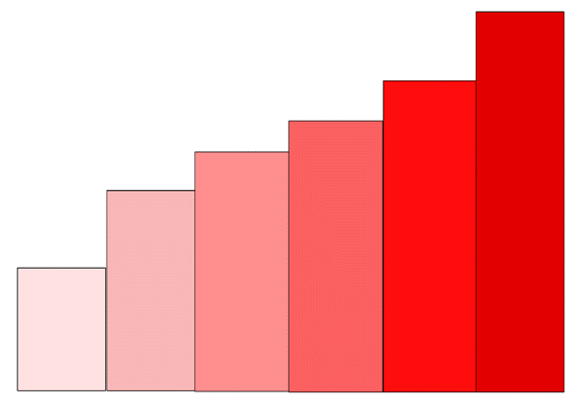

A. Annual Report: Alabama Commission on Higher Education
2020-21 State Plan Update
Update On
Building Human Capital
The Educational Path to
Alabama’s Economic Success
2020-2021
Annual Report
Alabama Commission on Higher Education
Strategic Plan (2018-2030)
(Board Approved 12/8/2017)
The plan’s 12-year period will allow for an appropriate evaluation of the strategies identified in each of the five priorities. The data that is used to evaluate each priority
will establish benchmarks and provide annual progress reports.

Slide 45
Priority One: Improving Access
Public H.S. Graduates better prepared for college
Source: Alabama Statewide Student Database
*College-Ready students are those not requiring developmental education courses while in college. In Fall 2018, 74.6% of students enrolled full-time were college-ready. That number increased in Fall 2019 to 76.4%. It further increased in Fall 2020 to 78.7%.
Significant Increase in State Aid

Slide 46
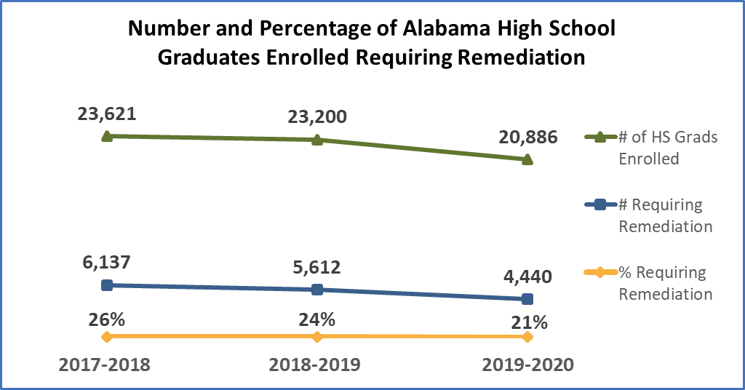
Priority Two: Enhancing Student Success
Decline in % and # of students remediated
In 2019, Dual Enrollment credits at the universities increased 18% from prior year, and there was an increase of 17.5% at the community colleges.
Source: Alabama Statewide Student Database
Alabama High School Feedback Report
Dual Enrollment Increased
Source: Southern Regional Education Board (SREB) Data Exchange Survey

Slide 47
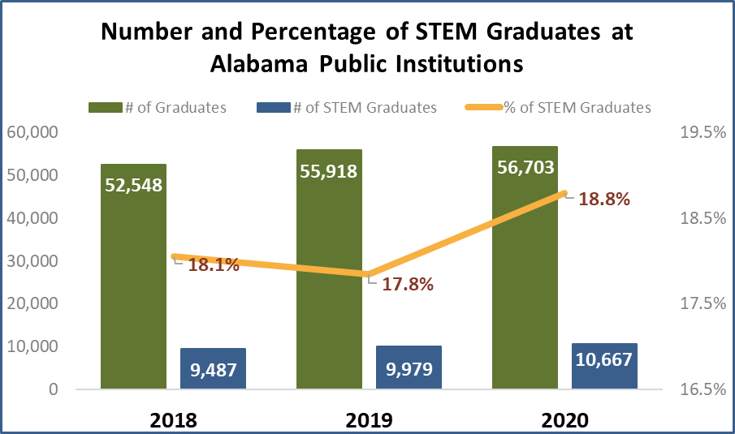
Priority Three: Enhancing STEM Programs
STEM Enrollment Decreased
A decrease of -0.05% of students enrolled in STEM
Source: Alabama Statewide Student Database
% STEM Graduates Increased

Slide 48

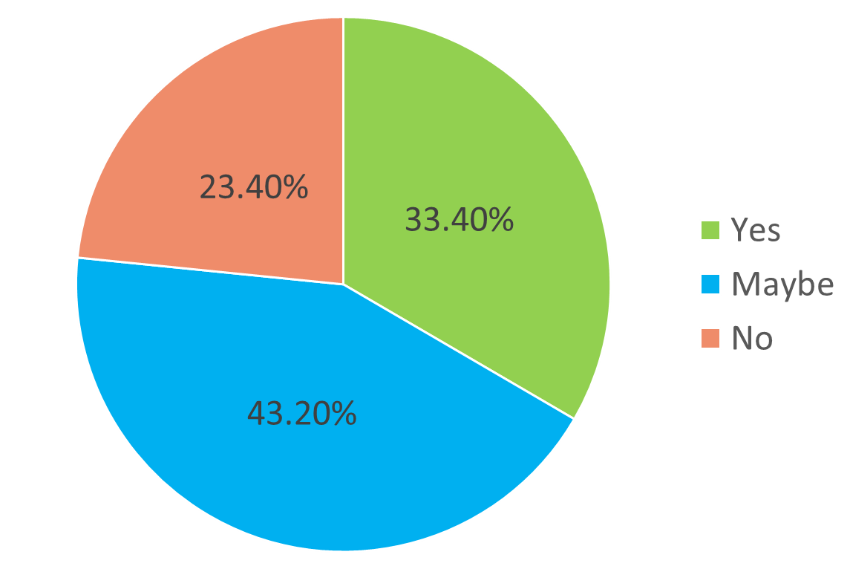
Priority Four: Developing Alabama’s
Economy and Workforce
Although 2 out of 3 in-state students are in the workforce one year after graduation, the retention of recent Alabama graduates is low compared to other states.
Of the sophomore, junior, and senior college students that responded to the survey, 43% indicated “maybe” when asked if they would stay in Alabama after graduation.

Slide 49
Priority Four: Developing
Alabama’s Economy and Workforce
Huntsville’s Cummings Research Park is the second largest research and technology park in the U.S.
Alabama is home to 780 bioscience companies with an annual economic impact estimated at $7.3 billion
Fastest growing economy in the country is in the Southeast
The Port of Mobile is the ninth largest deep-water seaport in the U.S.
In Auburn, Si02 Materials Science has invested $163 million to ramp up production of its patented vials for the Covid-19 vaccine program
HudsonAlpha Institute for Biotechnology in Huntsville is a nationwide leader in research on the human genome
Birmingham-based Southern Research has discovered seven FDA-approved drugs used in cancer treatment

Slide 50
Priority Four: Developing
Alabama’s Economy and Workforce
Past Decade Growth…
Future Opportunities…
Alabama has attracted economic development projects involving almost $54 billion in new private sector capital investment and over 160,000 jobs
FedEx plans $57 million logistics facility in Dothan
J.M. Smucker announces $1.1 billion Alabama manufacturing plant to be built in Birmingham creating 750 jobs
Alabama ranks fifth in the U.S. in the concentration of manufacturing employment
Amazon is expanding its Alabama investment with three new operational facilities and a new fulfilment center
Mercedes-Benz, Boeing, Lockheed Martin, among others have expanded their Alabama operations
Mazda Toyota Manufacturing, Airbus, Google, Amazon, GE Aviation, Polaris, Blue Origin have established major Alabama operations
Telemedicine startup MomentMD is establishing an Alabama headquarters in Birmingham

Slide 51
Priority Five: Organizational Effectiveness
and Efficiency
  FAFSA Completion Portal to increase college going rates
  Financial Aid Study in conjunction with Lumina Strategy Labs to improve affordability
  Retain Alabama and Recall Alabama to retain Alabama graduates and improve the workforce
  Financial Budget Hearings to determine institutional needs for the consolidated budget recommendation

Slide 52
Motion, Decision Item A:
That the Commission accept the 2020-2021 ACHE Annual Report.

Slide 53
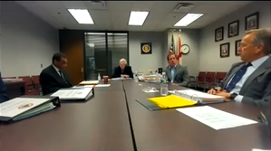
B. Finance Sub-Committee Budget Recommendations
1. Executive Budget Request for FY 2022-2023

Slide 54
Executive Budget Request for
FY 2022-2023
Staff Presenter: Mrs. Veronica Harris

Slide 55

STATE OF ALABAMA
Department of Finance
STATE AGENCY
BUDGET REQUEST INSTRUCTIONS
Fiscal Year 2023
Kay Ivey
Governor

Slide 56
BUDGET REQUEST SUBMISSION
The Code of Alabama, Title 41, Chapter 19, Section 6 (a) (3) states that, each state agency/department, on the date and in the form and content prescribed by the Department of Finance, shall prepare and forward to the Budget Officer the budget requested to carry out its proposed plans in the succeeding fiscal year.
The due date for Budget Request packages, as set by law is November 1st of each year. Therefore, the FY 2022-2023 budget request packages are due Monday, November 1, 2021 (§ 41-4-84, Code of Alabama 1975).
In order to comply with the designated submission deadline, a draft budget request will be submitted to EBO.
Any changes made by the Commission will be submitted through a budget request revision.

Slide 57

Planning assumptions used in developing the
FY 2022-23 Executive Budget Request:
Planning and Coordination (Operations and Maintenance),
A 5.0% increase is being requested due to:
An increase is needed for employee termination costs (retirements)
Increased costs for building operations and rent
Increases are need to cover increases in Information Service Division (ISD) charges, postage, and telephone services
Increases are needed for subscriptions, software purchases, replacement of computers and printers, UPS/FedEx shipping costs, State Higher Education Executive Officers organization (SHEEO) dues, and general office supplies
Increases are needed for Comptroller Office transaction charges

Slide 58

Alabama Commission on Higher Education
FY 2022-23 Executive Budget Request
ACHE is requesting a total of $52,002,632 for FY 2022-23, of which $50,819,643 is from state funds.
This represents an overall 9.57% increase over the total amount appropriated for FY 2021-22.
The FY 2022-23 Request contains requests for 35 programs under 5 appropriation units.
This includes requests for three new programs.

Slide 59
Assumptions for Other Existing Programs
5% for Student Assistance
5% for other Educational Activities
Most State Programs are held at prior year appropriations, except for:
  AKEEP, 50% increase ($49,473) to support their initiative to help address Alabama’s Teacher shortage in Math and Science.
  The first cohort of licensed teachers from South Korea are now being enrolled in graduate schools in Alabama and will soon have teaching experiences in participating school districts.
  HBCU Consortium 12% ($82,500) increase to support professional development opportunities for member institution staff.

Slide 60
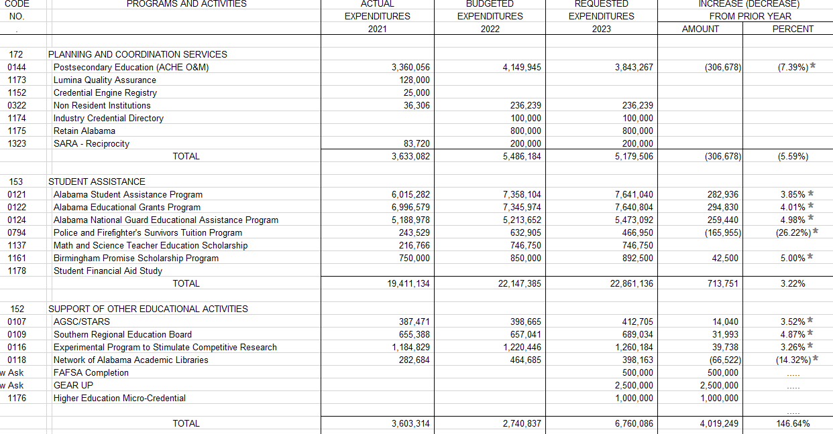


* 5% increase over prior year

Slide 61
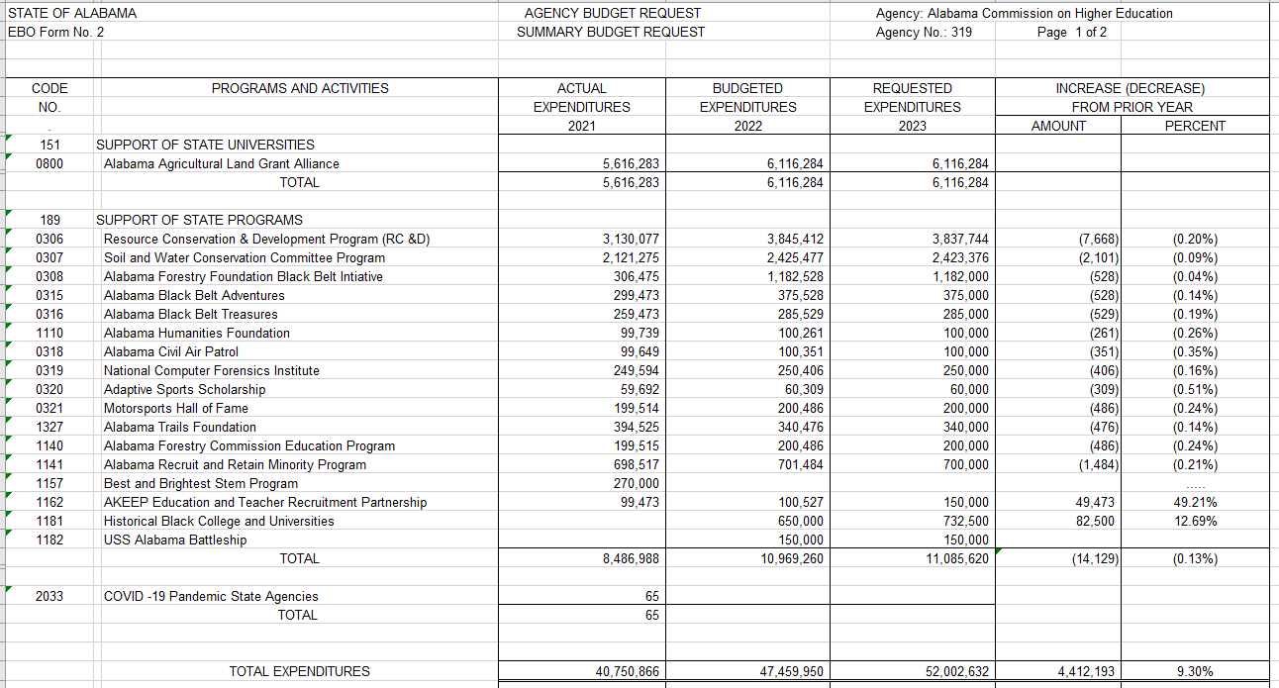
#
#
# denotes only recommended increases

Slide 62
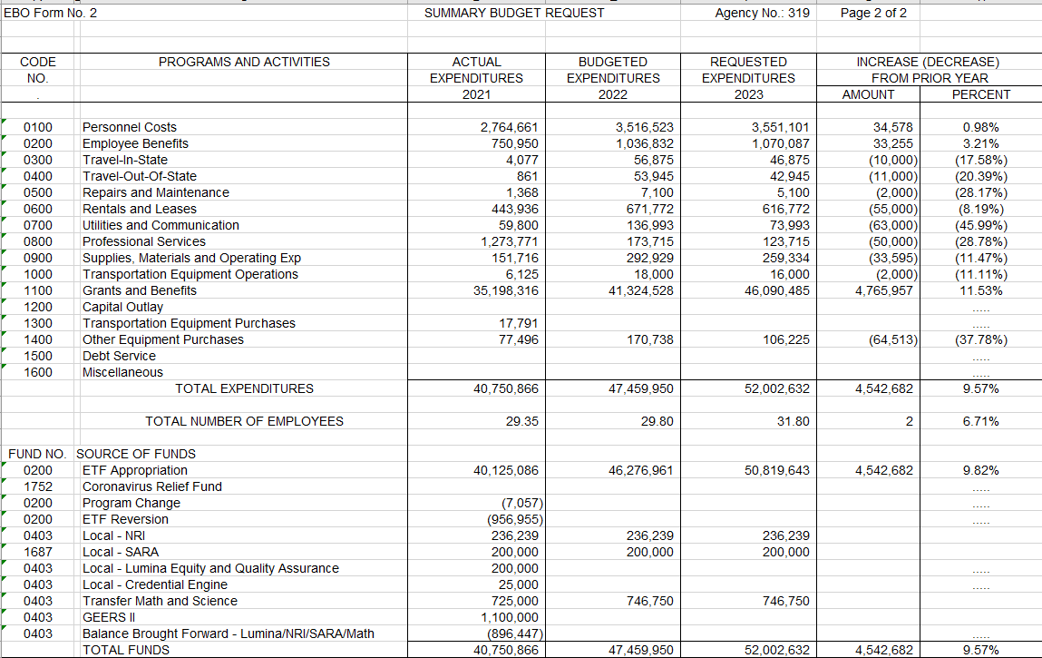

Slide 63
Alabama Commission on Higher Education
FY 2022-23 Executive Budget Request Summary
ACHE is requesting a total of $52,002,632 for FY 2022-23, of which $50,819,643 is from state funds.
This represents an overall 9.57% increase over the total amount appropriated for FY 2021-22.
This includes requests for three new programs:
FAFSA Completion ($500,000)
Alabama Gear Up ($2,500,000)
Higher education Micro-Credentials Fund ($1,000,000)

Slide 64
B. Finance Sub-Committee Budget Recommendations
2. Consolidated Budget Recommendation for FY 2022-2023

Slide 65
Consolidated Budget Recommendation (CBR) for FY 2022-2023
Staff Presenter: Dr. Jim Hood

Slide 66

Section 16-5-9(b) of the Code of Alabama states that “...The Commission ... shall present to each institution and the Governor and legislature, a single unified budget report containing budget recommendations for the separate appropriations to each of the institutions.”

Slide 67
CBR for FY 2022-2023: Considerations
In developing the Consolidated Budget Recommendation (CBR), the following information was considered:
Cap on ETF Appropriation due to the Rolling Reserve Act
Increased revenue projections (taxes, license & use fees, other costs)
Historical Split Between Higher Education (25.51%), K-12 (68.5%), & Other Education (5.99%)
Requested Amounts from Budget Proposals
New Initiatives and High-Need Areas Highlighted in Budget Hearings
Notes:
This year’s recommendation is based on several factors and considerations.

Slide 68
CBR for FY 2022-2023:
Considerations of Recommendation
Budget Hearings
Conducted budget hearings in early November.
Institutions had opportunity to provide additional context on budget requests and highlight areas of need.
Financial Affairs Committee had opportunity to ask questions and get a better understanding of the financial challenges facing colleges and universities.
Some of the areas of need focused on the following:
  Personnel and salary issues, including salary compression,
  Increased mandatory costs related to retirement and insurance,
  Growing need for capital assets to address deferred maintenance, building construction and building renovation, and
  Need for technical upgrades in response to growing online instruction.

Slide 69
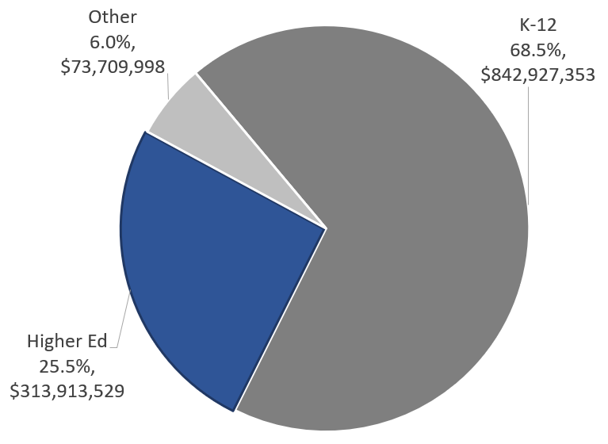
CBR for FY 2022-2023: for Higher Education
Estimated ETF FY2023 Revenue Calculation: $8.90 Billion
ETF Appropriation from FY2022: $7.67 Billion
Estimated ETF Increase for Education: $1.23 Billion
Higher Education (25.5%) estimated increase $313.91 million

Slide 70
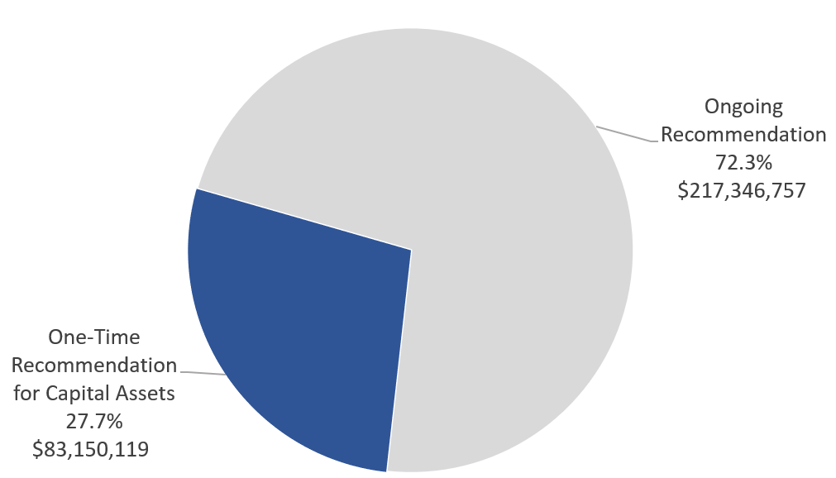
CBR for FY 2022-2023: One-Time Recommendation
$83,150,119
$83.15 million (27.7%) of total CBR is related to one-time funds associated with capital asset expenditures.

Slide 71
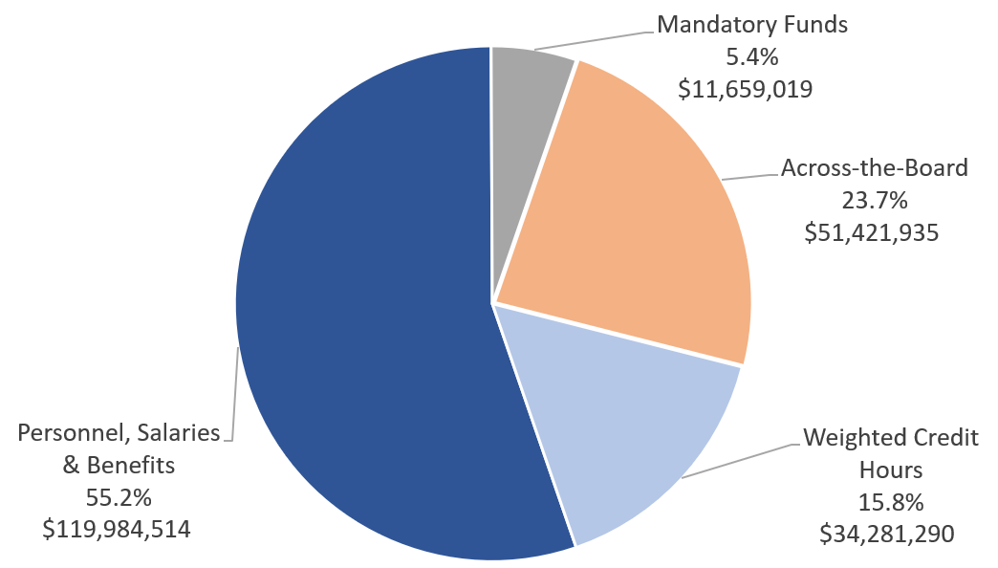
CBR for FY 2022-2023: Ongoing Recommendation
$217,346,757
$217.35 million (72.3%) of total CBR is related to ongoing funds associated with personnel and other related expenses

Slide 72
CBR for FY 2022-2023:
Ongoing Recommendation
Personnel, Salaries, and Benefits
Rationale: Personnel costs were reoccurring themes in the budget hearings. Institutions are struggling to retain and attract employees in COVID environment, including resolving going salary compression issues.
Calculation: 7 percent over total FY 2022 appropriation. The 7 percent was chosen to outpace recent Consumer Price Index (CPI) inflation rates of 6.2 percent, and provide additional monies to address salary compression. These funds reflect roughly 55.2% of the ongoing CBR which closely aligns with the 54% of total E&G expenditures typically spent on salaries and benefits.
Amount: $119.98 million (55.2% of ongoing CBR*)
*Does not include statewide line items.

Slide 73
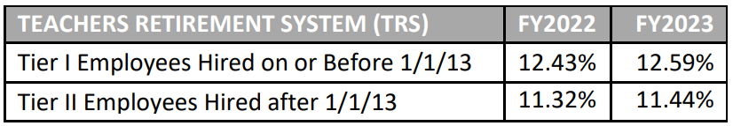
CBR for FY 2022-2023:
Ongoing Recommendation
Mandatory Funds
Rationale: Funds available to give institutions support in addressing mandatory increased costs related to retirement obligations and increases costs related to Public Education Employees’ Health Insurance Program (PEEHIP).
Calculation: Reflects requested funds reported from institutional needs assessment reporting. Increases in retirement rates:
Amount: $11.66 million (5.4% of ongoing CBR*)
*Does not include statewide line items.

Slide 74
CBR for FY 2022-2023:
Ongoing Recommendation
Across-the-Board Allocation
Rationale: Pool of funds made available to give institutions flexibility in addressing rising utility costs, upgrades to technical infrastructure, and other unique needs of their campuses.
Calculation: 3 percent over total FY 2022 appropriation. The 3 percent was chosen because it slightly outpaces recent Higher Education Price Index (HEPI) of 2.2 percent used for fiscal year 2021. The index is used to project future budget increases required to preserve purchasing power.
Amount: $51.42 million (23.7% of ongoing CBR*)
*Does not include statewide line items.

Slide 75
CBR for FY 2022-2023:
Ongoing Recommendation
Weighted Credit Hours
Rationale: Pool of funds made available based on weighted credit hours using weighting methodology from ACHE Standard Formula. These funds recognize increases in enrollment, credit hour productivity, and the need to fund STEM and other high-costs programs requiring more resources.
Calculation: 2 percent over total FY 2022 appropriation distributed by weighted credit hours from AY 2021 using weights from ACHE Standard Formula.
Amount: $34.28 million (15.8% of ongoing CBR*)
*Does not include statewide line items.

Slide 76
CBR for FY 2022-2023:
One-Time Recommendation
Capital Assets
Rationale: Capital assets was a reoccurring theme in budget hearings. These funds will help address deferred maintenance as well as building renovation and construction. These funds also help enhance technology and support more online activity in response to COVID.
Calculation: After previously mentioned areas were funded, remaining funds from $313 million estimate were distributed using the Advancement and Technology (A&T) formula for higher education. This formula divided these funds using a three-year average enrollment by residency.
Amount: $83.15 million (27.7% of total CBR*)
*Does not include statewide line items.

Slide 77
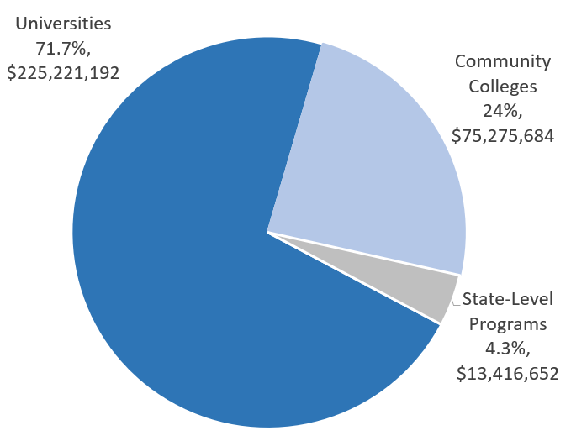
CBR for FY 2022-2023: by Sector
Universities (71.7%)
$225.2 Million
17.0% increase over FY2022
Community Colleges (24.0%)
$75.3 Million
19.4% increase over FY2022
State-Level Programs (4.3%)
$13.4 Million
5.5% increase over FY2022

Slide 78



Slide 79
Motion, Decision Item B-2:
That the Commission approve the Executive Budget Recommendation and the Consolidated Budget Recommendation for FY 2022-2023.

Slide 80

C. Report on the Facilities Master Plan & Capital Projects Requests for
FY 2022-2023 – FY 2026-2027
Staff Presenter: Julian Rogers

Slide 81


Report on the Facilities Master Plan & Capital Projects Requests for
FY 2022-2023 - FY 2026-2027
Section 16-5-15 of the Code of Alabama requires that each public college & university annually submit a 5-year facilities master plan to the Commission. Each institution is also required to prioritize its capital requests and to provide a needs assessment for requested projects.
The five years reported are broken into three time segments: Immediate, Intermediate, and Long-Term capital projects.
Immediate projects are defined as those within the first year of the master planning cycle (FY 2023).
Intermediate projects are defined as those within the second year of the planning cycle (FY 2024).
Long-Term projects fall into the last three years of the planning cycle (FY 2025 - 2027).
The projects are further divided into four separate project categories:
New Construction/Acquisition
Renovation and Remodeling
Major Capital Equipment
Deferred Maintenance/Facilities Renewal

Slide 82


Immediate Capital Projects Requests
FY 2022-2023
The colleges and universities are requesting a total of $2.01 billion.
40% or over $807 million of this total is requested from the Education Trust Fund.
67% of this funding is for new construction, and 31% is for deferred maintenance or remodeling of current structures.

Slide 83


Total Five-Year Capital Projects Requests
FY 2022-2023 – FY 2026-2027
For the five-year period that this report covers:
Institutions project that $5.7 billion will be needed for proposed projects. This includes $2.2 billion for deferred maintenance or remodeling of current structures.
Institutions project that 54% or $3.08 billion of this total will be provided by the Education Trust Fund or other State-related funds.

Slide 84

Age of Buildings
=39%
Almost 39% of the buildings being used by the public colleges and universities in Alabama were built between 1960 and 1989. An additional 13.5% of the buildings were built prior to 1960.

Slide 85


Bond Issues and Debt Service
The State of Alabama does not provide regular funding for capital projects for education; this is true for K-12 as well as Postsecondary Education.
The institutions in Alabama are allowed to float their own bond issues.
The four- and two-year institutions currently have approximately $4.09 billion in bonds outstanding.
The institutions paid approximately $364.6 million in debt service in the last fiscal year to pay these bonds off. ($339.3M-4YR / $25.3M-2YR)
Alabama A&M University received $85.5 million in debt relief for federal loans.
Alabama State University received $138.6 million in debt relief for federal loans.
Institutions commonly use Tuition and student fees as a Source of Funds for Debt Service.

Slide 86
Motion, Decision Item C:
That the Commission accept the Report on the Facilities Master Plan & Capital Projects Requests for FY 2022-2023 - FY 2026-2027.

Slide 87

D. Academic Programs
Staff Presenters: Dr. Robin McGill and
Mrs. Kristan White

Slide 88














FOUR-YEAR INSTITUTIONS

Slide 89

Alabama A&M University
1a. Master of Science in Counseling (CIP 42.2803)
The proposed program will prepare students for employment either as Rehabilitation Counselors (SOC 21-1015) or as Educational Guidance, Career Counselors, and Advisors (21-1012), both of which appear on the Statewide In-Demand Occupations List.
Graduates will be eligible for professional licensure as Licensed Professional Counselors (LPC) credential, with certification either as Clinical Rehabilitation Counselors (CRCs) or as School Counselors at the Class A level, depending on the concentration selected.
The proposed MS significantly updates AAMU’s previous program to align with new accreditation standards and will continue to offer a pathway to attract African Americans and other individuals of color into the professional counseling field.
This Photo by Unknown Author is licensed under CC BY-ND

Slide 90
Motion, Decision Item D-1a:
That the Commission approve Alabama A&M University’s proposal to offer a Master of Science in Counseling.

Slide 91

Alabama A&M University
1b. Doctor of Philosophy in Curriculum and Instruction
(CIP 13.0301)
The PhD in Curriculum and Instruction is designed to prepare graduates for employment as Education Administrators (SOC 11-9032) and Instructional Coordinators (SOC 25-9031), both of which appear on the Statewide In-Demand Occupations List.
The program will be offered in a hybrid format with most courses online, making it more accessible for working professionals. The proposed program would also be the only doctoral-level education program offered in the Huntsville area.
The proposed PhD in Curriculum and Instruction is designed
to extend AAMU’s existing master’s-level programs to the
doctoral level, and it will replace the PhD in Reading and Literacy
(CIP 13.1315), which is currently in teach out.
This Photo by Unknown Author is licensed under CC BY-ND

Slide 92
Motion, Decision Item D-1b:
That the Commission approve Alabama A&M University’s proposal to offer a Doctor of Philosophy in Curriculum and Instruction.

Slide 93


Auburn University
2. Doctor of Physical Therapy in Physical Therapy (CIP 51.2308)
Each of Alabama’s four accredited DPT programs receive large numbers of applicants for a capped number of acceptances, indicating strong unmet demand across the State.
There is a high industry demand for physical therapists (SOC 29-1123), which appears on the Statewide In-Demand Occupations List. With the need of physical therapists serving all ages, from infancy to elderly, the demand for these professionals over the next decade will continue to grow.
AU has identified potential clinical sites through its existing
relationships with the US Army and other partners in the east
Alabama area. These sites will extend clinical partnerships and
not create competition with existing DPT programs.
This Photo by Unknown Author is licensed under CC BY-ND

Slide 94
Motion, Decision Item D-2:
That the Commission approve Auburn University’s proposal to offer a Doctor of Physical Therapy in Physical Therapy.

Slide 95

Athens State University
3a. Bachelor of Science in Aerospace Systems
Management (CIP 49.0104)
The proposed online, collaborative program will support
working professionals in advancing their careers in the
growing aerospace sector in north Alabama.
This program offers a Bachelor’s degree option for those students who complete the Wallace State CC or Calhoun CC associate degree programs in either aviation or aerospace technology (or similar AAS program in aviation or aerospace technology at other community colleges) and desire advancement opportunities in overall systems management requiring a baccalaureate degree.
ATSU’s proposal includes seven letters of support from partners, including the Florida Institute of Technology, Redstone Arsenal Center; VAYA Space; Badgate Aviation, LLC: and Mars Desert Research Station, Utah.
This Photo by Unknown Author is licensed under CC BY-ND

Slide 96
Motion, Decision Item D-3a:
That the Commission approve Athens State University’s proposal to offer a Bachelor of Science in Aerospace Systems Management.

Slide 97

Athens State University
3b. Master of Science in Computer Science (CIP 11.0101)
The proposed program is designed to support graduates’ career advancement in computer science and related fields. Graduates will be prepared for employment in a number of in-demand occupations, including applications software developers (SOC 15-1132) and systems software developers (SOC 15-1133).
This program is designed primarily for working professionals enrolling part-time. Coursework will be offered in both online/hybrid and traditional formats, allowing flexibility for students to move between delivery options each semester to facilitate completion in a timely manner.
ATSU’s proposal includes letters of support from industry
partners, including Dynetics, Inc.; Raytheon Intelligence
& Space; Mission Multiplier Consulting, LLC; and Sentar, Inc.
This Photo by Unknown Author is licensed under CC BY-ND

Slide 98
Motion, Decision Item D-3b:
That the Commission approve Athens State University’s proposal to offer a Master of Science in Computer Science.

Slide 99

Athens State University
3c. Master of Science in Cybersecurity (CIP 11.1003)
The proposed program is designed to support graduates’ career advancement in cybersecurity and related fields. Graduates will be prepared for employment in a number of in-demand occupations, including information security analysts (SOC 15-1122), computer systems analysts (SOC 15-1121), and computer and information systems managers (SOC 11-3021).
This program is designed primarily for working professionals enrolling part-time. Coursework will be offered in both online/hybrid and traditional formats, allowing flexibility for students to move between delivery options each semester to facilitate completion in a timely manner.
ATSU’s proposal includes letters of support from industry
partners, including Dynetics, Inc.; Raytheon Intelligence
& Space; Mission Multiplier Consulting, LLC; and Sentar, Inc.
This Photo by Unknown Author is licensed under CC BY-ND

Slide 100
Motion, Decision Item D-3c:
That the Commission approve Athens State University’s proposal to offer a Master of Science in Cybersecurity.

Slide 101

Troy University
4. Bachelor of Science in Graphic Design (CIP 50.0409)
– Substantive Modification
Troy University (TROY) is proposing to modify the CIP code for its BS in Graphic Design from CIP 50.0701, which is shared with the BA/BFA in Fine Arts, to CIP 50.0409 (Graphic Design), which better describes the content of the degree. Consistent with Commission policy, the proposed substantive modification pertains to a program that has already been in existence and does not require any additional funding to deliver in its modified form.

Slide 102
Motion, Decision Item D-4:
That the Commission approve Troy University’s request for substantive modification to its Bachelor of Science in Graphic Design.

Slide 103

University of North Alabama
5a. Associate of Science in Culinary Arts (CIP 12.0503)
Graduates of the AS in Culinary Arts will be prepared for employment as cooks (SOC 35-2014), chefs/head cooks (SOC 35-1011), and food prep and serving supervisors (SOC 35-1012), all of which appear on the Statewide In-Demand Occupations List.
The proposed AS program is configured around a general education core with stackable certificates in the following areas: Dining/Restaurant Supervision, Kitchen Supervision, Banquet/Events Supervision. Students will complete two of three certificates, along with a required internship. This structure will enable students to transfer credit to a related baccalaureate program.
The proposed program leverages UNA’s existing resources
for the BS in Culinary Arts Management, along with new facilities
at the Lauderdale County Agricultural Events Center, and after
initial investment, is projected to become self-sufficient by Year 4.

Slide 104
Motion, Decision Item D-5a:
That the Commission approve The University of North Alabama’s proposal to offer an Associate of Science in Culinary Arts.

Slide 105

University of North Alabama
5b. Associate of Science in Mechatronics (CIP 15.0613)
The proposed AS in Mechatronics is designed to prepare graduates for employment as electrical/electronic engineering technologists (SOC 17-3023), electro-mechanical/mechatronics technologists (SOC 17-3024), and electrical/electronic assemblers (SOC 51-2028), all of which appear on the Statewide In-Demand Occupations List or on the Region 1 In-Demand Occupations List.
The proposed AS program is configured around a general education core with stackable certificates in the following areas: Controls Systems, Mechanical Systems, and Systems Operations. This structure will enable students to transfer credit to a related baccalaureate program.
Coursework will prepare students to pass industry certification
examinations in Industry Electricity, Fluid Power, Motor/Motor Controls,
and Programmable Logic Controllers.

Slide 106
Motion, Decision Item D-5b:
That the Commission approve The University of North Alabama’s proposal to offer an Associate of Science in Mechatronics.

Slide 107

University of North Alabama
5c. Associate of Science in Hospitality & Events Management
(CIP 52.0901)
Graduates of the AS in Hospitality and Events Management will be prepared for employment as lodging managers (SOC 11-9081), meeting and event planners (SOC 13-1121), and supervisors of housekeeping and janitorial workers (SOC 37-1011), all of which appear on the Statewide In-Demand Occupations List.
The proposed AS program is configured around a general education core with stackable certificates in the following areas: Lodging and Tourism Management, Events and Foodservice Management, and Hospitality Management. Students will complete two of three certificates, along with a required internship. This structure will enable students to transfer credit to a related baccalaureate program.
The proposed program leverages UNA’s existing resources for the BS
in Hospitality and Events Management, along with new facilities at the
Lauderdale County Agricultural Events Center, and after initial investment,
is projected to become self-sufficient by Year 3.

Slide 108
Motion, Decision Item D-5c:
That the Commission approve The University of North Alabama’s proposal to offer an Associate of Science in Hospitality and Events Management.

Slide 109


University of South Alabama
6. Master of Science in Biomedical Sciences (CIP 26.0102)
USA houses one of two public colleges of medicine in Alabama, and the proposed program is intended to support students who need additional preparation for admission to MD programs or other professional doctorate programs in health sciences.
For those students not intending to pursue further graduate study, the program will prepare them for employment in Alabama’s growing biosciences sector.

Slide 110
Motion, Decision Item D-6:
That the Commission approve The University of South Alabama’s proposal to offer a Master of Science in Biomedical Sciences.

Slide 111

University of West Alabama
7. Associate of Science in Forestry Technology (CIP 03.0511)
The proposed AS in Forestry Technology is designed to prepare graduates primarily for employment as forest technicians (SOC 19-4071). Alabama has the third largest timberland base in the US, with 23 million acres, and forest technicians are important for proper stewardship of the Alabama’s forest resources.
Only one other forestry technology program is offered in the state at Lurleen B. Wallace Community College in Andalusia, Alabama.
The proposed program leverages UWA’s Cahaba Biodiversity Center, which includes 2000 acres of undeveloped land in Bibb County.

Slide 112
Motion, Decision Item D-7:
That the Commission approve The University of West Alabama’s proposal to offer a Associate of Science in Forestry Technology.

Slide 113

























ALABAMA COMMUNITY COLLEGE SYSTEM

Slide 114

Bevill State Community College
8. Associate of Applied Science and Short-Term Certificate in
Medical Assistant Technology (CIP 51.0801)
The proposed program will prepare graduates for employment as medical assistants (SOC 31-9092) and phlebotomists (31-9097), both of which appear on the Statewide In-Demand Occupations List. Labor market data projects strong growth for Medical Assistant Technologists in the next five years within a 60-mile radius of Jasper, which is central to BEV’s service area.
The proposed program provides an alternative pathway
for students not admitted to BEV’s AAS in Nursing program.
A survey of local healthcare providers showed that the
majority are willing to serve as clinical partners for this program.

Slide 115
Motion, Decision Item D-8:
That the Commission approve the Bevill State Community College’s proposal to offer an Associate of Applied Science and Short-Term Certificate in Medical Assistant Technology.

Slide 116

Coastal Alabama Community College
9a. Associate of Applied Science in Medical Assistant
Technology (CIP 51.0801)
The proposed program will prepare graduates for employment as medical assistants (SOC 31-9092) and phlebotomists (31-9097), both of which appear on the Statewide In-Demand Occupations List.
Several hospitals in the college’s service area have requested CACC offer a medical assistant program to help meet high demand in the region.
The proposed program provides an alternative pathway for students not admitted to CACC’s nursing program.
This proposal includes 11 letters of support from
local healthcare facilities and professionals attesting
to the strong need for the program.

Slide 117
Motion, Decision Item D-9a:
That the Commission approve the Coastal Alabama Community College’s proposal to offer an Associate of Applied Science in Medical Assistant Technology.

Slide 118

Coastal Alabama Community College
9b. Associate of Applied Science in Medical Laboratory
Technician (CIP 51.1004)
Several hospitals in the CACC’s service area have requested that the college offer a medical laboratory program to help meet high demand for laboratory technicians and technologists throughout the region.
The proposed program provides an alternative pathway for students not admitted to CACC’s nursing program.
This proposal includes 8 letters of support from local healthcare facilities attesting to the program’s strengths and expressing the need for more technicians.

Slide 119
Motion, Decision Item D-9b:
That the Commission approve the Coastal Alabama Community College’s proposal to offer an Associate of Applied Science in Medical Laboratory Technician.

Slide 120

Lawson State Community College
10. Associate of Applied Science in Dental Assisting
(CIP 51.0601)
This program will help meet statewide industry demand for dental assistants (SOC 31-9091), which are included on the State’s In-Demand Occupations List.
This program will use resources available for LAW’s existing Certificate in Dental Assisting (CIP 51.0601) and Associate of Occupational Technology in Dental Assisting, and therefore, will not require any additional funds to deliver.
This proposal includes letters of support from the Jefferson County Health Department attesting to the need for this program.

Slide 121
Motion, Decision Item D-10:
That the Commission approve the Lawson State Community College’s proposal to offer an Associate of Applied Science in Dental Assisting.

Slide 122

Southern Union State Community College
11. Associate of Applied Science in Wellness and
Therapeutic Massage (CIP 51.3501)
The proposed program is designed to prepare graduates for employment as massage therapists (SOC 31-9011), which is included on the Statewide In-Demand Occupations List.
Local business partners have agreed to help pay for the cost of therapeutic massage licensure exams through potential employment agreements with students.
This proposal includes five letters of support from local business owners and professionals attesting to the need for this program.

Slide 123
Motion, Decision Item D-11:
That the Commission approve the Southern Union State Community College’s proposal to offer an Associate of Applied Science in Wellness and Therapeutic Massage.

Slide 124

E. INFORMATION ITEMS
Implementation of New Short Certificate Programs (Less than 30 Semester Hours)
Implementation of Non-Degree Programs at Senior Institutions
Changes to the Academic Program Inventory
Implementation of Distance Education Programs
Updates to Units of Instruction, Research, Public Service, and Administration
Extensions/Alterations to Existing Programs of Instruction
Summary of Post-Implementation Reports

Slide 125
7. Summary of Post-Implementation Reports
Programs that met post-implementation conditions
Athens State Community College: BS in Education in Educational Studies (CIP 13.9999)
Auburn University at Montgomery: BS in Communication Disorders
(CIP 51.0204)
Coastal Alabama Community College: AAS in Airframe Technology
(CIP 47.0607)
Coastal Alabama Community College: AAS in Powerplant Technology
(CIP 47.0608)

Slide 126
7. Summary of Post-Implementation Reports
Programs that met post-implementation conditions, Continued
Jacksonville State University: BS in Respiratory Therapy (CIP 51.0908)
Jacksonville State University: DNP in Nursing (CIP 51.3818)
University of Alabama at Birmingham: BA in Computer Science
(CIP 11.0101)
University of Alabama at Birmingham: BGS in General Studies
(CIP 24.0102)

Slide 127
7. Summary of Post-Implementation Reports
Programs that met post-implementation conditions, Continued
University of Alabama at Birmingham: BS in Digital Forensics
(CIP 43.0116)
University of Alabama at Birmingham: BS in Human Resource Management (CIP 52.1001)
University of Alabama at Birmingham: MAEd in School Psychometry
(CIP 13.0604)
University of Alabama at Birmingham: PhD in Educational Studies
in Diverse Populations (CIP 30.2301)

Slide 128
7. Summary of Post-Implementation Reports
Programs that met post-implementation conditions, Continued
University of Alabama at Birmingham: DNP in Nursing (CIP 51.3818)
University of Alabama in Huntsville: BA in Writing (CIP 23.1301)
University of Alabama in Huntsville : BA/BS in Professional Studies
(CIP 30.9999)
University of Alabama in Huntsville : MA in Professional Communication (CIP 09.0100)

Slide 129
7. Summary of Post-Implementation Reports
Programs that met post-implementation conditions, Continued
University of Montevallo: BA/BS in Environmental Studies (CIP 03.0103)
University of North Alabama: BS in Engineering Technology (CIP 15.0000)
University of South Alabama: MM in Music (CIP 50.0901)
University of West Alabama: MS in Conservation Biology (CIP 26.1307)

Slide 130
7. Summary of Post-Implementation Reports
b. Programs that did not meet post-implementation conditions
Coastal Alabama Community College: AAS in Avionics Technology
(CIP 47.0609)

Slide 131
Motion, Decision Item E:
That the Commission accept the information items as presented.

Slide 132
F. ADJOURNMENT

