Slide 1
Alabama Commission on Higher Education
Commission Meeting
March 11, 2022

Slide 2
CALL TO ORDER, PRAYER, AND PLEDGE OF ALLEGIANCE

Slide 3
II. ROLL CALL and QUORUM DETERMINATION

Slide 4
III. APPROVAL OF AGENDA
Commission Meeting Agenda of
March 11, 2022

Slide 5
IV. CONSIDERATION OF FINANCE SUB-COMMITTEE MINUTES
Commission Meeting Minutes of Finance Sub-Committee December 10, 2021

Slide 6
V. CONSIDERATION OF MINUTES
Commission Meeting Minutes of December 10, 2021

Slide 7
VI. CHAIRMAN’S REPORT

Slide 8
VII. EXECUTIVE DIRECTOR’S REPORT

Slide 10
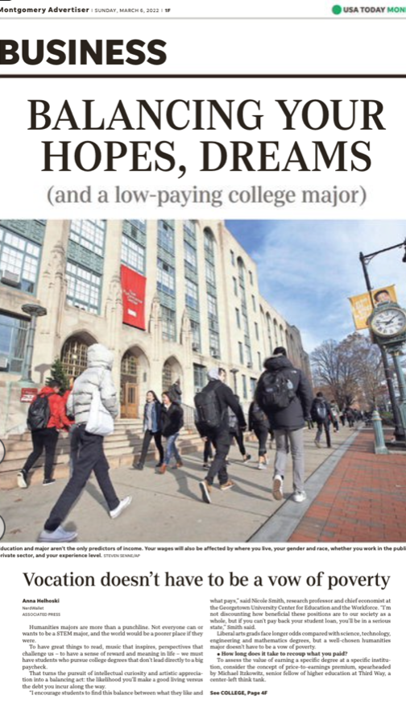
To assess the value of earning a specific degree at a specific institution, consider the concept of price-to-earnings premium, spearheaded by Michael Itzkowitz, senior fellow of higher education at Third Way, a center-left think tank.
Among the programs with no economic ROI at all: drama, fine arts and anthropology.
Itzkowitz said the majority of college programs enable students to recoup costs within 10 years or less. “College is still worth it the vast majority of the time,” he said.
Unfortunately, his research also found nearly one-quarter of all college programs of study show graduates failing to recoup their costs in the 20 years after graduation.
Your humanities degree could go much further if you get an advanced degree – generally, the more education you have, the greater your earnings, according to Bureau of Labor Statistics data.

Slide 11
“I encourage students to find this balance between what they like and what pays.
I’m not discounting how beneficial these positions are to our society as a whole, but if you can’t pay back your student loan, you’ll be in a serious state.”
Nicole Smith
Georgetown University Center for Education and the Workforce

Slide 12
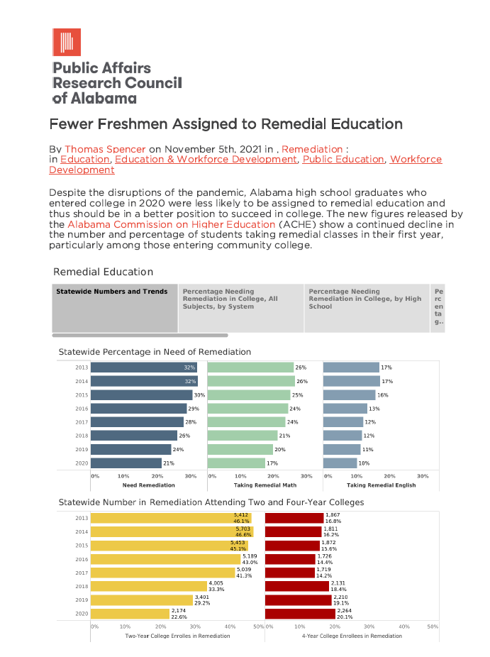
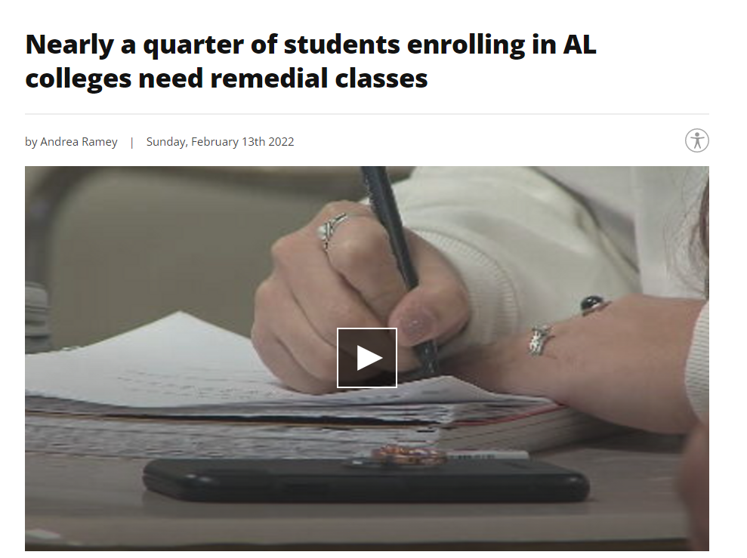

Slide 13
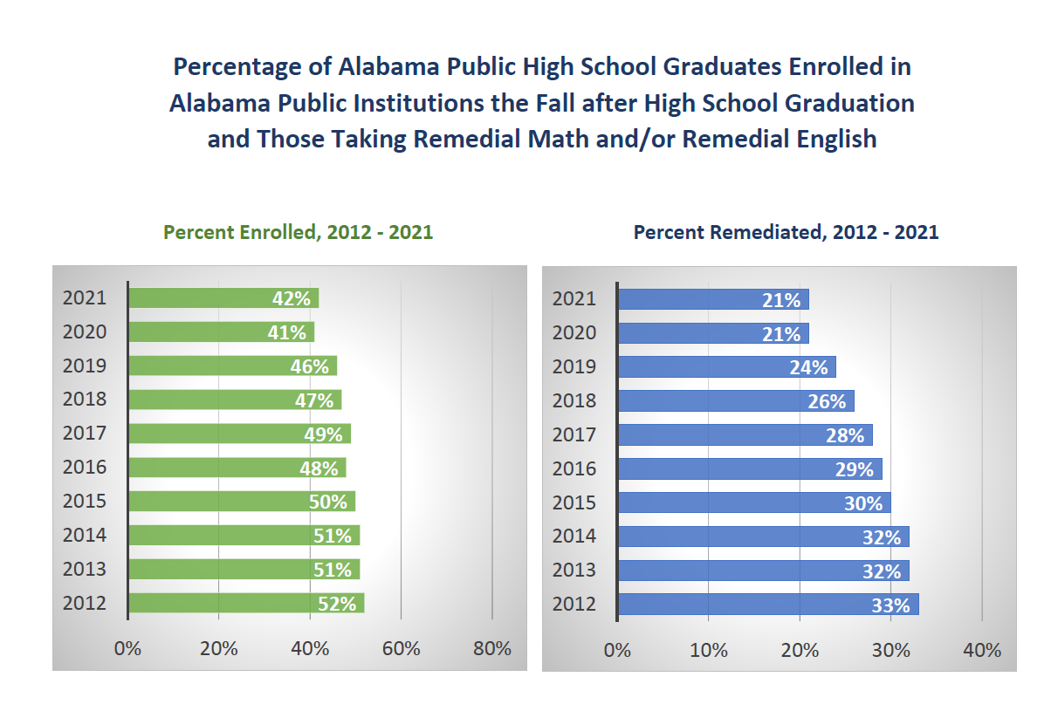
Developmental Education

Slide 14
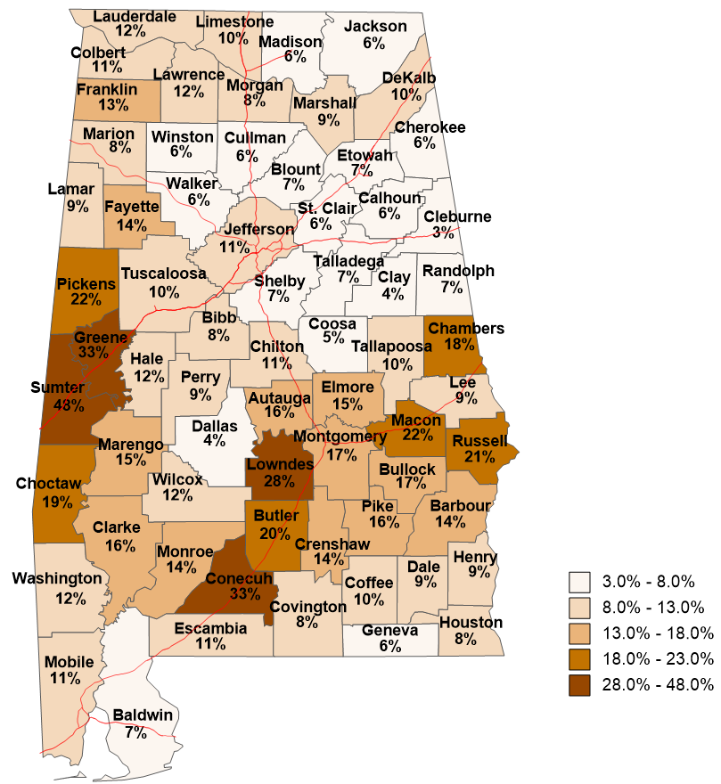
2020-2021
High School Graduates
Who Enrolled in
Alabama Public Institutions
Fall 2021
and were Enrolled in
Remedial English
2/72
2/49
12/25
6/140
Remedial English
All Races/Ethnicities
Percent of High School Graduates from the county who Enrolled in Remedial English.
State Total Remediation
English 10%
SOURCES: Alabama Statewide Student Database Fall 2021 Student Data & Alabama State Dept. of Education.

Slide 15
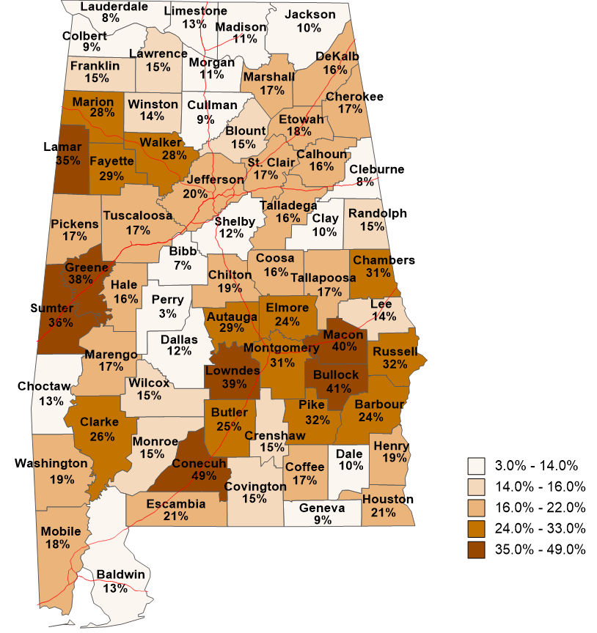
37/446
2020-2021
High School Graduates
Who Enrolled in
Alabama Public Institutions
Fall 2021
and were Enrolled in
Remedial Math
6/72
6/86
Remedial Math
1/35
All Races/Ethnicities
22/55
Percent of High School Graduates from the county who Enrolled in Remedial Math.
12/29
22/45
State Total Remediation
Math 17%
SOURCES: Alabama Statewide Student Database Fall 2021 Student Data & Alabama State Dept. of Education.

Slide 16
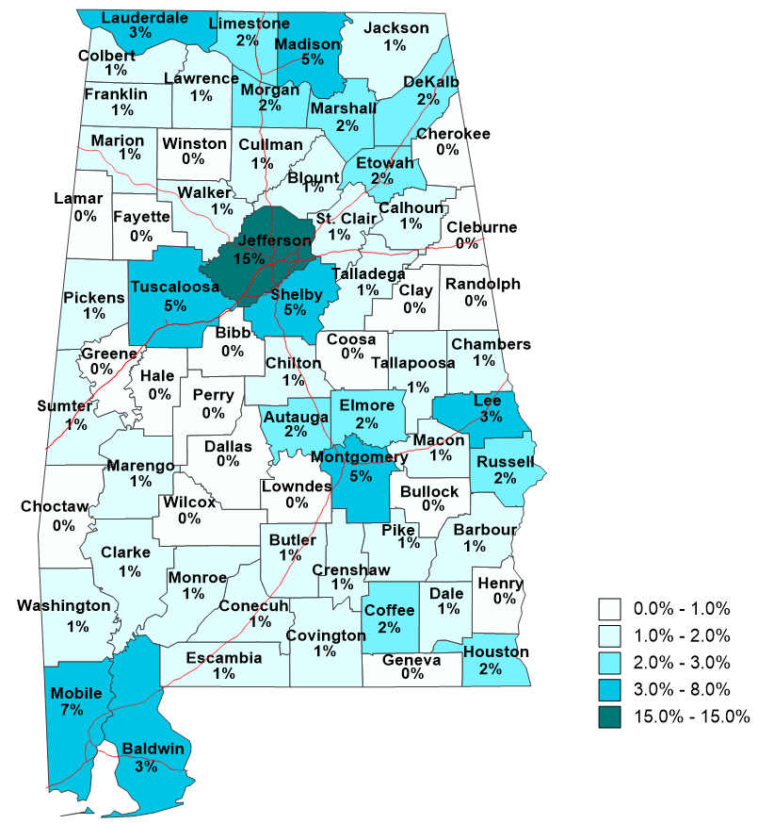
2020-2021
High School Graduates
Who Enrolled in
Alabama Public Institutions
Fall 2021
and were Enrolled in
Remedial English
301/1991
Remedial English
All Races/Ethnicities
Remedial English of County divided by State total Remedial English
SOURCES: Alabama Statewide Student Database Fall 2021 Student Data & Alabama State Dept. of Education.

Slide 17
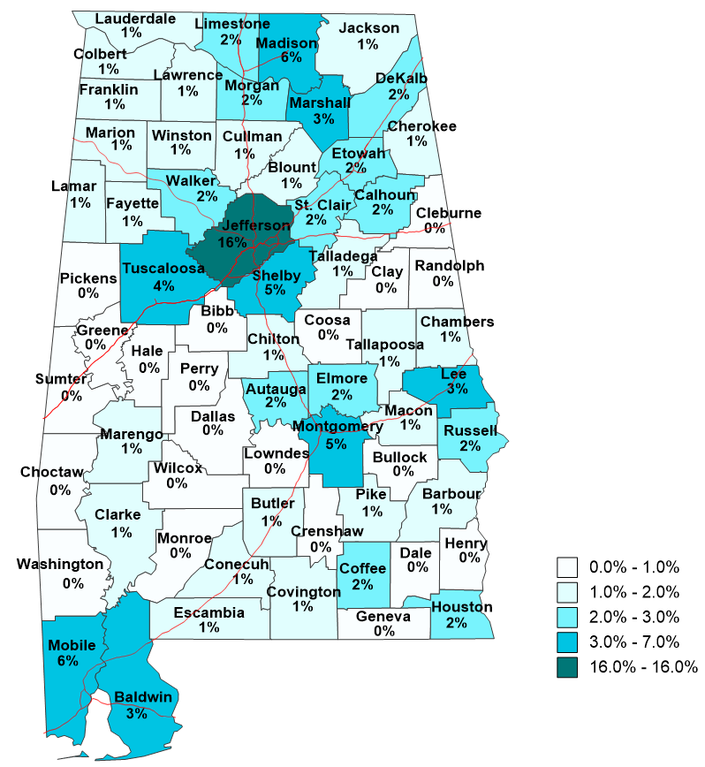
2020-2021
High School Graduates
Who Enrolled in
Alabama Public Institutions
Fall 2021
and were Enrolled in
Remedial Math
581/3532
Remedial Math
All Races/Ethnicities
Remedial Math of County divided by State total Remedial Math
SOURCES: Alabama Statewide Student Database Fall 2021 Student Data & Alabama State Dept. of Education.

Slide 18
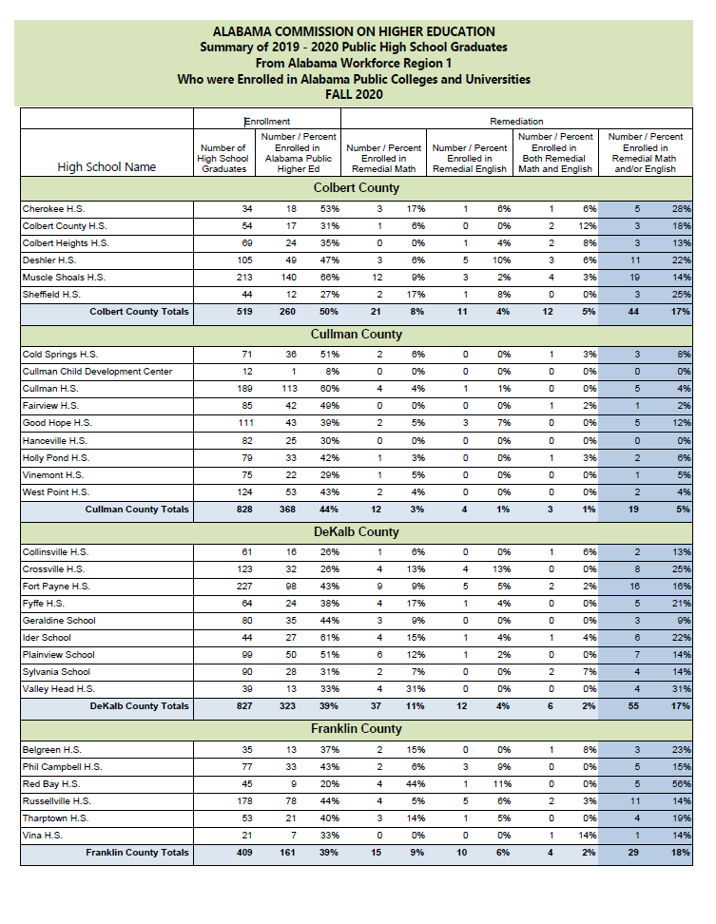

Slide 19
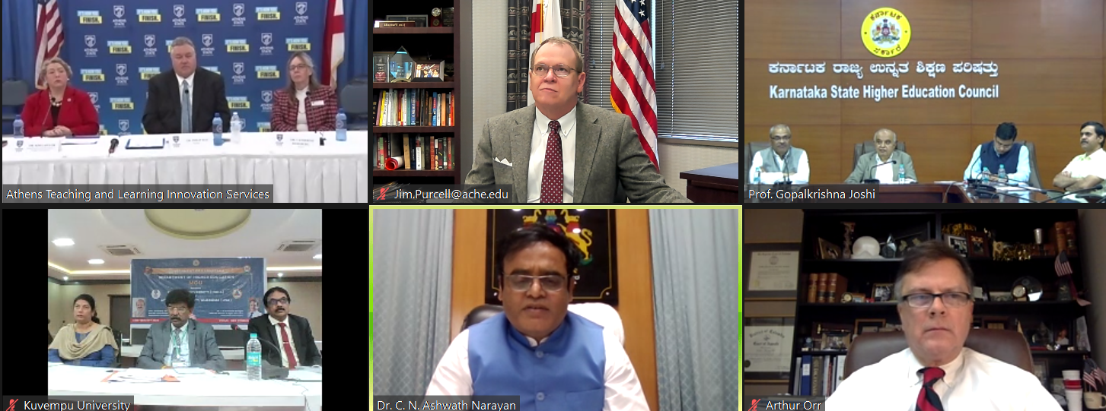
Congratulations Athens State University! Athens recently signed exchange agreements with two Indian universities*. The agreements will establish cultural exchange opportunities as well as promote collaborations related to research and academic programs.
*Vijayanagara Sri Krishnadevaraya University and Kuvempu University (India).

Slide 20
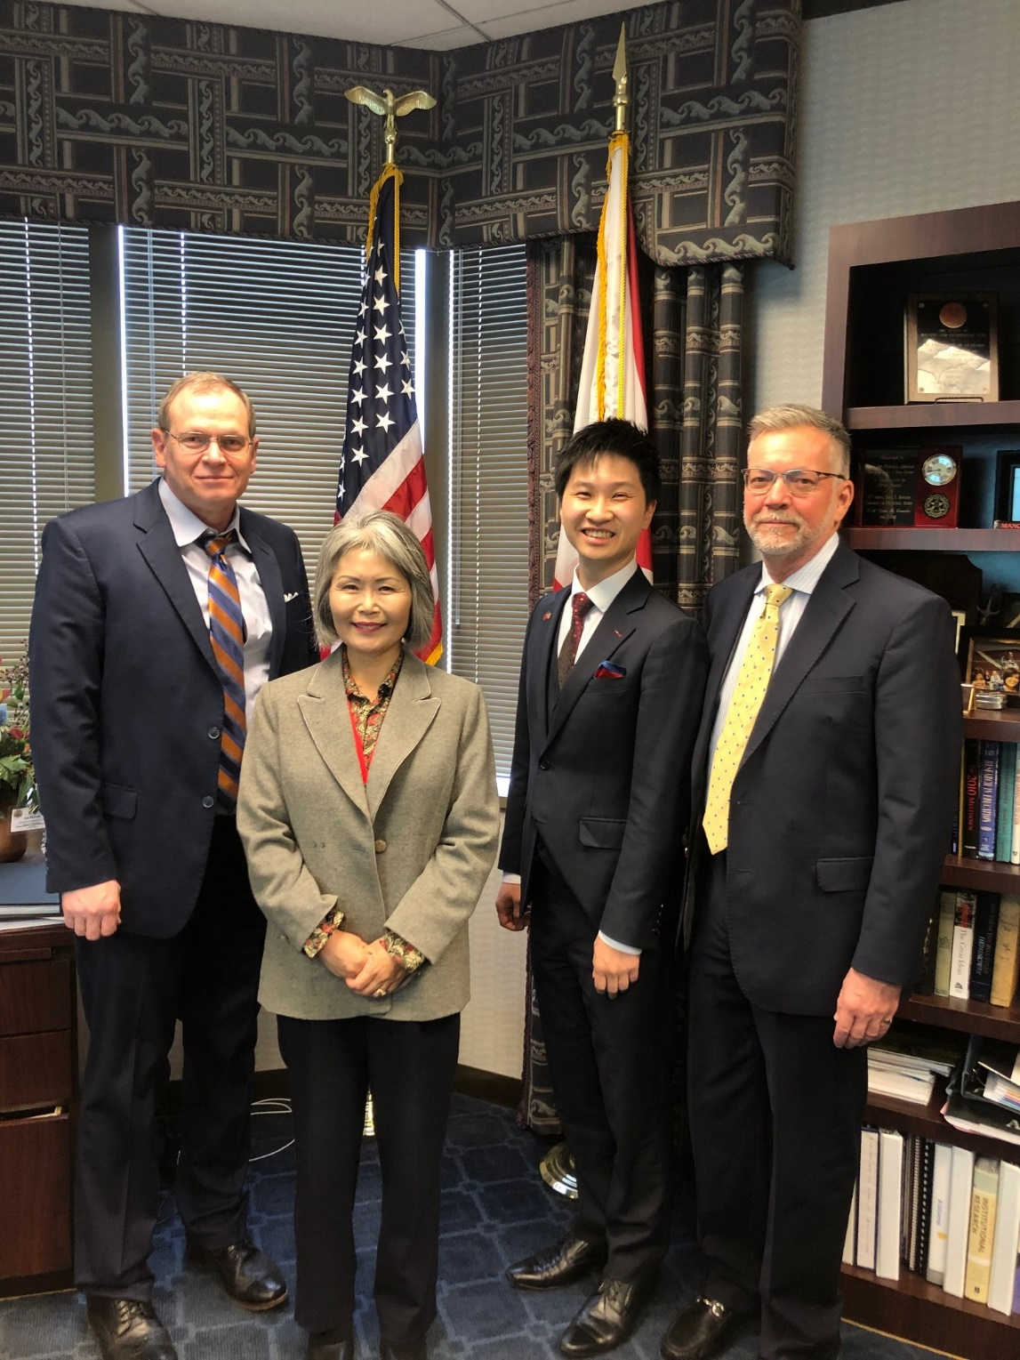
Alabama & Taiwan
Hsien-Yu (Billy) Chung, Consular Officer from Taipei Economic & Cultural Office in Atlanta met with Dr. Purcell to discuss possible educational partnerships in the near future.

Slide 21
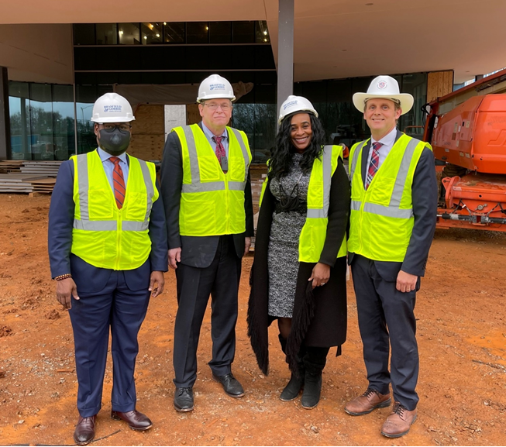
Dr. Purcell visits construction activities at the Alabama School of Cyber Technology and Engineering

Slide 22
Social Media Presence
Enhanced Email Signatures

Slide 23
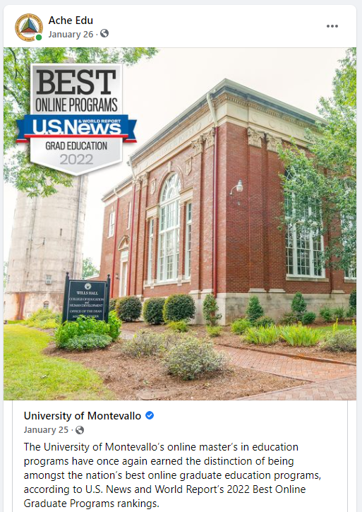
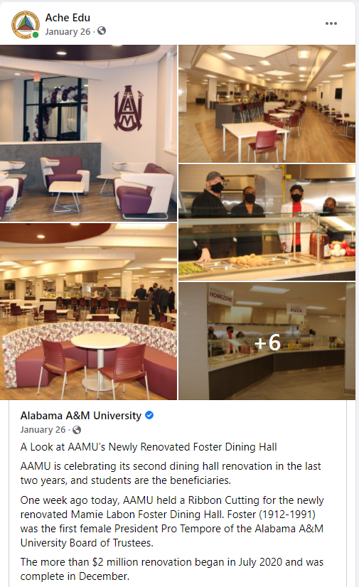
Using social media to promote Alabama’s colleges and universities

Slide 24
Using social media to promote higher education in Alabama

Slide 25
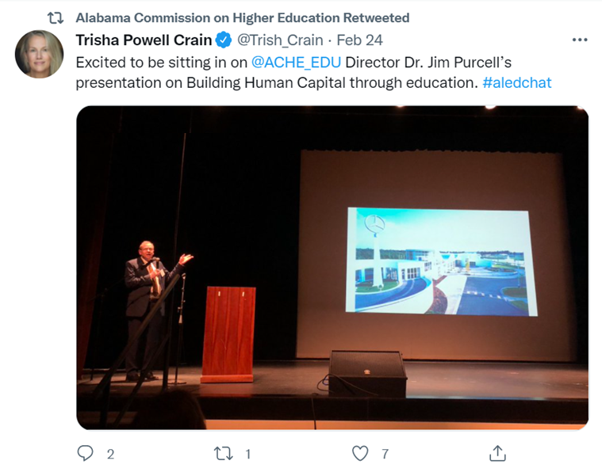
Dr. Purcell discusses Building Human Capital through Education!

Slide 26
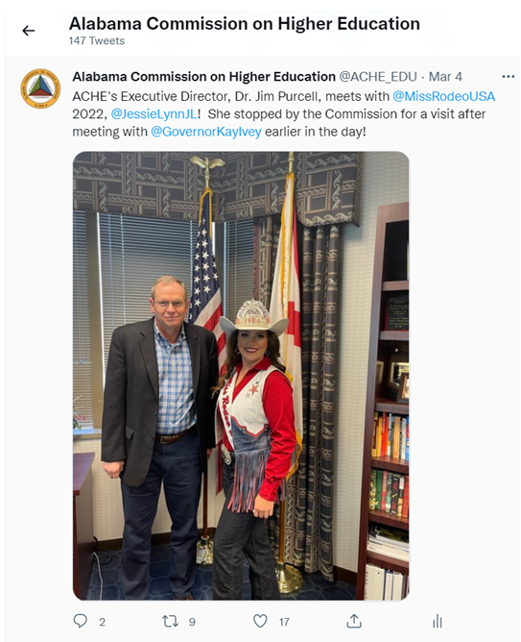
Dr. Purcell meets with Auburn Graduate, Jessie Lynn Nichols, Miss Rodeo USA 2022!
She stopped by the Commission for a visit after meeting with Alabama Governor Kay Ivey earlier in the day!

Slide 27
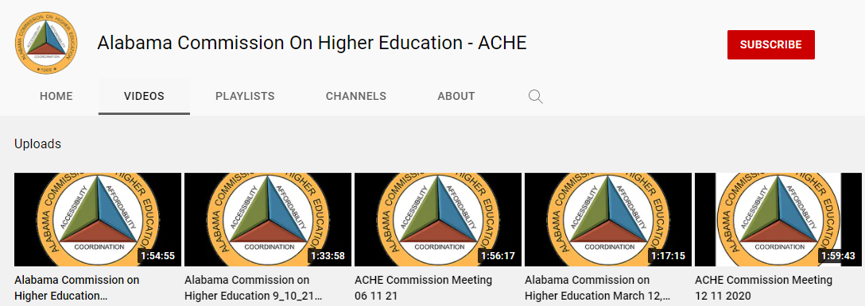
Using YouTube to make ACHE meetings and other activities more accessible.

Slide 28
FAFSA Completion

Slide 29
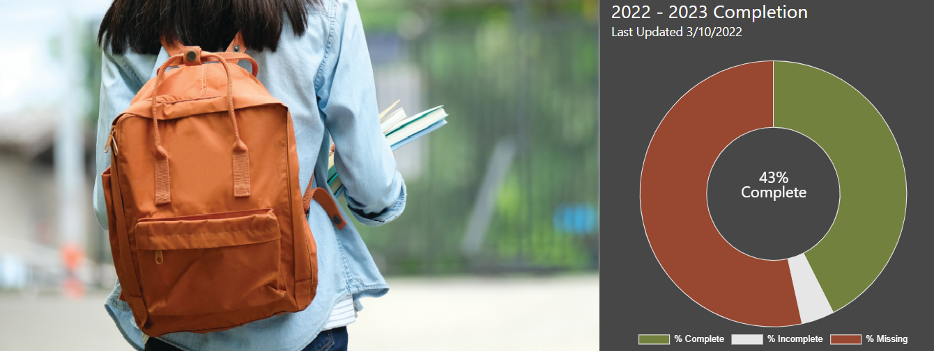
Alabama Commission on Higher Education
Improving FAFSA Completion
fafsa.ache.edu

Slide 30
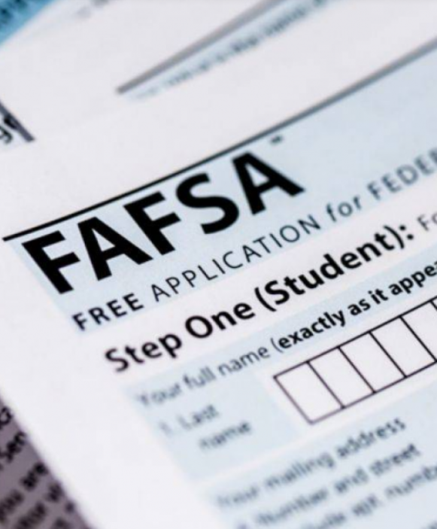
Why is completing the FAFSA important?
A gateway to over $150 billion in federal aid, and most state and institution aid.
Alabama’s Class of 2021 left roughly $67.8 million in unclaimed Pell Grant money on the table (ranked 15th nationally).
FAFSA completion strongly associated with positive outcomes:
92% of seniors who completed FAFSA enrolled in college or university following graduation
Education linked to higher incomes, better health, more civic engagement

Slide 31
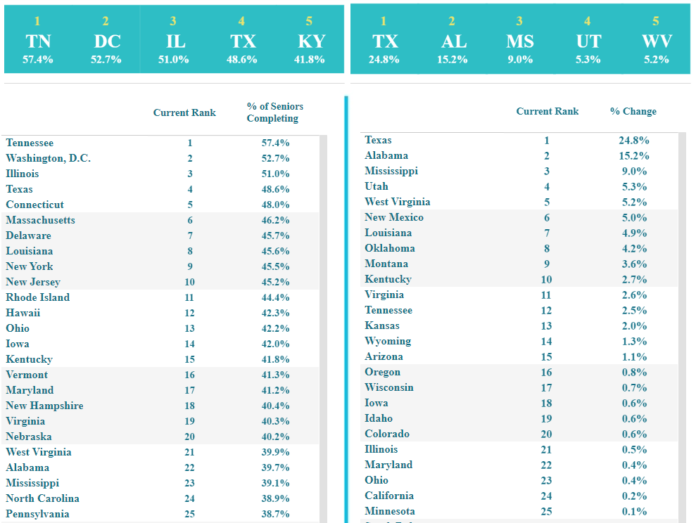
FAFSA Completion State Rankings:
22nd nationally in overall completion
(39.7% completion)
2nd nationally in 1-year improvement
(15.2% increase)
Source: www.ncan.org

Slide 32
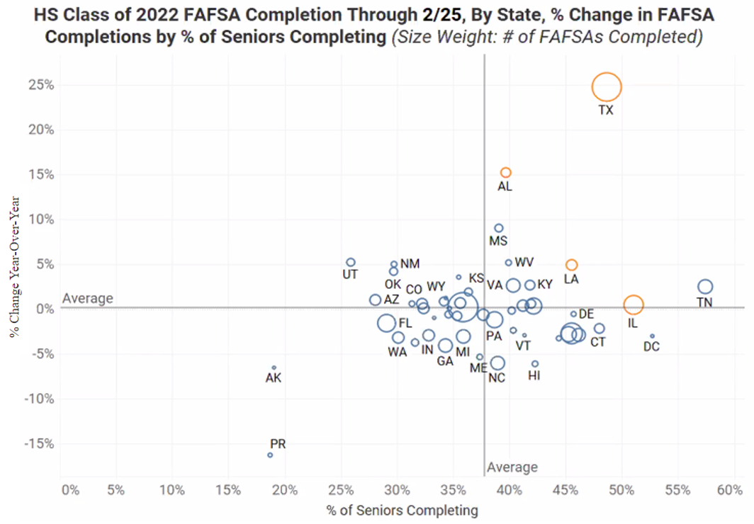
FAFSA Completion State Rankings:
States (in Yellow) with universal FAFSA completion policies: AL, LA, IL, TX
Circles weighted in size by # of FAFSAs Completed: Larger circles reflect more students
Source: www.ncan.org

Slide 33
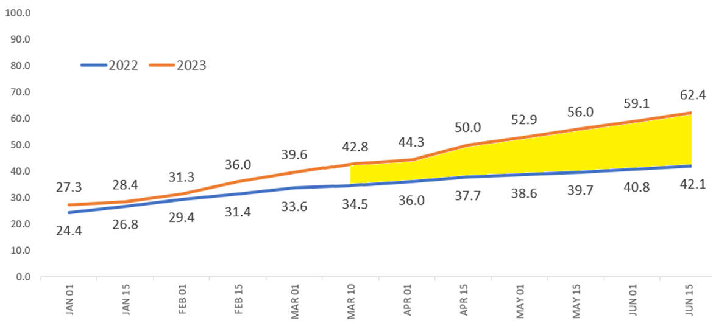
ACHE FAFSA Completion Portal Trend and Projected Data as of 3/10/2022
100% Completion Goal
Projected
Current

Slide 34
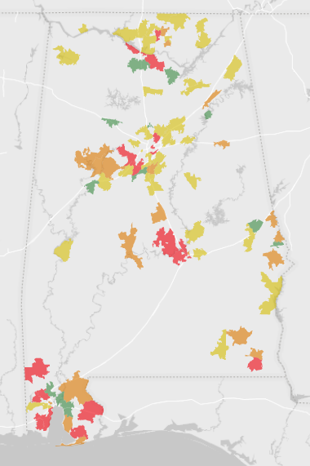
FAFSA Completion Areas of Concern Based on Latest 2-Year Averages
5 key areas with high enrollment and low completion rates:
Mobile
Montgomery
Birmingham
Huntsville
Dothan
Includes 105 high schools (35.0%) enrolling 30,038 students (63.1%)
Excludes high schools with less than 150 students

Slide 35
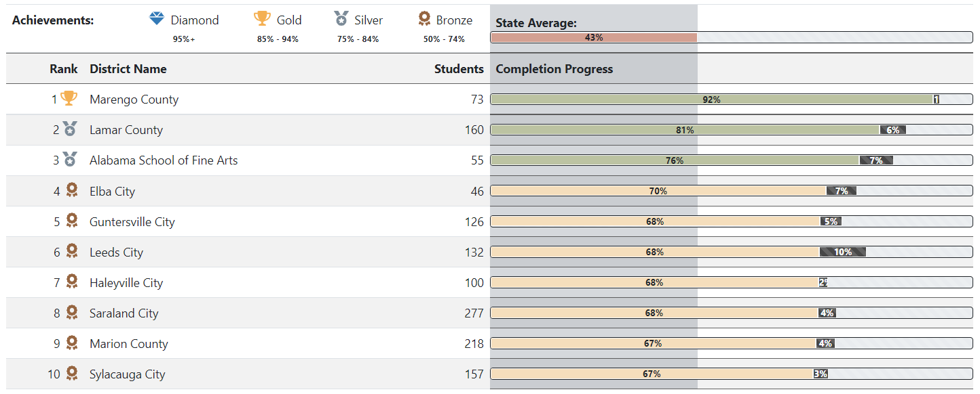
District Top 10 for Academic Year 2022-23, so far
As of 3/10/2022

Slide 36
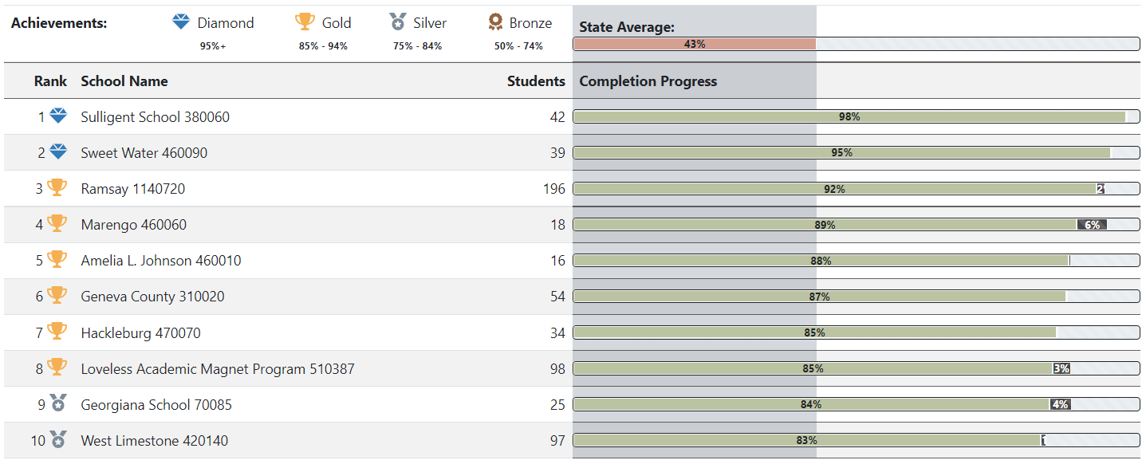
All High Schools: High School Top 10 for Academic Year 2022-23, so far
As of 3/10/2022

Slide 37
6A* High Schools: High School Top 10 for Academic Year 2022-23, so far
As of 3/10/2022
* 6A classification: 579-1,007 student enrollment

Slide 38
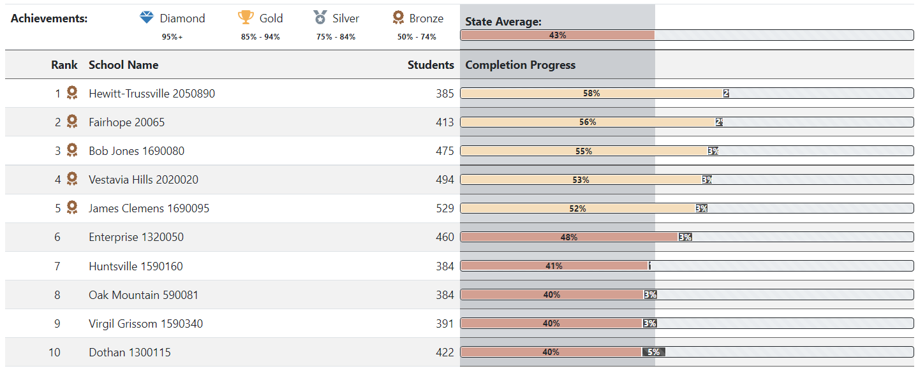
5A* High Schools: High School Top 10 for Academic Year 2022-23, so far
As of 3/10/2022
* 5A classification: 379 - 578 student enrollment

Slide 39
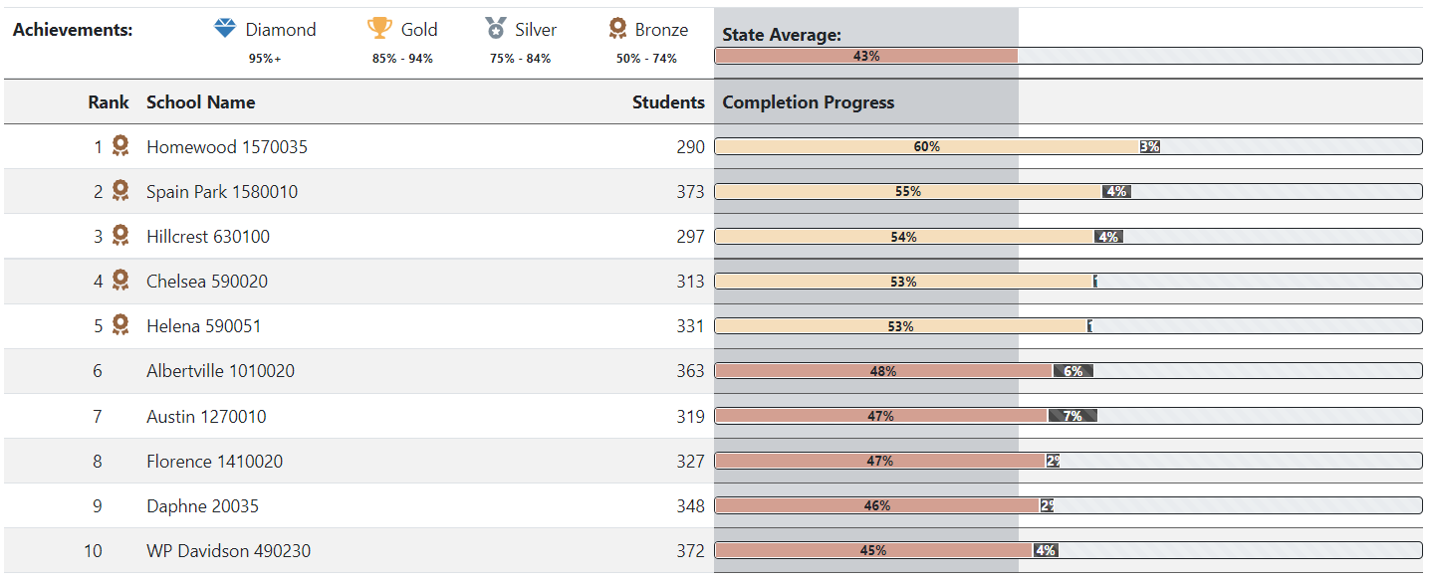
4A* High Schools: High School Top 10 for Academic Year 2022-23, so far
As of 3/10/2022
* 4A classification: 286 - 378 student enrollment

Slide 40
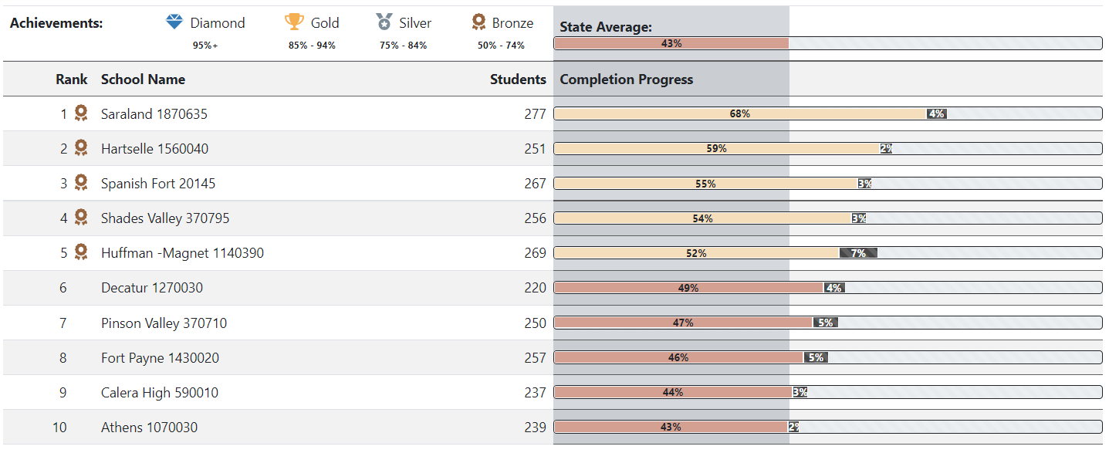
3A* High Schools: High School Top 10 for Academic Year 2022-23, so far
As of 3/10/2022
* 3A classification: 210 - 285 student enrollment

Slide 41
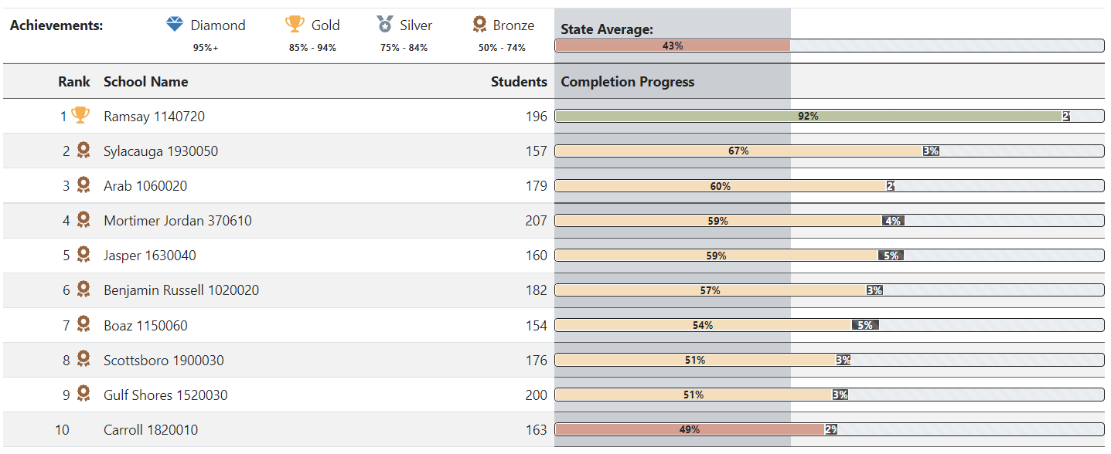
2A* High Schools: High School Top 10 for Academic Year 2022-23, so far
As of 3/10/2022
* 2A classification: 145 - 209 student enrollment

Slide 42
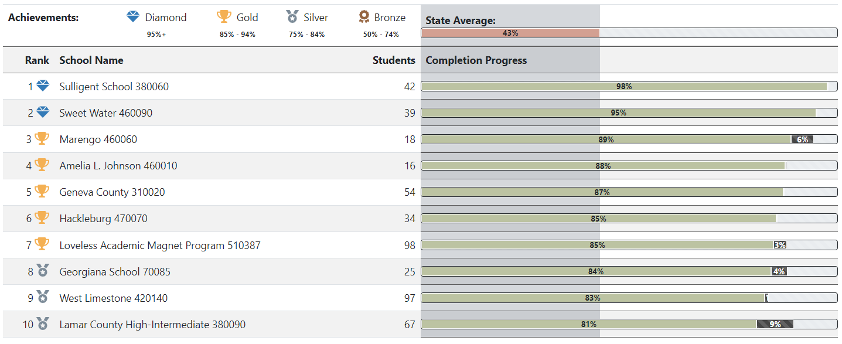
1A* High Schools: High School Top 10 for Academic Year 2022-23, so far
As of 3/10/2022
* 1A classification: Up to 144 student enrollment

Slide 43
VIII. DISCUSSION ITEMS

Slide 44
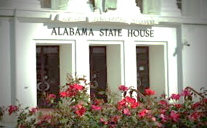
2022 ACHE Legislative Session
Presented by: Mrs. Margaret Gunter

Slide 45
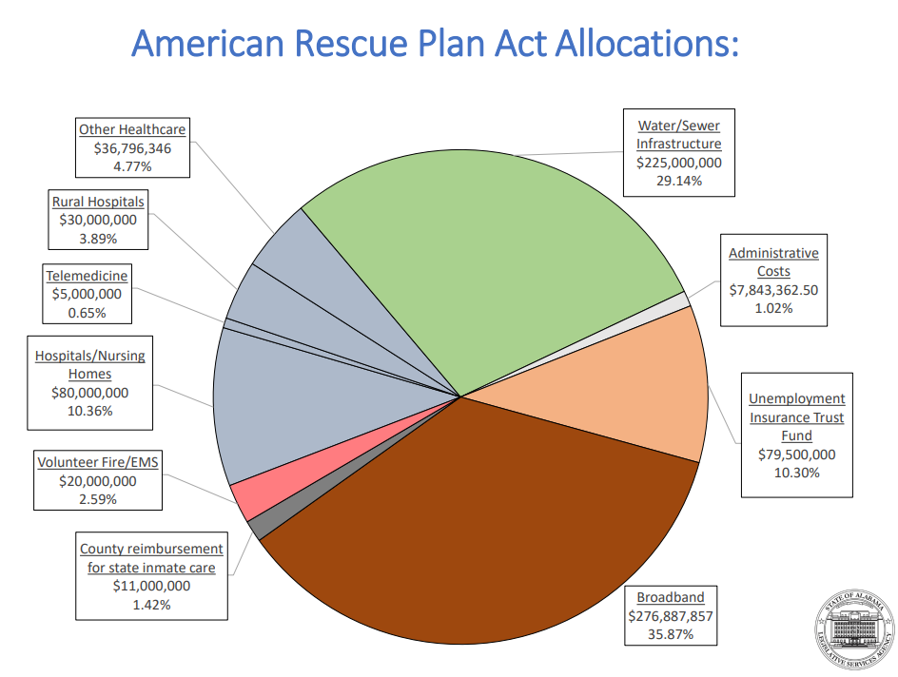

Slide 46
Education Budget
$8.17 Billion
(HB135 W&ME Substitute)
“I think it’s no secret that we’re sitting on a mountain of cash,”
said House Ways & Means Education Committee Chairman Danny Garrett in his first year at the helm of the money committee.
Increases for higher education
7.88% increase for the Alabama Community College System
Approximately 8.79% increase for the state universities
4% pay raise for teachers and state employees
Education budget heads to the Senate F&TE committee

Slide 47
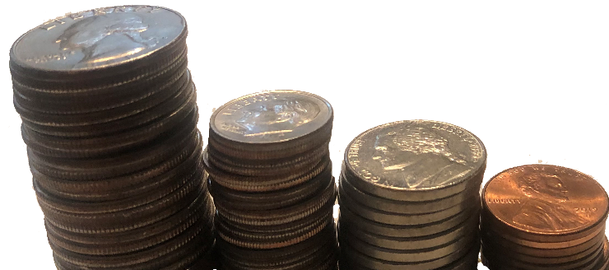
Helping Pay for College
Good news for financial assistance programs administered by ACHE
Alabama Student Assistance Program – 9.93% - $8,000,000
Alabama Student Grant Program – 9.93% - $8,000,000
Police Officer’s/Firefighter’s Survivor Educational Assistance Program – 5.00% increase - $466,935
Alabama National Guard Educational Assistance Program – 5.00% increase - $5,472,952

Slide 48
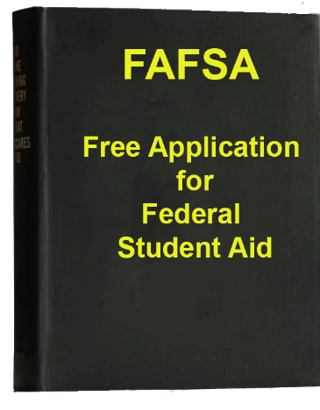
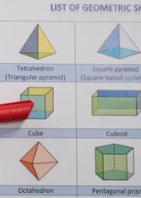
New Items in ACHE Budget
FAFSA Completion- $500,000
STEM Major Teacher Recruitment- $4,500,000
HBCU Deferred Maintenance $5,000,000
STEM
Science Technology Engineering Mathematics

Slide 49
Numeracy Bill (SB171)
Improve math proficiency of K-5 students
ACHE makes appointments to:
Elementary Mathematics Task Force
Postsecondary Mathematics Task Force
ACHE prepares annual report on the status of the implementation and adoption of the mathematics education guidelines for postsecondary institutions

Slide 50
Changes related to the Alabama Literacy Act
(Act #2019-523)
Technical changes to the law
ACHE has an appointment to the Literacy Task Force
Write More
Learn More
Read More

Slide 51
Open Meetings
(SB147)
Expands participation by governmental bodies in meetings by electronic communication
Members of the public must have access to hear the meeting
A member participating virtually may not claim reimbursement for expenses relating to the meeting, including mileage and per diem

Slide 52
Alabama Math and Science Teacher Education Program
(SB251)
Increases the award amount from $2,500 to $3,750 for math and science teachers
Changes applicable after the 2022 spring semester

Slide 53
State Seal of Biliteracy
(HB46)
Recognizes high school graduates with the proficiency in English and at least one world language, including American sign language

Slide 54
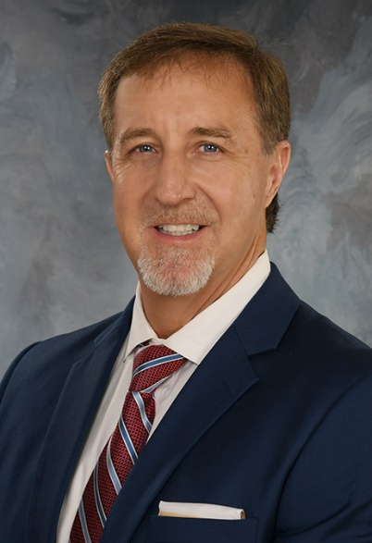
Commissioner Singleton Pending Confirmation by Alabama Senate
Jody M. Singleton

Slide 55
Social Work Employment Outcomes
Presented by: Dr. Dawna Nelson and Mrs. Bryn Bakoyema

Slide 56
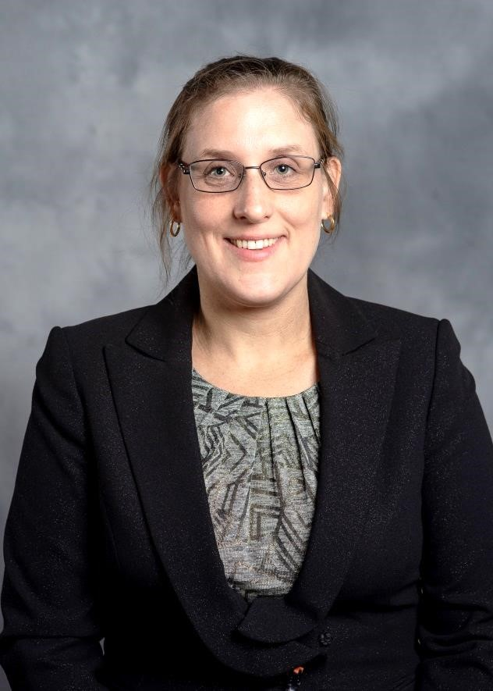
Bryn Bakoyéma, ACHE Visiting Research Associate
Bryn Bakoyéma earned bachelor’s degrees from North Carolina State University in Agronomy and Multidisciplinary Studies, a masters from Indiana University in Cultural Anthropology and is currently a PhD student in Educational Leadership, Policy, and Law at Alabama State University. She also serves full-time as the Director of Institutional Research at ASU.
Her expertise is in statistical analysis. Two of her projects “Exploring Career Choices for Education Bachelor’s Graduates” and “Assessing Student Intentions to Remain In-State Post Graduation” will also be presented at the Southern Association of Institutional Research conference in October.

Slide 57
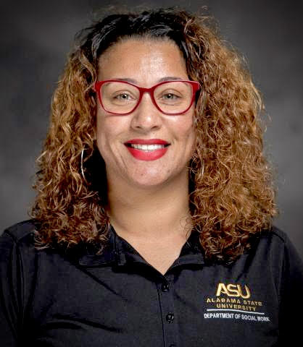
Dr. Dawna Nelson, ACHE Fellow
Dr. Nelson studied Social Welfare at the University of Hawaii at Manoa and is currently an Assistant Professor and the Master of Social Work Program Director at Alabama State University, her alma mater. She has worked in the field of Social Work for over 15 years as both a clinician and researcher. Her clinical experience involved working with trauma patients as a Medical Social Worker at a Level 1 trauma facility as well as providing evidence-based psychotherapy for Veterans and their family members within the VA system. Additionally, Dr. Nelson spent over five years at the National Center for PTSD researching Veterans and their families in relation to PTSD, rurality, and access and barriers to care.

Slide 58
Social Work Graduates’ Career Choices in Alabama
March, 2022

Slide 59
Public University Programs in Alabama
University | BSW Degree | MSW Degree
Alabama A&M | 1979 | 1996
Alabama State | 1987 | 2015
Auburn University | 1978 | 2017
Auburn University at Montgomery | 2019
Jacksonville State | 1988 | 2017
Troy University | 1987 | 2013
University of Alabama | 1974 | 1969
University of Alabama at Birmingham | 1977 | 2016
University of Montevallo | 1974
University of North Alabama | 1974
University of South Alabama | 2005
Notes:
Dawna: Currently 11 BSW and 7 MSW programs at public Universities in Alabama. Today I will be presenting data about the graduates of the highlighted programs

Slide 60
Number of Social Work Programs
Notes:
From 1960’s until early 2000’s there were only 2 MSW programs. In the last 15 years the MSW programs have doubled. One PHd Program

Slide 61
Social Work Program Enrollment by Degree
Notes:
As you can see, the enrollment has grown corresponding to these program changes with 1/3rd of current enrollees being MSW students

Slide 62
Notes:
The number at top reflects our PHD graduates. This slide emphasizes that we are seeing an increase in the BSW and MSW
Recolored the top number so it doesn't look like the number below is a truncation

Slide 63
Overview of Alabama’s Social Work Shortage
Alabama currently faces the following shortages based on anticipated workforce needs:
16% increase by 2025 in demand for social workers working in mental health and substance use treatment
15% increase by 2025 in demand for social workers working in healthcare settings
Source: Alabama Employment Outlook, 2020
Notes:
Areas where we expect to see an increased need are mental health, substance use, and healthcare settings

Slide 64
Data Sources

Slide 65
Employment Outcomes Dataset
Partnership between Alabama Commission on Higher Education (ACHE), Alabama Department of Labor (DOL), & Alabama Social Work Board (ASWB)
ACHE: major, year of graduation, demographics
DOL: employer type, year employed, wage
ASWB: license type and year
https://ache.edu/ACHE_Reports/Reports/Accountability/EmploymentOutcomesReport.pdf

Slide 66
Workforce Caveats
Alabama DOL workforce data includes employees reported for unemployment insurance.
Does not include individuals who are self-employed, federally employed, enlisted in the military, employed out-of-state, or working without unemployment insurance
Also, this study excluded occasional workers who earn less than $5,000/year
Notes:
May not capture people who are working in private practice.

Slide 67
Licensure Data
Alabama Social Work Board matched licensure data with student graduation data
Critical to understand patterns of obtaining licenses and subsequent employment and wages
Caveat: Represents a small sample of all licensed social workers
Notes:
ASWB identified licensed Social Workers in the dataset

Slide 68
Career Choices of Social Work Majors: Research Questions

Slide 69
Research Questions
Are social work majors from the 14 public universities:
More likely to be found working in the Alabama workforce?
Differences by gender, ethnicity, or degree level?
For those found in the Alabama workforce, are there
Employer type differences by degree level?
Wages differences by degree level and employer type?
Employer type or wage differences by licensure status?
Two subsets – 1 year and 5 years after earning degree
Notes:
Dawna: Today’s presentation will focus on Subset 2, the 5-year subset which explored the demographics, employment and license of graduates 5-years after degree completion.

Slide 70
Social Work Graduates Working in Alabama
1 Year After Graduation
2,157 graduates
(2015, 2016, 2017)
69%
5 Years After Graduation
1,661 graduates
(2011, 2012, 2013)
62%
High likelihood Social Work Graduates will work in Alabama.
Notes:
Bryn

Slide 71
Graduates in Alabama’s Economy
Notes:
Bryn

Slide 72
Subset Demographics
 | 5-year subset # graduates
Females | 1491
Males | 169
90%
10%
 | 5-year subset # graduates
White | 779
African American | 801
Other Minority | 56
47%
48%
3%
Note: Some graduates’ race is unknown causing the percentages to not equal 100%
Other Minority includes Hispanic, Multiracial, International student, Asian, American Indian
Notes:
State mimics national data where women represent 83% of the workforce overall and 86% of MSW holders in 2015.
Dawna: In subsequent discussions, some information will only be presented comparing white and African American due to the small n. (in order from most to least)

Slide 73
Social Work Graduates Working in Alabama
Notes:
Bryn

Slide 74
Key Trends by Demographics
Females more likely to be found working in Alabama.
The percent of AA and white graduates staying in Alabama is the same. A lower percentage of other minorities stay in Alabama; however, the number of graduates in this category is small.
BSW graduates are the most likely found in the AL workforce, followed closely by MSW graduates. Doctoral students are the least likely, also the smaller number of graduates.

Slide 75
Working in Alabama by County Type – Year 1*
Of the rural social workers in the dataset, nearly 2/3rd identify as White
Notes:
Because Alabama contains 11 counties that are a part of the rural southern Blackbelt, an area that is commonly known to have high need due to various factors including systemic oppression, we wanted to see where Social Workers were practicing and if there were differences by race. Of those social workers found in the Alabama workforce after 1-year who are practicing in rural areas, the majority are white. Black Social Workers were found working in urban areas at a higher percentage among the 1-year subset.
Of the 38 rural counties, 11 categorized as being in the Blackbelt area have unique needs and many of these counties are disproportionately African American.
United States Census Bureau’s Office of Rural Health Policy identifies rural counties in each state (2016). Of Alabama’s 67 counties, they designated 38 as rural. The counties which contain the four largest cities, Jefferson, Madison, Mobile, and Montgomery, were designated as urban. The remaining counties, which include mostly suburban and more populated counties, were designated as other.

Slide 76
Working in Alabama by County Type – Year 5*
The proportion of African Americans employed in rural areas increases at 5-years
Notes:
We see more Black social workers employed in rural areas in the 5-year subset. The other counties, which includes counties that more commonly referred to as suburban, for example Shelby County outside of Birmingham, continue to have a higher percentage of white social workers. This give a snapshot, albeit a fuzzy one, into where social workers are practicing geographically.

Slide 77
Social Work Graduates working in Social Work in Alabama
100%
69%
62%
72%
58%
53%
Social Work
Graduates
Working in Alabama
1
year after graduation
Working in Social Work 1
year after graduation
Working in Alabama
5
years after graduation
Working in Social Work
5
years after graduation
Notes:
Bryn

Slide 78
Alabama Employer Types
Notes:
Now lets take a look at the types of employers that social work graduates are working for and the wages they are earning related to that employment

Slide 79
Employer Types for Social Work Majors
Child & Youth Services (children’s homes, K-12 ed, child/youth services, child care)
Education (higher ed, other ed related, NOT K-12)
Elderly & Disabled Services (retirement, nursing, home health, residential)
Department of Human Resources
Hospitals & Clinics (mental facilities, excluding specific mental health focus)
Mental Health/ Substance Use Treatment (residential or out-patient)
Other Government (city, county, corrections, public health, attorney general, etc.)
Services & Advocacy (family counseling & support, crisis, voc rehab, housing, etc.)
Other Sectors (retail, restaurants, clerical, temporary)
Notes:
Reminder that shortage areas are mental health and substance use and healthcare settings
Dawna – employment data was separated in 9 categories. You will notice that 4, Department of Human Resources, was labeled at it’s own category because this one agency employees such a significant percentage of the Social Work graduates in the state of Alabama. The remaining employer types contain various agencies and empoyers.
Other sector – manufacturing – now we know that there are roles for social workers in these types of for-profit companies, for example Hyundai. However, wage data was provided for the employer type, not the employee role, one of the limitations previously discussed.

Slide 80
% Social Work Graduates in Alabama Workforce by Employer Type
and
Degree Level - Year 5
BSW are more likely to be found in DHR and other sectors
MSW are more likely to be found in Hospital/Clinic and Mental Health/Substance Use Treatment
Notes:
Dawna – AMOng the 5-yer subset, we see similar patterns. However there is a decrease of both BSW and MSW in DHR, mental health, and

Slide 81
% Social Work Graduates in Alabama Workforce by Employer Type
and
Race/Ethnicity - Year 5
White students – higher % at Hospital/Clinic, Elderly & Disabled, Mental Health/Substance
African American students – higher % at DHR, Child & Youth
Notes:
Dawna: taking a look at the 5 year cohort we see similar patterns with a higher percentage of white graduates employed in hospitals and clinics and Black graduates working in DHR and Child and youth. We also see higher % of white graduates in the employer types elderly and disabled and mental health/substance abuse.

Slide 82
Alabama Social Work Graduate Wages
Notes:
Now lets take a look at the types of employers that social work graduates are working for and the wages they are earning related to that employment

Slide 83
Graduates in Alabama’s Economy
Notes:
At one year, Bachelor recipients are in the bottom 3rd, and while their earnings are growing some, not growing at the rate that they anticipate to see equivalent to other professions.

Slide 84
Wage Comparison by Employer Type – 5 Year
 | BSW | MSW
Child & Youth | Lowest
Department of Human Resources | Highest | Highest
Education | Highest | Highest
Elderly & Disabled
Hospital/ Clinic | Highest | Highest
Mental Health/ Substance Abuse Treatment | Lowest | Lowest
Other Government
Services & Advocacy
Other Sectors | Lowest | Lowest
BSW Lowest = high $20K, Highest = mid $30K
MSW Lowest = low $30K, Highest = low/mid $40K
Highest: indicates employer type with the highest wage for each major category
Notes:
Average wage at year 5 for BSW is $32171 and MSW is $38976.

Slide 85
Wage Comparison by Employer Type – 5 Year
 | BSW | MSW
Child & Youth | Lowest
Department of Human Resources | Highest | Highest
Education | Highest | Highest
Elderly & Disabled
Hospital/ Clinic | Highest | Highest
Mental Health/ Substance Abuse Treatment | Lowest | Lowest
Other Government
Services & Advocacy
Other Sectors | Lowest | Lowest
Difference between BSW & MSW average wages across all employer types 5 year after graduation = $6,805
*Negligible difference
Highest: indicates employer type with the highest wage for each major category
Notes:
Bryn

Slide 86
Alabama License, Employer Types, & Wages

Slide 87
Key Trends in Social Work Licensure
A higher percentage of white graduates than AA have obtained their license.
MSW graduates are more likely to have a license than BSW.
The largest number of licensed graduates work for Hospital/Clinic and DHR.
About half of BSW graduates with a license work for DHR .
2/3rds of MSW graduate with a license are employed by either DHR or an employer type that indicates they are practicing in a clinical capacity.

Slide 88
Licensed Graduates & Wages
1 Year
Mean wages increase with license and more advanced license
5 Years
Mean wages increase with license and more advanced license
Mean wage of LICSW lower than LMSW
Wages for all levels at 5 years higher than at 1 year
No license | LBSW | LMSW
$26,694 | $29,631 | $35,765
No license | LBSW | LMSW | LICSW
$33,555 | $35,101 | $39,907 | $37,682
Notes:
Dawna: Next we were interested in seeing if wage differences persisted with licensure levels. At 1-year, we see trends that are consistent with national data. Higher earnings with higher licensure status. However not true for LICSW due to not being able to practice in full scope of practice.
Among the 5-year subset we see higher wages comparing LBSW and LMSW though the gap dissipates some. However, of note, we did not see the wage diffences we would expect to see between the LMSW and LICSW at 5-year. In fact, in both

Slide 89
Findings

Slide 90
Overall findings
Large proportion of social work graduates found employed in Alabama soon after graduation;
Large proportion of social work graduates are working for social work-related employers;
Social workers who earned a graduate degree are compensated with higher wages;
Obtaining a social work license yields additional compensation in workplaces where there are jobs requiring that level of credential;
Notes:
Dawna

Slide 91
Overall findings
Licensure rates for those working in social work are low;
Overall wages are compressed at the lower end of the middle class; and
Wages for employers hiring in some high demand fields (i.e., Mental Health/Substance Use Treatment) are lower than for employers focused on Other Sector
Notes:
This could be contributing to difficulty in filling these high demand and attrition from field.

Slide 92
Policy Recommendations
Incentivize the diversification of the social work profession in regard to critical shortage areas (i.e., rural areas)
Incentivize obtaining licensure
Address pass rates
Government, Universities, & Employers collaborate to
recruit more students,
advocate for salaries commensurate with degree and licensure costs and value
advocate for increases in salary for mental health/ drug abuse treatment and child & youth work
Revise state laws to expand the allowable roles for social workers to meet the workforce needs of Alabama
Notes:
Purcell

Slide 93
IX. Decision ITEMS

Slide 94
A. Academic Programs
Staff Presenters: Dr. Robin McGill and
Mrs. Kristan White

Slide 95
FOUR-YEAR INSTITUTIONS

Slide 96
Athens State University
1a. Master of Arts in Interdisciplinary Studies (CIP 30.0000)
The proposed MA in Interdisciplinary Studies will allow students to blend distinct areas of expertise needed to compete for and advance within contemporary careers. The program is designed to attract part-time students, particularly working professionals who may be looking to upskill.
ATSU’s proposal includes six letters of support from local partners, including Alabama State Senator, Arthur Orr; the City of Athens Mayor, William Marks; and the CEO of the Decatur-Morgan County Chamber of Commerce, Crystal Brown.
The proposed program offers flexibility within ATSU’s existing graduate
offerings and will not require any additional resources to deliver.
This Photo by Unknown Author is licensed under CC BY-ND

Slide 97
Motion, Decision Item A-1a:
That the Commission approve Athens State University’s proposal to offer a Master of Arts in Interdisciplinary Studies.

Slide 98
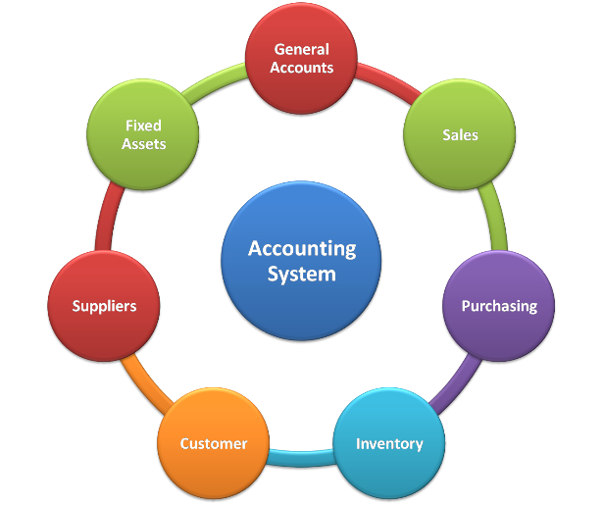
Athens State University
1b. Master of Accountancy in Accounting (CIP 52.0301)
The proposed program will be offered online only, is designed to meet the needs of working professionals, and to fulfill educational requirements for bachelor’s-degree holders seeking state licensure as Certified Public Accountants (CPA).
ATSU’s existing BS in Accounting graduates over 70 students per year, and there is strong demand among existing students to extend their studies to the master’s level.
ATSU’s proposal includes 20 letters of support from local industry and education partners.
This Photo by Unknown Author is licensed under CC BY-ND

Slide 99
Motion, Decision Item A-1b:
That the Commission approve Athens State University’s proposal to offer a Master of Accountancy in Accounting.

Slide 100
University of Alabama at Birmingham
2. Doctor of Philosophy in Mechanical Engineering (CIP 14.1901)
UAB currently offers a BSME and an MSME in Mechanical Engineering (CIP 14.1901), and the proposed program will extend offerings to the doctoral level, which will be an advantage for the recruitment and retention of students and faculty.
The program proposal includes letters of support from the Deans of Engineering at Auburn University, the University of Alabama, and the University of Alabama in Huntsville, whose institutions currently offer a PhD in Mechanical Engineering.
UAB’s mechanical engineering faculty have a strong track record of securing external funding and building research collaborations inside and outside the institution. These resources will support research assistantships for doctoral students.
This Photo by Unknown Author is licensed under CC BY-ND

Slide 101
Motion, Decision Item A-2:
That the Commission approve the University of Alabama at Birmingham’s proposal to offer a Doctor of Philosophy in Mechanical Engineering.

Slide 102
University of Alabama in Huntsville
3. Bachelor of Science in Child, Family, and Community
Development (CIP 19.0799)
The proposed program is designed to fulfill a need for additional high-skilled professionals who work with youth and young children, especially in the Greater Huntsville area.
The proposed program builds on existing partnerships with local community colleges offering associate-level programs in Child Development.
This Photo by Unknown Author is licensed under CC BY-ND

Slide 103
Motion, Decision Item A-3:
That the Commission approve the University of Alabama in Huntsville’s proposal to offer a Bachelor of Science in Child, Family, and Community Development.

Slide 104
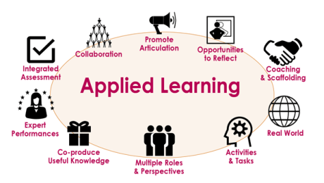
University of Montevallo
4. Master of Education in Applied Instruction (CIP 13.0101)
The proposed program provides advanced training for professionals in educational contexts outside the traditional K-12 setting, and will prepare graduates for employment as Training and Development Specialists (SOC 13-1151) and Self-Enrichment Education Teachers (SOC 25-3021), both of which appear on the Statewide In-Demand Jobs list.
The program consists of coursework already offered for existing master’s-level programs and will not require any additional resources to deliver.
This Photo by Unknown Author is licensed under CC BY-ND

Slide 105
Motion, Decision Item A-4:
That the Commission approve the University of Montevallo’s proposal to offer a Master of Education in Applied Instruction.

Slide 106
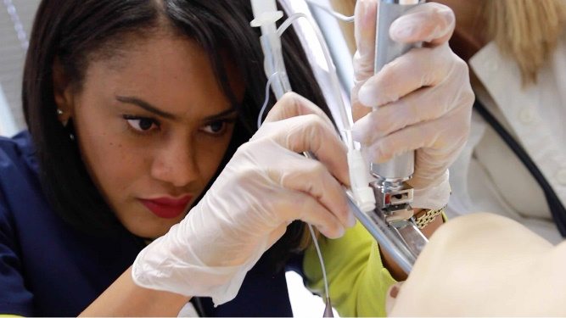
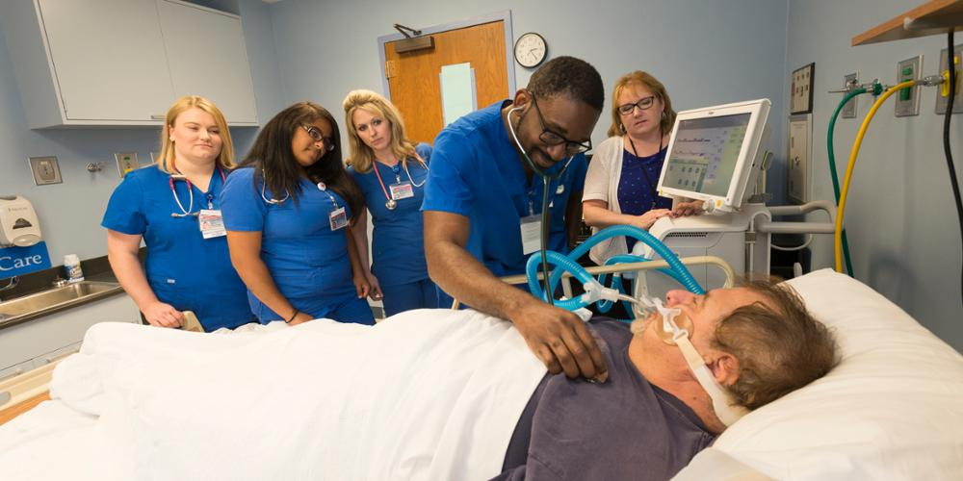
University of North Alabama
5a. Bachelor of Science in Respiratory Care (CIP 51.0908)
The proposed BS in Respiratory Care is designed to prepare graduates for employment as respiratory therapists (SOC 29-1126), which appear on the Statewide In-Demand Occupations List and are in high-demand due to the COVID pandemic and high growth in Region 1.
The proposed program will be accredited by the Commission on Accreditation for Respiratory Care (CoARC) and will prepare students for certification through the National Board for Respiratory Care and state licensure through the Alabama State Board of Respiratory Therapy.
The proposal includes 5 letters of support from industry partners and potential employers, including North Alabama Medical Center, Helen Keller Hospital, Athens Limestone Hospital, Huntsville Hospital Madison, and UAB Hospital.
This Photo by Unknown Author is licensed under CC BY-ND

Slide 107
Motion, Decision Item A-5a:
That the Commission approve the University of North Alabama’s proposal to offer a Bachelor of Science in Respiratory Care.

Slide 108
University of North Alabama
5b. Doctor of Nursing Practice in Nursing (CIP 51.3818)
The proposed DNP is designed to prepare graduates for employment as Nurse Practitioners and Nursing Instructors and Teachers, Post-Secondary (SOC 25-1072), both of which are included on the Statewide In-Demand Occupations List.
The proposed program will offer a strategic benefit by supporting the nursing pipeline in an underserved area of the State and by offering unique tracks in Population Health with a focus on simulation and Educational Leadership with a focus on simulation.
The proposal includes seven letters of support, including
representatives from the following: City of Florence Mayor,
Northwest-Shoals Community College, the Alabama
Department of Public Health, and the North Alabama
Medical Center.
This Photo by Unknown Author is licensed under CC BY-ND

Slide 109
Motion, Decision Item A-5b:
That the Commission approve the University of North Alabama’s proposal to offer a Doctor of Nursing Practice in Nursing.

Slide 110
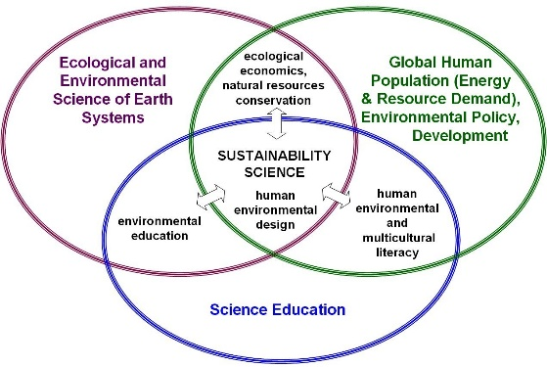
University of South Alabama
6a. Bachelor of Science in Environmental Science and
Sustainability (CIP 30.3301)
The proposed program is related to USA’s existing graduate programs in marine conservation and environmental toxicology, and fits within the mission of the newly launched School of Marine and Environmental Sciences.
The proposed program will take advantage of USA’s proximity to the delta and coastal regions of the State, allowing for hands-on education and the ability to partner with local environmental, consulting, petro-chemical, new sustainability and government agencies.
The proposal includes four letters of support from the following private industries and government agencies: the Alabama Department of Conservation and Natural Resources, the Nature Conservancy of Alabama, Thompson Engineering, Inc., and the Mobile Bay National Estuary Program.

Slide 111
Motion, Decision Item A-6a:
That the Commission approve the University of South Alabama’s proposal to offer a Bachelor of Science in Environmental Science and Sustainability.

Slide 112
University of South Alabama
6b. Bachelor of Science in Marine Sciences (CIP 30.3201)
The proposed program expands upon USA’s existing MS and PhD programs in Marine Sciences, and will not require any additional resources to deliver.
The proposed program will take advantage of USA’s proximity to the delta and coastal regions of the State, as well as existing partnerships with maritime industries, non-governmental organizations, and federal and state resource agencies along the central Gulf of Mexico coast.
The proposal includes five letters of support attesting to the need for this program: the Alabama Marine Resources Division of the Department of Conservation and Natural Resources, the Nature Conservancy, the Dauphin Island Sea Lab, the Alabama Coastal Federation, and USA’s Marine Science Student Association.

Slide 113
Motion, Decision Item A-6b:
That the Commission approve the University of South Alabama’s proposal to offer a Bachelor of Science in Marine Sciences.

Slide 114
ALABAMA COMMUNITY COLLEGE SYSTEM

Slide 115
Chattahoochee Valley Community College
7a. Associate of Applied Science and Short-Term Certificate in
Emergency Medical Services - Paramedic (CIP 51.0904)
This program is designed to prepare students for national certification and licensure as Paramedics through the Alabama Department of Public Health, Office of Emergency Medical Services, and will help meet the demand for Emergency Medical Services in the state and local area.
Each semester, local EMS services request to visit classrooms with job offerings. Graduates will be prepared for employment as paramedics, emergency medical technicians, and firefighters.
CVCC’s existing multiple allied health programs provide the foundation, facilities and equipment need to support this new program.

Slide 116
Motion, Decision Item A-7a:
That the Commission approve Chattahoochee Valley Community College’s proposal to offer an Associate of Applied Science and Short-Term Certificate in Emergency Medical Services - Paramedic.

Slide 117
Chattahoochee Valley Community College
7b. Associate of Applied Science in Medical Laboratory
Technician(CIP 51.1004)
Awareness of a need for a local Medical Laboratory Technician (MLT) program arose from discussions with local healthcare facilities and workforce regional councils pointing to the high demand in the region.
CVCC has strong partnerships with area health care facilities and currently utilizes these facilities as clinical sites for existing health science programs.
This proposal includes two letters of support from St. Francis Emory Healthcare in Columbus, Georgia and Martin Army Community Hospital in Ft., Benning, Georgia attesting to the program’s strengths and expressing the need for more technicians.

Slide 118
Motion, Decision Item A-7b:
That the Commission approve Chattahoochee Valley Community College’s proposal to offer an Associate of Applied Science in Medical Laboratory Technician.

Slide 119
Gadsden State Community College
8. Associate of Applied Science and Certificate in Dental
Assistant (CIP 51.0601)
This program will help meet statewide industry demand for dental assistants (SOC 31-9091), which are included on the State’s In-Demand Occupations List.
This proposal includes five letters of support from local employers and economic developers attesting to the need for this program.

Slide 120
Motion, Decision Item A-8:
That the Commission approve the Gadsden State Community College’s proposal to offer an Associate of Applied Science and Certificate in Dental Assistant.

Slide 121
Lurleen B. Wallace Community College
9. Associate of Applied Science in Building Construction
(CIP 46.0415)
This program will help meet industry demand for skilled construction trades workers, which appear on Alabama’s Statewide In-Demand Occupations List.
This proposal includes four letters of strong support from the following future industry partners and local officials: Wyatt Sasser Construction, Wright Brothers Construction, Crenshaw County Commission, Crenshaw County Schools.

Slide 122
Motion, Decision Item A-9:
That the Commission approve the Lurleen B. Wallace Community College’s proposal to offer an Associate of Applied Science in Building Construction.

Slide 123
B. INFORMATION ITEMS
Implementation of Non-Degree Programs at Senior Institutions
Changes to the Academic Program Inventory
Implementation of Distance Education Programs
Updates to Units of Instruction, Research, Public Service, and Administration
Extensions/Alterations to Existing Programs of Instruction
Implementation of New Short Certificate Programs (Less than 30 Semester Hours)
Summary of Post-Implementation Reports

Slide 124
7. Summary of Post-Implementation Reports
Programs that met post-implementation conditions
Athens State University: MEd in Career and Technical Education
(CIP 13.1319)
Auburn University: MA in Counseling Psychology (CIP 42.2803)

Slide 125
7. Summary of Post-Implementation Reports
b. Programs that did not meet post-implementation conditions
None

Slide 126
Motion, Decision Item B:
That the Commission accept the information items as presented.

Slide 127
C. ADJOURNMENT

