Slide 1

Alabama Commission on Higher Education
Commission Meeting
June 10, 2022

Slide 2


CALL TO ORDER, PRAYER, AND PLEDGE OF ALLEGIANCE

Slide 3

II. ROLL CALL and
QUORUM DETERMINATION

Slide 4

III. APPROVAL OF AGENDA
Commission Meeting Agenda of
June 10, 2022

Slide 5

IV. CONSIDERATION OF MINUTES
Commission Meeting Minutes of March 11, 2022

Slide 6

V. CHAIRMAN’S REPORT

Slide 7

VI. EXECUTIVE DIRECTOR’S REPORT

Slide 8


Professional Milestones
Earned 5-year pin at ACHE in April.
Longest serving State Higher Education Executive Officer (SHEEO) in the country.
14 years (AR, LA, RI, AL)

Slide 9
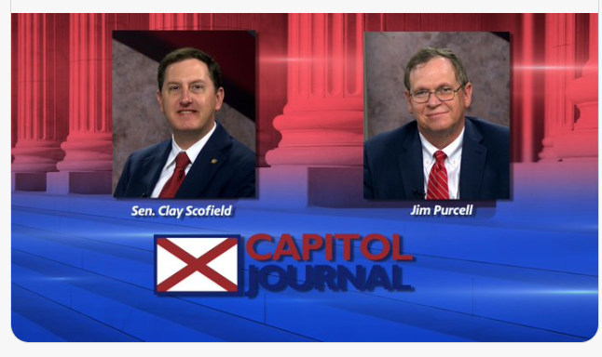
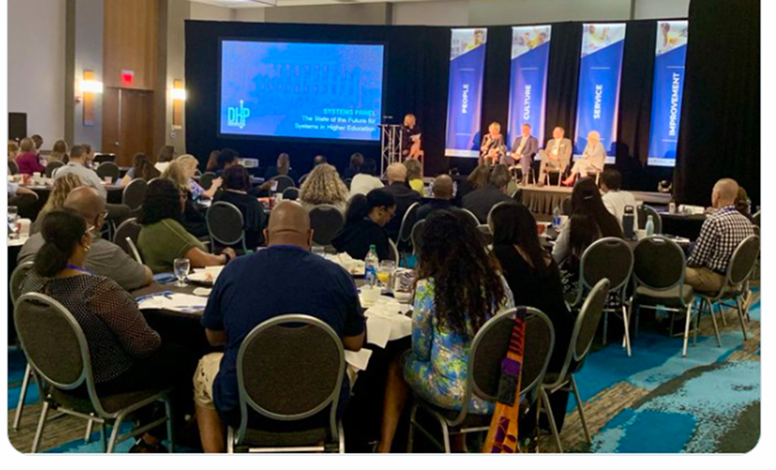
Dr. Purcell appeared on APTV Capitol Journal and discussed:
Funding for higher education,
FAFSA completion initiatives,
changing needs of the workforce,
Retain Alabama, and
Alabama’s teacher shortage.
The State of the Future for Systems of Higher Education. The Future of Higher Education convening by Studer Education, Pensacola, FL.

Slide 10
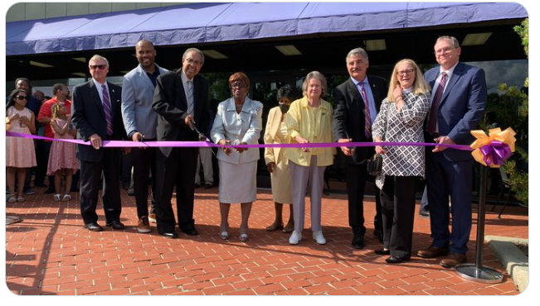
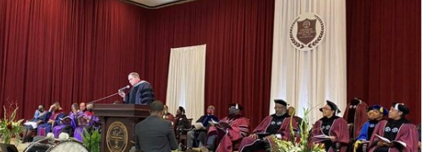
In Montevallo for the dedication ceremony to rename the “UM on Main Building” to “Dr. Wilson Fallin Jr. Hall”
In Huntsville to bring greetings from ACHE at the investiture of Dr. Daniel Wims as the 12th President of Alabama A&M

Slide 11
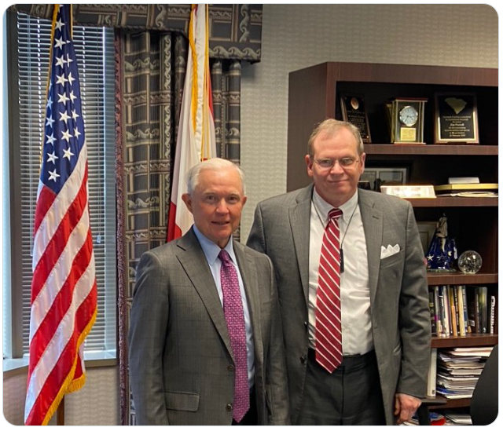
Visited by former US Senator and
former Attorney General Jeff Sessions

Slide 12

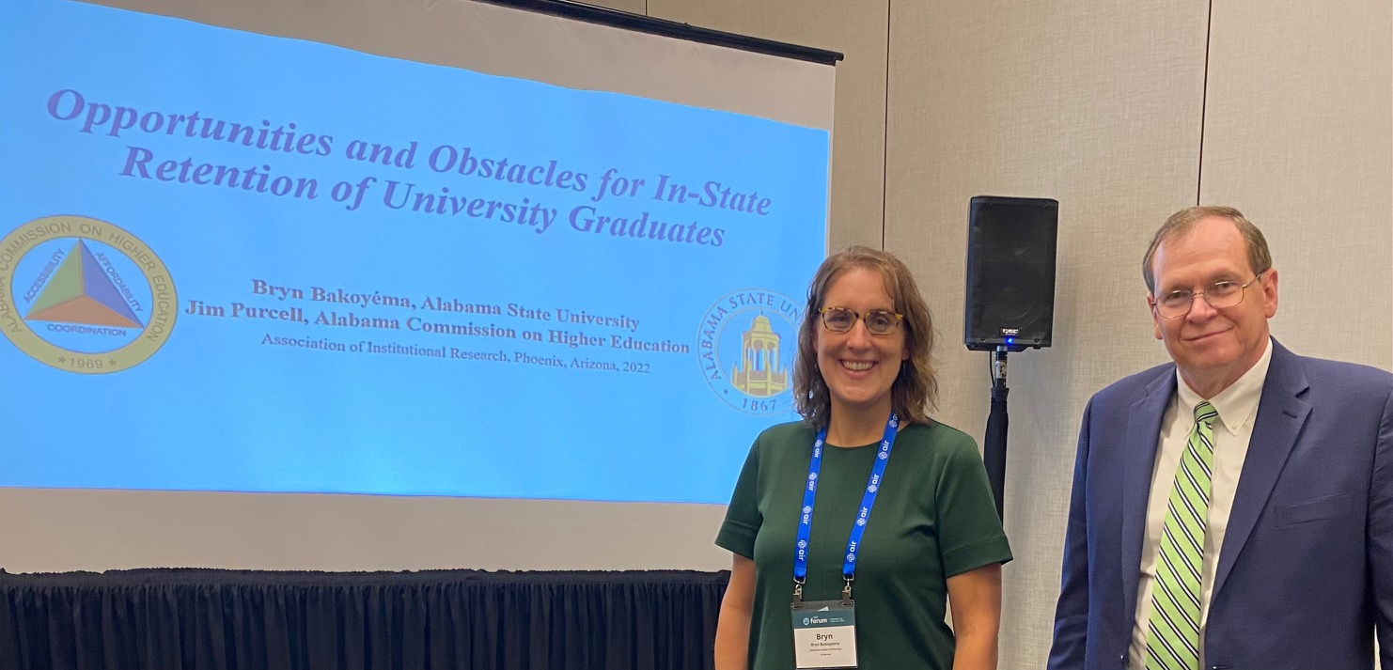

SAIR “Best Paper” Award
Southern Association of Institutional Research (SAIR) 2021 “Best paper” winner with Bryn Bakoyema for the paper: Opportunities and Barriers for Retaining Alabama’s University Graduates. The award brought with it an invitation to speak at the national convening of researchers in Phoenix, Arizona this week.

Slide 13

Research Fellows

Slide 14
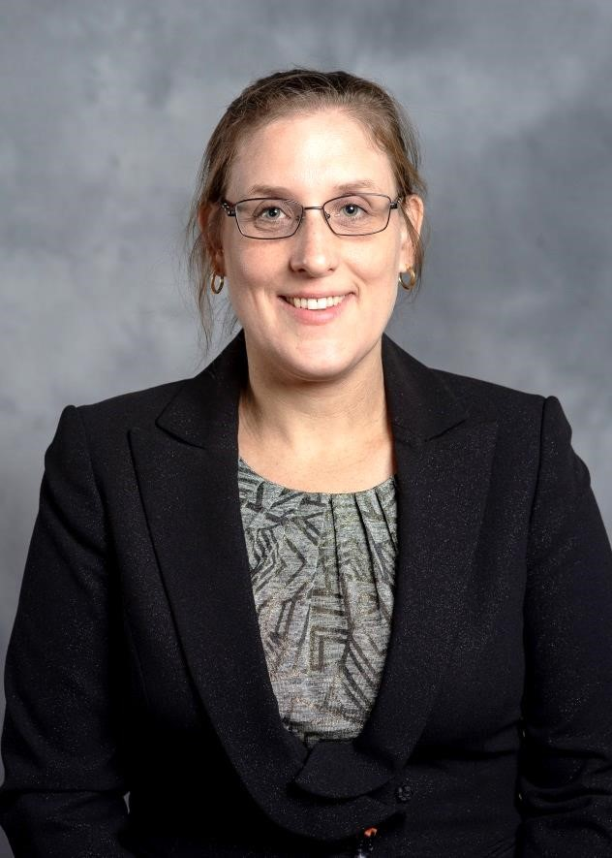
Bryn Bakoyéma
Bryn Bakoyéma is currently a PhD student in Educational Leadership, Policy, and Law at Alabama State University while serving full-time as the Director of Institutional Research at ASU.
Her expertise is in statistical analysis. Two of her projects “Exploring Career Choices for Education Bachelor’s Graduates” and “Assessing Student Intentions to Remain In-State Post Graduation” will be presented at the Southern Association of Institutional Research conference in October.
Bryn is a native of North Carolina and currently resides in Montgomery.

Slide 15
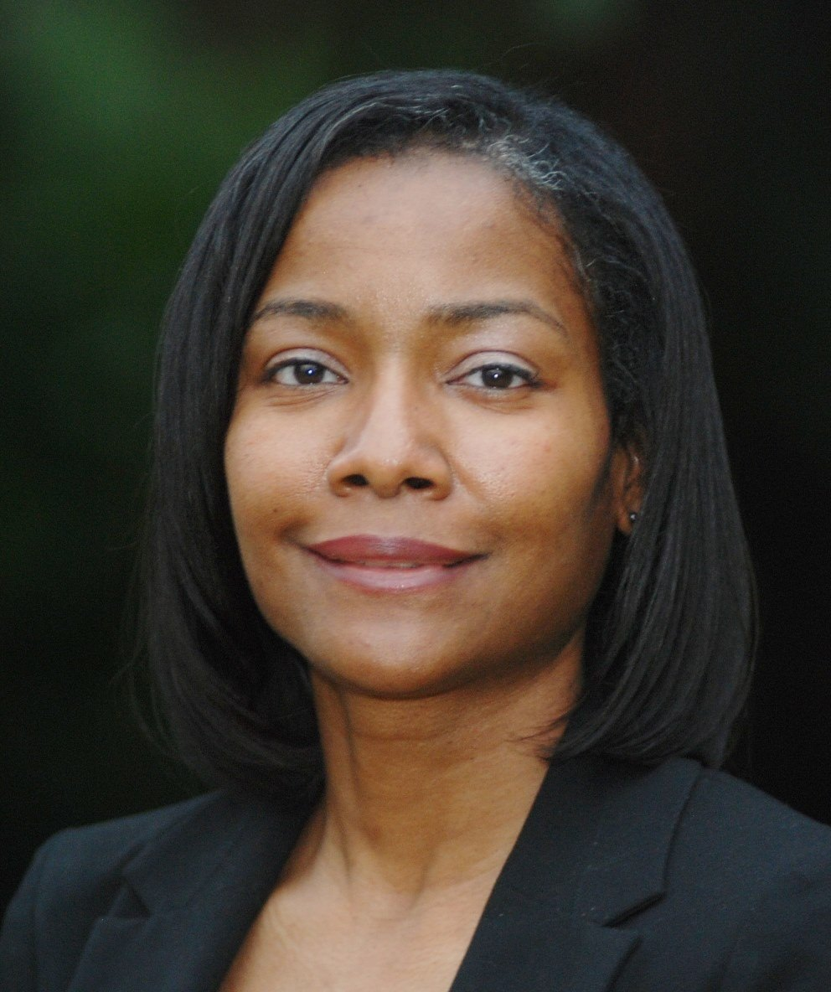
Dana K. Harmon, Ph.D.
Dr. Dana Harmon currently serves as a Clinical Associate Professor and Accreditation Specialist for Loyola University’s School of Social Work. Her research interests focus on licensure exam pass rates and implications of licensure on salaries. Her interests also include the impact of licensed social work faculty on licensure pass rates.
Dana is a native of Tuskegee and currently resides in Montgomery.

Slide 16
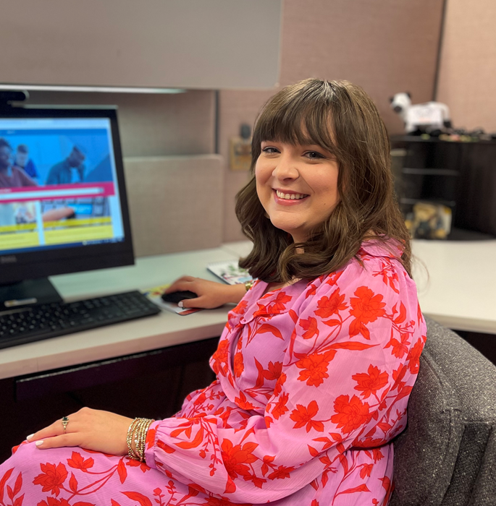
Dalis Lampkins
Dalis Lampkins is currently a PhD student at the University of Alabama majoring in Political Science with a concentration in American Politics. Her research interests include affordability and accessibility, postsecondary funding, and student retention at the institution and workforce.
Dalis is a native of Gleason, TN and currently resides in Tuscaloosa.

Slide 17
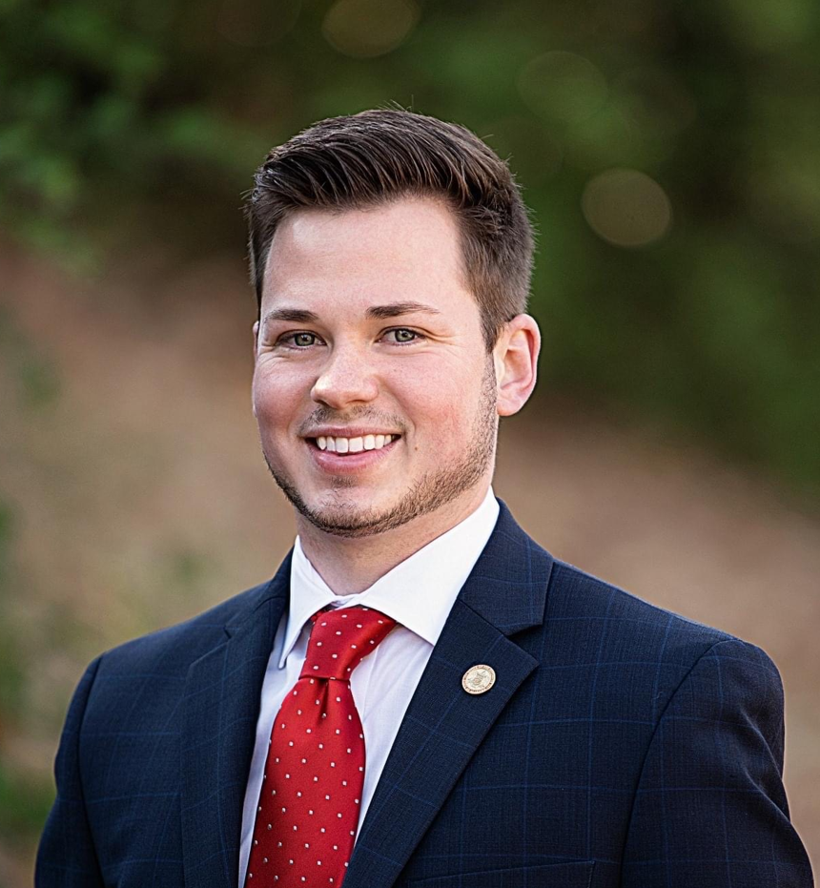
Brian Massey
Brian Massey is currently a PhD student at Auburn University majoring in Educational Foundations, Leadership, and Technology with a concentration in disadvantaged student populations. He also serves as the Director of Governmental Relations at the Alabama Education Association where he manages the lobby function and establishes legislative strategies and plans for the Association.
Brian is a native of Enterprise and currently resides in Montgomery.

Slide 18
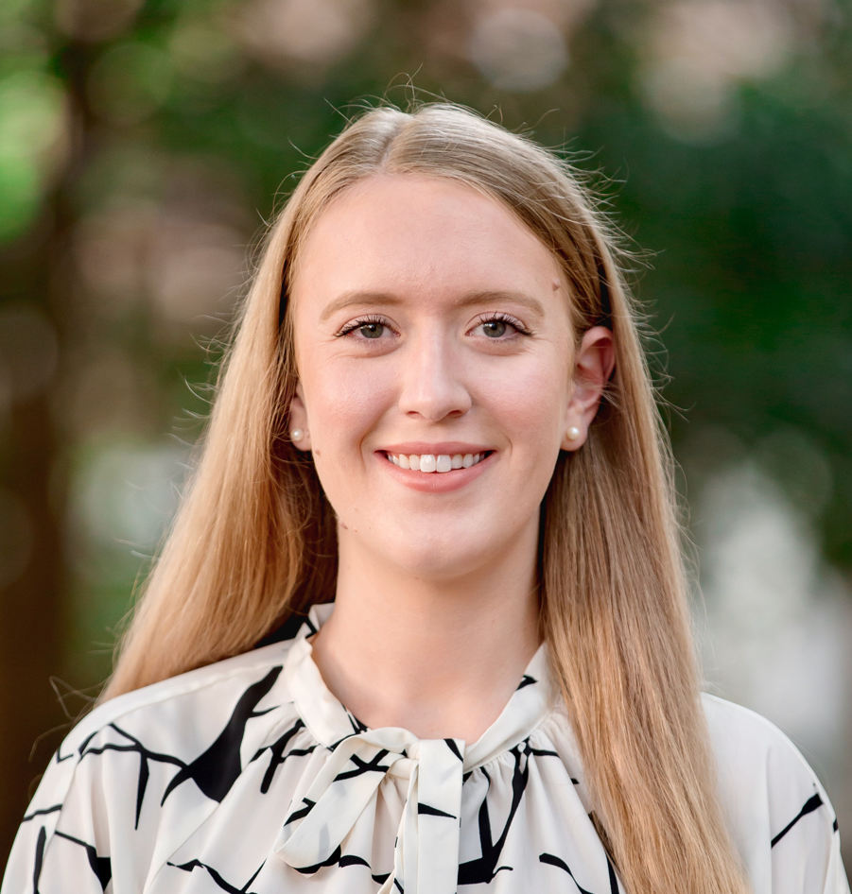
Natalie Millar
Natalie Millar is currently a PhD student at the University of Alabama majoring in Economics with a concurrent fellowship at Stanford University’s Hoover Institution. Her research interests include postsecondary economics, applied microeconomics, and compliance and workforce development.
Natalie is a native of Cullman and currently resides in Tuscaloosa.

Slide 19
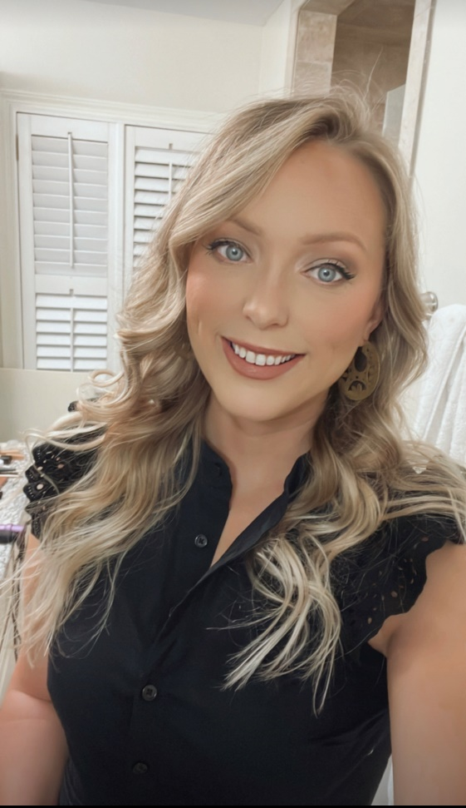
Shelby Morris
Shelby Morris is currently a PhD student at the University of Alabama majoring in Instructional Leadership with a concentration in Social and Cultural Studies. She is currently serving as a Graduate Council Fellow. Her research interests include student aid, tuition and financial barriers along with certificates and micro-credentials that align with workforce opportunities.
Shelby is is a native of Nashville, TN and currently resides in Tuscaloosa.

Slide 20
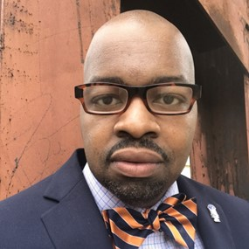
Will Thomas
Will Thomas is currently a PhD student at Auburn University majoring in History. He has served as a professional historian, museum curator, and history librarian. His research interests include financial aid, nontraditional adult students, and online learning.
Will is a native of Detroit, MI and currently resides in Auburn.

Slide 21

High School Summer Interns
(Students developed their own slides)

Slide 22
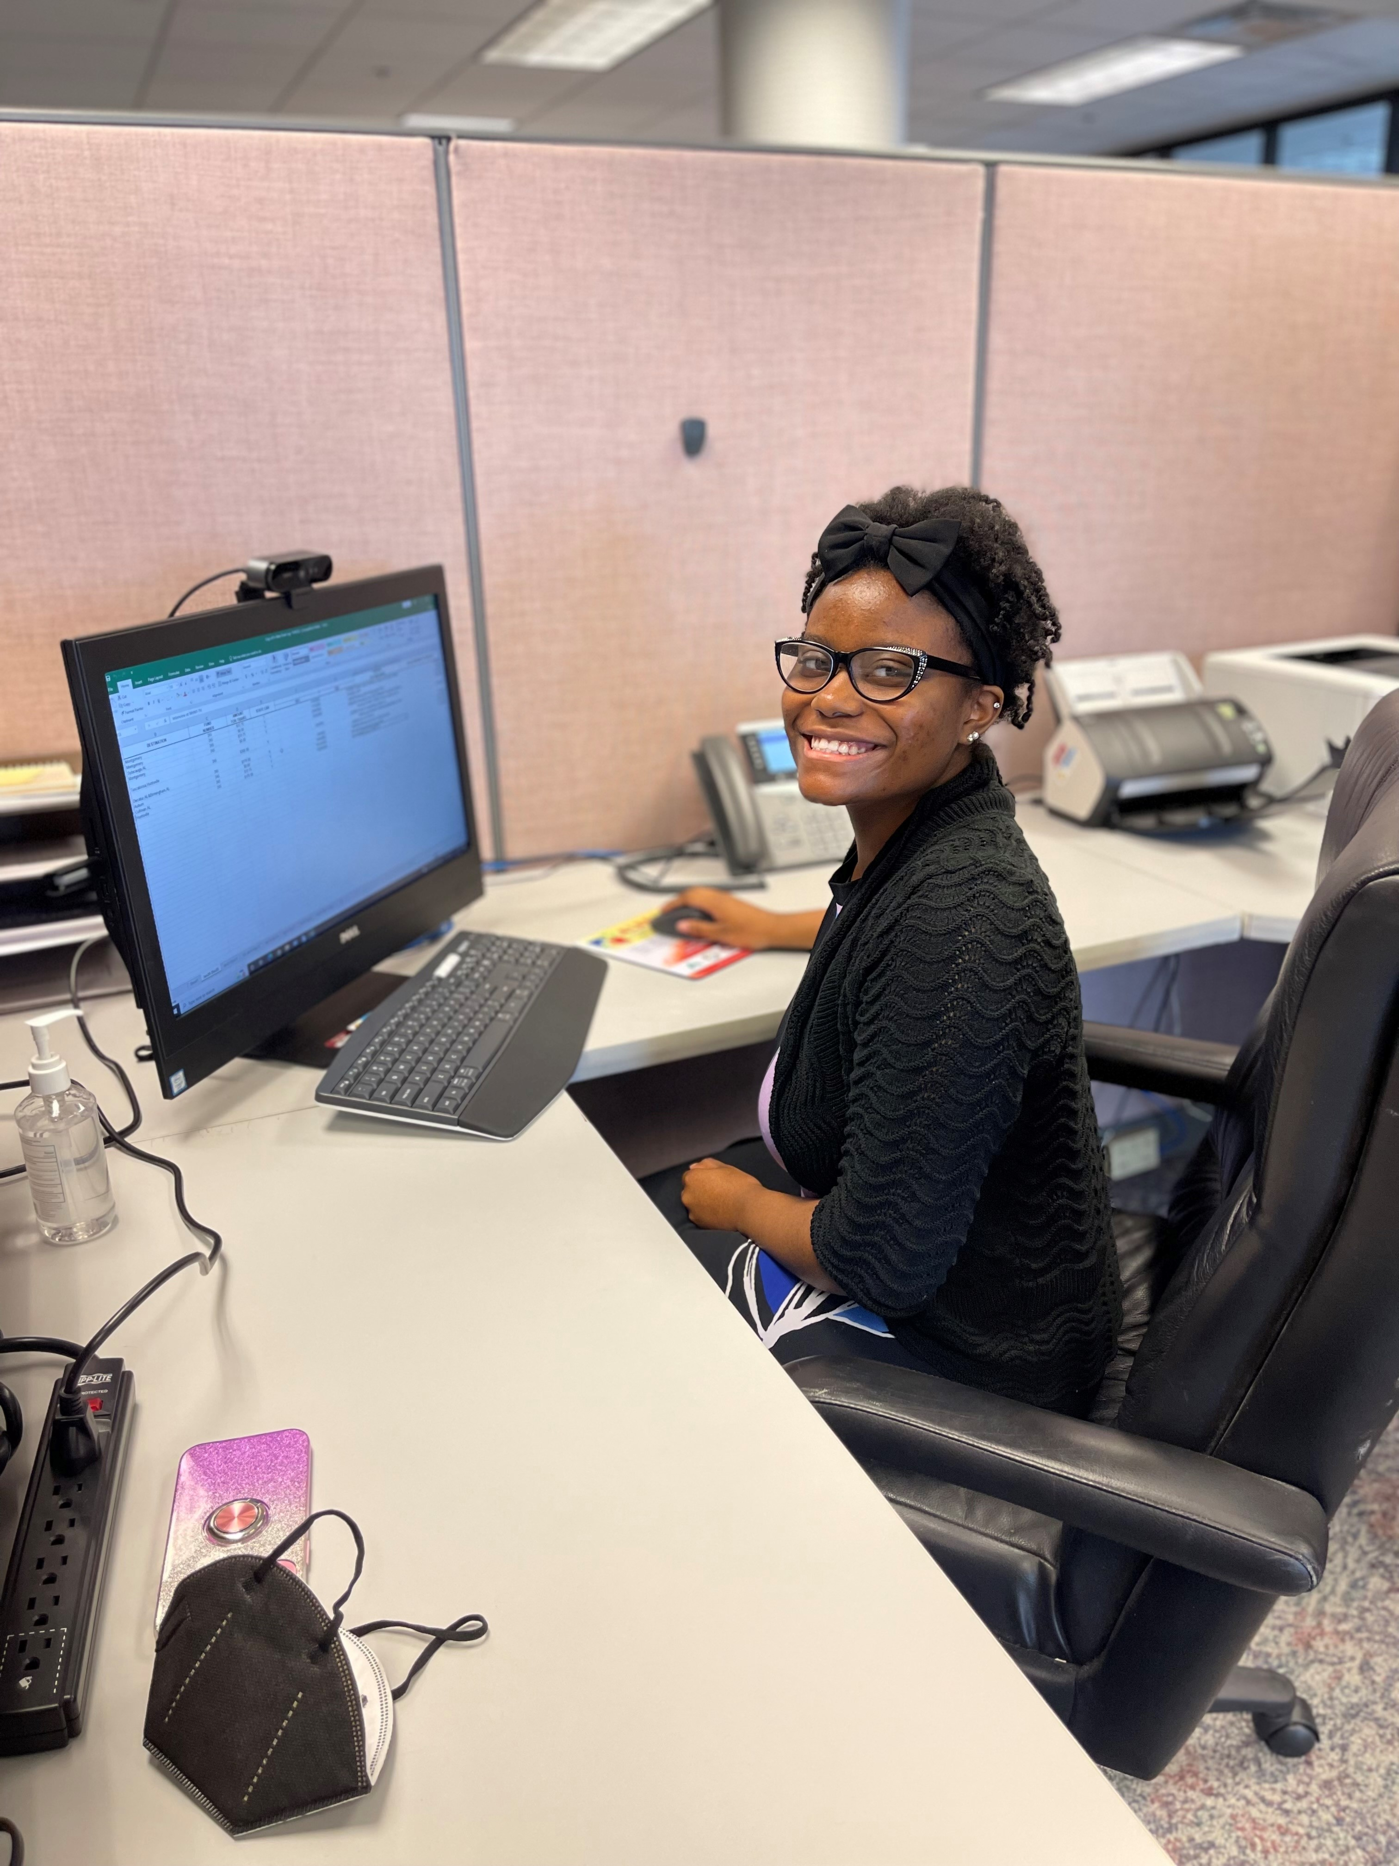
Arnecia Smith
High School: Brewbaker Technology Magnet High School
Grade: 12th (Fall 2022)
Hobbies: Singing, Dancing, and Netflix

Slide 23
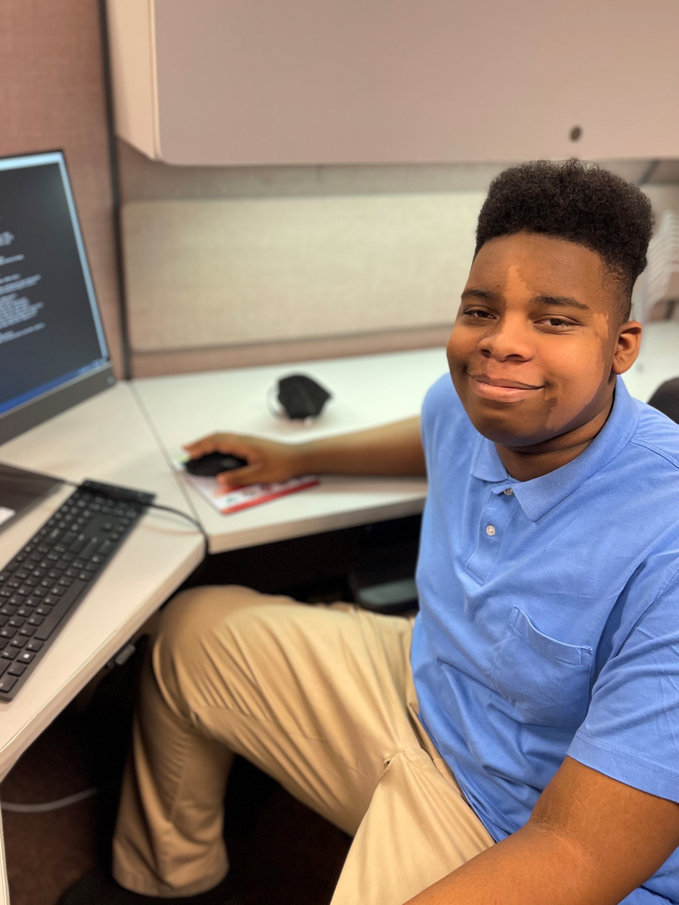
Duane Jon Harris
High School: Brewbaker Technology Magnet High School
Grade: 12th (Fall 2022)
Hobbies: Video Games, Reading, and Computers

Slide 24
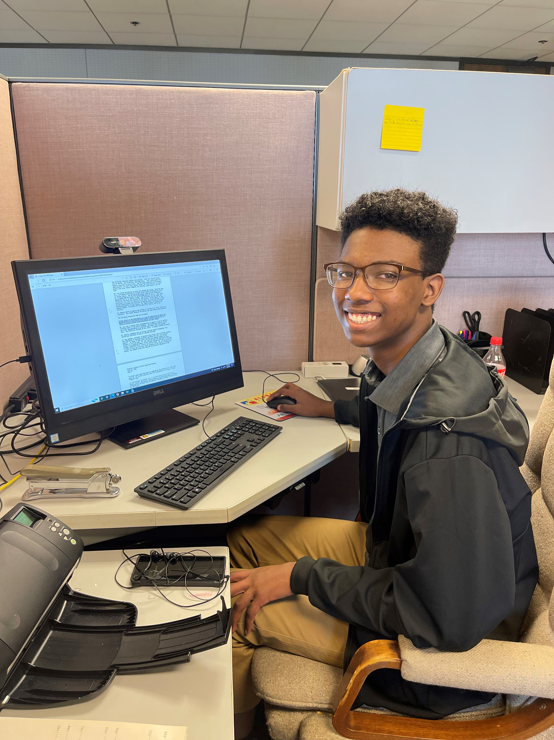
Jackson Bell
High School: Montgomery Catholic Preparatory School
Grade: 12th (Fall 2022)
Hobbies: Video Games, Music, and Swimming

Slide 25

FAFSA Completion Initiatives

Slide 26
Why is completing the FAFSA important?
Gateway to over $150 billion in federal grants, loans, aid, as well as certain state-based aid.
Alabama’s Class of 2021 left roughly $67.8 million in unclaimed Pell Grant money on the table (ranked 15th nationally).
FAFSA completion strongly associated with postsecondary enrollment:
92% of seniors who completed the FAFSA enrolled by the November following graduation vs. 51% who did not complete a FAFSA.
Financial investment in today’s students and tomorrow’s workforce.

Slide 27
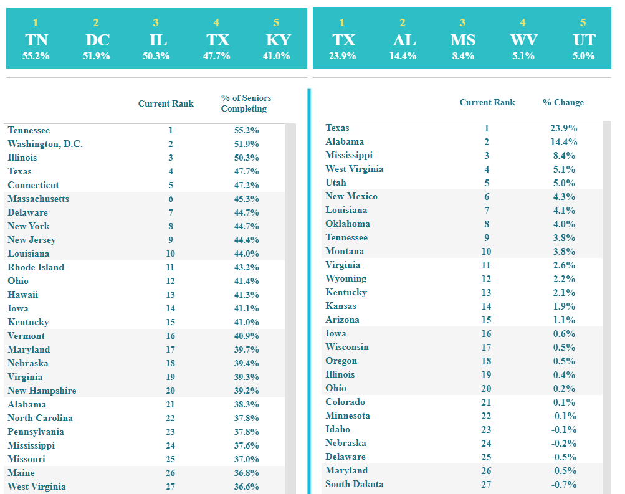
03/07/22
FAFSA Completion State Rankings:
21st nationally in overall completion
(38.3% completion)
2nd nationally in 1-year improvement
(14.4% increase)

Slide 28
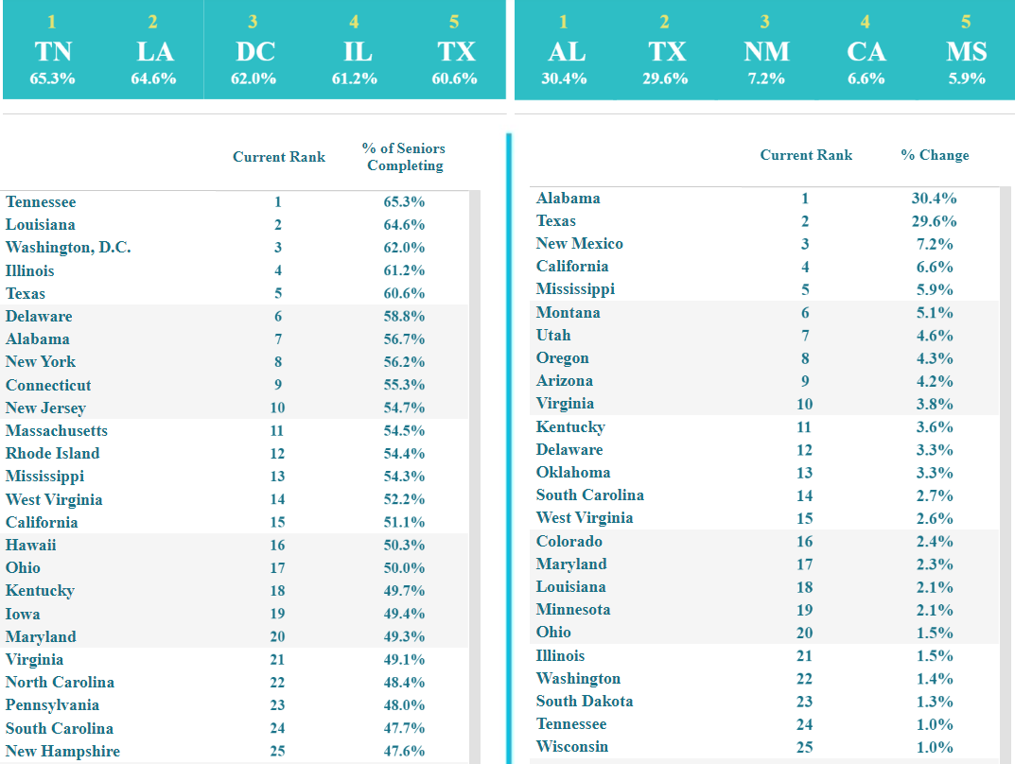
05/27/2022
FAFSA Completion State Rankings:
7th nationally in overall completion
(56.7% completion)
1st nationally in 1-year improvement
(30.4% increase)
Source: www.ncan.org

Slide 29
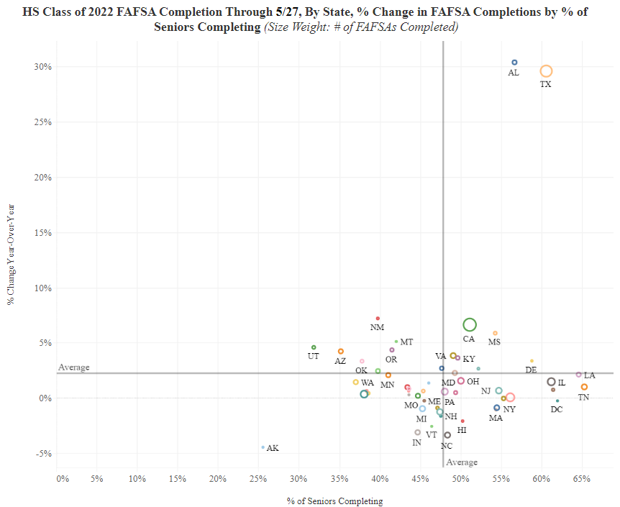
05/27/2022
FAFSA Completion State Rankings:
7th nationally in overall completion
(56.7% completion)
1st nationally in 1-year improvement
(30.4% increase)
#1 Nationally: 30.4% in one-year improvement
#7 Nationally: 56.7% overall completion
Source: www.ncan.org

Slide 30
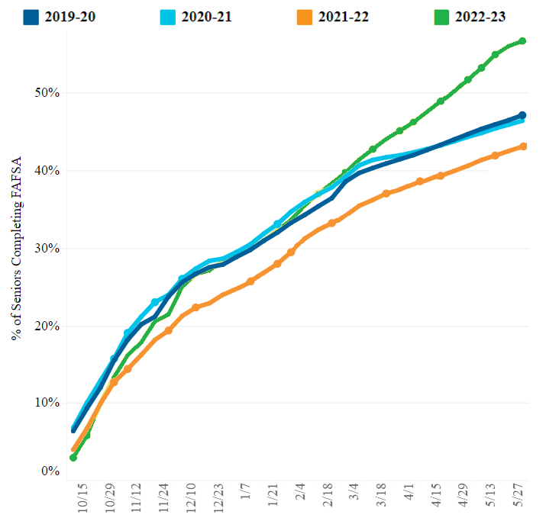
Alabama
FAFSA Completion Four-Year Trend:
2022-23: 54.9%
2021-22: 41.9%
2020-21: 45.4%
2019-20: 45.9%
Email outreach to students began on 2/23
Growth coincides with emails
Source: www.ncan.org

Slide 31
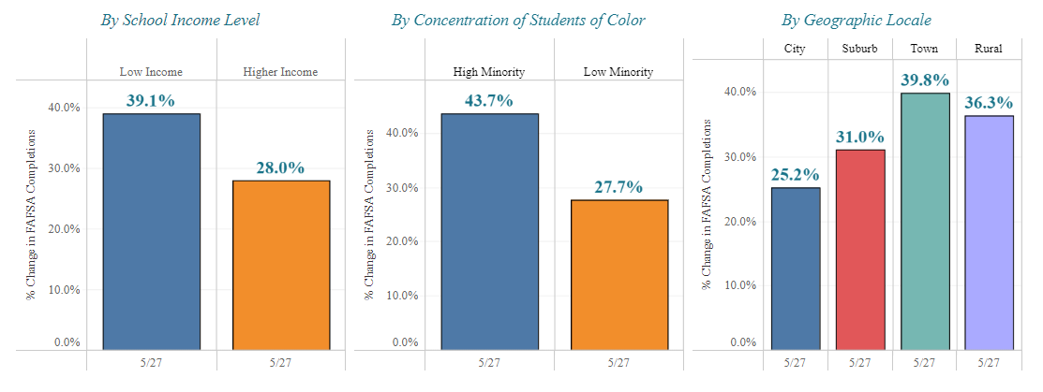
% Change in FAFSA Completion Year-Over-Year By Selected Characteristics Through 5/27 Alabama
US Average | 9.7% | 2.3% |  | 9.6% | 1.4% |  | 7.2% | 3.5% | 3.7% | 4.4%
US Rank | 1st | 1st |  | 1st | 1st |  | 2nd | 1st | 1st | 1st
Source: www.ncan.org

Slide 32
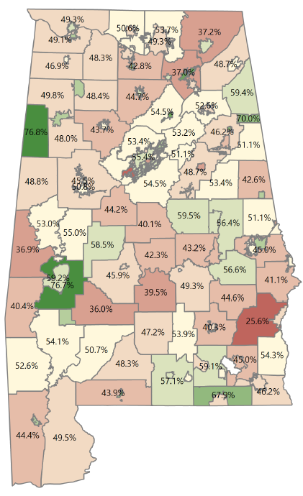
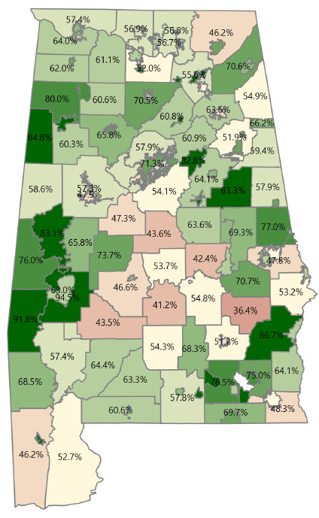
FAFSA Completions by School District
2021-22 2022-23
Select Counties:
Barbour
25.6% to 86.7%
Sumter
36.9% to 76.0%
Choctaw
40.4% to 91.8%

Slide 33

Public Higher Education Funding

Slide 34
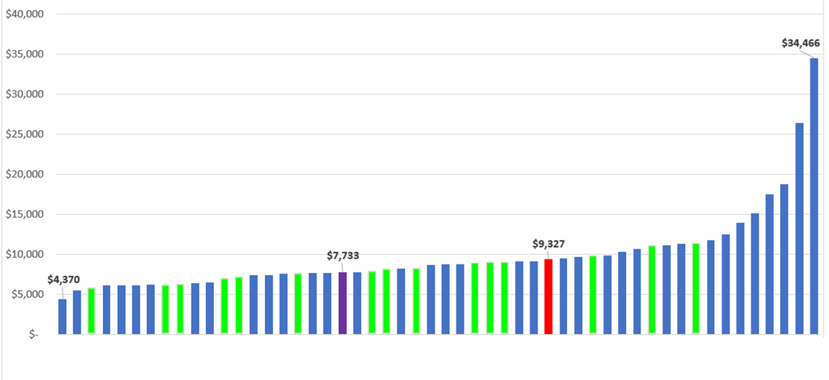
Public Higher Education Appropriations per FTE by State, FY2021 (Adjusted)
Alabama appropriates less per FTE than the national average, and less than neighboring states Georgia, Tennessee, Mississippi, and Florida
Index to U.S. Average
.83
AL
US
Source: Embargoed SHEF Report 2021, Figure 3.2
SREB States in Green

Slide 35
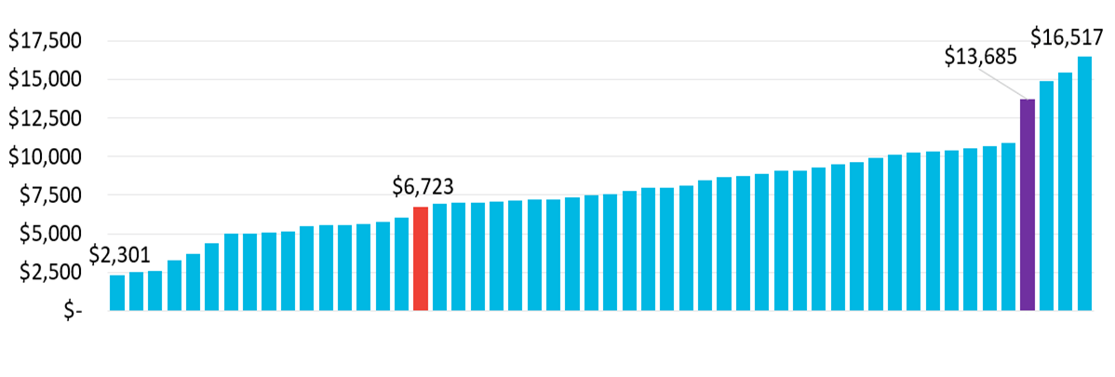
Public Higher Education Net Tuition Revenue per FTE by State, FY 2021 (Adjusted)
Alabama has the 4th highest tuition revenue in the country; over two times (2.04) greater than the U.S. average.
INDEX TO U.S. AVERAGE
2.04
US
AL
Source: Embargoed SHEF Report 2021, Figure 4.1

Slide 36
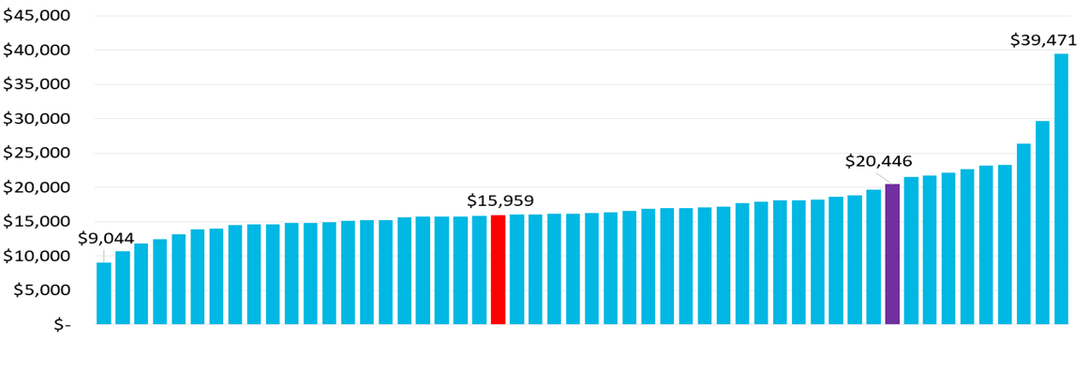
Public Higher Education Total Education Revenue per FTE by State, FY 2021 (Adjusted)
Alabama is ranked 10th in overall revenue per FTE (state support, tuition, and fees); 28 percent above the US average.
INDEX TO U.S. AVERAGE
1.28
US
AL
Source: Embargoed SHEF Report 2021, Figure 4.2

Slide 37
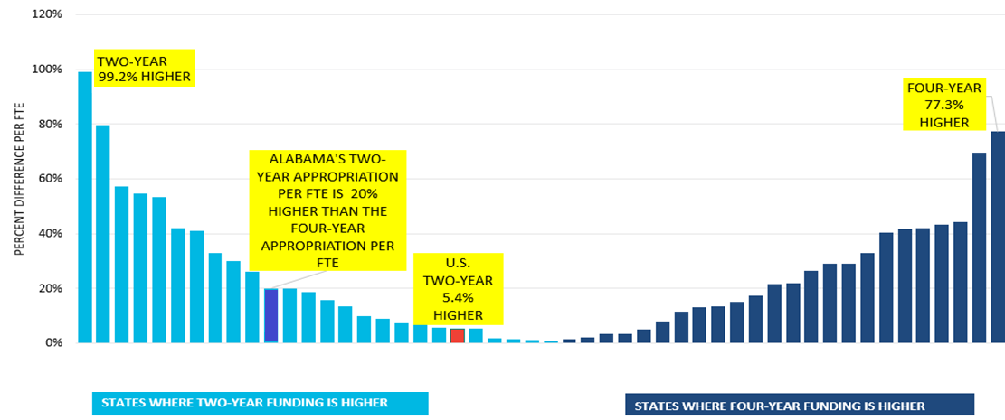
Percent Difference in Two-Year and Four-Year Public Higher Education Appropriation per FTE by State, FY2021
AL
US
Source: Embargoed SHEF Report 2021, Figure 3.2A

Slide 38
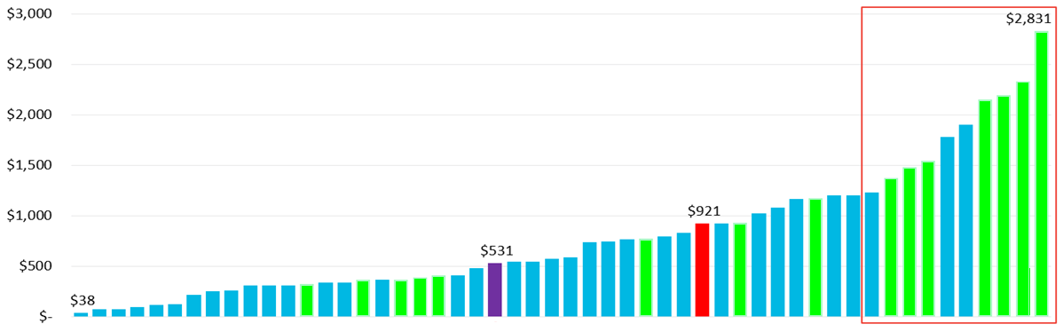
Public Higher Education State Financial Aid per FTE by State, FY 2021 (Adjusted)
Seven of the top ten states that offer the most financial aid are our neighboring SREB states.
Financial Aid is money for students and not a direct support to the institution.
Alabama has the 4th highest net tuition revenue in the country, but is ranked 26th in financial aid.
In Alabama, the largest financial aid programs are for veterans and their families.
INDEX TO U.S. AVERAGE
0.58
AL
US
SREB States in Green
Source: Embargoed SHEF Report 2021, Figure 3.3

Slide 39
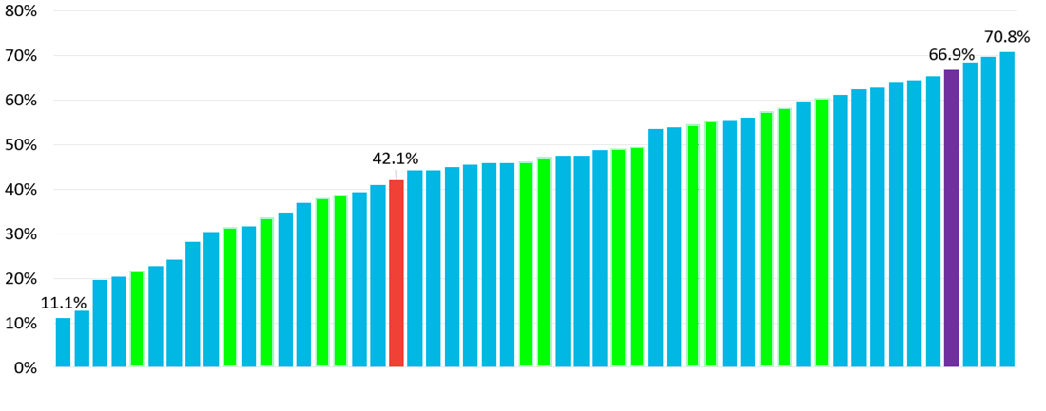
Student Share: Net Tuition as a Percent of Total Education Revenue by State, FY2021
With 66.9% of Higher Education’s total revenue being dependent on tuition, Alabama is 60% higher than the national average.
Neighboring SREB states, Florida, Georgia, and Tennessee are below the national average.
Alabama ranks 4th in Net Tuition
INDEX TO U.S. AVERAGE
1.59
US
AL
SREB States in Green
Source: Embargoed SHEF Report 2021, Figure 4.3

Slide 40
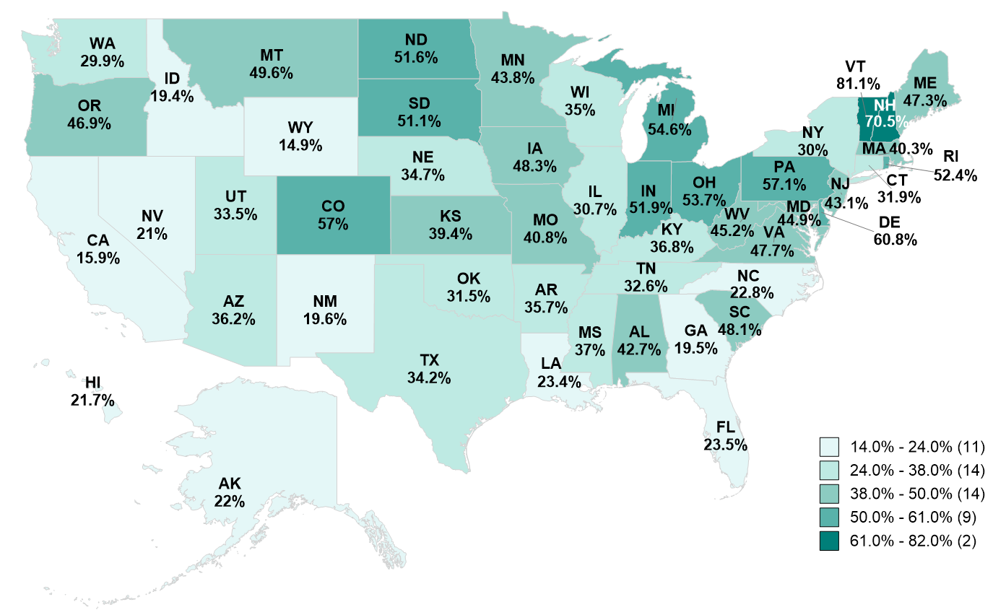
Student Share 2008
2008 States
38.0% - 50.0%
Montana 49.6%
Iowa 48.3%
South Carolina 48.1%
Virginia 47.7%
Maine 47.3%
Oregon 46.9%
West Virginia 45.2%
Maryland 44.9%
Minnesota 43.8%
New Jersey 43.1%
Alabama 42.7%
Missouri 40.8%
Massachusetts 40.3%
Kansas 39.4%
Note: Data for D.C. unavailable.
Source: SHEF Report 2020.
Source:

Slide 41
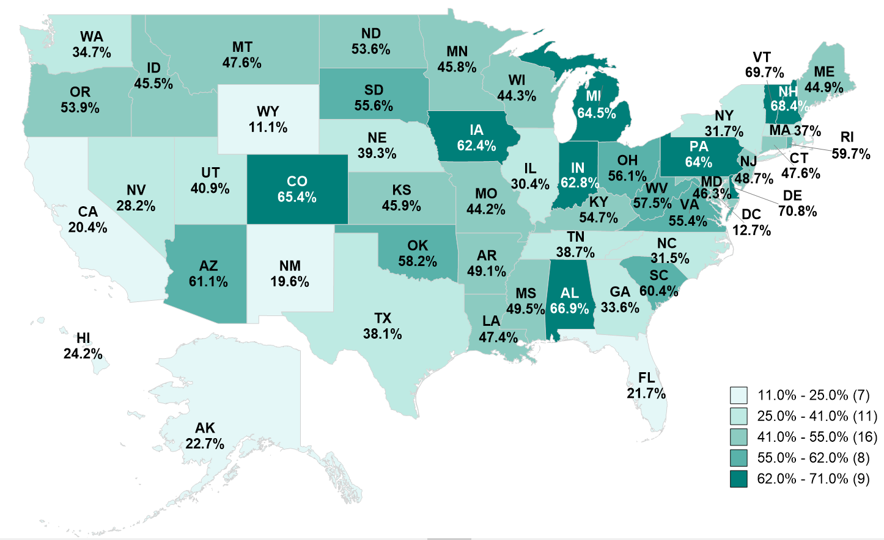
Student Share 2021
2021 States
62.0% - 71.0%
Delaware 70.8%
Vermont 69.7%
New Hampshire 68.4%
Alabama 66.9%
Colorado 65.4%
Michigan 64.5%
Pennsylvania 64.0%
Indiana 62.8%
Iowa 62.4%
Source: Embargoed SHEF Report 2021
Source:

Slide 42

VII. DISCUSSION ITEMS

Slide 43
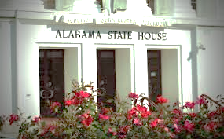
2022 ACHE Legislative Session
Presented by: Mrs. Margaret Gunter

Slide 44
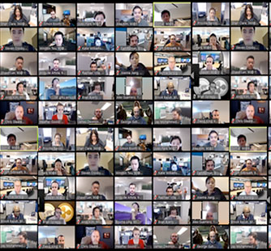
Virtual Meetings
Act #2022-421
Expands participation by governmental bodies in meetings by electronic communication
Members of the public must have access to hear the meeting
Any board member participating virtually may not claim reimbursement for expenses relating to the meeting, including mileage and per diem
At least three members, or a majority of a quorum of members, whichever is less, must be physically present

Slide 45
Education Budget
$8.26 Billion
Act #2022-393
32% increase for ACHE (4% for O&M)
9.71% increase for the Alabama Community College System
8.91% increase for the state universities
4% pay raise for teachers and state employees
Expansion of existing dual enrollment/career and technical education programs
“The 2022-23 education budget provides a substantial amount of funding that will allow us the opportunity to address several critical educational needs across the state.”
- Senate Finance/Taxation Education Chairman Arthur Orr

Slide 46
Helping Students Afford College
Working to Increase State Financial Aid
Program | 1-Year % Increase | Total Awards (millions) | 5-Year % Increase
Alabama Student Assistance Program | 9.9% | $ 8.00 | 185%
Alabama Student Grant Program | 9.9% | $ 8.00 | 96%
Police Officer’s/Firefighter’s Survivor Education Assistant Program | 5.0% | $ 0.47 | 104%
Alabama National Guard Educational Assistance Program | 5.0% | $ 5.47 | 75%

Slide 47



New Items in ACHE Budget
FAFSA Completion $500,000
STEM Major Teacher Recruitment $4,500,000
HBCU Deferred Maintenance $5,000,000

Slide 48



AMSTEP
Act #2022-396
Increases AMSTEP award amount from $2,500 to $3,750 for math and science teachers
Changes are effective 2022 fall semester

Slide 49
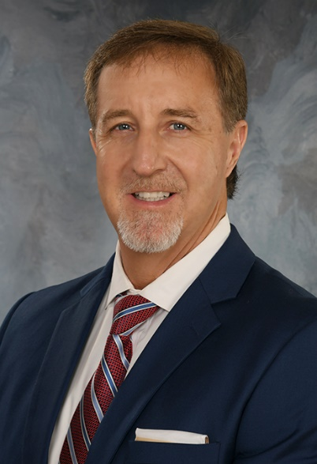
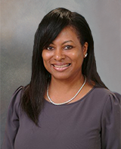
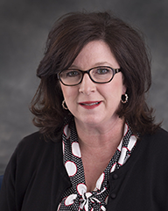
ACHE Commissioners
Commissioner Jody Singleton confirmed by the Senate
Commissioner Miranda Frost appointed to the Joint Interim Study Commission on Responsible Technology by Public Education
Commissioner Amy Price appointed to the Alabama Health Care Workforce Task Force

Slide 50

Numeracy Act 2022-249
ACHE makes appointments to:
Elementary Mathematics Task Force
Postsecondary Mathematics Task Force
ACHE prepares annual report on the status of the implementation and adoption of the mathematics education guidelines for postsecondary institutions

Slide 51
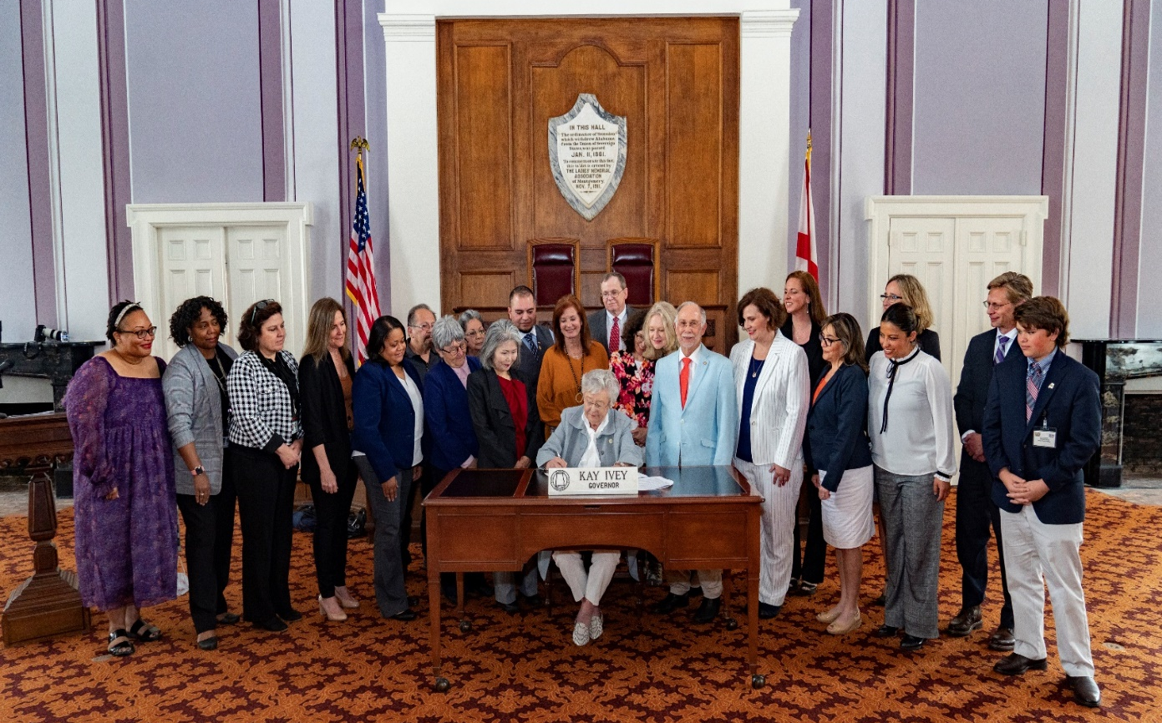
State Seal of Biliteracy
Act 2022-200
Recognizes high school graduates with the proficiency in English and at least one world language, including American sign language

Slide 52

Public Funds
Act #2022-428
Colleges and universities, local boards of education, schools and governmental agencies, departments, boards or commissions are prohibited from using public funds to advocate for or against ballot measures

Slide 53
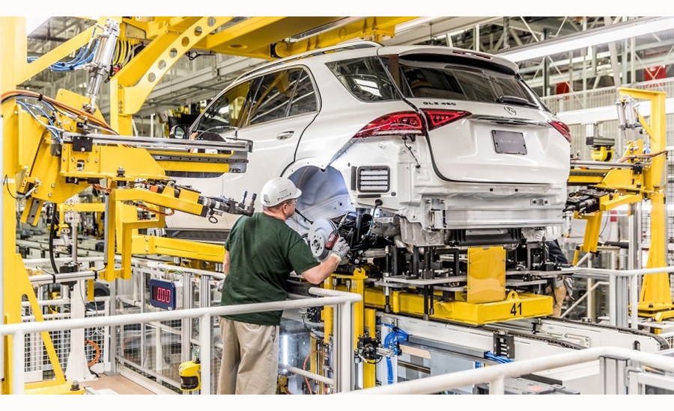
Workforce Needs Index
Presented by: Dr. Patrick Kelly

Slide 54

Using Data and Research to Guide Policy
Areas of Focus:
Research and Strategy
Practice
Implementation
Measure Progress
Ongoing Evaluation and Review
Strategy
Establish Framework for Continuity
Assign Responsibility
Research
Develop Plan to Address Problems
Involve Stakeholders and Build Consensus
Identify Problem Areas
Establish Research Questions
Data
Leverage Public & Proprietary Data

Slide 55



Developing Human Capital
Alabama Workforce Regions
Lauderdale
Limestone
Colbert
1
Madison
Jackson
What We Learn
Where We Live
Colbert
Lawrence
Franklin
Morgan
DeKalb
Marshall
DeKalb
Cullman
Cullman
Cherokee
Marion
Winston
Etowah
Cherokee
Blount
Etowah
Blount
2
Lamar
Fayette
Walker
4
Calhoun
Fayette
St. Clair
St. Clair
Cleburne
Jefferson
Cleburne
3
Tuscaloosa
Talladega
Randolph
Pickens
Shelby
Clay
Clay
Bibb
Coosa
Chambers
Greene
Greene
Chilton
Tallapoosa
Hale
Tallapoosa
Perry
Elmore
5
Sumter
Lee
Sumter
Dallas
Autauga
Macon
Marengo
Montgomery
Russell
How We Work
Choctaw
Marengo
Choctaw
Lowndes
Bullock
Wilcox
Wilcox
Butler
Barbour
7
Butler
Pike
Clarke
Clarke
Monroe
Monroe
Crenshaw
6
Henry
Washington
Conecuh
Coffee
Dale
Conecuh
Covington
Escambia
Houston
Geneva
Houston
Baldwin
Who We Are
Mobile
Baldwin

Slide 56
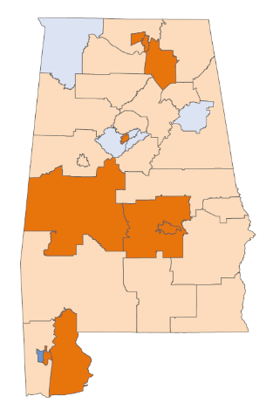
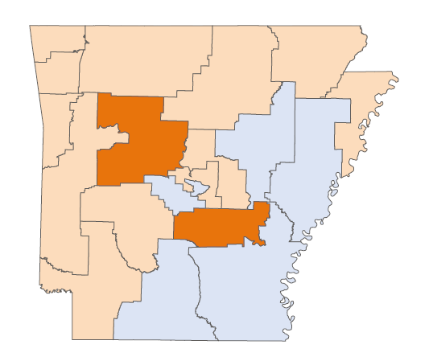
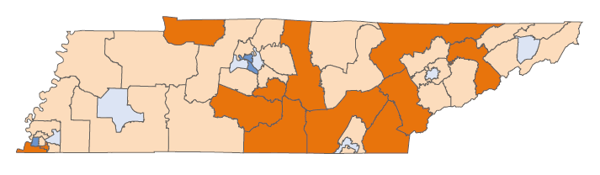
Education and Workforce NEEDS INDEX (EWNI)
2022
KY
TN
AR
Finding Solutions
AL
Needs Index Team
Raising the education levels of the population and workforce
Meeting employment and workforce demands and aspiration
Addressing population challenges related to growth, diversity, and age
Houston Davis, President: University of Central Arkansas
Brian Noland, President: East Tennessee State University
Patrick Kelly, Research Officer: Alabama Commission on Higher Education, East Tennessee State University, Kentucky Council on Postsecondary Education
Jim Purcell, Executive Director: Alabama Commission on Higher Education

Slide 57
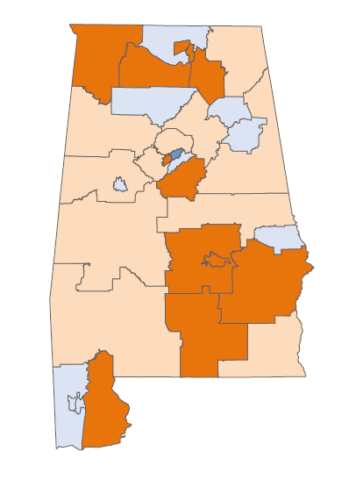

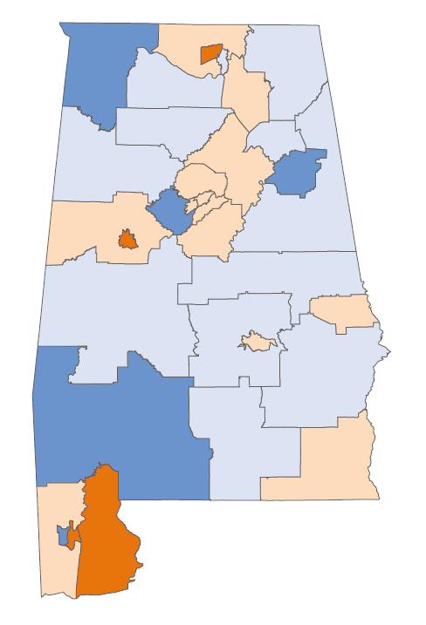
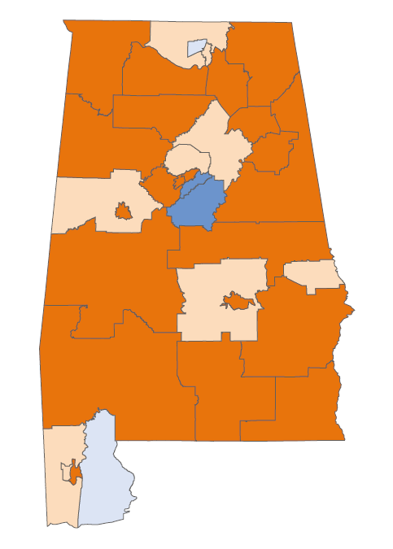
Education and Workforce NEEDS INDEX
Overall Education and Workforce Need
Education
Lauderdale
Ages 18 to 64 with a High School Diploma
Ages 25 to 64 with an Associates Degree
Ages 25 to 64 with a Bachelor’s Degree
Difference in College Attainment between Young and Older Adults
Ages 18 to 29 with No College Credential, Not Enrolled
Limestone
Limestone
Madison
Jackson
Most Critical
Colbert
Colbert
Lawrence
Critical
Franklin
Morgan
DeKalb
Marshall
DeKalb
Less Critical
Cullman
Cullman
Cherokee
Marion
Winston
Etowah
Cherokee
Least Critical
Blount
Etowah
Blount
Lamar
Fayette
Walker
Calhoun
Fayette
St. Clair
St. Clair
Population
Cleburne
Jefferson
Cleburne
Tuscaloosa
Shelby
Talladega
Randolph
Population Ages 0 to 19
Population Ages 20 to 44
Underrepresented Minorities
Annual % Change in Population
Under 65 Years of Age
Ages 25 to 64 in Poverty
Population Metrics Impact
Education & Workforce Needs
Pickens
Clay
Clay
Bibb
Coosa
Chambers
Greene
Greene
Chilton
Tallapoosa
Hale
Tallapoosa
Sumter
Perry
Elmore
Lee
Sumter
Dallas
Autauga
Macon
Marengo
Montgomery
Russell
Choctaw
Marengo
Choctaw
Lowndes
Bullock
Wilcox
Wilcox
Butler
Barbour
Butler
Crenshaw
Pike
Clarke
Clarke
Monroe
Monroe
Henry
Washington
Conecuh
Coffee
Dale
Workforce
Conecuh
Covington
Escambia
Houston
Working-Age Participation in the Labor Force
Unemployment
Employment in Manufacturing and Extraction
Median Personal Income
Median Annual Wage Income
Adults with SSI or Welfare Income
Geneva
Houston
Baldwin
Mobile
Baldwin
Data Sources
U.S. Census Bureau, 2019 American Community Survey 5-year PUMS (Public Use Microdata Sample).
Steven Ruggles, Sarah Flood, Sophia Foster, Ronald Goeken, Jose Pacas, Megan Schouweiler and Matthew Sobek. IPUMS USA: Version 11.0 [dataset]. Minneapolis, MN: IPUMS, 2021. https://doi.org/10.18128/D010.V11.0

Slide 58
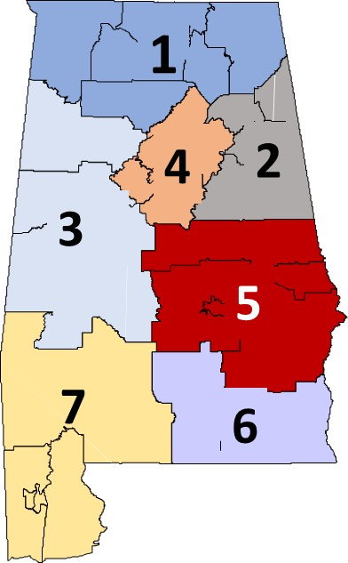
Education and Workforce NEEDS INDEX
Workforce Region 5

Slide 59
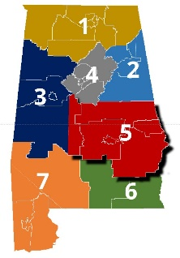
Education and Workforce NEEDS INDEX
Workforce Region 5
U.S. Quartiles
Alabama
Region 5
Regions
Least Critical
Less Critical
Critical
Most Critical
Overall Education and Workforce NEEDS
4
2
1
3
7
6
5

Slide 60

Education and Workforce NEEDS INDEX
Region 5
Alabama
U.S. Quartiles
Region 5
Regions
Least Critical
Less Critical
Critical
Most Critical
Overall Education and Workforce NEED
4
2
1
3
7
6
5
EDUCATION
2
3
4
7
1
6
5
High School Completion
2
6
3
7
5
1
4
Associate Degree Completion
6
4
1
2
7
3
5
Completion of a Bachelor's Degree or Higher
4
1
5
7
3
6
2
College Attainment of Young vs Older Adults
2
3
7
4
1
6
5
Enrollment of Young Adult without a College Degree
7
4
6
5
3
1
2
1
6
WORKFORCE
7
4
2
5
3
Labor Force Participation
4
1
5
6
7
3
2
Unemployment
1
7
4
5
2
6
3
Employment in Manufacturing and Extraction
7
4
6
5
3
1
2
Median Annual Wage Earnings
4
1
7
5
6
3
2
Personal Income
4
1
5
7
6
2
3
Working-Age Adults with SSI or Welfare Income
4
1
5
7
6
3
2

Slide 61
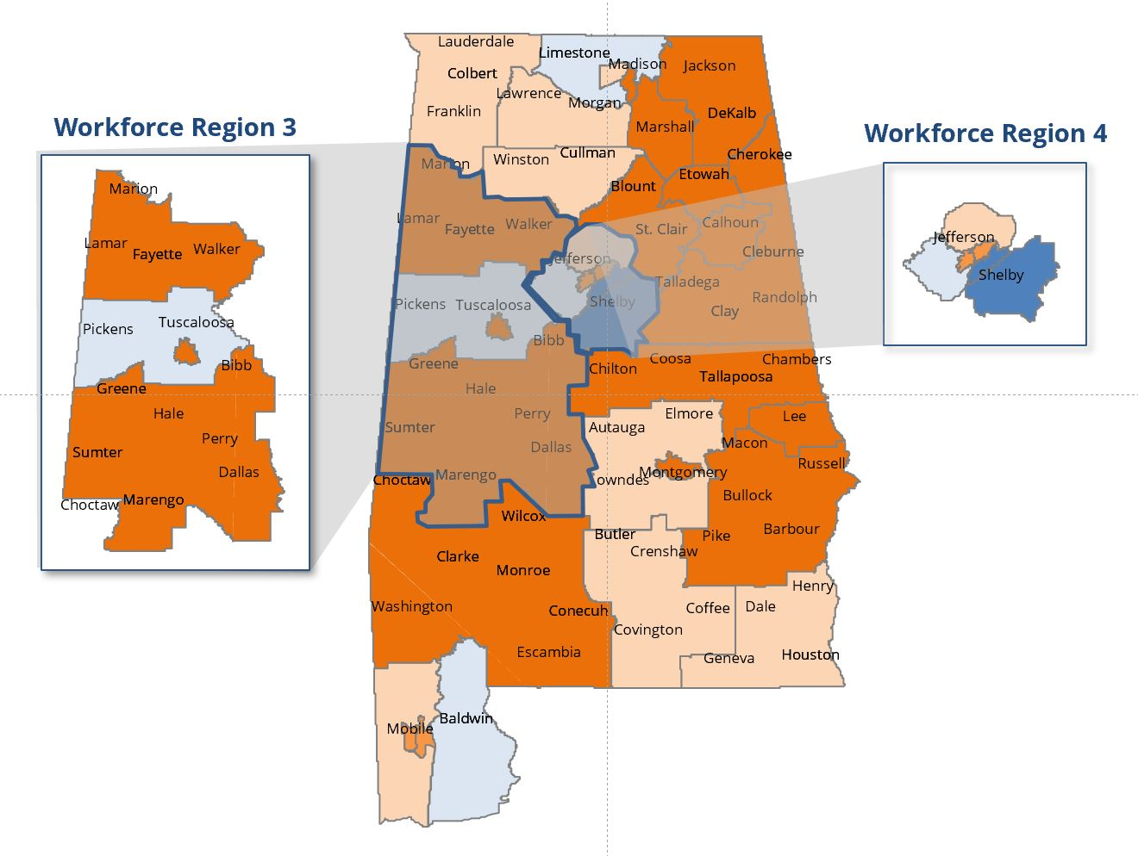
Analyzing within Workforce Region
Percent of Population Ages 25 to 64 Living in Poverty
Region 4- Jefferson and Shelby Counties
Most Critical
High Need
Critical
Less Critical
Least Critical
Low Need
Data Sources: U.S. Census Bureau, 2019 American Community Survey 5-year PUMS (Public Use Microdata Sample). Steven Ruggles, Sarah Flood, Sophia Foster, Ronald Goeken, Jose Pacas, Megan Schouweiler and Matthew Sobek. IPUMS USA: Version 11.0 [dataset]. Minneapolis, MN: IPUMS, 2021. https://doi.org/10.18128/D010.V11.0C

Slide 62
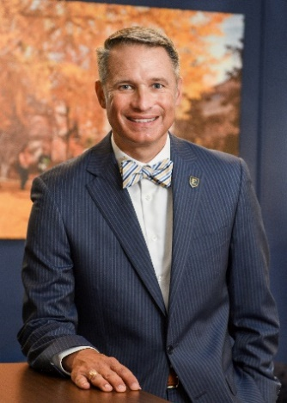
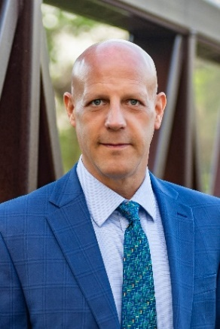
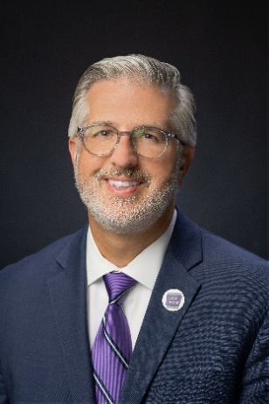

Education and Workforce Needs Index Team
Dr. Brian Noland is the 9th president of East Tennessee State University. Under his leadership, ETSU embarked has upon a series of mission-driven transformative initiatives related to teaching, research, and service. Sustaining ETSU’s focus on regional service, President Noland has partnered with civic and corporate entities to launch Overmountain Recovery, the region’s only fully comprehensive treatment and addiction recovery center.
In addition, he has secured $25 million in external funds to create the Center for Rural Health Research, a state center of excellence focused on advancing health and improving the quality of life in rural communities. Recently, he helped forge a partnership with Ballad Health, a local health system to establish a first-of-its-kind institute dedicated to promoting the awareness and study of adverse childhood experiences.
Dr. Patrick Kelly currently serves as a Research Officer at the Alabama Commission on Higher Education, the Kentucky Council on Postsecondary Education, and East Tennessee State University. He leads projects with staff related to demographic and education trends, workforce characteristics and participation, and student and institutional performance.
Patrick was previously Vice-President at the National Center for Higher Education Management Systems (NCHEMS) where he worked with many college leaders, state postsecondary education and system leaders, and workforce and economic development leaders, and advocates to improve postsecondary education and its alignment with workforce and economic needs.
For more about Dr. Kelly visit www.pjkelly.org
Dr. Patrick Kelly
Dr. Brian Noland
Dr. Houston Davis is the 11th president of the University of Central Arkansas. Prior to UCA, Davis was interim President of Kennesaw State University and served as CAO of the University System of Georgia. Davis served as the Vice Chancellor for Academic Affairs for the Oklahoma State Regents for Higher Education, as Associate Vice Chancellor for the Tennessee Board of Regents, on faculty and in leadership for Austin Peay State University, in fiscal and academic affairs for the Tennessee Higher Education Commission, and as a regional counselor for the University of Memphis. He received his Ph.D. from Vanderbilt University with other degrees from the University of Memphis and Tennessee State University.
James E. Purcell, Ed.D., is the State Higher Education Executive Officer (SHEEO) of the Alabama Commission on Higher Education in April 2017, having served previously as the SHEEO in Rhode Island, Louisiana and Arkansas.
Dr. Purcell is a strong advocate for institutional research and planning as a means to implement policies and programs related to higher education. During his career, he has secured grant funding from state, federal and private philanthropic organizations to support these goals, particularly for adult degree completions.
Dr. Purcell is a past president of the Southern Association for Institutional Research and a former member of the executive council of SHEEO.
Dr. Jim Purcell
Dr. Houston Davis

Slide 63

Educational Needs Index 2002
Funded by Lumina Foundation
Well received
Not sustained
Needs to be more connected to the workforce

Slide 64
Education and Workforce NEEDS INDEX
Workforce Region 5
U.S. Quartiles
Alabama
Region 5
Regions
Least Critical
Less Critical
Critical
Most Critical
Overall Education and Workforce NEED
4
2
1
3
7
6
5
EDUCATION
2
3
4
7
1
6
5
High School Completion
2
6
3
7
5
1
4
Associate Degree Completion
6
4
1
2
7
3
5
Completion of a Bachelor's Degree or Higher
4
1
5
7
3
6
2
College Attainment of Young vs Older Adults
2
3
7
4
1
6
5
Enrollment of Young Adult without a College Degree
7
4
6
5
3
1
2
1
6
WORKFORCE
7
4
2
5
3
Labor Force Participation
4
1
5
6
7
3
2
Unemployment
1
7
4
5
2
6
3
Employment in Manufacturing and Extraction
7
4
6
5
3
1
2
Median Annual Wage Earnings
4
1
7
5
6
3
2
Personal Income
4
1
5
7
6
2
3
Working-Age Adults with SSI or Welfare Income
4
1
5
7
6
3
2

Slide 65

Webpage Revision
Presented by: Dr. Jim Hood

Slide 66

Current Website
Webpage Revision

Slide 67



Website
Pages
Data
Portal
Visualizations

Slide 68


Slide 69

Proposed Updates to the Administrative Procedures for Program Review

Slide 70

VIII. Decision ITEMS

Slide 71

A. Preliminary Approval of Amendments to the Administrative Procedures for the Alabama Math and Science Teacher Education Program-Loan Repayment Program
Staff Presenter: Mrs. Artcola Pettway

Slide 72


Alabama Math and Science Teacher Education Program
Loan Repayment Program
2018 First AMSTEP bill for math and science teachers passed
2019 Computer science teachers were added
2020 Eligibility requirements for participants
were expanded, but passage was interrupted by the Covid -19 pandemic
2021 Bill was signed into law by Gov. Ivey that will allow more qualifying teachers to participate in the loan forgiveness program

Slide 73


Preliminary Approval of Amendments to the Administrative Procedures for the Alabama Math And Science Teacher Education Program –
Loan Repayment Program
During the 2022 Legislative Session, Alabama Act 2022-396 was passed. This Act made modifications to the AMSTEP program. The major changes were aimed at participants for:
Math and Science teachers.
The base loan repayment amount was increased from $ 2,500 to $3,750 per semester.
Beginning Fall 2022 semester and forward.

Slide 74
Acute Shortage Districts
83.33% Perry County
78.95% Marengo County
66.67% Lowndes County
66.67% Sumter County
61.54% Barbour County
54.17% Hale County
53.85% Conecuh County
50.00% Bullock County
50.00% Choctaw County
50.00% Dallas County
48.39% Butler County
42.86% Wilcox County
41.00% Winston County
38.89% Troy County
38.10% Macon County
37.50% Eufaula City
37.04% Russell County
35.71% Montgomery County
34.62% Randolph County
32.00% Phenix City
31.82% Pike County
30.77% Pickens County
30.00% Lamar County
30.00% Washington County

Slide 75
The Process for Approval of Amendments to the Administrative Procedures
Once the proposed amendment is preliminarily approved by the Commission (today), the proposed changes will be filed with the Legislative Services Agency.
It will be published in the Alabama Administrative Monthly for 45 days for interested parties to comment.
Then at the September Commission meeting the amendment will be brought back to the Commission to grant final approval to these proposed changes.
The certified changes will be filed with the Alabama Procedures Office and will go into effect a minimum of 45 days after the certification notice is published.

Slide 76
Motion, Decision Item A:
That the Commission approve the proposed Amendments to the Administrative Procedures for the Alabama Math and Science Teacher Education Program – Loan Repayment Program.

Slide 77

B. Academic Programs
Staff Presenters: Dr. Robin McGill and
Mrs. Kristan White

Slide 78














FOUR-YEAR INSTITUTIONS

Slide 79

Alabama A&M University
1. Master of Science in Food Science Business (CIP 01.1099)
The proposed program aligns with AAMU’s mission as a public land-grant institution, and AAMU can deliver the program using existing faculty and other resources.
The proposed program will be offered fully online to accommodate working professionals seeking to advance their careers in the Food Science industry.
Alabama has over 400 food production and beverage product employers operating in the State, employing over 34,000 workers. Graduates of the program will have opportunities for employment within this sector.
This Photo by Unknown Author is licensed under CC BY-ND

Slide 80
Motion, Decision Item B-1:
That the Commission approve Alabama A&M University’s proposal to offer a Master of Science in Food Science Business.

Slide 81

Athens State University
2. Bachelor of Science in Public Health (CIP 51.2201)
The proposed program is configured to meet standards for baccalaureate program accreditation through the Council on Education for Public Health (CEPH), and when approved would be one of two CEPH-accredited undergraduate programs offered in Alabama.
The program is related to ATSU’s existing offerings in Health Sciences and can be delivered by ATSU’s existing faculty, with minimal additional costs.
The proposed program is designed to prepare graduates
for employment as Community Health Workers (SOC 21-1094)
and Health Education Specialists (SOC 21-1091), both of which
are in-demand occupations in Alabama.
This Photo by Unknown Author is licensed under CC BY-ND

Slide 82
Motion, Decision Item B-2:
That the Commission approve Athens State University’s proposal to offer a Bachelor of Science in Public Health.

Slide 83


Troy University
3a. Bachelor of Science in Interprofessional Health Sciences
(CIP 51.0000)
The proposed program is intended to combine the existing BS in Allied Health Sciences (51.0000) and the BS in Health Promotion (CIP 51.0001), and will not require any additional funds to deliver.
This program designed to provide greater flexibility and interdisciplinary focus to meet demands of the healthcare workforce (i.e., leadership, human resources, healthcare sciences, case management, rehabilitation).
This Photo by Unknown Author is licensed under CC BY-ND

Slide 84
Motion, Decision Item B-3a:
That the Commission approve Troy University’s proposal to offer a Bachelor of Science in Interprofessional Health Sciences.

Slide 85

Troy University
3b. Bachelor of Science in Sport Management (CIP 31.0504)
– Substantive Modification
Troy University (TROY) is proposing to modify the CIP code for its BS in Sport Management from CIP 52.0901, which is currently shared with the BS in Hospitality, Tourism, and Event Management, to CIP 31.0504 (Sport Management), which better describes the content of the degree. Prior to 2014, the BS in Sport Management was offered as a standalone degree at CIP 31.0504. In June 2021, the combined degree programs moved from CIP 31.0504 to CIP 52.0901.
TROY is now requesting that the BS in Sport Management revert to its original code, which is better aligned with the program’s specialized accreditation through the Commission on Sport Management Accreditation (COSMA). Consistent with Commission policy, the proposed substantive modification pertains to a program that has already been in existence and does not require any additional funding to deliver in its modified form.

Slide 86
Motion, Decision Item B-3b:
That the Commission approve Troy University’s proposal to offer a Bachelor of Science in Interprofessional Health Sciences.

Slide 87

University of Alabama in Huntsville
4. Bachelor of Science in Business Administration in General Business (CIP 52.0101)
The proposed BSBA in General Business will replace the existing concentration in General Business offered through the BSBA in Management (CIP 52.0201), with no changes to the curriculum or additional resources required.
The proposed program is designed to allow students the flexibility to take courses corresponding to their interests, while still completing the required business core and learning the basics of all business functions. This flexible degree will allow students to find employment in a number of different industries or functions.
The proposal includes a letter of support from Calhoun Community College indicating that the proposed BSBA will offer a more seamless pathway for associate degree graduates to complete their baccalaureate degree.
This Photo by Unknown Author is licensed under CC BY-ND

Slide 88
Motion, Decision Item B-4:
That the Commission approve the University of Alabama in Huntsville’s proposal to offer a Bachelor of Science in Business Administration in General Business.

Slide 89

























ALABAMA COMMUNITY COLLEGE SYSTEM

Slide 90



Coastal Alabama Community College
5. Associate of Applied Science in Respiratory Care Therapy/ Therapist
(CIP 51.0908)
This program will help meet industry demand for respiratory therapists, which appear on Alabama’s Statewide In-Demand Occupations List.
Several hospitals in the Coastal Alabama region have requested the College offer a Respiratory Care Therapist program, and the proposal includes 13 letters of support attesting to the need for additional graduates.

Slide 91
Motion, Decision Item B-5:
That the Commission approve Coastal Alabama Community College’s proposal to offer an Associate of Applied Science in Respiratory Care Therapy/ Therapist.

Slide 92



Gadsden State Community College
6. Associate of Applied Science and Certificate in Medical Assistant
(CIP 51.0801)
The proposed program will prepare graduates for employment as medical assistants (SOC 31-9092), an occupation which appears on the Statewide In-Demand Occupations List, and it is designed to meet an identified need for the college’s service area.
This proposal includes three letters of support from local healthcare facilities and professionals attesting to the strong need for the program.

Slide 93
Motion, Decision Item B-6:
That the Commission approve Gadsden State Community College’s proposal to offer an Associate of Applied Science and Certificate in Medical Assistant.

Slide 94


Northeast Alabama Community College
7. Associate of Applied Science and Certificate in Advanced
Manufacturing (CIP 15.0613)
The proposed program will replace the current AAS and CER in Drafting & Design Technology, and as such will require minimal new investment to deliver.
The new program configuration will greatly enhance the options for students who wish to enter the field of Advanced Manufacturing.
This proposal includes six letters of support from the industry and economic development partners attesting to the need for the proposed program.

Slide 95
Motion, Decision Item B-7:
That the Commission approve the Northeast Alabama Community College’s proposal to offer an Associate of Applied Science and Certificate in Advanced Manufacturing.

Slide 96



Snead State Community College
8. Associate of Applied Science in Welding Technology/ Technologist
(CIP 48.0508)
The proposed AAS and CER in Welding Technology/ Technologist are designed to prepare graduates for employment as Welders, Cutters, Solderers, and Brazers (SOC 51-4121) and as Industrial Machinery Mechanics (SOC 49-9041), both of which appear on the Statewide In-Demand Occupations List.
SND plans to leverage existing partnerships with Marshall County Technical School to support facilities and equipment for the proposed program with minimal new expenditures.
This proposal includes six letters of support from industry and economic development partners attesting to the need for this program in SND’s service area.

Slide 97
Motion, Decision Item B-8:
That the Commission approve the Snead State Community College’s proposal to offer an Associate of Applied Science in Welding Technology.

Slide 98



Trenholm State Community College
9. Associate of Applied Science in Medical Laboratory Technician
(CIP 51.1004)
The proposed program will help fulfill the need for trained Medical Laboratory Technicians in the greater Montgomery area.
TRE maintains strong partnerships with area health care facilities for its existing allied health programs and plans to work with these facilities as clinical sites for the proposed program.
This proposal includes eight letters of support from local and regional healthcare facilities attesting to the need for the program.

Slide 99
Motion, Decision Item B-9:
That the Commission approve the Trenholm State Community College’s proposal to offer an Associate of Applied Science in Medical Laboratory Technician.

Slide 100

Request to Amend Post-Implementation Conditions
10a. Athens State University MA in Religious Studies (CIP 38.0201)
The program did not meet the enrollment condition.
ATSU has requested that the original post-implementation condition for new enrollments be modified to reflect the actual enrollment achieved over the first five years and that the MA in Religious Studies be deemed a viable program going forward. ACHE staff is recommending approval of the request based on the following rationale:
  The program has demonstrated its viability by exceeding the required minimum number of graduates per year each year since it began to produce graduates.
  Average new enrollments have exceeded
  the required minimum number of graduates,
  indicating that there is a sustainable pipeline
  of students.
MA in Religious Studies (38.0201) | Avg New Enrollments | Average Graduates
Required | 18 (13.5 w/ 25% reduction) | 3.75
Reported | 5.5 | 5.3

Slide 101
Motion, Decision Item B-10a:
That the Commission approve Athens State University’s request to amend post-implementation conditions for the Master of Arts in Religious Studies.

Slide 102

Request to Amend Post-Implementation Conditions
10b. Auburn University at Montgomery BS in Business
Administration in Entrepreneurship (CIP 52.0701)
The program did not meet the minimum graduate requirement of 7.5 annual graduates on average.
AUM has requested an extension of the post-implementation period for two years (AY 2022-23 and AY 2023-24) to produce enough graduates to meet the viability standard for baccalaureate programs. ACHE staff is recommending approval of the request based on the following rationale:
  The program has demonstrated strong enrollment numbers throughout its first five years of implementation, exceeding the number of students needed to build a sustainable program pipeline.
  AUM has indicated that there are enough students
  in the program on track to graduate within
  the next two academic years to meet the
  viability requirement for graduates.
  COVID interruptions delayed students from reaching
  graduation on time.
BS in Business Administration in Entrepreneurship (52.0701) | Avg New Enrollments | Average Graduates
Required | 10 | 7.5
Reported | 32.8 | 4.3

Slide 103
Motion, Decision Item B-10b:
That the Commission approve Auburn University at Montgomery’s request to amend post-implementation conditions for the Bachelor of Science in Business Administration in Entrepreneurship.

Slide 104

Request to Amend Post-Implementation Conditions
10c. University of South Alabama, MFA in Creative Technologies
and Practice (CIP 50.0706)
The program did not meet the condition for average graduates.
USA has requested that ACHE consider the program as a terminal post-master’s degree, similar to the Education Specialist degree, and evaluate program viability using the standard for that level. ACHE staff is recommending approval of the request based on the following rationale:
  The MFA’s extensive requirements are more extensive than other master’s-level programs, comparable to terminal post-master’s programs, and therefore, it makes sense to evaluate viability using the standard for those comparable programs.
  USA’s MFA in Creative Technologies and Practice
  has built a steady pipeline of enrollments and
  graduates to sustain an average of 3.0 graduates
  per year following the post-implementation
  monitoring period.
MFA in Creative Technologies and Practice (50.0706) | Avg New Enrollments | Average Graduates
Required | 6 (4.5 w/ 25% reduction) | 3.75
Reported | 5.4 | 3.67

Slide 105
Motion, Decision Item B-10c:
That the Commission approve The University of South Alabama’s request to amend post-implementation conditions for the Master of Fine Arts in Creative Technologies and Practice.

Slide 106

C. INFORMATION ITEMS
Troy University Notification of Instructional Offering at Montgomery Campus
Troy University Annual Report of Program Offerings at Dothan and Montgomery Campuses
Implementation of Non-Degree Programs at Senior Institutions
Implementation of New Short Certificate Programs (Less than 30 Semester Hours)
Changes to the Academic Program Inventory
Updates to Units of Instruction, Research, Public Service, and Administration
Extensions/ Alterations to Existing Programs of Instruction
Implementation of Distance Education Programs
Annual Off-Campus Site Follow-Up Report for Academic Year 2020-2021
Summary of Post-Implementation Reports

Slide 107
10. Summary of Post-Implementation Reports
Programs that met post-implementation conditions
Auburn University at Montgomery: BFA in Art (CIP 50.0701)
University of Alabama: DNP in Nursing (CIP 51.3818)
University of Alabama in Huntsville: DNP in Nursing (CIP 51.3818)

Slide 108
10. Summary of Post-Implementation Reports
b. Programs that did not meet post-implementation conditions
Athens State University: MA in Religious Studies (CIP 38.0201)
Auburn University at Montgomery: BS in Business Administration in Entrepreneurship (CIP 52.0701)
University of South Alabama: MFA in Arts in Creative Technologies and Practice (CIP 50.0706)

Slide 109
Motion, Decision Item C:
That the Commission accept the information items as presented.

Slide 110
D. ADJOURNMENT

