Slide 1

Alabama Commission on Higher Education
Commission Meeting
September 9, 2022

Slide 2


CALL TO ORDER, PRAYER, AND PLEDGE OF ALLEGIANCE

Slide 3

II. ROLL CALL and
QUORUM DETERMINATION

Slide 4

III. APPROVAL OF AGENDA
Commission Meeting Agenda
of September 9, 2022

Slide 5

IV. CONSIDERATION OF MINUTES
Commission Meeting Minutes of June 10, 2022

Slide 6

V. CHAIRMAN’S REPORT

Slide 7

VI. ELECTION OF OFFICERS

Slide 8

VII. EXECUTIVE DIRECTOR’S REPORT

Slide 9
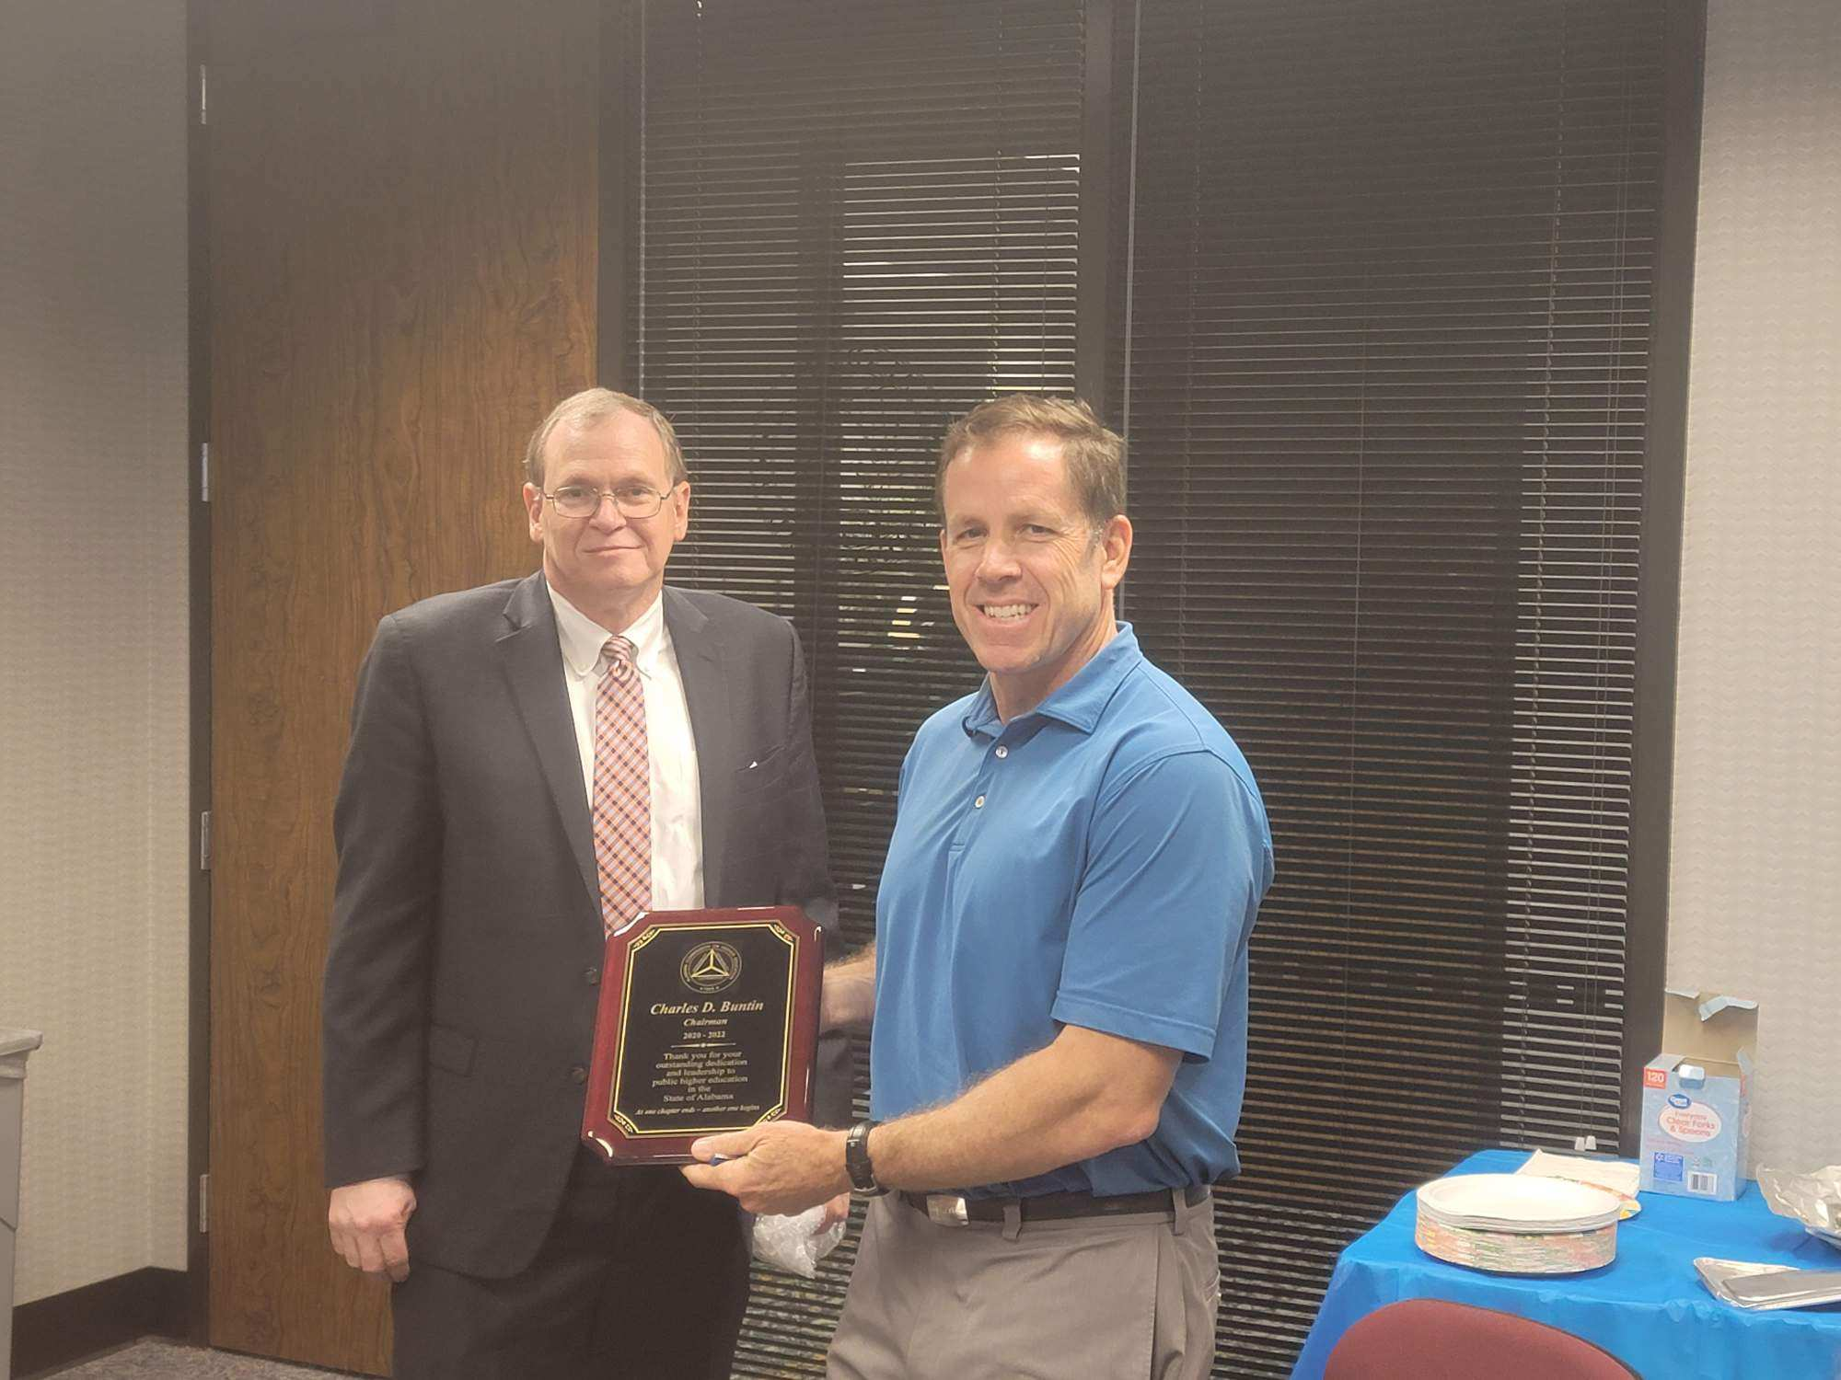
Chairman Buntin, Celebratory Luncheon

Slide 10
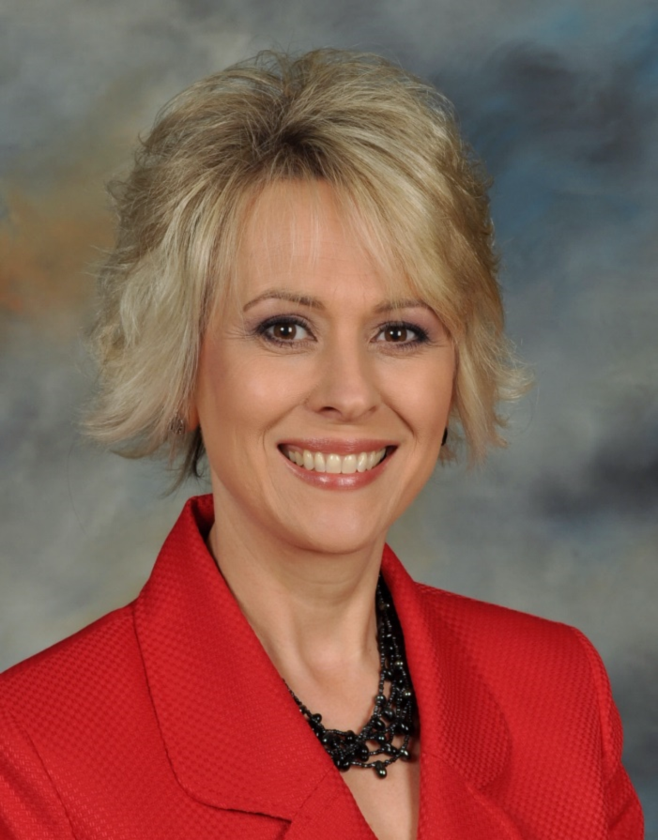
Dr. Stephanie C. Dolan
Stephanie, a new retiree from the State of Mississippi, has served in education for 32 years. She earned her B.S. and M.S. in mathematics from Mississippi State University and a doctorate in higher education administration from the University of Mississippi.
Stephanie has taught and worked for K-12, two-year colleges, and four-year universities throughout her career. Most recently, she was the Director of Institutional Research and Effectiveness, Title IX Coordinator, OCR Compliance Officer, and QEP Director. Stephanie also has 17 years of experience with SACSCOC accreditation in higher education, serving on several review committees.
Stephanie has three adult children and now resides in Pike Road.

Slide 11
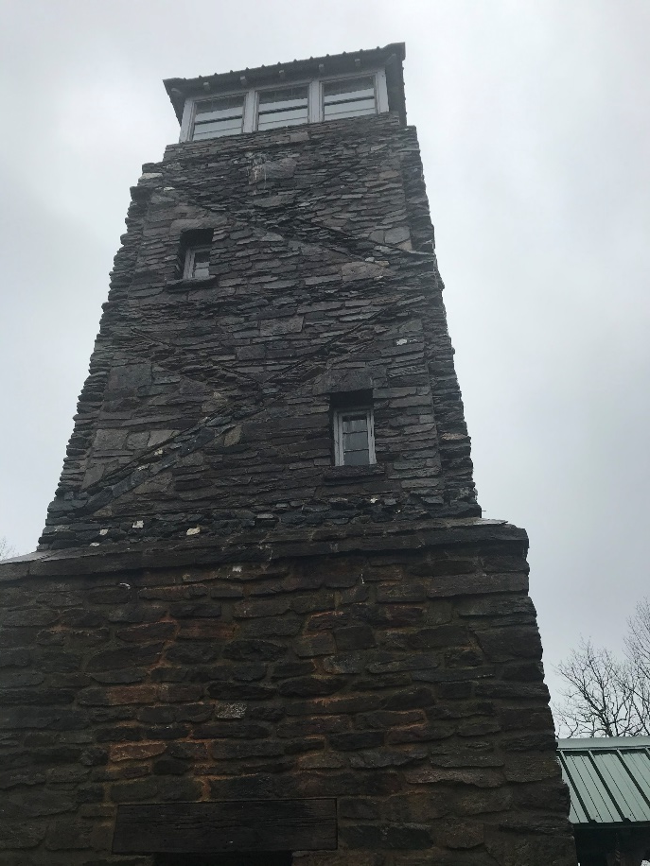
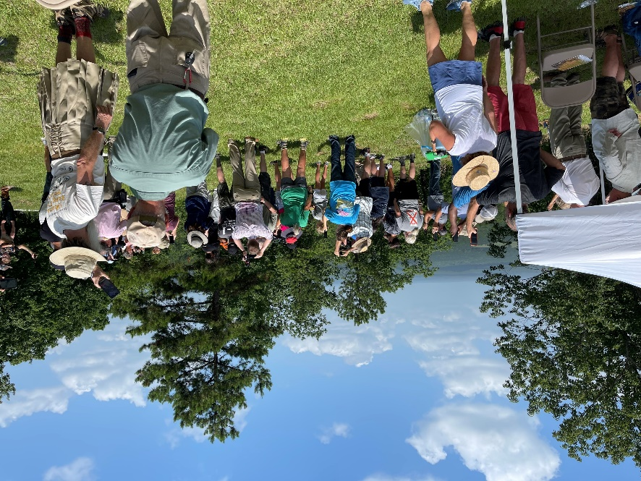
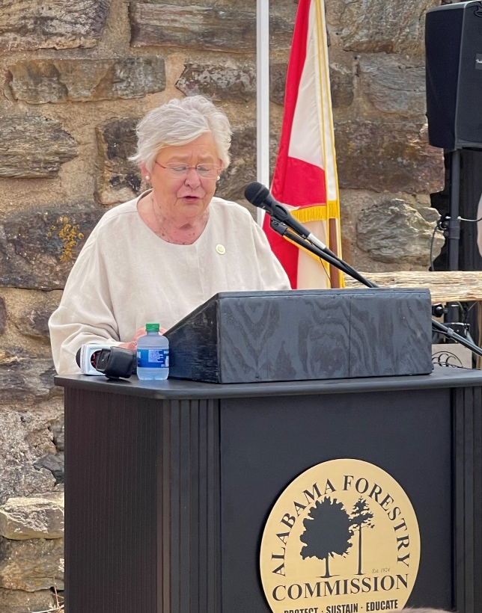

Flag Mountain Renovation/Dedication
Alabama Forestry Commission
Alabama Trails Foundation
Jacksonville State University
Alabama Wildlife Center Red-tailed Hawk Release
Flagg Mountain is the southernmost Appalachian peak over 1,000 feet.
It is the start of the Pinhoti Trail, a 330-mile route that connects to the Appalachian Trail in north Georgia.

Slide 12
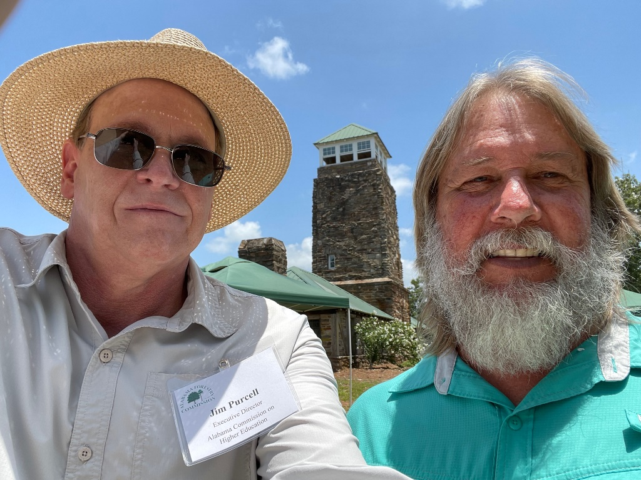



New Caretaker
Randy Anderson
M.J. Eberhart
At 83, ‘Nimblewill Nomad’ Enters the Appalachian Trail Record Book.
M.J. Eberhart, known by his trail name, hiked into Dalton, Mass., on Sunday and became the oldest known person to hike the more than 2,000 miles of trail from Georgia to Maine.

Slide 13
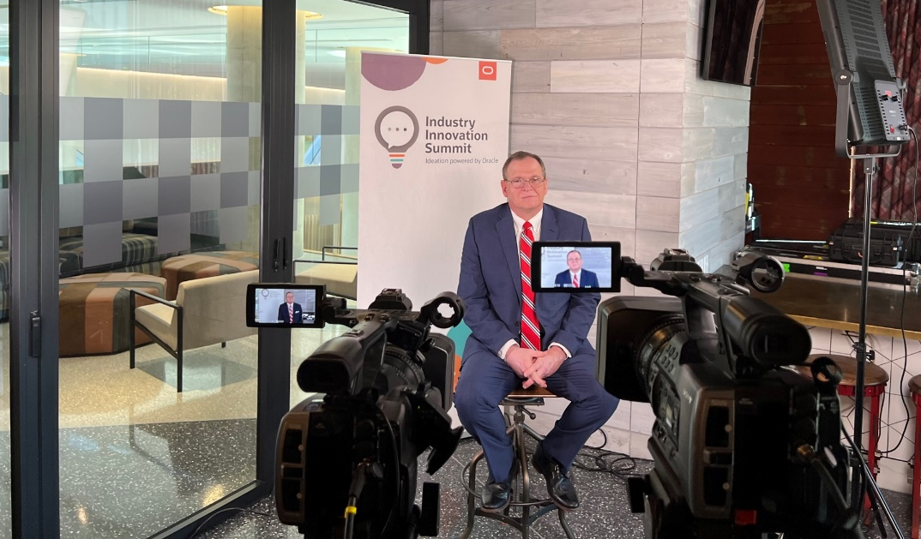
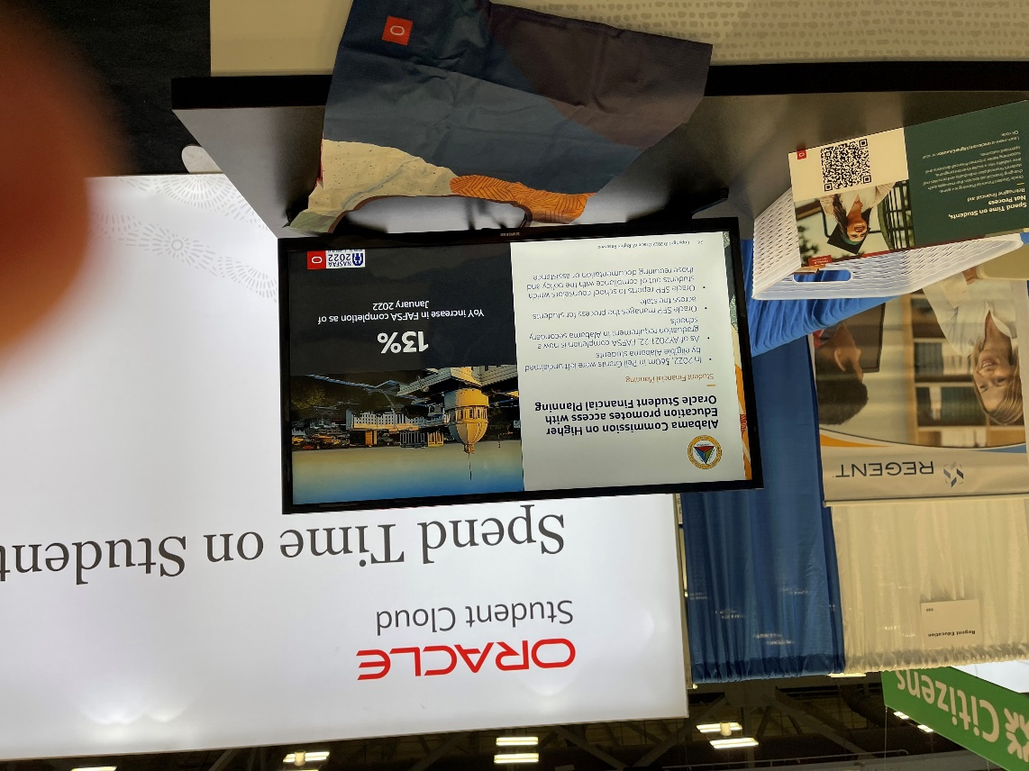

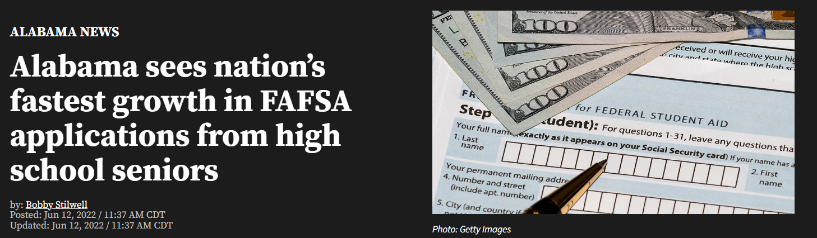
Industry Innovation Summit and NASFAA Conference, Austin Texas

Slide 14
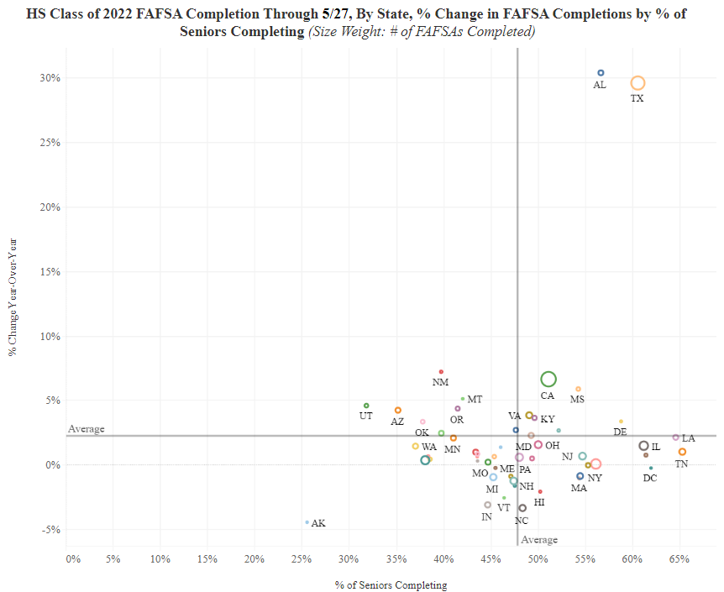
05/27/2022
FAFSA Completion State Rankings:
7th nationally in overall completion
(56.7% completion)
1st nationally in 1-year improvement
(30.4% increase)
#1 Nationally: 30.4% in one-year improvement
#7 Nationally: 56.7% overall completion
Source: www.ncan.org

Slide 15
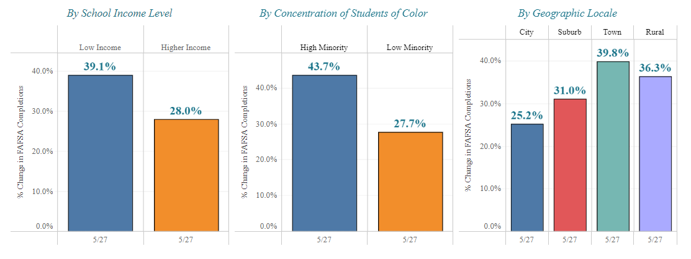
% Change in FAFSA Completion Year-Over-Year By Selected Characteristics Through 5/27 Alabama
US Average | 9.7% | 2.3% |  | 9.6% | 1.4% |  | 7.2% | 3.5% | 3.7% | 4.4%
US Rank | 1st | 1st |  | 1st | 1st |  | 2nd | 1st | 1st | 1st
Source: www.ncan.org

Slide 16
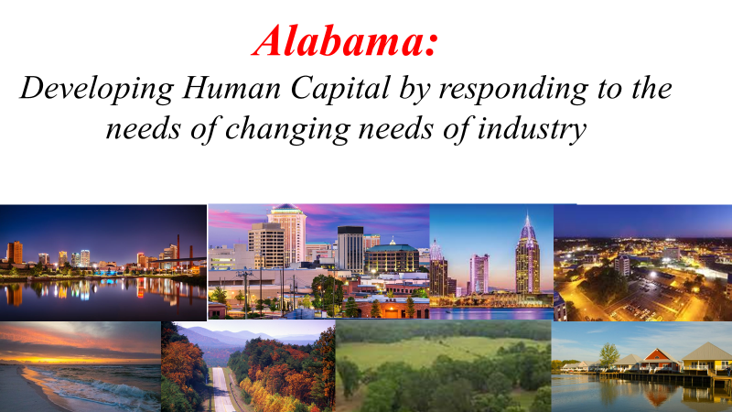
Summer presentations to AZ, SC, DE, NC, SREB, WICHE.
Fall presentations to MS, CCA, SC, NC, WV, KY.

Slide 17
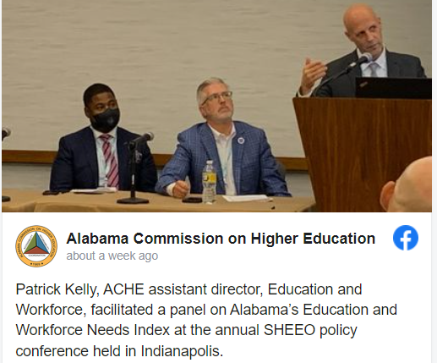
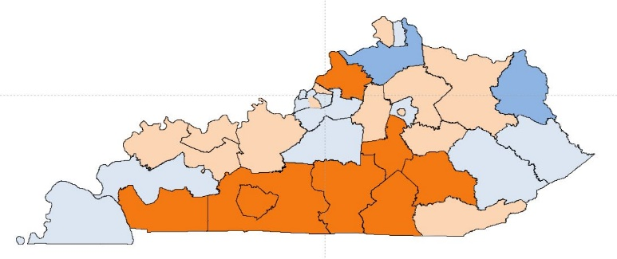
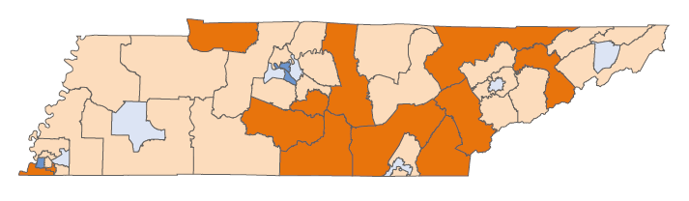
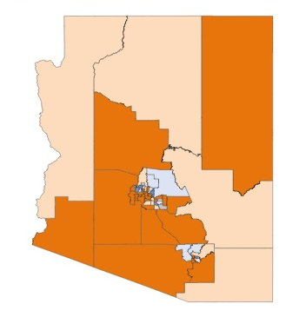
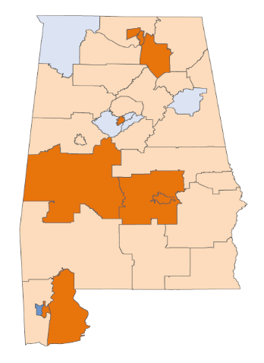
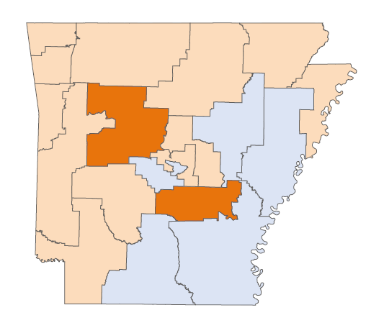
Patrick Kelly
Education and Workforce Needs Index presentations to SHEEO, SREB and WICHE
Nicholas Bolden
KY
TN
AZ
AR
AL

Slide 18
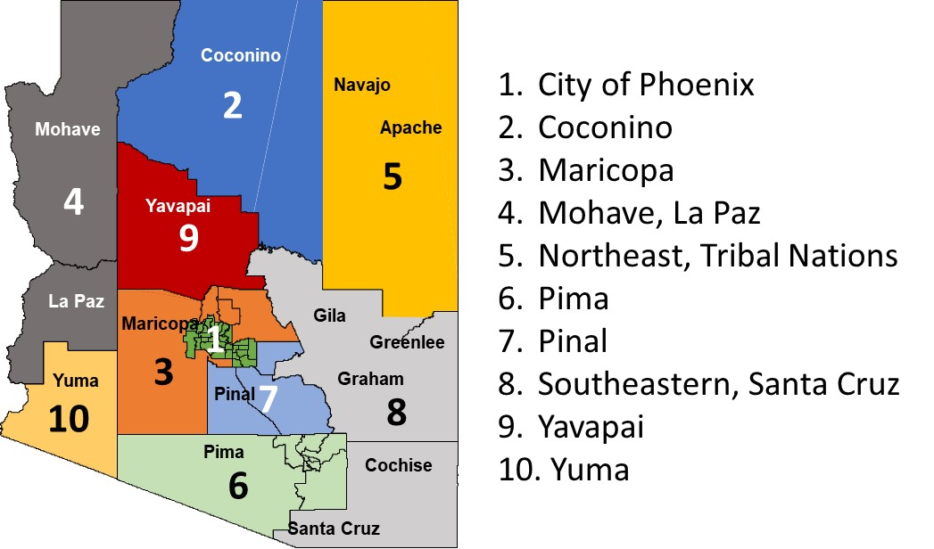
Education and Workforce NEEDS INDEX
Arizona
U.S. Quartiles
Coconino
Regions
Lower Need
Highest Need
Overall Education and Workforce NEED
3
2
6
8
9
4
1
7
10
5
EDUCATION
2
4
1
6
10
3
9
8
5
7
High School Completion Only
3
6
1
2
10
8
9
7
5
4
7
2
4
1
3
10
Associate Degree Completion
9
8
6
5
3
2
10
4
Completion of a Bachelor's Degree or Higher
6
1
9
8
7
5
College Attainment of Young vs Older Adults
2
4
1
10
6
8
9
5
3
7
Enrollment of Young Adults without a College Degree
10
3
9
7
2
5
4
1
6
8
WORKFORCE
3
1
2
7
10
4
5
6
9
8
Labor Force Participation
1
2
3
6
10
9
8
4
7
5
3
1
7
4
10
Unemployment
9
6
8
2
5
Employment in Volatile Industries
5
10
4
3
9
2
8
1
6
7
Median Annual Wage Earnings
3
6
2
7
1
10
4
5
9
8
7
2
4
5
Personal Income
3
6
1
9
10
8
Working-Age Adults with SSI or Welfare Income
2
3
1
10
6
7
8
9
5
4

Slide 19
Education and Workforce NEEDS INDEX
Arizona
U.S. Quartiles
Coconino
Regions
Lower Need
Highest Need
Overall Education and Workforce NEED
3
2
6
8
9
4
1
7
10
5
EDUCATION
2
4
1
6
10
3
9
8
5
7
High School Completion Only
3
6
1
2
10
8
9
7
5
4
7
2
4
1
3
10
Associate Degree Completion
9
8
6
5
3
2
10
4
Completion of a Bachelor's Degree or Higher
6
1
9
8
7
5
College Attainment of Young vs Older Adults
2
4
1
10
6
8
9
5
3
7
Enrollment of Young Adults without a College Degree
10
3
9
7
2
5
4
1
6
8
WORKFORCE
3
1
2
7
10
4
5
6
9
8
Labor Force Participation
1
2
3
6
10
9
8
4
7
5
3
1
7
4
10
Unemployment
9
6
8
2
5
Employment in Volatile Industries
5
10
4
3
9
2
8
1
6
7
Median Annual Wage Earnings
3
6
2
7
1
10
4
5
9
8
7
2
4
5
Personal Income
3
6
1
9
10
8
Working-Age Adults with SSI or Welfare Income
2
3
1
10
6
7
8
9
5
4

Slide 20
Education and Workforce NEEDS INDEX
Alabama
U.S. Quartiles
Region _
Regions
Least Critical
Less Critical
Critical
Most Critical
Overall Education and Workforce NEED
4
2
1
3
7
6
5
EDUCATION
4
2
3
7
1
6
5
High School Completion Only
4
1
5
7
3
6
2
Associate Degree Completion
6
4
1
2
7
3
5
Completion of a Bachelor's Degree or Higher
4
1
5
7
3
6
2
College Attainment of Young vs Older Adults
2
3
7
4
1
6
5
Enrollment of Young Adults without a College Degree
7
4
6
5
3
1
2
7
4
1
2
3
2
WORKFORCE
6
5
Labor Force Participation
4
1
5
6
7
3
2
Unemployment
1
7
4
5
2
6
3
Employment in Volatile Industries
7
4
6
5
3
1
2
Median Annual Wage Earnings
4
1
7
5
6
3
2
Personal Income
4
1
5
7
6
2
3
Working-Age Adults with SSI or Welfare Income
4
1
5
7
6
3
2

Slide 21


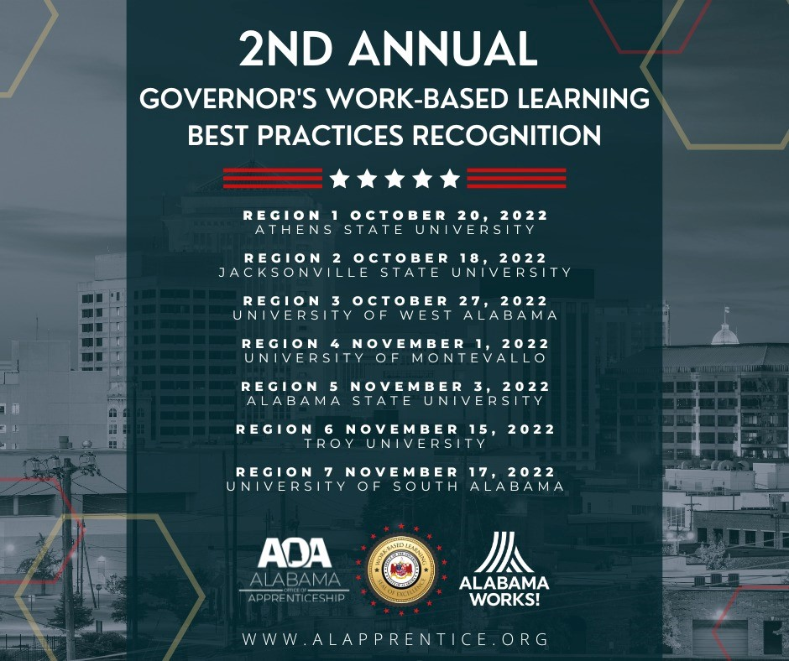
Outreach to communities related to workforce
Morning -- Governor’s Work-Based Learning Best practices Recognition Event.
Afternoon – ACHE Workforce Initiatives
Region 1 October 20th, Athens State
Region 2 October 18th, Jacksonville State
Region 3 October 27th , West Alabama
Region 4 November 1st, Montevallo
Region 5 November 3rd, Alabama State
Region 6 November 15th, Troy
Region 7 November 17th, U of South Alabama

Slide 22
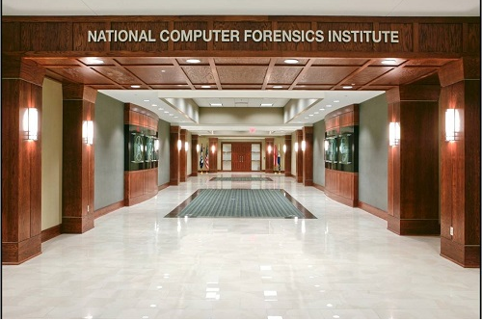

National Computer Forensics Institute (NCFI)
ACHE has partnered with NCFI to provide digital forensics training to colleges and universities
NCFI is nation’s premier law enforcement training facility in cyber crime forensics (located in Hoover)
Training will improve cybersecurity posture and help colleges and universities better react to a cyber attack
30 people from 15 institutions registered for the first class in November

Slide 23

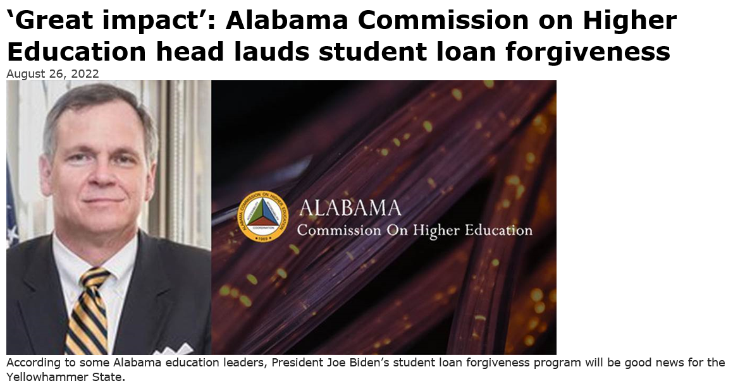
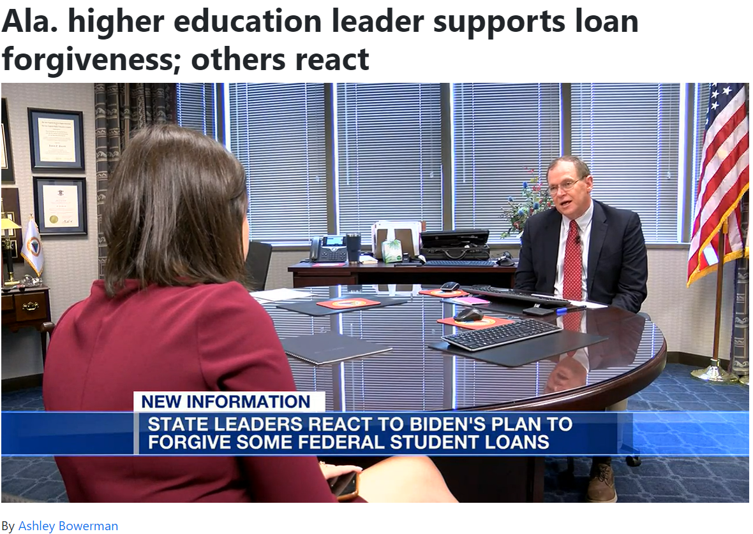

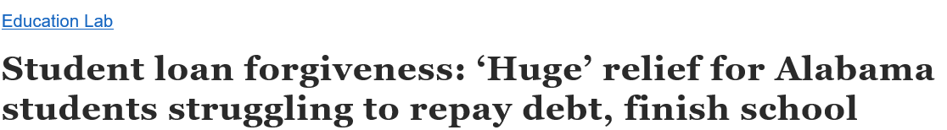
Federal Loan Forgiveness
The across-the-board loan forgiveness program is bad public policy. -- It is what it is.
Forgiveness of student debt is good news for many former college students.
It is particularly good news for Alabama.
Over 630,000 Alabama residents have an average college debt of $37,000 which exceeds the national average.
Alabama ranks among the top 10 nationally in college debt.
Possibly 500,000 of these former students will have some level of debt forgiveness.
By
Rebecca Griesbach | rgriesbach@al.com

Slide 24
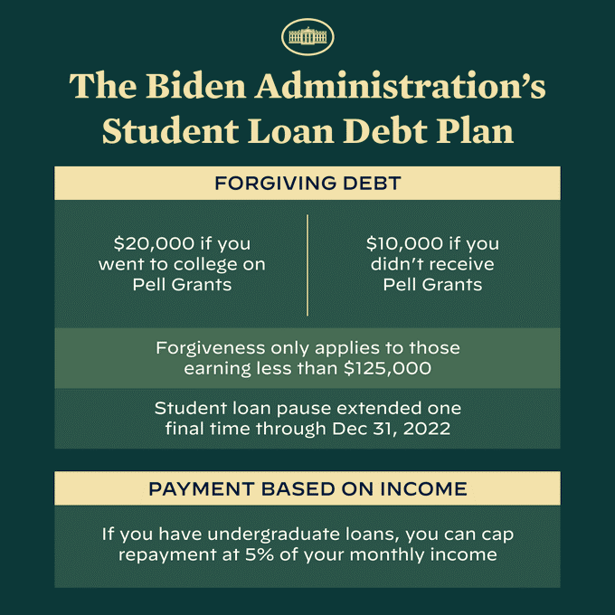
Biden’s Student Loan Debt Forgiveness Plan
Only federally owned student loans qualify for the program; private loans are excluded.
Qualifiers are identified by their Adjusted Gross Income (AGI) of the 2020 or 2021 tax year.
Debt forgiveness of $10,000 applies to -
    Individual borrowers who made less than $125,000 a year
    Married couples or heads of households who made less than $250,000 a year
Debt forgiveness of $20,000 applies to those who also received a federal Pell grant while enrolled in college

Slide 25
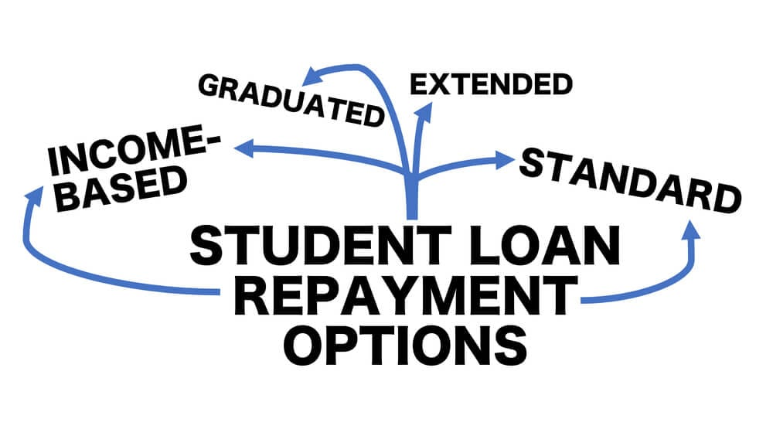
Federal Student Loan Payments Resume 2023
If qualification requirements are met, others may be eligible for the program -
  Current student borrowers
  Parent borrowers of the federal Parent PLUS loans
    Limited to $20,000 per family for loans of multiple children
  Graduate student borrowers
If enrolled in the standard repayment plan, the monthly payment will change once the debt forgiveness is applied.
If enrolled in the income-driven repayment plan, the monthly payment may not change, but final balance could be adjusted according to changes in new plan percentage cap and years of repayment.

Slide 26


Additional Potential Financial Impact
Borrowers who made payments during the pandemic-related payment pause may request a refund if qualification requirements are met.
Borrowers will not have to pay federal income tax on the forgiven student loan debt.
Some states will impose a state income tax (i.e., MS, AR, NC). Alabama does not currently collect state tax on student loan debt forgiveness.
Applications will be available by early October for borrowers who do not have their income information on file with the U.S. Department of Education (USDE).

Slide 27
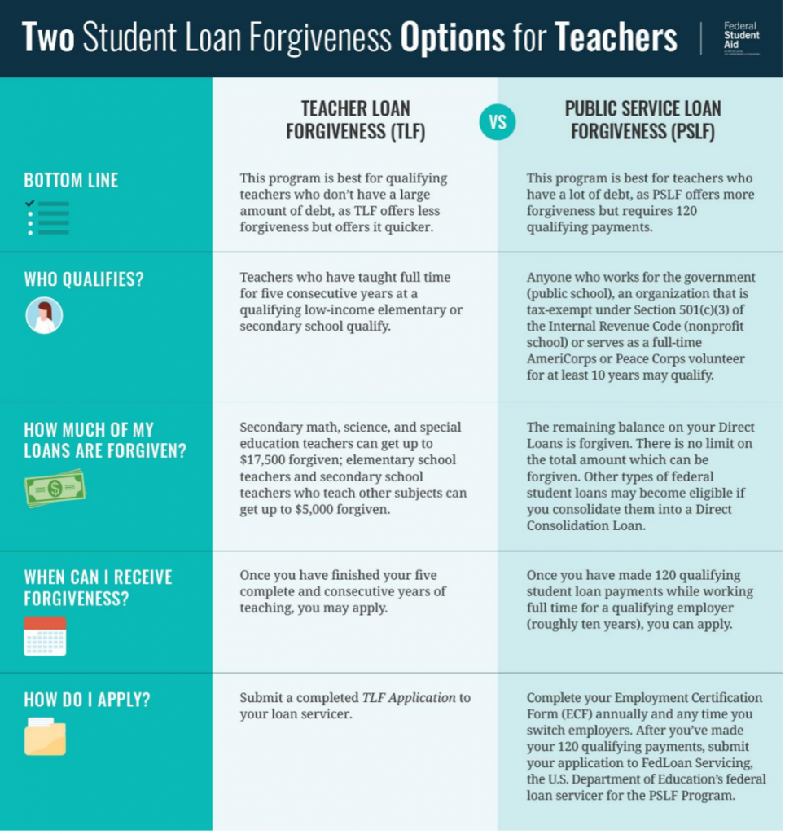
Oct 31, 2022
Other Loan Forgiveness Options
  Teacher Loan Forgiveness (TLF) forgives up to $17,500 on Direct Subsidized, Unsubsidized, and Federal Stafford Loans if employed as a full-time teacher for five complete, consecutive years in a low-income school or educational service agency
  Public Service Loan Forgiveness (PSLF) forgives remaining balance after 120 monthly payments are made via repayment plan while working full-time for qualifying educational system

Slide 28
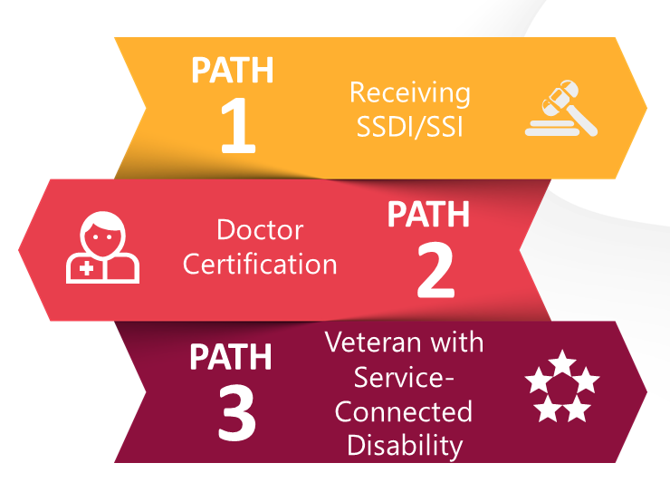

Other Loan Forgiveness Options
  Total and Permanent Disability Discharge forgiveness is provided if proof of eligibility documentation is given by Social Security Administration, a qualified physician, or U.S. Department of Veterans Affairs
  Closed School Discharge forgiveness of federal student loan is given if school permanently closes while enrolled or soon after student withdraws from the school

Slide 29
Federal versus Private Loan Forgiveness
Forgiveness only applies to federal student loans as these loans provide benefits that are not provided by other loans. Forgiveness for private student loans (i.e., private bank) would require additional funding for the USDE budget as well as consideration of foregone payments of prior USDE expenditures and future USDE budgets.
Federal Student Loans
Private Student Loans
Provided by the government
Conditions mandated by law
Fixed interest rates
Income-driven repayment plan
Loan forgiveness programs
Default rehabilitation
Cap on loan amount
Provided by a bank or lender
Conditions mandated by lender
Possible variable interest rates
No affordable repayment plans
No loan forgiveness programs
No default rehabilitation
Credit history-based

Slide 30
AMSTEP is a loan repayment program
The Alabama Math and Science Teacher Education Program is a loan repayment program where ACHE pays a math, science, or computer science teacher a certain amount annually, based upon their federal student loan balance for up to four years.
The Biden forgiveness program will reduce the amount of a teacher’s total debt, which will, in the short-term, reduce the amount ACHE is obligated.

Slide 31
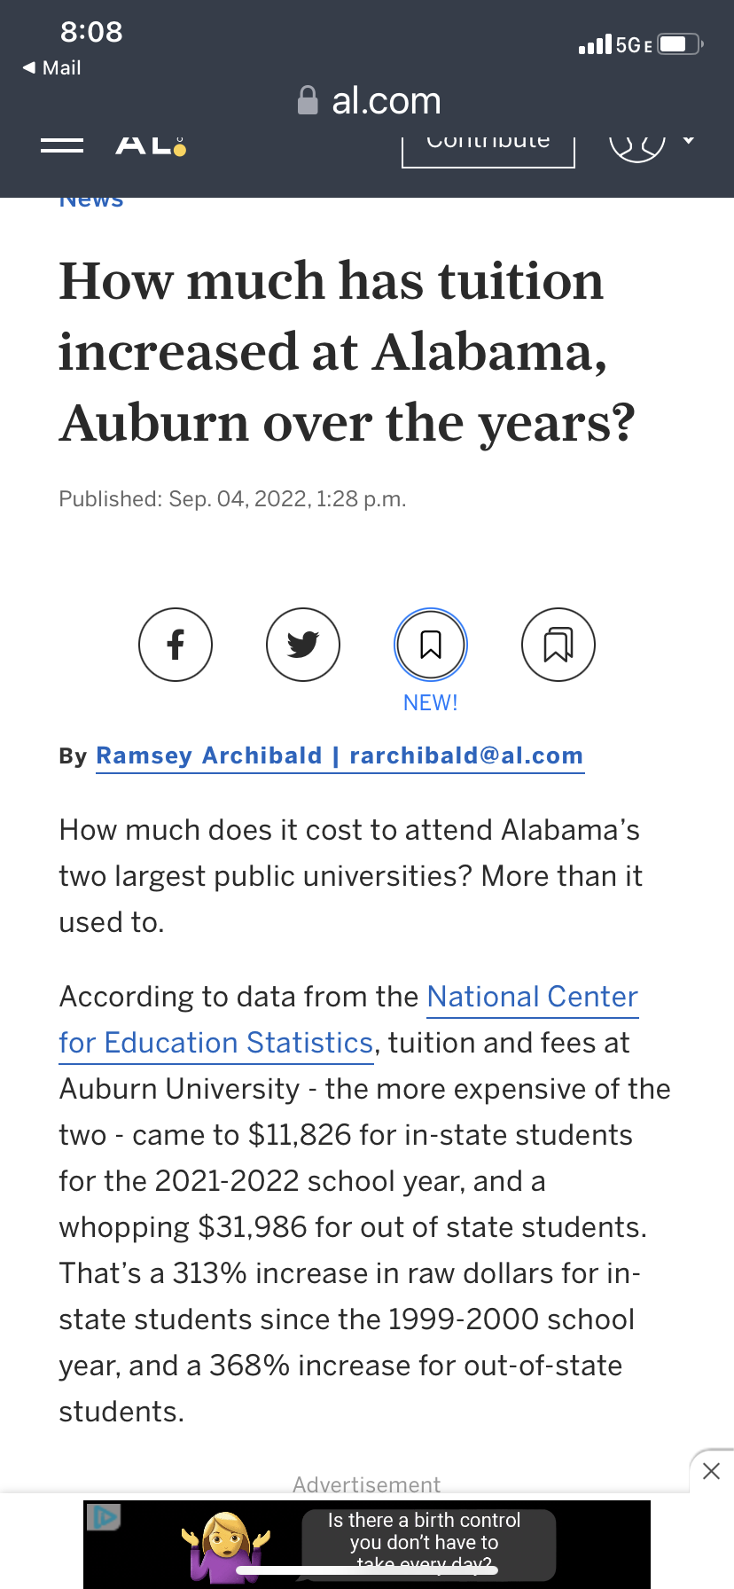
Cost of higher education is still a big issue

Slide 32
Affordability: Two-Year Colleges
Net Price
KY, MS and TN among most affordable states. AL middle of the pack

Slide 33
Affordability: Regional Universities
AL tied with MS for third highest (least affordable)

Slide 34
Affordability: Research Universities
AL significantly higher than other states in SREB Region

Slide 35
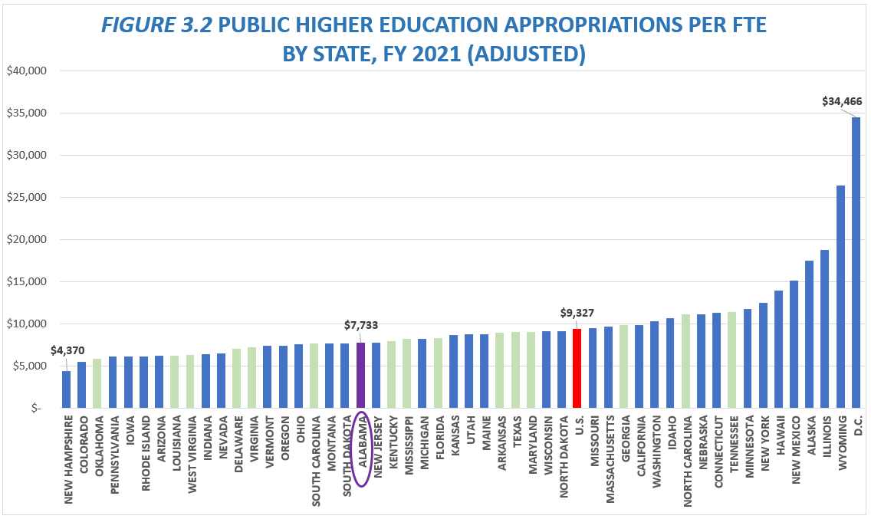
Alabama appropriates less per FTE than the national average, and less than neighboring states Georgia, Tennessee, Mississippi, and Florida
Index to U.S. Average
.83
Source: Embargoed SHEF Report 2021
SREB States

Slide 36
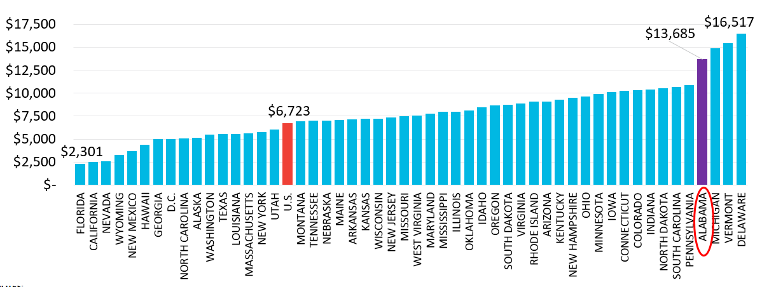
FIGURE 4.1 PUBLIC HIGHER EDUCATION NET TUITION REVENUE PER FTE BY STATE, FY 2021 (ADJUSTED)
Alabama has the 4th highest tuition revenue in the country; over two times greater than the U.S. average.
INDEX TO U.S. AVERAGE
2.04
SOURCE: SHEF REPORT 2021

Slide 37
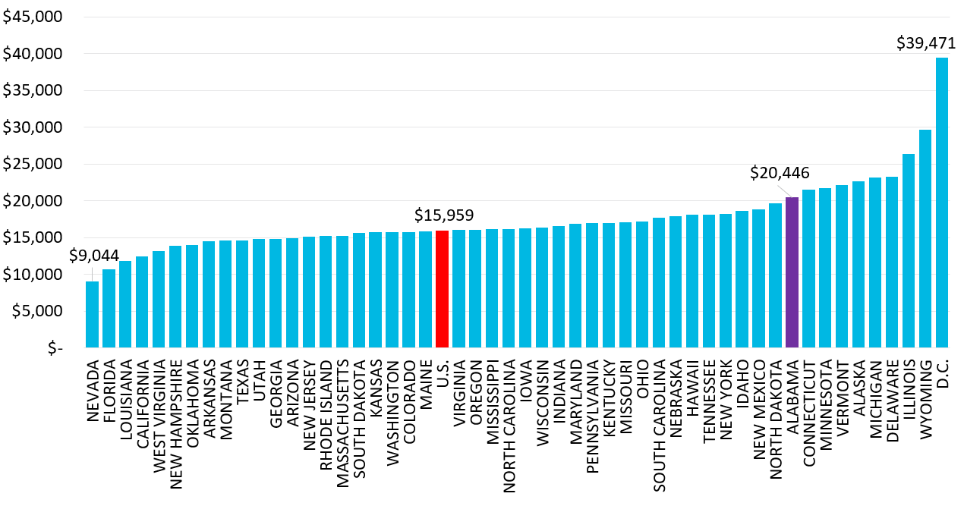
FIGURE 4.2
PUBLIC HIGHER EDUCATION TOTAL EDUCATION REVENUE PER FTE BY STATE, FY 2021 (ADJUSTED)
Alabama is ranked 10th in overall revenue per FTE (state support, tuition, and fees)
INDEX TO U.S. AVERAGE
1.28
SOURCE: SHEF REPORT 2021

Slide 38
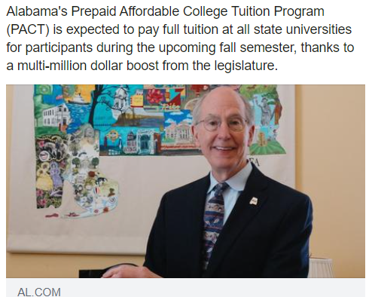
Shout out to
Treasurer Young Boozer and the PACT Board

Slide 39

VIII. DISCUSSION ITEMS

Slide 40
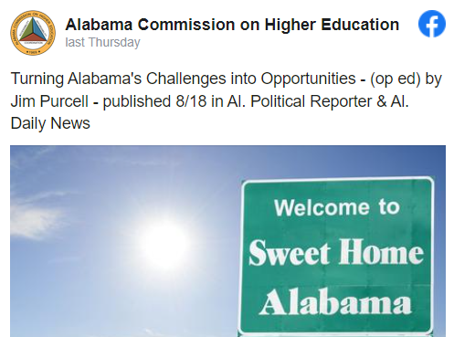

Adult Degree Completion Initiative
Retain Alabama - encourage existing students to consider a future in Alabama
Recall Alabama - encourage expatriates (graduates that left) to return to Alabama
(Re)Engage Alabama – encourage adults, especially those with some college, to return to college to complete their degree. Develop scholarships for returning adults majoring in high demand high-wage programs.

Slide 41
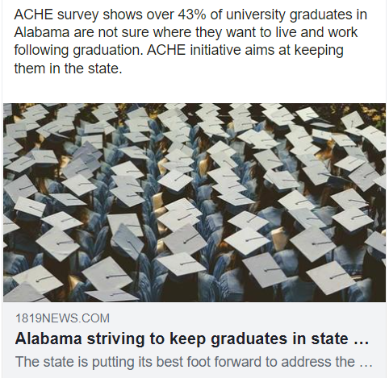
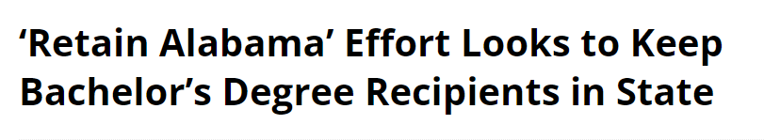

Retain Alabama

Slide 42
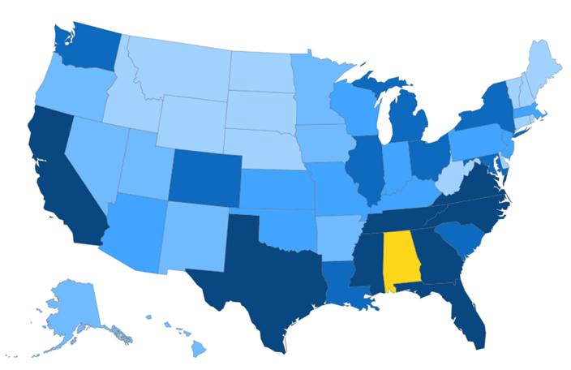
Recall Alabama
Note: Participating universities only.
State | Students | % of Total
AL | 62,083 | 74.8
GA | 5,005 | 6.0
FL | 3,848 | 4.6
MS | 2,887 | 3.5
TN | 1,655 | 2.0
TX | 1,150 | 1.4
OTHER | 6,376 | 7.7
TOTAL | 83,004

Slide 43
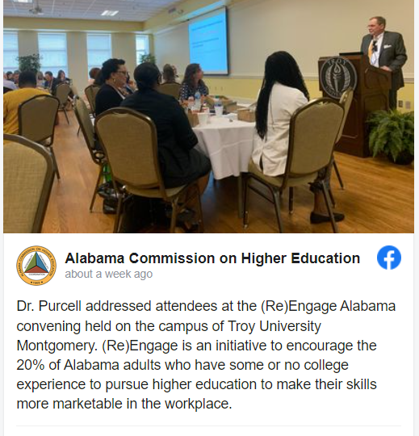
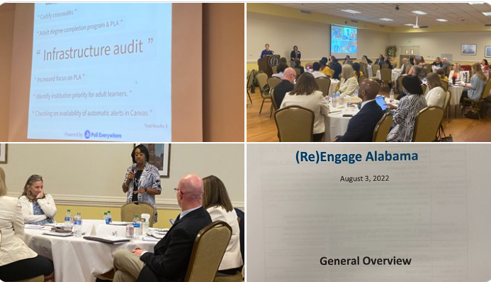
(Re)Engage Alabama

Slide 44

HBCU Deferred Maintenance
Grant Program

Slide 45
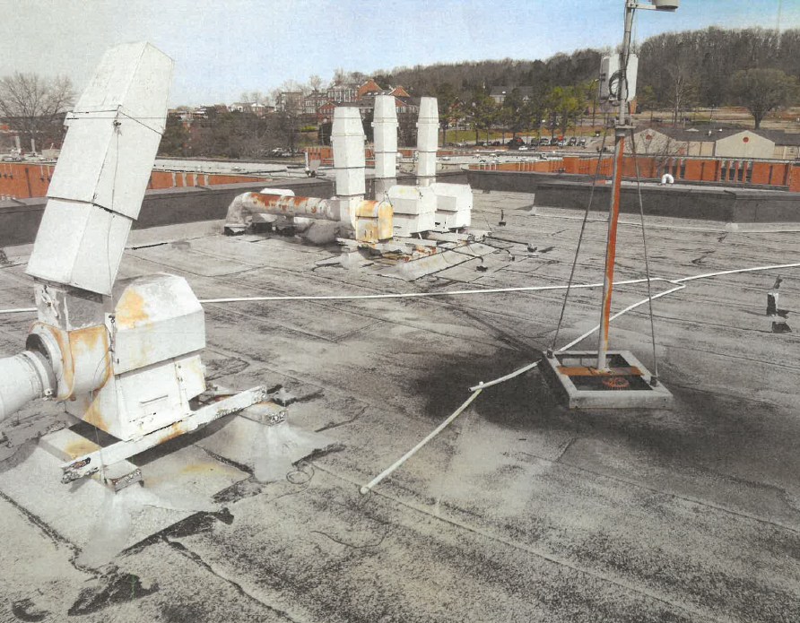
HBCU Deferred Maintenance Grant Program
Lawmakers passed Act 2022-393 (HB135) that funded a $5 million Deferred Maintenance Grant Program for Historically Black Colleges and Universities (HBCUs)
Legislation charged ACHE with administering the grant
Projects limited to deferred maintenance related to the upkeep and maintenance of facilities
Roof repair project for Carver Complex
at Alabama A&M

Slide 46
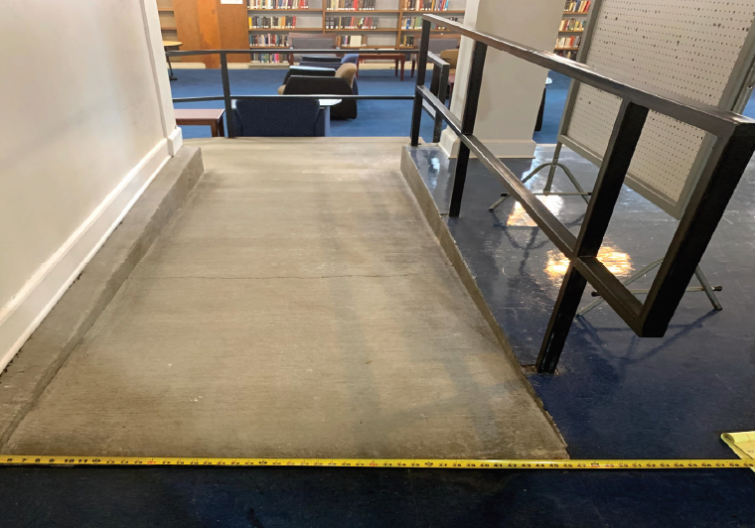
HBCU Deferred Maintenance Grant Program
Dollar-for-dollar match between institutional and state funds
$1 million grant limit per institution
Priority placed on projects related to ADA, health, and safety compliance
Institutions submitted projects in priority order on July 15th
ADA ramp renovation at Stillman College

Slide 47
HBCU Deferred Maintenance Grant Program
Institutions submitted 35 projects totaling over $10.4 million
Review committee began reviewing projects on July 18th and finalized awards on August 2nd
Committee Members:
  Commissioner Stan Nelson
  Commissioner Jody Singleton
  Jim Purcell
  Julian Rogers
  Jacinta Whitehurst
  Jim Hood
ADA bathroom renovation at
Gadsden State Community College

Slide 48
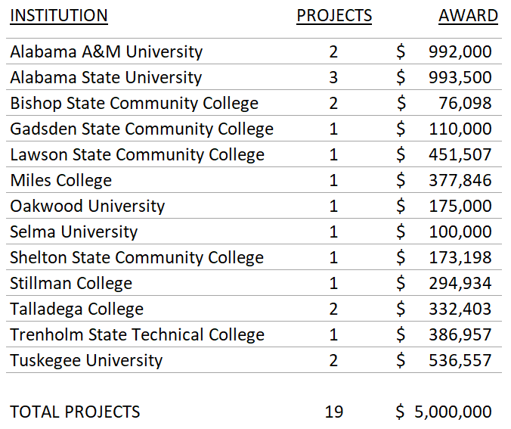
HBCU Deferred Maintenance Grant Program
All institutions accepted awards and verified matching funds
Notification of consent to proceed with work sent on August 15th
Every institution received partial or complete funding for their priority project

Slide 49

ACHE Website Update

Slide 50

ACHE Website Update

Slide 51

IX. Decision ITEMS

Slide 52

A. Approval of 2023 Meeting Schedule
Staff Presenter: Dr. Stephanie Dolan
Proposed Meeting Schedule for 2023
March 10, 2023
June 9, 2023
September 8, 2023
December 8, 2023

Slide 53
Motion, Decision Item A:
That the Commission approve the meeting schedule for 2023.

Slide 54

B. Final Approval of Amendments to the Administrative Procedures for the Alabama Math and Science Teacher Education Program-Loan Repayment Program
Staff Presenter: Mrs. Artcola Pettway

Slide 55

B. Final Approval of Amendments to the Administrative Procedures for the Alabama Math and Science Teacher Education Program –
Loan Repayment Program
During the 2022 Legislative Session, Alabama Act 2022-396 was passed.
Changes were aimed at eligible participants for :
  Math and Science teachers
  The base loan repayment amount increased from $2,500 to $3,750 per semester
  Beginning Fall 2022 semester and forward

Slide 56

B. Final Approval of Amendments to the Administrative Procedures for the Alabama Math and Science Teacher Education Program –
Loan Repayment Program
Preliminary approval of the proposed amendments to this rule was granted by the Commission on Friday, June 10, 2022. The proposed changes were filed with the Legislative Services Agency on June 15, 2022, and published in the Alabama Administrative Monthly on June 30, 2022. Interested parties had until August 9, 2022, to comment. No comments were received.
Should the Commission grant final approval to these proposed changes, the certified changes will be filed with the Alabama Procedures Office on September 13, 2022, and will go into effect on November 15, 2022.

Slide 57
Motion, Decision Item B:
That the Commission give final approval of the amendments to the Administrative Procedures for the Alabama Math and Science Teacher Education Program – Loan Repayment Program

Slide 58
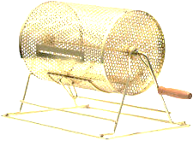
C. Public Drawing to Determine Order of Payment of ASGP Funds for 2022–23
Staff Presenter: Mrs. Takena Jones
Alabama Student Grant Program (ASGP) provides grants for eligible in-state students attending one of the following private institutions:
  Amridge University
  Birmingham Southern College
  Faulkner University
  Huntingdon College
  Miles College
  Oakwood University
Since all funds cannot be disbursed immediately, drawing is needed to determine disbursement order by institution.
Samford University
Spring Hill College
South University - Montgomery
Stillman College
U.S. Sports Academy
University of Mobile

Slide 59













Slide 60
Motion, Decision Item C:
That the Commission approve the 2022-2023 disbursement schedule for the institutions receiving Alabama Student Grant Program (ASGP) funds.

Slide 61

D. Fiscal Year 2022-2023 Operations Plan
Staff Presenter: Mrs. Veronica Harris

Slide 62
Alabama Commission on Higher Education
FY 2022-23 Budgetary Facts
The Commission has 35 programs under six appropriation units.
Three new programs are included in the FY 2022-23 budget as follows:
STEM Major Teacher Recruitment
Deferred Maintenance (HBCU)
FAFSA Completion Assistance
The FY 2022-23 budget represents a 32.46% increase over the previous fiscal year’s budget.
The FY 2022-23 Operations Plan, showing expenditures for each of the fiscal year’s quarters, was submitted to Executive Budget Office (EBO) on July 29, 2022. Any changes made by the Commission can be made through an Operations Plan revision after October 1, 2022.

Slide 63
Alabama Commission on Higher Education - All Funds
FUND CODE NO. | PROGRAMS AND ACTIVITIES | FY 2021-22 Appropriated | FY 2022-23 As Passed | Difference in Dollars | Difference in Percent
172 | PLANNING AND COORDINATION SERVICES
0144 | Postsecondary Education (ACHE O&M) | $3,660,422 | $3,809,631 | $149,209 | 4.08%
1174 | Industry Credential Directory | $100,000 | $100,000 | $0 | 0.00%
1175 | Retain Alabama ($400,000 to ACHE, $300,000 to EDPA, and $250,000 to AHEP) | $800,000 | $950,000 | $150,000 | 18.75%
1209 | FAFSA Completion | $0 | $500,000 | $500,000
Subtotal O&M |  | $4,560,422 | $5,359,631 | $799,209 | 17.52%
0322 | Non-Resident Institutions Fees (Local Funds - Fees) | $236,239 | $236,239 | $0 | 0.00%
1323 | NC-SARA Fees (Local Funds - Fees) | $200,000 | $200,000 | $0 | 0.00%
TOTAL |  | $4,996,661 | $5,795,870 | $799,209 | 15.99%
153 | STUDENT ASSISTANCE
0121 | Alabama Student Assistance Program | $7,277,225 | $8,000,000 | $722,775 | 9.93%
0122 | Alabama Educational Grants Program | $7,277,225 | $8,000,000 | $722,775 | 9.93%
0124 | Alabama National Guard Educational Assistance Program | $5,212,335 | $5,472,952 | $260,617 | 5.00%
0794 | Police and Firefighter's Survivors Tuition Program | $444,700 | $466,935 | $22,235 | 5.00%
1137 | Alabama Math and Science Teacher Education Program | $746,750 | $746,750 | $0 | 0.00%
1161 | Birmingham Promise Scholarship Program | $850,000 | $892,500 | $42,500 | 5.00%
TOTAL |  | $21,808,235 | $23,579,137 | $1,770,902 | 8.12%
152 | SUPPORT OF OTHER EDUCATIONAL ACTIVITIES
0109 | Southern Regional Education Board | $656,214 | $656,214 | $0 | 0.00%
0118 | Network of Alabama Academic Libraries | $379,201 | $379,201 | $0 | 0.00%
0107 | AGSC/STARS | $393,067 | $393,067 | $0 | 0.00%
0116 | Established Program to Stimulate Competitive Research | $1,200,216 | $1,200,216 | $0 | 0.00%
1208 | Stem Major Teacher Recruitment | $0 | $4,500,000 | $4,500,000
TOTAL |  | $2,628,698 | $7,128,698 | $4,500,000 | 171.19%
151 | SUPPORT OF STATE UNIVERSITIES
0800 | Alabama Agricultural Land Grant Alliance | $6,116,283 | $6,391,283 | $275,000 | 4.50%
TOTAL |  | $6,116,283 | $6,391,283 | $275,000 | 4.50%
189 | SUPPORT OF STATE PROGRAMS
0306 | Resource Conservation & Development Program (RC &D) | $3,837,744 | $5,287,744 | $1,450,000 | 37.78%
0307 | Soil and Water Conservation Committee Program | $2,423,376 | $2,673,376 | $250,000 | 10.32%
0308 | AL Forestry Foundation Black Belt Initiative ($650,000 to Sloan-Dixon Center) | $1,182,000 | $1,182,000 | $0 | 0.00%
0315 | Alabama Black Belt Adventures | $375,000 | $475,000 | $100,000 | 26.67%
0316 | Alabama Black Belt Treasures | $285,000 | $335,000 | $50,000 | 17.54%
1110 | Humanities Foundation | $100,000 | $200,000 | $100,000 | 100.00%
0318 | Alabama Civil Air Patrol | $100,000 | $100,000 | $0 | 0.00%
0319 | National Computer Forensics Institute | $250,000 | $450,000 | $200,000 | 80.00%
0320 | Adaptive Sports Scholarship | $60,000 | $60,000 | $0 | 0.00%
0324 | Motorsports Hall of Fame | $200,000 | $200,000 | $0 | 0.00%
1327 | Alabama Trails Foundation | $340,000 | $340,000 | $0 | 0.00%
1140 | Forestry Commission Education Program | $200,000 | $200,000 | $0 | 0.00%
1141 | Alabama Recruit and Retain Minority Teachers Pilot | $700,000 | $700,000 | $0 | 0.00%
1162 | AKEEP - Education and Teacher Recruitment Partnership | $100,000 | $100,000 | $0 | 0.00%
1182 | USS Alabama | $150,000 | $750,000 | $600,000 | 400.00%
1181 | HBCU Consortium | $650,000 | $650,000 | $0 | 0.00%
TOTAL |  | $10,953,120 | $13,703,120 | $2,750,000 | 25.11%
340 | DEFERRED MAINTENANCE PROGRAM
1142 | Deferred Maintenance Program (HBCU) |  | $5,000,000 | $5,000,000
GRAND TOTAL (includes Local Funds) |  | $46,502,997 | $61,598,108 | $15,095,111 | 32.46%
 | SOURCE OF FUNDS
200 | Education Trust Fund | $46,066,758 | $61,161,869 | $15,095,111 | 32.77%
403 | Federal Funds | $0 | $0 | $0
403 | Local Funds (Fees and Grants) | $436,239 | $436,239 | $0 | 0.00%
GRAND TOTAL |  | $46,502,997 | $61,598,108 | $15,095,111 | 32.46%

Slide 65
Types of Costs

Slide 66
2014-15 = 18.9%
2014-15 = 81.1%
2014-15 = 21,572,000
2022-23 = 61,598,000
185% increase in the overall budget

Slide 69
Motion, Decision Item D:
That the Commission approve the ACHE Fiscal Year 2022-2023 Operations Plan.

Slide 70

E. Academic Programs
Staff Presenters: Dr. Robin McGill and
Mrs. Kristan White

Slide 71














FOUR-YEAR INSTITUTIONS

Slide 72
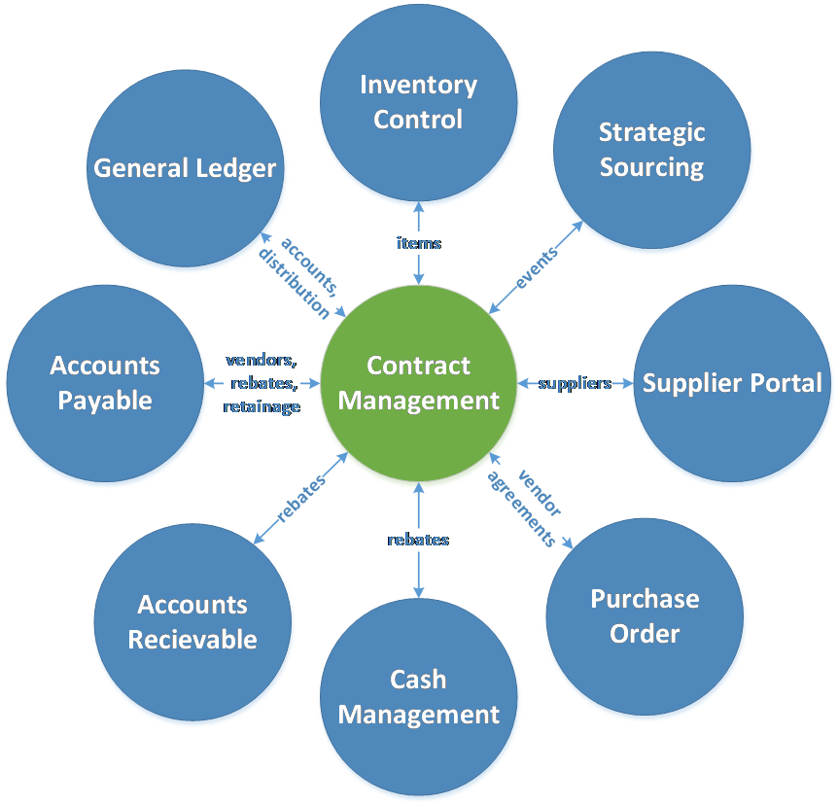
Athens State University
Master of Science in Acquisition and Contract
Management (CIP 52.0202)
This program is designed to address the growing regional, national, and worldwide demand for purchasing and contract practitioners that possess the skills needed to handle major government and corporate procurement processes.
This program will build upon the existing BS in Acquisition and
Contract Management and fulfill a local need from Redstone
Arsenal to provide in-person graduate training for personnel,
including those at the US Army Materiel Command, US Army
Contracting Command, and US Army Aviation and Missile
Command.
This proposal contains letters of support from employer partners
attesting to the need for this program.
This Photo by Unknown Author is licensed under CC BY-ND

Slide 73
Motion, Decision Item E-1:
That the Commission approve Athens State University’s proposal to offer a Master of Science in Acquisition and Contract Management.

Slide 74

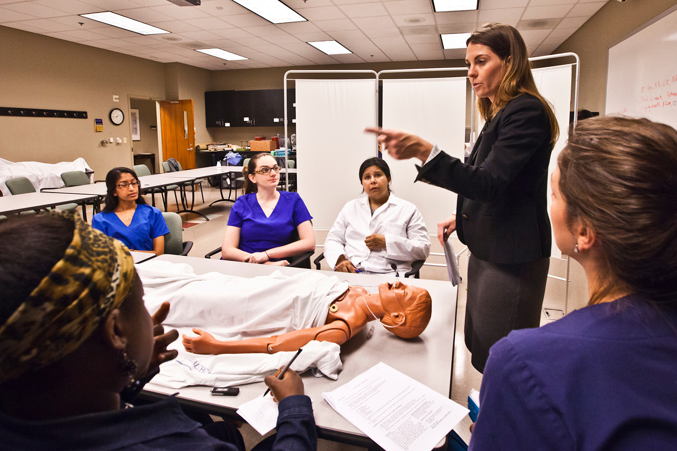

Auburn University
2. Doctor of Philosophy in Nursing (CIP 51.3808)
The proposed PhD program is designed to prepare students for employment within academia and nursing research. Graduates will expand the pool of candidates qualified for tenure-track positions at research-focused institutions.
AU has made significant investments in the College of Nursing, and the proposed research-focused program is designed to raise the institution’s standing in the discipline of Nursing.
This Photo by Unknown Author is licensed under CC BY-ND

Slide 75
Motion, Decision Item E-2:
That the Commission approve Auburn University’s proposal to offer a Doctor of Philosophy in Nursing.

Slide 76


Jacksonville State University
3. Doctor of Education in Educational Leadership (CIP 13.0401)
The proposed EdD will extend JSU’s offerings in Educational Leadership to the doctoral level. JSU’s existing MEd in Educational Leadership and EdS in Educational Leadership have demonstrated strong enrollment and completion numbers.
The proposed program would become the third practical doctorate offered by JSU, along with the DSc in Emergency Management and the DNP in Nursing. Both of the existing doctoral programs have shown strong performance since implementation.
The proposed program is designed to prepare graduates for employment as Elementary and Secondary Education Administrators, which appear on the 2022 Statewide In-Demand Occupations List, as well as Postsecondary Educational Administrators.
This Photo by Unknown Author is licensed under CC BY-ND

Slide 77
Motion, Decision Item E-3:
That the Commission approve Jacksonville State University’s proposal to offer a Doctor of Education in Educational Leadership.

Slide 78



University of Alabama
4a. Bachelor of Science in Neuroscience (CIP 26.1501)
The proposed multidisciplinary program will leverage faculty and coursework from several different academic units, including Psychology, Biological Sciences, Education, Physics, Chemistry, Mathematics, Engineering, Communicative Disorders, Anthropology, and Philosophy, and will not require any new resources to deliver.
Enrollment numbers in the existing minor in Neuroscience, along with the survey response from current students majoring in Psychology, indicate strong interest in the proposed BS in Neuroscience.

Slide 79
Motion, Decision Item E-4a:
That the Commission approve the University of Alabama’s proposal to offer a Bachelor of Science in Neuroscience.

Slide 80



University of Alabama
4b. Bachelor of Science in Sport Management (CIP 31.0504)
The proposed program will extend the Sport, Entertainment and Event Management Concentration in the BS in Hospitality Management to a standalone degree, and therefore, will require minimal new resources to implement.
Student demand for the proposed program is evident in the strong enrollment numbers for the existing undergraduate concentration.
This proposal includes three letters of support from employer partners in the sport tourism industry.

Slide 81
Motion, Decision Item E-4b:
That the Commission approve the University of Alabama’s proposal to offer a Bachelor of Science in Sport Management.

Slide 82


University of Alabama
4c. Bachelor of Science in Business Cyber Security
(CIP 52.1206)
The proposed program is designed to prepare graduates for employment as Information Security Analysts (SOC 15-1122), Computer Systems Analysts (SOC 15-1121), and Computer and Information Systems Managers (SOC 11-3021), all of which are included on the 2022 Statewide In-Demand Occupations List.
This program focuses on the management of cyber security operations, rather than the technical aspects of protecting digital information, and, in doing so, the program fills a need in the employment market.
The proposed program will leverage coursework
developed for existing undergraduate program
offerings at UA and will not require any
additional resources to deliver

Slide 83
Motion, Decision Item E-4c:
That the Commission approve the University of Alabama’s proposal to offer a Bachelor of Science in Business Cyber Security.

Slide 84




University of Montevallo
5. Bachelor of Science in Nursing (CIP 51.3801)
The proposed BSN is designed to prepare graduates for employment as Registered Nurses (SOC 29-1141), which are included on the Statewide In-Demand Occupations List.
The Alabama Legislature has appropriated funding from the Education Trust Fund to support the development of a nursing program at UM. Based on enrollment and tuition projections, the proposed BSN will be self-sustaining by Year 4.
UM has outlined a plan to meet nursing education requirements set by the Alabama Board of Nursing and intends to seek accreditation through the Council on Collegiate Nursing Education (CCNE).
This Photo by Unknown Author is licensed under CC BY-ND

Slide 85
Motion, Decision Item E-5:
That the Commission approve the University of Montevallo’s proposal to offer a Bachelor of Science in Nursing.

Slide 86


University of North Alabama
6a. Bachelor of Business Administration in Innovation and
Entrepreneurship (CIP 52.0701)
The proposed BBA in Innovation and Entrepreneurship aligns with the statewide economic development plan focused on innovation and small business growth, led by the Innovation Corporation.
The proposed program builds upon an existing concentration in Innovation and Entrepreneurship within the BBA in Professional Management (CIP 52.0201), and therefore will require minimal new resources to deliver.
The proposal includes 5 letters of support from:
Shoals Business Incubator (SBI),
Shoals Chamber of Commerce,
Alabama Small Business Development Center (SBDC) at UNA,
Shoals Economic Development Authority (Shoals EDA), and
Innovation Engineering Institute.

Slide 87
Motion, Decision Item E-6a:
That the Commission approve the University of North Alabama’s proposal to offer a Bachelor of Business Administration in Innovation and Entrepreneurship.

Slide 88



University of North Alabama
6b. Master of Health Administration in Health Administration
(CIP 51.0701)
The proposed program is designed to prepare graduates for employment as Medical and Health Services Managers (SOC 11-9111), which appears on the Statewide In-Demand Occupations List.
The curriculum for the proposed MHA will be delivered 100% online through flexible 8-week courses, intended to accommodate working professionals.
The proposal includes four letters of support from the following industry partners: Alabama Department of Public Health, Huntsville Hospital Health System, Brookwood Baptist Medical Center, and Shoals Community Clinic.

Slide 89
Motion, Decision Item E-6b:
That the Commission approve the University of North Alabama’s proposal to offer a Master of Health Administration in Health Administration.

Slide 90



University of South Alabama
7. Doctor of Occupational Therapy in Occupational Therapy
(CIP 51.2306)
The proposed OTD will replace USA’s existing Master of Science in Occupational Therapy (MSOT) program. Due to updated program length requirements from the Accreditation Board for Occupational Therapy Education (ACOTE), USA must reconfigure its existing MSOT program, and they are proposing to elevate the program to the doctoral level.
The proposed program is designed to prepare graduates for employment as Occupational Therapists (SOC 29-1122), an occupation which is included on the 2022 Statewide In-Demand Occupations List.
USA’s existing MSOT program has a strong pass rate
on the National Board for Certification in Occupational
Therapy (NBCOT) examination, which is required for
graduates to earn professional licensure.

Slide 91
Motion, Decision Item E-7:
That the Commission approve the University of South Alabama’s proposal to offer a Doctor of Occupational Therapy in Occupational Therapy.

Slide 92

























ALABAMA COMMUNITY COLLEGE SYSTEM

Slide 93


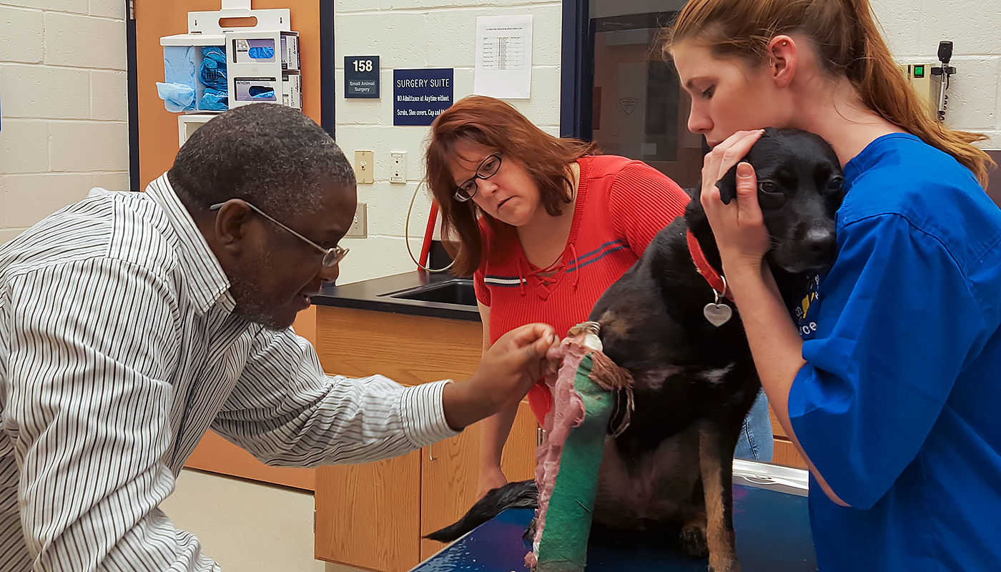
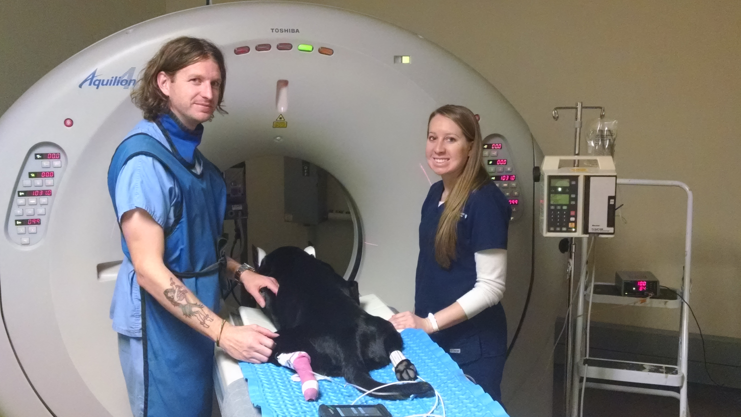
Southern Union State Community College
8. Associate of Applied Science in Veterinary Technology/
Technician (CIP 01.8301)
The proposed program will be the only program in the state to utilize 100% classroom-based instruction. Its clinical sites will be in East Central Alabama.
This program will partner with the College of Veterinary Medicine at Auburn University on lab activities and clinical rotations.
The program is designed to prepare graduates for immediate employment as Veterinary Technologists and Technicians (SOC 29-2056), which appear on the Statewide In-Demand Jobs List.

Slide 94
Motion, Decision Item E-8:
That the Commission approve Southern Union State Community College’s proposal to offer an Associate of Applied Science in Veterinary Technology/ Technician.

Slide 95

F. INFORMATION ITEMS
Distribution of 2022-2023 Alabama Student Assistance Program (ASAP) Funds
Implementation of Non-Degree Programs at Senior Institutions
Implementation of New Short Certificate Programs (Less than 30 Semester Hours)
Changes to the Academic Program Inventory
Updates to Units of Instruction, Research, Public Service, and Administration
Extensions/ Alterations to Existing Programs of Instruction
Implementation of Distance Education Programs
Summary of Post-Implementation Reports

Slide 96
8a. Summary of Post-Implementation Reports
Programs that met post-implementation conditions
University of North Alabama: Masters of Arts in Writing (CIP 23.1301)

Slide 97
8b. Summary of Post-Implementation Reports
b. Programs that did not meet post-implementation conditions
None

Slide 98
Motion, Decision Item F:
That the Commission accept the information items as presented.

Slide 99
G. ADJOURNMENT

