Slide 1
Alabama Commission on Higher Education ACHE
Columbia Southern University
November 22, 2024

Slide 2
AGENDA
Mission & Responsibilities
Programs, Services, Initiatives, and Activities
SARA in Alabama
Year-end-review
Plans for 2025
Q&A

Slide 3
Mission Statement:
The Alabama Commission on Higher Education (ACHE) is the
state agency responsible for the overall statewide
planning and coordination of higher education in Alabama,
the administration of various student aid programs,
and the performance of designated regulatory functions.

Slide 4
Responsibilities:
Approves any new academic programs
Prepares a Consolidated Budget Recommendation to the Governor and Legislature
Administers student financial assistance programs
Maintains an electronic student unit record system to provide accountability on student progress
Serves as the State Portal Entity (SPE) for Alabama’s participation in the State Authorization Reciprocity Agreements (SARA)
Etc.

Slide 5
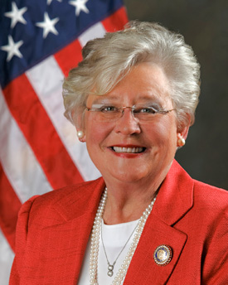
Strong Start, Strong Finish: An Education-to-Workforce Vision for Alabama
Governor Ivey established a strategic vision for aligning Alabama’s education and workforce programs from Pre-K to the workforce to provide for a seamless education-to-workforce continuum for all Alabamians in 2018.
Governor Ivey set a postsecondary education attainment goal of adding 500,000 credential holders to Alabama’s workforce by 2025.
Based on latest available data, the
Credential Attainment across Alabama for 2021
was 214,922 with projections of 365,000 for 2023.

Slide 6
500,000 Credentials Needed by 2025
1/3
of needed credentials can be earned at
2-year institutions
2/3
of new jobs in Alabama will require
a 4-year degree

Slide 7
All in Alabama is an ACHE statewide initiative aimed at retaining current and former graduates within the state. By keeping these highly qualified and educated individuals in Alabama’s workforce, the initiative seeks to enhance the state’s educational attainment and workforce capacity, leading to a stronger economy and improved quality of life for all Alabamians. The initiative has three programs that target specific segments of current and former students.
Notes:
RETAIN Alabama – Retain Alabama focuses on four-year college students to encourage them to remain in Alabama to live and work following graduation. Two college student surveys have been conducted by ACHE to learn more about future plans following graduation and why or why not they would choose to remain in the state. While 43.3% of students indicated that they are very likely to remain in AL post-graduation, 43.2% of students were either likely or unlikely to remain in AL. This is the target audience for Retain.
RECALL Alabama – Recall Alabama identifies former graduates who have left the state and are most likely to return based on consumer profiles developed by data mining services. These former graduates will be contacted through direct marketing campaigns in conjunction with institutional alumni and workforce development groups.
(RE)ENGAGE Alabama – Between 2017 and 2021, students over the age of 25 comprised nearly 15% of the total baccalaureate-seeking population at Alabama’s public universities, with just under 20,000 enrolled per year on average (Alabama Statewide Student Database). Reengage Alabama focuses on former students in Alabama with some college and no degree. This program is designed to identify those students who previously attended a college or university, but may be short of earning an undergraduate degree by a few credits. It connects those former students with Alabama’s colleges and universities by working to remove academic and financial barriers that often prevent these students from reengaging in the academic process and completing their credential or degree.
Dr. Stephanie C. Dolan
Associate Director of Planning and Policy
Stephanie.Dolan@ache.edu
(334) 353-9153

Slide 8
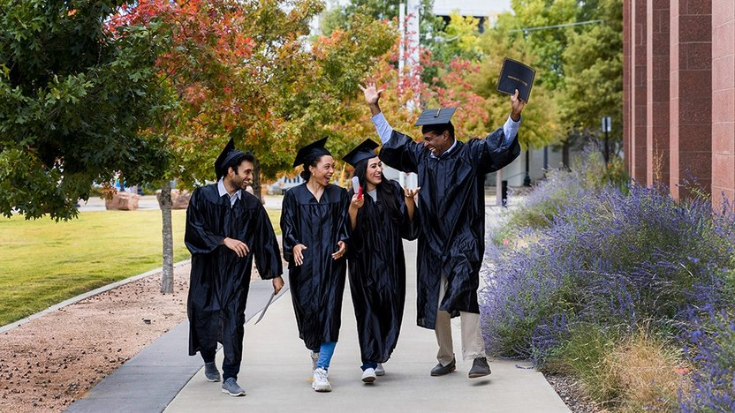
Retain Alabama and the State’s Workforce
The Retain Alabama Initiative led to the All in Alabama campaign and its three components:
Retain Alabama – encourage college graduates to live and work in Alabama after graduation.
Recall Alabama – outreach to former graduates to entice them to return to the state’s workforce
(Re)Engage Alabama Grant Program – help adults to return to college and finish their degrees
Notes:
RETAIN Alabama – Retain Alabama focuses on four-year college students to encourage them to remain in Alabama to live and work following graduation. Two college student surveys have been conducted by ACHE to learn more about future plans following graduation and why or why not they would choose to remain in the state. While 43.3% of students indicated that they are very likely to remain in AL post-graduation, 43.2% of students were either likely or unlikely to remain in AL. This is the target audience for Retain.
RECALL Alabama – Recall Alabama identifies former graduates who have left the state and are most likely to return based on consumer profiles developed by data mining services. These former graduates will be contacted through direct marketing campaigns in conjunction with institutional alumni and workforce development groups.
(RE)ENGAGE Alabama – Between 2017 and 2021, students over the age of 25 comprised nearly 15% of the total baccalaureate-seeking population at Alabama’s public universities, with just under 20,000 enrolled per year on average (Alabama Statewide Student Database). Reengage Alabama focuses on former students in Alabama with some college and no degree. This program is designed to identify those students who previously attended a college or university, but may be short of earning an undergraduate degree by a few credits. It connects those former students with Alabama’s colleges and universities by working to remove academic and financial barriers that often prevent these students from reengaging in the academic process and completing their credential or degree.
Dr. Stephanie C. Dolan
Associate Director of Planning and Policy
Stephanie.Dolan@ache.edu
(334) 353-9153

Slide 9
Act 2023-539 (Re)Engage Alabama Grant Program
In 2023, the Alabama Legislature approved the appropriation of $4.5 million to benefit students who earned some college credit and met given criteria to start spring 2024. In 2024, the legislature approved another $4.5 million appropriation to extend financial assistance to more qualified students. The (Re)Engage Alabama Grant Program seeks to remove academic and financial barriers that often prevent adults from reengaging the academic process and completing their degrees. By aligning specific programs of study with Alabama’s high-wage, high-demand occupations identified by the Alabama Committee on Credentialing and Career Pathways (ACCCP),Alabama residents have new means to enhance their career opportunities and enrich the workforce of Alabama.

Slide 11
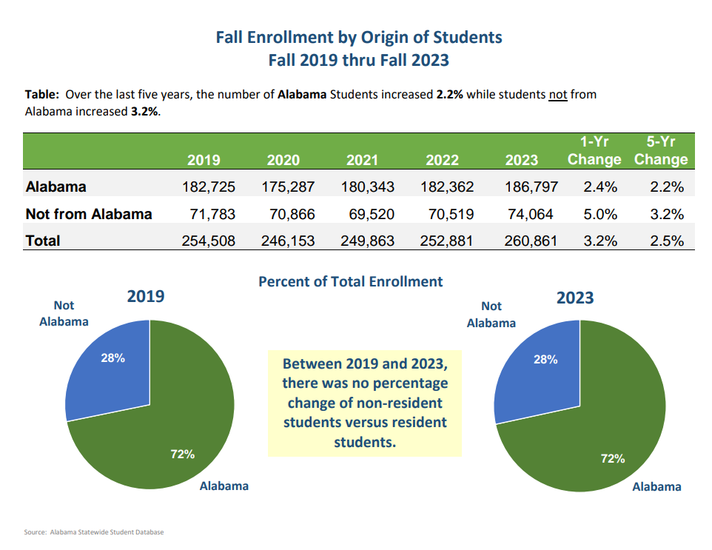

Slide 12
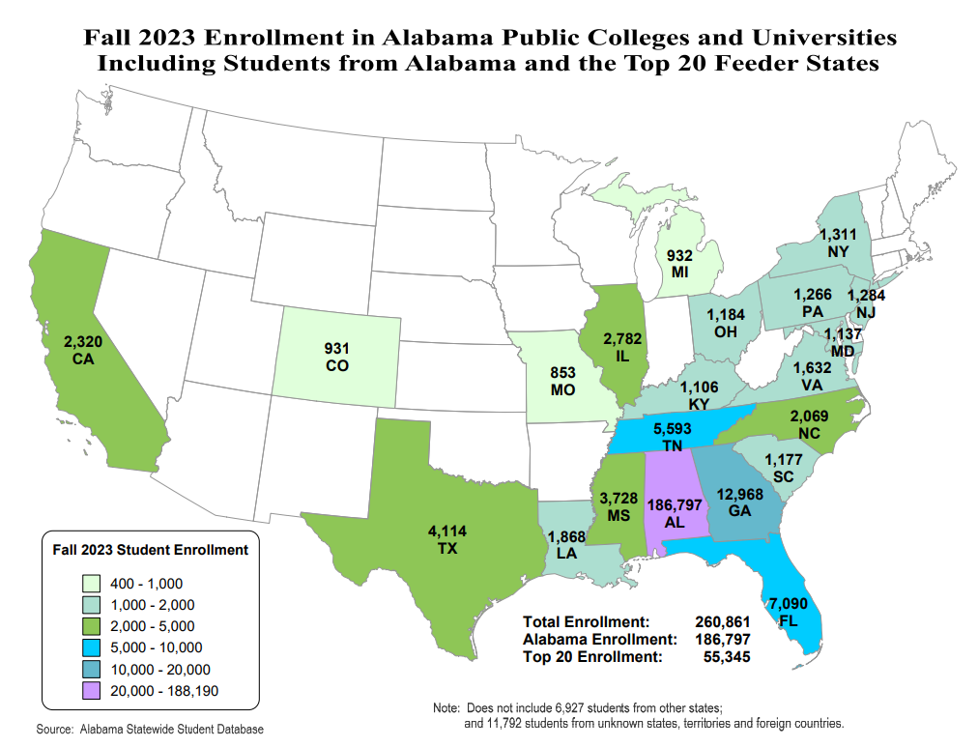

Slide 13
Student Horizon Database
The Students’ Right to Know Act was passed during the 2023 legislative session as Act 2023-556.
This law charges the Alabama Commission on Higher Education with developing the Student Horizon Database.
Horizon is an online interactive tool designed to provide parents and students with a variety of financial and academic information to help them make informed decisions about their education and future career paths.

Slide 15
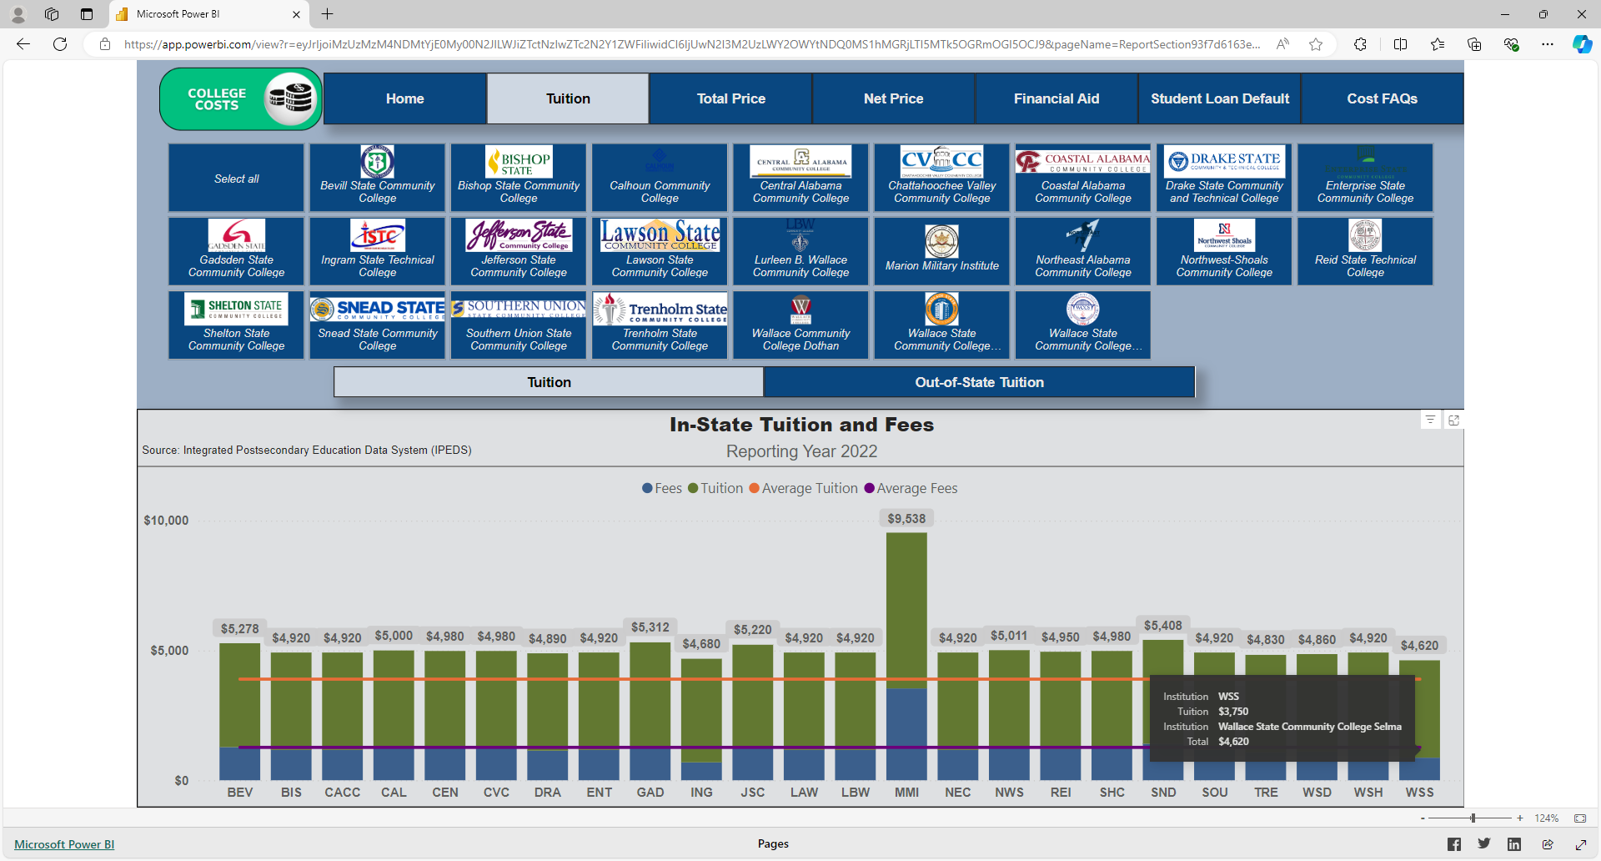

Slide 16
Free Application for Federal Student Aid (FAFSA)

Slide 17
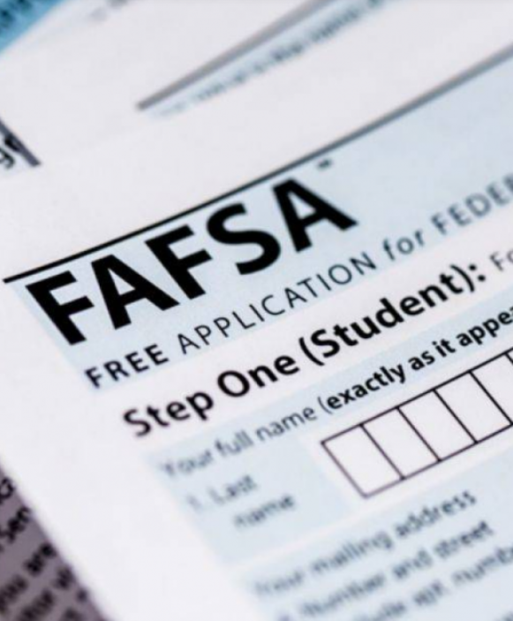
Why is completing the FAFSA important?
A gateway to over $150 billion in federal aid, and most state and institution aid.
Alabama’s Class of 2021 left roughly $67.8 million in unclaimed Pell Grant money on the table (ranked 15th nationally).
FAFSA completion strongly associated with positive outcomes:
92% of seniors who completed FAFSA enrolled in college or university following graduation
Education linked to higher incomes, better health, more civic engagement

Slide 18
Alabama's Estimated Unclaimed Pell Dollars & Students Completing FAFSA
AL reduced its unclaimed Pell dollars by $1.3M for every percentage increase in FAFSA Completion
AL students “claimed” an estimated $11.8M in 2022 and $14.4M in 2023 in unclaimed Pell due to improved FAFSA completion.
Alabama’s annual commitment of $500,000 yielded an average increase in federal student aid of $13,100,000.
Before Intervention
After Intervention
After Intervention
Source: National College Attainment Network (NCAN.org)

Slide 19
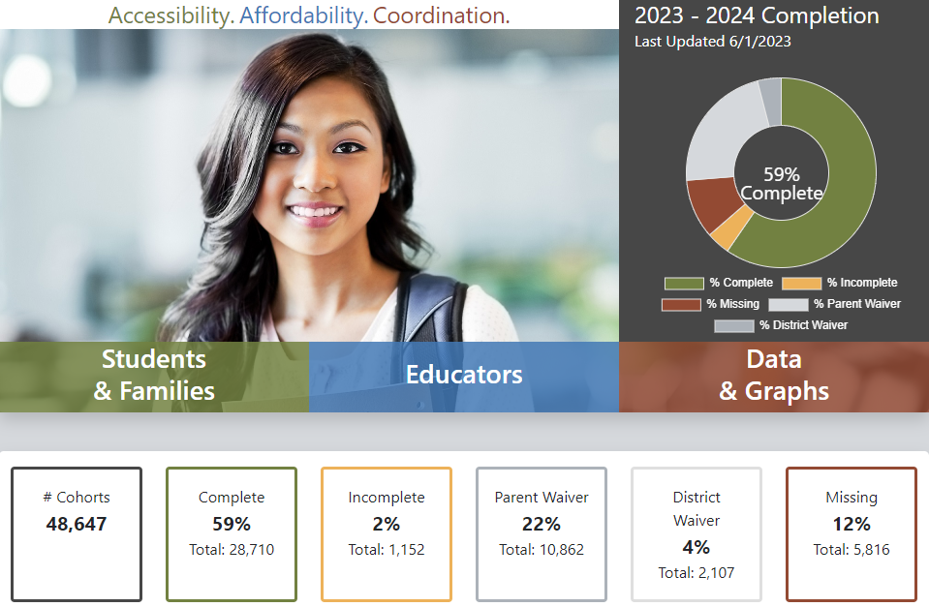
ACHE’s FAFSA Completion Portal
fafsa.ache.edu

Slide 20
SARA Year-End Review
Accomplishments and Activities in 2024:
Current membership: 42 institutions*
One student complaint investigated and resolved
Provided SAN membership to 11 institutions free of charge
SPE Activities
Awarded SARA Grants ($7,500) in 2023 and 2024
Attended virtual and in person Regional Steering Committees (RSC)
Regularly and actively participated in meetings to discuss policy proposals
Attended the annual SPE meeting and participated in a panel discussion
Served on the SARA portal advisory committee
*1 institution is in the process of rejoining

Slide 21
SARA in 2025
By January 1, 2025, ACHE will update the SARA documents on the website.
ACHE’s SARA Fee will increase on January 1, 2025, pending approval by the State Reciprocity Committee. The fee will mirror the NC-SARA fee.
During the month of January – ACHE will issue a callout to member institutions that are interested in complimentary SAN membership.
Later in the year, ACHE will sponsor an event or another workshop for SARA members.

Slide 22
The End

Slide 23
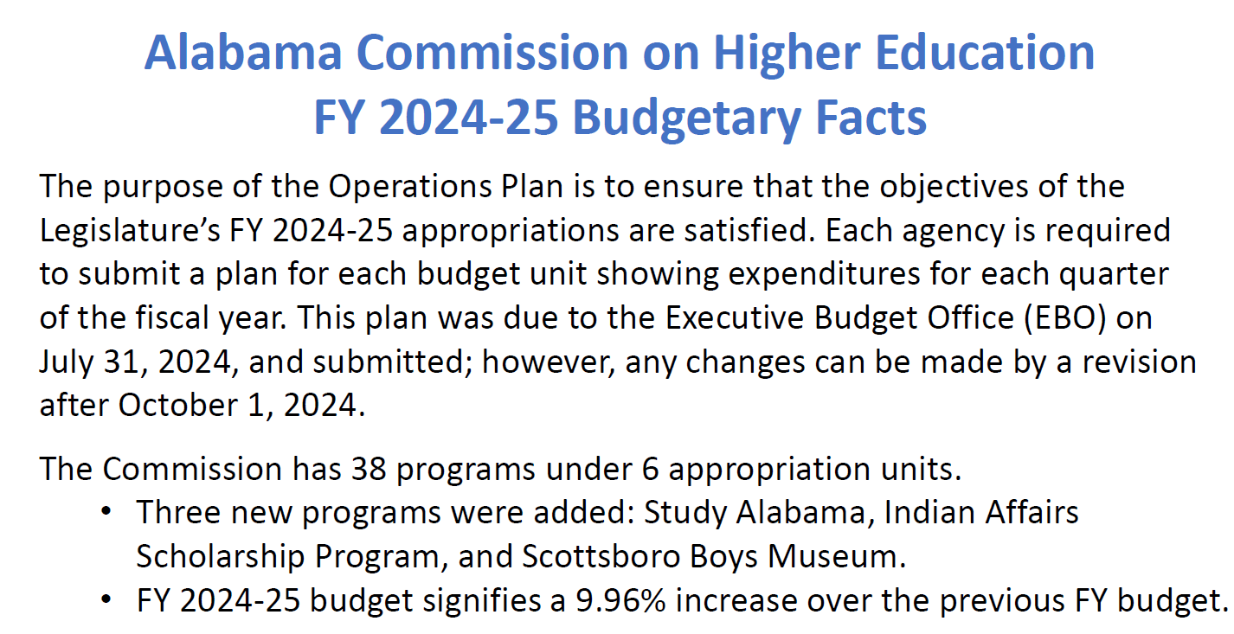

Slide 24
