Slide 1
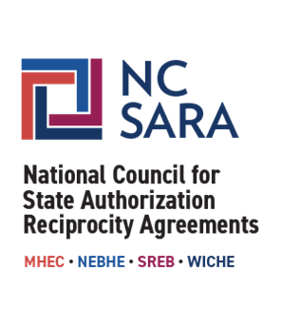
NC-SARA
Updates and Resources for
SARA-Participating Institutions
Jared Abdirkin, Director, Institutional Engagement & Initiatives, NC-SARA
Alabama SARA Institution Program
November 22, 2024

Slide 2
What is SARA, What is NC-SARA
NC-SARA Resources
Policy Modification Process
SARA Developments
SARA Data
U.S. Department of Education
AGENDA

Slide 3
What is SARA?
State Authorization Reciprocity Agreements (SARA) is an agreement amongst member states, districts, and territories that establishes comparable national standards and streamlines regulations, fees, and approvals for institutions offering interstate distance education programs. More than 2,400 institutions in 49 member states, the District of Columbia, Puerto Rico, and the U.S. Virgin Islands all voluntarily participate in SARA.
What is NC-SARA?
The National Council for State Authorization Reciprocity Agreements (NC-SARA) is a private nonprofit organization [501(c)(3)] that in partnership with the four regional compacts coordinates the implementation of SARA nationally. NC-SARA supports, facilitates, and serves the regional compacts, the regional steering committees, the State Portal Entities, and SARA participating institutions.

Slide 4
SARA Partners and Impact
Institutions
Over 2,400 institutions voluntarily participate in SARA,
are reviewed for renewal annually
States (states/districts/territories)
52 states are members of SARA
and have a biennial renewal review
Regional Compacts (MHEC, NEBHE, SREB, WICHE)
oversee SARA in their region
State Portal Entities (SPE)
One SPE for each SARA member state
Regional Steering Committees (RSC)
One RSC for each regional compact
SARA Student Access
Over 1.6 million students attended SARA participating institutions exclusively via distance education (430,000+ out of state learning placements)

Slide 5
The Critical Role of the States
States approve their “home-state” institutions to participate in SARA
The SARA State Portal Entity (SPE) is the state agency responsible for SARA approvals and compliance
Notes:
State Portal Entity is the agency – you can find SPE on NC-SARA directory; always check with your SPE for state-specific guidance

Slide 6
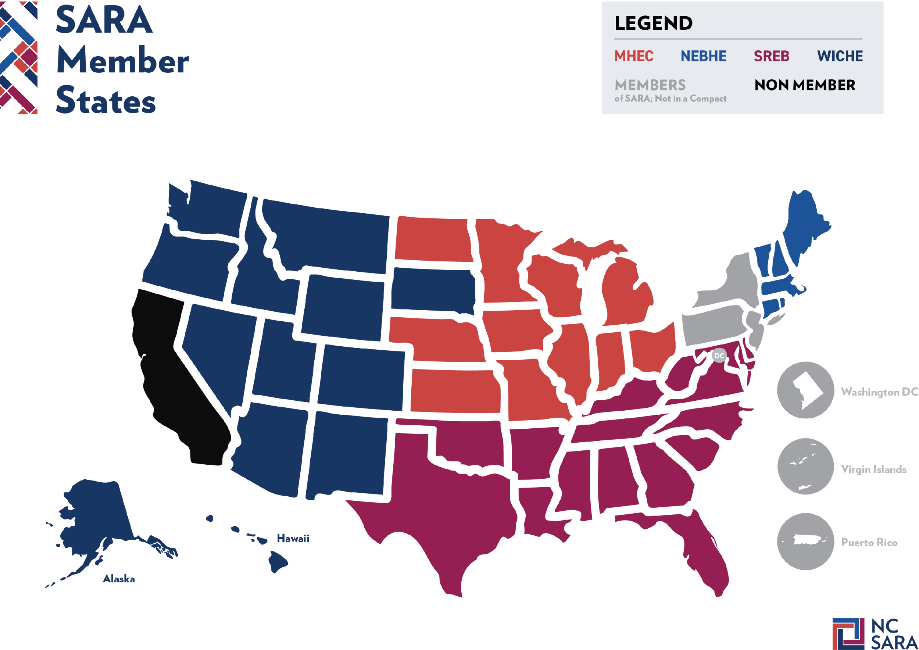

Slide 7
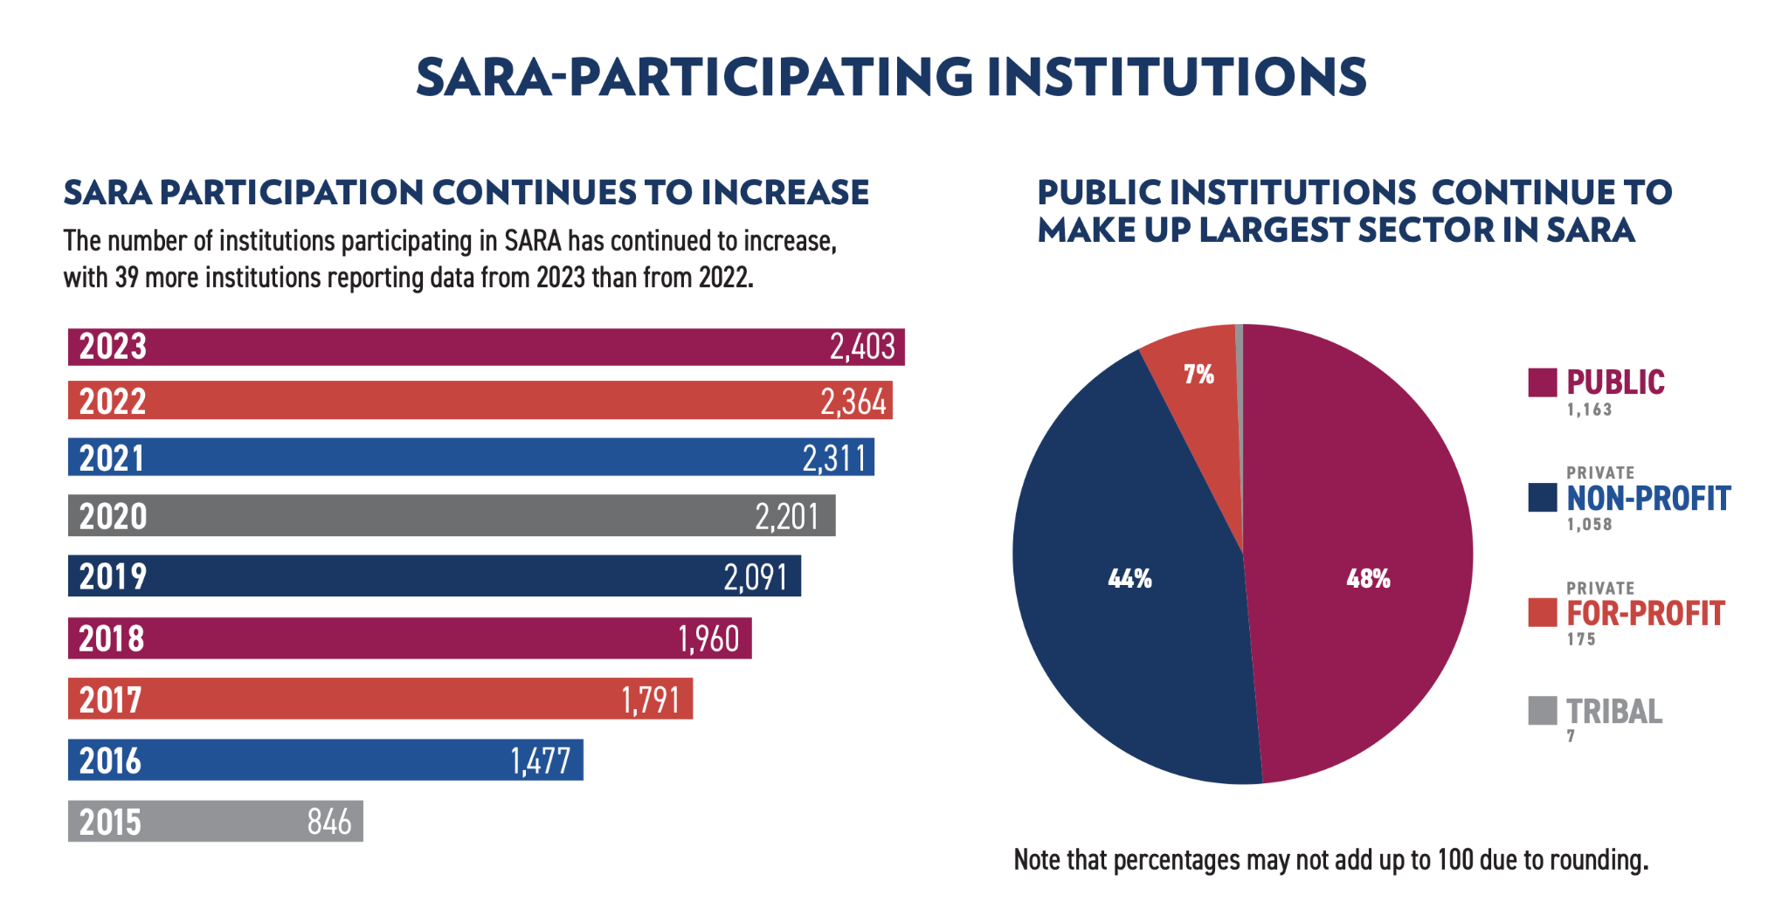

Slide 8
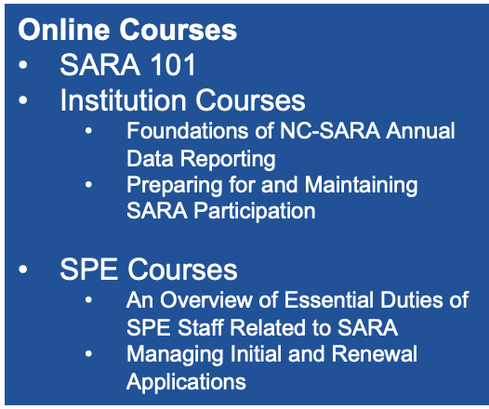
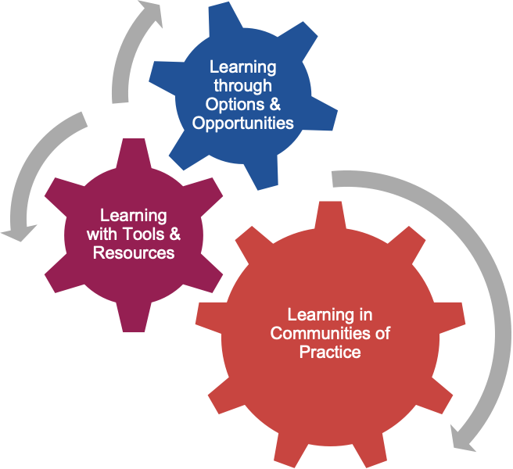
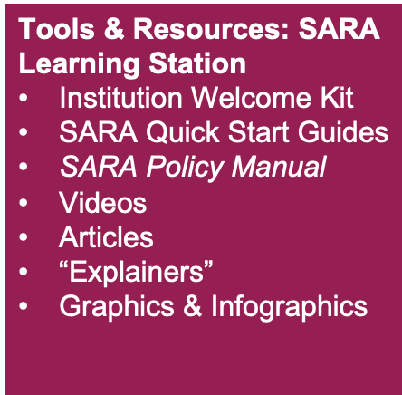

Slide 9
Recent and Upcoming Webinars
2024 SARA Policy Modification Process Wrap-Up: Results of NC-SARA Board Voting and Implications for SARA-Participating Institutions and State Portal Entities (November 19)
Department of Education Negotiated Rulemaking – Fall 2024 Update for the SARA Community
NC-SARA Annual Data Report Release
Specialized/Programmatic Accreditation: Ensuring Educational Quality
SARA's 10-Year Anniversary: A Decade of Opportunity
Visit our website to register in advance or to access the recording and materials afterward:
Webinars | NC-SARA

Slide 10
Annual Data Reporting
California Students
Field Trips
Institution Applications
Military Bases
Overseas Students
SARA Policy Modification Process
8. Professional Licensure
9. SARA Fees
10. SARA Late Fees
11. Short Courses
12. Student Complaints
13. Third Party Contracts

Slide 11
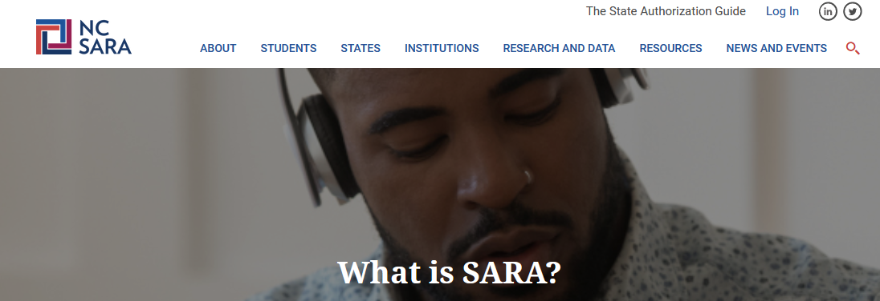
NC-SARA provides:
Professional Licensure Directory
State Authorization Guide
SARA Student Complaint information
Cost Savings Calculator
SARA Participating Institution Directory
Notes:
SARA Source!!!

Slide 12
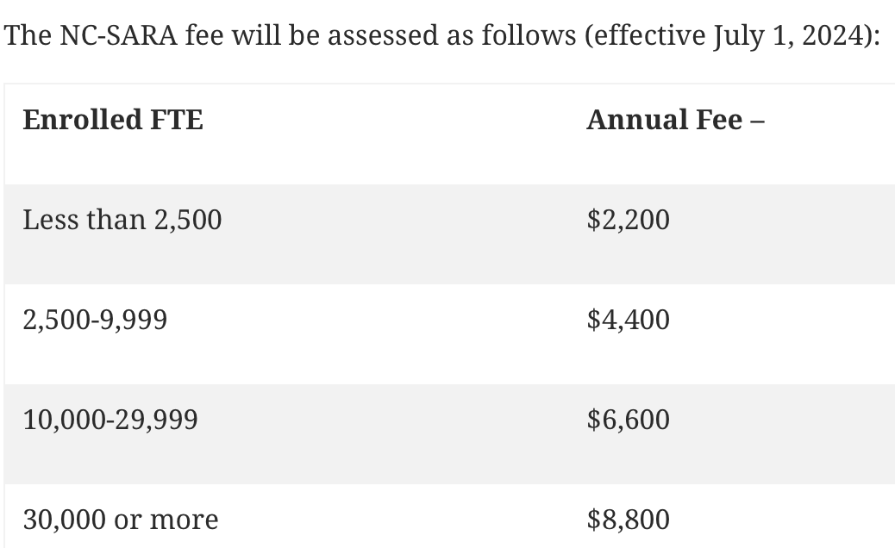
NC-SARA Participation Fees
Note – this is separate from and in addition to any fees
charged by the State of Alabama for SARA participation

Slide 13
SARA Policy Modification Process
Engage directly with proposers.
Attend and share your opinion during the “public form”.
Register your final thoughts during the “public comment” period.

Slide 14
SARA Policy Modification Process
2024 cycle summary - Student Consumer Protection Focus
Tip: Watch 11/19 webinar, look for updates as policies implemented
Clarifies that institutions that lose SARA participation must meet state-specific authorization requirements
Aligns SARA policy with federal requirements regarding professional licensure
SARA-participating institutions may remain on provisional status until condition(s) improve
Clarifies criteria for a state to place a SARA-participating institution on provisional status
Requires public sharing of reason for a SARA-participating institution placed on provisional status
SARA-participating institutions must provide SARA student complaint resolution policies on their website and in their catalog or equivalent
Improves SARA student complaint data collection and reporting to include complaint type and student location
2025 cycle - submissions begin January 21, 2025

Slide 15
Current Areas of Work
Converting to eForms - starting with initial and participation renewal extension (AF1 & AF2)
SARA Institution Application
new versions - 7/1/24, 1/1/25, 7/1/25 (expected)
new policies require updates
1/1/25 also includes updates to institution
“contact roles”
NC-SARA Institutional Advisory Committee

Slide 16
Future Areas of Work
CSV Upload Feature for Data Reporting
Data is saved in a table structured format
SARA Portal Access for Institutional Contacts
Institutional Engagement
Newsletter (late 2024 or early 2025)
Survey (Q1 2025)
Timely webinars
Updated learning resources

Slide 17
U.S. Department of Education
Negotiated Rulemaking
Still on our radar

Slide 18
Who is Working on Neg Reg?
Regional Compact Presidents
NC-SARA Board & the Neg Reg Working Group
Board Officers, regional compact president, regional compact staff, board members (attorney, SPEs), and NC-SARA staff
Meet twice a month for the last year; review documents and discuss strategy
This work may move to the NC-SARA Board Committee - Consumer Protection & Policy
White Board Advisors - A communications, research, and strategic consulting firm
Penn Hill - Extensive knowledge of what is happening in Washington, DC and the US Department of Education. Helping us strategize and inform our work around Federal Policy

Slide 19
What is the SARA Community Doing?
Working Group – Institutional Closures
Teach out plan / teach out agreement
Financial arrangements
Records retention
SARA Narrative
White papers/blogs on a variety of topics
One pager on student consumer protections - New
What is SARA Blog with SAN (Coming soon!)
The Value of SARA (February 2025)
Collect, Review, and Disseminate Information
Collect and share exclusively distance education enrollments trend data with SPEs - New
Continue to gather data and information from SARA states/institutions on issues related to Neg Reg.

Slide 20
Conversations, Communication, and Collaboration
NC-SARA Board, regional compacts, SPEs, SARA participating institutions, HED organizations, and ED
Webinars, attending meetings, e-blasts…
Continue to share information, data, evidence with SARA Community (including ED).
Stay Informed!
SARA Call to Action Page - https://nc-sara.org/sara-neg-reg-call-action
Sign Up for SARA Updates - https://formstack.io/71987
Stay Tuned!

Slide 21
Questions and Discussion

Slide 22
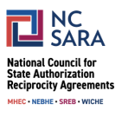
Thank You!
For NC-SARA questions please email:
info@nc-sara.org
NC-SARA Website: www.nc-sara.org

