Slide 1
Challenges and Strategies for Recruiting Online Students
Cindy Chiribao
Associate Vice President, Admissions

Slide 2
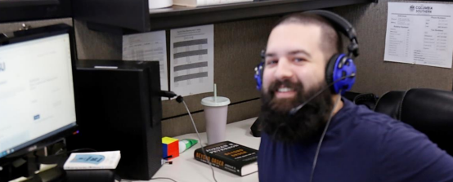
Importance of Admissions Interactions
Recruitment
Information Sharing
Personalized Guidance & Relationship Building
Enrollment Decisions

Slide 3
Challenges
Around-The-Clock World
Limited Resources
Balancing Quick-Engagement and Subject Matter Experts

Slide 4
What Works for CSU
Personalization
Customer Service
Admission Timeline
Multichannel Engagement
Self-Serve Portal

