Slide 1
The University of Alabama Online
SARA Workshop
November 20, 2024

Slide 2
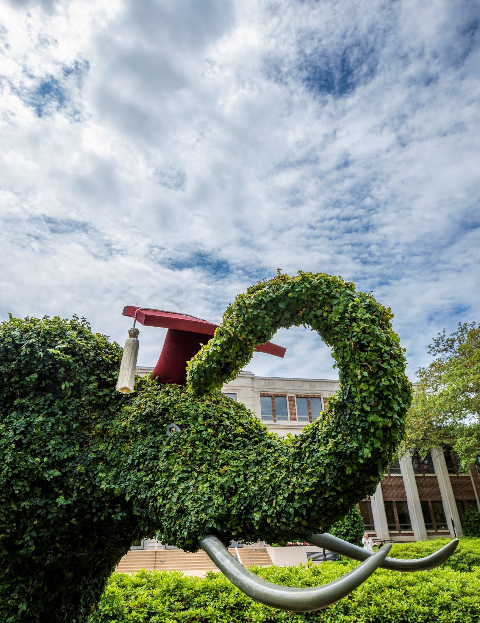
UA Online
The University of Alabama Online
Over 100 majors, minors, degrees, and academic certificates
One tuition rate no matter the state

Slide 3
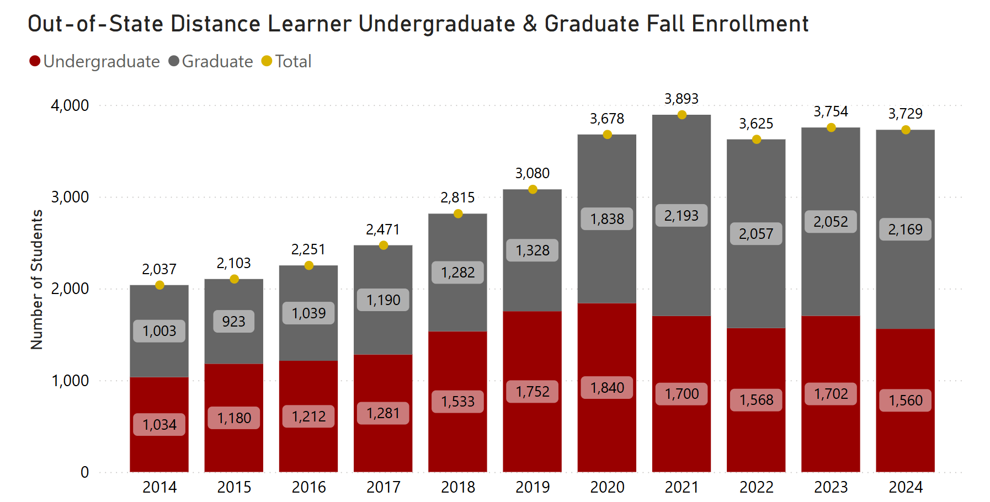
Out-of-State Enrollment

Slide 4
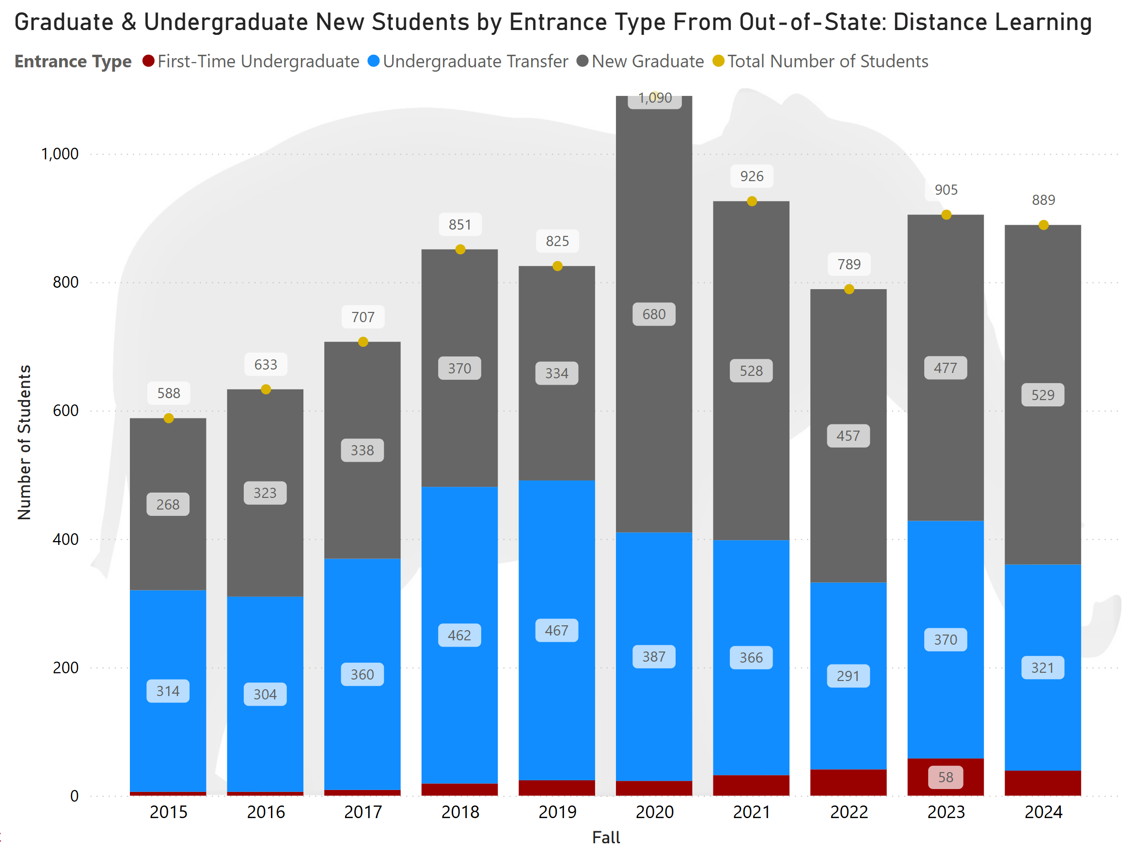
Out-of-State Enrollment

Slide 5
Recruitment
Identifying Key Conferences
Set up as a vendor at professional conferences connected to key graduate programs
Participate in and table at CCME to increase reach for recruitment of military students
Military coordinator travels to installations across the country
Military grants for undergraduate TA recipients
CRM email drip campaigns

Slide 6
Marketing
Investment in digital marketing
Google display, search, and retargeting
Paid social media ads (Instagram, Facebook, LinkedIn) and social mirroring
Industry-specific print ads in publications and conference programs
Geofencing targeted areas, military installations, and professional conferences
Partnership with Hanover Research for market research

Slide 7
Retention
Student Success Focus
Bama Ready orientation
Entry-term advising
Success coaching
Military Services Grant
Online Tutoring through brainfuse
Online Counseling through Uwill

Slide 8
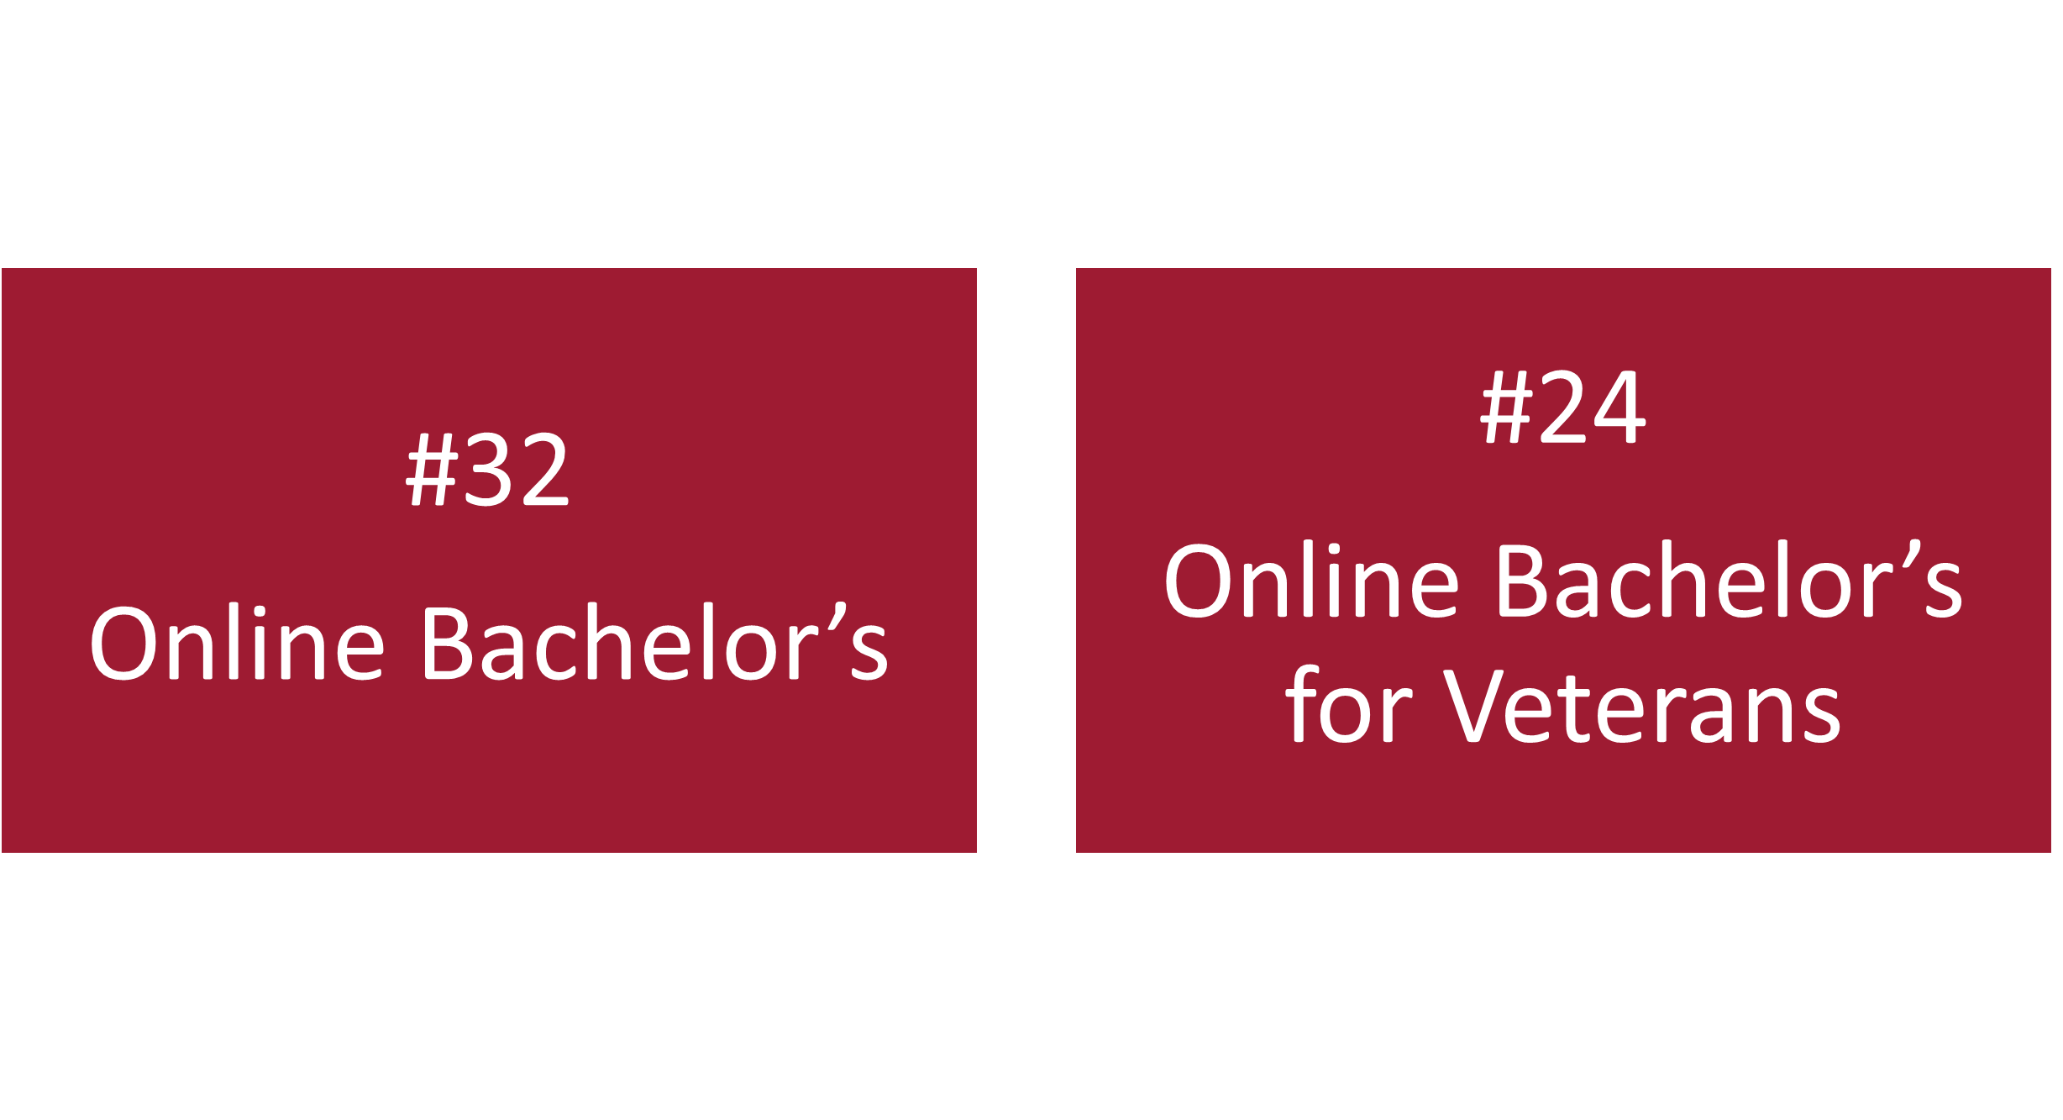
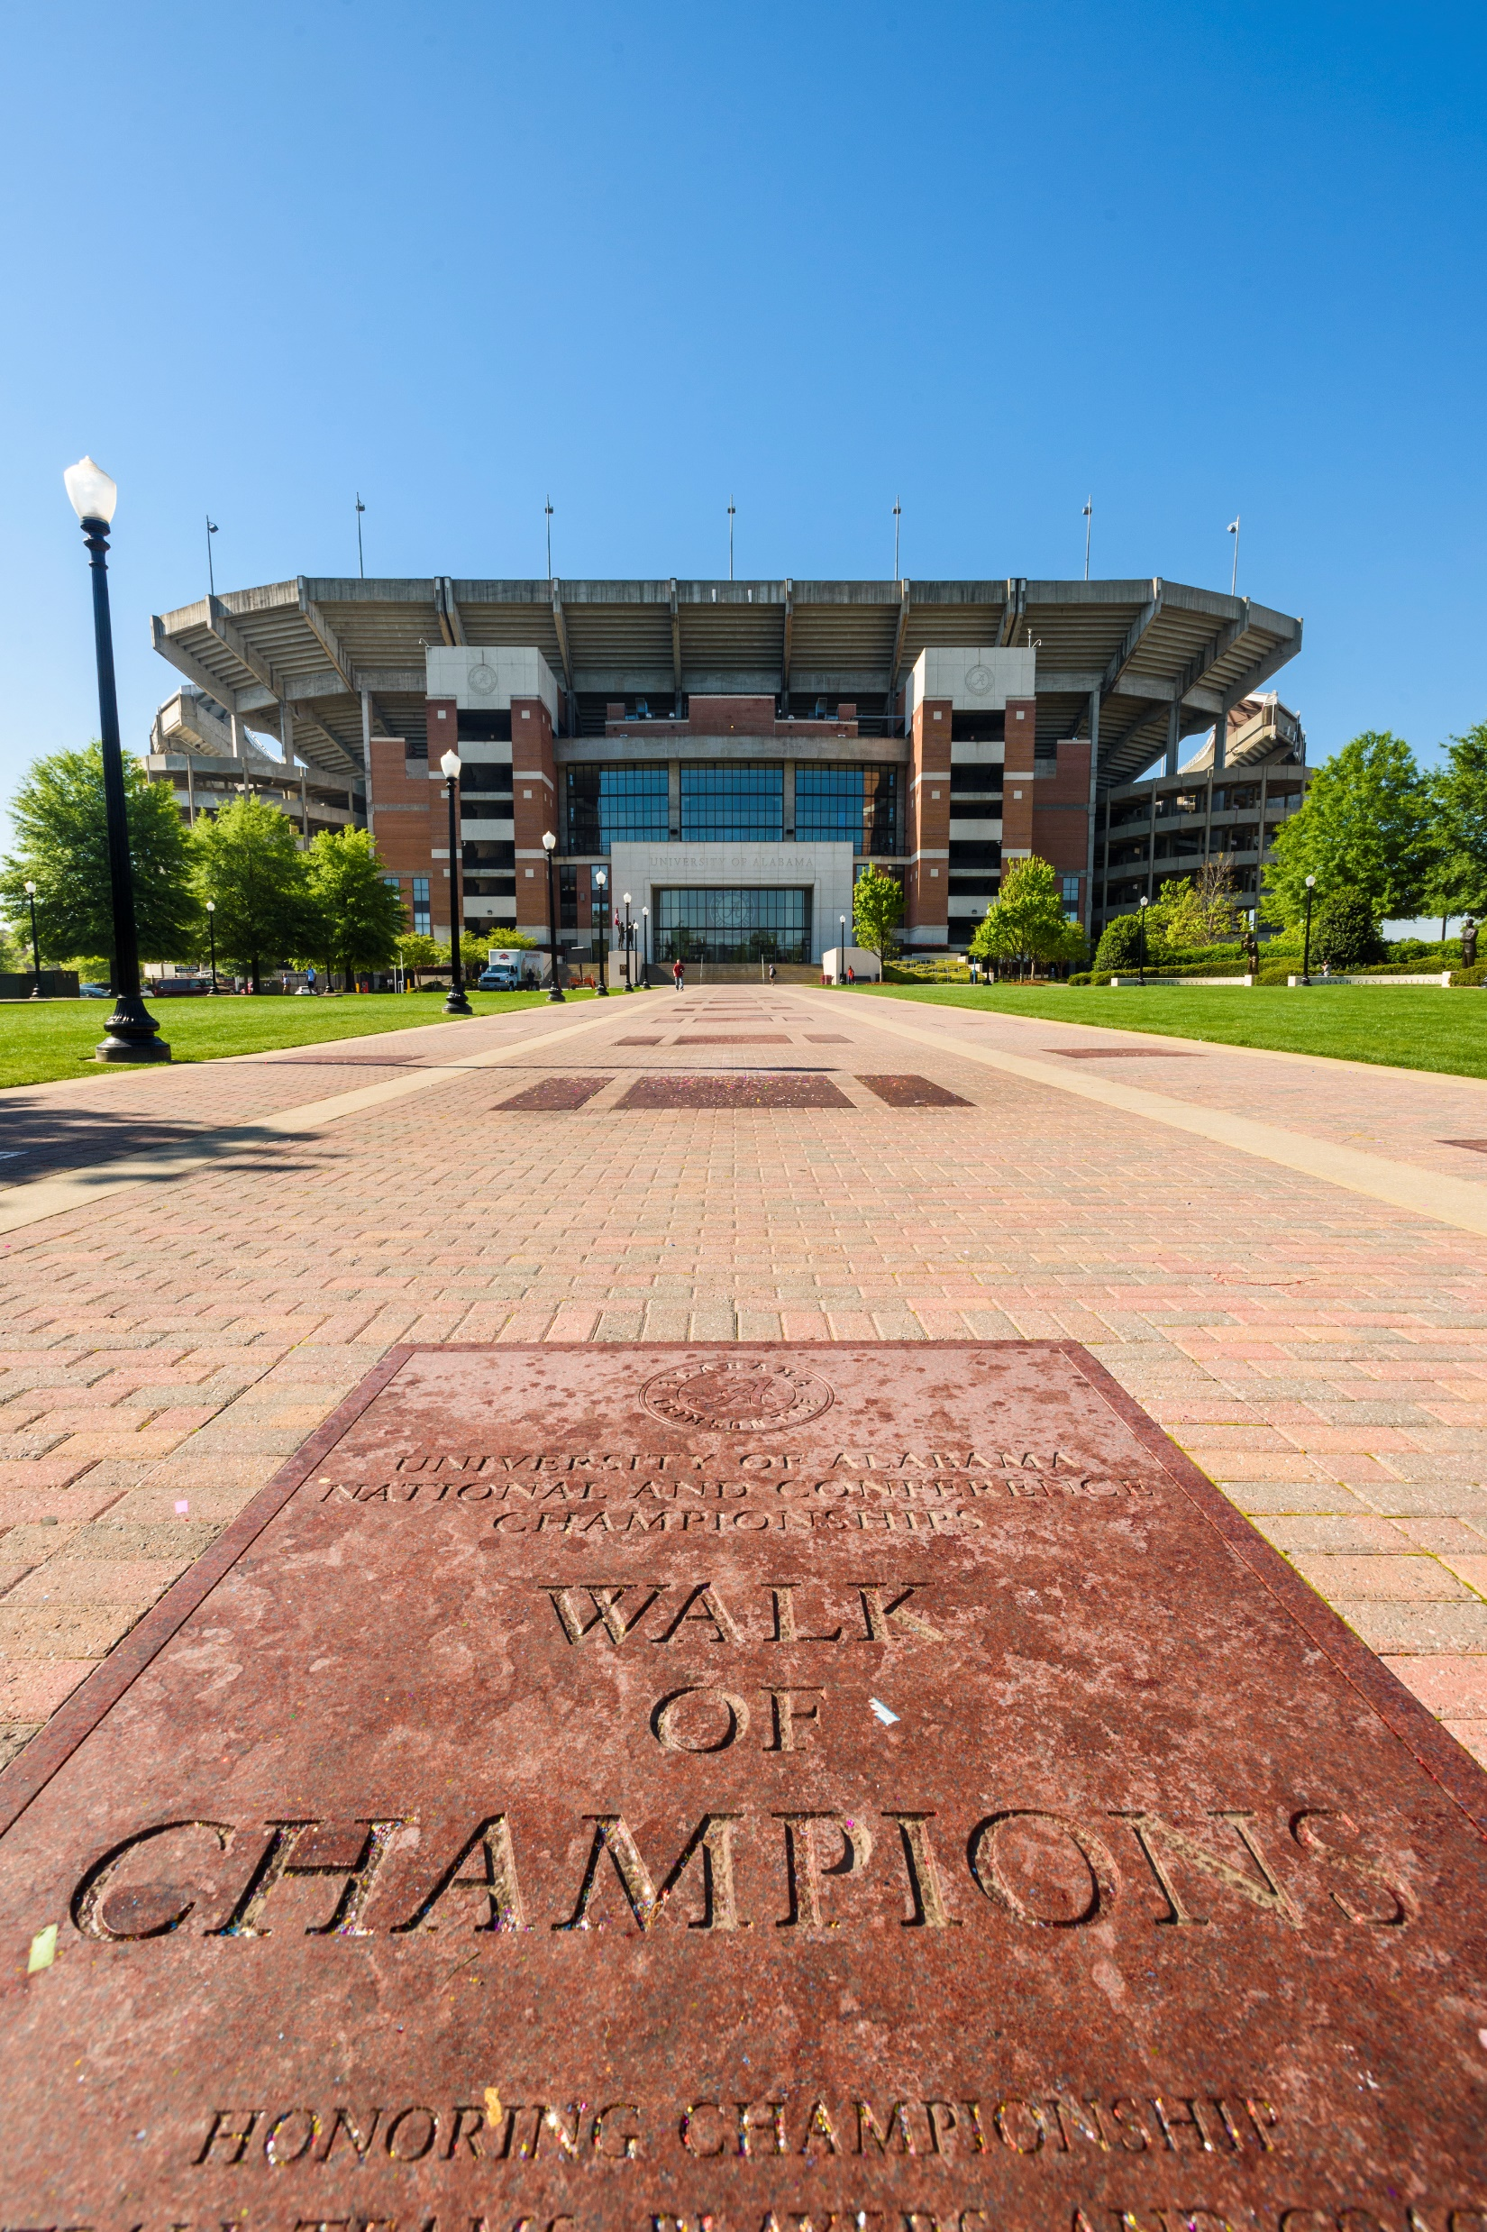
U.S. News & World Report

