Slide 1
2023 Data Reporting in 2024
Alabama SARA Institution Program
Terri Taylor Straut
Senior Director,
Educational Programs &
Data Team

Slide 2
2023 Data Reporting in 2024: Alabama & SREB Data
Agenda:
Why We Collect SARA Data
Methodology
Participating SARA Institutions
Exclusively Distance Education Enrollment (EDEE)
Out-of-State Learning Placements (OOSLP)
NC-SARA Dashboards
Changes for 2025 Data Reporting
Resources & Important Dates
Questions & Answers

Slide 3
Why We Collect SARA Data
Notes:
MB-Mentioned positioning this as “Where we’ve been and where we are going”, I changed the section heading to Why We Collect SARA Data instead of SARA Landscape (but I kept those couple of intro. slides).

Slide 4
Why Does SARA Collect Data?
Collecting, reporting, and analyzing data about the interstate delivery of distance education are important parts of NC-SARA's mission. Data collection and reporting help measure the impact of SARA.
The Promise of Data Collection to States
Standard across country
Public and shared
History of SARA Data Reports
9 years of reporting exclusively distance education enrollments
6 years of reporting out-of-state learning placement data
Notes:
MB:
Member states agreed to require data collection from all SARA-participating institutions as a condition of participation from the inception of SARA in 2014.
Beginning with 2015 data reported in the spring of 2016, participating institutions reported their out-of-state Exclusive Distance Education Enrollment (EDEE).
In 2017 data reporting in the spring of 2018, participating institutions also began reporting their in-state EDEE to better reflect the distance education landscape.
In 2018 Out-of-state Learning Placements (OOSLP) were added to the SARA data requirements, based on NC-SARA’s leadership’s commitments to several state regulators who had a strong interest in continuing to understand how their state’s resources were being used to support the learning placement needs of students from other states.
Since the initial data reporting in the spring of 2016, NC-SARA has used online reporting forms that are tied to the SARA Portal. And since that time, institutional staff have been requesting csv uploads instead of manual data reporting via the forms.
This year we piloted the data uploads with a selection of institutions of various sizes and sectors. It went very well and Rachel will talk more about how this change will be rolled out later in the webinar today.
We wanted you to know that this long-awaited change is coming!

Slide 5
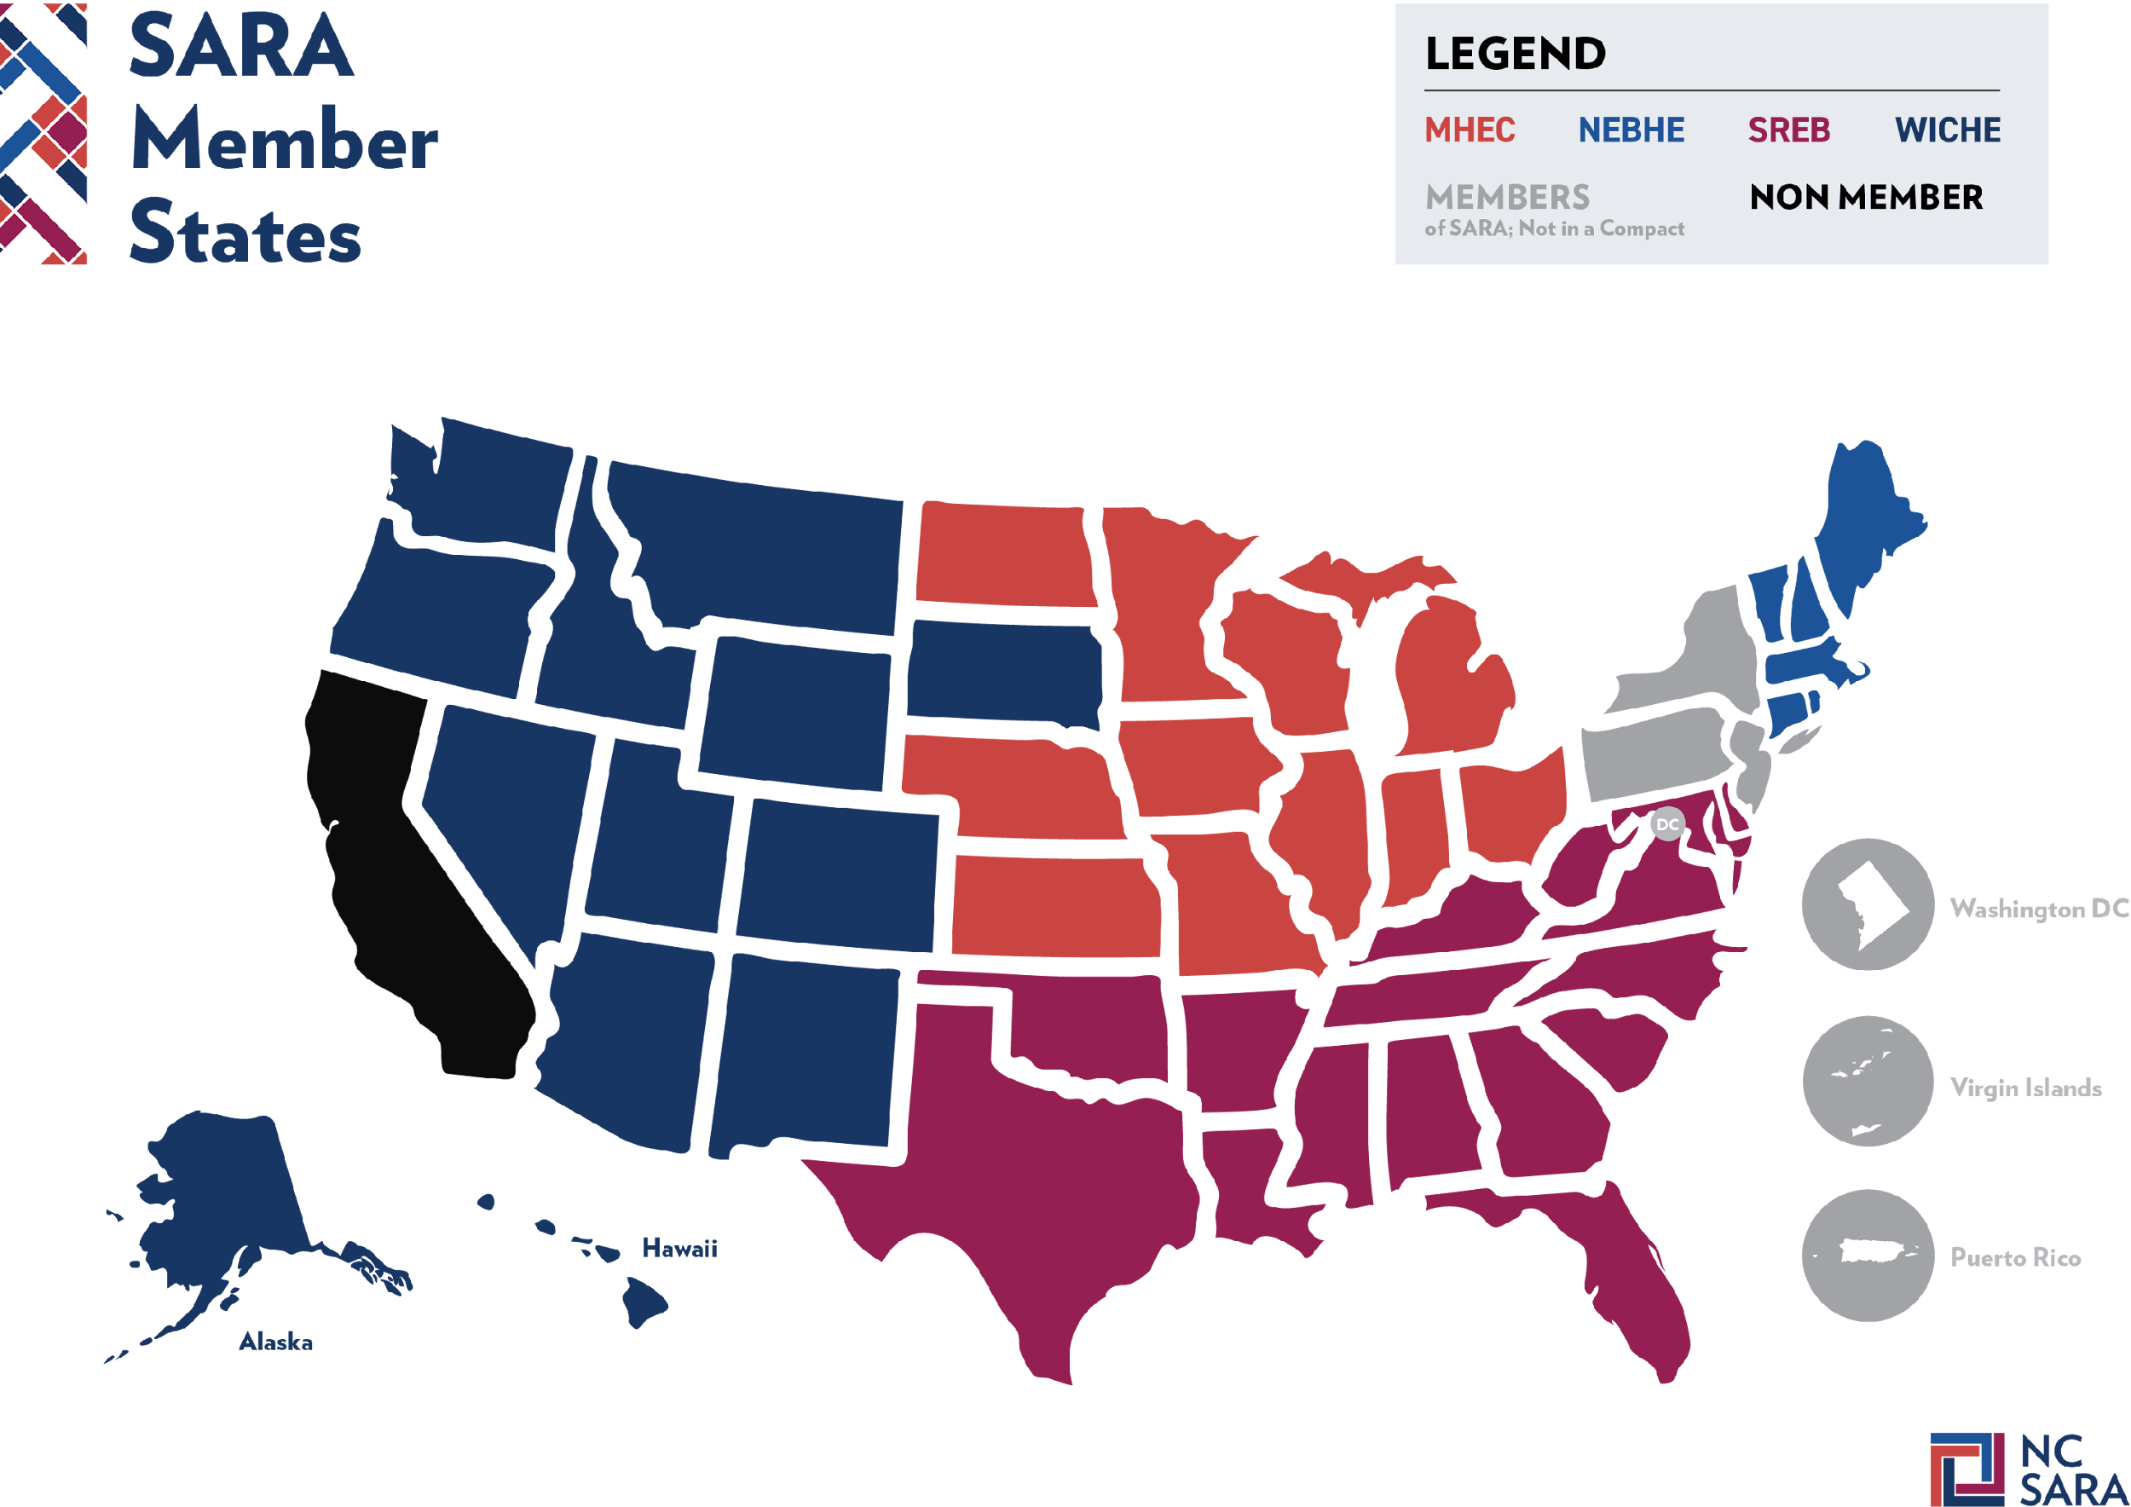
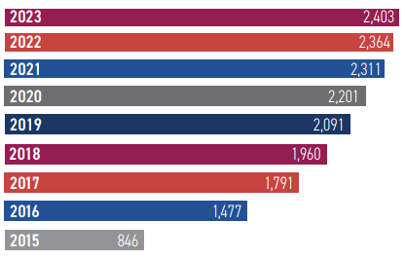
SARA Landscape
52 MEMBER STATES AND TERRITORIES
As of May 2023:
2,428 Participating Institutions
2,403 Reporting Institutions

Slide 6
What is the SARA Data?
Exclusively Distance Education Enrollment (EDEE):
Students enrolled exclusively in distance education courses
Same enrollment reported to IPEDS (Fall EF report) – but disaggregated by state
Includes in-state and out-of-state
Out-of-State Learning Placements (OOSLP):
Learning placements are on-ground, out-of-state experiential learning activities
On-ground and online students who participate in an OOSLP are included
OOSLP Does NOT include In-State
Notes:
RC

Slide 7
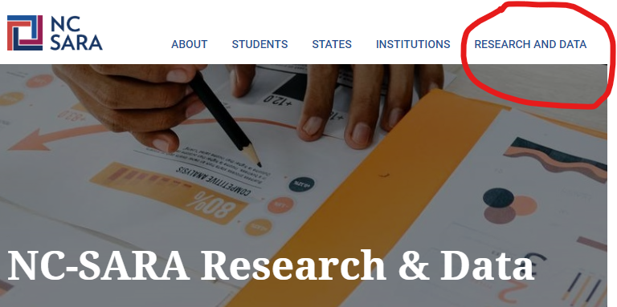
Where to Access the SARA Data?
Notes:
Rachel

Slide 8
NC-SARA’s Data Dashboards
Notes:
Just show where the Data Dashboards are, no time for a demo this time.
Mention what is new this year. – 2 vs 4 year, more filters on the raw reports.

Slide 9
Methodology
Notes:
RC

Slide 10
Methodology
SARA Data Reporting Window is May 15 – June 15 each year
2,428 Institutions were sent email requests to report
25 exemptions were extended
23 non-renewals or institutional closures
1 joined near the end of 2023
1 exemption given due to extreme staff shortage
0 institutions did not report
Notes:
RC
2,428 Institutions were sent email requests to report
25 exemptions were extended
23 non-renewals or institutional closures
1 joined near the end of 2023
1 exemption given due to extreme staff shortage
0 institutions did not report

Slide 11
Improved Communications & Refined OOSLP Guidance
Adjusted SARA Portal settings to ensure invitation to report and all reminders were received even if prior emails had bounced.
Emailed contacts at institutions where over 50 total EDEE were reported, but zero in-state EDEE were reported.
Clarified OOSLP reporting guidance to request that each placement a students participated in was reported, even if it was in the same state and CIP program area.
Notes:
RC Three Improvements in Methodology this year.
Adjusted SARA Portal settings to ensure invitation to report and all reminders were received even if prior emails had bounced.
Emailed contacts at institutions where over 50 total EDEE were reported, but zero in-state EDEE were reported.
Clarified OOSLP reporting guidance to request that each placement a students participated in was reported, even if it was in the same state and CIP program area.

Slide 12
Participating SARA Institutions

Slide 13
Number of Reporting Institutions
2015-2023
Notes:
TTS
15% increase in # of institutions 2019-2023.

Slide 14
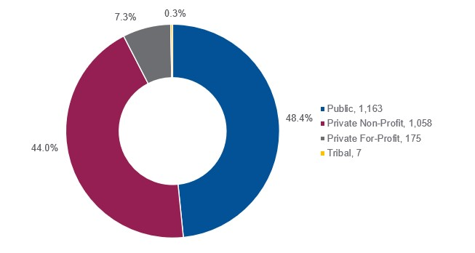
Reporting Institutions by Sector for 2023
2,403 Reporting Institutions
Notes:
Terri—Public institutions are consistently nearly half of all participating institutions.

Slide 15
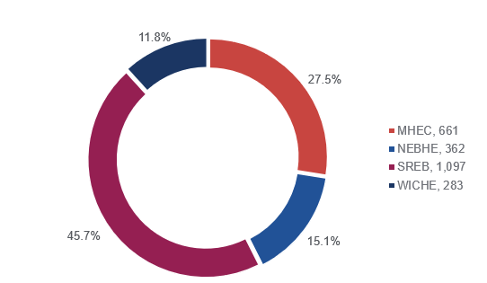
Reporting Institutions by Regional Compact for 2023

Slide 16
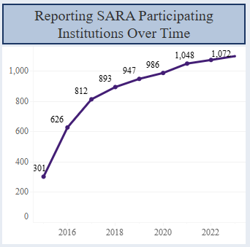
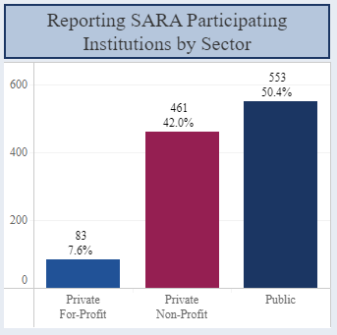
SREB Reporting Institutions & Sector Analysis for 2023
Explore the interactive data dashboards: https://nc-sara.org/data-dashboards
Private For-Profit 7.6%
Private Non-Profit 42.0%
Public 50.4%

Slide 17
Number of Institutions in SREB States for 2023
* SARA Affiliate, not full member

Slide 18
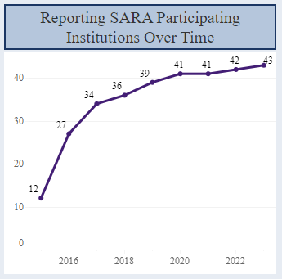
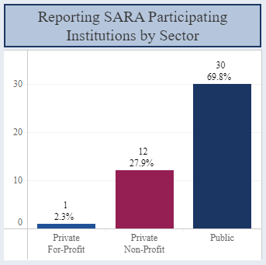
AL Reporting Institutions & Sector Analysis
Explore the interactive data dashboards: https://nc-sara.org/data-dashboards
Private For-Profit 2.3%
Private Non-Profit 27.9%
Public 69.8%

Slide 19
2023 Exclusively Distance Education Enrollment (EDEE)

Slide 20
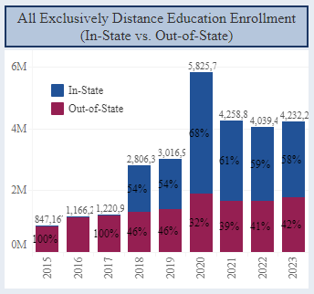
Total Reported In-State and Out-of-State EDEE 2015-2023

Slide 21
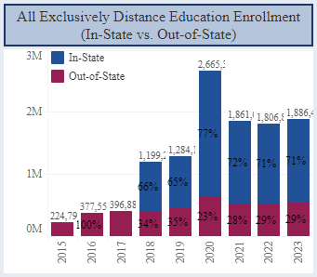
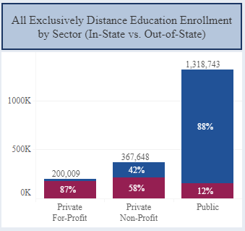
SREB Total EDEE & Sector Trends for 2023
Explore the interactive data dashboards: https://nc-sara.org/data-dashboards

Slide 22
In-State and Out-of-State EDEE in SREB States for 2023
Alabama:
In-state EDEE = 49,598
Out-of-state EDEE = 32,549
* SARA Affiliate, not full compact member

Slide 23
State Proportion of SREB EDEE for 2023
(out-of-state only)
* SARA Affiliate, not full compact member

Slide 24
Out-of-State EDEE and Institutions by Sector for 2023
Notes:
Terri
Make the point that SARA is about out-of-state distance education activity

Slide 25
Total SREB EDEE & Institution by Sector for 2023
Alabama Total EDEE:
Public 14,558
Non-Profit 16,593
For-Profit 1,397

Slide 26
Reported SARA & Non-SARA State’s EDEE 2019-2023
(out-of-state enrollment only)
Notes:
Mention 1.6 million – up 100k from last year.

Slide 27
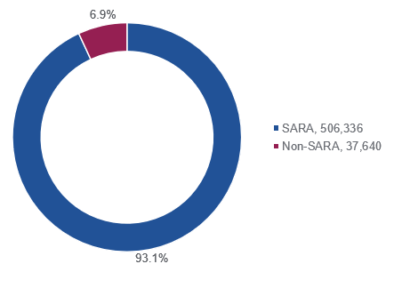
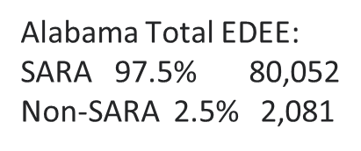
SREB & AL Reported SARA & Non-SARA State’s EDEE for 2023
(out-of-state enrollment only)

Slide 28
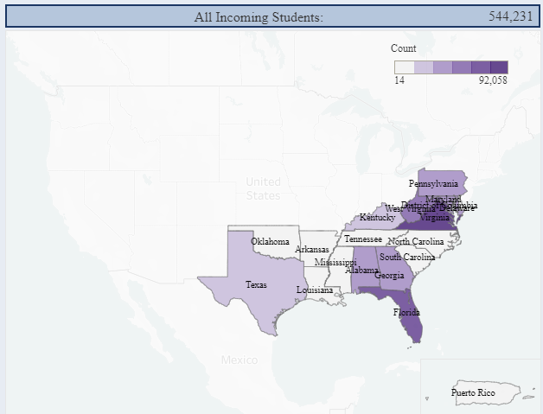
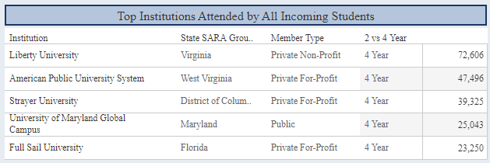
SREB Incoming EDEE Map for 2023
Explore the interactive data dashboards: https://nc-sara.org/data-dashboards

Slide 29
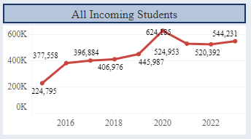
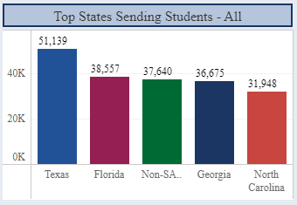
SREB Incoming EDEE for 2023
Explore the interactive data dashboards: https://nc-sara.org/data-dashboards

Slide 30
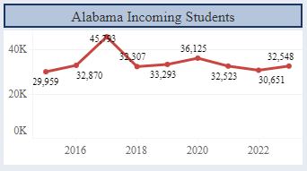
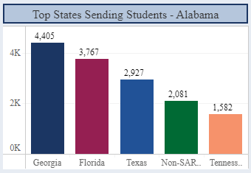
Alabama Incoming EDEE for 2023
Explore the interactive data dashboards: https://nc-sara.org/data-dashboards

Slide 31
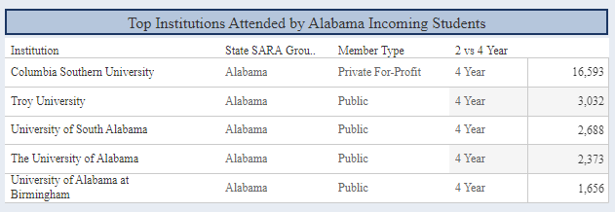
Alabama Incoming EDEE for 2023
Explore the interactive data dashboards: https://nc-sara.org/data-dashboards

Slide 32
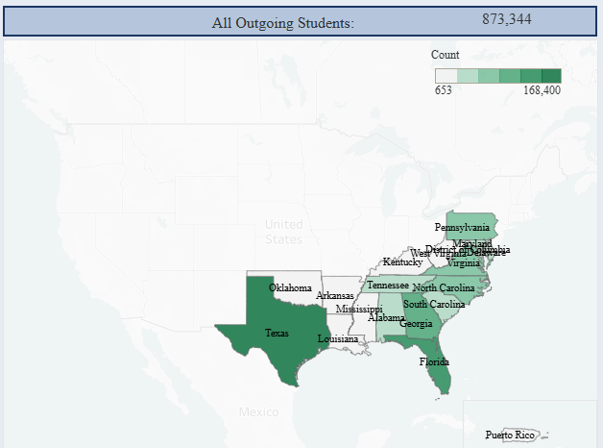
SREB Outgoing EDEE Map for 2023
Explore the interactive data dashboards: https://nc-sara.org/data-dashboards

Slide 33
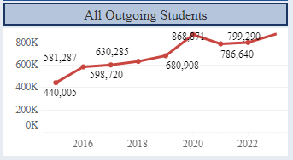
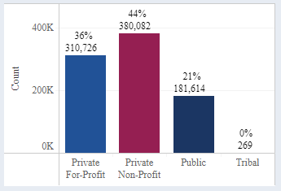
SREB Outgoing EDEE for 2023
873,344
2023
Private For-Profit 36%
Private Non-Profit 44%
Public 21%
Tribal 0%
Explore the interactive data dashboards: https://nc-sara.org/data-dashboards

Slide 34
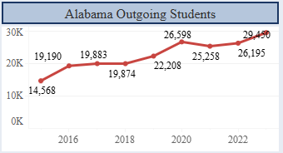
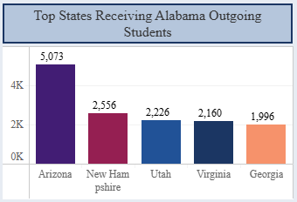
Alabama Outgoing EDEE for 2023
Explore the interactive data dashboards: https://nc-sara.org/data-dashboards

Slide 35
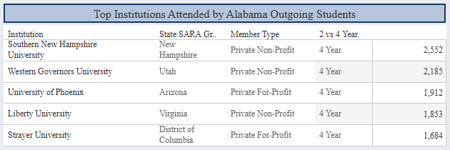
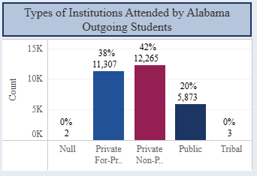
Alabama Outgoing EDEE for 2023
Explore the interactive data dashboards: https://nc-sara.org/data-dashboards
Private For-Profit 38%
Private Non-Profit 42%
Public 20%
Tribal 0%

Slide 36
2023 Out-of-State Learning Placements

Slide 37
Out-of-State Learning Placements (OOSLP)
What are OOSLP?
Learning placements are on-ground, out-of-state experiential learning activities
OOSLP include clinical rotations, student teaching, internships, and other similar
activities
OOSLP are often a required part of obtaining a degree and/or license to
practice a particular profession
Note that reporting includes on-ground students as well as distance education
students
Notes:
Rachel

Slide 38
Total Reported Out-of-State Learning Placements 2020-2023

Slide 39
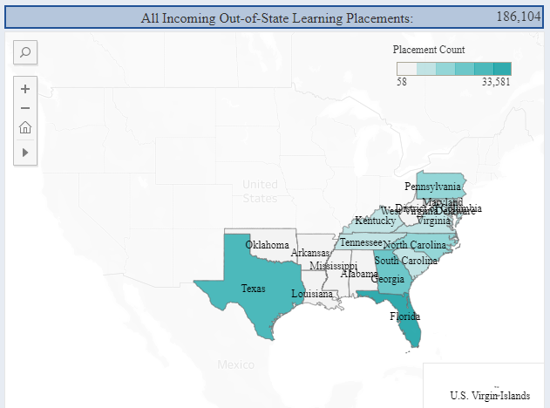
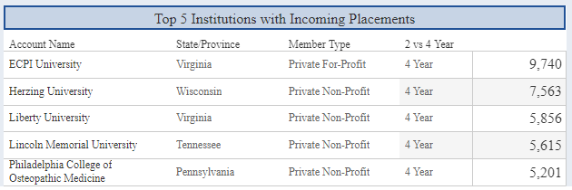
SREB Incoming Out-of-State Learning Placements Map
Explore the interactive data dashboards: https://nc-sara.org/data-dashboards

Slide 40
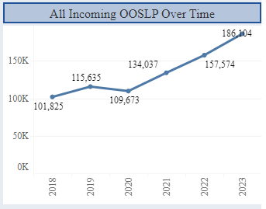
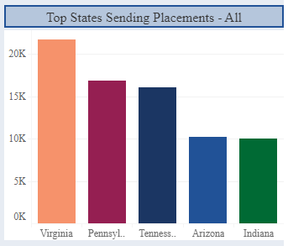
SREB Incoming Out-of-State Learning Placements
Explore the interactive data dashboards: https://nc-sara.org/data-dashboards

Slide 41
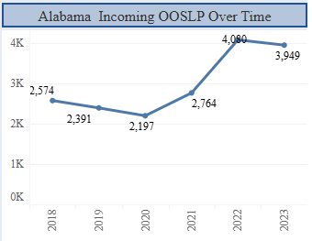
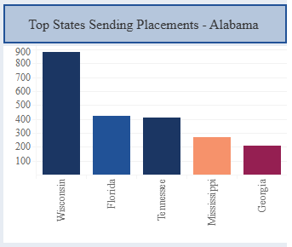
Alabama Incoming Out-of-State Learning Placements
Explore the interactive data dashboards: https://nc-sara.org/data-dashboards

Slide 42
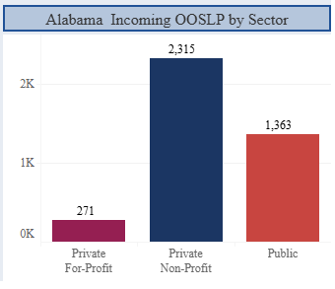
Alabama Incoming Out-of-State Learning Placements
Explore the interactive data dashboards: https://nc-sara.org/data-dashboards
Private For-Profit 6.9%
Private Non-Profit 58.6%
Public 3.5%
Tribal 0%

Slide 43
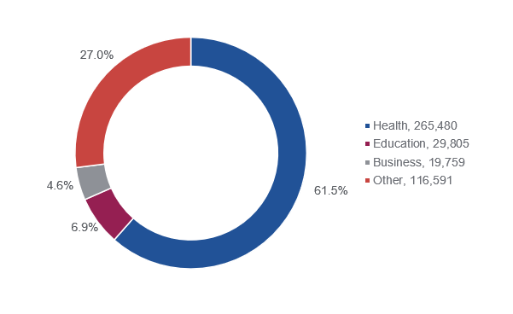
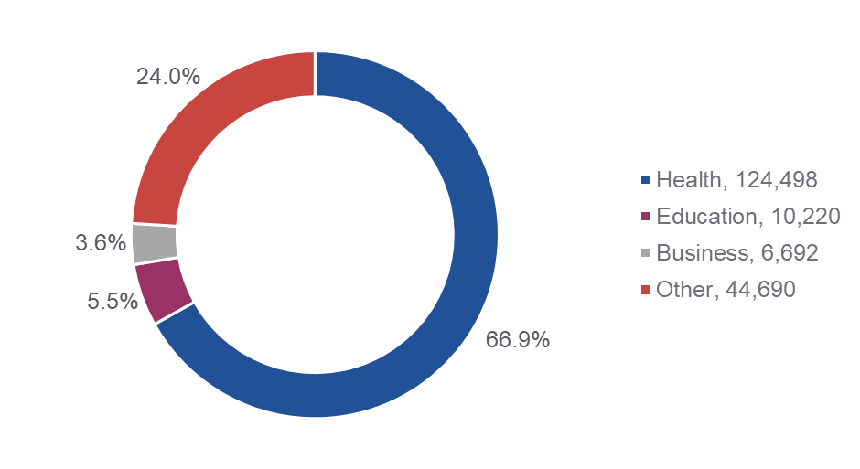
Out-of-State Incoming Learning Placements Reported
by CIP Code Program Areas for 2023
Total Incoming OOSLP
SREB Incoming OOSLP

Slide 44
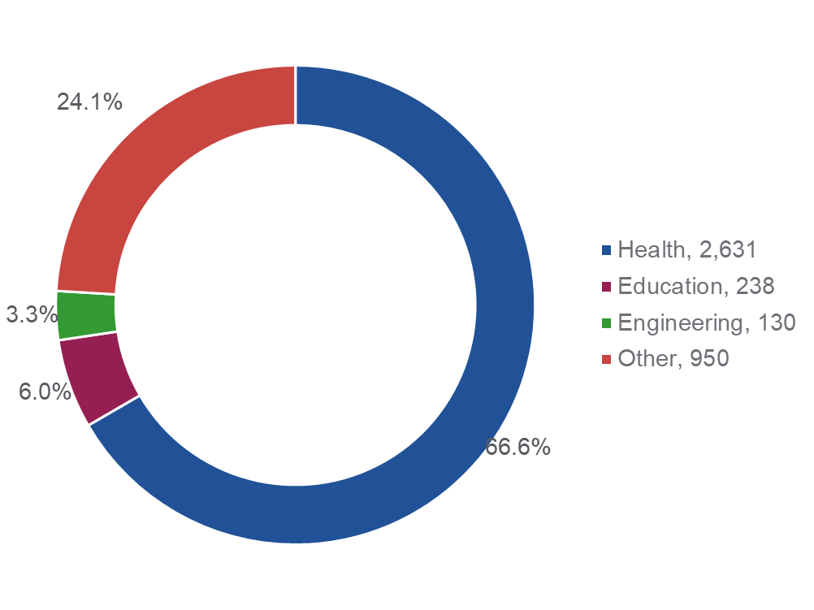
Alabama Out-of-State Incoming Learning Placements Reported
by CIP Code Program Areas for 2023

Slide 45
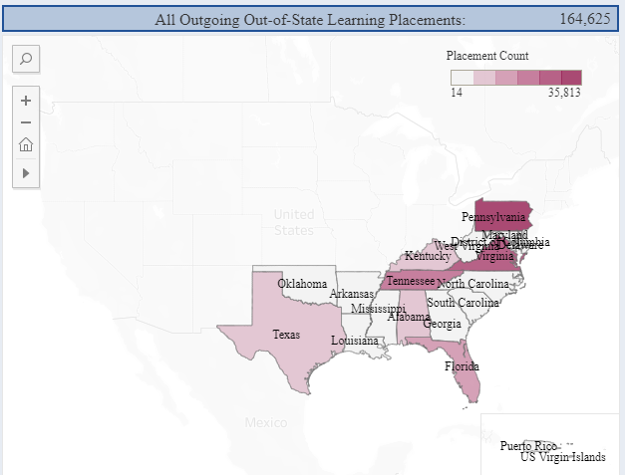
SREB Outgoing Out-of-State Learning Placements Map
Explore the interactive data dashboards: https://nc-sara.org/data-dashboards

Slide 46
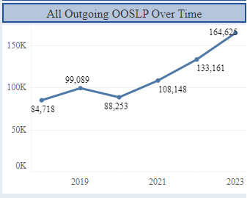
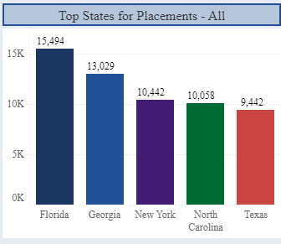
SREB Outgoing Out-of-State Learning Placements
Explore the interactive data dashboards: https://nc-sara.org/data-dashboards

Slide 47
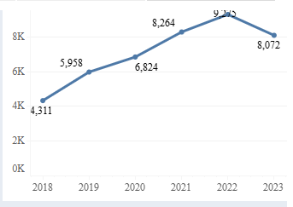
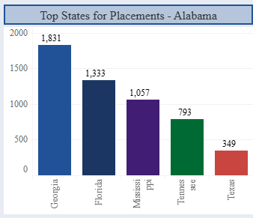
Alabama Outgoing Out-of-State Learning Placements
Explore the interactive data dashboards: https://nc-sara.org/data-dashboards

Slide 48
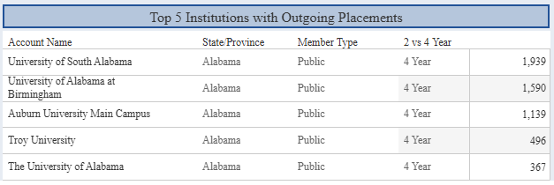
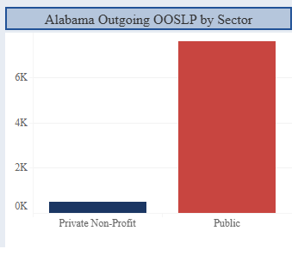
Alabama Outgoing Out-of-State Learning Placements
Explore the interactive data dashboards: https://nc-sara.org/data-dashboards
Private For-Profit 0%
Private Non-Profit 94%
Public 6%
Tribal 0%

Slide 49
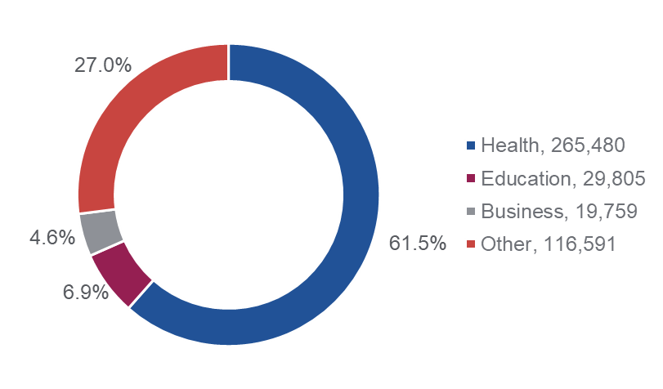
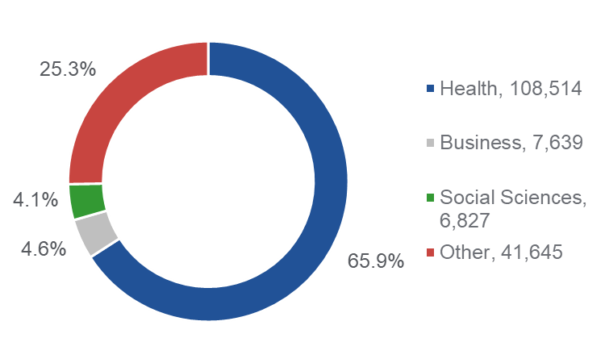
Out-of-State Outgoing Learning Placements Reported
by CIP Code Program Areas for 2023
SREB Outgoing OOSLP
Total Outgoing OOSLP

Slide 50
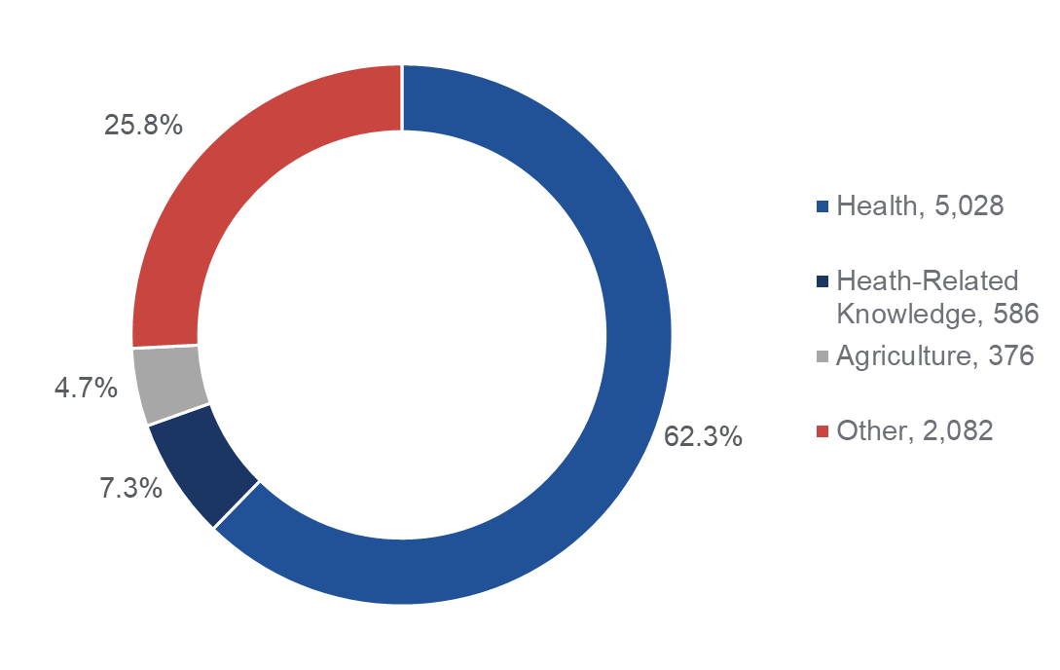
Alabama Out-of-State Outgoing Learning Placements Reported
by CIP Code Program Areas for 2023

Slide 51
NC-SARA’s Data Dashboards

Slide 52
How You Might Use the SARA Data
Nine years of reported EDEE and six years of OOSLP data are available
The data describe the distance education landscape in your state or region
They hold historical trends and may provide insights that could inform key
decisions about distance education offerings
Consider how these data may be used as your institution plans for new distance education programs to meet student needs and institutional goals

Slide 53
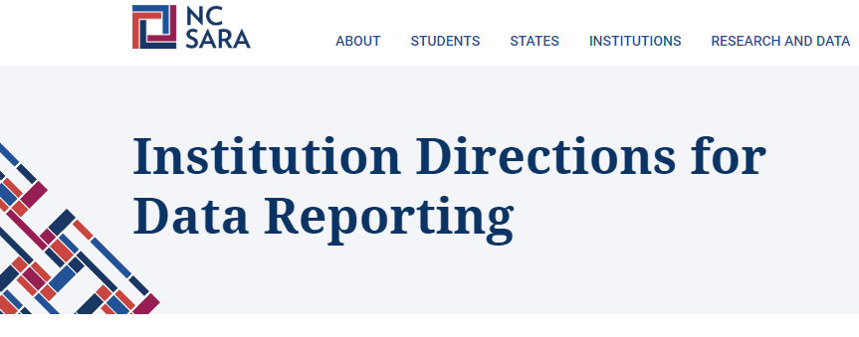
NC-SARA’s Resources for Data Reporting
Notes:
First: A one-stop-shop at the Institution Directions for Data Reporting – you can find all your resources there including:
--Data Reporting Handbook
--Quick Start Guide on Data Reporting
--Free Online course: Foundations of NC-SARA Annual Data Reporting
--Webinar Recordings
Make sure to check out SARA Learning Station for our other SARA-related resources including the online course SARA 101!

Slide 54
Changes for 2025 Reporting

Slide 55
Huge Thanks to Our Pilot Institutions
Notes:
RC

Slide 56
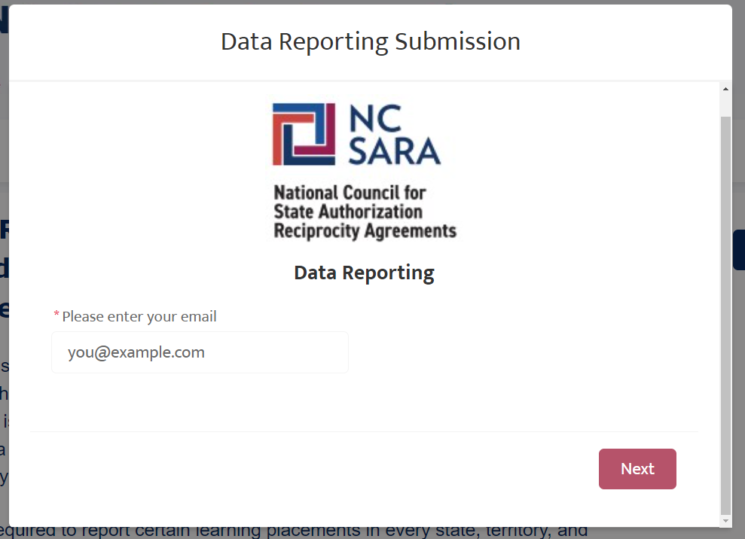
Changes for 2025 Data Collection
Contact Verification
Only users assigned as an institutional contact in Salesforce will be able to upload data.
Users not in Salesforce will need to be verified by a current Salesforce contact for their institution (then entered by NC-SARA staff).
Data reporting portal will be one public link, rather than individual institution links.
Contacts for multiple institutions will be able to select the institution to submit for.
Notes:
Rachel
UPDATE YOUR CONTACTS NOW!!

Slide 57
Changes for 2025 Data Collection
File Upload vs. Manual Entry
Users will be provided with two templates to compile their EDEE and OOSLP data.
Data will be upload in a .csv file, rather than manually entered in the web form.
Institutions will be given the chance to confirm data and resubmit a file in case of errors.
Confirmation emails will include counts and submitter name.
Users will easily see when they have a submission outstanding.
Notes:
Rachel then turn to Terri to briefly talk about Resources.

Slide 58
All Resources will be updated for 2025 by the end of January.
Notes:
Terri

Slide 59
Important Annual Data Reporting Dates
2023 Data Release: October 3, 2024
2024 Annual Data Handbook Available: January 2025
2024 Annual Data Collection Webinar: March 2025
2024 Annual Data Collection Window: May 15 – June 15, 2025
Notes:
Terri
Also mention changes for next year to improve security and ease of use.
All materials will be updated on the NC-SARA website by the end of January.
We will provide updates via the Institution Newsletter (which Jared is about to drop any time now).

Slide 60
Questions and Discussion

Slide 61
For questions please email: data@nc-sara.org NC-SARA Website: www.nc-sara.org
Thank You!

