Slide 1
Alabama SARA Meeting
Columbia Southern University
November 22, 2024
Elisa Jaden, Ed.S.
Regional SARA Director
Postsecondary Access and Student Success

Slide 2
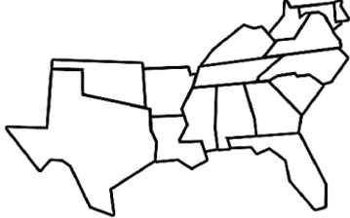
SREB Operates as:
    Largest Compact
      The most states
      The most institutions
    16 original member states
    4 affiliates (solely for SARA)
      Pennsylvania
      District of Columbia
      Virgin Islands
      Puerto Rico

Slide 3
SREB SARA Operates as:
SARA is a voluntary program for both states and institutions that participate.
SARA membership versus SARA Participation.
States gain SARA membership through their regional compact membership, while institutions can participate in SARA through membership in their state agencies that facilitate SARA, as long as the state is a member of one of the four regional education compacts.
States renew SARA membership every two years and institutions renew SARA participation annually.

Slide 4
S-SARA RSC Operates as:
The SREB SARA Regional Steering Committee (S-SARA RSC) consists of the SPEs from SREB’s 16 member states and its 4 affiliates, as well as 5 at-large members that represent various higher education sectors and SARA stakeholders:
Large Online 4-year
Two-year
Private and Vocational
Higher Education Policy Consultant
SREB’s RSC includes both the states and institutions’ voices in conversations and votes regarding SARA matters.

Slide 5
SREB’s 5 Priorities

Slide 6
SREB’s Priority Work
AI in Education
Career Pathways and Credentials
Educator Workforce
Longitudinal Literacy
Student Success in Postsecondary

Slide 7
AI in Education
The SREB Commission on Artificial Intelligence in Education will evaluate research, industry data, and advice from experts to determine how education can successfully adopt and integrate AI across the region and lead the nation.

Slide 8
Our Charge
Based on this critical evaluation, the Commission will then develop recommendations for:
  Policies regarding the use of AI in K-12 and postsecondary education,
  The use of AI in instruction to promote AI literacy among students, educators, and the workforce, and
  The development of skills and seamless pathways in the education-to-workforce system to meet industry and state needs.

Slide 9
Commission Focus:
AI in Education integrates artificial intelligence technologies to enhance learning, teaching, and leading.
AI equips students with the skills to use it in a digitally driven future, solving complex problems and personalizing learning.
AI in education advances efficiency, effectiveness, and accessibility, mitigating disparities in an ethical manner without losing the human element of learning.
Notes:
Building an Initial Definition

Slide 10
AI Commission Subcommittees
K-12 AI Policies
PSE AI Policies
K-12 AI Instruction
PSE AI Instruction
AI Skill Development

Slide 11
Career Pathways and Credentials
Career pathways provide students of all ages opportunities to gain knowledge and skills needed to achieve personal goals and earn industry-valued credentials.

Slide 12
Defining SREB Career Pathways
SREB Career Pathways connect elementary, secondary, and postsecondary education and training with rigorous and high-quality learning experiences.
Based on research and past experiences, SREB has identified six essential elements of career pathways that support workforce needs and thriving economies.
Notes:
Explain the definition. Explain why we need a SREB definition.

Slide 13








Key Elements of Career Pathways
Alignment
Data Analysis, Research and Evaluation
College and Career Readiness
Stackable Credentials
Systems of Guidance and Support
Employment, Continuing Education, and Career Advancement

Slide 14
Programs of Study
SREB Career Pathways
Elementary School
Middle School
High School Diploma and Related Certifications
Certificate Program
Associate Degree
Bachelor’s Degree
Additional Credentials
Progression of Skills and Knowledge
Appropriate WBL Experiences
Career Awareness
Career Exploration
Employment
Career Advancement

Slide 15
Educator Workforce
To sustain our economy, we must have great teachers and school leaders to fully prepare the next generation of leaders, entrepreneurs and workers.

Slide 16
Educator Workforce cont’d
SREB is laying the groundwork to become a national leader in solving the complex issue of building and maintaining a first-rate educator workforce.

Slide 17


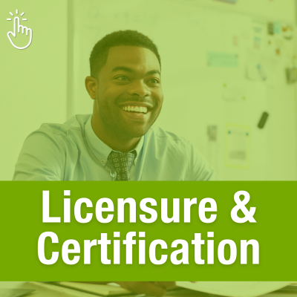
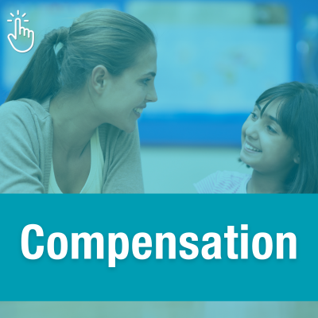
SREB’s Educator Workforce Blueprint
Pathways & Preparation
Professional Supports
A variety of entry points into teaching that share common high standards
Quality mentorship and induction for novice teachers and leaders
A variety of quality professional learning
Preparation programs attuned to teachers’ real-life needs, such as classroom management and the science of reading
The flexibility, time, resources and support staff needed for teachers and their students to succeed
Licensure & Advancement
Compensation
Licensure systems that scaffold strategic roles based on teachers’
Salary structures that are strategic and reward teachers’ skills, knowledge, impact and leadership
Health and retirement benefits that are high-quality and affordable
Other recognitions and incentives
skills, competencies and impact — and align with
pay and ongoing support
Certification for levels from pre-service to advanced teacher-leadership roles

Slide 18
Longitudinal Literacy
Longitudinal literacy understands literacy as a continuous journey, with each stage playing a crucial role in shaping personal and professional success. Addressing literacy needs at every life stage—from preschool to adulthood—aims to equip individuals with the skills needed to succeed in education, contribute to their communities, and ultimately support national economic growth.

Slide 19
Defining Longitudinal Literacy
Longitudinal Literacy is a lifelong approach to learning that views literacy as a progression through three interconnected skills: comprehending, processing, and applying information.
This journey spans from early childhood to adulthood, recognizing that literacy development extends far beyond early education.

Slide 20
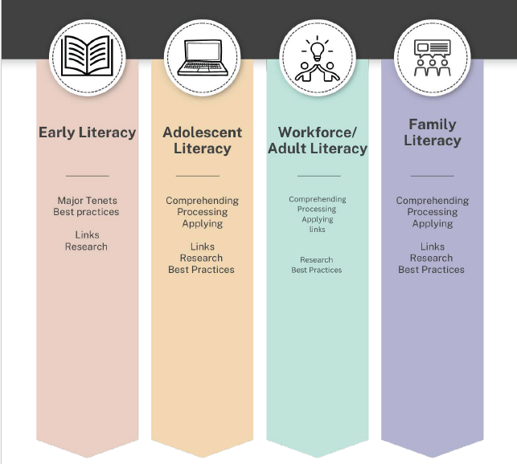
Longitudinal Literacy Continuum
Notes:
Add comments from committee
When we hear the word literacy we immediately think of early childhood, early elementary focus on reading, writing, listening and speaking. Many states in our region have developed and implemented strong policy emphasizing the need to be able to read by third grade. But does literacy stop there?
SREB believes that literacy is a lifelong, critical skill that evolves throughout pk-12 grade, postsecondary and into families and workforce. We all understand that within our biggest priorities – those we have talked about this weekend - teacher workforce, Artificial intelligence, Pathways, and overall student success – literacy is the foundational skill.
So let’s see how literate we are.
In the next few examples I want you to identify what content or occupation this is and what level would you use this – secondary, postsecondary or work force.

Slide 21
Student Success in Postsecondary – A Framework

Slide 22
Why a Framework for Student Success?
Increase Access for All Students
Support Completion and Persistence
Align Education with Workforce Needs
Facilitate Seamless Transitions
Data-Driven Strategies
Strengthen Economic Outcomes
Holistic Student Support

Slide 23
Student Success Defined
The Southern Regional Education Board defines Student Success as access to and completion of postsecondary credentials that lead to lifelong learning, fulfilling careers, and stronger economies. SREB has identified four pillars as the foundation of the framework for Student Success — access, persistence, retention and attainment.

Slide 24
The 4 Pillars Defined
Access | Postsecondary access refers to the capacity of all institutional stakeholders to prepare students to pursue and succeed in education beyond high school, encompassing awareness of various options, entry requirements and processes, and affordability.
Persistence | Postsecondary persistence emphasizes individual agency and goal- oriented progress towards personal goals in an aligned and transparent system by actively engaging with resources and supports.
Retention | Postsecondary retention is providing students with tools and services that enable them to complete their intended courses of study, including streamlined processes, robust support services, comprehensive learning environments, clear academic and career pathways, and proactive monitoring and support of each student’s progress.
Attainment | Attainment refers to the completion of postsecondary education and training, including certificates, degrees, and work-based experiences, to prepare individuals for fulfilling careers and foster a diverse, skilled workforce.

Slide 25
For more information on:
SREB’s 5 Priorities
Stephen Pruitt
President
Stephen.Pruitt@sreb.org
SREB SARA
Elisa Jaden
Regional SARA Director
Elisa. Jaden@sreb.org

