Slide 1

Alabama Commission on Higher Education
Commission Meeting
June 12, 2026

Slide 2



I. Call to Order, Prayer,
and Pledge of Allegiance

Slide 3

II. Roll Call and
Quorum Determination

Slide 4

III. Approval of Agenda
Commission Meeting Agenda
of June 12, 2026

Slide 5
Motion, Item III:
That the Commission accept the agenda for the June 12, 2026, meeting.

Slide 6

III. Approval of Agenda
Commission Meeting Agenda
of March 13, 2026

Slide 7
Motion, Item IV:
That the Commission accept the Commission Meeting Minutes for the March 13, 2026, meeting.

Slide 8
V. Consideration of
Special Meeting Minutes
Special Meeting Minutes of
May 7, 2026

Slide 9
Motion, Item V:
That the Commission accept the Special Meeting minutes for the May 7, 2026, meeting.

Slide 10

VI. Chairman’s Report

Slide 11

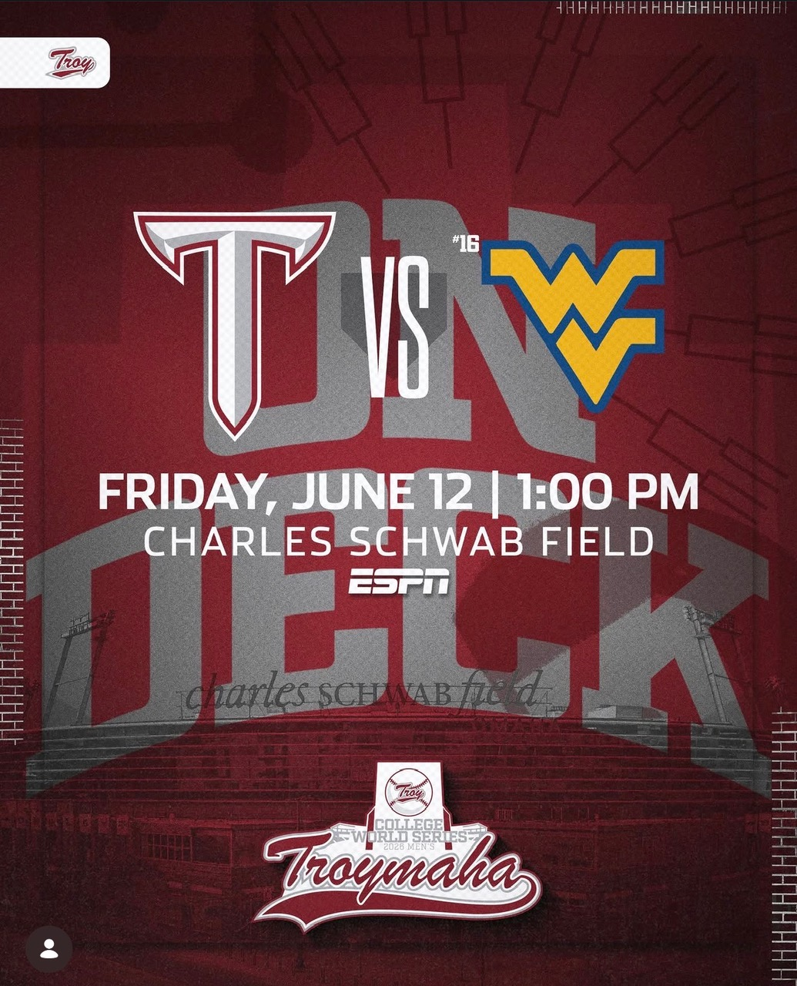


Slide 12
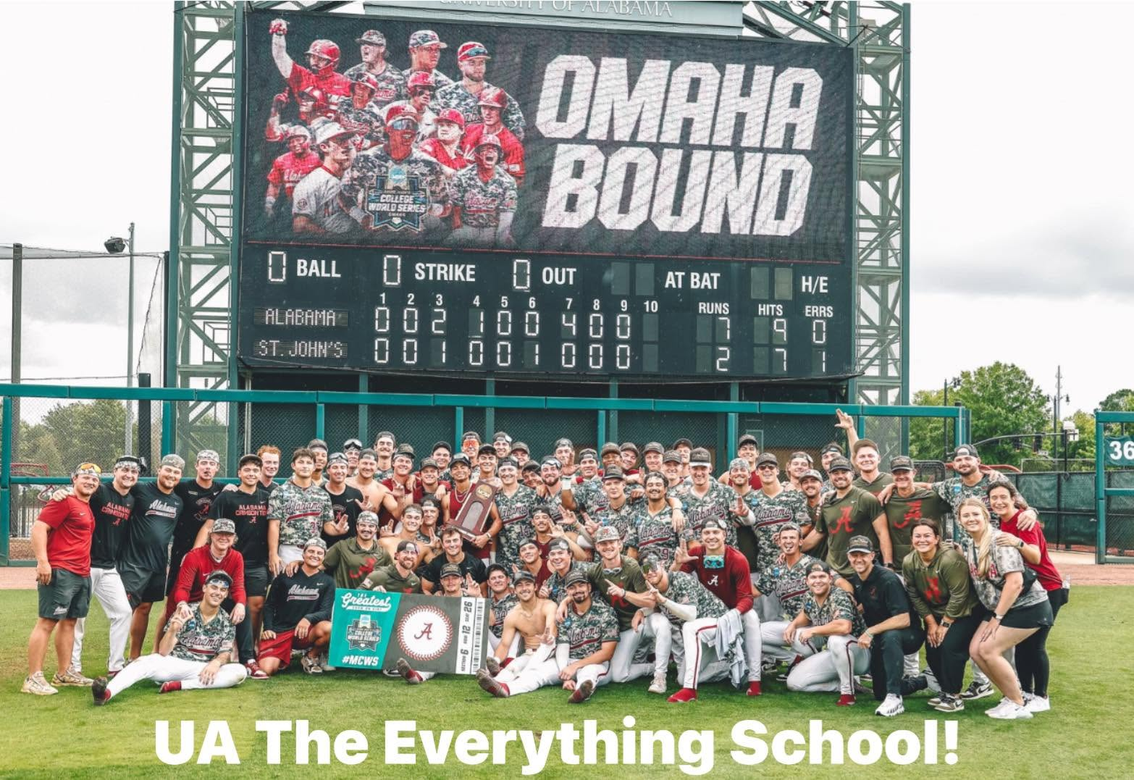

Slide 13
The CWS begins June 12 and could last until June 22.
Game 1: No. 16 West Virginia vs. Troy, 1 p.m., June 12 (ESPN)
Game 2: No. 5 North Carolina vs. Ole Miss, 6 p.m., June 12 (ESPN)
Game 3: No. 7 Alabama vs. Oklahoma, 2 p.m., June 13 (ESPN)
Game 4: No. 3 Georgia vs. No. 6 Texas, 7 p.m., June 13 (ESPN)
*All game times are listed in Central Time (CT).

Slide 14

VII. Executive Director’s Report

Slide 15

2026 ACHE Research Fellows
and Summer Interns

Slide 16
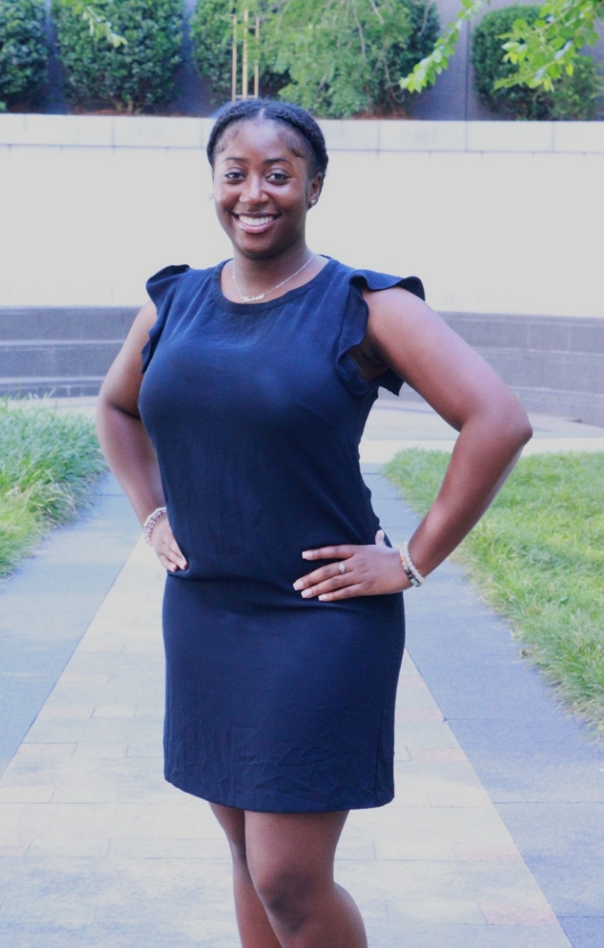
Research Fellow Victoria Johnson
Victoria Johnson is a recent 2026 graduate of Tennessee State University, where she earned a B.S. in Biology with a minor in Chemistry. During her senior year as an undergraduate, she worked with ACHE in a data entry role, assisting with grant input and administrative support during the summer and winter breaks. In Summer 2026, she began her first term as a Research Fellow, contributing to higher education research and policy initiatives. As an aspiring Obstetrician-Gynecologist, Victoria is passionate about advancing women's health and improving access to quality healthcare. She plans to matriculate into medical school in Fall 2028 and is committed to a career centered on patient care, advocacy, and medical excellence.

Slide 17
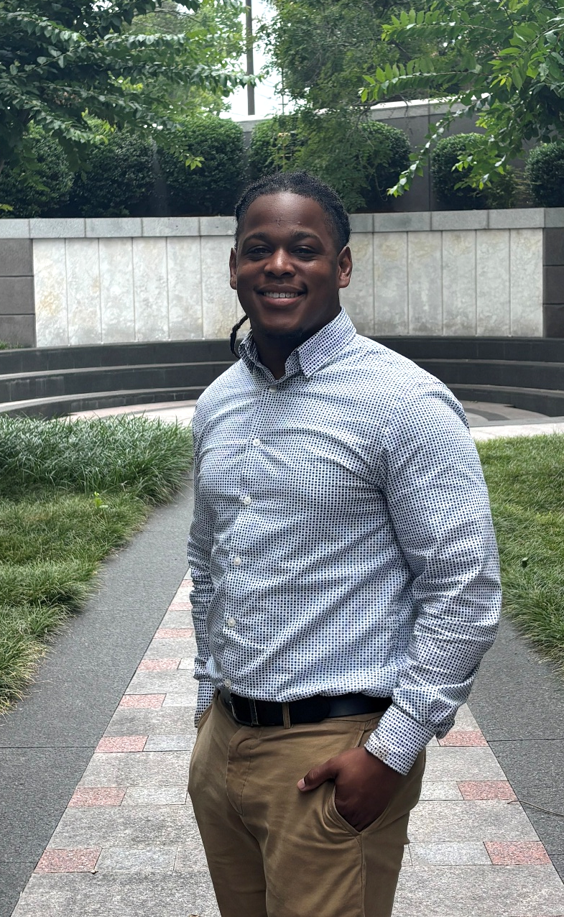
Research Fellow Dailan Green
Dailan Green, a graduate of Alabama State University with a double major of business management and finance, is an information technology professional and educator with experience in technical support, cybersecurity, and technology education. He is passionate about analytical problem-solving and emerging technologies, with interests in cybersecurity, cloud computing, and artificial intelligence. Dailan enjoys continuous learning and solving complex problems, continuously learning and exploring innovative ways technology can create meaningful impact for individuals, organizations, and communities.

Slide 18
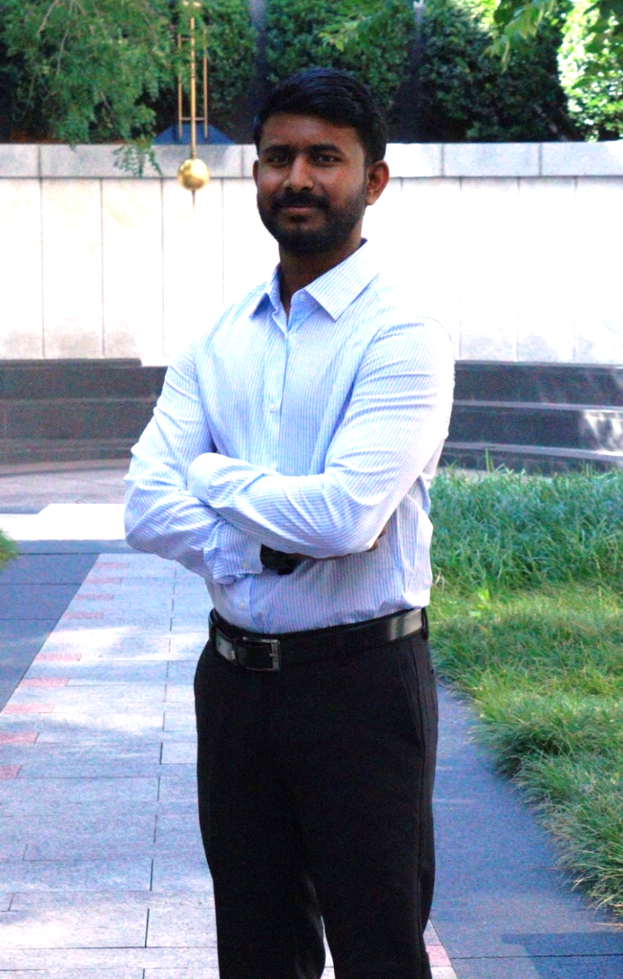
Power BI Developer Nagesh Bachanagoni
Nagesh recently joined ACHE as a Power BI Developer. Originally from India, he is the first member of his family to pursue higher education abroad. Nagesh holds bachelor’s and master’s degrees in Computer Science and has experience in data analytics, database management, Python programming, GIS, and data visualization. Prior to joining ACHE, he worked as a Data Analyst with UST Global, specializing in Microsoft technologies such as Power BI, Power Apps, Power Automate, and SharePoint. Nagesh is passionate about business intelligence, automation, and artificial intelligence, with a goal of becoming a full-stack data professional specializing in database engineering and advanced Power BI development. Outside of work, he enjoys playing chess, badminton, and table tennis, spending time with friends, and exploring new technologies.

Slide 19
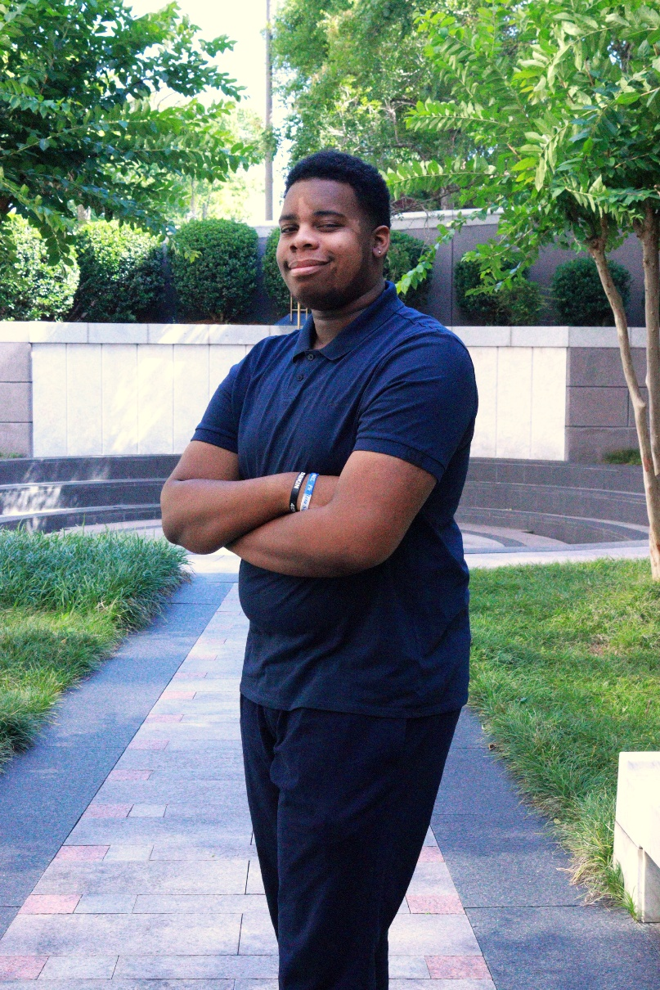
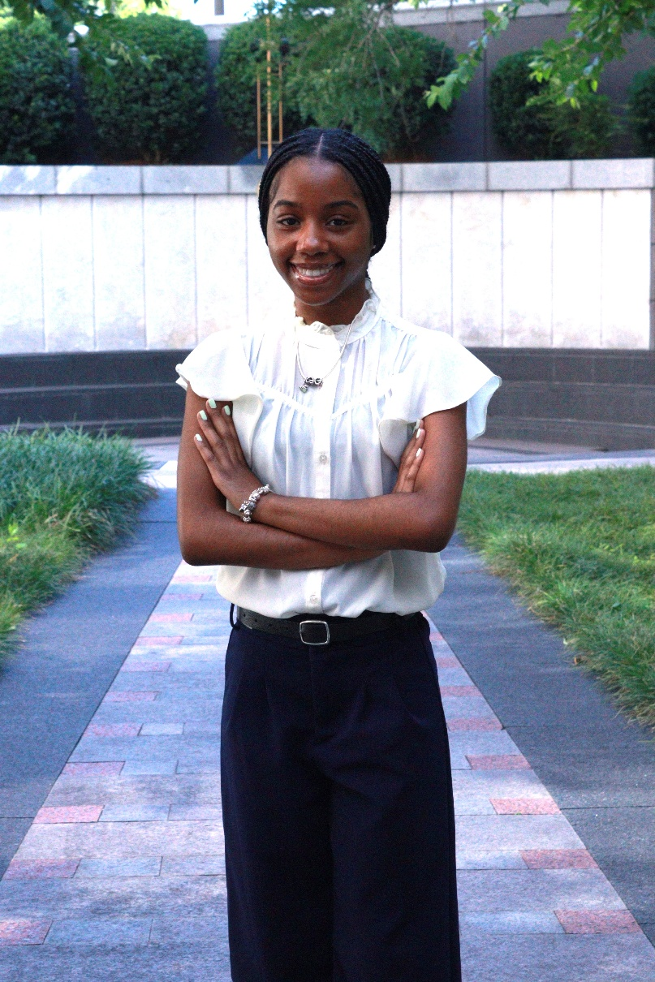
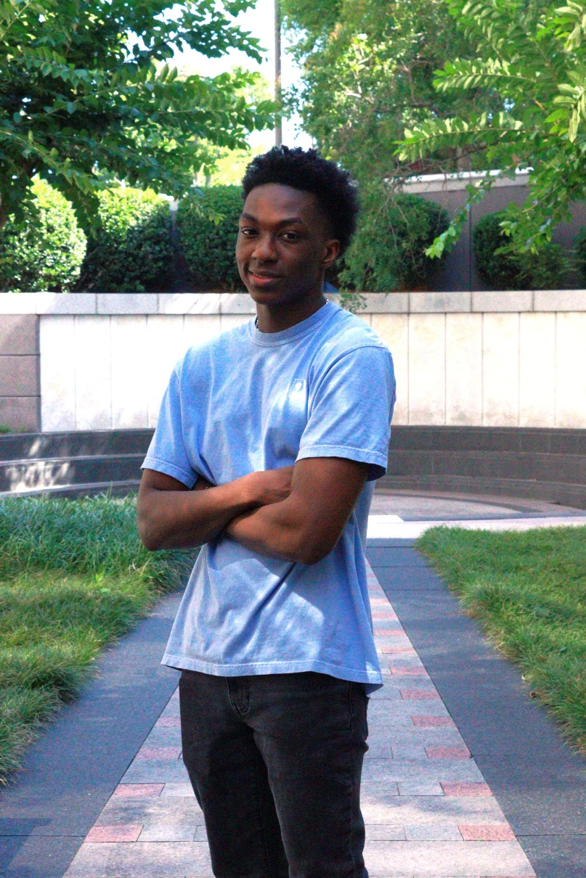
2026 ACHE Summer Interns
Duane Jon (DJ) Harris
Returning
Auburn University at Montgomery
Senior
Computer Science
Grace Lewis
Returning
Savannah State University
Senior
Computer Science
Daniel Pettway
Returning
Auburn University
Junior
Graphic Design

Slide 20
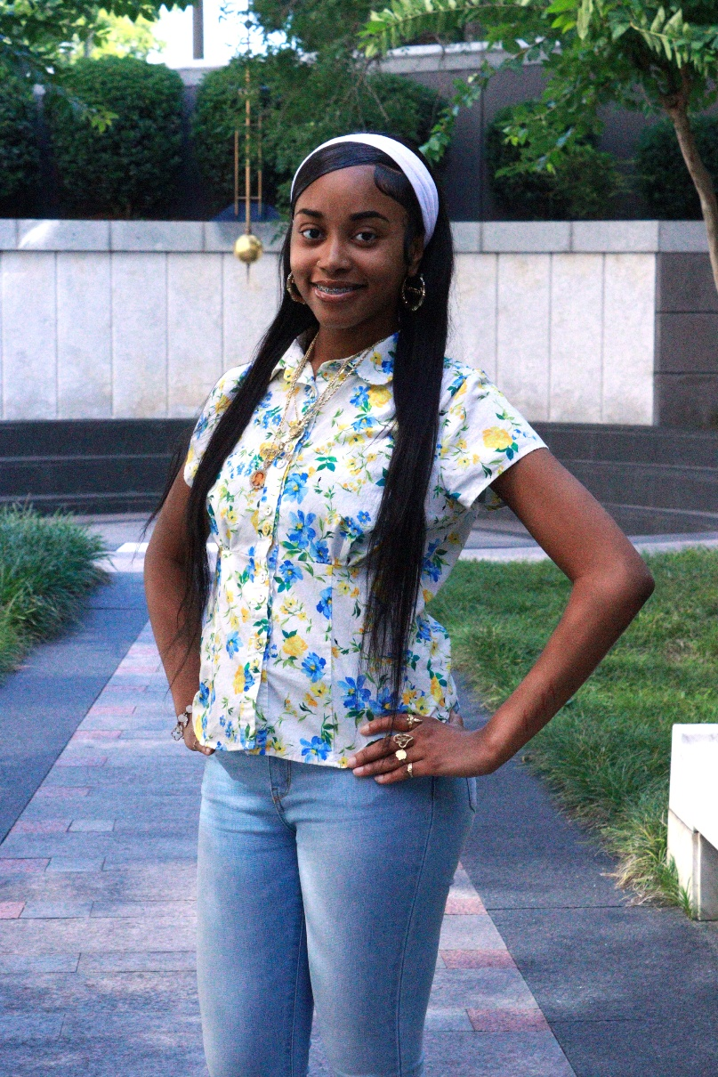

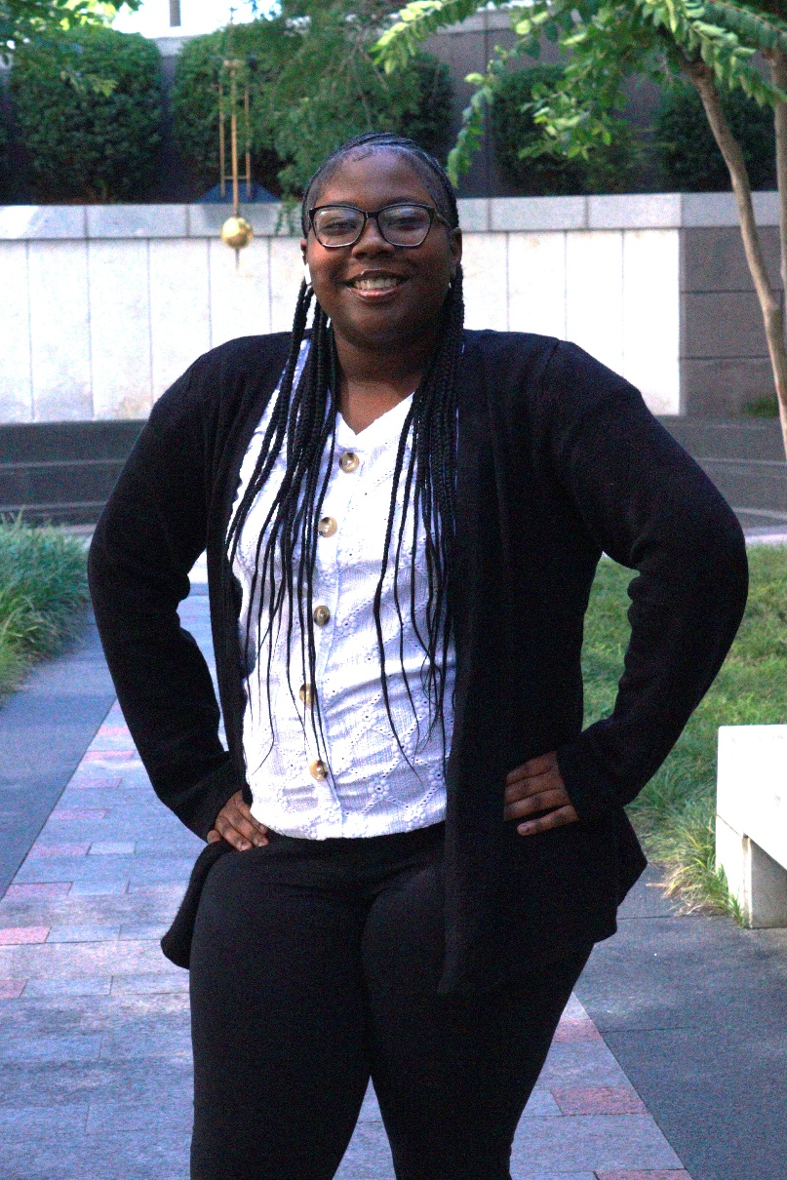
2026 ACHE Summer Interns
Harmoni Harris
New
University of Alabama at Birmingham
Sophomore
Nursing
Kelis Ward
New
Marion Military Institute
Freshman
Leadership Education
Alissa Smith
New
Booker T. Washington Magnet High School
H.S. Junior
Future Major: Education

Slide 21
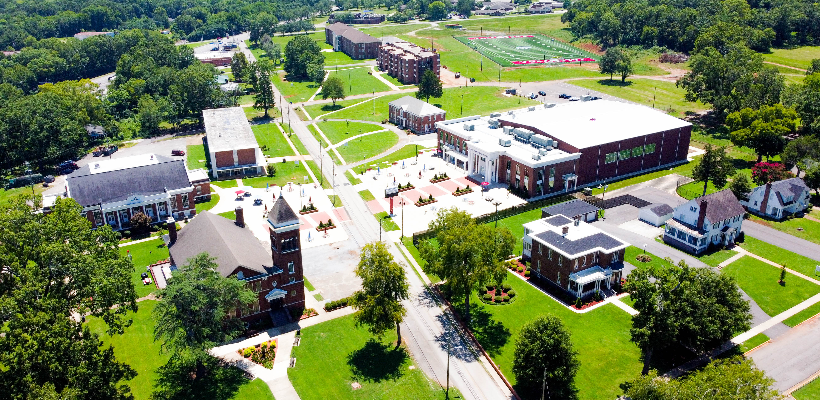
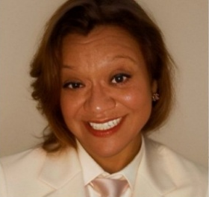
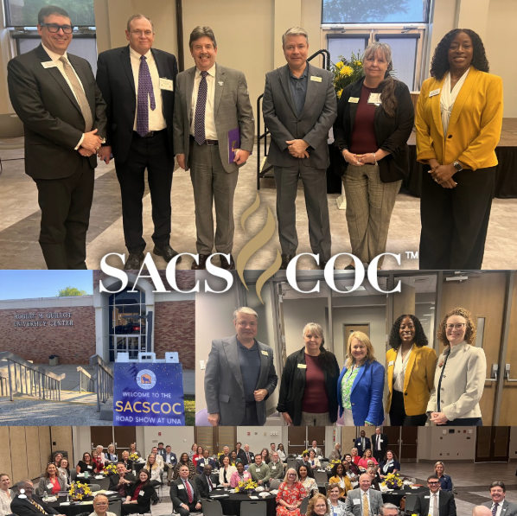
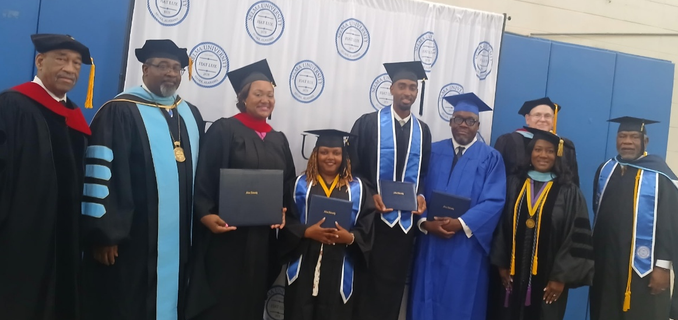
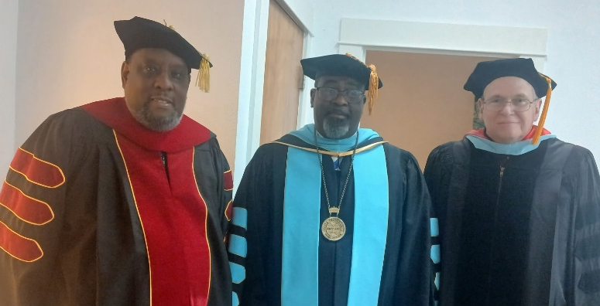
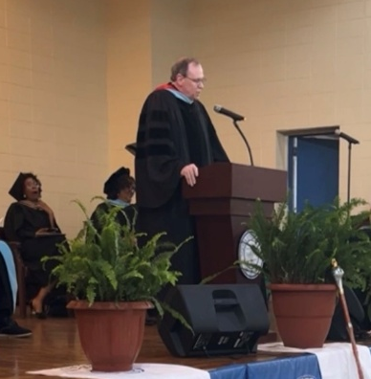
Margie Velma, Amazon Web Services
Trustee for Talladega College
April 29-30, 2026
SACSCOC Roadshow
University of North Alabama
April 21-22, 2026
Selma University Commencement
University of North Alabama
May 8, 2026

Slide 22

Three ways to get involved:
  Speak on a Panel: Contribute your perspective from industry, higher education, or workforce development.
  Present a Poster: Showcase your AI work, research, or partnerships in a digital format throughout the venue.
  Register to Attend: Be part of the conversation as space is limited, so register early.
July 21, 2026 | 8:30 AM – 4:00 PM | Auburn University
Register: https://auburn.qualtrics.com/jfe/form/SV_8nQdAh1x3zzFD0O
Call for Participation: https://auburn.qualtrics.com/jfe/form/SV_3gxKKfagS9wHIwu
Call for Posters: https://auburn.qualtrics.com/jfe/form/SV_2gbMSA9KD1zg1tY

Slide 23
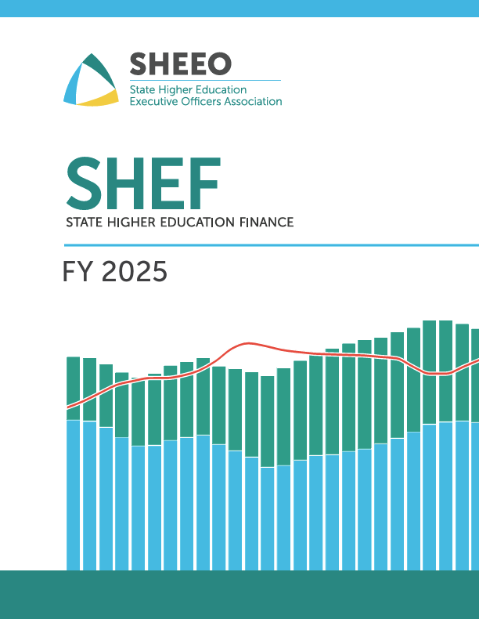
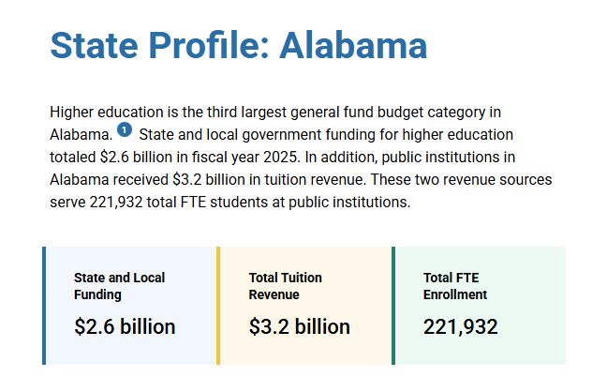

Slide 24
Public Higher Education Total Education Revenue
per FTE by State, (FY 2025)
Alabama reports the highest total public higher education revenue
per FTE of any SREB state other than Delaware.
Index to
U.S. Average
1.31
Source: State Higher Education Executive Officers Association
SREB States

Slide 25
Percentage of Education Appropriations*
Compared to Tuition Revenue, FY 2025
In Alabama, the tuition share (students’ portion) of public higher education equates to over half of the revenue per FTE.
12.8%
75.4%
24.6%
87.2%
Source: State Higher Education Executive Officers Association
*Education Appropriations are a measure of state and local support available for public higher education operating expenses and student financial aid, including federal stimulus funding but excluding appropriations for research, hospitals, and medical education.
SREB States

Slide 26
Public Higher Education Appropriations
per FTE by State, FY 2025 (Adjusted)
Alabama’s public higher education appropriations are
slightly less per FTE than the U.S. average.
Index to
U.S. Average
0.93
Source: State Higher Education Executive Officers Association
SREB States

Slide 27
Public Two-Year College Appropriations
per FTE by State, FY 2025 (Adjusted)
Appropriations to Alabama’s public two-year colleges
are slightly more than the U. S. average.
Index to
U.S. Average
1.03
Source: State Higher Education Executive Officers Association
SREB States

Slide 28
Public Four-Year University Appropriations
per FTE by State, FY 2025 (Adjusted)
Alabama provided more per FTE to the public four-year universities than the U.S. average but less than seven
other SREB States, including Alabama’s bordering states.
Index to
U.S. Average
1.08
Source: State Higher Education Executive Officers Association
SREB States

Slide 29
Net Tuition Revenue per FTE,
FY 2025 (Adjusted)
Alabama’s net tuition revenue per FTE is the
fourth highest in the nation.
Source: State Higher Education Executive Officers Association
SREB States

Slide 30
Public Higher Education Net Tuition Revenue
per Two-Year College FTE by State, FY 2025 (Adjusted)
Alabama’s net tuition revenue per public two-year college FTE is
more than any other SREB state and more than twice the U.S. average.
Source: State Higher Education Executive Officers Association
SREB States

Slide 31
Public Higher Education Net Tuition Revenue
per Four-Year University FTE by State, FY 2025 (Adjusted)
Alabama’s net tuition revenue per four-year university FTE is the third highest in the U.S., while Georgia and Florida are among the lowest.
Index to
U.S. Average
1.86
Source: State Higher Education Executive Officers Association
SREB States

Slide 32
Percentage of State Higher Education Funding Used
for Research, Agriculture, and Medicine (RAM), FY 2025
Alabama uses a greater percentage of its state public higher education funding for research, agriculture, and medicine than the U.S. average but much less than Mississippi.
Source: State Higher Education Executive Officers Association
SREB States

Slide 33
Public Higher Education State Financial Aid as a Percentage of Education Appropriations by State, FY 2025 (Adjusted)
Alabama appropriates a smaller percentage of its
state public higher education funding for financial aid
than any other SREB state.
Source: State Higher Education Executive Officers Association
SREB States

Slide 34
Public Higher Education State Financial Aid
per FTE by State, FY 2025 (Adjusted)
Alabama appropriates less state financial aid per FTE for
public higher education than any other SREB state.
Index to
U.S. Average
0.26
Source: State Higher Education Executive Officers Association
SREB States

Slide 35
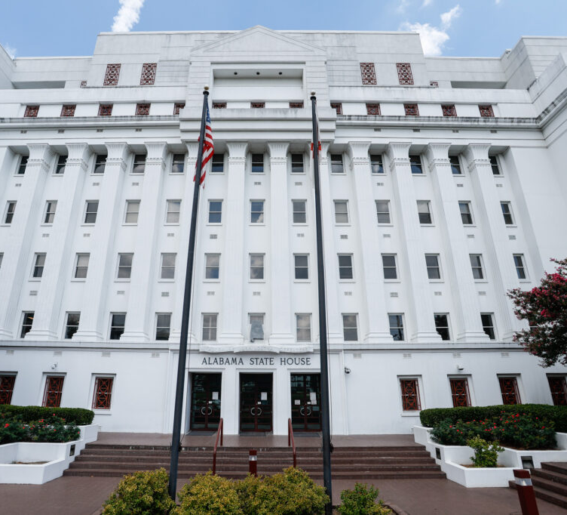
2026 Legislative Update
Staff Presenter:
Dr. Stephanie C. Dolan

Slide 36
Act 2026-380
Education Trust Fund (ETF) Budget
Institutions of Higher Education | 2026 Appropriation | 2027 Appropriation | Percentage of Change
Alabama A&M University | $61,115,089 | $64,254,117 | 5.14%
Miles College* | $493,486 | $493,486 | 0.00%
Alabama State University | $66,556,368 | $69,335,841 | 4.18%
University of Alabama - Main Campus | $266,214,571 | $284,765,168 | 6.97%
University of Alabama at Birmingham | $421,143,986 | $443,576,636 | 5.33%
University of Alabama in Huntsville | $77,280,307 | $81,713,659 | 5.74%
Athens State University | $23,502,462 | $24,650,048 | 4.88%
Auburn University | $379,246,504 | $403,992,530 | 6.53%
Auburn University Montgomery | $34,989,116 | $36,598,473 | 4.60%
Jacksonville State University | $61,933,407 | $66,543,021 | 7.44%
University of Montevallo | $33,018,738 | $34,874,394 | 5.62%
University of North Alabama | $57,665,778 | $61,435,950 | 6.54%
University of South Alabama | $171,209,511 | $184,001,844 | 7.47%
Troy University System | $87,931,064 | $92,920,654 | 5.67%
University of West Alabama | $34,218,443 | $37,331,748 | 9.10%
Stillman College** | $100,000 | $200,000 | 100.00%
Institutions of Higher Education Total | $1,776,618,830 | $1,886,687,569 | 6.20%
Alabama Community College System | $622,223,785 | $660,356,653 | 6.13%
Tuskegee University | $15,816,579 | $16,300,159 | 3.06%
Talladega College | $1,326,157 | $1,372,572 | 3.50%
* Pass-through Alabama A&M to Miles College
** Pass-through West Alabama to Stillman College

Slide 37

Act 2026-380
ACHE Education Trust Fund (ETF) Budget
Alabama Commission on Higher Education Programs and Activities | FY26 Enacted | FY27 Enacted | FY26 to FY27 Comparison
HBCU Deferred Maintenance Program | $5,000,000 | $5,000,000 | $0 | 0.00%
Planning and Coordination Services Program | $8,385,148 | $11,533,866 | $3,148,718 | 37.55%
Student Financial Aid Programs | $38,790,549 | $33,790,549 | -$5,000,000 | -12.89%
Support of Other Educational Activities | $8,025,063 | $3,925,063 | -$4,100,000 | -51.09%
Support of State Universities Programs | $6,491,283 | $6,491,283 | $0 | 0.00%
Support of Other State Programs | $18,548,120 | $19,410,376 | $862,256 | 4.65%
Total ETF Funds for ACHE | $85,240,163 | $80,151,137 | -$5,089,026 | -5.97%

Slide 38
Act 2026-380: ACHE ETF Budget
Alabama Commission on Higher Education Programs and Activities | FY26 Enacted | FY27 Enacted | FY26 to FY27 Comparison
HBCU Deferred Maintenance Program | $5,000,000 | $5,000,000 | $0 | 0.00%
Planning & Coordination Services Program | $8,385,148 | $11,533,866 | $3,148,718 | 37.55%
Planning & Coordination O&M | $4,470,148 | $4,618,866 | $148,718 | 3.33%
FAFSA Completion | $580,000 | $580,000 | $0 | 0.00%
Industry Credential Directory | $100,000 | $100,000 | $0 | 0.00%
Pathways to Progress | $600,000 | $600,000 | $0 | 0.00%
(Re)Engage Alabama (Per Chapter 33D, Title 16) | $1,935,000 | $1,935,000 | $0 | 0.00%
Retain Alabama | $650,000 | $650,000 | $0 | 0.00%
AL Higher Education Partnership Student Retention Council | $250,000 | $250,000
Retain Alabama Project - Administered by ACHE | $400,000 | $400,000
Study Alabama | $50,000 | $50,000 | $0 | 0.00%
Move On When Ready |  | $3,000,000 | $3,000,000
Student Financial Aid Programs | $38,790,549 | $38,790,549 | - $5,000,000 | - 12.89%
National Guard Scholarship (ANGEAP) | $9,331,114 | $9,831,114 | $500,000 | 5.36%
Student Assistance Program (ASAP) | $10,000,000 | $10,000,000 | $0 | 0.00%
Birmingham Promise Scholarship Program | $892,500 | $892,500 | $0 | 0.00%
Educational Grants (ASGP) | $10,000,000 | $10,500,000 | $500,000 | 0.00%
Indian Affairs Scholarships | $100,000 | $100,000 | $0 | 0.00%
Policemen's Survivor Tuition Program | $466,935 | $466,935 | $0 | 0.00%
Alabama Law Enforcement Officers' Family Scholarship | $8,000,000 | $2,000,000 | - $6,000,000 | - 75%
Support of Other Educational Activities | $8,025,063 | $3,925,063 | - $4,100,000 | - 51.09%
Articulation System STARS | $799,589 | $999,589 | $200,000 | 25.01%
Best and Brightest | $250,000 | $250,000 | $0 | 0.00%
EPSCoR | $1,260,184 | $1,460,184 | $200,000 | 15.87%
NAAL | $384,076 | $384,076 | $0 | 0.00%
SREB | $831,214 | $831,214 | $0 | 0.00%
STEM Major Recruitment Program | $4,500,000 | $0 | - $4,500,000 | - 100.00%

Slide 39
Act 2026-380: ACHE ETF Budget
Alabama Commission on Higher Education Programs and Activities | FY26 Enacted | FY27 Enacted | FY26 to FY27 Comparison
Support of State Universities Programs | $6,491,283 | $6,491,283 | $0 | 0.00%
AALGA - for McIntire-Stennis Forestry | $539,524 | $539,524 | $0 | 0.00%
Agricultural Land Grant Alliance Program | $5,006,831 | $5,006,831 | $0 | 0.00%
AALGA - Tuskegee University | $944,928 | $944,928 | $0 | 0.00%
Support of Other State Programs | $18,548,120 | $19,410,376 | $862,256 | 4.65%
AKEEP Education and Teacher Recruitment Partnership (ALIEEP) | $400,000 | $0 | - $400,000 | - 100.00%
Adaptive and Disability Sports Education | $60,000 | $60,000 | $0 | 0.00%
Alabama Civil Air Patrol | $155,000 | $155,000 | $0 | 24.00%
Alabama Forestry Commission Education Program | $200,000 | $200,000 | $0 | 0.00%
Alabama Forestry Foundation Blackbelt Initiative | $532,000 | $532,000 | $0 | 0.00%
Alabama Recruit and Retain Urban/Rural Teachers | $700,000 | $0 | - $700,000 | - 100.00%
Alabama Trails Commission | $340,000 | $340,000 | $0 | 0.00%
Black Belt Adventures | $475,000 | $500,000 | $25,000 | 5.26%
Black Belt Treasures | $350,000 | $350,000 | $0 | 0.00%
Motorsports Hall of Fame | $200,000 | $200,000 | $0 | 0.00%
National Computer Forensics Institute | $650,000 | $650,000 | $0 | 0.00%
Resource Conservation and Development Program (RC&D) | $8,962,744 | $10,500,000 | $1,537,256 | 17.15%
Soil and Water Conservation Committee Program | $3,023,376 | $3,023,376 | $0 | 0.00%
Humanities Foundation | $300,000 | $300,000 | $0 | 0.00%
USS Alabama Battleship | $1,550,000 | $1,750,000 | $200,000 | 12.90%
HBCU Cares | $650,000 | $650,000 | $0 | 0.00%
Alabama HBCU Consortium | $0 | $200,000 | $200,000
Total ACHE ETF | $85,240,163 | $80,151,137 | - $5,089,026 | - 5.97%

Slide 40
ACT 2026-599
ACHE 2026 Supplemental Appropriation
Alabama Battleship | $2,000,000
North Alabama Agriplex | $400,000
Alabama Veterinary Hospital - Birmingham Zoo | $2,000,000
Tuskegee University - Deferred Maintenance | $1,250,992
Tuskegee University - Kellog Conference Center | $1,500,000
Talladega College - Deferred Maintenance | $62,968
North Alabama Land Trust | $250,000
Sweet Trails | $1,000,000
Selma University | $200,000
Tennessee Riverline Program | $185,000
Total 2026 Supplemental Appropriation | $8,848,960

Slide 41
2026 Legislative Update
Administrative Monthly | Volume XLIV, No. 8 Published 5/29/2026 | Open for Public Comment until July 3, 2026 (https://admincode.legislature.state.al.us/administrative-monthly)
Chapter 300-4-4 (Act 2026-521) | Alabama National Guard Educational Assistance Program (ANGEAP) | To expand benefit costs and to expand scholarship eligibility to workforce development programs through joint approval and collaboration between the Adjutant General of Alabama and the Executive Director of ACHE (HB233/SB108)
Chapter 300-4-12 (Act 2026-303) | Loan Assistance in Support of Educators in Alabama (LASEA) | To rename AMSTEP as the Loan Assistance in Support of Educators in Alabama (LASEA) program and to expand loan assistance eligibility to additional critical educator shortage areas across the state (HB124/SB74)
Chapter 300-4-13 (Act 2026-304) | (Re)Engage Alabama Grant Program | To change the eligibility age from 25 to 22 and to extend loan assistance to individuals pursuing their first bachelor’s degree after earning an associate degree, provided all other eligibility requirements are met, and they have not previously received the award (HB125/SB72)
Chapter 300-4-15 (Act 2026 381) | Alabama Law Enforcement Officers’ Family Scholarship | To establish a scholarship program for the spouses and dependents of law enforcement officers at Alabama’s public institutions of higher education (HB98)

Slide 42
2026 Legislative Update
Administrative Code | Statutory Authority: Code of Ala. 1975, §16-5-1; Alabama Act 2025-412 | Effective May 15, 2026
Chapter 300-4-16 (Act 2025-412) | Move On When Ready | To establish the Move On When Ready Program that allows eligible Alabama 11th and 12th grade students to complete all high school coursework through enrollment at eligible public institutions of higher education that choose to participate in the program and to define the framework for secondary credit, funding, and oversight
ACHE is in the process of reviewing recent legislative guidance, and revisions to the Administrative Code are expected to be forthcoming.

Slide 43
2026 Legislative Update
Additional Higher Education Acts
Alabama Act 2026-422 | College and Higher Education Excellence and Results (CHEER) Act | To establish a process to provide bonus funding to higher education institutions that meet identified student and institution performance goals and objectives; to establish the CHEER Fund and provide for its funding and appropriations; and to establish the Outcomes-Based Higher Education Funding Coordinating Committee and provide for its duties and responsibilities (HB565)
Alabama Act 2026-432 | Faculty Senates and Tenure Policies of Public Institutions of Higher Education | To provide for the creation, membership, and duties of a faculty senate at a public institution of higher education; to provide that faculty senates are advisory only; to require the governing board of each public institution of higher education to adopt a tenure policy; to require periodic post-tenure reviews of tenured faculty; to require governing boards to approve curriculum; to provide for the dismissal of certain tenured faculty members; to provide governing boards with certain control over curriculum and courses; and to prohibit accrediting agencies from taking certain actions related to state law (HB580)
Alabama Act 2026-597 | Federal Fund Reporting Requirements for Public Institutions of Higher Education | To remove ACCS from federal fund reporting requirements; to require each public institution of higher education in the state to submit an annual report regarding state and federal fund receipts and expenditures, including plans for operating the institution if state or federal funding is reduced (SB59)

Slide 44

VIII. Decision Items

Slide 45

A. Academic Programs
Staff Presenters:
Dr. Robin McGill and Ms. Kristan White

Slide 46














Alabama Public Four-Year Institutions

Slide 47

Athens State University
A. Master of Science in Nursing in Nursing Education (CIP 51.3203)
The program will help fill the need for additional nurse educators arising from the convergence of an aging nursing faculty workforce and a critical nursing shortage.
The proposal includes four letters of support attesting to the need for this program from the following: Calhoun Community College, Northeast Alabama Community College, Athens Limestone Hospital, and Huntsville Hospital.

Slide 48
Motion, Decision Item A:
That the Commission approve Athens State University’s proposal to offer a Master of Science in Nursing in Nursing Education.

Slide 49

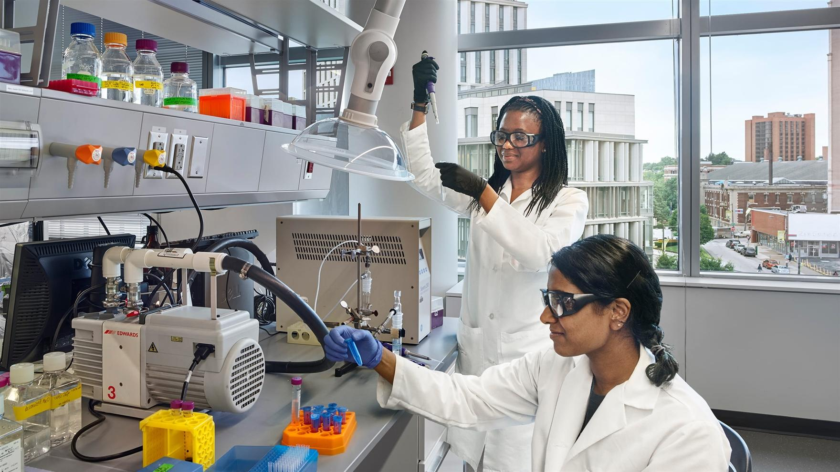
Auburn University
A-2a. Master of Science in Biomedical Engineering (CIP 14.0501)
The program will build on existing curriculum, faculty, and resources across AU’s College of Engineering, specifically within the Department of Chemical Engineering to support a coherent course of study in Biomedical Engineering.
The proposal includes detailed projections for student demand based on existing elective coursework and the potential for an Accelerated Bachelor’s to Master’s (ABM) pathway.
The proposed program is designed to prepare graduates for employment in the following occupations: Bioengineers and Biomedical Engineers; Engineers, All Other; and Bioinformatics Scientists, occupations which are needed to support statewide economic development efforts in the biotechnology and pharmaceutical industries.

Slide 50
Motion, Decision Item A-2a:
That the Commission approve Auburn University’s proposal to offer a Master of Science in Biomedical Engineering.

Slide 51
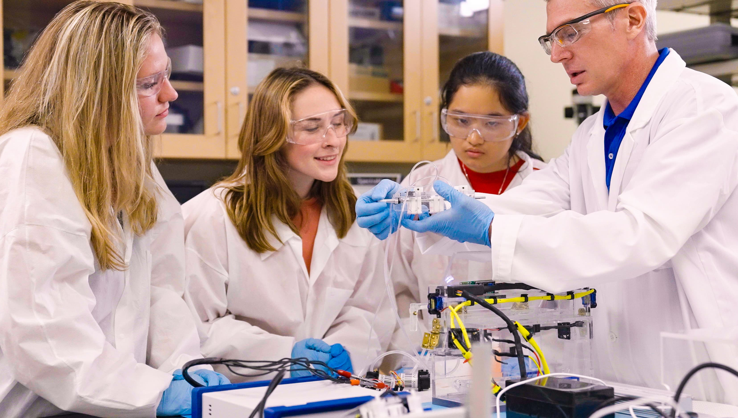
Auburn University
A-2b. Doctor of Philosophy in Biomedical Engineering (CIP 14.0501)
The program will build on existing curriculum, faculty, and resources across AU’s College of Engineering and specifically within the Department of Chemical Engineering to support a coherent doctoral course of study in Biomedical Engineering.
The proposed program is designed to prepare graduates for employment as bioengineers, biomedical engineers, all other engineers, and bioinformatics scientists, which are needed to support statewide economic development efforts in the biotechnology and pharmaceutical industries.
The proposed PhD program has been designed to align with the MS in Biomedical Engineering, so that students completing the master’s will be able to seamlessly transition into the PhD program.

Slide 52
Motion, Decision Item A-2b:
That the Commission approve Auburn University’s proposal to offer a Doctor of Philosophy in Biomedical Engineering.

Slide 53

Auburn University at Montgomery
A-3a. Bachelor of Science in Artificial Intelligence and Robotics (CIP 11.0102)
Graduates of the BS in AI and Robotics program will be prepared for employment as software developers, which are included on the 2024-25 Alabama Demand Occupations List, as well as data scientists and robotics engineers.
This program will build on AUM’s existing faculty expertise in Computer Science and AI and will require no new resources to implement as proposed.

Slide 54
Motion, Decision Item A-3a:
That the Commission approve Auburn University at Montgomery’s proposal to offer a Bachelor of Science in Artificial Intelligence and Robotics.

Slide 55

Auburn University at Montgomery
A-3b. Bachelor of Science in Information Technology and Cybersecurity
(CIP 11.1003)
Graduates of the BS in Information Technology and Cybersecurity will be prepared for employment in positions included on the 2024-25 Alabama Demand Occupations List including information security analysts, computer user support specialists, and software developers.
This program will build on AUM’s existing faculty expertise in information technology and cybersecurity and will require no new resources to implement as proposed.

Slide 56
Motion, Decision Item A-3b:
That the Commission approve Auburn University at Montgomery’s proposal to offer a Bachelor of Science in Information Technology and Cybersecurity.

Slide 57

Jacksonville State University
A-4a. Doctor of Arts in English (CIP 23.0101)
The proposed DA will extend JSU’s graduate offerings in English to the doctoral level. JSU’s existing MA in English (CIP 23.0101) and MSEd in Secondary Education--English Language Arts (CIP 13.1205) have demonstrated healthy enrollment and completion numbers.
The proposed program is designed to prepare graduates for employment as Secondary School Teachers, Except Special and Career/ Technical Education Postsecondary (SOC 25-2031), which appear on the 2024-25 Alabama Demand Occupations list. Additionally, Secondary English Language Arts teachers are regularly included in the statewide list of teacher shortage areas.
The program will be delivered 100% online and is designed for secondary and postsecondary English teachers who want to advance their expertise and salary while continuing to teach full-time.

Slide 58
Motion, Decision Item A-4a:
That the Commission approve Jacksonville State University’s proposal to offer a Doctor of Arts in English.

Slide 59
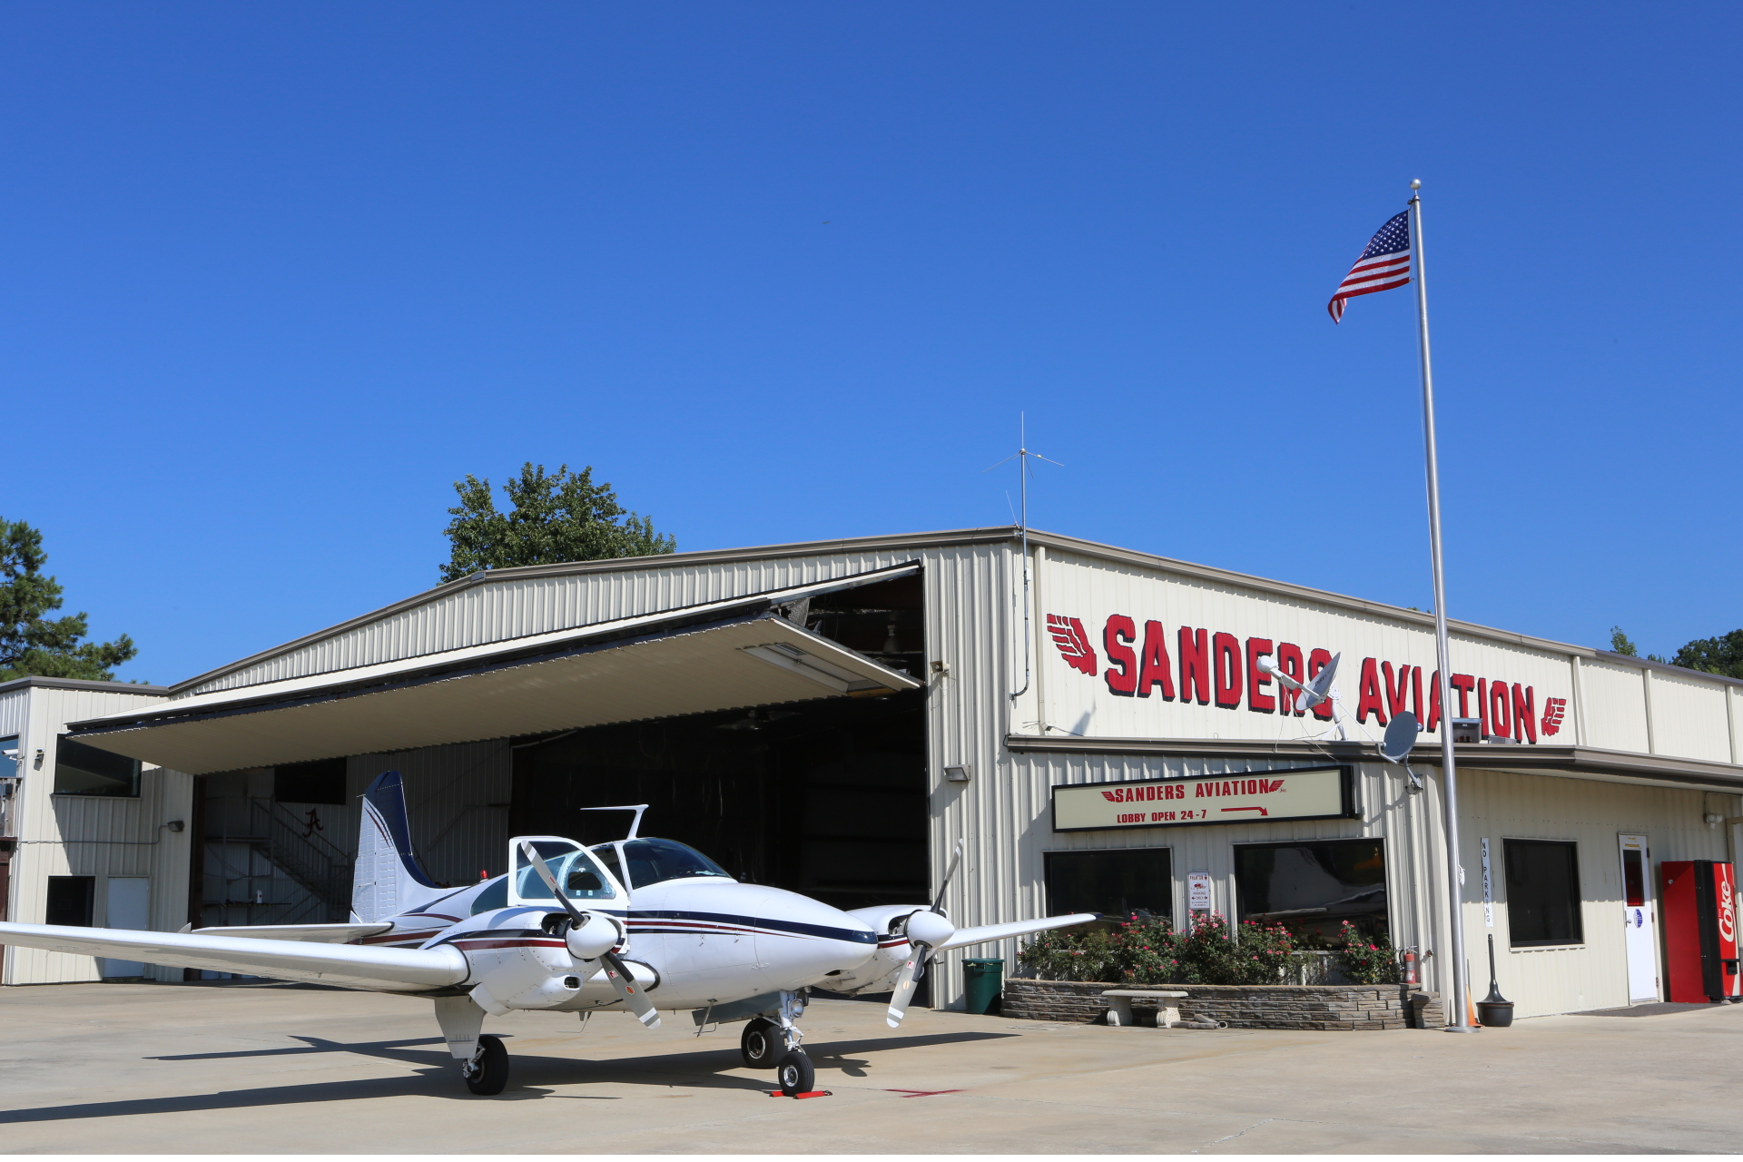
Jacksonville State University
A-4b. New Non-Exempt Off-Campus Site with Academic Programs: Sanders Flight Training Center, Jasper, Alabama
The proposed site has all necessary FAA certifications to provide aviation-related instruction, in keeping with the new BS in Aviation approved for JSU at the March 2026 ACHE meeting.
Off-campus instruction at Sanders Flight Training Center will be self-supporting through tuition, fees, and associated flight lab fees. Flight lab fees will cover fuel, instructors, aircraft maintenance, and related instructional costs through the partner flight school arrangement.
Those universities whose service area includes the proposed site (The University of Alabama and University of Alabama at Birmingham) do not offer aviation-related undergraduate programs.

Slide 60
Motion, Decision Item A-4b:
That the Commission approve Jacksonville State University’s proposal to offer a New Non-Exempt Off-Campus Site with Academic Programs at Sanders Flight Training Center in Jasper, Alabama.

Slide 61

The University of Alabama
A-5a. Bachelor of Arts in Public Policy (CIP 44.0501)
The proposed BA in Public Policy will prepare graduates for roles included on the 2024-25 Alabama Demand Occupations List, such as social and community service managers and compliance officers.
The proposed program will be a foundational offering within the newly established School of Leadership and Policy and is expected to attract a significant number of students and advance the School’s mission to contribute meaningfully to Alabama’s social, economic, and civic development.

Slide 62
Motion, Decision Item A-5a:
That the Commission approve The University of Alabama’s proposal to offer a Bachelor of Arts in Public Policy.

Slide 63

The University of Alabama
A-5b. Master of Public Policy in Public Policy (CIP 44.0501)
Alabama faces many complex public policy challenges, yet no public university in the state has a degree program exclusively dedicated to teaching the skills and knowledge necessary for meaningful participation in the making of public policy.
The proposed MPP will require significant institutional investment, which will be offset by tuition revenue from the BA program and by external grant funding.
The proposed program will be a foundational offering within the newly established School of Leadership and Policy and will advance the School’s mission to contribute meaningfully to Alabama’s social, economic, and civic development.

Slide 64
Motion, Decision Item A-5b:
That the Commission approve The University of Alabama’s proposal to offer a Master of Public Policy in Public Policy.

Slide 65
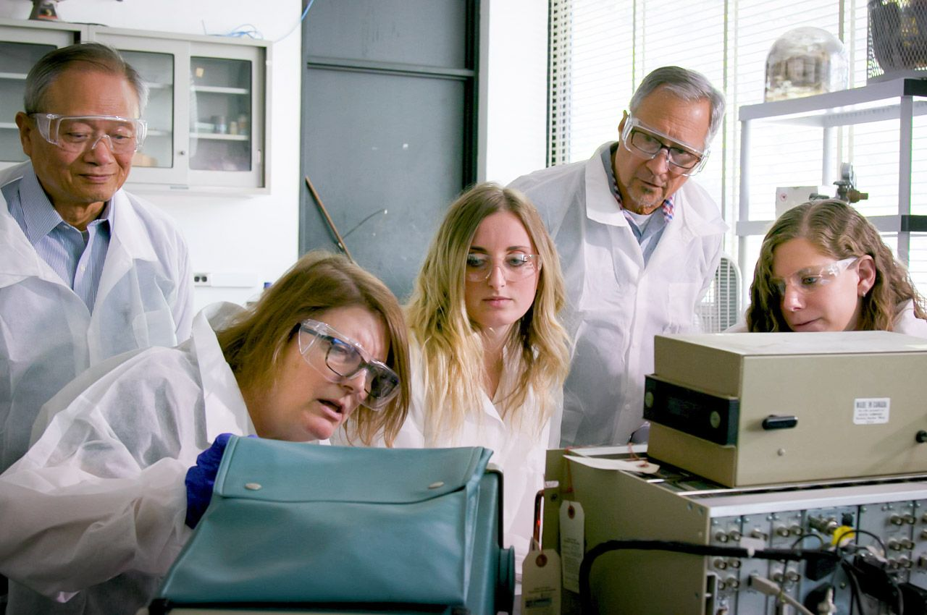
University of Alabama at Birmingham
A-6. Doctor of Philosophy in Health Physics (CIP 51.2205)
The proposed program is designed to build on UAB’s MS in Health Physics and extend educational pathways to the doctoral level. The institution demonstrates sufficient capacity to deliver the program, supported by faculty expertise, strong external partnerships, established facilities, and secured external funding streams, all of which will ensure high-quality program delivery and sustainability.
The proposed program will help to address state and national workforce shortages identified by professional organizations such as the International Commission on Radiation Protection (ICRP) and the National Council on Radiation Protection and Measurements (NCRP).

Slide 66
Motion, Decision Item A-6:
That the Commission approve the University of Alabama at Birmingham’s proposal to offer a Doctor of Philosophy in Health Physics.

Slide 67
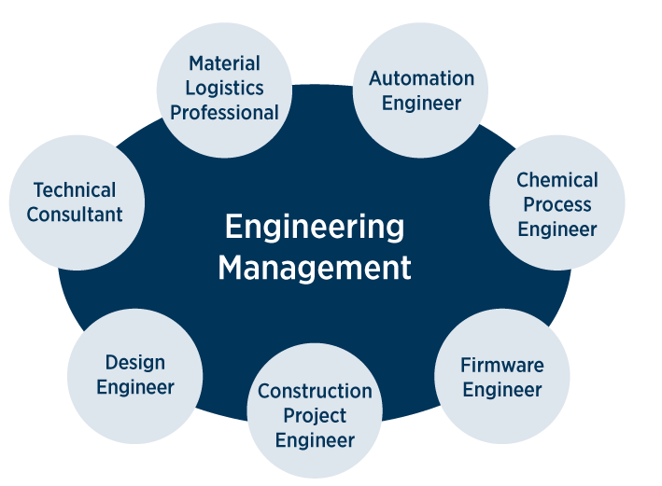
University of Alabama in Huntsville
A-7. Doctor of Engineering in Engineering Management (CIP 15.1501)
The program will prepare graduates for senior positions as architectural and engineering managers and general and operations managers, which are included on the 2024-25 Alabama Demand Occupations List.
Huntsville has one of the highest concentrations of engineers in the nation, in addition to having high concentrations of individuals with STEM degrees and doctoral degrees. The proposed degree will offer a pathway for career advancement for engineers and STEM professionals who want to address complex industry problems with research-based solutions, but who may not be interested in a PhD program.

Slide 68
Motion, Decision Item A-7:
That the Commission approve the University of Alabama in Huntsville’s proposal to offer a Doctor of Engineering in Engineering Management.

Slide 69

University of Montevallo
A-8. Bachelor of Arts and Bachelor of Science in Civic Leadership
(CIP 44.0201)
This program will prepare graduates for employment in positions included on the 2024-25 Alabama Demand Occupations list, including social and community service managers and public affairs/ public relations specialists.
The program will repackage existing courses and resources and require minimal new funds to implement.
The proposal is supported by five letters of support from community and business partners attesting to the need for this program and offering opportunities for collaboration.
This Photo by Unknown Author is licensed under CC BY-ND

Slide 70
Motion, Decision Item A-8:
That the Commission approve University of Montevallo’s proposal to offer a Bachelor of Arts and Bachelor of Science in Civic Leadership.

Slide 71

























Alabama Community College System

Slide 72

Bishop State Community College
A-9. Substantive Modification to Academic Program Inventory
Bishop State Community College (BIS) is proposing to make the following two modifications to its inventory that require Commission approval:
Separating the existing AAS in Process and Maintenance Technology (CIP 15.0404) into three distinct programs: Process and Maintenance Technology, Welding Technology, and Machine Tool Technology.
Converting the existing AOT in Occupational Technology (CIP 30.9999) into six distinct programs: Cosmetology, Barbering and Hairstyling, Air Conditioning/ Refrigeration Technology, Electrical Technology, Automotive Technology, and Diesel Technology.

Slide 73
Motion, Decision Item A-9:
That the Commission approve Bishop State Community College’s substantive modification to the academic program inventory.

Slide 74
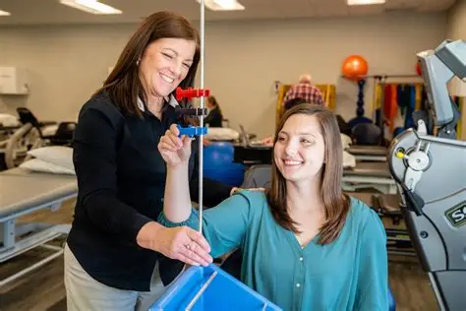
Coastal Alabama Community College
A-10a. Associate of Applied Science in Occupational Therapy Assistant (CIP 51.0803)
The proposed program is designed to fulfill requirements for professional licensure and prepare graduates for employment as Occupational Therapist Assistants (SOC 31-2011), an occupation which is included on the 2024-25 Statewide Demand Occupations list.
This proposal includes letters of support from four potential clinical partners and employers attesting to the need for this program.

Slide 75
Motion, Decision Item A-10a:
That the Commission approve Coastal Alabama Community College’s proposal to offer an Associate of Applied Science in Occupational Therapy Assistant.

Slide 76
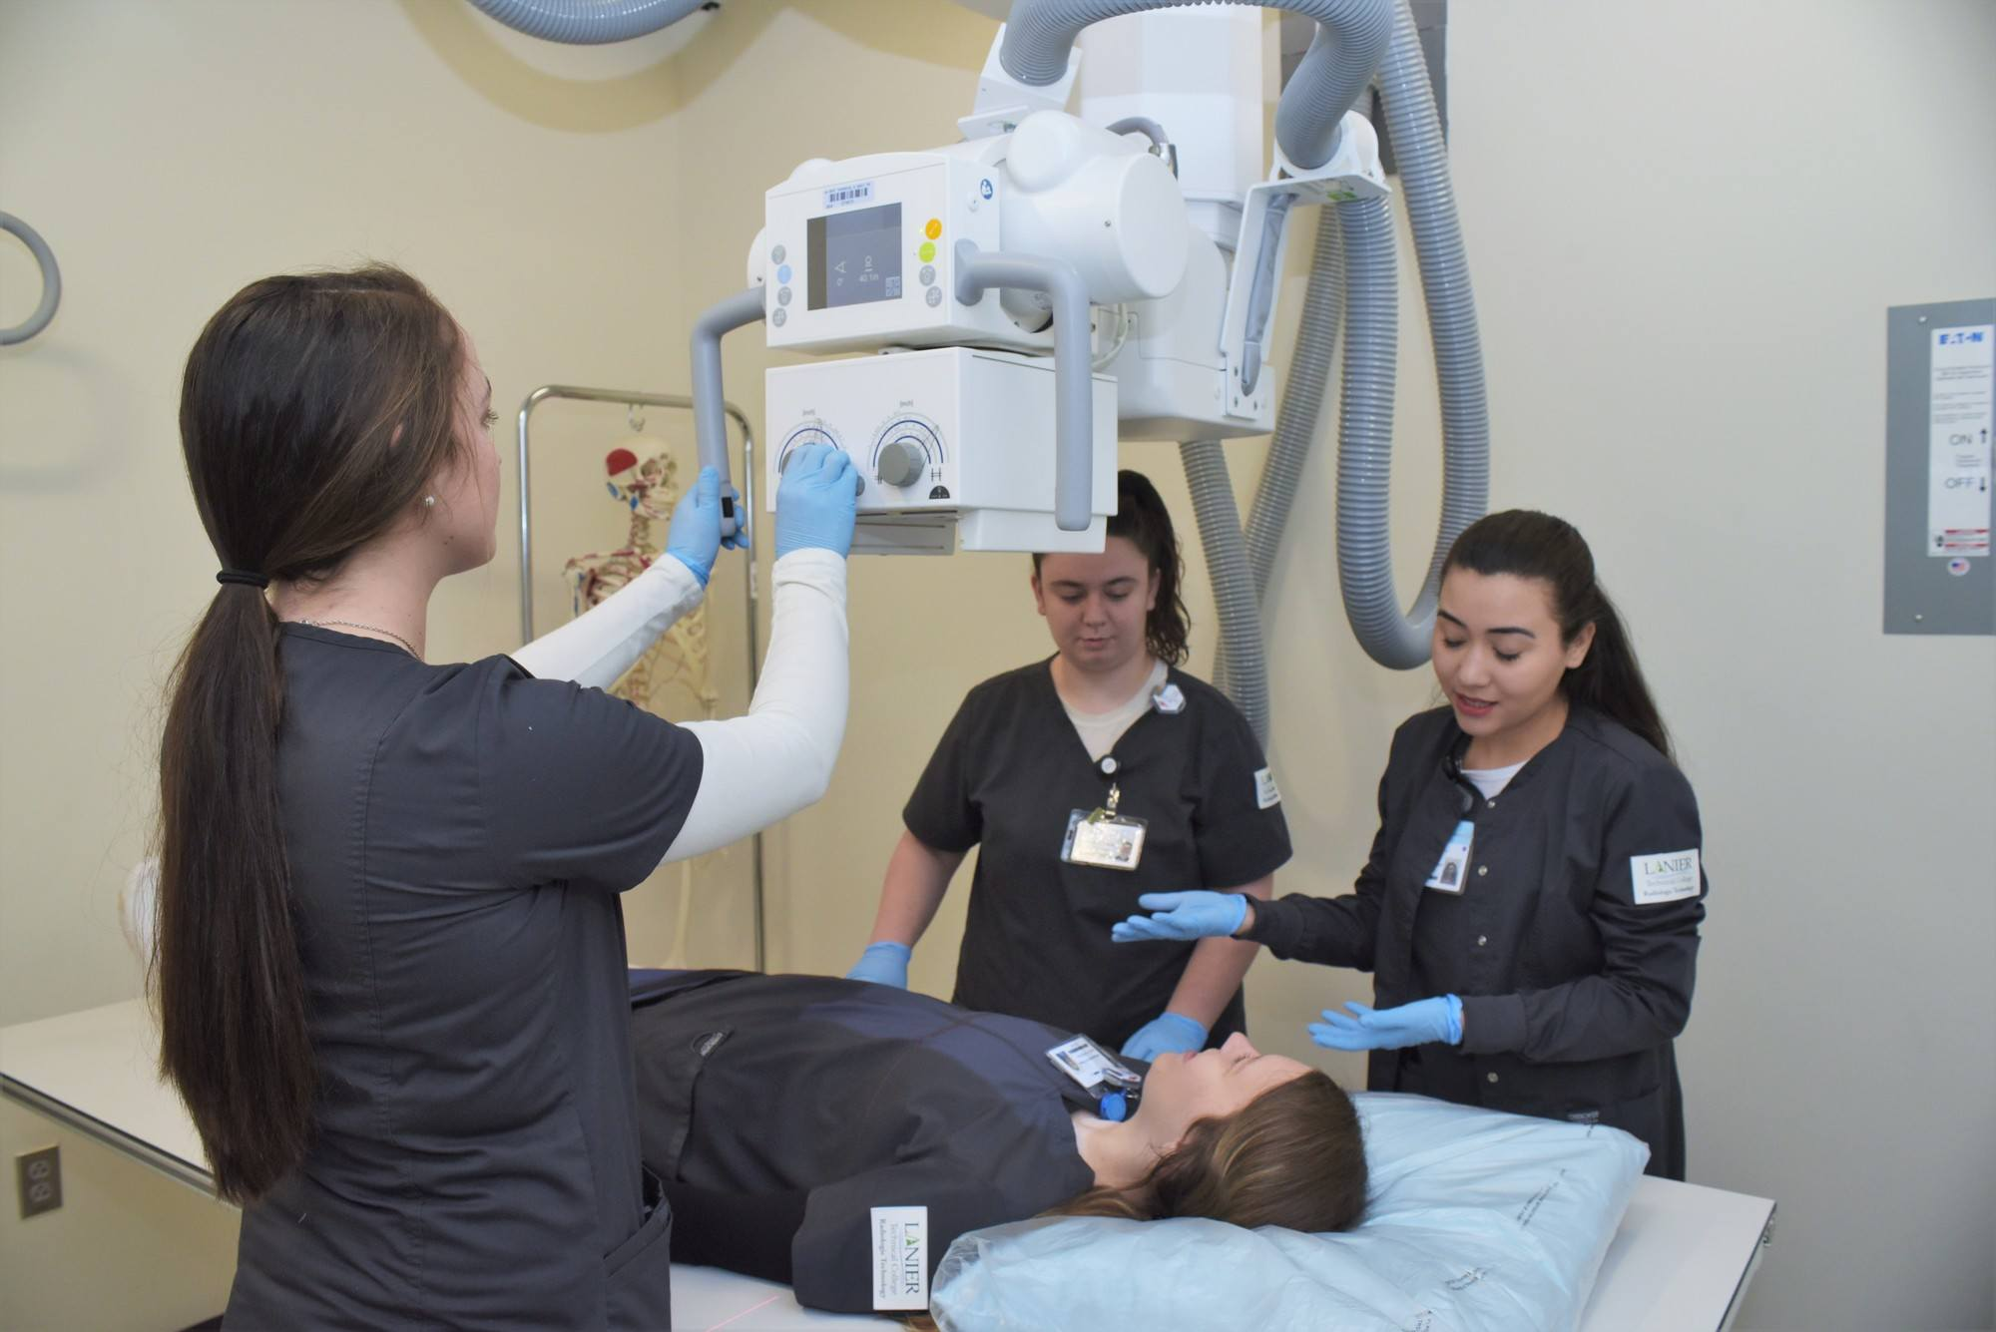
Coastal Alabama Community College
A-10b. Associate of Applied Science in Radiologic Technology
(CIP 51.0911)
The proposed program is designed to prepare graduates for entry-level employment as radiologic technologists and Technicians, which are included on the 2024-25 Alabama Demand Occupations List.
This proposal includes letters of support from local and regional institutions and healthcare facilities attesting to the need for the program and providing assurance that adequate clinical sites will be available.

Slide 77
Motion, Decision Item A-10b:
That the Commission approve Coastal Alabama Community College’s proposal to offer an Associate of Applied Science in Radiologic Technology.

Slide 78
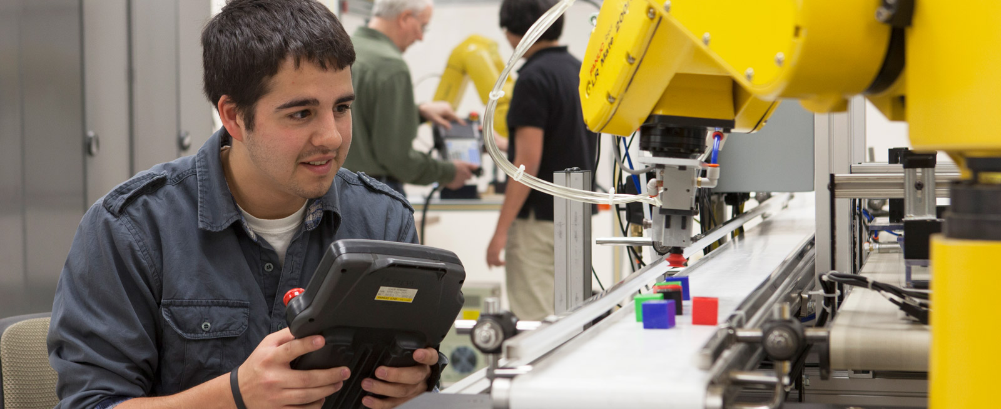
Central Alabama Community College
A-11. Associate of Applied Science in Industrial Automation Technology
(CIP 47.0303)
The program is designed to prepare graduates for entry-level employment in careers included on the 2024-25 Alabama Demand Occupations list including industrial machinery mechanics and maintenance and repair workers.
The program is built on the nationally recognized FAME model and developed in partnership with regional manufacturing employers, ensuring curriculum relevance, validated workforce demand, and strong job placement opportunities for graduates.

Slide 79
Motion, Decision Item A-11:
That the Commission approve Central Alabama Community College’s proposal to offer an Associate of Applied Science in Industrial Automation Technology.

Slide 80
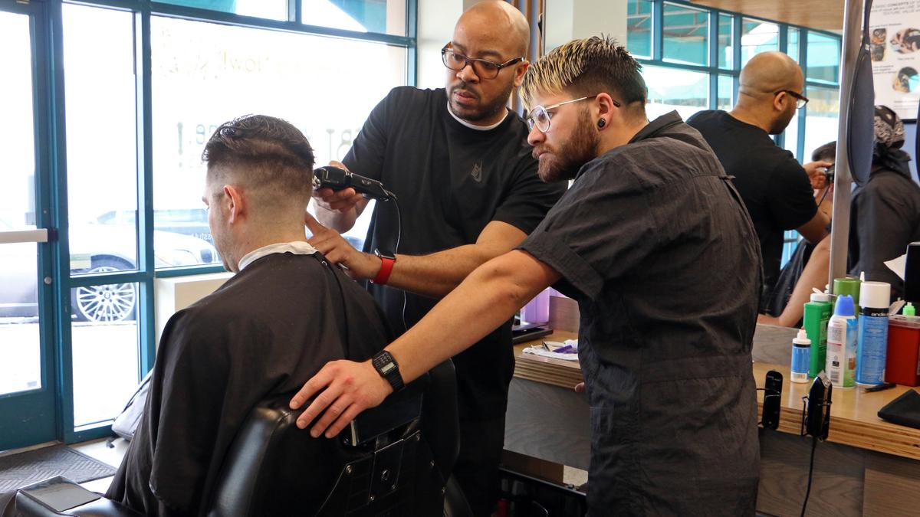
Northeast Alabama Community College
A-12. Associate of Applied Science and Certificate in Barbering
(CIP 12.0402)
The AAS and Certificate in Barbering is designed for working adults and non-traditional learners and will offer evening scheduling to allow students to balance work, family, and education.
The program proposal includes letters of support from local businesses attesting to the need for the program, including the Kevin Dukes Career and Innovation Academy, The Next Level Barber and Style, and the DeKalb County Technology Center.

Slide 81
Motion, Decision Item A-12:
That the Commission approve Northeast Alabama Community College’s proposal to offer an Associate of Applied Science and Certificate in Barbering.

Slide 82
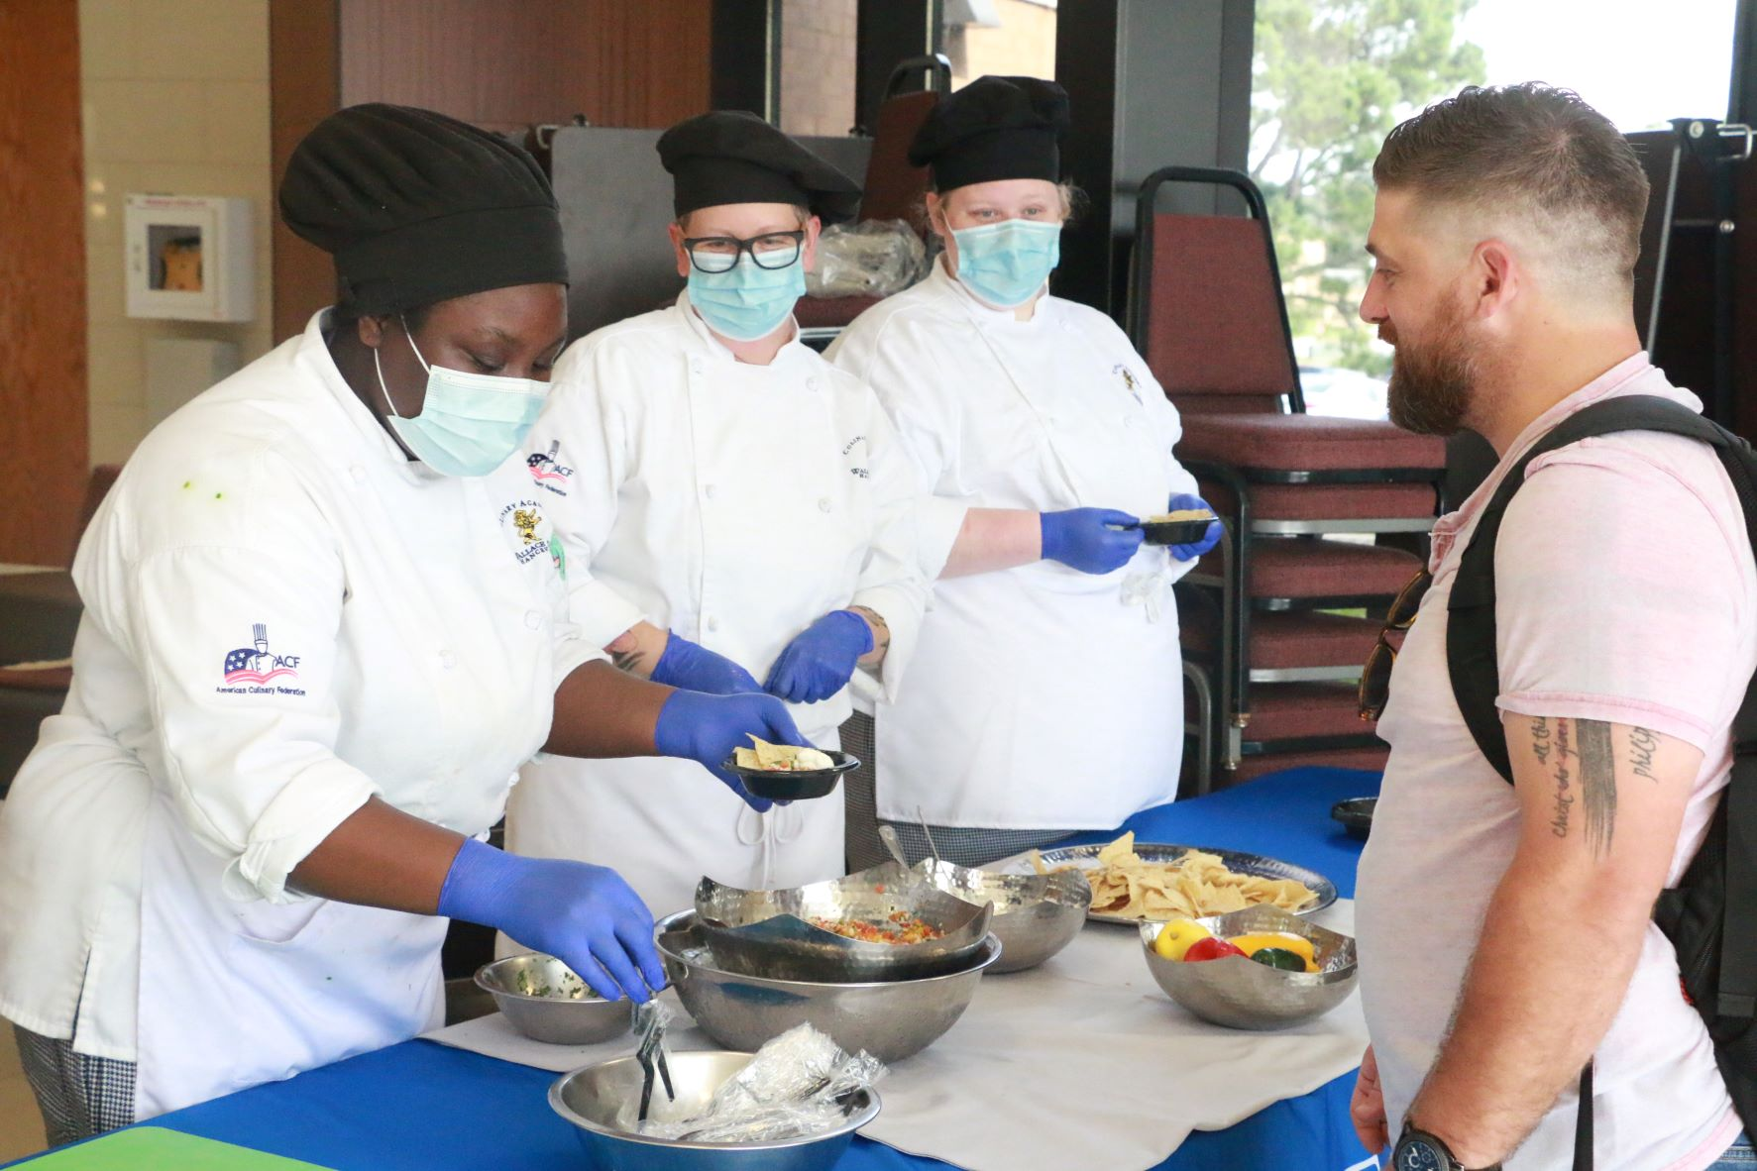
Wallace State Community College - Hanceville
A-13a. Associate of Applied Science and Certificate in Baking and Pastry
(CIP 12.0501)
The Baking and Pastry program will prepare graduates for positions included on the 2024-25 Alabama In-Demand Occupations List, including bakers, and chefs and head cooks.
The program proposal includes letters of support from local businesses attesting to the need for the program, including 412 Public House and Jubilee Kitchen and Bar.

Slide 83
Motion, Decision Item A-13a:
That the Commission approve Wallace State Community College - Hanceville’s proposal to offer an Associate of Applied Science and Certificate in Baking and Pastry.

Slide 84
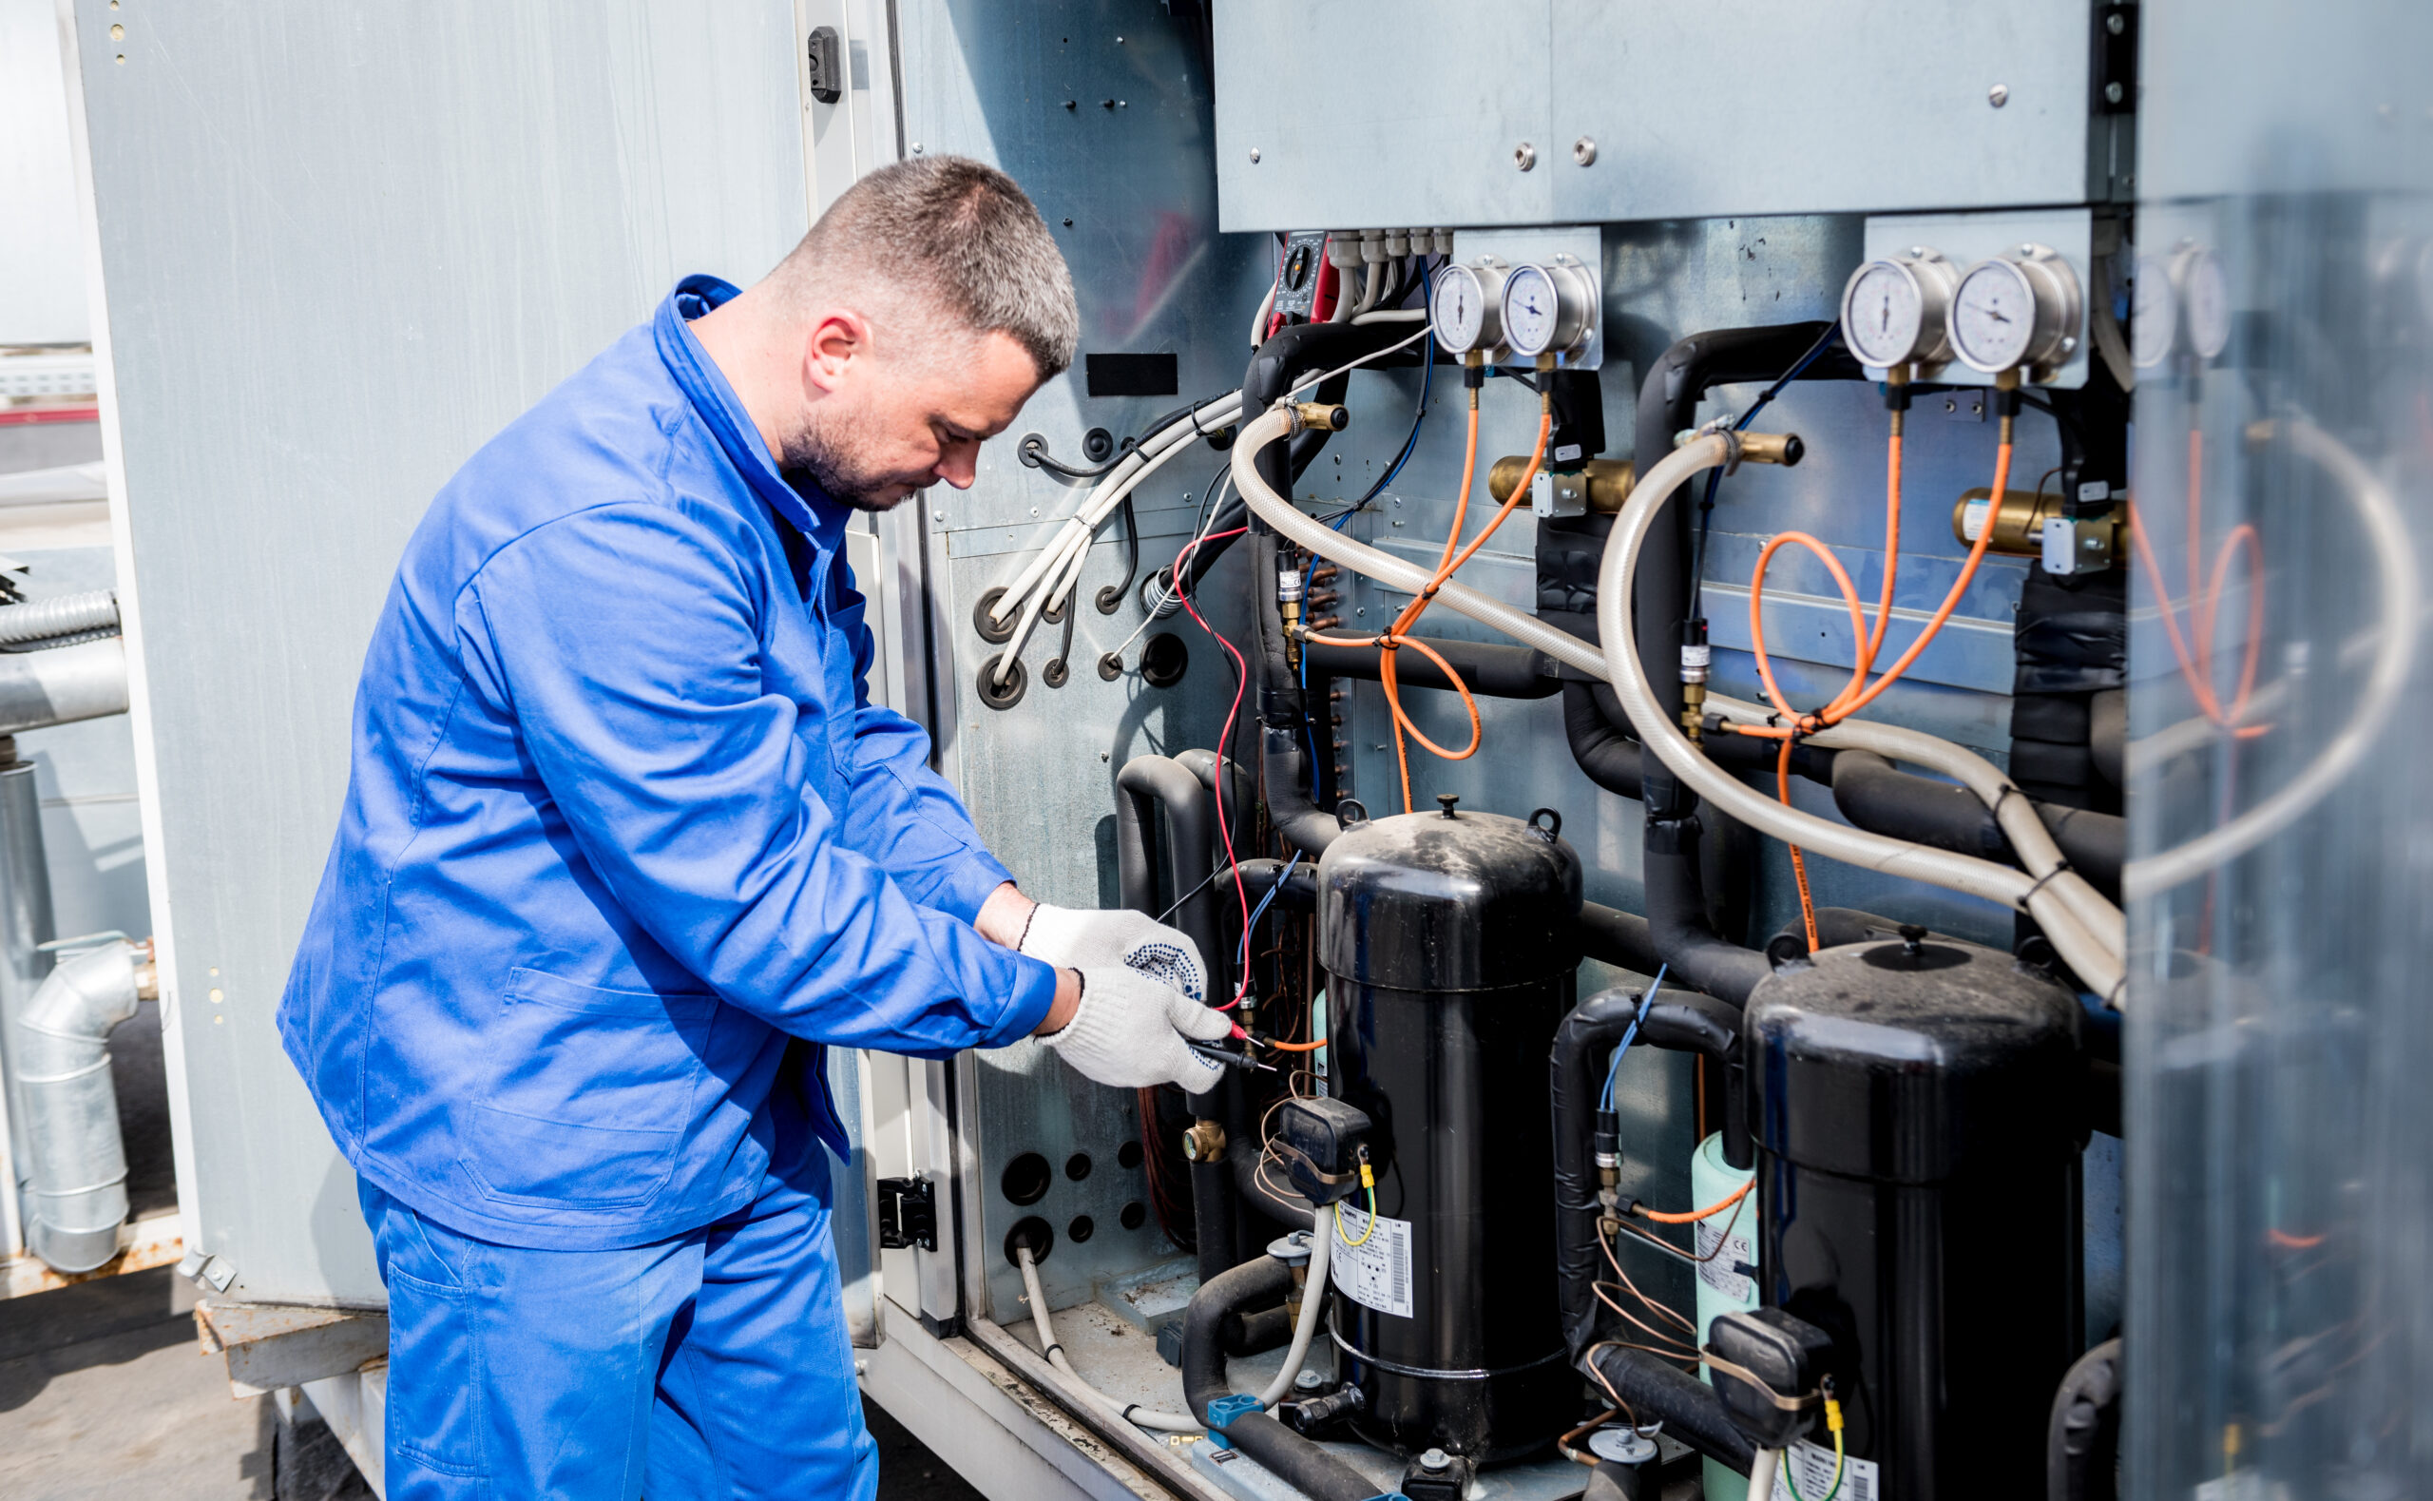
Wallace State Community College - Hanceville
A-13b. Associate of Applied Science in Facility Maintenance Technology
(CIP 46.0401)
The proposed AAS in Facility Maintenance Technology will prepare graduates for employment in positions included on the 2024-25 Alabama Demand Occupations list including maintenance and repair workers, industrial machinery mechanics, and heating, air conditioning, and refrigeration mechanics and installers.
The program proposal includes letters of support attesting to the need for the program, including Mazda Toyota Manufacturing and Y-TEC Keylex Toyotetsu Alabama.

Slide 85
Motion, Decision Item A-13b:
That the Commission approve Wallace State Community College - Hanceville’s proposal to offer an Associate of Applied Science in Facility Maintenance Technology.

Slide 86

B. Information Items
Implementation of For-Credit Non-Degree Certificate Programs
Changes to the Academic Program Inventory
Curricular Modifications for Existing Degree Programs
Updates to Academic Units
Implementation of Distance Education Programs

Slide 87
Motion, Decision Item B:
That the Commission accept the Information Items as presented.

Slide 88
IX. Adjournment

