Slide 1

Alabama Commission on Higher Education
Commission Meeting
December 9, 2022

Slide 2


CALL TO ORDER, PRAYER, AND PLEDGE OF ALLEGIANCE

Slide 3

II. ROLL CALL and
QUORUM DETERMINATION

Slide 4

III. APPROVAL OF AGENDA
Commission Meeting Agenda
of December 9, 2022

Slide 5

IV. CONSIDERATION OF MINUTES
Commission Meeting Minutes of September 9, 2022

Slide 6

V. CHAIRMAN’S REPORT

Slide 7

VI. EXECUTIVE DIRECTOR’S REPORT

Slide 8
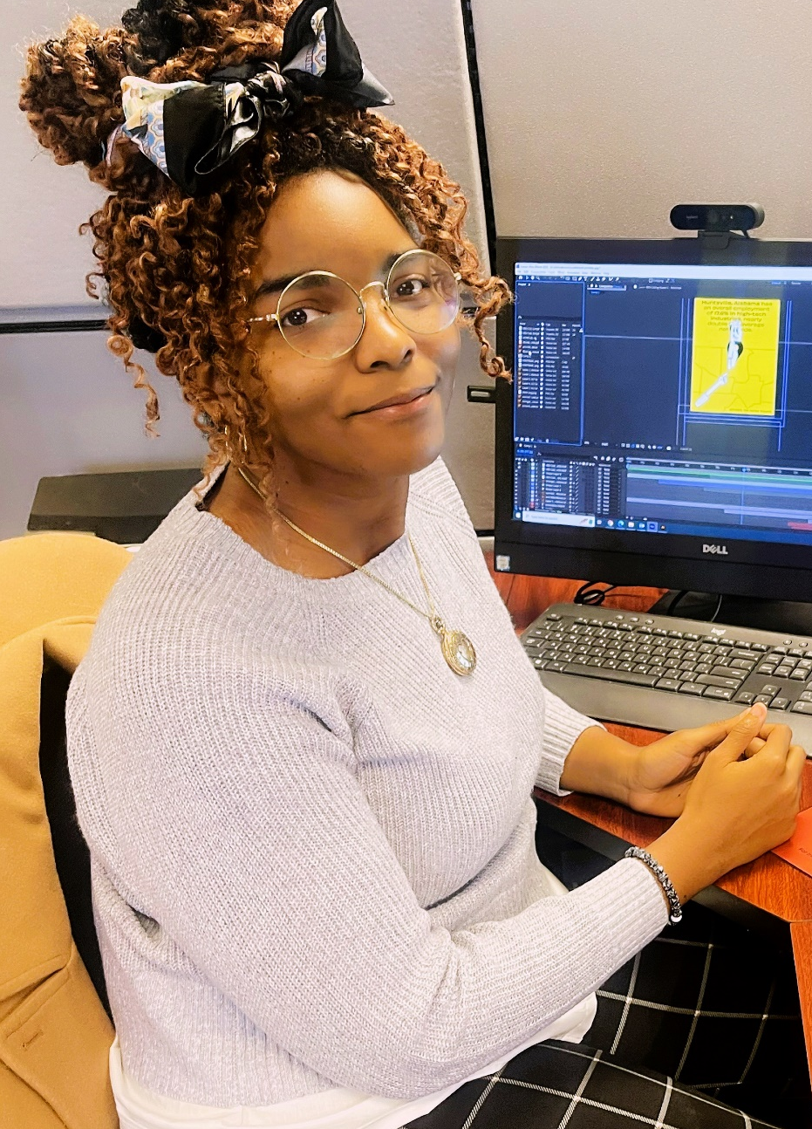
Samia Goodwyn
Samia Goodwyn serves as a Graphic Design Specialist for ACHE on a part-time basis. Samia received a BFA in Graphic Design in 2022 from Auburn University at Montgomery and graduated with honors (Cum Laude).
While a recent graduate, Samia has worked professionally for over 5 years doing commission and freelance work involving illustration art, concept design, and graphic design. While working at ACHE, Samia is concurrently participating in an internship in the video game industry as a character designer.

Slide 9

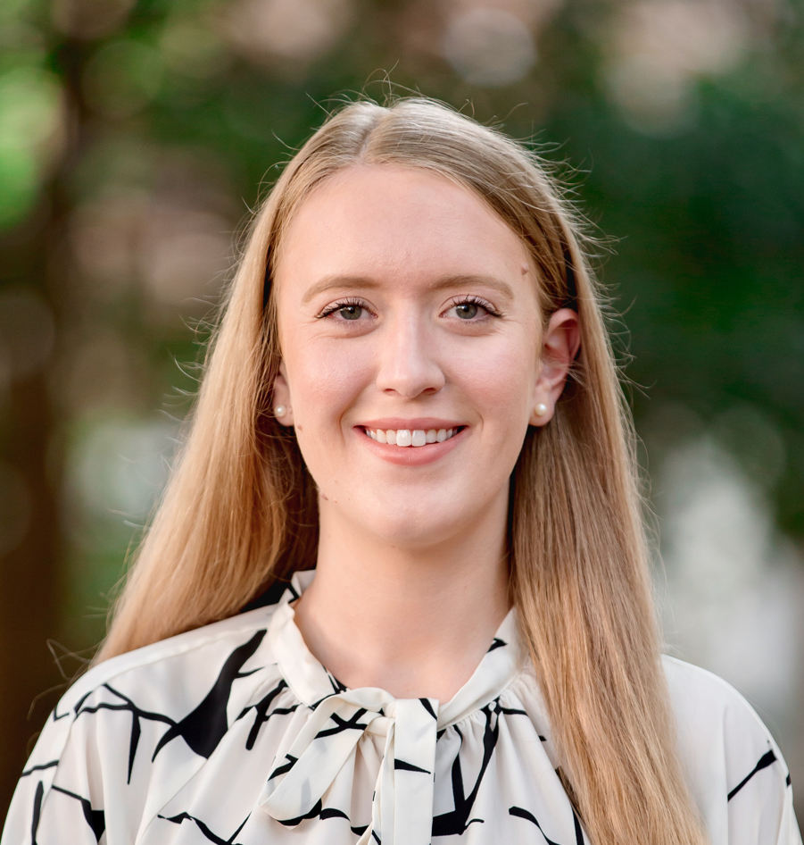
ACHE Research Fellow wins Best Paper Award
ACHE Research Fellow, Natalie Millar, recently earned a PhD in Economics from the University of Alabama while completing a concurrent fellowship at Stanford University.
Dr. Millar recently received the Best Paper Award at the annual Association for Career and Technical Education Research (ACTER) meeting in Las Vegas.
Her research used data from Alabama’s community colleges to explore data-driven modeling to help predict retention among community college students.

Slide 10
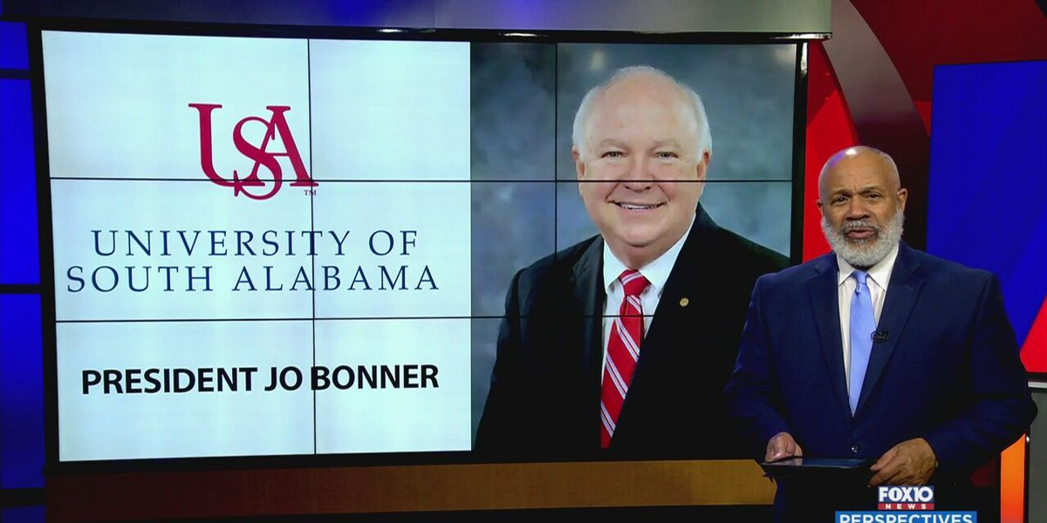
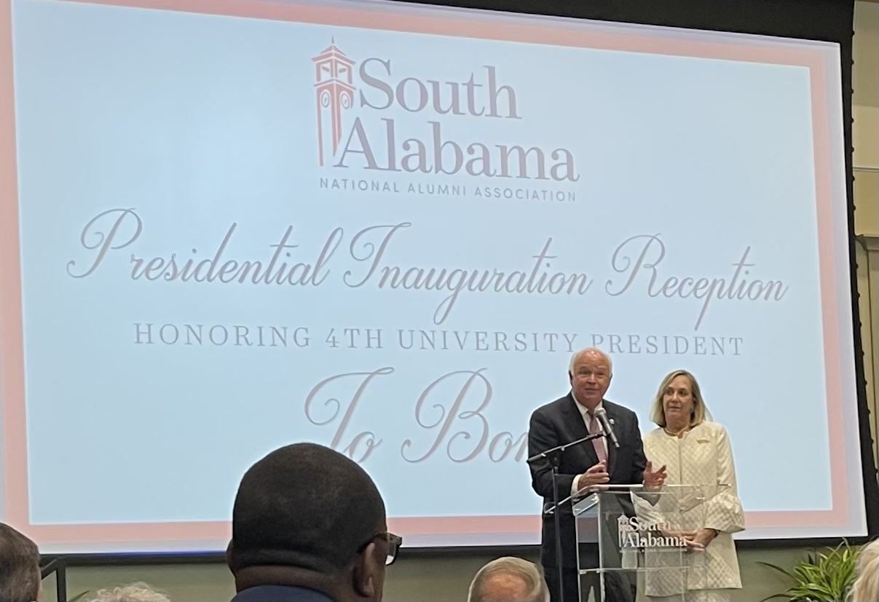
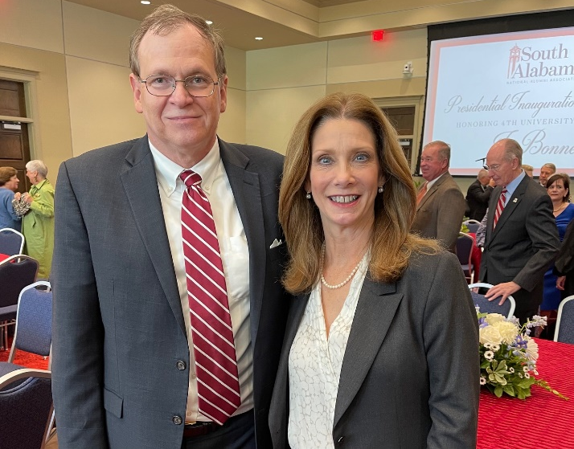

Slide 11


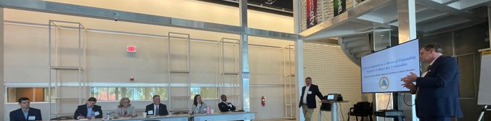
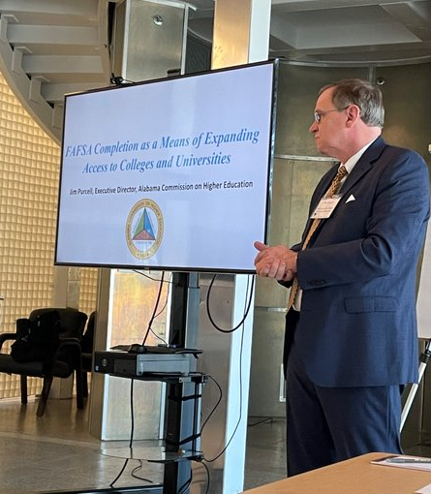
Role of Boards and other thoughts
Mississippi Institutions of Higher Learning
Board Retreat
Role of Trustees /staff
State higher education structures compared
Issues in Higher Ed
Some initiatives to ponder

Slide 12
Mark J. Drozdowski, (2022)
“7 Challenges Threatening the Future of Higher Education.” Bestcolleges.com
Enrollment Declines Signal Changing Student Preferences
Spiraling Costs Make College Unaffordable
Student Debt Reaches Record Levels
New Alternatives to College Abound
Dozens of Colleges Closing and Merging
Tenure Is Threatened, and Faculty Are Dissatisfied
Politicians Meddle, and Public Opinion Wanes

Slide 13

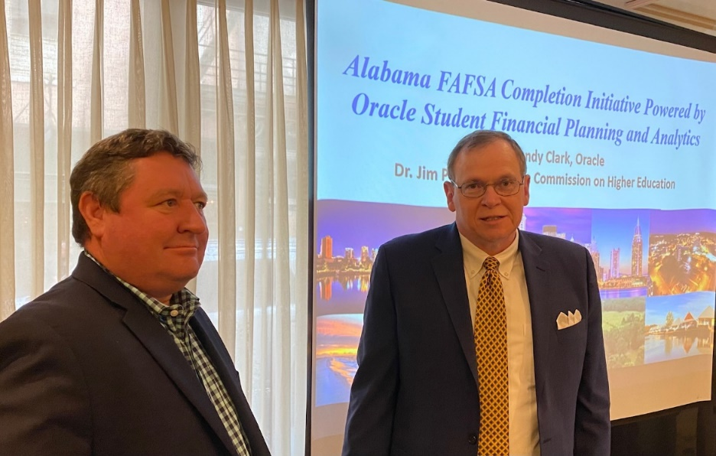
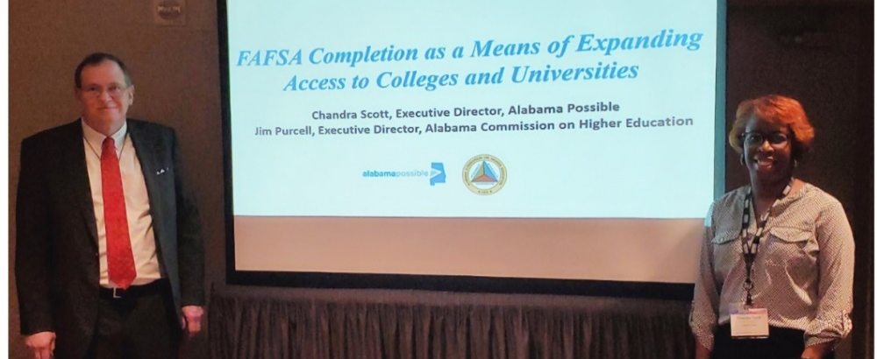
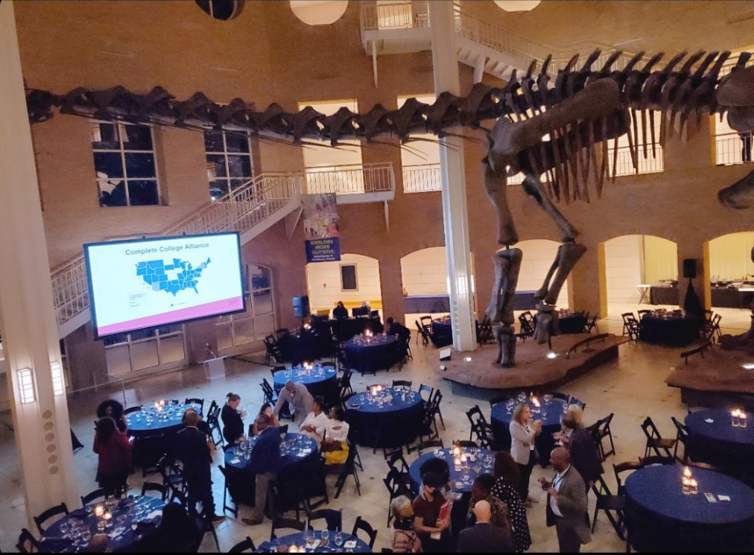
FAFSA Completion
Southern Association of Institutional Research – New Orleans
Complete College America – Atlanta

Slide 14

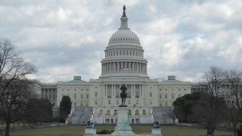
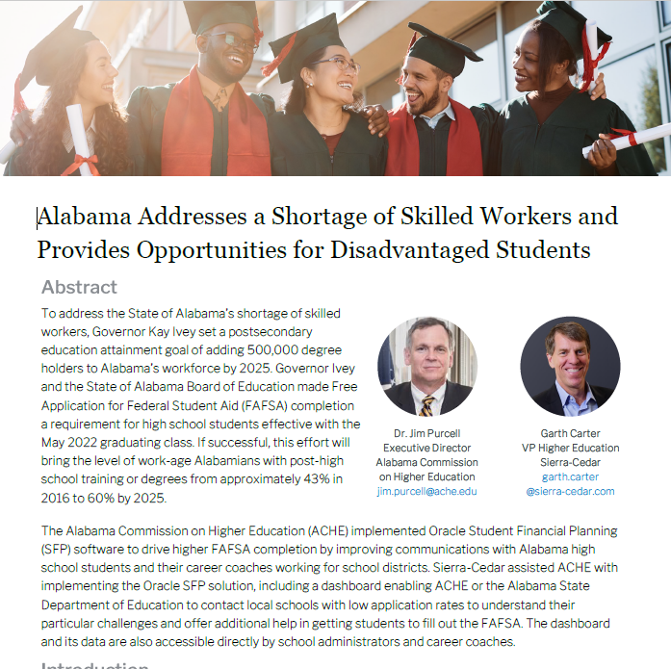
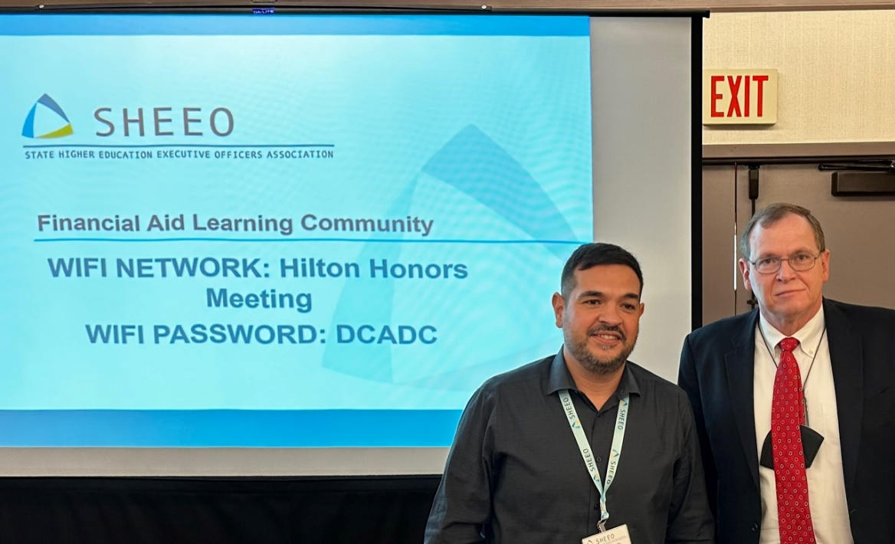
Jim Purcell (AL) and Eric Zarnikow (IL)
FAFSA Completion Strategies
FAFSA Simplification

Slide 15

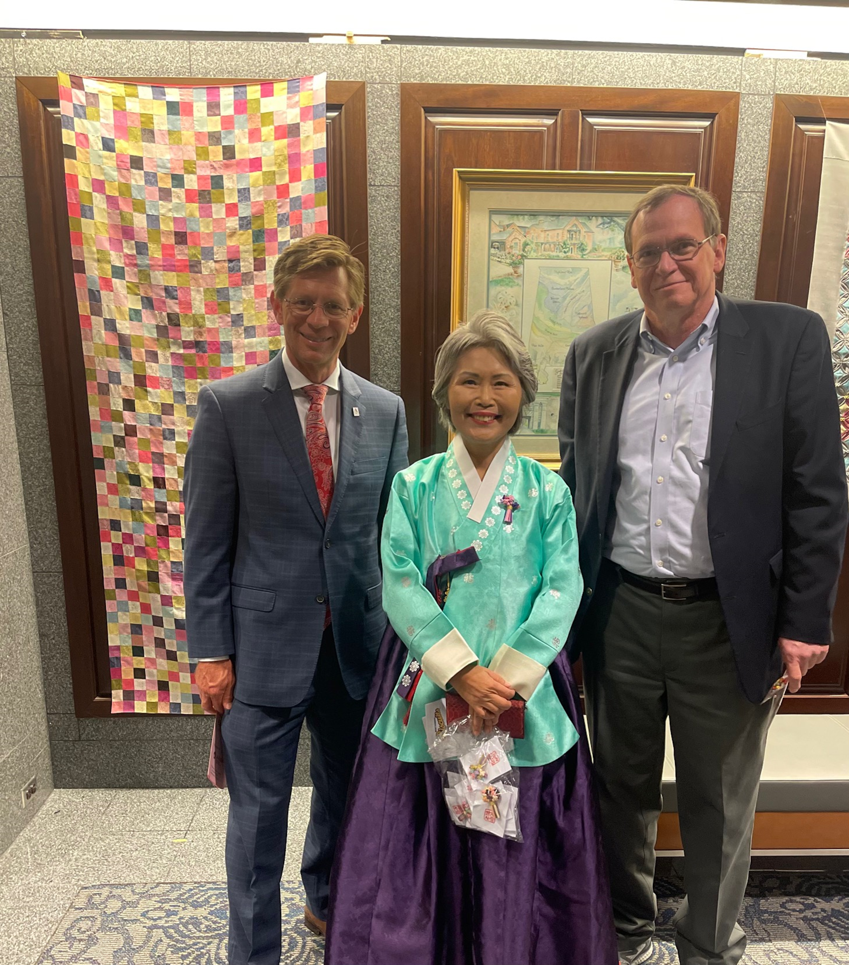
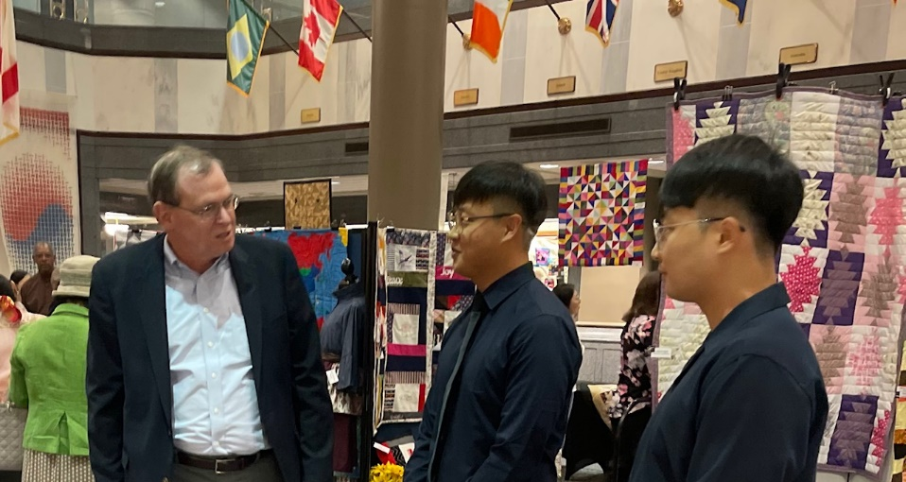
Cultural event (Korean Tapestries)
The AKEEP STEM teacher program currently has 10 masters degree students enrolled at the University of North Alabama.
In addition, 49 Korean students participated in a practicum at K-12 schools in Alabama this year.
AKEEP is now Alabama International Education and Economic Partnership (AIEEP, “International Partnership”) to serve as a global workforce resource in Alabama to provide multilingual, multicultural diversity education to the students and professionals and bridge the differences and barriers between communities, institutions, and corporations as a global partnership facilitator.

Slide 16



Outreach to communities related to workforce
Morning -- Governor’s Work-Based Learning Best practices Recognition Event.
Afternoon – ACHE Workforce Initiatives
Region 1 October 20th, Athens State
Region 2 October 18th, Jacksonville State
Region 3 October 27th , West Alabama
Region 4 November 1st, Montevallo
Region 5 November 3rd, Alabama State
Region 6 November 15th, Troy
Region 7 November 17th, U of South Alabama
Attending the events were Chair Frost (R1), Vice Chair Price (R2) and Commissioner Buntin (R6)

Slide 17
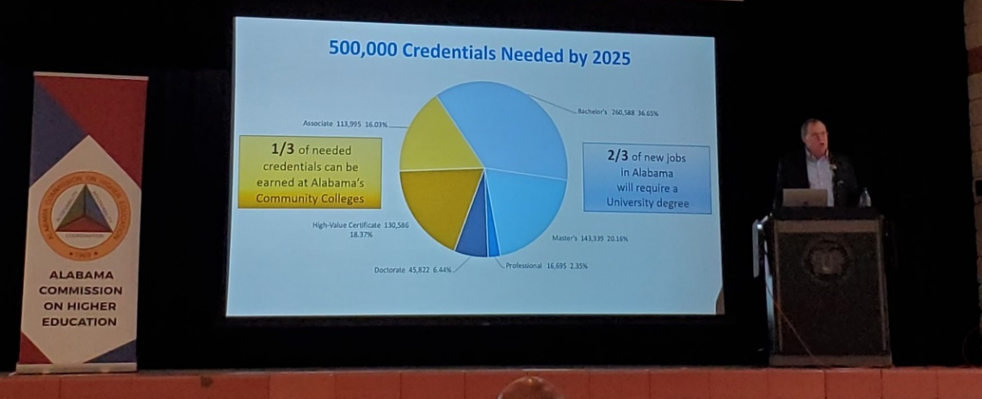
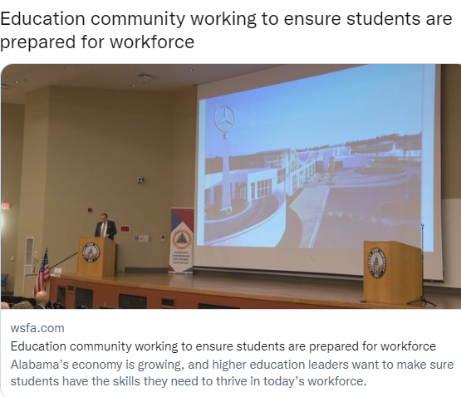
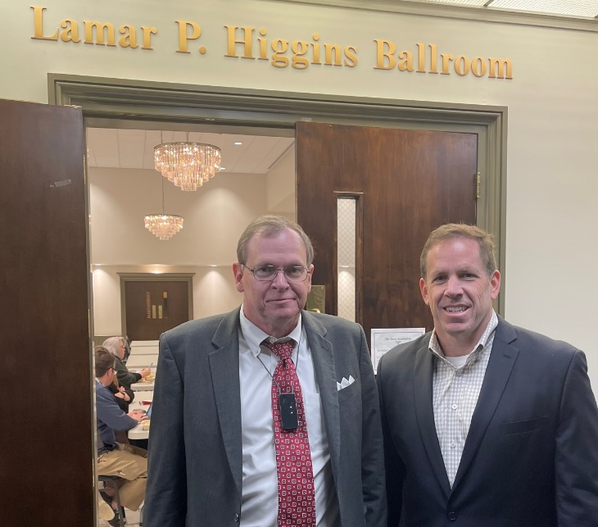
Jacksonville State University
Alabama State University
Troy University

Slide 18
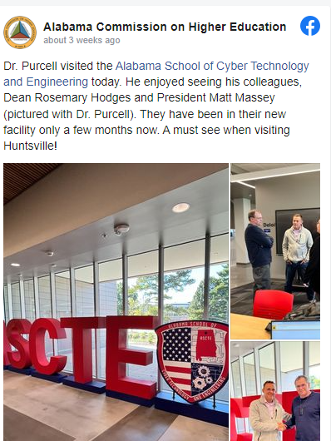
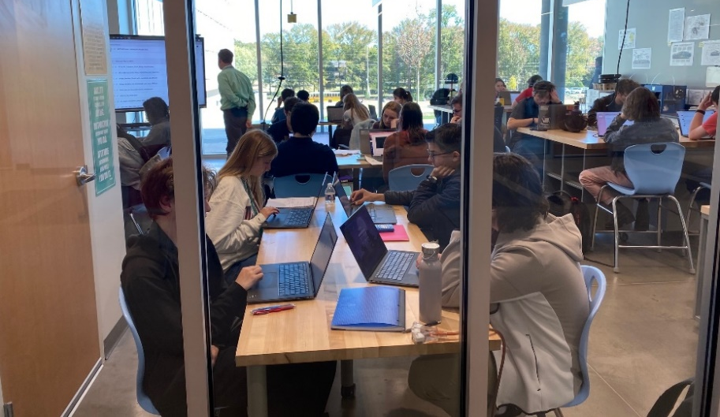
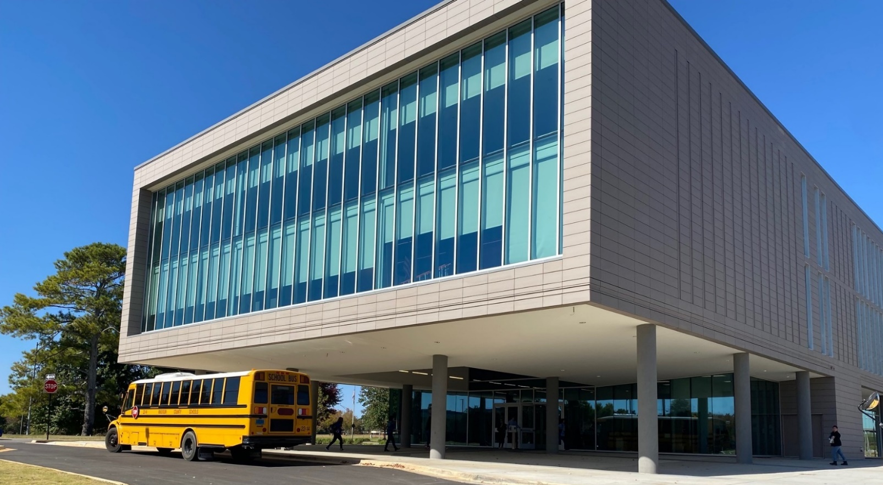
Alabama School of Cyber Technology and Engineering
Nicholas Bolden and I assisted ASCTE in writing their Strategic Plan

Slide 19
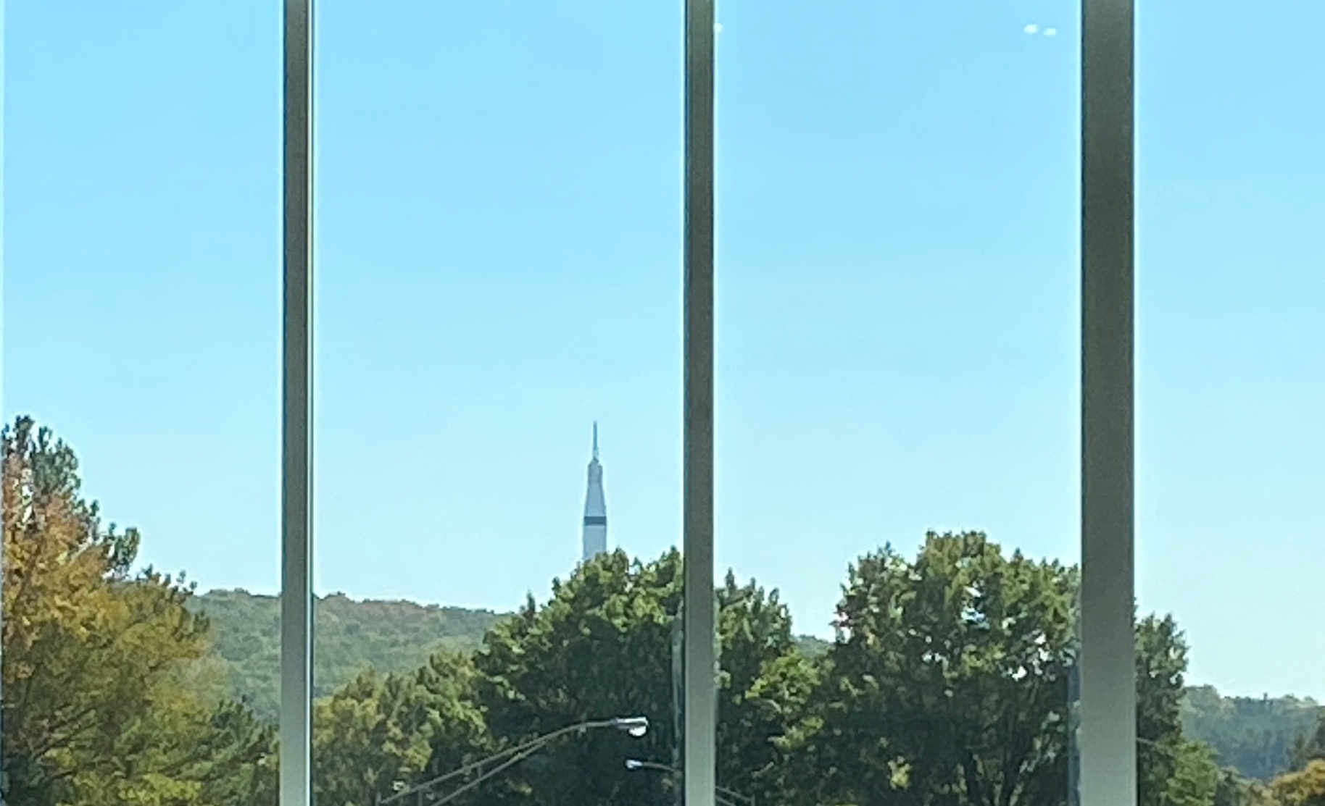

Slide 20
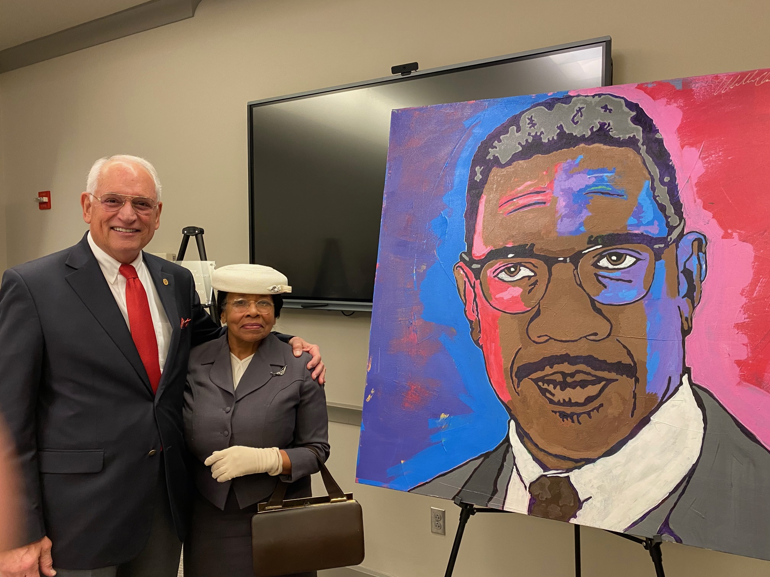

Slide 21

What Staff do when they aren’t working
Dr. Jim Hood plays an Irish prison guard in a TV show on prison escapes.
Video will come over separate cover

Slide 22

VII. DISCUSSION ITEMS

Slide 23


Alabama EPSCoR Graduate Research Scholars Program 2022 Round 17 Awardee
Staff Presenter: Mrs. Margaret Gunter

Slide 24

$20 Million National Science Foundation EPSCoR Grant: “Future Technologies and Enabling Plasma Processes”
Record year - $42 million of federal EPSCoR awards brought to Alabama

Slide 25
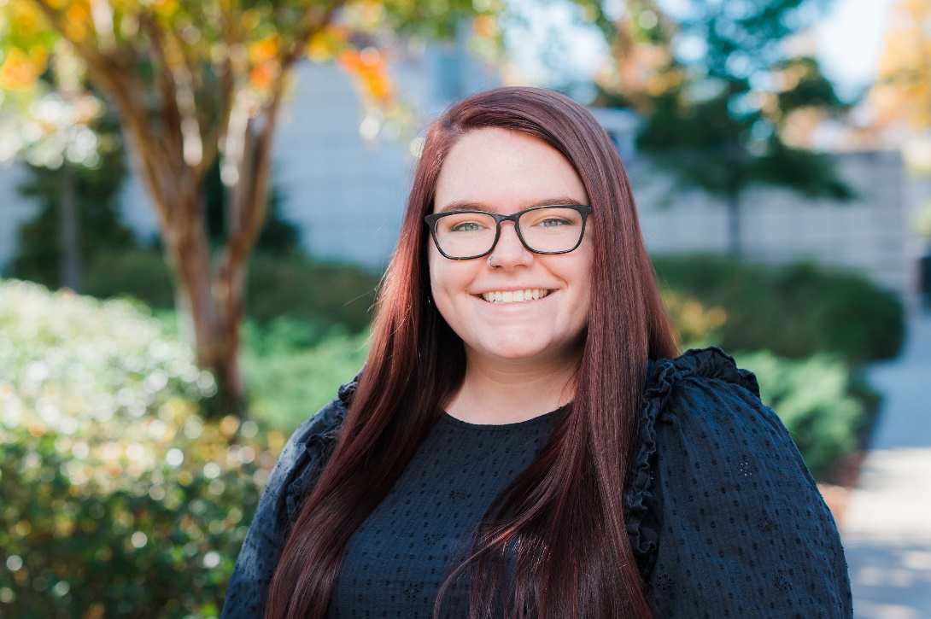

Ms. Sarah Sims
Graduate research assistant at the University of Alabama at Birmingham
Awardee of the 2022 Round 17 Alabama EPSCoR Graduate Research Scholars Program
Research uses fruit flies as a model system for studying an important protein family involved in the maintenance of DNA and overall health in many species, including humans

Slide 26
My Journey as an EPSCoR Scholar
By: Sarah Sims

Slide 27
My Story

Slide 28
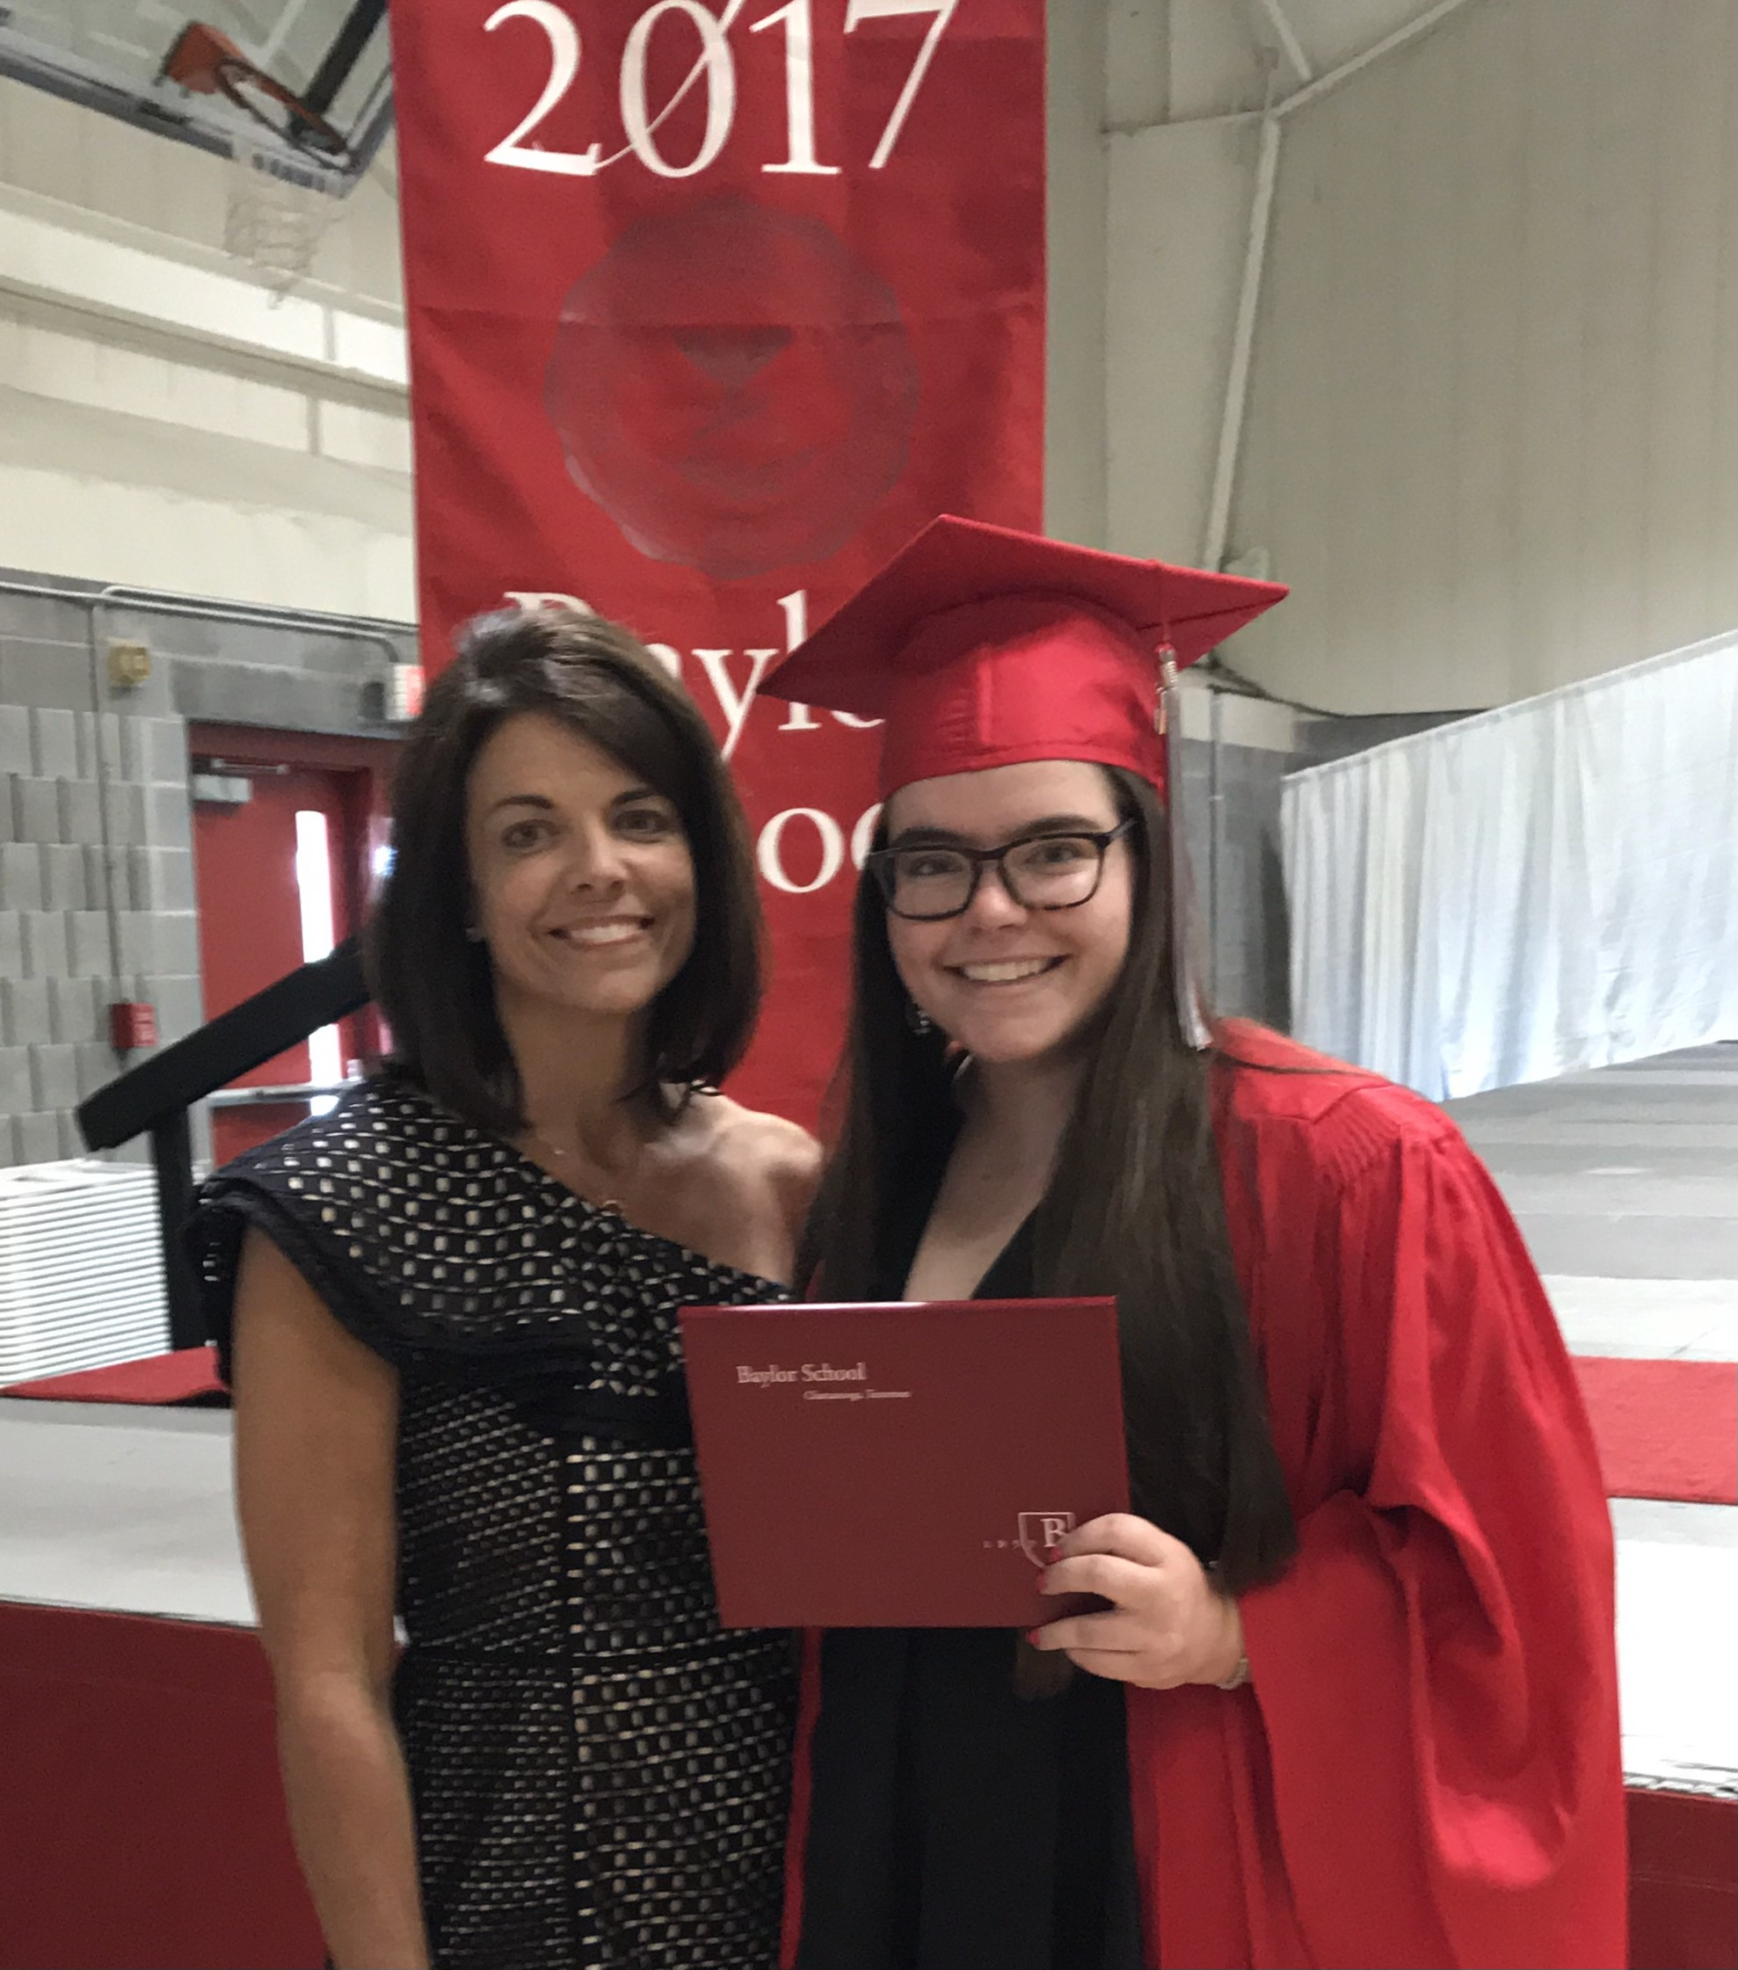
Graduating high school
Notes:
This is me and my mom during my high school graduation in 2017. I was an ambitious honors student with interests in science. Like many other 18-year-olds, at this point, I did not know how my interests could lead to a career. Being one of the first people in my family to attend a four-year college, and the first to consider graduate education, I did not have much guidance in planning my academic future. Because medical school was portrayed as the ultimate goal for students interested in science, I settled on pursuing a career in medicine at The University of Alabama at Birmingham. Thus, I started my college journey on the pre-medical pathway, primarily due to the influence of peers and teachers.

Slide 29
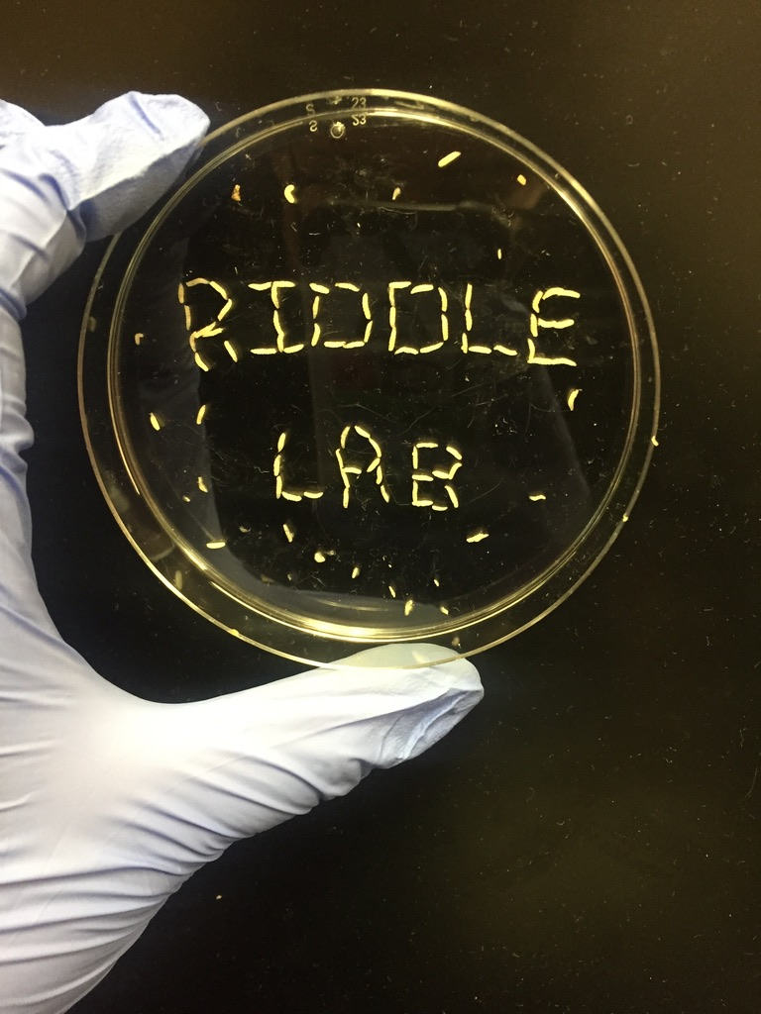
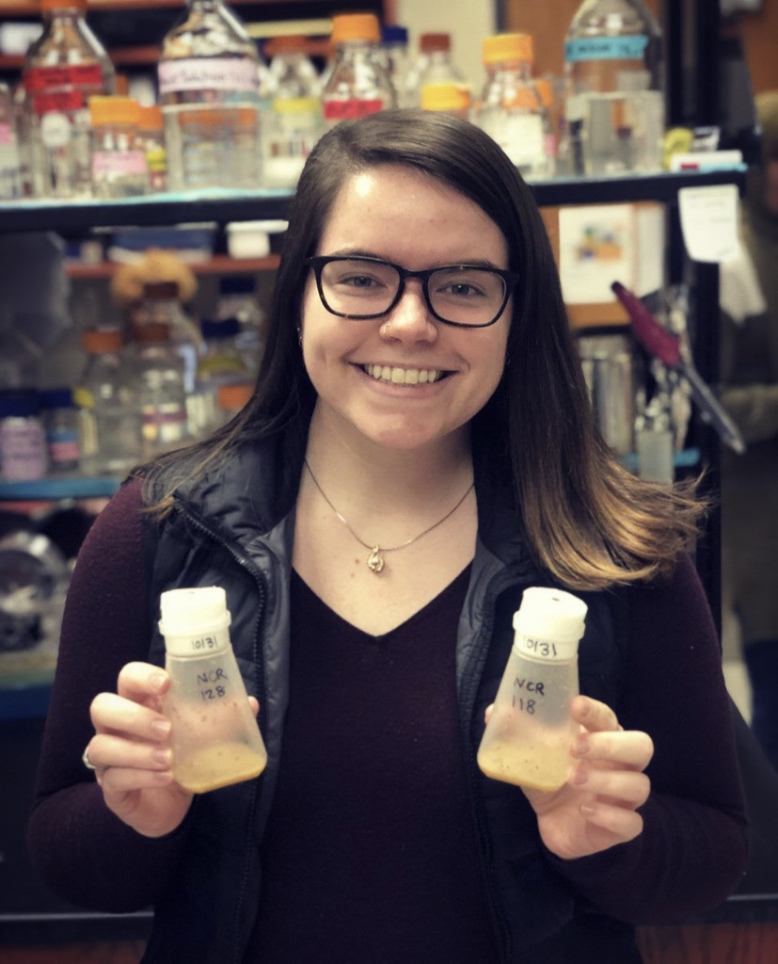
Joining the Riddle Lab
Notes:
When I got to UAB, I wanted to get involved in the student population, and so I joined several student groups on campus.
However, I really longed for more involvement in the realm of science. I always had an interest in scientific research, so I decided to apply to research labs on campus. I wasn’t interested in working with the typical mice or rat labs, and I had always had an interest in bugs since I was a kid, so when I saw that a fruit fly lab was hiring, I figured I would give it a shot. When I received an email offering me the student research assistant position in Dr. Nicole Riddle’s lab, I immediately accepted. Here I would be able to gain research experience, which at the time I thought would be an important stepping-stone on the way to medical school.

Slide 30
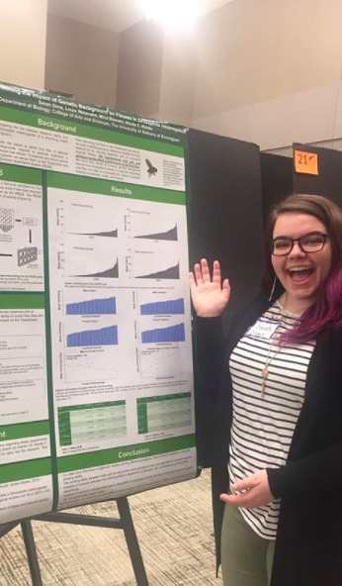
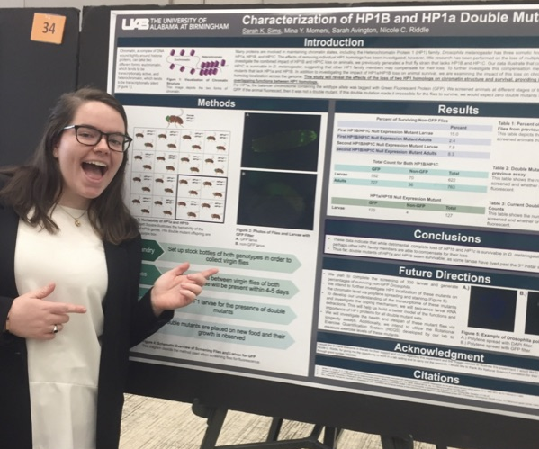
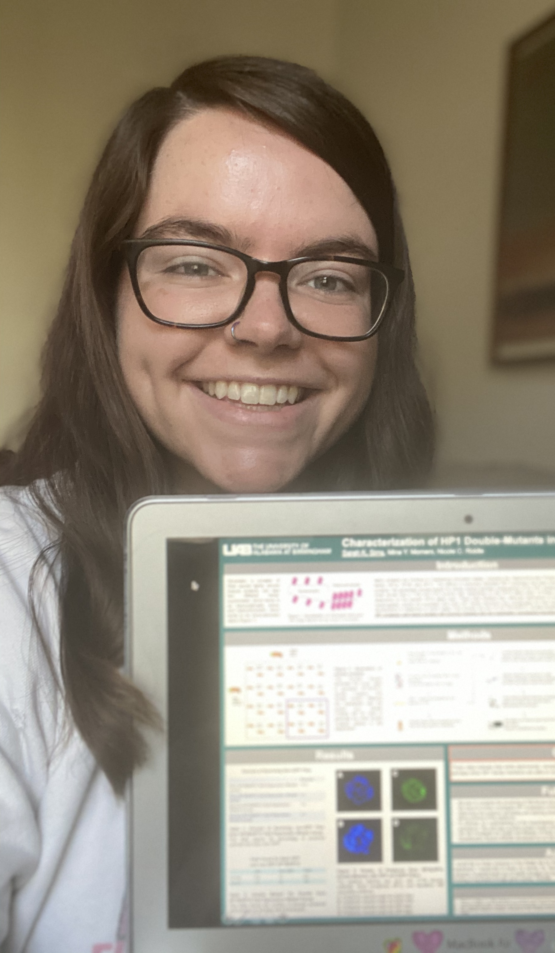
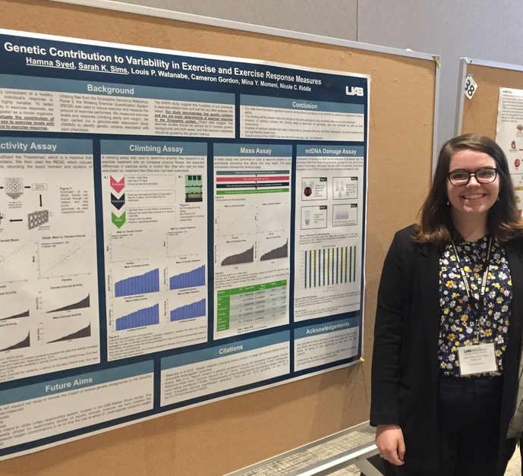
Gaining research experience
COVID=
Virtual
Conference
Notes:
I joined the Riddle Lab in 2018, and after a year or so in the lab, I started working on my own research project. And as I gained more experience working with fruit flies, gathering data, and presenting my research at local and national conferences, I had to do a reality check with myself. My interest was no longer in going to medical school, my heart was in research! With graduation fast-approaching, I had to make a huge change for my future– I quit the pre-medical pathway and applied to graduate school.

Slide 31
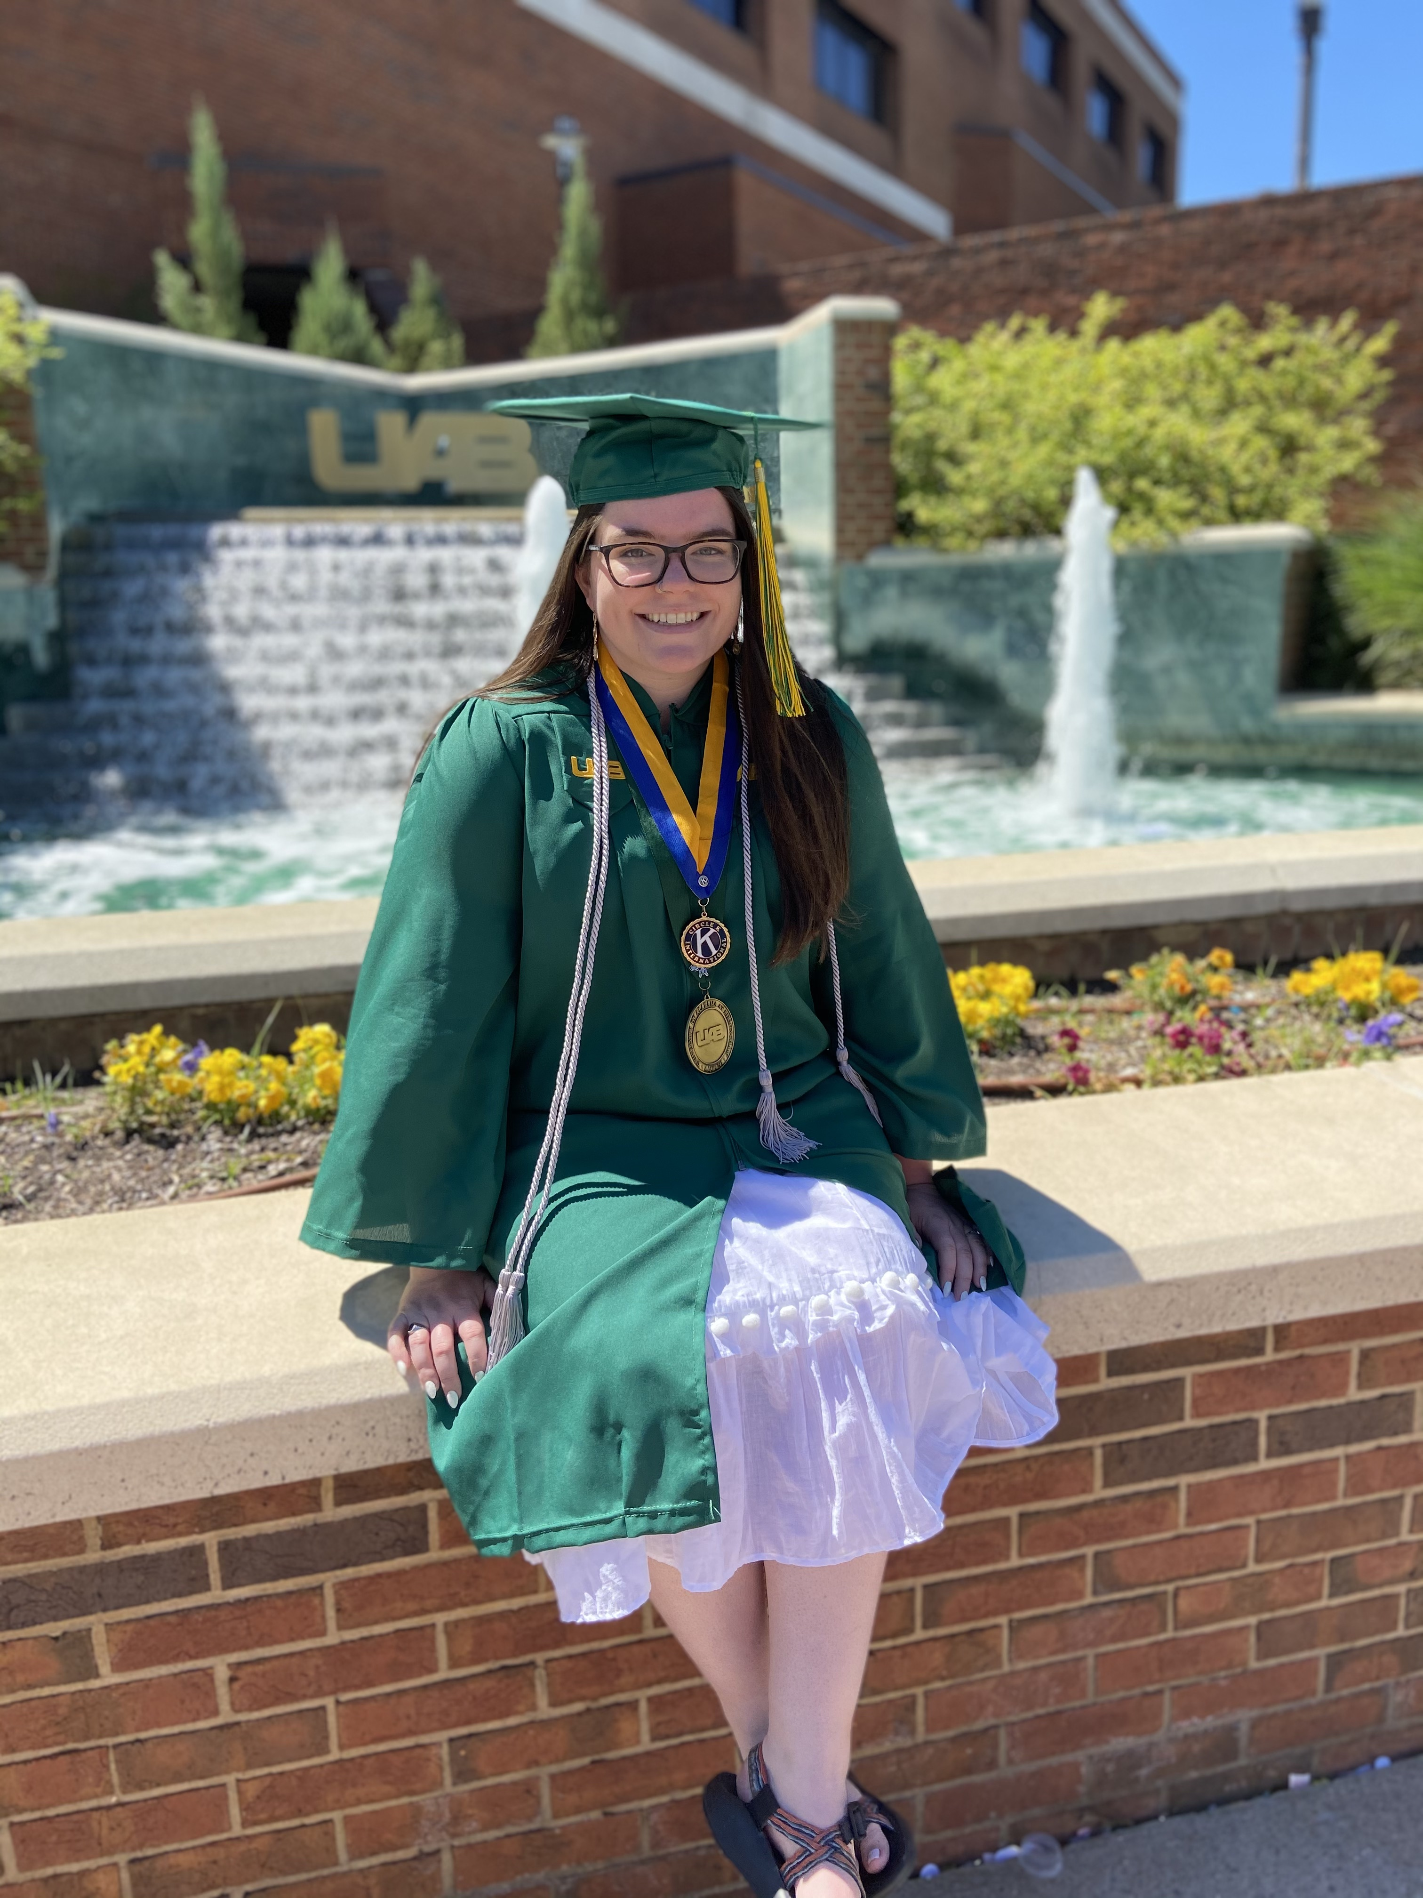
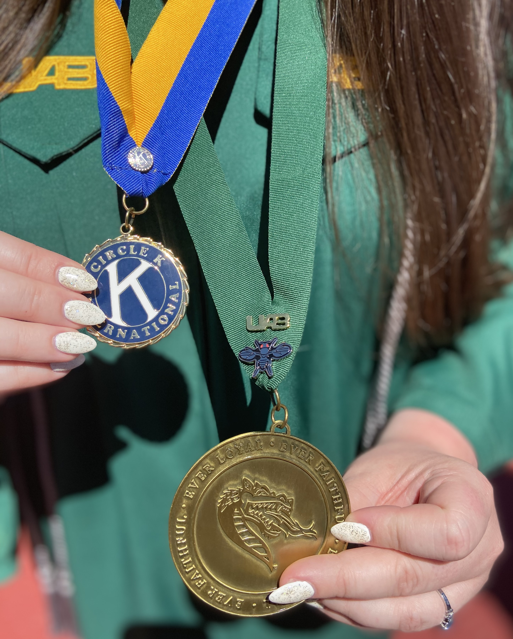
Graduating with a Bachelor of Science
Notes:
I was accepted into UAB’s graduate program on the fast-track path to where I could start pursuing my graduate degree early. Thus, I began my path towards a Master of Science in Biology while finishing my senior year of undergraduate studies. This is me on my on senior graduation day, and I even wore a little a little fruit fly pin on my academic medal as a nod to my research journey.

Slide 32
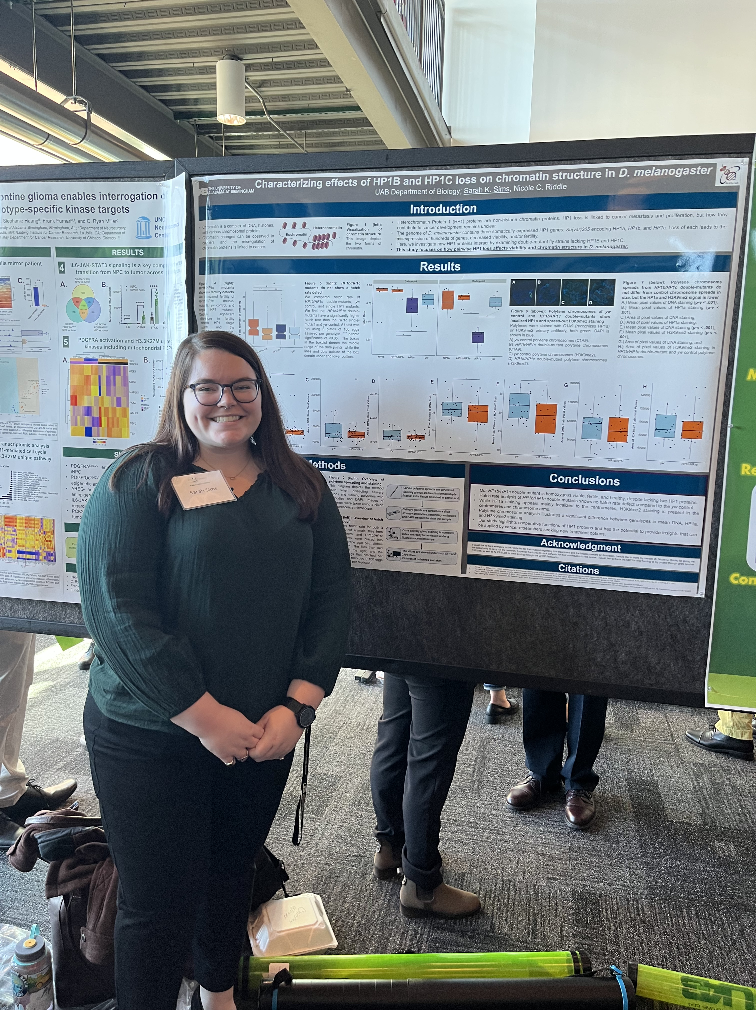
Pursuing a Master of Biology
Notes:
I have been pursuing my master’s in biology full-time for about a year now. My degree is thesis-based, in which I will defend my thesis in order to graduate. Through this degree program, I take a variety of rigorous science classes and work on my research project every day of the week, which is preparing me for a career as a research scientist.

Slide 33
My Research Project

Slide 34
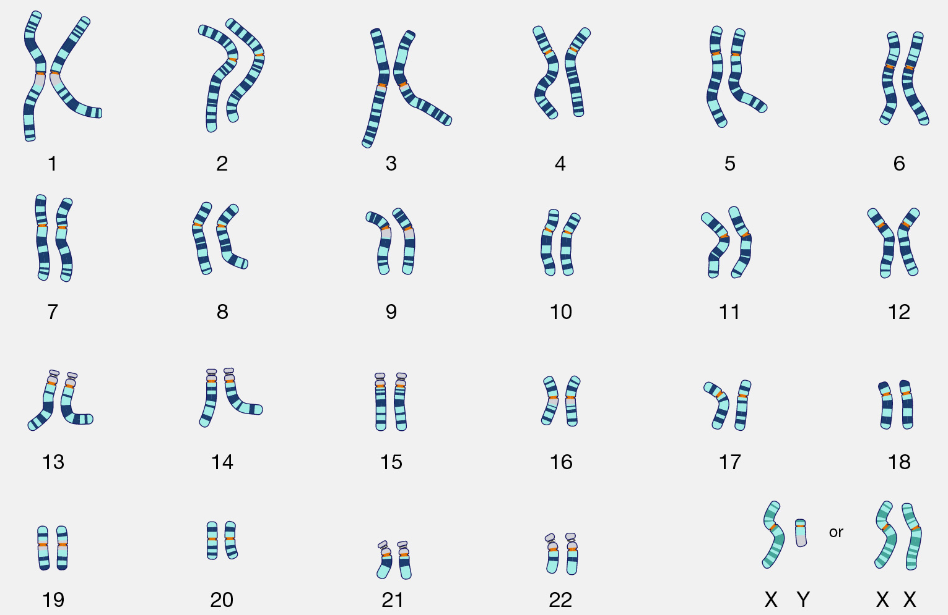

Chromosome karyotyping
Notes:
Some of you may have seen an image like this before, but this is what's called a karyotype. And a karyotype is simply a complete set of an individual’s chromosomes. Each and every one of our cells contains 23 pairs of chromosomes, which you can see mapped out here.

Slide 35

Chromosomes carry our genetic information
Chromosome
Notes:
These chromosome structures are responsible for carrying all of our genetic information in the form of genes, which makes us all unique individuals. Chromosomes are typically portrayed in this linear X-shaped structure.

Slide 36

Chromosomes are made of chromatin
Chromosome
Chromatin
Notes:
If you zoom in on a chromosome to see what it’s really made of, you see a tightly wound complex that is called chromatin. Chromatin has a very important job of taking all your genetic information and coiling it up into compact chromosomes so that the cell stays organized. The chromatin structure allows the cell to control which portions of DNA are used. Controlling which sections of DNA get used is critical, because if there are errors in DNA usage, bad things happen like disease or cancer development. Since it’s time for the holidays, a helpful analogy you can use to think about chromatin is holiday lights. Chromatin is like a well-organized pack of lights that you just bought at the store. Our cells are smart to package chromatin tightly wound like new Christmas lights, as opposed to the jumbled mess of lights you have stored in your attic. If your strings of lights are all jumbled up, bad things may happen like accidentally busting a bulb when you untangle them.

Slide 37

Chromatin is made of DNA and proteins
Chromosome
Chromatin
DNA wrapped around proteins
Notes:
If you zoom in even further on chromatin itself, you see that chromatin is made up DNA strands wrapped around proteins. DNA, which is shown as the black string, is often called the molecule of life because it provides the information required for an organism’s development and is present in every cell.

Slide 38
HP1 proteins influence DNA use
Heterochromatin Protein 1
HP1
Chromosome
Chromatin
DNA wrapped around proteins
Notes:
There are many different proteins that are a part of chromatin, and I study one of them called the Heterochromatin Protein 1 family. This is a mouthful that can also be called the HP1 family, for short. This protein family influences which DNA pieces are accessed in a cell. In previous studies, it has been shown that when you lose a protein family such as HP1 that’s involved in DNA maintenance, the result is disease and cancer development.

Slide 39
Interest in HP1 cooperation
Heterochromatin Protein 1
HP1
HP1
HP1
Chromosome
Chromatin
DNA wrapped around proteins
Notes:
A large number of organisms have multiple HP1 proteins, including humans. Our lab is interested in how these multiple HP1 proteins work together. Our main interest is in three different HP1 proteins, all of which affect access to DNA and impact overall health. Although HP1 proteins have been studied individually, few studies observe how HP1 proteins work together.

Slide 40
Studying effects of pairwise HP1 loss
Heterochromatin Protein 1
HP1
HP1
HP1
Chromosome
Chromatin
DNA wrapped around proteins
Notes:
My project involves removing a pair of HP1 proteins to examine the effects on chromatin and the access to the information in the DNA. This study will identify how HP1 proteins interact with one another, and if the loss of one affects the others. Given that HP1 proteins are present in many species, the findings from my project will be informative for studying chromatin in other organisms, including humans.

Slide 41

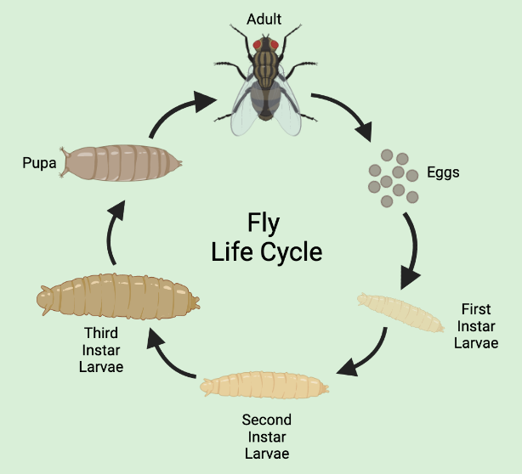
Fruit flies as a model organism
Notes:
In my project, I don’t work with humans, I work with fruit flies. So, some of you may be wondering how pesky little bugs that gather around your fruit bowls at home could ever be useful in any way. Well, they have very short gestation times, so they produce new generations very quickly. They have short lifespans and approximately a 10-day life cycle from which they go from eggs to adults. They’re small so they don’t take up much space, they’re relatively cheap to maintain, and they’re easy to work with. But one of the coolest facts about them is that we share about 75% of human disease-causing genes with them. They are a great and tiny model organism to study human disease!

Slide 42

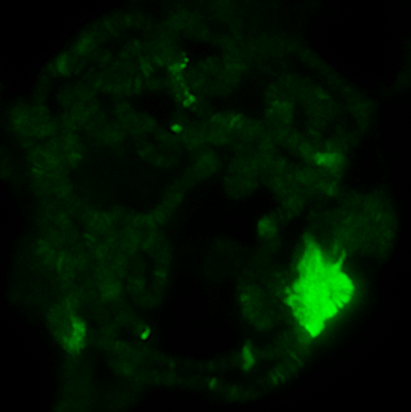
Visualizing HP1 in fly chromosomes
DNA
HP1
Notes:
I wanted to show you all an example of data that I am able to gather from this project. This is a fly chromosome—and yes, they look pretty different from our human X-shaped chromosomes. A large part of my research involves extracting fly chromosomes and staining them different colors to visualize where HP1 proteins reside. On the left, I have stained the chromosome blue for DNA. It makes sense that the entire chromosome is blue, because we know that chromosomes are made of compacted DNA. On the right, I have stained this same chromosome green for HP1 protein. Thus, we can see that the HP1 protein I stained for resides only in certain areas of the chromosome, instead of the entire chromosome. This is a useful experiment for when I remove HP1 proteins and want to see what happens to the localization of any HP1 proteins that may be remaining.

Slide 43
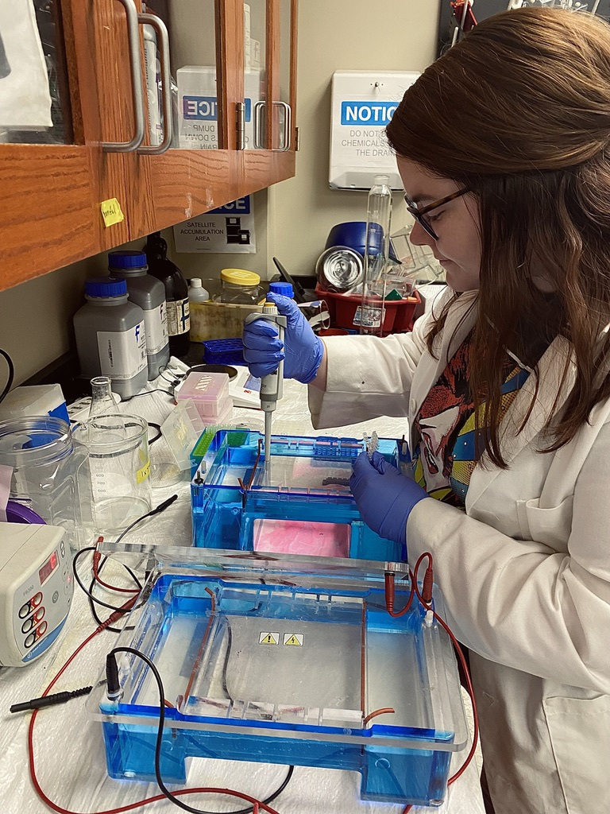

How EPSCoR makes a difference
Notes:
So now that I have told you all about my research topic, how does my EPSCoR fellowship help me along the way? With the support of funding from EPSCoR, I no longer have to be a teaching assistant every semester for intro biology courses to support myself. Since I don’t have to teach, this leaves me with much more time on my hands. I have more free time to attend more scientific meetings and can do more networking with other scientists. I am able to conduct this important research full time, with the hopes of further characterizing a protein family involved in human disease. Upon completion of my studies, I hope to pursue a career as a bench scientist, either in a clinical, industry, or university position in Alabama. My EPSCoR fellowship is making this dream possible by allowing me to continue earning research experience in my lab at UAB. With the support of funding from EPSCoR, I am able to continue my pursuit of a master’s in biology, which will prepare me for a successful career as a member of the Alabama STEM workforce.

Slide 44


THANK YOU
Riddle Lab:
Dr. Nicole Riddle
Dr. Annesha King
Heidi Johnson
Caitlin Bryan
James Walts
Ami Dave
Rachel Ferris
Anabel Byars
Taylor Green
Andrea Torres
Juliana Boyett
Kenneth Ho
Special thanks:
Dr. Jack Schoelz
Mina Momeni
Katie Varden
Louis Watanabe
Simra Syed
Hamna Syed
Committee Members:
Dr. Nicole Riddle
Dr. Melissa Harris
Dr. Farah Lubin
All figures created with Biorender
Notes:
THANKS!

Slide 45

Twelfth Quadrennial Review of the Alabama Commission on Higher Education
Staff Presenter: Ms. Dalis Lampkins

Slide 46
Code of Alabama, 1975, Section 16-5-12
During the last year of each gubernatorial term, the commission shall conduct a survey of members of the education community, the Legislature, the Executive Branch of the state and business and industry to evaluate the effectiveness of the work of the commission.
A report detailing the results of the survey and any recommended changes, shall be submitted to the Governor, the Legislature, the presidents and governing boards of the public institutions of higher education of this state, and the public.

Slide 47
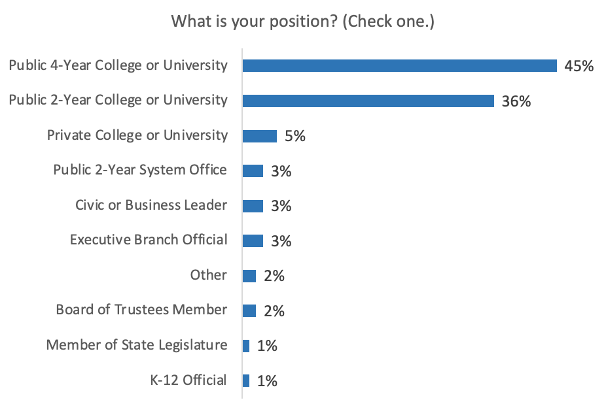
Survey Respondents
Notes:
A ten-question online survey was emailed to a diverse group of over 350 constituents with 115 respondents. Most respondents, 86 percent, were officials of public two- and four-year and private institutions, which is consistent with the response rate from the same group in 2018.

Slide 48
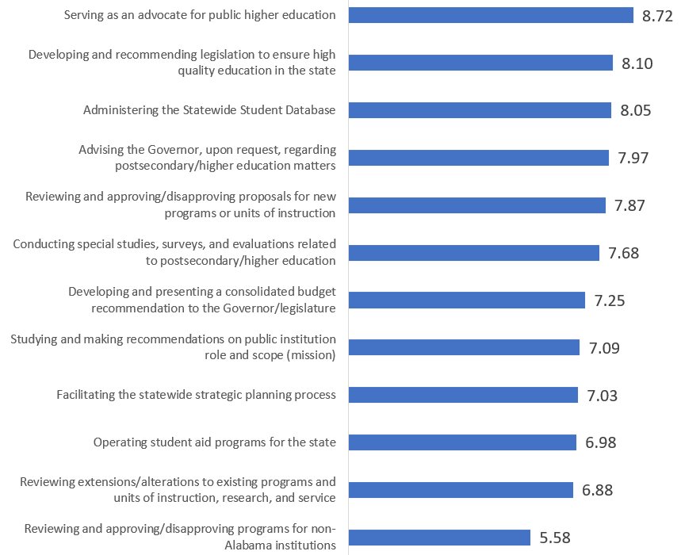
Rate Importance of Commission Responsibilities
(with 10 being most important)

Slide 49
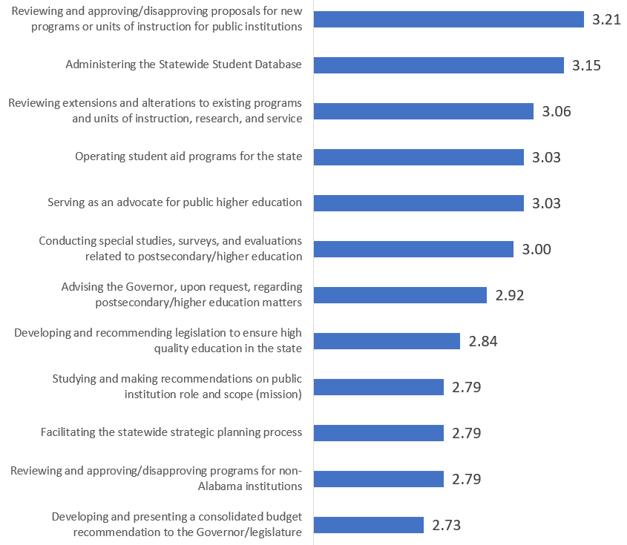
Rate Commission's Effectiveness by Responsibility
(on a scale of 1 to 4)

Slide 50
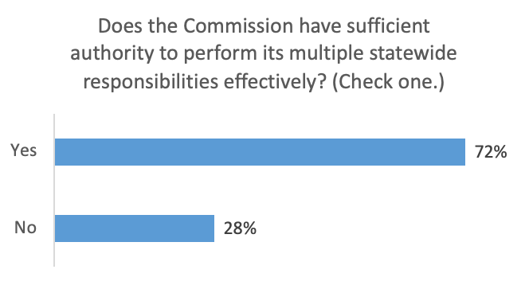
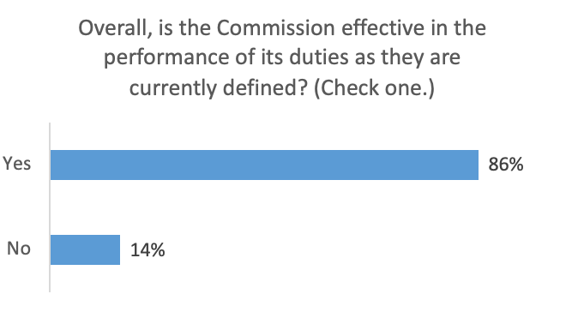
Commission's Authority and Effectiveness
Authority
Effectiveness

Slide 51
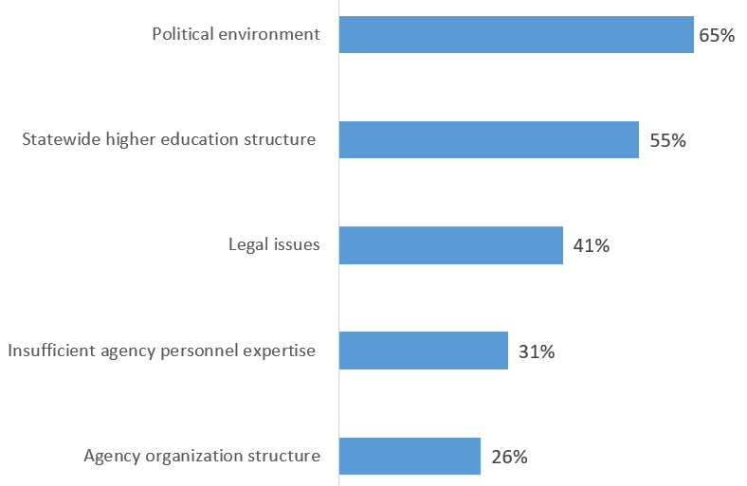
Impediments to Commission's Ability to Provide Leadership

Slide 52
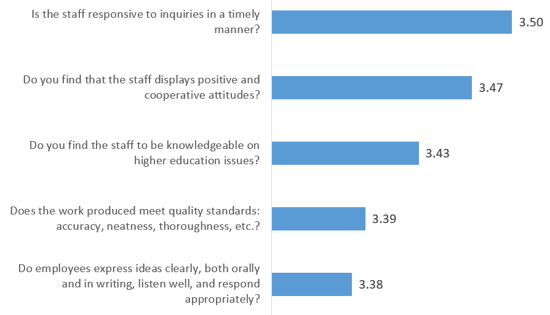
Commission Staff's Effectiveness
(on a scale of 1 to 4)

Slide 53
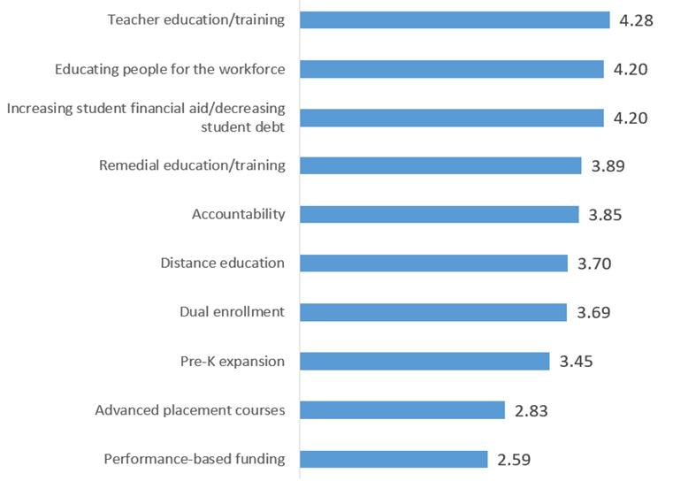
Significant Issues Facing Alabama Higher Education
(on a scale of 1 to 5)

Slide 54
Conclusions
Overall, survey results mirror prior quadrennial reviews.
Almost 9 out of 10 (86%) respondents feel the Commission is meeting its statutory obligations as the state’s coordinating board for higher education.
There was greater satisfaction related to Reviewing and approving/disapproving proposals for new programs or units of instruction for public institutions and Administering the Statewide Student Database.
Recent work to streamline ACHE’s procedures, and a reduction and clarification of ACHE policy may have contributed to improved satisfaction.
Advocacy for institutional budget increases and need-based financial aid could also be a contributing factor.

Slide 55
Recommendations
  Continue focus on advocacy and coordination of higher education, including affordability and expanded student aid programs.
  Expand services to campuses including professional development.
  Continue to provide valuable data through the Statewide Student Database and work to provide even more objective analyses and reports on important measures.
  Continue to coordinate with statewide education and non-education agencies (i.e. workforce, ATLAS, etc.).
  Continue to investigate and promote cost-saving measures for students (i.e. FAFSA completions, textbook costs, etc.).

Slide 56
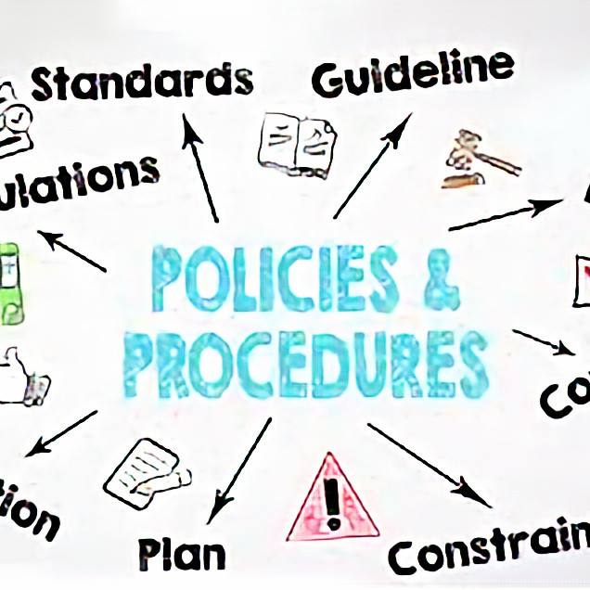
Administrative Procedures
Staff Presenter: Dr. Robin McGill

Slide 57
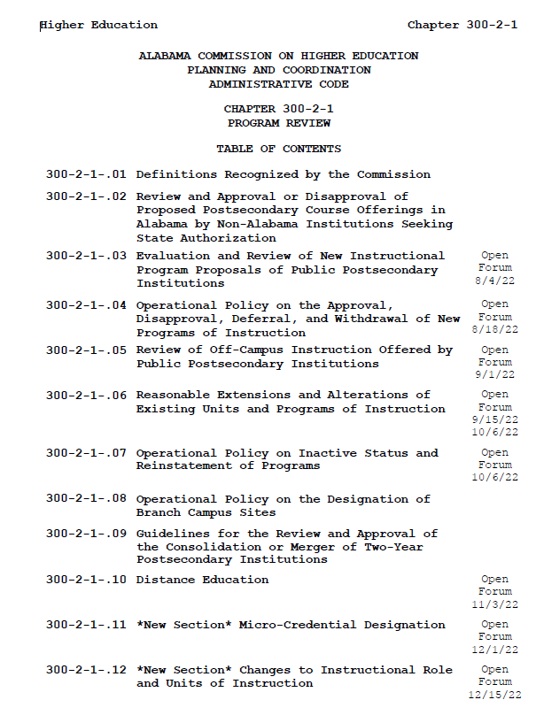
Administrative Code for Program Review (Chapter 300-2-1)
Includes regulations related to ACHE’s authority under Code of Alabama 1975 §16-5-8 “Review, coordination, establishment, etc. of programs”
Governs Commission business around program approval, post-implementation reporting, extensions/alterations, off-campus
Last major revisions occurred before 2000
Since June, 8 open forum sessions held with campus stakeholders
Identified opportunities to streamline regulations, align with accreditation standards, and reflect current practice

Slide 58
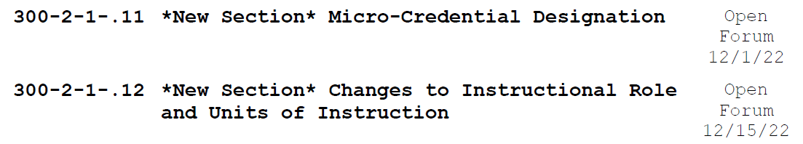
Administrative Code for Program Review (Chapter 300-2-1)
Two new sections under discussion
ACHE staff would like to engage the Academic Affairs Committee in these revisions.
Proposed timeline:
  Preliminary approval at March 2023 mtg
  Final approval at June 2023 mtg

Slide 59

VIII. Decision ITEMS

Slide 60

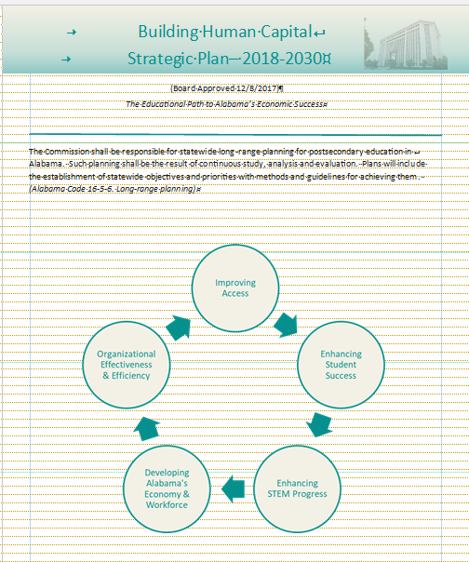
A. Annual Report: Alabama Commission on Higher Education
2021-22 State Plan Update
Staff Presenter: Mrs. Margaret Gunter

Slide 61


Highlights from 2021-22
Historic State Support for Public Education $8.2 billion
Increases in student aid programs
Funding for deferred maintenance at state’s HBCUs.

Slide 62

ACHE Highlights 2021-2022
49 New Programs of Study Approved
Alabama Statewide Student Database -- 14,800,688 Student Records
ACHE Website Designed with Interactive Report Features
Students Benefitted Through Financial Assistance Programs Administered by ACHE

Slide 63


Priority One: Improving Access
Public H.S. Graduates better prepared for college
Significant Increase in State Aid

Slide 64


Priority Two: Enhancing Student Success
Increase in transfers
Increase in Reverse Transfers

Slide 65


Priority Three: Enhancing STEM Progress
STEM Enrollment Increased
STEM Graduates Increased
Source: Alabama Statewide Student Database

Slide 66

Priority Four: Developing Alabama’s Economy and Workforce
Monitor Alabama’s employment based on degree levels

Slide 67
Priority Five: Organizational Effectiveness and Efficiency
FAFSA Completion Portal - increase college going rates
All in Alabama campaign - improve the workforce
Institutional Student Profiles - show demographic information about the student populations of Alabama’s public two- and four-year institutions
Financial Budget Hearings - determine institutional needs for the Consolidated Budget Recommendation

Slide 68
Motion, Decision Item A:
That the Commission accept the ACHE 2021-22 Annual Report.

Slide 69

B. Executive Budget Request for FY 2023-2024
Staff Presenter: Mrs. Veronica Harris

Slide 70
BUDGET REQUEST SUBMISSION
The Code of Alabama, Title 41, Chapter 19, Section 6 (a) (3) states that, each state agency/department, on the date and in the form and content prescribed by the Department of Finance, shall prepare and forward to the Budget Officer the budget requested to carry out its proposed plans in the succeeding fiscal year.
The due date for Budget Request packages, as set by law is November 1st of each year. Therefore, the FY 2023-2024 budget request packages were due Tuesday, November 1, 2022 (§ 41-4-84, Code of Alabama 1975).
In order to comply with the designated submission deadline, a budget request was submitted to EBO.
Any changes made by the Commission will be submitted through a budget request revision.

Slide 71

Alabama Commission on Higher Education
FY 2023-24 Executive Budget Request
ACHE is requesting a total of $77,909,449 for FY 2023-24, of which $77,473,210 is from state funds.
This represents an overall 26.48% increase over the total amount appropriated for FY 2022-23.
91% of the increase is directed at targeted efforts:
  colleges and universities via grants and financial aid (74%)
  support of state programs (17%)
The FY 2023-24 Request contains requests for 39 programs under 6 appropriation units, and also includes requests for three new programs.

Slide 72
New Program Requests for FY 2023-24 (1 of 3)
(RE)Engage Alabama ($6,000,000)
Census figures suggest 1-in-5 (21.6%) of adults 25 and over have some college and no degree. This program will target adults who have some college without a degree.
Addresses the increased needs of business and industry for credentialed workers.
Includes $1.5 million for one-time campus support for campus efforts with an adult learner focus.
Includes $4.5 million financial aid for adults completing a degree related to fields on the state’s Critical Occupations list.

Slide 73
New Program Requests for FY 2023-24 (2 of 3)
Economic Industry Alignment ($150,000)
The Economic Industry Alignment continues to align the work at the state’s colleges and universities to the needs of business and industry.
ACHE has used census and Labor Department data to develop an Employment Outcomes Report and an Education Workforce Needs Index to determine employee supply and demand for the workplace.
This initiative is a strategic component in supporting Alabama’s future economic success.

Slide 74
New Program Requests for FY 2023-24 (3 of 3)
Higher Education Micro-Credential Fund ($1,000,000)
The Higher Education Micro-Credential Fund will support the development of short-term certificates at the state’s universities that lead to industry recognized credentials.
ACCS received funding to support the development of micro-credentials at their institutions in their 2022-23 budget.
These educational certificates can be incorporated into existing academic programs or serve as a stand-alone credential available to persons seeking to enhance their work skills.

Slide 75

Planning assumptions used in developing
the FY 2023-24 Executive Budget Request:
Planning and Coordination (Operations and Maintenance),
An increase is being requested due to:
An increase is needed for employee termination costs (retirements)
Increased costs for building operations and rent
Increases are need to cover increases in Information Service Division (ISD) charges, postage, and telephone services
Increases are needed for subscriptions, software purchases, replacement of computers and printers, shipping costs, State Higher Education Executive Officers organization (SHEEO) dues, and general office supplies
Increases are needed for Comptroller Office transaction charges

Slide 76
Assumptions for Other Existing Programs
O&M (5%)
5% for Student Assistance, except for:
Alabama National Guard $2,527,048 (46%)
5% for other Educational Activities, except for:
Computer-Based Articulation (STAARS), 52.65% increase ($206,933)
Southern Regional Education Board, 22.86% increase ($150,000)
Most State Programs are held at prior year appropriations, except for:
AKEEP, 50% increase ($50,000)
Deferred Maintenance, 100% increase ($5,000,000) via RFP w/ no match requirement

Slide 77


Slide 78


Slide 79

-3.19%

Slide 80
Motion, Decision Item B:
That the Commission approve the FY 2023-2024
ACHE Executive Budget Request.

Slide 81

C. Consolidated Budget Recommendation for
FY 2023–2024
Staff Presenter: Dr. Jim Hood

Slide 82

Section 16-5-9(b) of the Code of Alabama states that “...The Commission ... shall present to each institution and the Governor and legislature, a single unified budget report containing budget recommendations for the separate appropriations to each of the institutions.”

Slide 83
CBR for FY2023-2024: Considerations
Historical considerations:
Cap on ETF Appropriation due to the Rolling Reserve Act
Recommendation largely based on increased revenue projections that include sales and income taxes, license & use fees, and other costs
Historical Split Between Higher Education (27.34%) and K-12 (72.66%)
Current considerations:
Percent increase in state appropriations from prior budget year
Requested amounts from budget proposals
New initiatives and high-need areas highlighted in budget hearings

Slide 84

CBR for FY2023-2024: Revenue Trends for ETF Estimate

Slide 85
CBR for FY2023-2024: Budget Hearings
Conducted institutional budget hearings on November 17th and 18th.
Institutions had opportunity to provide additional context on budget requests and highlight areas of need.
Financial Affairs Committee had opportunity to gain a better understanding of the financial challenges facing colleges and universities.
Some of the areas of need focused on the following:
  Personnel and salary issues, including salary compression,
  Increased mandatory costs related to retirement and insurance,
  Need for additional funds to address rising inflationary costs (i.e. utilities and construction), and
  Growing need for capital assets to address deferred maintenance, building construction and building renovation.

Slide 86
CBR for FY2023-2024: $207,147,719*
Reflects an 11.19% increase for public institutions
Less than last year’s recommended increase of 17.53%
More aligned with last year’s increases supported by the legislature (8.2%)
*Does not include statewide line items.

Slide 87
CBR for FY2023-2024: $207,147,719*
Personnel, Salaries, and Benefits
Rationale: Personnel costs were reoccurring themes in the budget hearings. Institutions are struggling to attract and retain employees as they wrestle with salary compression, compete with a growing number of remote work opportunities in the workforce, and keep pace with a higher cost of living for faculty and staff.
Calculation: 4.6 percent over total FY2023 appropriation. The 4.6 percent still trails ongoing rising standard of living costs. This includes an overall Consumer Price Index (CPI) of 7.7 percent, an increased energy index of 17.6 percent, and an increased food index of 10.9 percent in October 2022.
Amount: $85.16 million (41.1% of total CBR*)
*Does not include statewide line items.

Slide 88

CBR for FY2023-2024: $207,147,719*
Mandatory Funds
Rationale: Funds available to give institutions support in addressing mandatory increased costs related to retirement obligations and increases costs related to Public Education Employees’ Health Insurance Program (PEEHIP).
Calculation: Reflects requested funds reported from institutional needs assessment reporting. Increases in retirement rates:
Amount: $6.75 million (3.3% of total CBR*)
*Does not include statewide line items.

Slide 89
CBR for FY2023-2024: $207,147,719*
Inflationary Cost Adjustment
Rationale: Pool of funds made available to give institutions flexibility in addressing rising utility costs, increases in infrastructure costs, ongoing technology costs, and other unique needs of their campuses.
Calculation: 4.2 percent over total FY2023 appropriation. The 4.2 percent was chosen because it closely aligns with recent Higher Education Price Index (HEPI) estimates of 5.2 percent used for fiscal year 2022. The index is used to project future budget increases required to preserve purchasing power.
Amount: $78.21 million (37.8% of total CBR*)
*Does not include statewide line items.

Slide 90
CBR for FY2023-2024: $207,147,719*
Weighted Credit Hours
Rationale: Pool of funds made available based on weighted credit hours using weighting methodology from ACHE Standard Formula. These funds recognize increases in enrollment, credit hour productivity, and the need to fund STEM and other high-costs programs requiring more resources.
Calculation: 2 percent over total FY2023 appropriation distributed by weighted credit hours from AY2022 using weights from ACHE Standard Formula.
Amount: $37.03 million (17.9% of total CBR*)
*Does not include statewide line items.

Slide 91
CBR for FY2023-2024: by Sector
Universities (73.1%)
$166.24 Million
11.51% increase over prior year
Community Colleges (18.0%)
$40.91 Million
10.05% increase over prior year
State-Level Programs (9.0%)
$20.41 Million
7.29% increase over prior year

Slide 92


FY2023-24 Consolidated Budget Recommendation

Slide 93
Motion, Decision Item C:
That the Commission approve the Consolidated Budget Recommendation for FY 2023-2024.

Slide 94

D. Report on the Facilities Master Plan & Capital Projects Requests for FY 2023-2024 – FY 2027-2028
Staff Presenter: Julian Rogers

Slide 95
Report on the Facilities Master Plan & Capital Projects Requests for
FY 2023-2024 - FY 2027-2028
Section 16-5-15 of the Code of Alabama requires that each public college & university annually submit a 5-year facilities master plan to the Commission. Each institution is also required to prioritize its capital requests and to provide a needs assessment for requested projects.
The five years reported are broken into three time segments: Immediate, Intermediate, and Long-Term capital projects.
Immediate projects are defined as those within the first academic year of the master planning cycle (FY 2023-2024).
Intermediate projects are defined as those within the second academic year of the planning cycle (FY 2024-2025).
Long-Term projects fall into the final two academic years of the planning cycle (FY 2025-2026 and FY 2027 - 2028).
The projects are further divided into four separate project categories:
New Construction/Acquisition Renovation and Remodeling
Major Capital Equipment Deferred Maintenance/Facilities Renewal

Slide 96


Immediate Capital Projects Requests
FY 2023-2024
The colleges and universities are requesting a total of $2.29 billion.
37% of this total or over $858 million is requested from the Education Trust Fund.
72% of this funding is for new construction, and 24% is for deferred maintenance or remodeling of current structures.

Slide 97


Total Five-Year Capital Projects Requests
FY 2023-2024 – FY 2027-2028
For the five-year period that this report covers:
Institutions project that $6.1 billion will be needed for proposed projects. This includes $2.2 billion for deferred maintenance or remodeling of current structures.
Institutions project that 62% or $3.77 billion of this total will be provided by the Education Trust Fund or other State-related funds.

Slide 98

Physical Plant by year of Construction, Gross Square Feed (GSF)
Alabama Public Colleges and Universities, 1810-2022
An additional 13.2% of the space in use for Alabama’s Higher Education was constructed prior to 1960.
Almost 38% of the square footage currently used by the public colleges and universities in Alabama was constructed between 1960 and 1989.
The newest of these facilities have over thirty years of use and the oldest are 62 years old, which is beyond the “useful life” of major building components.

Slide 99


Bond Issues and Debt Service
The State of Alabama does not provide regular funding for capital projects for education; this is true for K-12 as well as Postsecondary Education.
The institutions in Alabama are allowed to float their own bond issues.
The two- and four-year institutions currently have approximately $4.18 billion in bonds outstanding.
The institutions paid approximately $533.3 million in debt service in the last fiscal year to pay these bonds off. ($25.6M-2YR / $507.7M-4YR)
Institutions commonly use tuition and student fees as a Source of Funds for Debt Service.

Slide 100
Motion, Decision Item D:
That the Commission accept the Report on the Facilities Master Plan & Capital Projects Requests for FY 2023-2024 - FY 2027-2028.

Slide 101

E. Academic Programs
Staff Presenters: Dr. Robin McGill and
Mrs. Kristan White

Slide 102













FOUR-YEAR INSTITUTIONS

Slide 103


Troy University
1a. Master of Science in Applied Mathematical Sciences
(CIP 27.0301)
The proposed program will be offered fully online, making it accessible for working professionals.
The proposed program is designed to prepare graduates for employment as quantitative research analysts and statisticians, as well as mathematics instructors at the postsecondary level.
The proposed program is comprised of graduate coursework
already developed for the MEd in Secondary Education,
Mathematics Education concentration, with no additional
resources required to deliver.
This Photo by Unknown Author is licensed under CC BY-ND

Slide 104
Motion, Decision Item E-1a:
That the Commission approve Troy University’s proposal to offer a Master of Science in Applied Mathematical Sciences.

Slide 105

Troy University
1b. Master of Science in Psychology (CIP 42.0101)
Graduates of this program will have the skills needed for specific in-demand jobs within the state of Alabama including: Social and Community Service Workers; Supervisors of Personal Service Workers; and Postsecondary Teachers (Alabama's Statewide List of In-Demand Occupations)
This program will be offered fully online and
will offer both thesis and non-thesis options.
Psychology is one of the most popular majors and minors at Troy University. Fall 2022 enrollment includes 819 psychology majors and 349 psychology minors.
This Photo by Unknown Author is licensed under CC BY-ND

Slide 106
Motion, Decision Item E-1b:
That the Commission approve Troy University’s proposal to offer a Master of Science in Psychology.

Slide 107


University of Alabama at Birmingham
2. Doctor of Philosophy in Biotechnology (CIP 26.1201)
The proposed PhD in Biotechnology is designed to prepare graduates to develop the advanced skills needed to contribute to Alabama’s growing biotechnology sector, including launching a biotech firm.
The proposed program extends UAB’s existing offerings in Biotechnology from the master’s to the doctoral level, and therefore, it will require minimal new resources to deliver.
The proposal includes 6 letters of support from
BIO Alabama, Birmingham Business Alliance (BBA),
City of Birmingham, Economic Development Partnership
of Alabama (EDPA), Jefferson County Commission,
and Southern Research.

Slide 108
Motion, Decision Item E-2:
That the Commission approve the University of Alabama at Birmingham’s proposal to offer a Doctor of Philosophy in Biotechnology.

Slide 109


University of West Alabama
3. Education Specialist in Physical Education (CIP 13.1314)
Once authorized by the Alabama State Board of Education, the proposed EdS in Physical Education will provide master’s-level educators with additional training needed for Class AA certification.
UWA currently offers an MAT/MEd in Physical Education (CIP 13.1314).
The proposed program extends coursework from the master’s level
to the education specialist level and therefore will require minimal
new resources to deliver.
The proposal includes external letters of support from
University Charter School, the City of Livingston, and
the Alabama Department of Public Health.

Slide 110
Motion, Decision Item E-3:
That the Commission approve the University of West Alabama’s proposal to offer an Education Specialist in Physical Education.

Slide 111

























ALABAMA COMMUNITY COLLEGE SYSTEM

Slide 112


Coastal Alabama Community College
4. Associate of Applied Science in Salon and Spa Management -
Cosmetology (CIP 12.0412)
This program will require no new funds to establish and will provide a pathway for students in the existing Certificate program to continue on to an AAS degree.
The program will help meet industry and local demand for cosmetologists and supervisors of personal care workers, an occupation that appears on Alabama’s Statewide In-Demand Occupations List.
This proposal includes four letters of support
attesting to the need for this program from
the following: City of Bay Minette, the North Baldwin
Education Foundation, Baldwin County Public Schools
and a local salon manager.

Slide 113
Motion, Decision Item E-4:
That the Commission approve Coastal Alabama Community College’s proposal to offer an Associate of Applied Science in Salon and Spa Management - Cosmetology.

Slide 114



Calhoun Community College
5. Associate of Applied Science in Respiratory Therapy/Therapist
(CIP 51.0908)
The addition of a respiratory care program will provide students interested in health careers an additional option to meet Alabama workforce needs in the northern Alabama area.
Calhoun currently offers seven accredited healthcare programs, and the experience of the health sciences division will serve as a foundation for new program development.
This proposal contains nine letters of support attesting to the need for additional graduates. The Huntsville Hospital Health System, one of the five largest public health systems in the country, and operating the second largest hospital in Alabama, has agreed to collaborate with the College on program development.

Slide 115
Motion, Decision Item E-5:
That the Commission approve Calhoun Community College’s proposal to offer an Associate of Applied Science in Respiratory Therapy/Therapist.

Slide 116

F. INFORMATION ITEMS
Implementation of Non-Degree Programs at Senior Institutions
Implementation of New Short Certificate Programs (Less than 30 Semester Hours)
Changes to the Academic Program Inventory
Updates to Units of Instruction, Research, Public Service, and Administration
Extensions/ Alterations to Existing Programs of Instruction
Implementation of Distance Education Programs
Summary of Post-Implementation Reports

Slide 117
7a. Summary of Post-Implementation Reports
Programs that met post-implementation conditions
Two-Year Institutions
• Calhoun Community College, Associate of Applied Science and Certificate in Automotive Technology (CIP 47.0604)
• Chattahoochee Valley Community College, Associate of Applied Science in Applied Technology (CIP 15.0613)
• Chattahoochee Valley Community College, Associate of Applied Science and Certificate in Medical Assisting (CIP 51.0801)
• Coastal Alabama Community College, Associate of Applied Science in Animation, Interactive, Video Graphics and Visual Effects (CIP 10.0304)
• Ingram State Technical College, Associate of Applied Technology and Certificate in Heating and Air Conditioning Technology (47.0201)

Slide 118
Programs that met post-implementation conditions
Two-Year Institutions, Continued
• Jefferson State Community College, Associate of Applied Science in Respiratory Therapy (CIP 51.0908)
• Northeast Alabama Community College, Associate of Applied Science and Certificate in Criminal Justice Technology (CIP 43.0107)
• Northwest-Shoals Community College, Associate of Applied Science in Medical Assisting Technology (CIP 51.0801)
• Shelton State Community College, Associated of Science and Certificate in Salon and Spa Management (CIP 12.0412)
• Southern Union State Community College, Associate of Applied Science and Certificate in Industrial Maintenance Technology (CIP 47.0303)

Slide 119
Programs that met post-implementation conditions
Four-Year Institutions
• Alabama A&M University, Bachelor of Science in Animal Bio-Health Sciences (CIP 01.0999)
• Alabama A&M University, Bachelor of Music in Music (CIP 50.0901)
• Alabama State University, Doctor of Philosophy in Educational Leadership, Policy and Law (CIP 13.0401)
• Alabama State University, Bachelor of Science or Bachelor of Arts in Interdisciplinary Studies (30.9999)
• Alabama State University, Bachelor of Science in Forensic Chemistry
(CIP 40.0510)
• Alabama State University, Bachelor of Science in Forensic Biology
(CIP 43.0402, moved from 43.0111)

Slide 120
Programs that met post-implementation conditions
Four-Year Institutions, Continued
• Athens State University, Bachelor of Science in Information Technology
(CIP 11.0103)
• Athens State University, Bachelor of Science in Management of Cybersecurity Operations (CIP 52.1201)
• Auburn University, Bachelor of Science in Agricultural Science (CIP 01.0000)
• Auburn University, Master of Science/ Master of Natural Resources in Natural Resource Management (CIP 03.0101)
• Auburn University, Bachelor of Science in Natural Resources Management (CIP 03.0201)
• Auburn University, Master of Science in Industrial and Organizational Psychology (CIP 42.2804)

Slide 121
Programs that met post-implementation conditions
Four-Year Institutions, Continued
• Auburn University at Montgomery, Master of Science in Applied Economics (CIP 45.0602, moved from CIP 45.0603)
• Jacksonville State University, Bachelor of Science in Forensic Investigation (CIP 43.0402, moved from CIP 43.0111)
• Jacksonville State University, Master of Social Work in Social Work
(CIP 44.0701)
• Jacksonville State University, Master of Science in Nursing in Nursing
(CIP 51.3801)
• Troy University, Master of Science in Kinesiology (CIP 31.0505)
• University of Alabama at Birmingham, Master of Science in Instructional Design and Development (CIP 13.0301)

Slide 122
Programs that met post-implementation conditions
Four-Year Institutions, Continued
• University of Alabama at Birmingham, Bachelor of Science in Immunology (CIP 26.0507)
• University of Alabama at Birmingham, Master of Science in Health Physics (CIP 51.2205)
• University of Alabama in Huntsville, Master of Education in Differentiated Instruction (CIP 13.1206)
• University of Alabama in Huntsville, Bachelor of Science in Aerospace Engineering in Aerospace Engineering (CIP 14.0201)
• University of Alabama in Huntsville, Master of Aerospace Systems Engineering in Aerospace Systems Engineering (CIP 14.0201)
• University of Alabama in Huntsville, Bachelor of Science in Economics and Computational Analysis (CIP 52.0601)

Slide 123
Programs that met post-implementation conditions
Four-Year Institutions, Continued
• University of Montevallo, Educational Specialist in Instructional Technology (CIP 13.0501)
• University of North Alabama, Bachelor of Science or Bachelor of Arts in Mass Communication (CIP 09.0102)
• University of North Alabama, Bachelor of Science in Education in Early Childhood Education (CIP 13.1210)
• University of North Alabama, Bachelor of Science in Sport and Recreation Management (CIP 31.0504)
• University of North Alabama, Bachelor of Science in Exercise Science
(CIP 31.0505)
• University of West Alabama, Bachelor of Science or Bachelor of Arts in Integrated Marketing Communications (CIP 09.0199)

Slide 124
Programs that met post-implementation conditions
Four-Year Institutions, Continued
• University of West Alabama, Bachelor of Science or Bachelor of Arts in Exercise Science (CIP 31.0505)
• University of West Alabama, Master of Science in Experimental Psychology (CIP 42.2704)

Slide 125
7b. Summary of Post-Implementation Reports
b. Programs that did not meet post-implementation conditions
None

Slide 126
Motion, Decision Item F:
That the Commission accept the information items as presented.

Slide 127
G. ADJOURNMENT

